Slide 1
Decision Trees
CSC4601 Theory of Machine Learning

Slide 2
Plan
Overview
Training and Prediction phases
Tree structure vs Overfitting/Underfitting
Advantages and Disadvantages
Extensions

Slide 3
Decision Trees
A Decision tree is a non-linear model that can be used for regression and classification.
It organizes classification/regression rules into a flowchart.
Once the structure of the tree is learned, we can predict the label of unlabeled data sample by:
asking the learned questions and getting the answers from the features of the given data sample.
Unlike linear models, it does not make any linearity assumptions on the data, and it accounts for the interaction between features.

Slide 4
Terminology
The root and each internal node represent a yes/no question:
The left branch represents the “yes” path.
The right branch represents the “no” path.
Each leaf node represents a particular decision. In supervised learning, the label to unlabeled feature vector is assigned at the leaf node.
Root Node
(Yes/No question)
branch
or edge
Yes
No
Yes
No
Internal Node
(Yes/No question)
Internal Node
(Yes/No question)
Yes
No
Yes
No
Leaf Node
Leaf Node
Leaf Node
Leaf Node

Slide 5
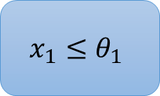
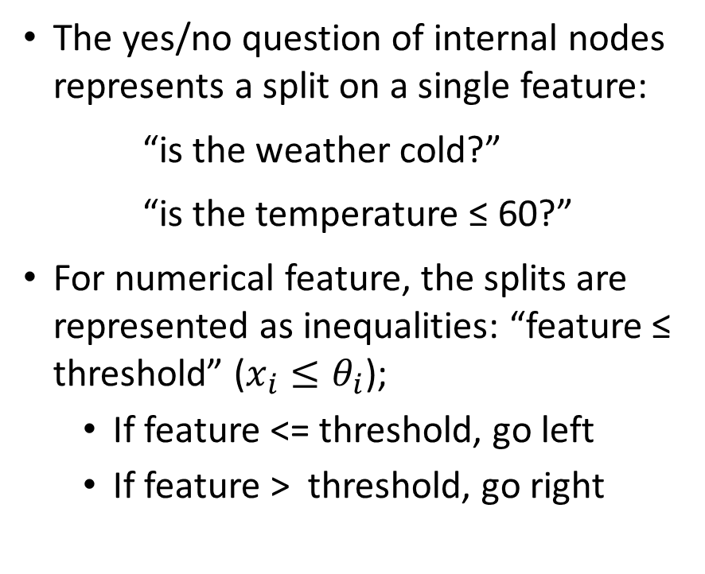
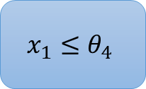
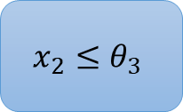
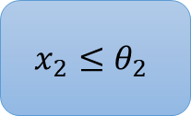
Terminology
The yes/no question of internal nodes represents a split on a single feature:
“is the weather cold?”
“is the temperature ≤ 60?”
For numerical feature, the splits are represented as inequalities: “feature ≤ threshold” ($x_{i}≤θ_{i}$);
If feature <= threshold, go left
If feature > threshold, go right
$$x_{1}≤θ_{1}$$
Yes
No
$$x_{2}≤θ_{2}$$
$$x_{2}≤θ_{3}$$
A
B
$$x_{1}≤θ_{4}$$
E
C
D

Slide 6
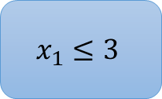
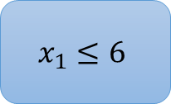
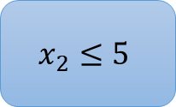
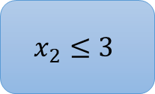
Geometric Interpretation of Decision Trees
Feature Space
$$x_{2}$$
$$x_{1}≤3$$
Yes
No
$$x_{2}≤3$$
$$x_{2}≤5$$
A : 0
B : 2
$$x_{1}≤6$$
E : 1
C : 1
D : 2
$$x_{1}$$

Slide 7

Decision Trees
Feature Space
It partitions the feature space into non overlapping regions (of rectangle/cuboid shape).
The leaves of the tree correspond to those regions: A, B, C, D, E
Each leaf or region stores the predicted labels from the training dataset: average or mode of labels.
Each region predicts the target variable as a constant (regression) or assigns it to a specific class (classification).
image source

Slide 8
Decision Trees - Prediction
Predict the label of x = (5, 4) ?
$$x_{1}≤3$$
Yes
No
$$x_{2}≤3$$
$$x_{2}≤5$$
A : 0
B : 2
$$x_{1}≤6$$
E : 1
C : 1
D : 2

Slide 9
Decision Trees Boolean Expressions
$$x_{1}≤3$$
Each path from the root to a leaf encodes a logical condition (rule)
Rules take the form of inequalities involving features combined with AND operations
These Boolean expressions can be used to explain how a prediction was made.
Yes
No
$$x_{2}≤3$$
$$x_{2}≤5$$
A : 0
B : 2
$$x_{1}≤6$$
E : 1
C : 1
D : 2

Slide 10
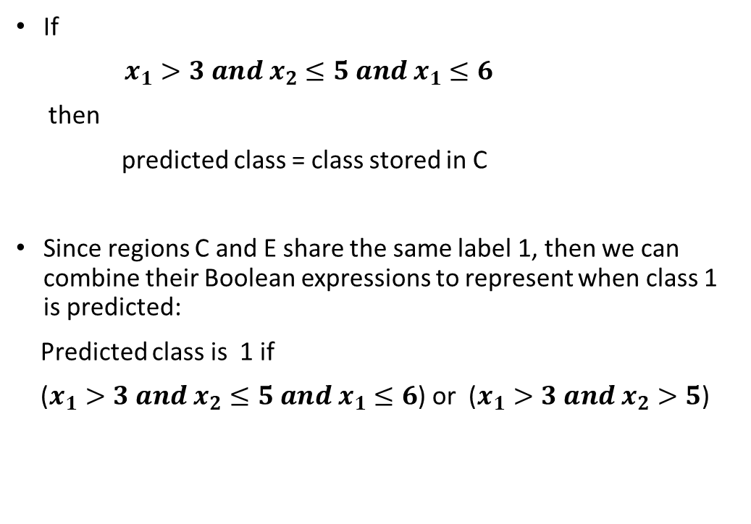
Decision Trees Boolean Expressions
$$x_{1}≤3$$
If
$x_{1}>3 and x_{2}≤5 and x_{1}≤6$
then
predicted class = class stored in C
Since regions C and E share the same label 1, then we can combine their Boolean expressions to represent when class 1 is predicted:
Predicted class is 1 if
($x_{1}>3 and x_{2}≤5 and x_{1}≤6$) or ($x_{1}>3 and x_{2}>5$)
Yes
No
$$x_{2}≤3$$
$$x_{2}≤5$$
A : 0
B : 2
$$x_{1}≤6$$
E : 1
C : 1
D : 2

Slide 11
How to construct a tree? Training Phase

Slide 12
Optimal Tree
Given a training set, how we can build a tree?
We need to know:
how many nodes to choose and,
for each node, which feature to choose and which threshold value to choose for that feature.
What do you think the best or optimal tree would be ?
Tree Structure
Predictive Power

Slide 13
Optimal Tree
“An optimal tree in one which minimizes the expected number of tests required to identify the unknown object” – Source
The best or optimal is a tree that:
has the smallest depth possible and
ends up with pure regions (classification) or regions with the smallest mean squared error possible (regression).
Why do we care about the depth of tree?
Deep trees are more prone to overfitting.
Shallow trees are more prone to underfitting.

Slide 14
Example
Try to construct a decision tree from this data. What is the depth of the smallest tree that has pure classification regions?
age | gender | is_smoking | TenYear Coronary Heart Disease (TYCD)
64 | F | Yes | 1
37 | M | No | 0
36 | F | Yes | 1
50 | M | Yes | 1
64 | F | Yes | 1
61 | F | No | 1
35 | M | No | 0
34 | F | No | 0
63 | M | No | 1

Slide 15
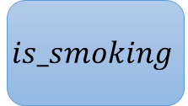
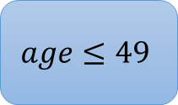
Example
$$is_smoking$$
age | gender | is_smoking | TenYear Coronary Heart Disease (TYCD)
64 | F | Yes | 1
37 | M | No | 0
36 | F | Yes | 1
50 | M | Yes | 1
64 | F | Yes | 1
61 | F | No | 1
35 | M | No | 0
34 | F | No | 0
63 | M | No | 1
Yes
No
Samples with TYCD=1
$$age≤49$$
Samples with TYCD=1
Samples with TYCD=0

Slide 16
Optimal Tree
That was a simple example where it was easy to come up with an optimal tree.
However, finding an optimal tree with the minimum number of features splits is not always computationally tractable:
NP-complete problem which means that it is unlikely to find an optimal solution to the problem in polynomial time.
In this case, the problem can be solved with an approximate or heuristic algorithm that is computational tractable, and that tries to find a ”reasonably good” tree.

Slide 17
Greedy Strategy – CART (Classification and Regression Trees)
It consists of a top-down greedy approach known as recursive binary splitting:
it begins at the root or top of the tree, finds the best split at the root
then successively repeats the same steps for each child node
Top-down: it starts from the root
Greedy: it chooses the best split at each step (a locally optimization choice is made).

Slide 18
CART (Classification and Regression Trees)
Start at the root.
Determine the best feature and threshold to split: for each feature, find the best threshold such that the optimization criterion is minimized. Then choose the best feature.
If a stopping criterion is reached, exit. Otherwise, repeat for each child node.

Slide 19
Optimization/Splitting Criterion
Choosing the pair of features and its corresponding threshold is done using:
Classification - an impurity function (Gini index or entropy) that measures label purity in a given region (problem-set): the pair that leads to the best pure regions is chosen.
Regression - an error metric (RMSE) : the pair that leads to regions with less errors is chosen.

Slide 20
Possible Thresholds
If the feature is categorical then the possible options for the thresholds are the possible categories that the feature can take.
”weather” a categorical feature whose possible values are {sunny, cloudy, rainy}.
Possible thresholds ”is the weather sunny?”, ”is the weather cloudy?” and ”is the weather rainy?”
If the feature is continuous, them threshold are chosen to be halfway between consecutive data values of the given feature.
For example, the feature age takes the following possible values:
{34, 35, 36, 37, 50, 61, 63, 64}
Then the possible thresholds are:
{34.5, 35.5, 36.5, 43.5, 55.5, 62, 63.5}

Slide 21
When to Stop?
node contains only one class
node contains less than x data points
max depth is reached
node purity is sufficient

Slide 22
Illustration of the Algorithm

Slide 23


$x_{2}$
We start with the root of the tree that represents the entire feature space.
$x_{1}$

Slide 24





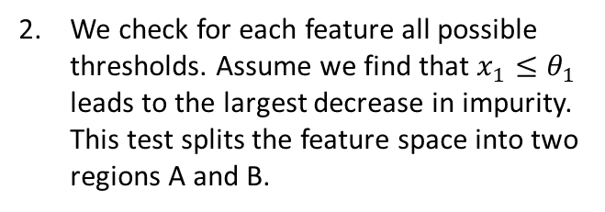

$x_{2}$
We start with the root of the tree that represents the entire feature space.
$x_{1}$
$x_{2}$
A
B
$$x_{1}≤θ_{1}$$
We check for each feature all possible thresholds. Assume we find that $x_{1}≤θ_{1}$ leads to the largest decrease in impurity. This test splits the feature space into two regions A and B.
A
B
$x_{1}$
$θ_{1}$

Slide 25




$x_{2}$
B
A
We now check the two regions A and B and repeat the same process that we did with the root node. Now region A is almost pure; this purity level is maybe enough for us (stopping criterion) so we will not split A. In this case, A is a leaf node.
$$x_{1}≤θ_{1}$$
A
B
$x_{1}$
$θ_{1}$

Slide 26

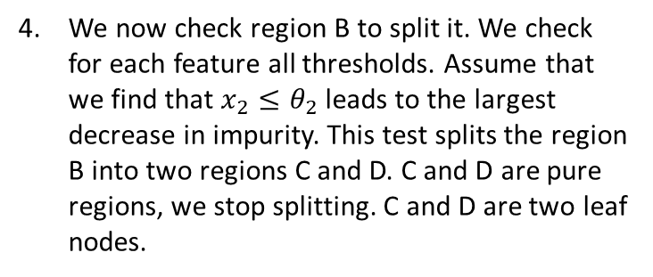









$x_{2}$
B
A
We now check the two regions A and B and repeat the same process that we did with the root node. Now region A is almost pure; this purity level is maybe enough for us (stopping criterion) so we will not split A. In this case, A is a leaf node.
$$x_{1}≤θ_{1}$$
A
B
$x_{1}$
$θ_{1}$
$x_{2}$
D
A
$$x_{1}≤θ_{1}$$
We now check region B to split it. We check for each feature all thresholds. Assume that we find that $x_{2}≤θ_{2}$ leads to the largest decrease in impurity. This test splits the region B into two regions C and D. C and D are pure regions, we stop splitting. C and D are two leaf nodes.
A
$θ_{2}$
$$x_{2}≤θ_{2}$$
C
$x_{1}$
C
D
$θ_{1}$

Slide 27
Prediction Phase

Slide 28




Prediction Phase
Prediction phase is simple, we just need to traverse the tree.
$$x_{1}≤3$$
Yes
No
$$x_{2}≤3$$
$$x_{2}≤5$$
A : 0
B : 2
$$x_{1}≤6$$
E : 1
C : 1
D : 2

Slide 29
Computational Complexity - FYI
n: number of training samples
m: number of features
Training phase: O(m*nlogn)
Prediction phase: O(depth) (if balance of trees is maintained: O(log n))

Slide 30
Tree Structure

Slide 31
Tree Structure
We stop to split a region once we reach a stopping criterion: maximum tree depth, minimum number of samples in a node, minimum purity level, ...
If the tree is left unconstrained, i.e., if we continue splitting each region until we obtain completely pure regions, the tree will fit the training data closely and will suffer from overfitting.
In fact, choosing the right structure or depth of the decision tree is about finding a good balance between overfitting and underfitting.

Slide 32
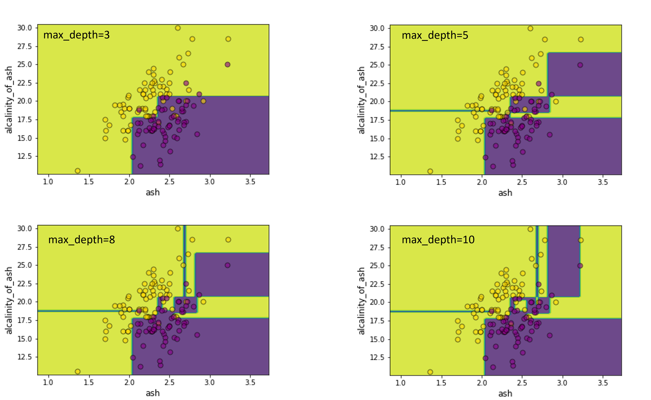
Tree Structure
A shallow tree might be too simple and not complex enough to properly divide the feature space into sufficiently pure regions.
A very deep tree might be too complex that might not generalize well.
We can use cross-validation to choose the appropriate max_depth.

Slide 33
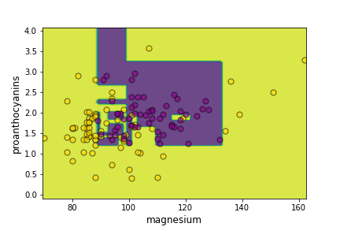
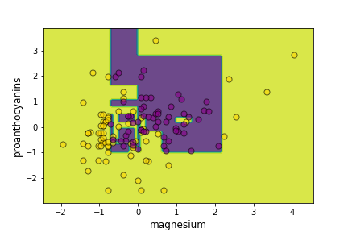
Sensitive to Feature Scaling?

Slide 34
Advatanges, Disadvatanges

Slide 35
Advantages
Interpretability: Decision trees are easy to interpret, each leaf node can be represented with a combination of boolean expression that can explain why a particular decision was made.
Extends easily to multi-class problem: Like KNN, decision tree works no matter how many classes we have to classify, it does not only work for binary classification. The label of each leaf node is the majority vote. The proportion of each class in each leaf node can be used as to represent the likelihood of a feature vector to belong to that class.
Requires little pre-processing: Decision trees are insensitive to feature scaling, can handle categorical and numerical features an features with missing values.
Robust to irrelevant features: Decision Tree algorithm is greedy, it picks the ”best” feature at each node. In this way, decision trees will only use features that are predictive. With other models, we may need to evaluate models on different combinations of features to find the best model (feature selection). Decision trees do this for you and automate part of model building.
Handles interaction between features: Decision trees consider feature combinations naturally through Boolean Expressions: if feature 1 > 5 and feature 2 < 10, then the sample is A; if feature 1 ≤ 5, then the sample is B

Slide 36
Disadvantages
Prone to overfitting: Decisions tree are easy to overfit and can fail to generalize to unseen data. Overfitting can be regularized by determining some stopping criteria or by performing pruning.
Sensitive to small changes in the dataset: This is closely related to the fact that decision trees are prone to overfitting. Decision trees can have high variance, which means that a small change in the training data can cause a large change in the final estimated tree.
Limited predictive power: In general decision trees do not have the same level of predictive power as some of the other regression and classification models.

Slide 37
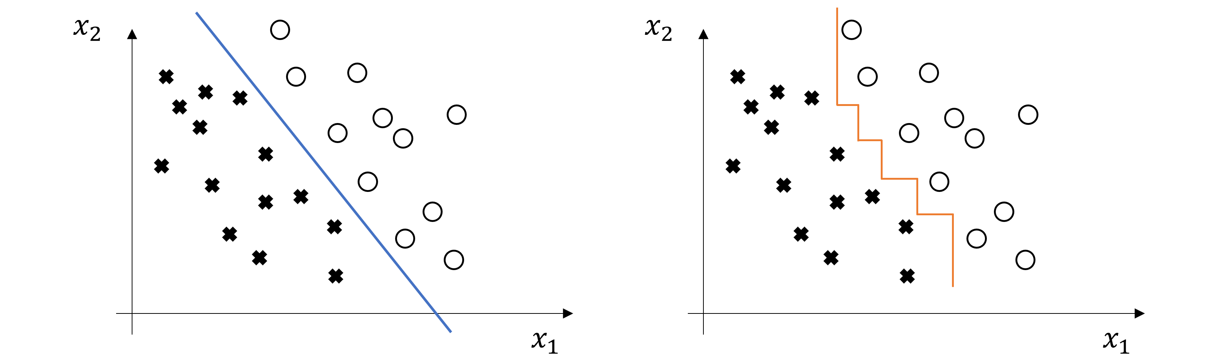
Disadvantages
A decision tree can only perform splits parallel to the axes. It cannot find a linear decision boundary when the data is linearly separable

Slide 38
Extensions

Slide 39
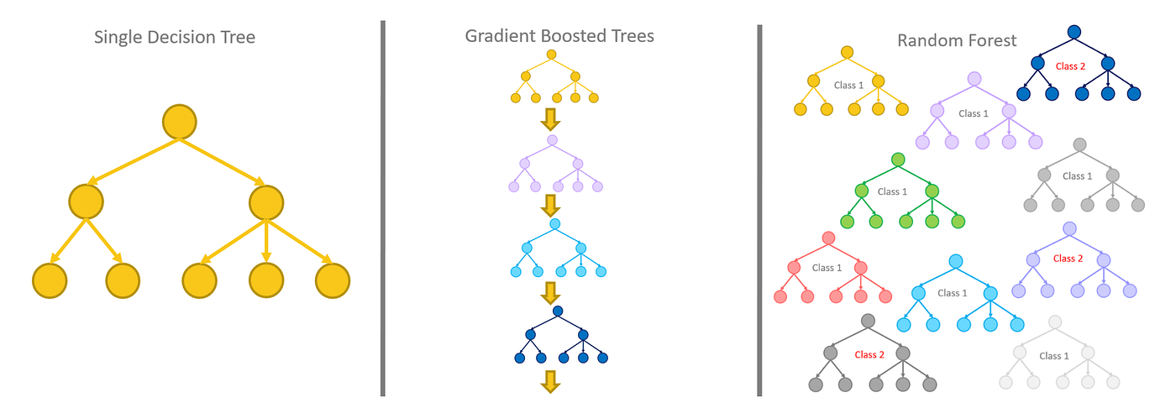
Ensemble Methods
A single tree is powerful, but can be unstable and overfit.
Ensemble methods combine many trees to make a stronger model.

Slide 40
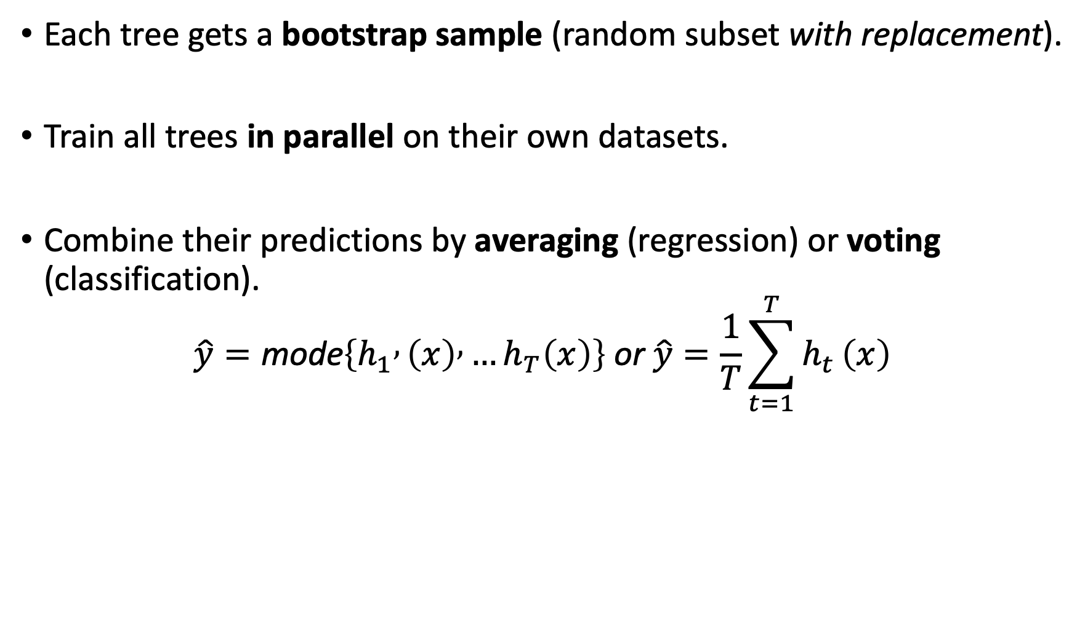
Bagging and Random Forests
Each tree gets a bootstrap sample (random subset with replacement).
Train all trees in parallel on their own datasets.
Combine their predictions by averaging (regression) or voting (classification).
$$\hat{y}=\text{mode}\left\{h_{1} , \left(x\right) , …h_{T}\left(x\right)\right\} \text{or} \hat{y}=\frac{1}{T}\sum_{t=1}^{T}{h_{t}}\left(x\right)$$

Slide 41
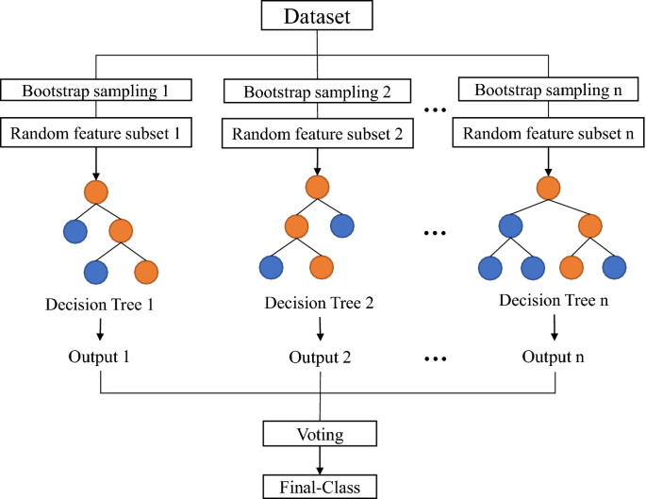
Bootstrapping and Feature Selection

Slide 42
Why Random Forests Work
Averaging many independent trees reduces variance.
Randomizing data and feature selection keeps trees decorrelated.
The result: stable predictions and lower overfitting.

Slide 43
Boosting = Sequential Ensemble
Instead of training trees independently, we train them one after another.
Each new tree focuses on the examples the previous trees got wrong.
The ensemble “learns from its mistakes” step by step.

Slide 44
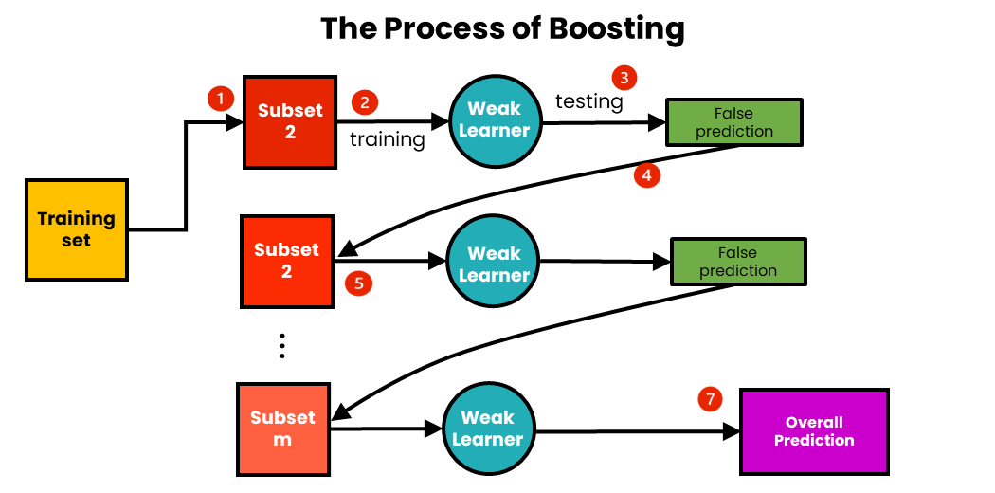
Boosting

Slide 45
Boosting Intuition
Start with a simple tree (a “weak learner”).
Evaluate which observations were misclassified or had large errors.
Give those observations more weight in the next round.
Combine all the trees using a weighted average of their predictions.

Slide 46
Comparing Forests vs Boosting
Aspect | Random Forest | Boosting
Tree Training | Parallel | Sequential
Goal | Reduce variance | Reduce bias
Data Sampling | Bootstrapping | Weight by previous error
Aggregation | Voting / Average | Weighted Sum
Risk | Underfit | Overfit

Slide 47
Summary
Bagging improves stability by averaging multiple trees.
Boosting improves accuracy by iteratively refining mistakes.
Both are ways to get better performance from simple trees —
one by combining many independent models,
the other by combining many corrective ones.

