Slide 1
Introduction to Machine Learning
CSC4601/5601 Theory of Machine Learning

Slide 2
Syllabus Introduction

Slide 3
Who am I?
Dr. John Bukowy
Ph.D. in Physiology?!
Other degrees in:
Biomedical Engineering
Electrical Engineering
Industry Experience
2 years at MERGE Healthcare
^{7th} year at MSOE
When I am not working I…

Slide 4
Introduce Yourselves
Let’s go around the room and introduce ourselves. Please tell me something fun and not work related you did over summer “break”.

Slide 5
Class Time Organization
Whole Class Meetings
2 time per week
Typically, 1-2 lectures of new materials
Occasionally we will do in-class problem sets to get hands on with topics
Lab Meetings
We have lab scheduled once a week for 2-hours
Expect a quiz at the beginning of lab each week
After the quiz we will use some of lab time to review last week’s lab and introduce the new lab.
For the rest of the time, I would encourage you to work on lab. Think of it as a focused office hour(s)

Slide 6
Class Time Organization
Questions?

Slide 7
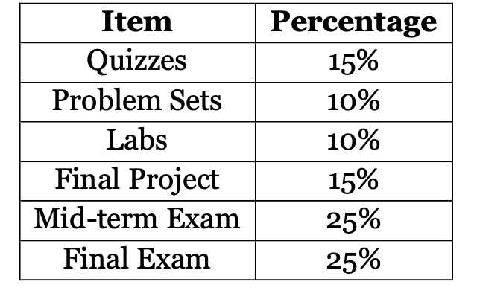
What Will I Be Graded On?
5 Activities will have grades associated with them
Problem Sets
Labs
Quizzes
Final Project
Exams

Slide 8
What Will I Be Graded On?
Problem Sets
Reinforce math + concepts; prepare for assessments.
Due one week after lab session (e.g., Wed lab → next Tue, 11:59 PM).
Submit Jupyter notebook via Canvas.
Grading:
Complete = full credit
Attempted = ½ credit
No submission = 0
Minimal written feedback; please bring to office hours for discussion. We will also have the opportunity to complete some problems in class.
Key ideas reviewed in class/lab after due date.

Slide 9
What Will I Be Graded On?
Labs
Weekly, hands-on assignments.
Due one week after lab session (e.g., Wed lab → next Tue, 11:59 PM).
Submit to Canvas + GitHub (check submission).
Grading:
Complete = full credit
Attempted = ½ credit
No submission = 0
Minimal written feedback — We will review the lab after the quiz during the next lab session. If you would like additional feedback, please bring your work to office hours for discussion.

Slide 10
What Will I Be Graded On?
Final Project
Goal: Research + present an ML topic; prepare materials as if teaching the class.
Week 8: groups/individual topics decided.
Week 15: in-class presentations.
CSC4601: Groups of 2–3 (self-assigned).
CSC5601: Individual projects with additional requirements.
Grade – %

Slide 11
What Will I Be Graded On?
Quizzes
Expect a weekly quiz at the beginning of lab (~15 minutes long)
Quizzes will focus most heavily on the learnings/methods/approaches from the previous week’s lab and/or problem set
Quizzes may also include questions about topics from the lecture
Quizzes will be composed of short response and workable problems
Grade – %

Slide 12
What Will I Be Graded On?
Exams
We will have 1 midterm exam during the quarter and a cumulative final at the end of the class.
Exam I will be given ~ week 8.
The final will be given in week 16.
Grade - %

Slide 13
What Will I Be Graded On?
Questions?

Slide 14
Course Philosophy
Build strong mental models of how ML works in feature & parameter space.
Math helps describe these relationships → practice builds intuition.
Learning comes through struggle + repetition, not shortcuts.
Labs & problem sets provide the practice needed to succeed in exams and your career.
AI tools can help if used thoughtfully, but blind trust undermines learning.

Slide 15
Generative AI: Do’s & Don’ts
Do
Use AI to explore ideas or check understanding.
Ask it for practice problems or alternate explanations.
Treat it as a study partner, not an answer key.
Don’t
Use it to write labs or problem sets — bypasses essential practice.
Assume AI outputs are always correct or unbiased.
Feed it the lab prompt and turn in the response.
Bottom line: Thoughtful use supports learning - careless use undermines learning it and may hurt on quizzes & exams.

Slide 16
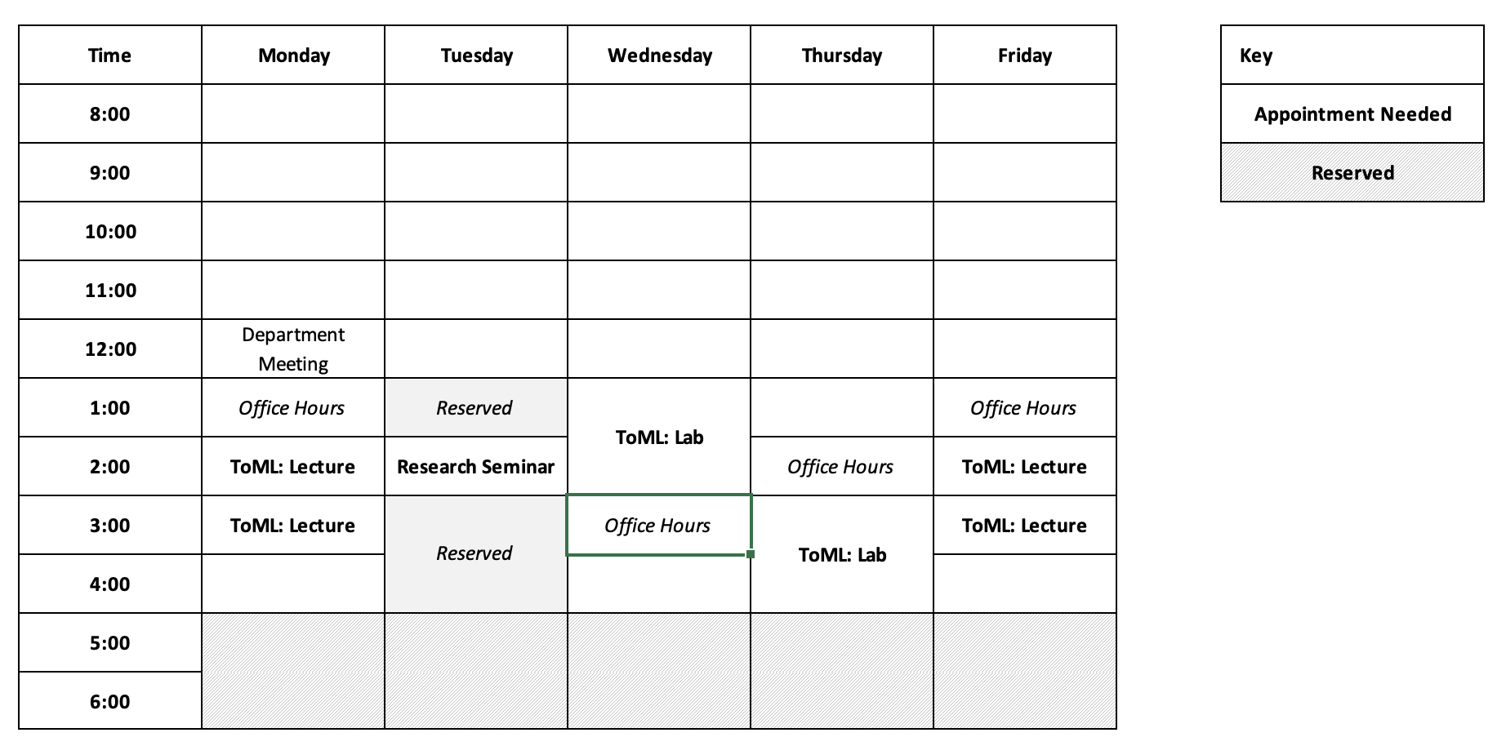
Office Hours

Slide 17
Course Introduction

Slide 18
What is Machine Learning?
Machine learning is a set of methods that allow computers to learn from data.
It helps detect patterns or structures directly from data, transforming data into knowledge.
“ [Machine Learning is the] field of study that gives computers the ability to learn without being explicitly programmed”.
Arthur Samuel, 1959

Slide 19
Traditional Programming vs Machine Learning
Traditional Programming
To perform a task, we write a program or come up with a model
Historical Data with Answers
Programmer
Manually-Derived Rules
(Model or Program)
Input (data)
Or/And
Domain knowledge
Program/Model
Machine Learning
Computer
(Training Algorithm)
Automatically-Derived Rules
(Model or Program)
Historical Data with Answers
Output (answers)

Slide 20
Traditional Programming vs Machine Learning
Example:
Task: design a spam filter that classifies an email as spam or not-spam.
Traditional programming:
A programmer manually examines the content of spam emails (not easy, time-consuming)
Then translates observations into rules that define the spam filter program
Machine Learning:
A computer is given a set of spam and not-spam emails
Then uses machine learning techniques to learn from data the spam filter program

Slide 21
Goal of Machine Learning
Goal of machine learning: Automate decision making
Use previously observed/recorded data to derive decision making rules.
Reduce the time / cost to make decisions
More consistent decision making
More accurate decision making

Slide 22
Types of Machine Learning Problems
Supervised Learning
Develop a predictive model. The data includes a target that we want to predict.
Examples:
spam or no spam filter
benign or cancerous tumor
predict the number of sales
forecast the wind power produced
Machine Learning
Unsupervised Learning
Learn hidden pattern or underlying structure in data. There is no target to predict in data.
Example:
group customers based on their
purchase history.
- dimensionality reduction.
Reinforcement Learning

Slide 23
Types of Machine Learning Problems
Supervised Learning
Develop a predictive model. The data includes a target that we want to predict.
Examples:
spam or no spam filter
benign or cancerous tumor
predict the number of sales
forecast the wind power produced
Classification
Predict a category
Regression
Predict a continuous value

Slide 24
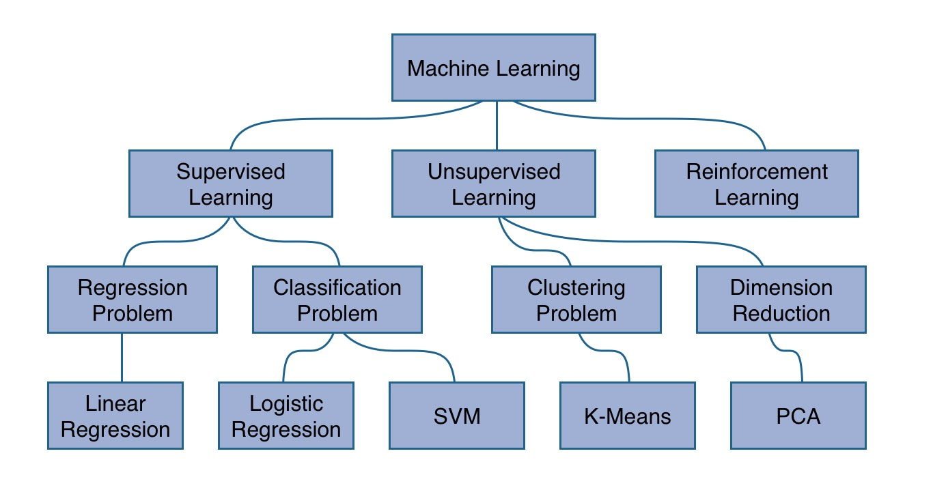
Types of Machine Learning Problems
https://www.robinwieruch.de/machine-learning-javascript-web-developers/

Slide 25
Terminology
Classification Scenario
Suppose you want to predict the presence of heart disease in patients.
You have a set of labeled patients’ data.
For each patient, you know the following: age, resting blood pressure, cholesterol level, fasting blood sugar and maximum heart rate achieved.
Regression Scenario
Suppose you want to predict the sale price of houses in a given area.
You have a set of labeled houses’ data.
For each house, you know the following: year, number of bedrooms, area in square foot, number of bathrooms, zip code.
Unsupervised Scenario
Suppose you want to segment your clients based on their purchase history.
You have a set of unlabeled clients’ data.
For each client, you know the following: date of order, items purchased, total cost, state, city, job, social status.
Feature (independent variable, predictor, attribute)?
Label (dependent variable, response, target)?
Sample (instance, observation, record, example)?

Slide 26
Steps of Building Machine Learning Systems
Data Pre-processing
Feature Engineering
Feature Scaling
Data Splitting into training and testing sets
Training
Use the training set to perform:
Model Fitting
Model selection: cross-validation, model tuning
Evaluation
Evaluation of final model on testing set
Prediction
Use the final model to predict the labels for new unlabeled data

Slide 27
Data Pre-processing
In traditional machine learning, each data sample is expected to be a collection of features and has a label.
Not every data comes in this structured form (raw or unstructured data: example text data).
The data pre-processing step:
transforms the raw data into pairs of features and labels;
partitions the data into training and testing sets.
Data Pre-processing
(raw data, labels)
Training Dataset
(features, labels)
Testing Dataset
(features, labels)

Slide 28
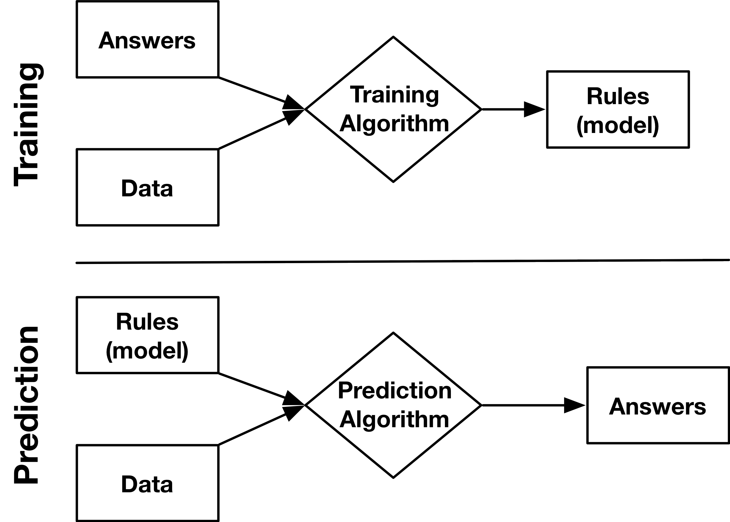
Training Phase : Model Fitting
(Labels)
(Features)
The goal of the training phase is to learn, from the labeled data (pairs of data features and labels), the rules or the mathematical formula that maps an input feature to its output label.
A training algorithm is implemented to learn this mapping from the training data.

Slide 29
Training Phase : Model Fitting
(Labels)
(Features)
So, what does exactly happen here?

Slide 30

Training Phase: Model Fitting
In order to find a mapping from data features to labels, we make assumptions on how they’re related to each other.
We may assume a certain functional form that models the relationship between features and labels.
These assumptions are captured by what is known as the machine learning models. There are different machine learning models, where each makes different assumptions.
Data features (Input)
Model
$$f(.)$$
Label
(Output)

Slide 31
Common Machine Learning Models
Regression
Classification
Linear Regression
k-Nearest Neighbors (kNN)
Decision Trees
Random Forests
Neural Networks
Logistic Regression
k-Nearest Neighbors (kNN)
Decision Trees
Random Forests
Support Vector Machines (SVMs)
Naïve Bayes
Neural Networks

Slide 32
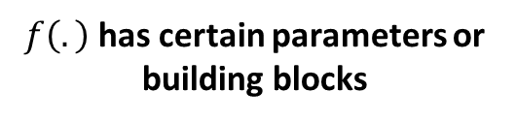

Training Phase: Model Fitting
Data features (Input)
Model
$f(.)$
Label
(Output)
$f\left(.\right)$ has certain parameters or building blocks
The functional form assumed by a machine learning model can be defined by certain characteristics (or parameters) that we need to find using the training data: a machine learning model tries to summarize the training data using its characteristics.
Fitting a machine learning model means finding the best model’s characteristics that best models the feature-label relationship.

Slide 33
Training Phase : Model Selection
Each machine learning models has its own weaknesses and advantages. We might not be sure which model could be successful.
In this case, we might need to train more than one model: this is known as model selection that could be performed using cross-validation techniques.

Slide 34
Training Phase
Okay, we found a model that maps data to answers. Can we use it immediately on new data?

Slide 35
Model Evaluation
Before we launch the model into production, we need to evaluate the model:
By evaluation, we need to understand how the model could perform on unseen data. Does the model only perform well on the available data? Does it generalize well to new data?

Slide 36
Evaluation Metrics
Regression
Classification
Root Mean-Squared Error
Mean Absolute Error
R-squared
Accuracy
Precision
Recall
F1-score
ROC curves
Precision recall curves
Confusion matrices

Slide 37
Prediction
Predicted labels (answers)
Unlabeled data

Slide 38
Model Errors
Models generally can go bad in many ways:
Option 1: models are not predictive at all (even on the training set!)
Data is not informative or rich enough (garbage in, garbage out).
Model is too simple.
Option 2: models "overfit" the training set
Models learn rules that enable perfect predictions on the training set.
But these rules aren't applicable to any other data points.
This might happen when we don’t have enough data or when use a too complex model for the data.

Slide 39
Python – NumPy and Scikit-Learn
Popular Python libraries for data science and machine learning
Widely used for machine learning applications
Key components:
High quality software with regular releases
Great user documentation
Scikit-Learn:
Fit nearly all models into a unified API
Includes a large array of algorithms – hard to find something missing!
(1)Link to NumPy user guide; (2)Link to Scikit-Learn user guide

Slide 40
Approach of This Course
The goal of this course is to provide you with the fundamentals of machine learning.
We will discuss specific ML models, but a bigger goal of this course is to teach you to think in this high dimensional space (Feature space, Parameter space).
First half focus: Terminology, linear algebra, evaluation metrics, and a few models
Second half focus: How do we use data to actually “train” our models – Optimization
Labs will focus on how do you actually implement certain algorithms on data.
We want to give you the tools to be successful when learning about new algorithms in the future.

