Slide 1
Iterative Methods
CSC4601 Theory of Machine Learning

Slide 2
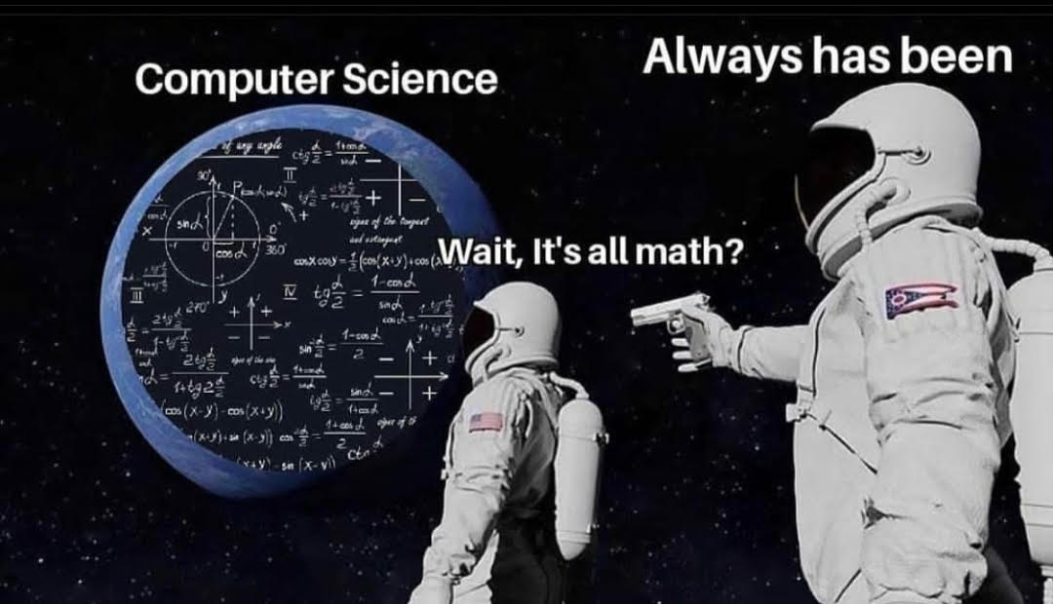

Slide 3
Approaches for Optimizing Model Parameters
"Naïve" Grid Search
Divide the parameter space into a grid
Try the parameters represented at each grid cell
"Smart" Grid Search:
Simulated Annealing
Genetic Algorithms
Analytical Calculus Techniques
Take the first derivative
Find the parameters which make the derivative output 0
Iterative Methods
Use the derivative to perform a "smart" search of the parameter space

Slide 4
Iterative Method – Gradient Descent

Slide 5
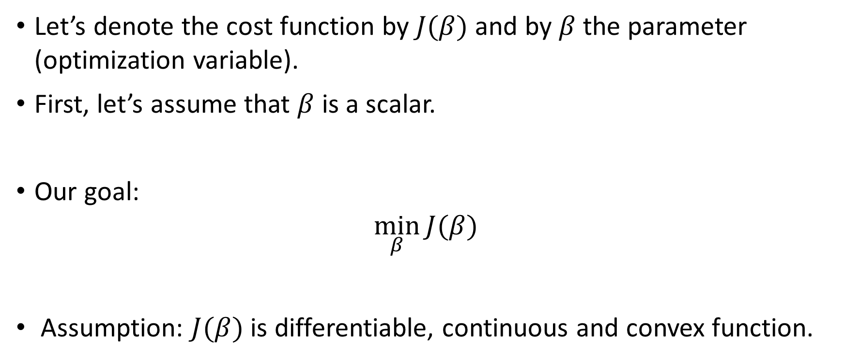
What is Gradient Descent?
Let’s denote the cost function by $J(β)$ and by $β$the parameter (optimization variable).
First, let’s assume that $β$ is a scalar.
Our goal:
$$\min_{β}{J(β)}$$
Assumption: $J(β)$ is differentiable, continuous and convex function.

Slide 6
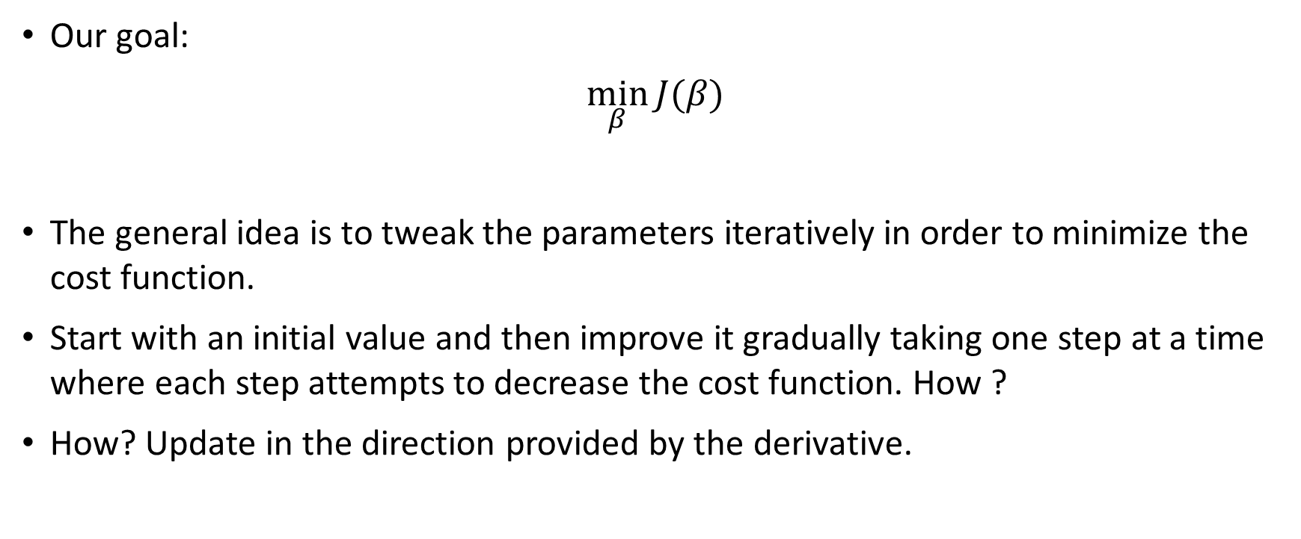
What is Gradient Descent?
Our goal:
$$\min_{β}{J(β)}$$
The general idea is to tweak the parameters iteratively in order to minimize the cost function.
Start with an initial value and then improve it gradually taking one step at a time where each step attempts to decrease the cost function. How ?
How? Update in the direction provided by the derivative.

Slide 7
What is Gradient Descent?
Our goal:
$$\min_{β}{J(β)}$$
Gradient Descent method:
Start with an initial guess: $β^{0}$
Repeat:
$β^{n+1}=β^{n} − α {\frac{dJ(β)}{dβ}}_{{ β = β}^{n}}$
Until a stopping criterion is met

Slide 8
Gradient Descent update step
$$β^{n+1}=β^{n} −{\frac{dJ\left(β\right)}{dβ}}_{{ β = β}^{n}} α$$
Step size or learning rate
Direction of step

Slide 9
Gradient Descent update step
$$β^{n+1}=β^{n} −{\frac{dJ\left(β\right)}{dβ}}_{{ β = β}^{n}} α$$
Step size or learning rate
Direction of step
Why does this update step make sense?
From calculus, the derivative at a given point points out in the direction of steepest ascent; here we’re taking its negative, so gradient descent updates the parameter in the direction of steepest descent.
It’s not hard to see this when $β$ is a scalar. Let’s see why!

Slide 10
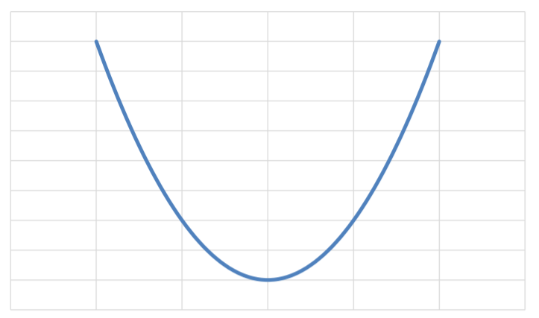
Understanding the update step
$$J(β)$$
$$β^{n+1}=β^{n} −{\frac{dJ\left(β\right)}{dβ}}_{{ β = β}^{n}} α$$
Direction of step
Step size or learning rate
$$β^{0}$$
$$β$$
If we start here, in which direction beta will be updated? To the right or left?

Slide 11
Understanding the update step
$$J(β)$$
$$β^{n+1}=β^{n} −{\frac{dJ\left(β\right)}{dβ}}_{{ β = β}^{n}} α$$
Direction of step
Step size or learning rate
Continue on updating
$$β$$

Slide 12
Understanding the update step
$$J(β)$$
$$β^{n+1}=β^{n} −{\frac{dJ\left(β\right)}{dβ}}_{{ β = β}^{n}} α$$
Direction of step
Step size or learning rate
$$β^{0}$$
$$β$$
If we start here, in which direction beta will be updated? To the right or left?

Slide 13
Understanding the update step
$$J(β)$$
$$β^{n+1}=β^{n} −{\frac{dJ\left(β\right)}{dβ}}_{{ β = β}^{n}} α$$
Direction of step
Step size or learning rate
Continue on updating
$$β$$

Slide 14
Understanding the update step
Question: As we approach the minimum, does gradient descent take smaller or larger steps?
$$J(β)$$
$$β^{n+1}=β^{n} −{\frac{dJ\left(β\right)}{dβ}}_{{ β = β}^{n}} α$$
Direction of step
Step size or learning rate
Continue on updating
$$β$$

Slide 15
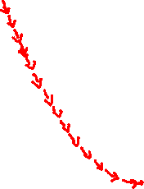
Understanding the learning rate
In which case, $α$ is too large ? $α$ is too small?
$$J(β)$$
$$J(β)$$
$$β$$
$$β$$

Slide 16
Understanding the learning rate
In which case, $α$ is too large ? $α$ is too small?
$$J(β)$$
$$J(β)$$
$$β$$
$$β$$
If $α$ is too large, gradient descent can bounce around the minimum. It may fail to converge, or even diverge.
If $α$ is too small, gradient descent can be very slow.

Slide 17
Understanding the learning rate
So how is $α$ chosen?
In optimization, people implement in practice a method called line search to determine a good value for $α$ .
In machine learning, $α$ is treated as a hyperparameter that needs to be tuned.
$$J(β)$$
$$J(β)$$
$$β$$
$$β$$
If $α$ is too large, gradient descent can bounce around the minimum. It may fail to converge, or even diverge.
If $α$ is too small, gradient descent can be very slow.

Slide 18
Gradient Descent
If the function is convex and an appropriate value for the step size is chosen, then Gradient descent is guaranteed to find the global minimum of the function

Slide 19
What if the function is non-convex?
$$J(β)$$
$$β$$
The function is still smooth: differentiable and continuous.

Slide 20
What if the function is non-convex?
$$J(β)$$
Depending on the starting point, gradient descent will reach a local minimum!
$$β$$

Slide 21
What if the function is non-convex?
$$J(β)$$
Depending on the starting point, gradient descent will reach a local minimum!
Physical analogy of gradient descent: ball rolling down a hilly surface.
If the ball is placed on top of a hill, it will roll down and the it stops at a valley.
$$β$$

Slide 22
Gradient Descent – More than one variable
$$\min_{β_{1}, β_{2}}{J(β_{1},β_{2})}$$
Start with an initial guess: ${β_{1}}^{0}$, ${β_{2}}^{0}$
Repeat:
${β_{1}}^{n+1}={β_{1}}^{n}− α{\frac{∂J(β_{1},β_{2})}{∂β_{1}}}_{{ β_{1}}^{n}\text{, }{β_{2}}^{n}}$
${β_{2}}^{n+1}={β_{2}}^{n}− α{\frac{∂J(β_{1},β_{2})}{∂β_{2}}}_{{ β_{1}}^{n}\text{, }{β_{2}}^{n}}$
Until a stopping criterion is met

Slide 23
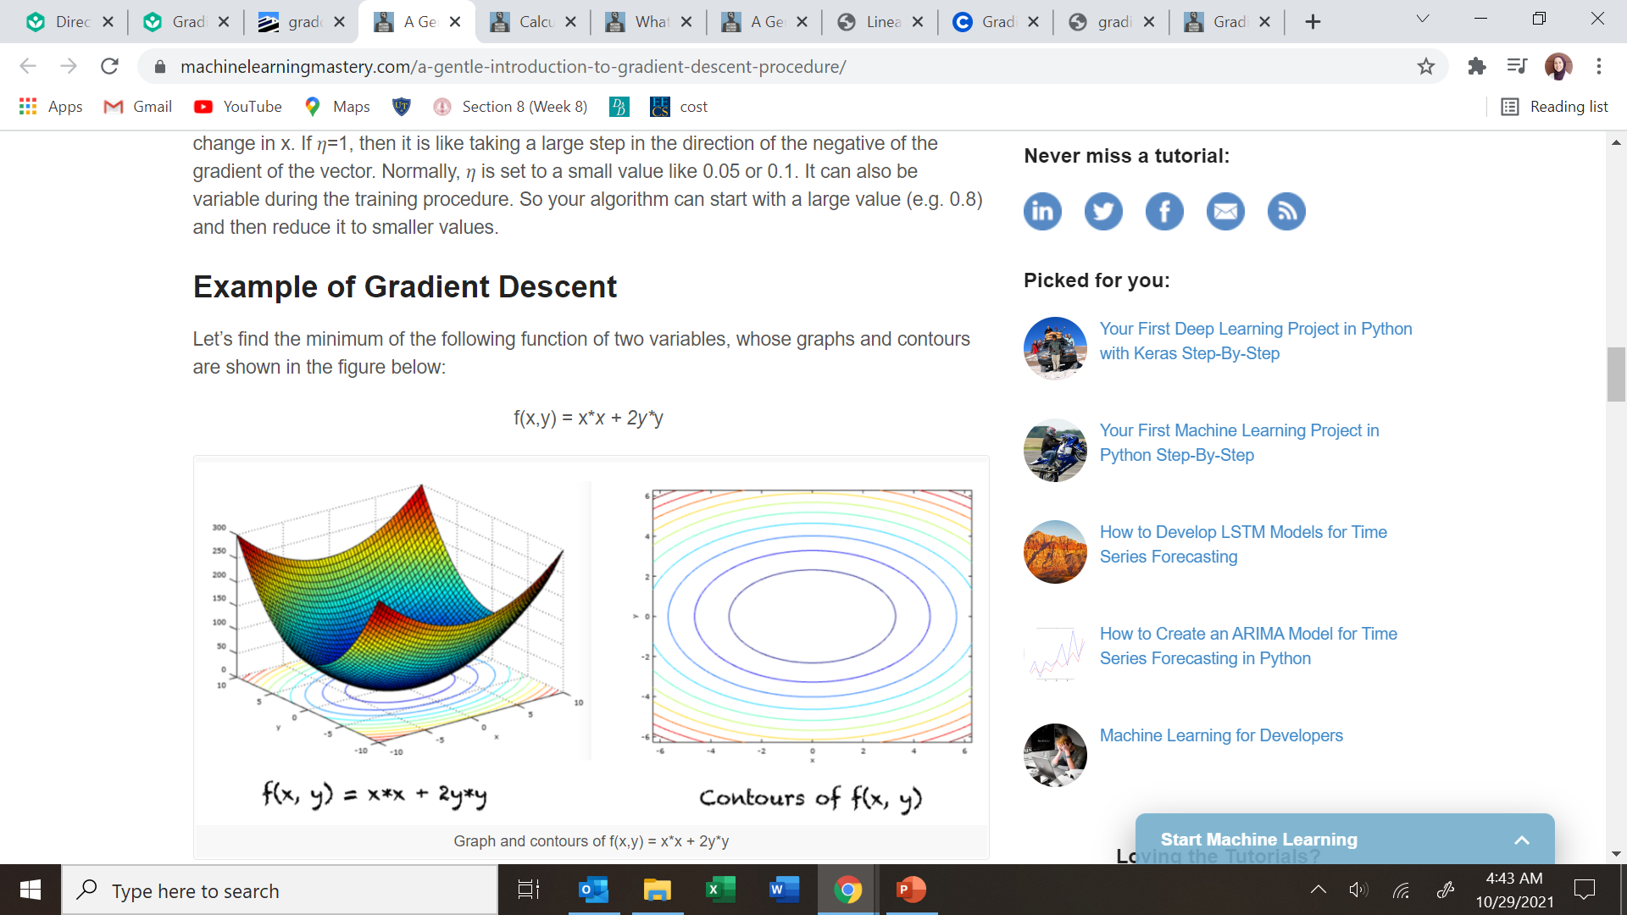
Gradients of 2D functions
source

Slide 24
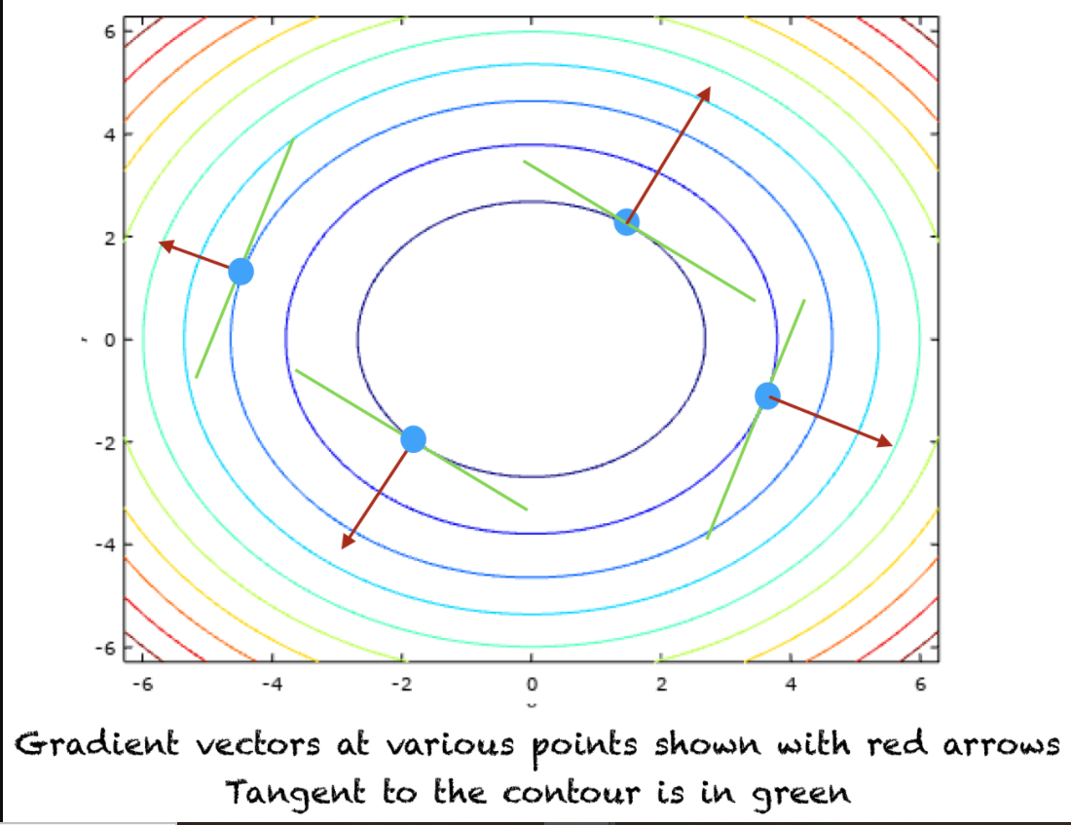
Gradients of 2D functions
From calculus, the gradient at a given point points out in the direction of steepest ascent; gradient descent takes the negative of the gradient -> updates the parameter in the direction of steepest descent.
source

Slide 25
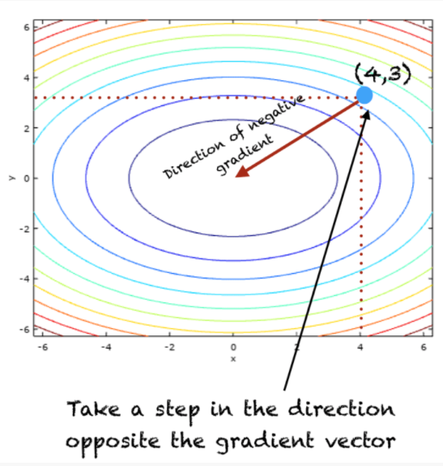
Gradients of 2D functions
From calculus, the gradient at a given point points out in the direction of steepest ascent; gradient descent takes the negative of the gradient -> updates the parameter in the direction of steepest descent.
source

Slide 26
Gradient Descent – More than one variable
$$\min_{β_{1}, β_{2}}{J(β_{1},β_{2})}$$
Start with an initial guess: ${β_{1}}^{0}$, ${β_{2}}^{0}$
Repeat:
${β_{1}}^{n+1}={β_{1}}^{n}− α{\frac{∂J(β_{1},β_{2})}{∂β_{1}}}_{{ β_{1}}^{n}\text{, }{β_{2}}^{n}}$
${β_{2}}^{n+1}={β_{2}}^{n}− α{\frac{∂J(β_{1},β_{2})}{∂β_{2}}}_{{ β_{1}}^{n}\text{, }{β_{2}}^{n}}$
Until a stopping criterion is met
The gradients can be analytically or numerically computed 1

Slide 27

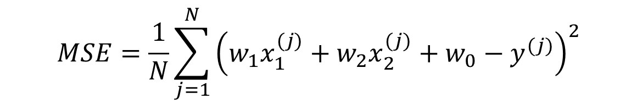


Training Linear Regression - Analytical
$$MSE=\frac{1}{N}\sum_{j=1}^{N}{{\left({w_{1}x}_{1}^{(j)}+{w_{2}x}_{2}^{(j)}+w_{0}−y^{(j)}\right)}^{2}}$$
$$\frac{∂MSE}{∂w_{0}}=$$
$$\frac{∂MSE}{∂w_{1}}=$$
$$\frac{∂MSE}{∂w_{2}}=$$

Slide 28

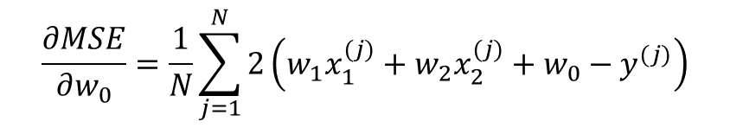
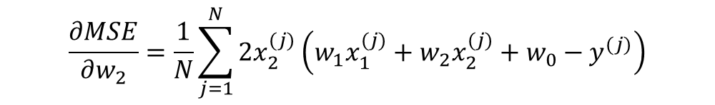
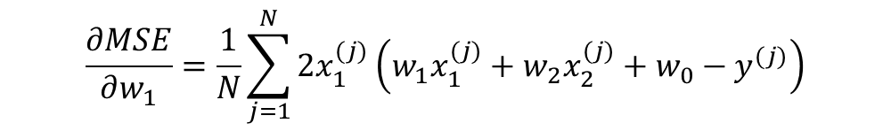
Training Linear Regression - Analytical
$$MSE=\frac{1}{N}\sum_{j=1}^{N}{{\left({w_{1}x}_{1}^{(j)}+{w_{2}x}_{2}^{(j)}+w_{0}−y^{(j)}\right)}^{2}}$$
$$\frac{∂MSE}{∂w_{0}}=\frac{1}{N}\sum_{j=1}^{N}{2\left({w_{1}x}_{1}^{(j)}+{w_{2}x}_{2}^{(j)}+w_{0}−y^{(j)}\right)}$$
Start with an initial guess: ${w_{1}}^{0}$, ${w_{2}}^{0}$, ${w_{0}}^{0}$
Repeat:
${w_{1}}^{n+1}={w_{1}}^{n}− α{\frac{∂MSE}{∂w_{1}}}_{{ w_{1}}^{n}\text{, }{w_{2}}^{n},{{ w}_{0}}^{n}}$
${w_{2}}^{n+1}={w_{2}}^{n}− α{\frac{∂MSE}{∂w_{2}}}_{{ w_{1}}^{n}\text{, }{w_{2}}^{n},{ w_{0}}^{n}}$
${w_{0}}^{n+1}={w_{0}}^{n}− α{\frac{∂MSE}{∂w_{0}}}_{{ w_{1}}^{n}\text{, }{w_{2}}^{n},{{ w}_{0}}^{n}}$
Until a stopping criterion is met
$$\frac{∂MSE}{∂w_{1}}=\frac{1}{N}\sum_{j=1}^{N}{{2x}_{1}^{(j)}\left({w_{1}x}_{1}^{(j)}+{w_{2}x}_{2}^{(j)}+w_{0}−y^{(j)}\right)}$$
$$\frac{∂MSE}{∂w_{2}}=\frac{1}{N}\sum_{j=1}^{N}{{2x}_{2}^{(j)}\left({w_{1}x}_{1}^{(j)}+{w_{2}x}_{2}^{(j)}+w_{0}−y^{(j)}\right)}$$

Slide 29
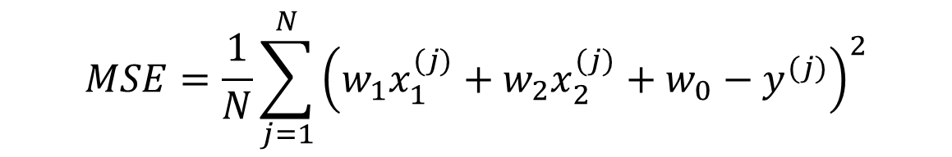

Training Linear Regression - Numerical
$$MSE=\frac{1}{N}\sum_{j=1}^{N}{{\left({w_{1}x}_{1}^{(j)}+{w_{2}x}_{2}^{(j)}+w_{0}−y^{(j)}\right)}^{2}}$$
$$\frac{∂f(u ,v)}{∂u}≈\frac{f\left(u+h, v \right)−f(u, v)}{h}$$
$\frac{∂MSE}{∂w_{0}}=$ $\frac{\frac{1}{N}\sum_{j=1}^{N}{{\left({w_{1}x}_{1}^{(j)}+{w_{2}x}_{2}^{(j)}+(w_{0}+h) −y^{(j)}\right)}^{2}− \frac{1}{N}\sum_{j=1}^{N}{{\left({w_{1}x}_{1}^{(j)}+{w_{2}x}_{2}^{(j)}+w_{0}−y^{(j)}\right)}^{2}}}}{h}$
$\frac{∂MSE}{∂w_{1}}=$ $\frac{\frac{1}{N}\sum_{j=1}^{N}{{\left({(w_{1}+h)x}_{1}^{(j)}+{w_{2}x}_{2}^{(j)}+w_{0}−y^{(j)}\right)}^{2}− \frac{1}{N}\sum_{j=1}^{N}{{\left({w_{1}x}_{1}^{(j)}+{w_{2}x}_{2}^{(j)}+w_{0}−y^{(j)}\right)}^{2}}}}{h}$
$\frac{∂MSE}{∂w_{2}}=$ $\frac{\frac{1}{N}\sum_{j=1}^{N}{{\left({w_{1}x}_{1}^{(j)}+{(w_{2}+h)x}_{2}^{(j)}++w_{0}−y^{(j)}\right)}^{2}− \frac{1}{N}\sum_{j=1}^{N}{{\left({w_{1}x}_{1}^{(j)}+{w_{2}x}_{2}^{(j)}+w_{0}−y^{(j)}\right)}^{2}}}}{h}$

Slide 30
Some more details
Starting values or guesses are generated randomly.
Stopping criteria might involve checking multiple conditions:
checking if the norm of the gradients is less than some threshold
the value of the objective function (or cost function)
all of them involve a maximum number of iterations.
When gradient descent is used for linear or logistic regression. It is important to scale the features.
Otherwise, the algorithm might be too slow to converge (find the optimal value) or it might stop too early.

Slide 31
Other Iterative Methods

Slide 32
Iterative Methods
Gradient Descent $$x_{n}=x_{n−1}−γf′(x_{n−1})$$
Newton's Method $$x_{n}=x_{n−1}−\frac{f′(x_{n−1})}{f′′(x_{n−1})}$$
Secant Method $$x_{n}=x_{n−1}−f′(x_{n−1})\frac{x_{n−1}−x_{n−2}}{f′\left(x_{n−1}\right)−f′(x_{n−2})}$$

Slide 33
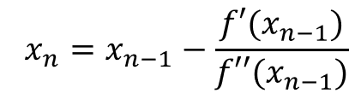

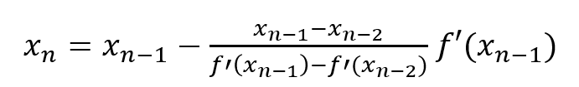
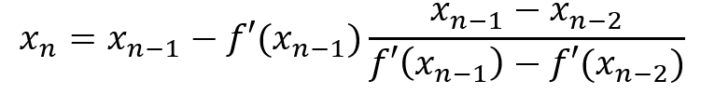
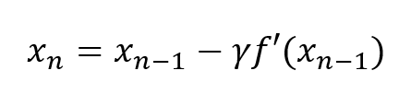
Iterative Methods
(Dissection of)
Newton's Method
Secant Method
Gradient Descent

Slide 34
Iterative Methods (Dissection of)
New estimate
Current estimate
Magnitude of change (step size)
Direction to minima

Slide 35
Iterative Methods
Newton's Method
Secant Method
Gradient Descent

Slide 36
Comparison
If the cost function is strongly convex (second derivative is strictly positive), then Newton’s method converges faster than gradient descent: it reaches the minimum in less number of iterations:
Newton’s method uses the information (about the curvature of the function) provided by the second derivative
Instead of just looking few steps ahead (gradient descent), Newton’s method looks further ahead and jumps to the lower point it can see.

Slide 37
Comparison
The bad news is that when we have multiple variables, Newton’s metho becomes costly:
In higher dimension, the second derivative is a matrix (m by m matrix (m is the number of features)): Hessian matrix
Newton’s method requires the computation of the inverse of the Hessian matrix.
This is why, in machine learning, the pure Newton’s method is not implemented:
Quasi-Newton’s method approximates the Hessian matrix.
They are faster than gradient but requires less computation steps than Newton’s method.

Slide 38
Comparison
Rate of convergence: estimate of how long the algorithm will take to reach the optimal value.
Time complexity
 | Newton's Method | Gradient Descent
Rate of Convergence | Quadratic: doubling the number of iterations will cut the error (f(x)-f(x*)) in four. | Linear: doubling the number of iterations will cut the error (f(x)-f(x*)) in half.
Second Derivative | Required: in case of multi-variate functions, the inverse of the second derivate becomes the inverse of a Hessian matrix: it is computationally expensive. | Not used
Convergence | Might diverge if the function is flat (second derivative is equal to zero) | Given that the learning rate is just right, gradient descent will always converge.
In other words, Newton’s method requires less number of iterations in order to converge.

Slide 39
Other Iterative Methods (optional)
When the objective function is the sum of a convex and differentiable function and another that is convex but not differentiable (Lasso)
Coordinate descent [reference]
Proximal gradient descent [reference]
When the objective function is not strongly convex,
SAGA
In deep learning (the problem is non-convex), we use methods that scales better with the number of samples/parameters and provides better convergence rate than gradient descent:
Adam (adaptive learning rate for each feature) [reference][paper]

Slide 40
Key questions for algorithm to work
How do we solve for the derivative (gradient)?
Analytical (closed form) solution
Numerical approximations
What function are we solving for the derivative of?
Loss/Objective Functions!
What are we taking the derivative with respect to?
The model parameters
Remember that when training models we are going to treat our dataset as “constant” and our model parameters are going to be “variable”.

Slide 41
Extra Example

Slide 42
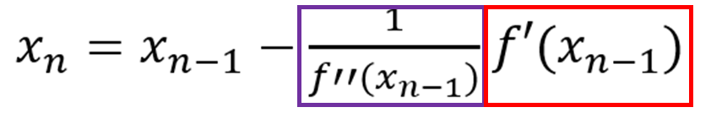
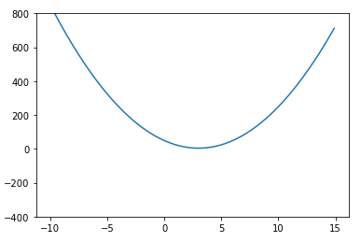
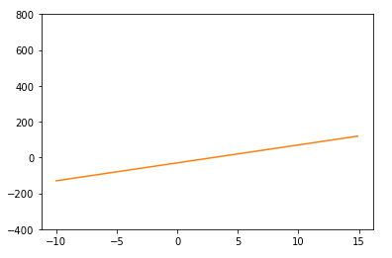
Example function
$$f\left(x\right)=5{\left(x−3\right)}^{2}+4$$
$$f′\left(x\right)=10\left(x−3\right)$$

Slide 43
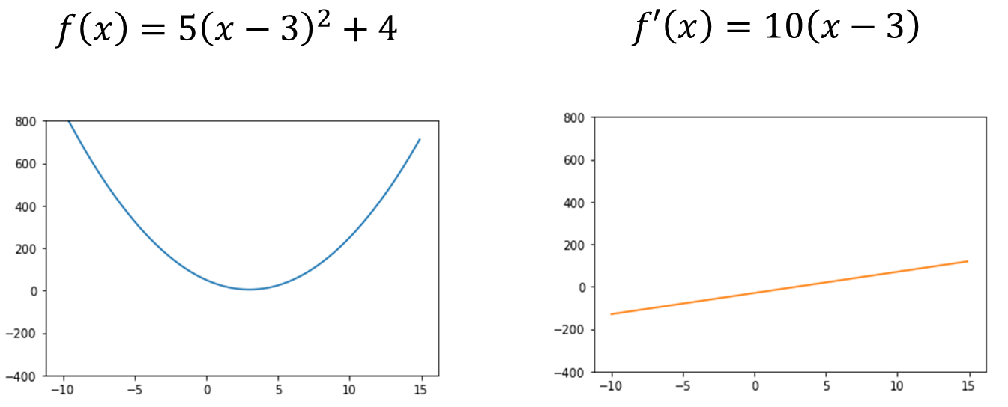
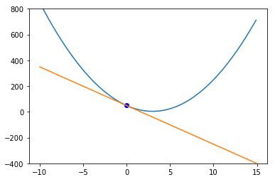
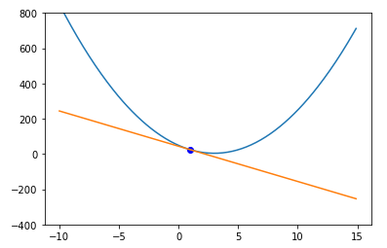
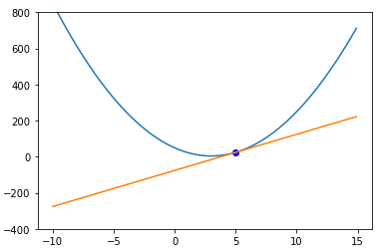
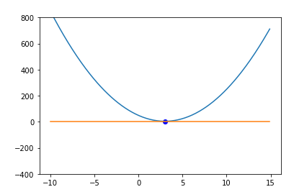
Derivative (gradient) term
$$x=0 | f^{′}\left(0\right)=10\left((0)−3\right)=−30$$
$$x=1 | f^{′}\left(1\right)=10\left((1)−3\right)=−20$$
$$x=5 | f^{′}\left(1\right)=10\left((5)−3\right)=20$$
$x=3 | f^{′}\left(3\right)=10\left((3)−3\right)=$0

Slide 44

Step Size term
$$f′\left(x\right)=10\left(x−3\right)$$
$$f′′\left(x\right)=10$$
$$y=mx+b$$
$$f′\left(x\right)=10\left(x−3\right)$$
$$b=−30$$
$$m=f^{′′}\left(x\right)=10$$

Slide 45
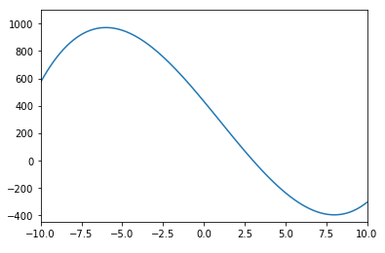
Example function
$$f\left(x\right)=x^{3}−3x^{2}−144x+432$$

Slide 46
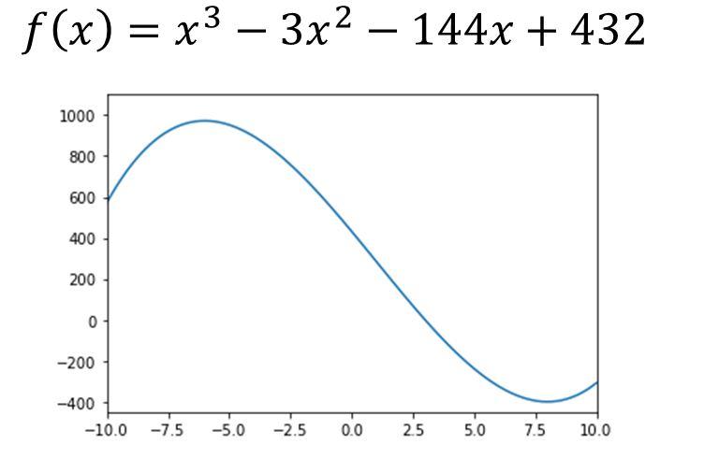
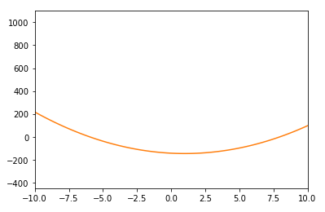
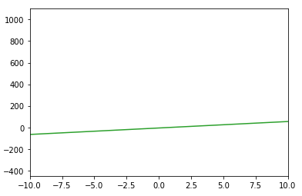
Example function
$$f^{′}\left(x\right)=3x^{2}−6x−144$$
$$f^{′′}\left(x\right)=6x−6$$

Slide 47
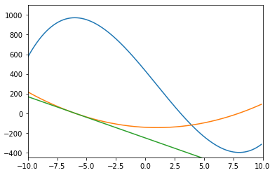
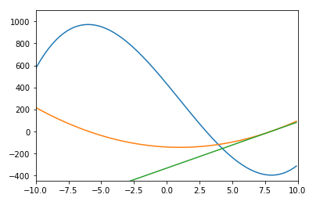
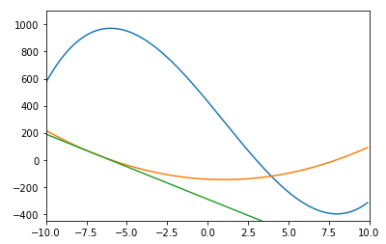
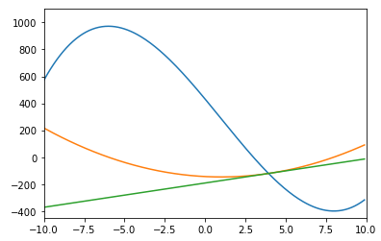
Example function
$$x=−6$$
$$x=−8$$
$$f\left(x\right)=x^{3}−3x^{2}−144x+432$$
$$f^{′}\left(x\right)=3x^{2}−6x−144$$
$$x=−7$$
$$x=4$$
$$f^{′′}\left(x\right)=6x−6$$
(Value represented as slope of line)

