Slide 1
Logistic Regression
CSC4601 Theory of Machine Learning

Slide 2
Plan
Overview - How does logistic regression predict the labels?
Training and Prediction phases
Logistic Regression in Scikit learn
Do we need to scale features?
Multi-class classification

Slide 3
Logistic Regression
Despite its name, Logistic Regression is a model for classification, not regression.
It’s a linear model for binary classification that is easy to implement.
It is one of the most widely used machine learning model.
Logistic regression models the class probability: the probability that an instance belongs to class 1 or 0.

Slide 4
Overview

Slide 5











Linear Models
Weight each feature
Weighted sum of features
$$x_{1}$$
$$w_{1}$$
$$x_{2}$$
$$w_{2}$$
+
$${w_{1}x}_{1}+{w_{2}x}_{2 }+⋯+w_{m}x_{m}+w_{0}$$
$$x^{T}w+w_{0}$$
$$w_{m}$$
$$x_{m}$$
$$w_{0}$$
$$1$$
where,
$x=\left[\begin{aligned}x_{1} \\ \begin{aligned}x_{2} \\ \begin{aligned}⋮ \\ x_{m}\end{aligned}\end{aligned}\end{aligned}\right]$ and $w=\left[\begin{aligned}w_{1} \\ \begin{aligned}w_{2} \\ \begin{aligned}⋮ \\ w_{m}\end{aligned}\end{aligned}\end{aligned}\right]$

Slide 6







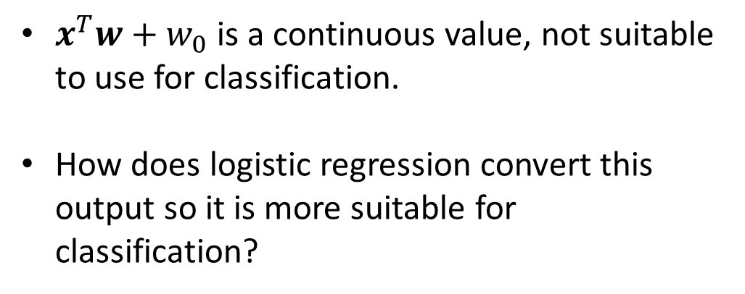


Logistic Regression
$$x_{1}$$
$$w_{1}$$
$x^{T}w+w_{0}$is a continuous value, not suitable to use for classification.
How does logistic regression convert this output so it is more suitable for classification?
$$x_{2}$$
$$w_{2}$$
$$x^{T}w+w_{0}$$
+
$$w_{m}$$
$$x_{m}$$
$$w_{0}$$
$$1$$

Slide 7
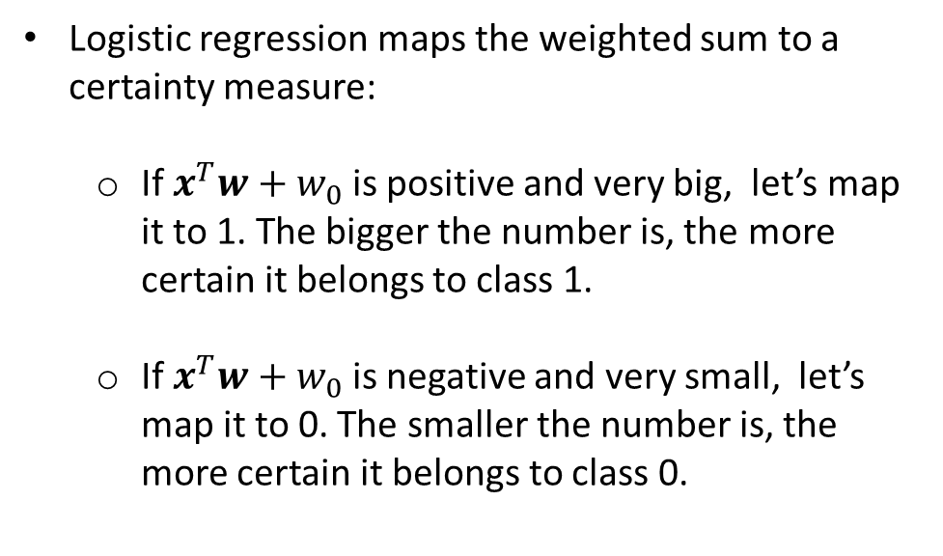
Logistic Regression
Logistic regression maps the weighted sum to a certainty measure:
If $x^{T}w+w_{0}$is positive and very big, let’s map it to 1. The bigger the number is, the more certain it belongs to class 1.
If $x^{T}w+w_{0}$is negative and very small, let’s map it to 0. The smaller the number is, the more certain it belongs to class 0.
$$x_{1}$$
$$w_{1}$$
$$x_{2}$$
$$w_{2}$$
$$x^{T}w+w_{0}$$
+
$$w_{m}$$
$$x_{m}$$
$$w_{0}$$
$$1$$
How is this exactly done? By passing the weighted sum through a logistic function.

Slide 8
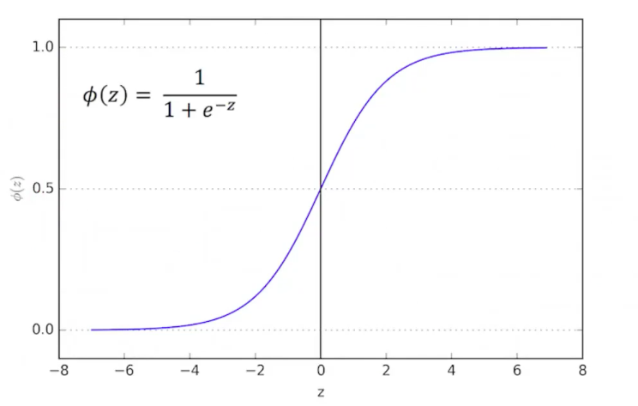
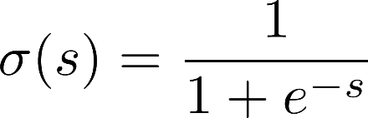

Sigmoid or Logistic Function
The sigmoid function compressions the range –infinity, infinity to the range 0 to 1.
The output of the sigmoid function is treated as certainty measure or probability.

Slide 9

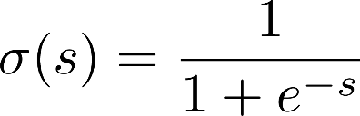


Logistic Regression
The output of sigmoid
is interpreted as:
$$P(y=1|x)$$
$$w_{1}$$
$$w_{2}$$
$$x^{T}w+w_{0}$$
$$\frac{1}{1+e^{−(x^{T}w+w_{0})}}$$
+
$$w_{m}$$
$$w_{0}$$
Logistic Function

Slide 10






Logistic Regression
$$P(y=1|x)$$
$$\frac{1}{1+e^{−(x^{T}w+w_{0})}}≥0.5$$
$$w_{1}$$
$$w_{2}$$
$$\frac{1}{1+e^{−(x^{T}w+w_{0})}}$$
$$x^{T}w+w_{0}$$
+
$$w_{m}$$
$$w_{0}$$
Logistic Function
$$\frac{1}{1+e^{−(x^{T}w+w_{0})}}<0.5$$
Thresholding

Slide 11
Logistic Regression
Logistic Regression assumes that there are two outputs (e.g., positive and negative)
Logistic Regression outputs a probability that the data point is in the positive class: P(y = 1)
We threshold this probability.
If P(y=1) >= 0.5, we predict y=1.
Otherwise, we predict y=0.
P(y = setosa)
0.99
0.01
0.99
0.01
0.01

Slide 12
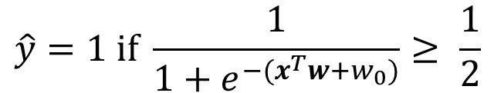
Geometric interpretation: linear classification model!
$$\hat{y}=1 if \frac{1}{1+e^{−(x^{T}w+w_{0})}}≥ \frac{1}{2}$$
Now,

Slide 13
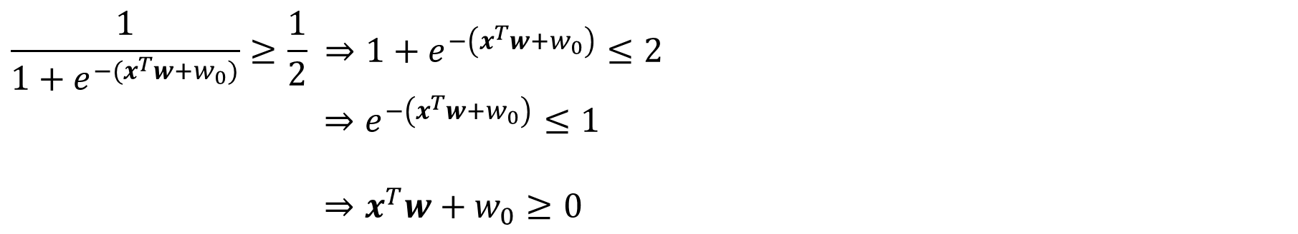
It’s a linear classification model!
$$\hat{y}=1 if \frac{1}{1+e^{−(x^{T}w+w_{0})}}≥ \frac{1}{2}$$
$$\frac{1}{1+e^{−(x^{T}w+w_{0})}}≥\frac{1}{2} ⇒1+e^{−\left(x^{T}w+w_{0}\right)}≤2$$
$⇒e^{−\left(x^{T}w+w_{0}\right)}≤1$
$⇒x^{T}w+w_{0}≥0$

Slide 14
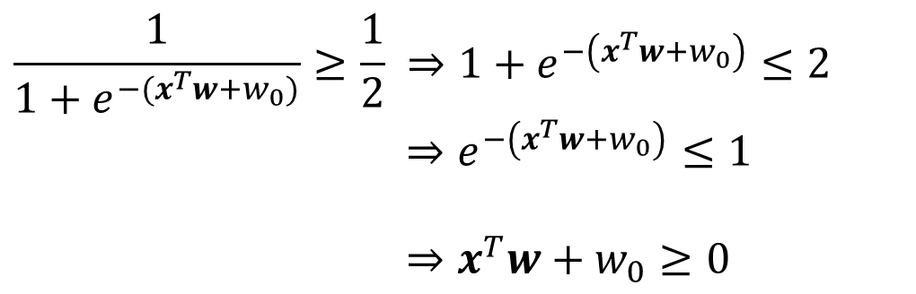
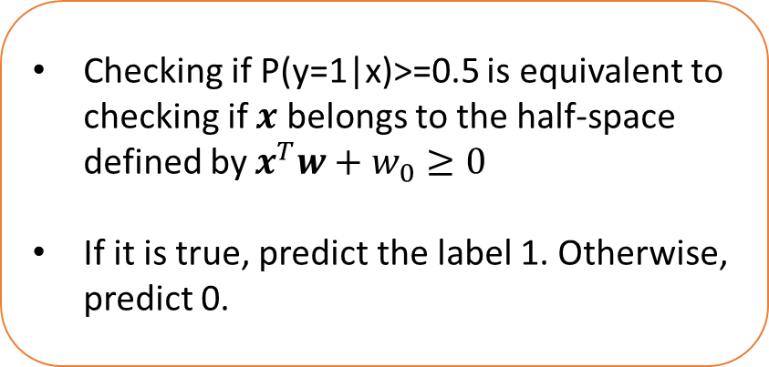
It’s a linear classification model!
$$\hat{y}=1 if \frac{1}{1+e^{−(x^{T}w+w_{0})}}≥ \frac{1}{2}$$
$$\frac{1}{1+e^{−(x^{T}w+w_{0})}}≥\frac{1}{2} ⇒1+e^{−\left(x^{T}w+w_{0}\right)}≤2$$
$⇒e^{−\left(x^{T}w+w_{0}\right)}≤1$
$⇒x^{T}w+w_{0}≥0$
Checking if P(y=1|x)>=0.5 is equivalent to checking if $x$ belongs to the half-space defined by $x^{T}w+w_{0}≥0$
If it is true, predict the label 1. Otherwise, predict 0.

Slide 15



Geometric Interpretation
$$x^{T}w+w_{0}≥0$$
$$w$$
$$x$$
d
$$x^{T}w+w_{0}<0$$
$$x^{T}w+w_{0}=0$$

Slide 16
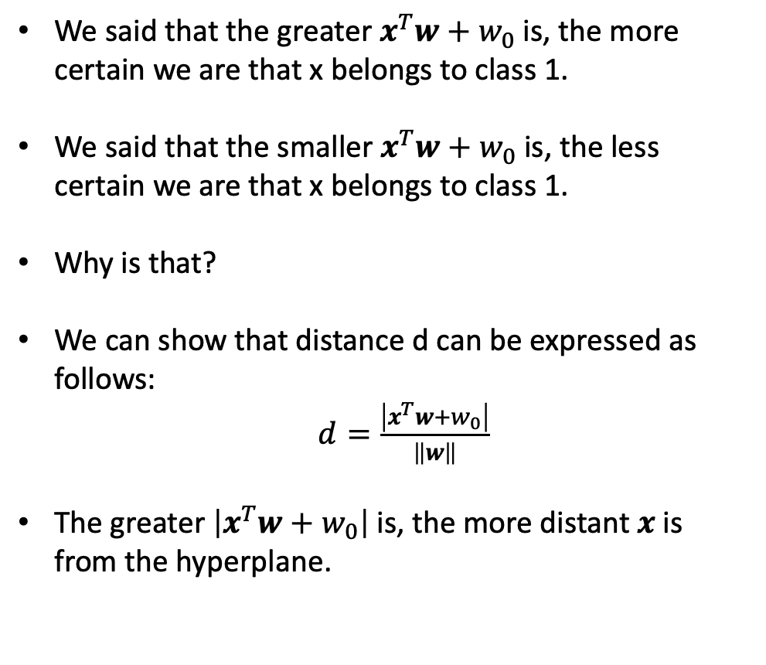
Geometric Interpretation
We said that the greater $x^{T}w+w_{0}$is, the more certain we are that x belongs to class 1.
We said that the smaller $x^{T}w+w_{0}$is, the less certain we are that x belongs to class 1.
Why is that?
We can show that distance d can be expressed as follows:
$d=\frac{\left|x^{T}w+w_{0}\right|}{\left\|w\right\|}$
The greater $\left|x^{T}w+w_{0}\right|$is, the more distant $x$is from the hyperplane.
$$x^{T}w+w_{0}≥0$$
$$w$$
$$x$$
d
$$x^{T}w+w_{0}<0$$
$$x^{T}w+w_{0}=0$$

Slide 17
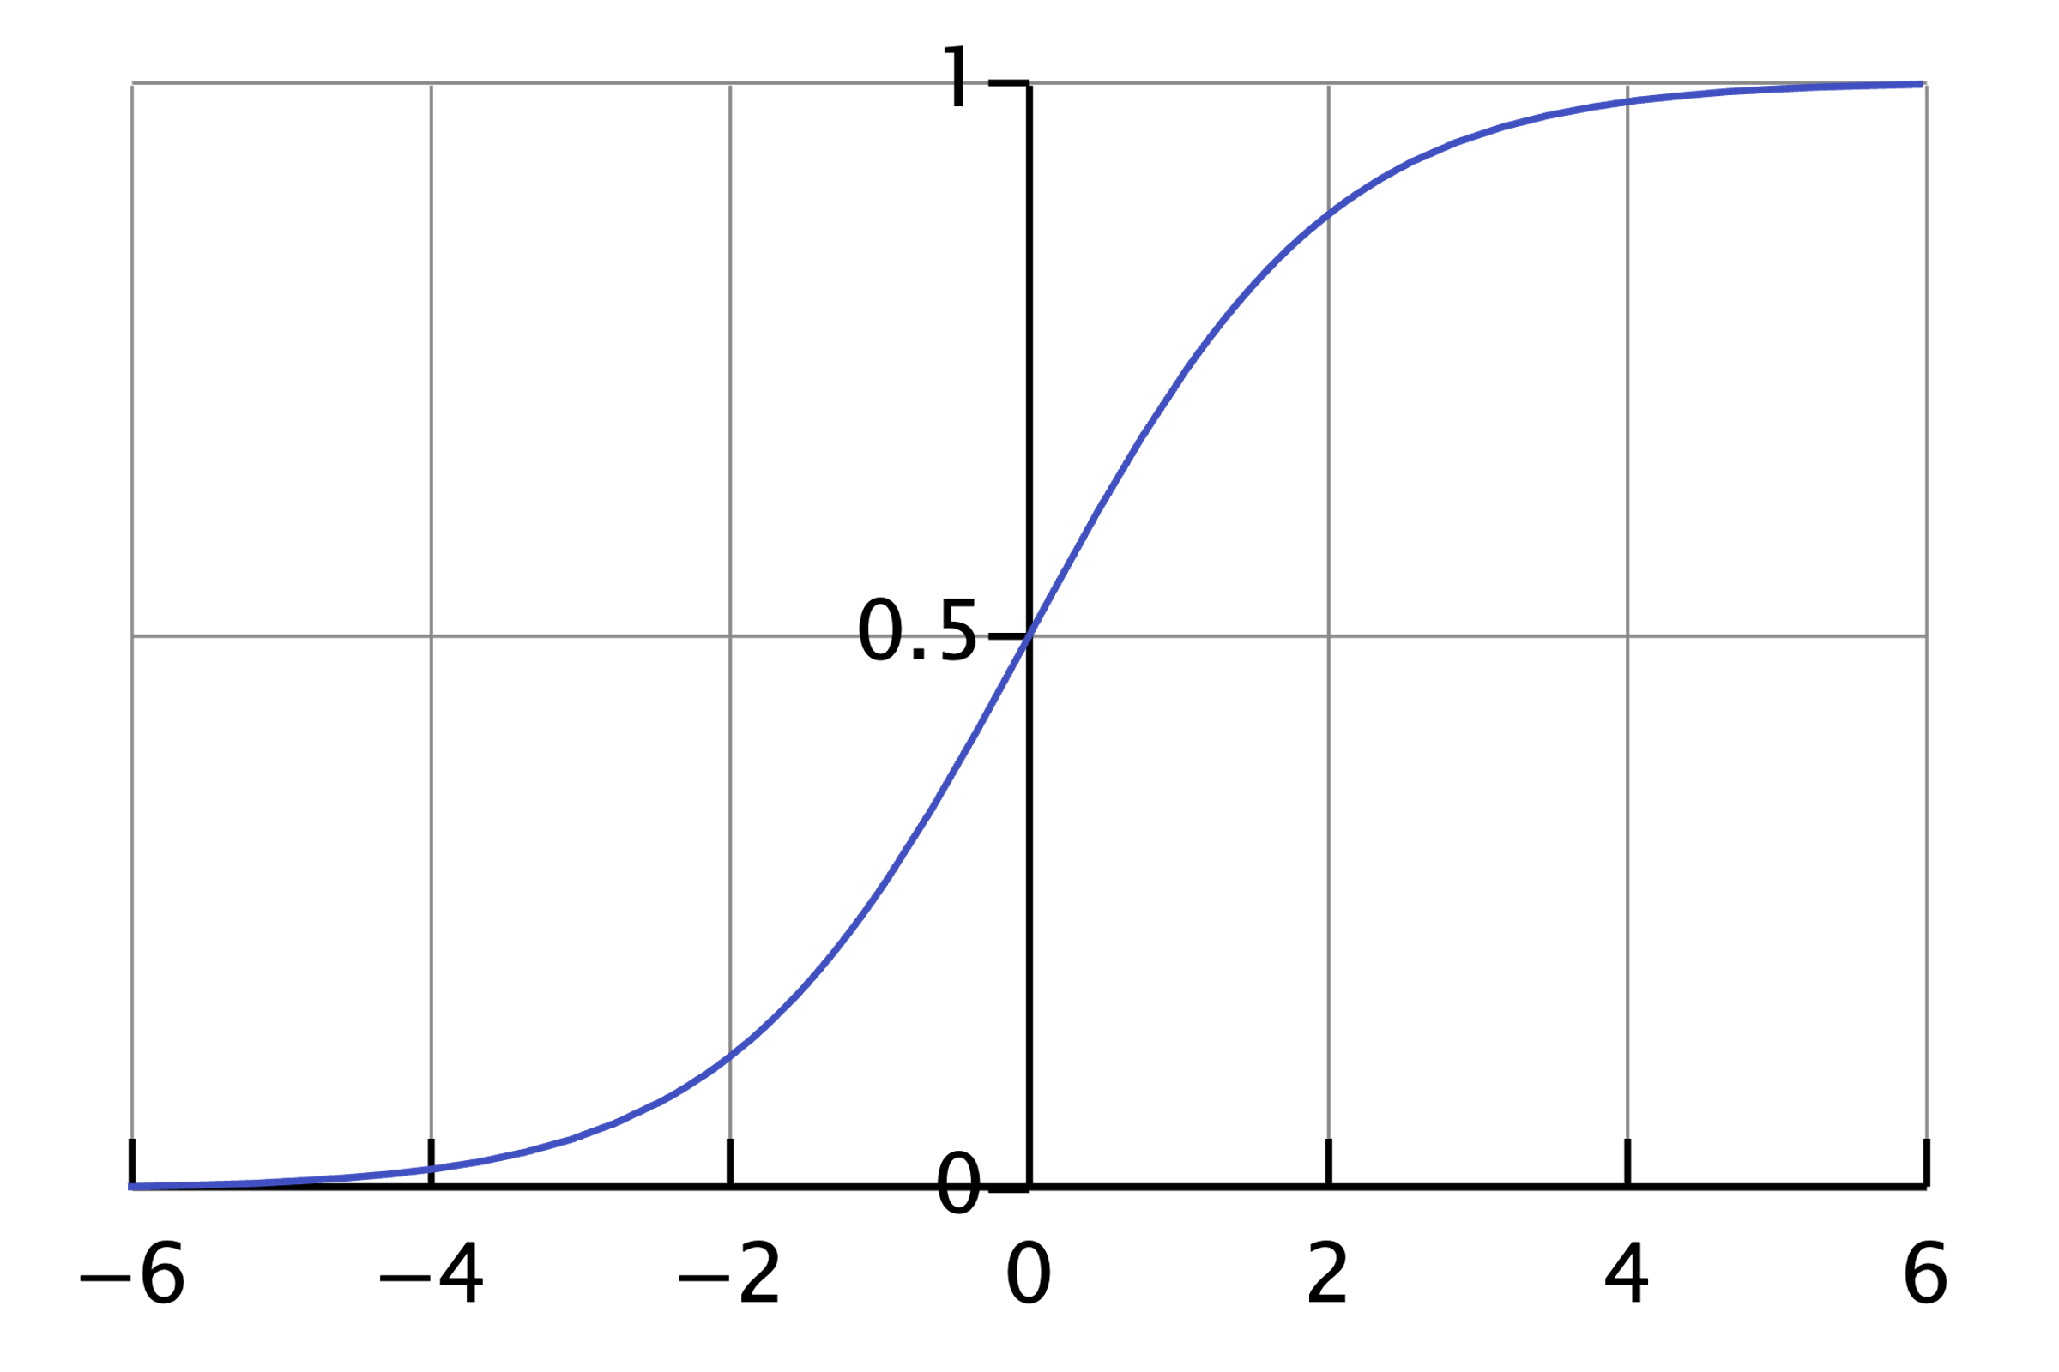
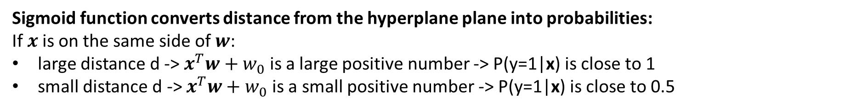



$$d=\frac{\left|x^{T}w+w_{0}\right|}{\left\|w\right\|}$$
$$σ\left(s\right)= \frac{1}{1+e^{−s}}$$
$$x^{T}w+w_{0}≥0$$
$$w$$
$$x$$
d
$$x^{T}w+w_{0}<0$$
$$x^{T}w+w_{0}=0$$
$$P\left(y=1 | x\right)=σ(x^{T}w+w_{0})$$
Sigmoid function converts distance from the hyperplane plane into probabilities:
If $x$is on the same side of $w$:
large distance d -> $x^{T}w+w_{0}$ is a large positive number -> P(y=1|x) is close to 1
small distance d -> $x^{T}w+w_{0}$ is a small positive number -> P(y=1|x) is close to 0.5

Slide 18
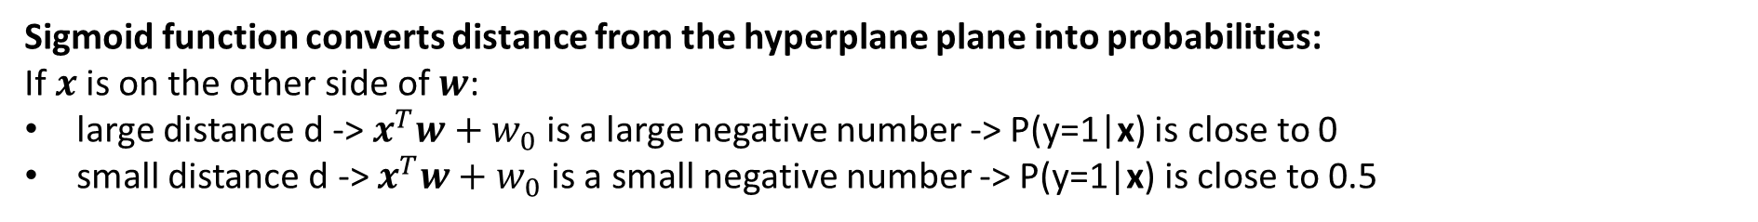

$$d=\frac{\left|x^{T}w+w_{0}\right|}{\left\|w\right\|}$$
$$σ\left(s\right)= \frac{1}{1+e^{−s}}$$
$$x^{T}w+w_{0}≥0$$
$$w$$
d
$$x$$
$$x^{T}w+w_{0}<0$$
$$x^{T}w+w_{0}=0$$
$$P\left(y=1 | x\right)=σ(x^{T}w+w_{0})$$
Sigmoid function converts distance from the hyperplane plane into probabilities:
If $x$is on the other side of $w$:
large distance d -> $x^{T}w+w_{0}$ is a large negative number -> P(y=1|x) is close to 0
small distance d -> $x^{T}w+w_{0}$ is a small negative number -> P(y=1|x) is close to 0.5

Slide 19
Certainty Expressed as Probability
The sigmoid function compressions the range –infinity, infinity to the range 0 to 1
That certainty is expressed as a probability
Sigmoid function converts distance from the plane into probabilities
$$σ\left(s\right)= \frac{1}{1+e^{−s}}$$

Slide 20
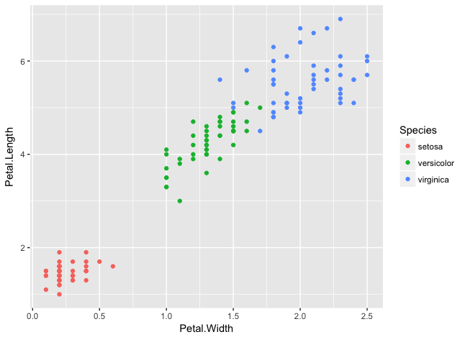
Certainty Comes from Distance
Distance from the plane is used to estimate the certainty
The further from the plane, the more confidence the model is
The magnitude of the equation becomes larger

Slide 21
Certainty Comes from Distance
Distance from the plane is used to estimate the certainty
The further from the plane, the more confidence the model is
The magnitude of the equation becomes larger
Less certain

Slide 22
Certainty Comes from Distance
Distance from the plane is used to estimate the certainty
The further from the plane, the more confidence the model is
The magnitude of the equation becomes larger
More certain

Slide 23
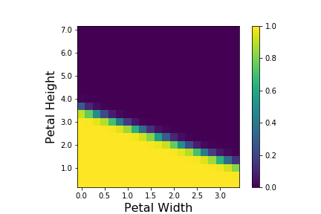
Example

Slide 24
Training Phase: How to find the weights?

Slide 25
How to Find the Weights?
Using the training data, the problem is formulated as an optimization problem.
We minimize/maximize a function that forces the classifier output to be as close as possible to the correct label in the training data.

Slide 26


Formulation of the Optimization Problem
If as great as possible.
If as great as possible.
$$P(y=1|x)$$
find w such that
$$1−P(y=1|x)$$

Slide 27
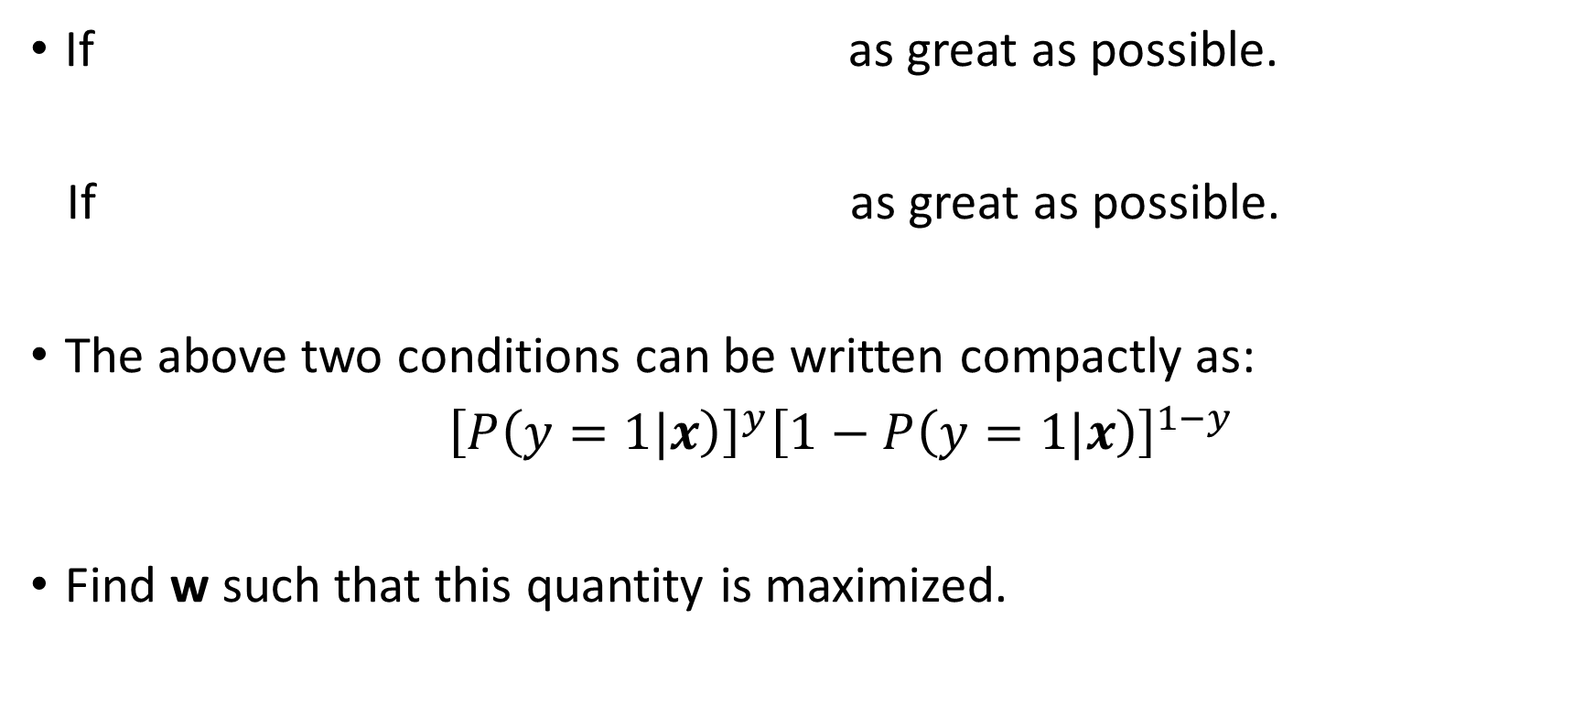
Formulation of the Optimization Problem
If as great as possible.
If as great as possible.
The above two conditions can be written compactly as:
${\left[P\left(y=1|x\right)\right]}^{y}{\left[1−P\left(y=1|x\right)\right]}^{1−y}$
Find w such that this quantity is maximized.
$$P(y=1|x)$$
find w such that
$$1−P(y=1|x)$$

Slide 28

Formulation of the Optimization Problem
Find w such that:
${\left[P\left(y=1|x\right)\right]}^{y}{\left[1−P\left(y=1|x\right)\right]}^{1−y}$
is maximized for each data point in the training set.

Slide 29
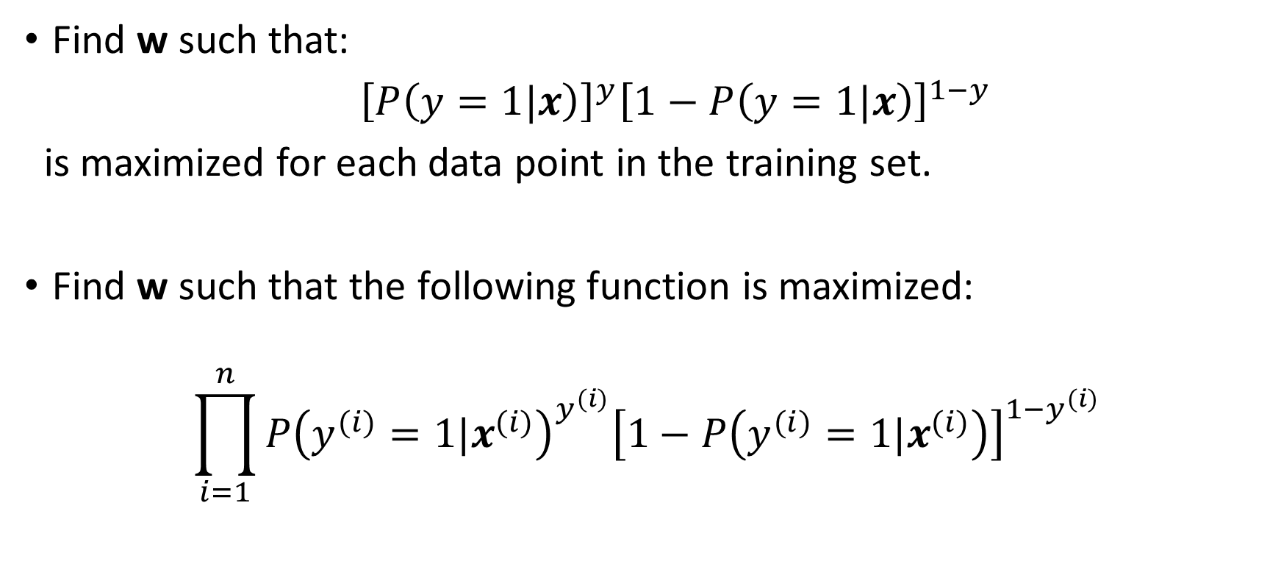
Formulation of the Optimization Problem
Find w such that:
${\left[P\left(y=1|x\right)\right]}^{y}{\left[1−P\left(y=1|x\right)\right]}^{1−y}$
is maximized for each data point in the training set.
Find w such that the following function is maximized:
$$\prod_{i=1}^{n}{{P\left(y^{(i)}=1|x^{(i)}\right)}^{y^{(i)}}{\left[1−P\left(y^{(i)}=1|x^{(i)}\right)\right]}^{1−y^{(i)}}}$$

Slide 30
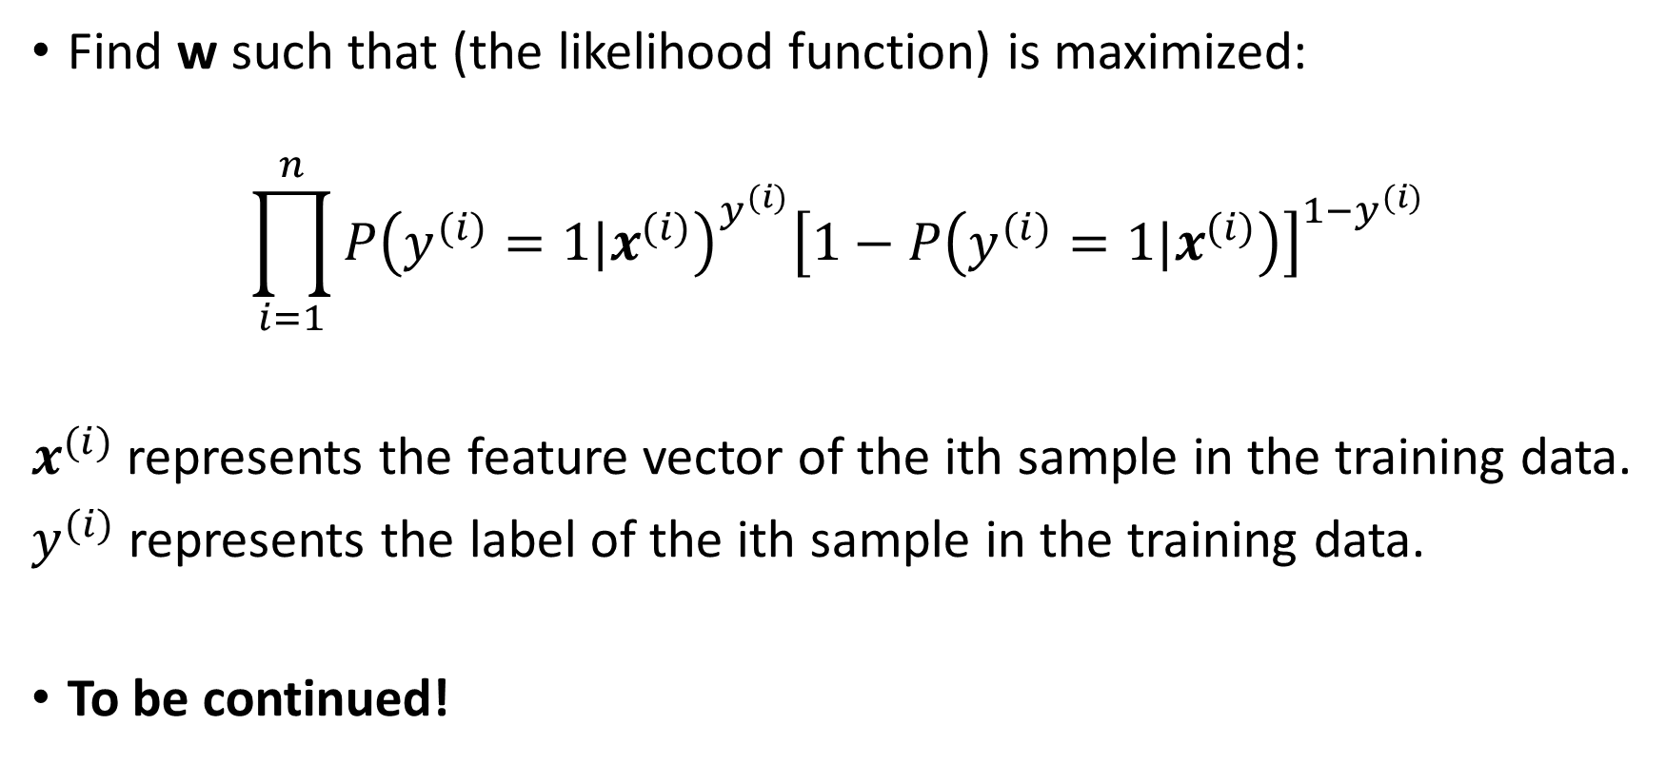
Formulation of the Optimization Problem
Find w such that (the likelihood function) is maximized:
$$\prod_{i=1}^{n}{{P\left(y^{(i)}=1|x^{(i)}\right)}^{y^{(i)}}{\left[1−P\left(y^{(i)}=1|x^{(i)}\right)\right]}^{1−y^{(i)}}}$$
$x^{(i)}$represents the feature vector of the ith sample in the training data.
$y^{(i)}$represents the label of the ith sample in the training data.
To be continued!

Slide 31
Optimization Problem
We will learn after week 9 how this optimization problem is solved.
The optimization algorithm that solves the optimization problem comes with a set of hyperparameters: learning rate, regularization factor. We will learn later about them!

Slide 32
Do we need to scale the features?
Theoretically speaking, the predictions of logistic regression should not change whether we scale the data or not.
However, the optimization algorithm behaves in a better way when the features are scaled.
So yes, we need to scale the features when using logistic regression.

Slide 33
Prediction Phase

Slide 34
Predict the label for new data
Learned weights
$$P(y=1|x)$$
$$\frac{1}{1+e^{−(x^{T}w+w_{0})}}≥0.5$$
$$x_{1}$$
$$w_{1}$$
$$x_{2}$$
$$w_{2}$$
$$\frac{1}{1+e^{−(x^{T}w+w_{0})}}$$
$$x^{T}w+w_{0}$$
+
$$w_{m}$$
$$x_{m}$$
$$w_{0}$$
Logistic Function
$$\frac{1}{1+e^{−(x^{T}w+w_{0})}}<0.5$$
$$1$$
Predict label for the given Feature vector
Thresholding

Slide 35
Logistic Regression in Scikit Learn
Scikit-Learn contains two main implementations:
LogisticRegression
SGDClassifier
X = iris.data
sgd = SGDClassifier( loss="log")
sgd.fit(X, setosa_labels)
pred_labels = sgd.predict(X)
pred_prob = sgd.predict_proba(X)

Slide 36
Logistic Regression with Multiple Classes
What if our classification problem as more than two classes?
We create a model for each class: is this setosa or not? is this virginica or not? is this versicolor or not?
When classifying objects, we pick the class with the highest estimated probability.
One-vs-all!
P(y = setosa) | P(y = virginica) | P(y = versicolor)
0.99 | 0.01 | 0.01
0.01 | 0.90 | 0.80
0.99 | 0.01 | 0.01
0.01 | 0.83 | 0.98
0.01 | 0.85 | 0.83

Slide 37
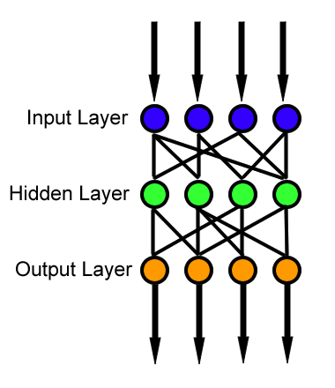
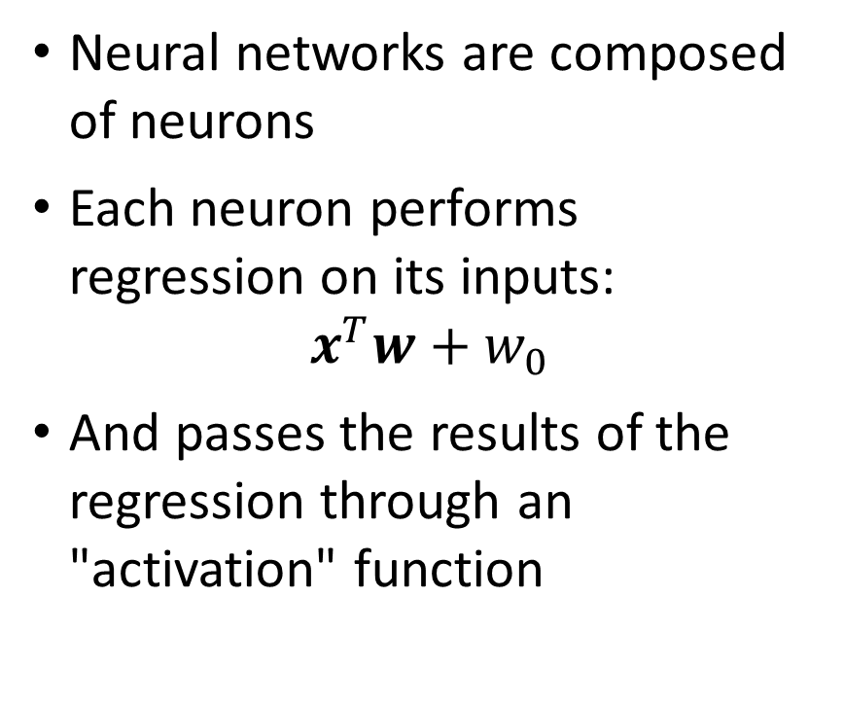
Connection to Neural Networks
Neural networks are composed of neurons
Each neuron performs regression on its inputs:
$$x^{T}w+w_{0}$$
And passes the results of the regression through an "activation" function

Slide 38
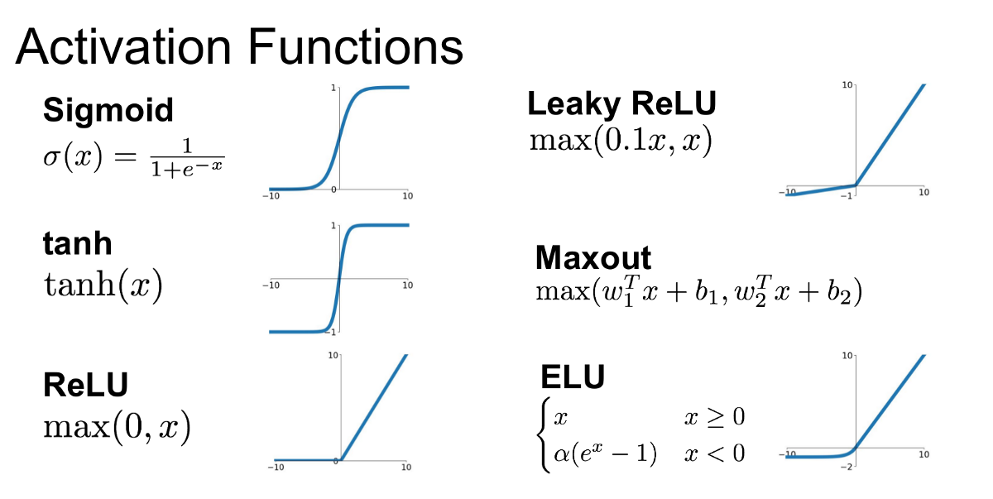
https://medium.com/@shrutijadon10104776/survey-on-activation-functions-for-deep-learning-9689331ba092

