Slide 1
Numerical Differentiation
CSC4601 Theory of Machine Learning

Slide 2
Derivatives
We use derivatives to find local minima and maxima
In other words, to optimize functions
The models and loss functions we use can get quite complicated
Calculating derivatives by hand can be tedious and error prone

Slide 3
Numerical Differentiation
Numerical differentiation is an alternative to analytical derivatives
Instead of finding a derivative function, we estimate the derivative function's value at each point
Conceptually, it's a direct application of the derivative formula from calculus

Slide 4

Derivative
$f^{′}\left(x\right)= \lim_{h→0}{\frac{f\left(x+h\right)−f(x)}{h}}$
Let’s take this quantity:
$\frac{f\left(x+h\right)−f(x)}{h}$
What does it represent graphically?

Slide 5
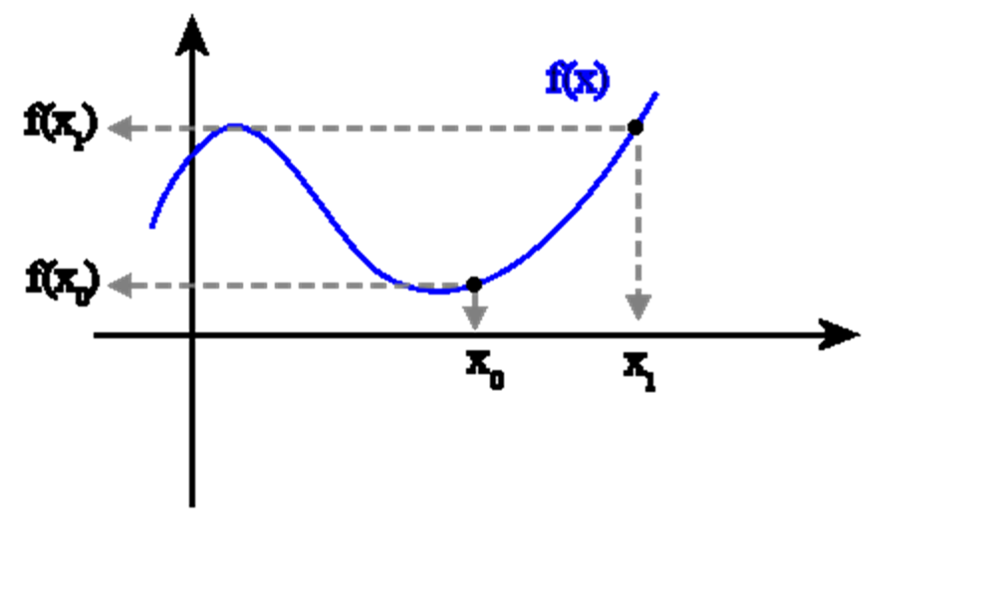

Derivative
$f^{′}\left(x\right)= \lim_{h→0}{\frac{f\left(x+h\right)−f(x)}{h}}$
Let’s take this quantity:
$\frac{f\left(x+h\right)−f(x)}{h}$
What does it represent graphically?
Slope of the secant line.
What if we make h small?
f(x+h)
f(x)
f(x)
x
x +h

Slide 6

Derivative
$f^{′}\left(x\right)= \lim_{h→0}{\frac{f\left(x+h\right)−f(x)}{h}}$
Let’s take this quantity:
$\frac{f\left(x+h\right)−f(x)}{h}$
f(x+h)
f(x)
f(x)
x
x +h

Slide 7
Derivative
$f^{′}\left(x\right)= \lim_{h→0}{\frac{f\left(x+h\right)−f(x)}{h}}$
Let’s take this quantity:
$\frac{f\left(x+h\right)−f(x)}{h}$
f(x+h)
f(x)
f(x)
x
x +h

Slide 8

Derivative
$f^{′}\left(x\right)= \lim_{h→0}{\frac{f\left(x+h\right)−f(x)}{h}}$
Let’s take this quantity:
$\frac{f\left(x+h\right)−f(x)}{h}$
What does it represent graphically?
f(x+h)
f(x)
f(x)
x
x +h

Slide 9

Derivative
$f^{′}\left(x\right)= \lim_{h→0}{\frac{f\left(x+h\right)−f(x)}{h}}$
Let’s take this quantity:
$\frac{f\left(x+h\right)−f(x)}{h}$
What does it represent graphically?
As h becomes smaller, the secant line approximates the tangent:
in this case the slope of the secant line approximates the slope of the tangent, i.e., the derivate of f at the point x.
f(x+h)
f(x)
f(x)
x
x +h

Slide 10
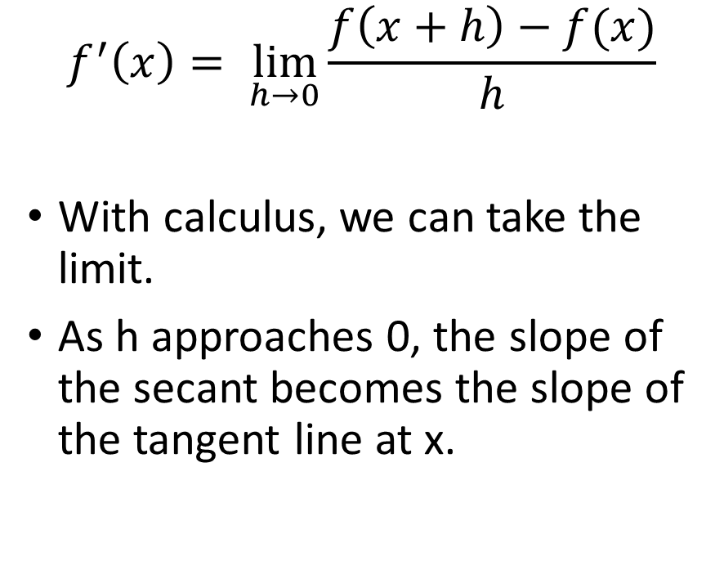
Approximating the Slope with the slope a Secant Line
$$f^{′}\left(x\right)= \lim_{h→0}{\frac{f\left(x+h\right)−f(x)}{h}}$$
With calculus, we can take the limit.
As h approaches 0, the slope of the secant becomes the slope of the tangent line at x.
http://clas.sa.ucsb.edu/staff/lee/Secant,%20Tangent,%20and%20Derivatives.htm

Slide 11
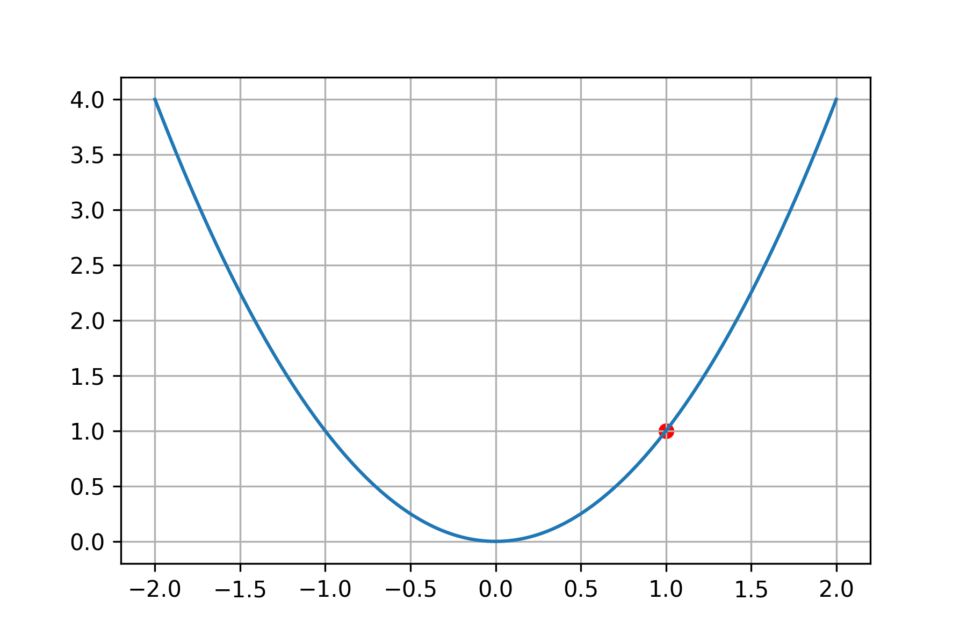
Numerical Differentiation
We apply the same idea for numerical differentiation
To find the derivative at x:
Find f(x)
Find f(x+h)
Find a line from the two points
Estimate f'(x) using the slope of the line

Slide 12
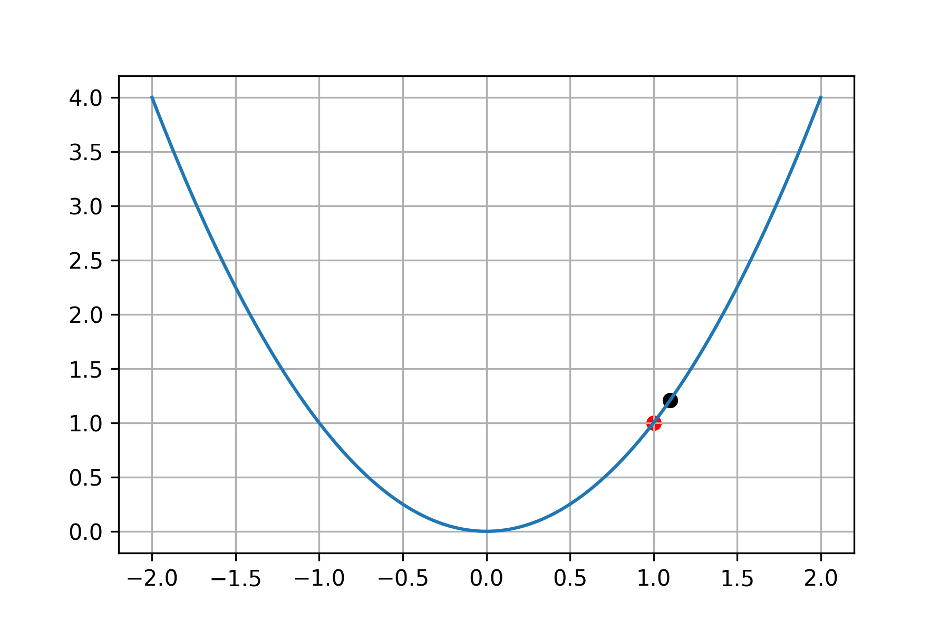
Numerical Differentiation
We apply the same idea for numerical differentiation
To find the derivative at x:
Find f(x)
Find f(x+h)
Find a line from the two points
Estimate f'(x) using the slope of the line

Slide 13
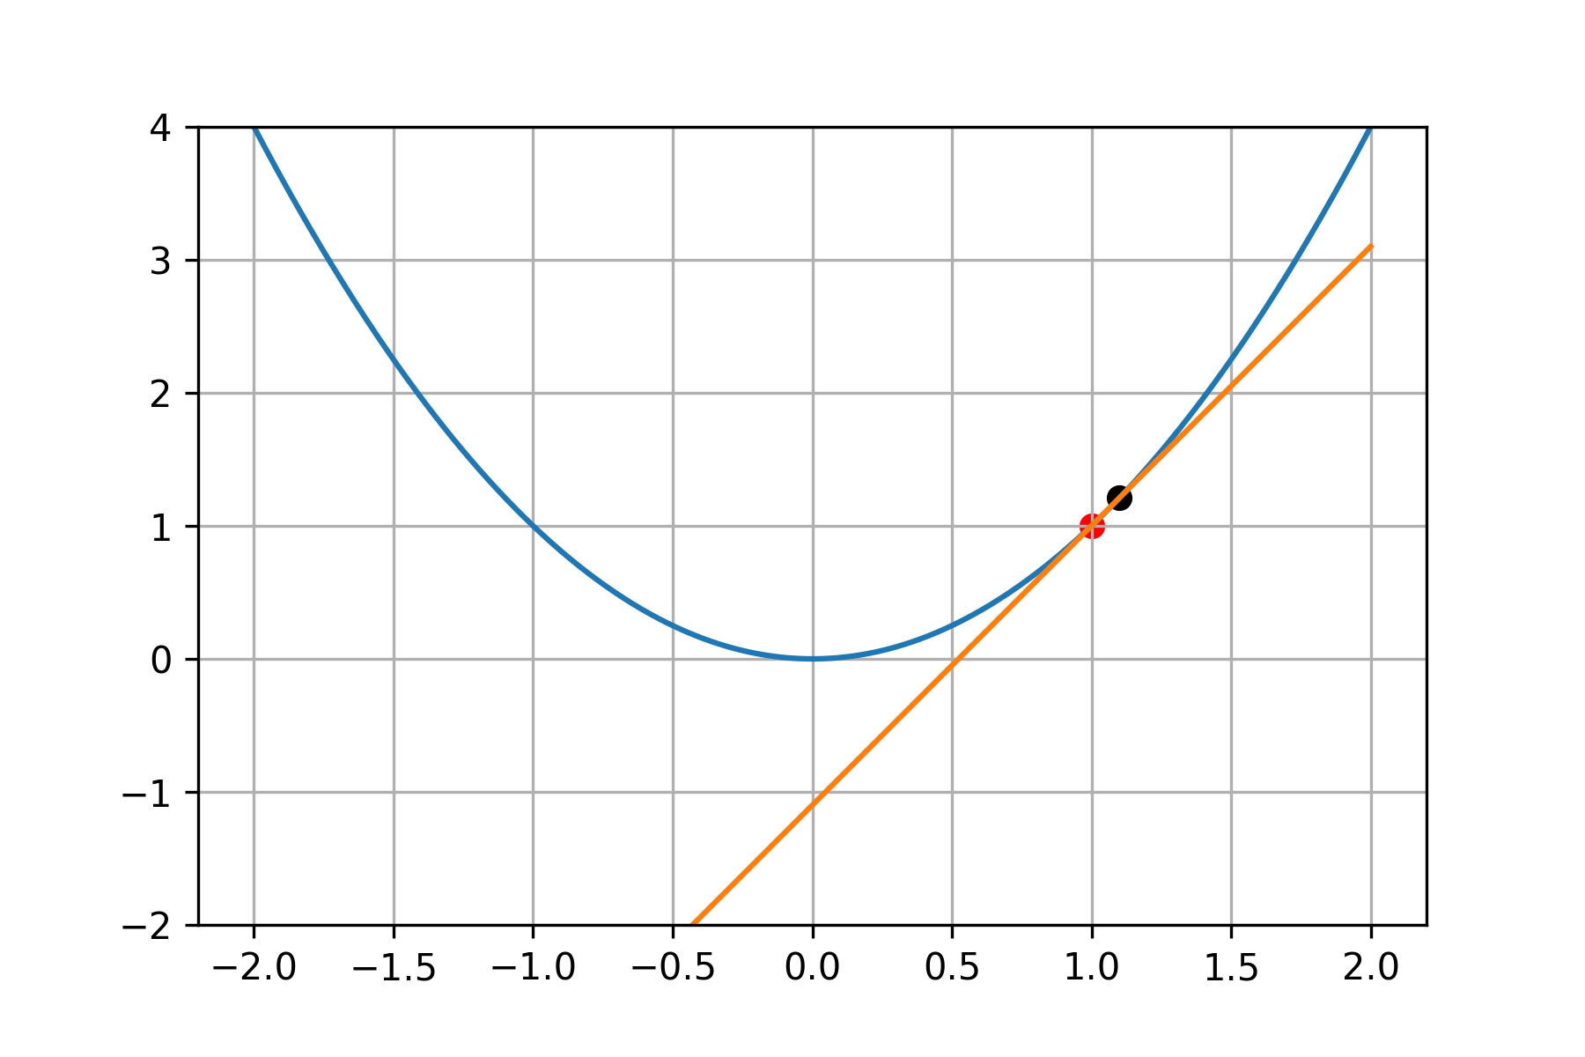
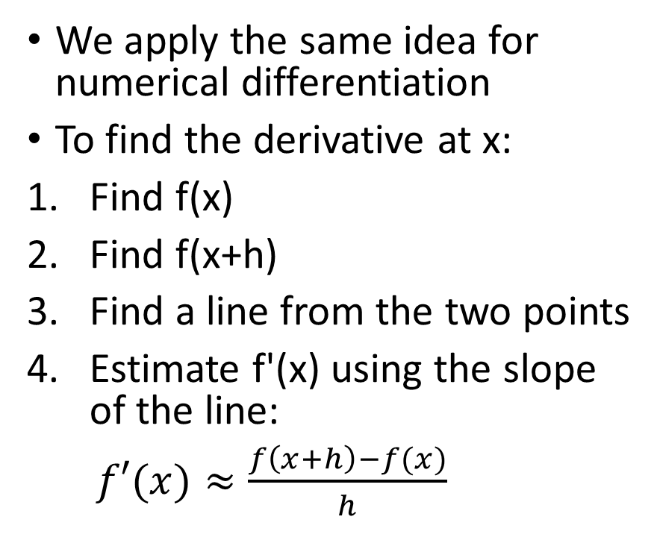
Numerical Differentiation
We apply the same idea for numerical differentiation
To find the derivative at x:
Find f(x)
Find f(x+h)
Find a line from the two points
Estimate f'(x) using the slope of the line:
$f′(x)≈\frac{f\left(x+h\right)−f(x)}{h}$

Slide 14
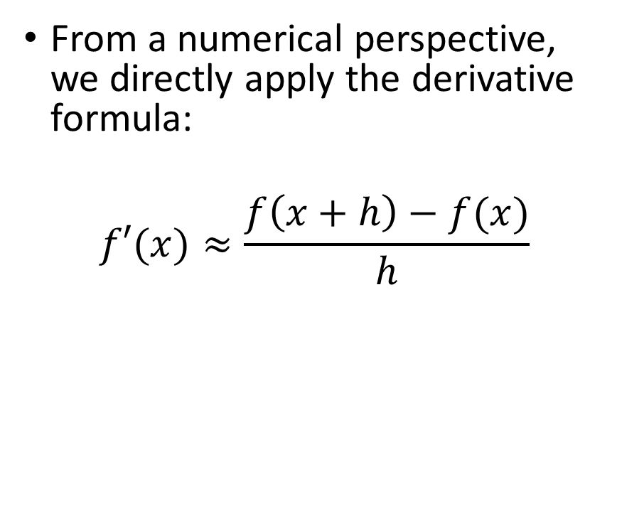
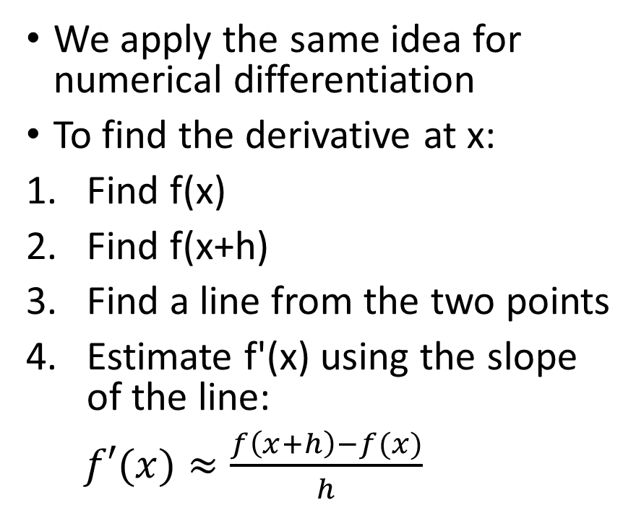
Numerical Differentiation
We apply the same idea for numerical differentiation
To find the derivative at x:
Find f(x)
Find f(x+h)
Find a line from the two points
Estimate f'(x) using the slope of the line:
$f′(x)≈\frac{f\left(x+h\right)−f(x)}{h}$
From a numerical perspective, we directly apply the derivative formula:
$$f′(x)≈\frac{f\left(x+h\right)−f(x)}{h}$$

Slide 15
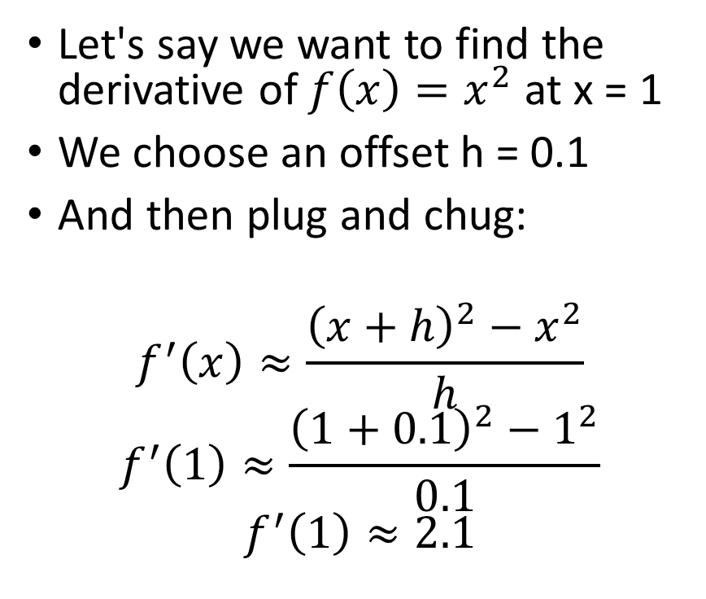
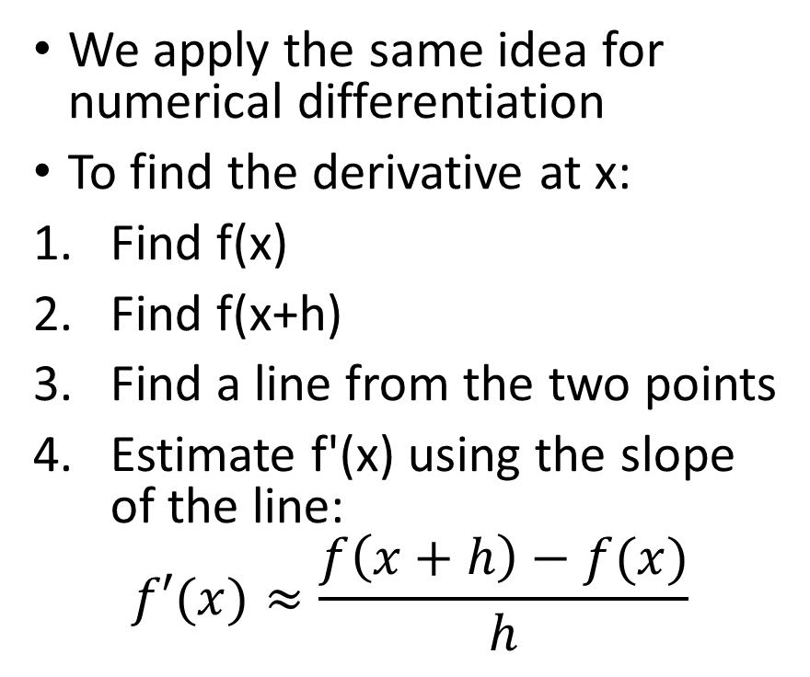
Numerical Differentiation
We apply the same idea for numerical differentiation
To find the derivative at x:
Find f(x)
Find f(x+h)
Find a line from the two points
Estimate f'(x) using the slope of the line:
$$f′(x)≈\frac{f\left(x+h\right)−f(x)}{h}$$
Let's say we want to find the derivative of $f\left(x\right)=x^{2}$ at x = 1
We choose an offset h = 0.1
And then plug and chug:
$$f^{′}\left(x\right)≈\frac{{\left(x+h\right)}^{2}−x^{2}}{h}$$
$$f^{′}\left(1\right)≈\frac{{\left(1+0.1\right)}^{2}−1^{2}}{0.1}$$
$$f^{′}\left(1\right)≈2.1$$

Slide 16
In Code
The example on the previous slide translates directly to code:
def f(x):
return x**2
def fp(x, h):
return (f(x+h)-f(x))/h

Slide 17
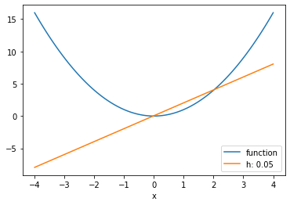
Estimating the Derivative Function
What if we want to plot the derivative function?
We simply evaluate at a bunch of points!
x = np.linspace(-4,4,100)
h = 0.05
plt.plot(x, f(x), label = "function")
plt.plot(x, fp(x, h), label = "h: " + str(h))
plt.xlabel("x")
plt.legend()
plt.show()

Slide 18

Numerical Differentiation – Other Approximations
Forward difference method:
$f^{′}\left(x\right)≈\frac{f\left(x+h\right)−f\left(x\right)}{h}$
It turns out (using Taylor’s series expansion), we can show
$f^{′}\left(x\right)=\frac{f\left(x+h\right)−f\left(x\right)}{h}+O(h)$
Formula error (approximation error)

Slide 19

Revisiting the Taylor Series Expansion
When we expand $f(x0+h)$and $f(x0+2h)$ using Taylor series, we get:

Slide 20
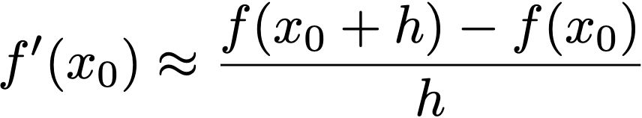
Error Analysis for Forward Difference Method
The forward difference formula:
From the Taylor series expansion:
Dividing by h:

Slide 21
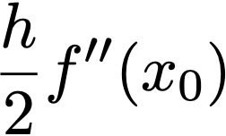
Error Analysis for Forward Difference Method
Error Term: The leading error term in this approximation is
indicating that the forward difference method is first-order accurate with a truncation error proportional to h.

Slide 22
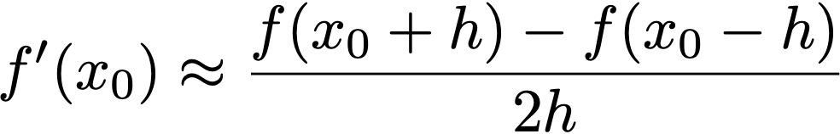
Error Analysis for Central Difference Method
The central difference formula:
From the Taylor series expansion:

Slide 23
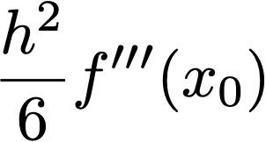

Error Analysis for Central Difference Method
Subtracting:
Dividing by 2h:
Error Term: The central difference method has a leading error term of
making it second-order accurate with an error proportional to

Slide 24

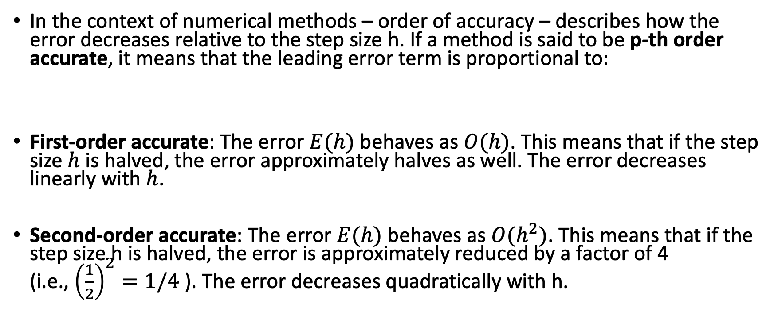
Order of Accuracy
In the context of numerical methods – order of accuracy – describes how the error decreases relative to the step size h. If a method is said to be p-th order accurate, it means that the leading error term is proportional to:
First-order accurate: The error $E(h)$ behaves as $O(h)$. This means that if the step size $h$ is halved, the error approximately halves as well. The error decreases linearly with $h$.
Second-order accurate: The error $E(h)$ behaves as $O(h^{2})$. This means that if the step size h is halved, the error is approximately reduced by a factor of 4 (i.e., ${\left(\frac{1}{2}\right)}^{2}=1/4$ ). The error decreases quadratically with h.

Slide 25
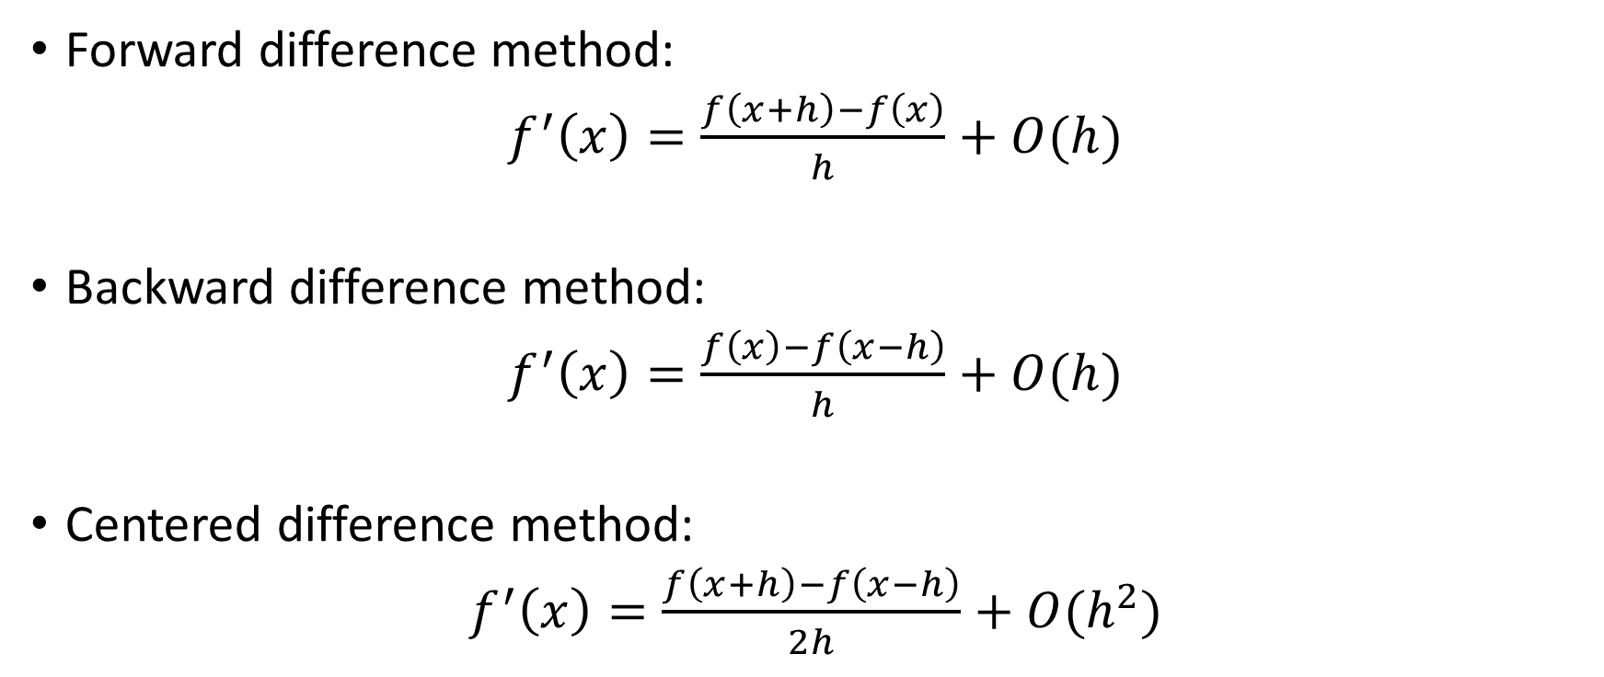
Numerical Differentiation – Other Approximations (Extra)
Forward difference method:
$f^{′}\left(x\right)=\frac{f\left(x+h\right)−f\left(x\right)}{h}+O(h)$
Backward difference method:
$f^{′}\left(x\right)=\frac{f\left(x\right)−f\left(x−h\right)}{h}+O(h)$
Centered difference method:
$f^{′}\left(x\right)=\frac{f\left(x+h\right)−f\left(x−h\right)}{2h}+O(h^{2})$

Slide 26
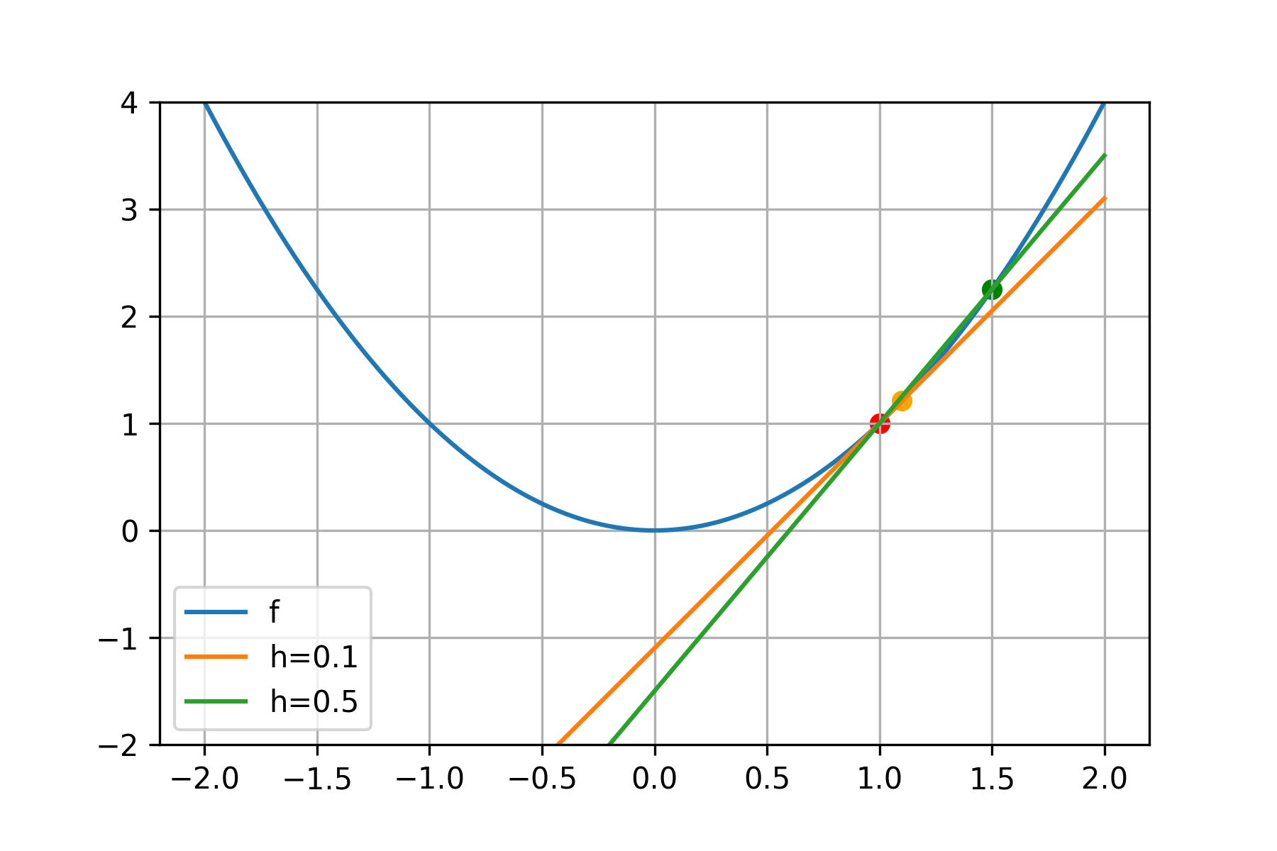
Choosing the step size (h)
Remember that numerical differentiation is an approximation.
The error in the derivative approximation largely depends on the perturbation, h
The smaller the h, the better the approximation is.
How small can we make h?

Slide 27
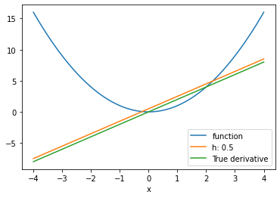
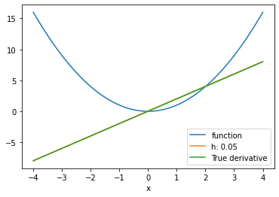
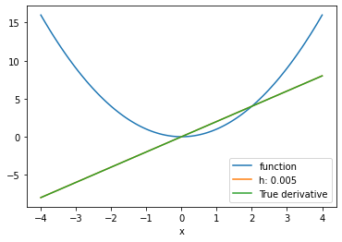
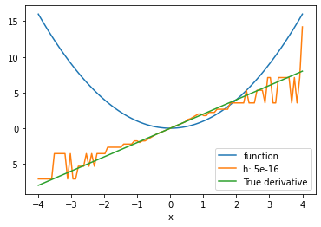
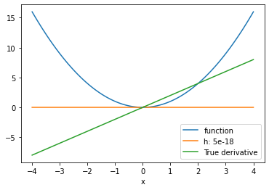
Decreasing h

Slide 28
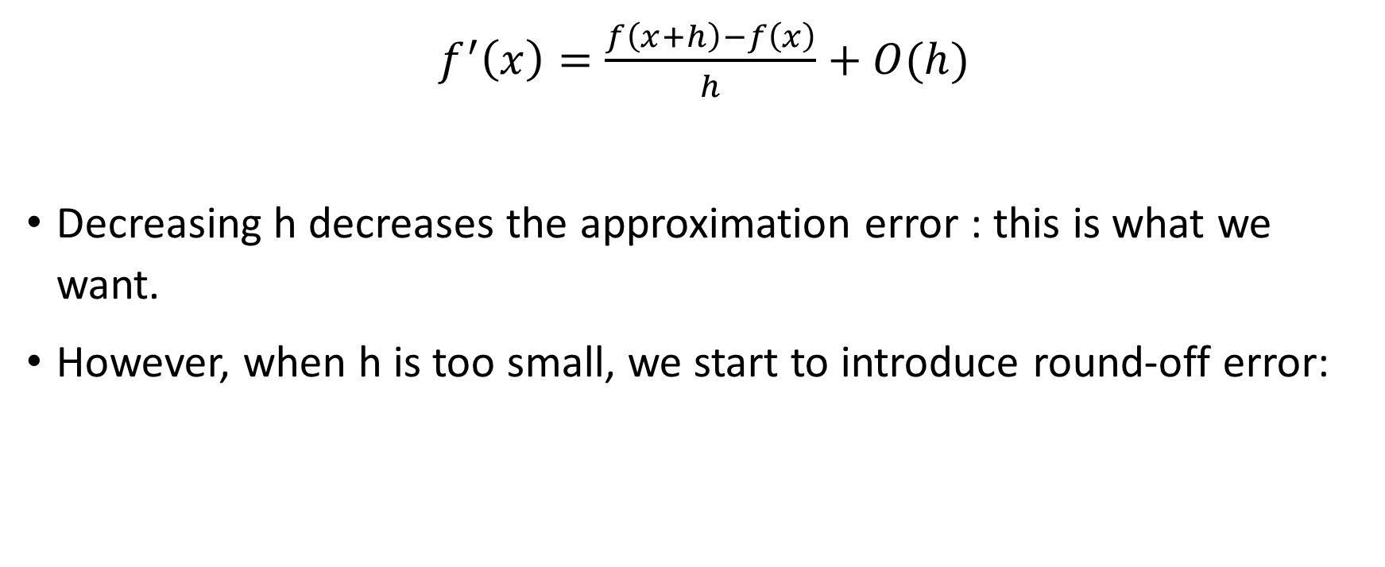
Choosing the step size h
$f^{′}\left(x\right)=\frac{f\left(x+h\right)−f\left(x\right)}{h}+O(h)$
Decreasing h decreases the approximation error : this is what we want.
However, when h is too small, we start to introduce round-off error:
Formula error (approximation error)

Slide 29
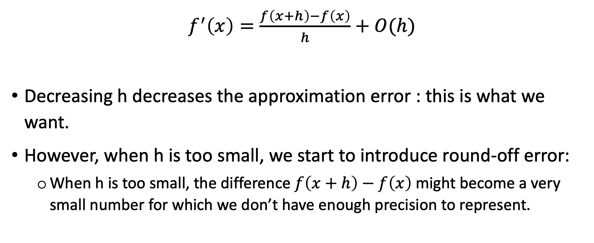
Choosing the step size h
$f^{′}\left(x\right)=\frac{f\left(x+h\right)−f\left(x\right)}{h}+O(h)$
Decreasing h decreases the approximation error : this is what we want.
However, when h is too small, we start to introduce round-off error:
When h is too small, the difference $f\left(x+h\right)−f\left(x\right)$ might become a very small number for which we don’t have enough precision to represent.
Formula error (approximation error)

Slide 30
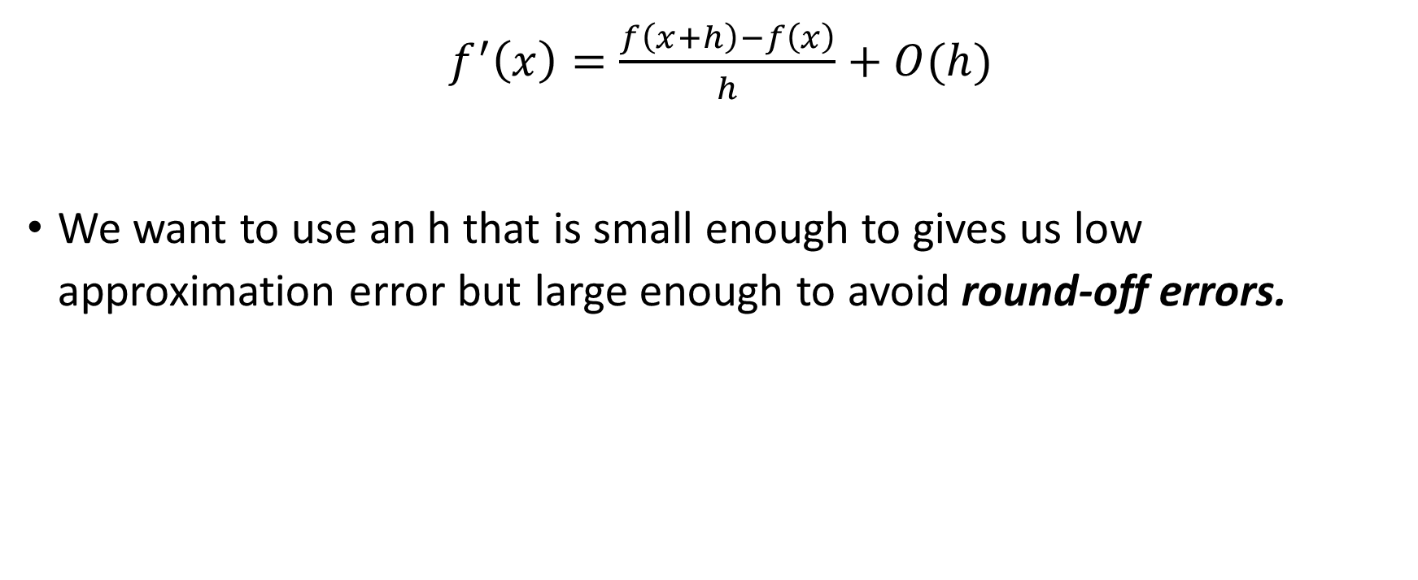
Choosing the step size h
Roundoff error
$f^{′}\left(x\right)=\frac{f\left(x+h\right)−f\left(x\right)}{h}+O(h)$
We want to use an h that is small enough to gives us low approximation error but large enough to avoid round-off errors.
Formula error (approximation error)

Slide 31
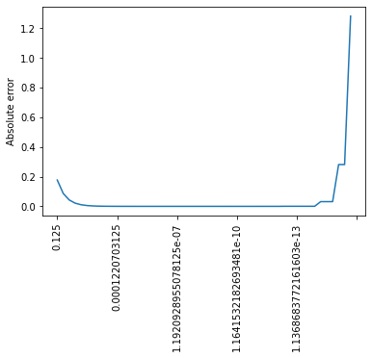
Choosing the step size - Extra
Simulation: approximating f’(x) at x = 1 where f is the exponential function
plt.plot(np.abs(np.array(dfs)- fpt(x)))
plt.xticks(np.arange(0,51,10), hs[::10], rotation='vertical')
plt.ylabel("Absolute error");
def f(x):
return np.exp(x)
def fp(x, h):
return (f(x+h)-f(x))/h
def fpt(x):
return np.exp(x)
x = 1 h = 0.125
hs = []
dfs = []
for i in range(50):
df = fp(x, h)
hs.append(h)
dfs.append(df)
print ("h=", h, "df=", df)
h = h/2.0
h values

Slide 32
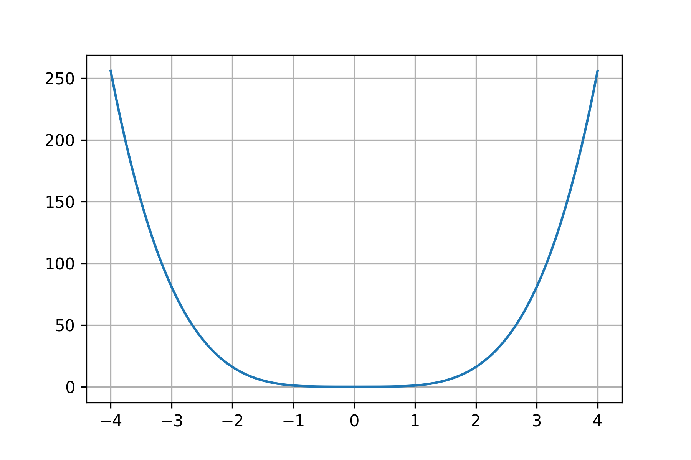
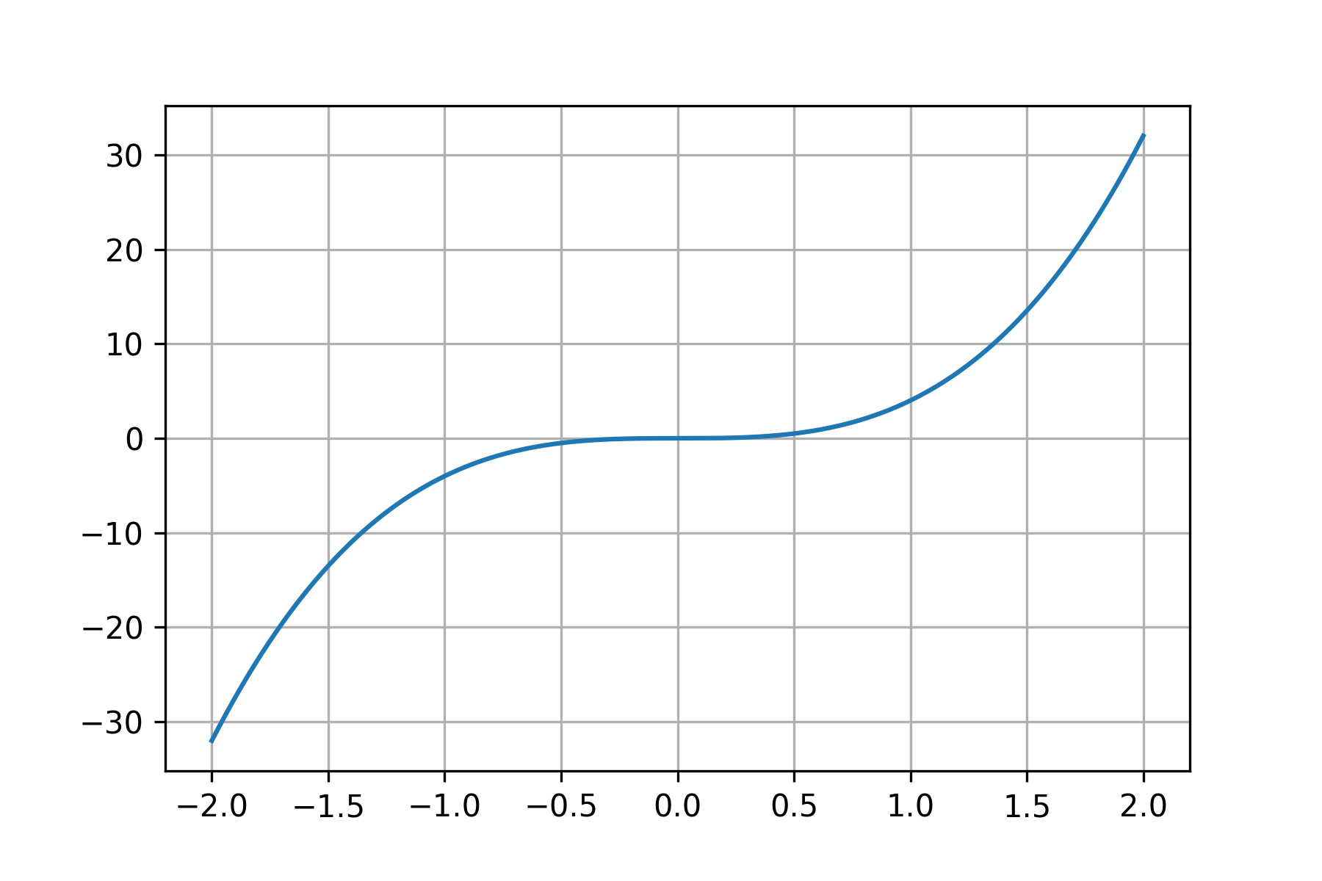
Picking h
Function
Derivative

Slide 33
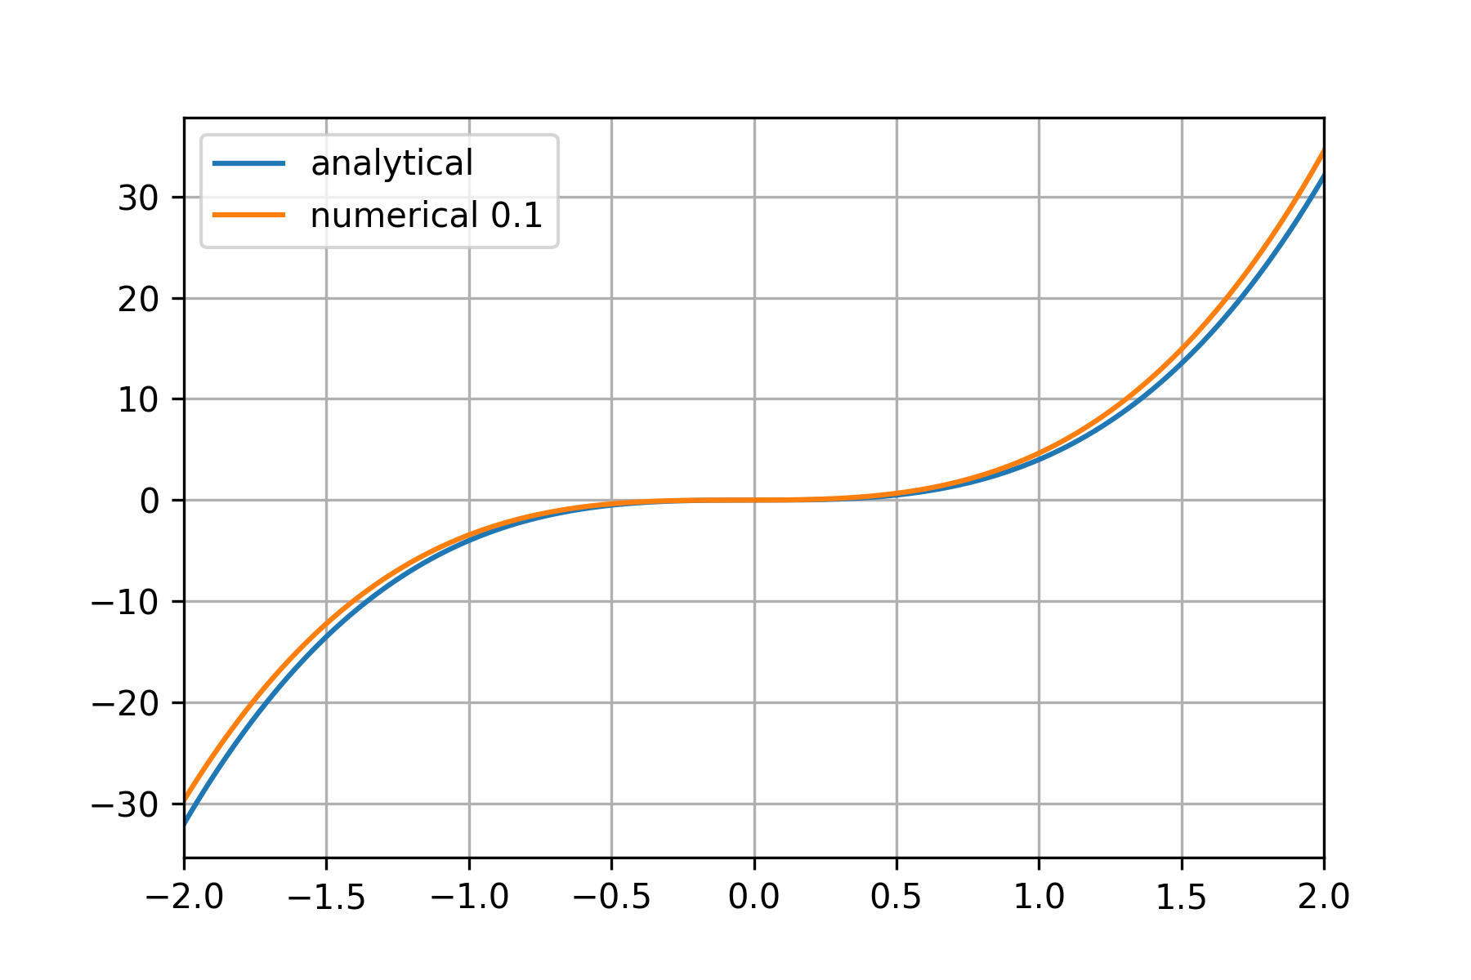
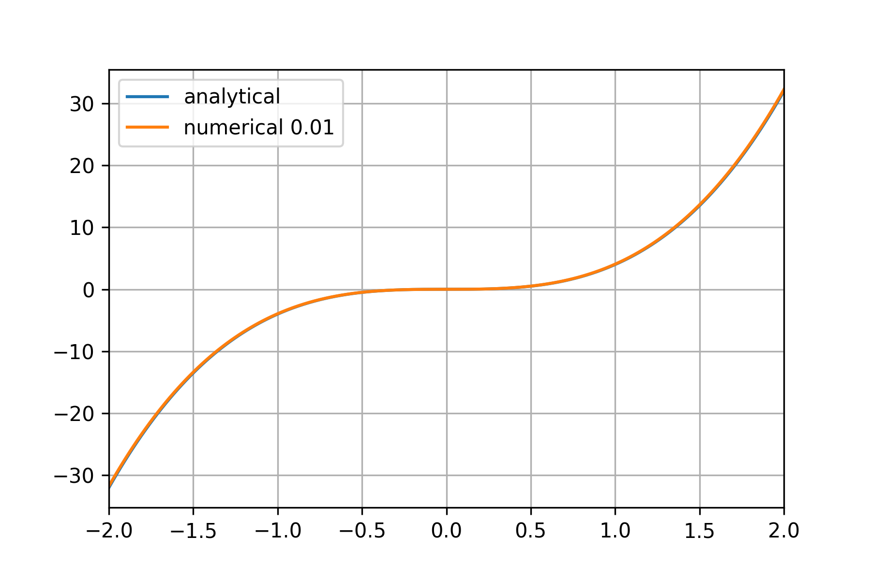
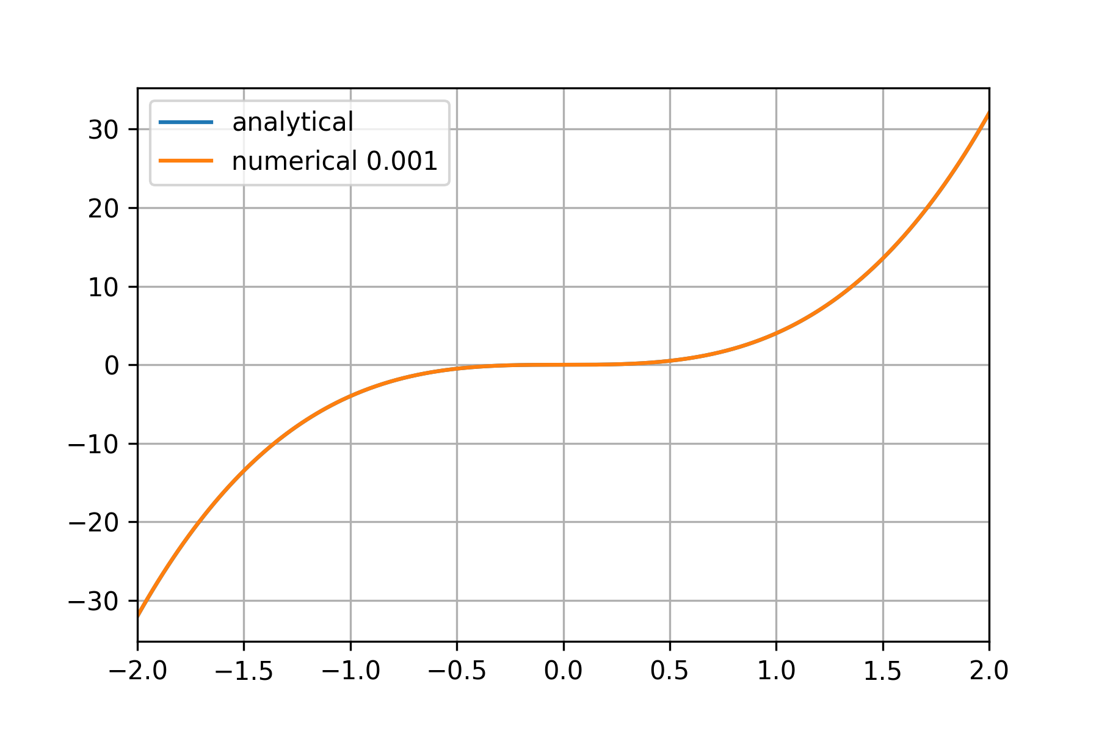
Picking h

Slide 34
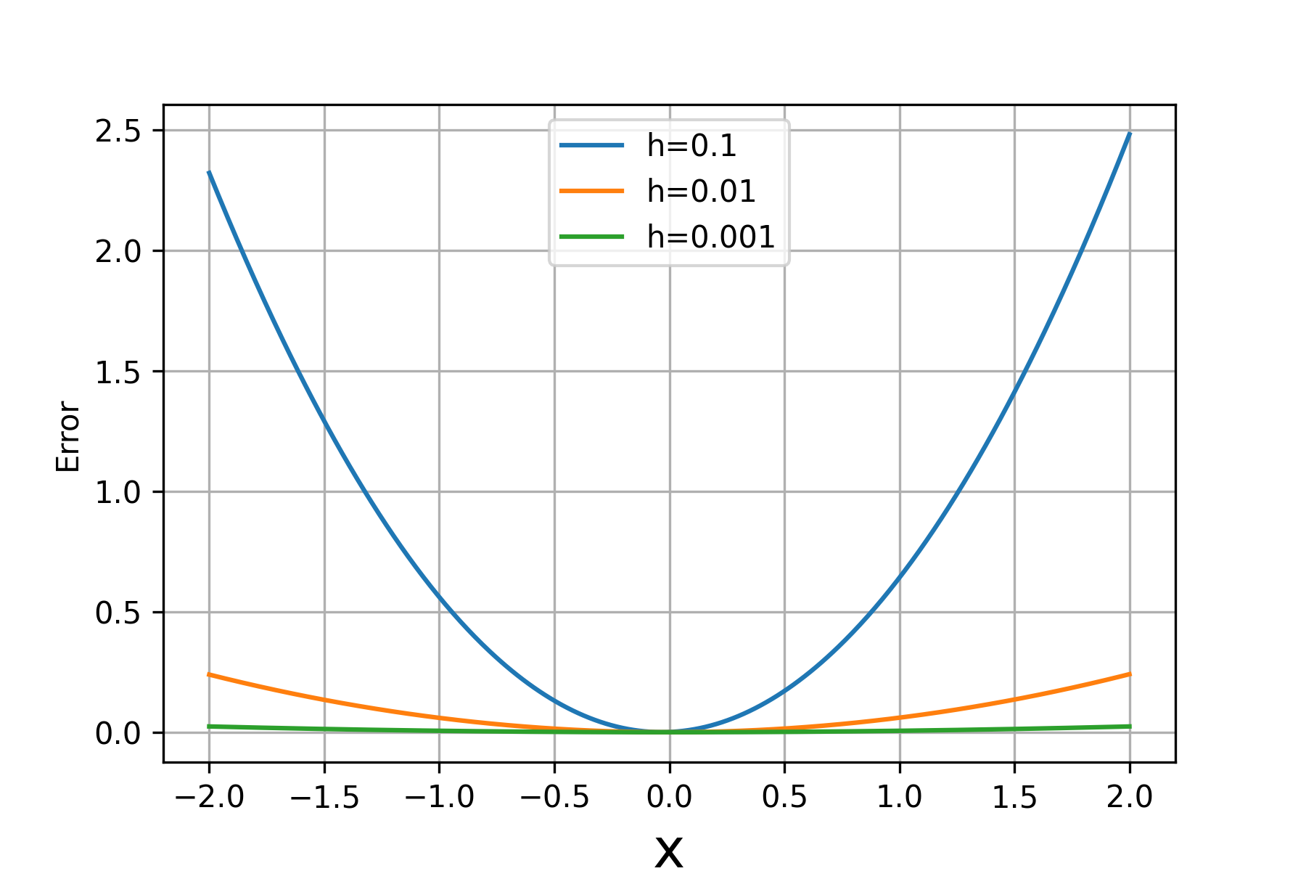
Picking h

Slide 35
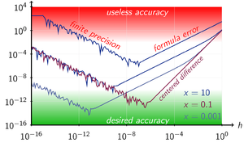
But we don’t know the true derivative!
There exist a formula for h that balances the rounding error against the approximation error for optimum accuracy:
https://en.wikipedia.org/wiki/Numerical_differentiation#Step_size

Slide 36
Numerical Differentiation with Multiple Variables
Most models in machine learning have more than one parameter
They are functions of multiple variables: f(w₀, w₁, w₂ ,w₃) = w₀ + w₁x₁ + w₂x₂ + w₃x₃

Slide 37
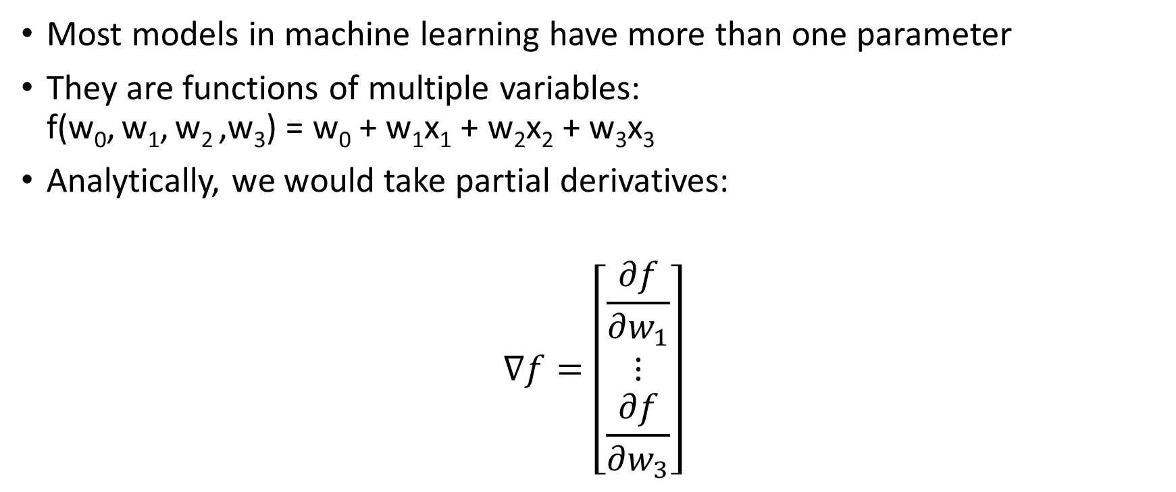
Numerical Differentiation with Multiple Variables
Most models in machine learning have more than one parameter
They are functions of multiple variables: f(w₀, w₁, w₂ ,w₃) = w₀ + w₁x₁ + w₂x₂ + w₃x₃
Analytically, we would take partial derivatives:
$$∇f=\left[\begin{matrix}\frac{∂f}{∂w_{1}} \\ ⋮ \\ \frac{∂f}{∂w_{3}}\end{matrix}\right]$$

Slide 38
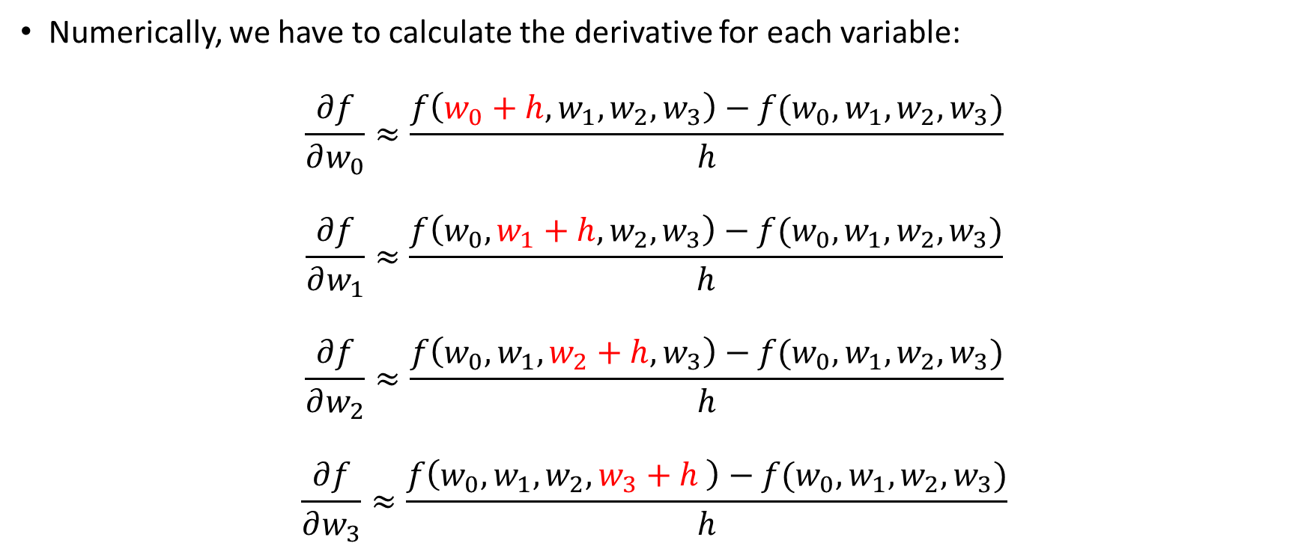
Numerical Differentiation with Multiple Variables
Numerically, we have to calculate the derivative for each variable:
$$\frac{∂f}{∂w_{0}}≈\frac{f\left(w_{0}+h,w_{1},w_{2},w_{3}\right)−f(w_{0},w_{1},w_{2},w_{3})}{h}$$
$$\frac{∂f}{∂w_{1}}≈\frac{f\left(w_{0}, w_{1}+h,w_{2},w_{3}\right)−f(w_{0},w_{1},w_{2},w_{3})}{h}$$
$$\frac{∂f}{∂w_{2}}≈\frac{f\left(w_{0}, w_{1}, w_{2}+h,w_{3}\right)−f(w_{0},w_{1},w_{2},w_{3})}{h}$$
$$\frac{∂f}{∂w_{3}}≈\frac{f\left(w_{0}, w_{1},w_{2}, w_{3}+h \right)−f(w_{0},w_{1},w_{2},w_{3})}{h}$$

