Slide 1
Support Vector Machine - SVM
CSC4601 Theory of Machine Learning

Slide 2
Quick Overview of SVM

Slide 3
Linear Classifier
Linear classifier uses a linear decision boundary to separate classes.
We’ve seen that logistic regression is an example of a linear classifier:
it uses a logistic function that quantifies how certain we are that a data point belongs to a class.
it translates into finding a linear decision boundary.
SVM explicitly models the boundary between the classes as linear:
it generalizes the idea of maximal margin classifier.

Slide 4
History of SVM
1957
1963
1992
1995
Perceptron
(linear classifier)
Rosenblatt
Maximal Margin Hyperplane
Vapnik and Chervonenkis
Kernel Trick applied to Maximal Margin Hyperplane
Boser, Guyon and Vapnik
Current Form of SVM (soft margin)
Cortes and Vapnik
Check here for a detailed History

Slide 5
Quick Overview of SVM
SVM is a supervised learning model that can be used for classification and regression.
The algorithm is based on finding the best linear classifier that separates the data points of different classes (separating hyperplane).
The kernel trick allows the expansion of features space and the design of non-linear classifier.

Slide 6
Maximal Margin Classifier

Slide 7




Notations
Consider a training set that consists of n samples:
: vector of features
: vector of features of the training sample i
: label of the training sample i

Slide 8
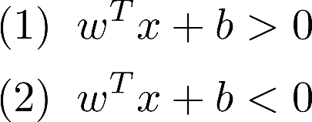
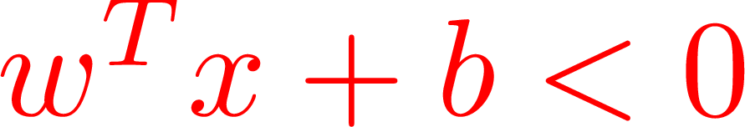
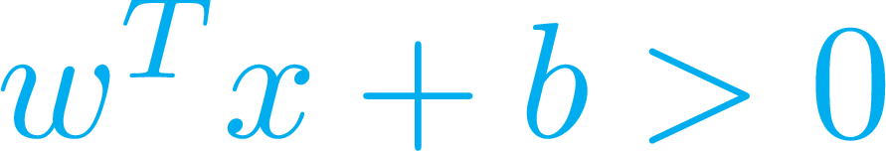
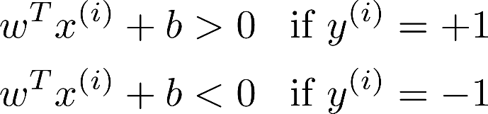
Linear Classifier
A separating hyperplane divides the p-dimensional space into two halves:
Goal: Based on the training data, find w and b such that for any training sample i:
How to find such hyperplane?
x₂
-1
+1
x₁

Slide 9
Linear Classifier
There is an infinite number of solutions:
Which one is the best or optimal separator? And in which sense can it be optimal?
x₂
x₂
x₂
x₂
x₂
x₂
-1
-1
-1
+1
+1
+1
x₁
x₁
x₁
x₁

Slide 10
Maximal Margin Classifier
A natural choice is the maximal margin hyperplane (or optimal separating hyperplane).
Margin is the distance between the hyperplane and the closest sample from either class (extend the hyperplane until it touches the first training data point).
margin
x₂
-1
x₂
x₂
-1
-1
+1
+1
+1
x₁
x₁
x₁
Note: some textbooks might define the margin as the distance between the two dashed lines.

Slide 11
Maximal Margin Classifier
margin
The maximal margin hyperplane is the hyperplane for which the margin is the largest: it lies at the maximum distance from data points of both classes.
It is the thickest separator that has better tolerance to noise.
x₂
-1
x₂
x₂
-1
-1
+1
+1
+1
x₁
x₁
x₁

Slide 12
Maximal Margin Classifier
How is it constructed? By solving an optimization problem that finds w and b such that the margin in maximized.
It turns out that the solution depends only on the support vectors and not on the entire training datasets.

Slide 13

Support Vectors for Maximal Margin Classifier
Support vectors are the training observations that lie on the dashed lines (or the margin boundaries).
They support (fully determine) the maximal margin hyperplane.
Adding more training examples beyond the margin boundaries would not affect the separating hyperplane.
If the support vectors were moved, then the separating hyperplane would move as well.
+1
-1

Slide 14
SVM Derivation

Slide 15
Maximal Margin Classifier – Mathematical Formulation
To construct the maximal margin classifier, we need to:
Express the distance from each training observation to a given hyperplane in terms of w and b.
Solve for w and b by maximizing the margin.

Slide 16

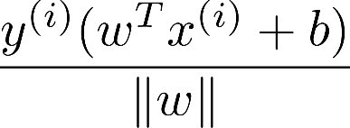

Maximal Margin Classifier – Mathematical Formulation
To construct the maximal margin classifier, we need to:
Express the distance from each training observation to a given hyperplane in terms of w and b.
Solve for w and b by maximizing the margin.
x₂
The distance from a training observation to a given hyperplane can be shown to be equal to:
distance
x₁

Slide 17
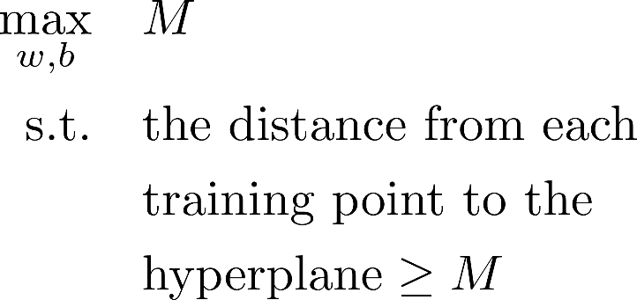
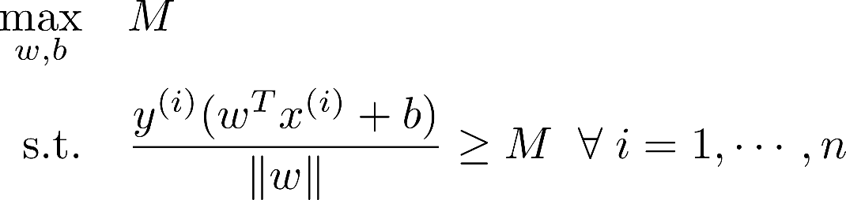

Maximal Margin Classifier – Mathematical Formulation
x₂
The distance from a training observation to a given hyperplane can be shown to be equal to:
Solve for w and b by maximizing the margin:.
distance
distance:
x₁

Slide 18
Maximal Margin Classifier – Mathematical Formulation
2. Solve for w and b by maximizing the margin M:
M
+1
-1

Slide 19
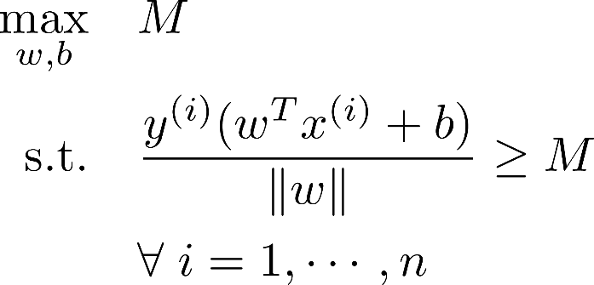
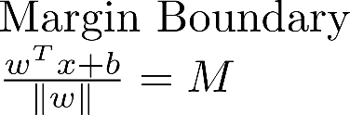
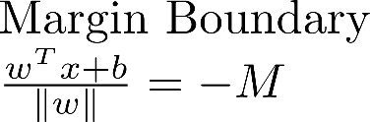

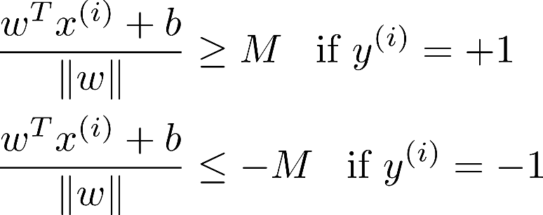
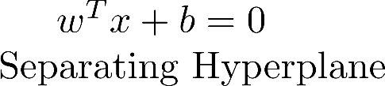
Maximal Margin Classifier – Mathematical Formulation
M
This means that we’re not only requiring that to be greater or less than 0 to classify the points, but we’re adding extra layer of cushion so that:
+1
-1

Slide 20
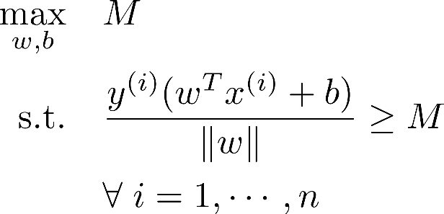
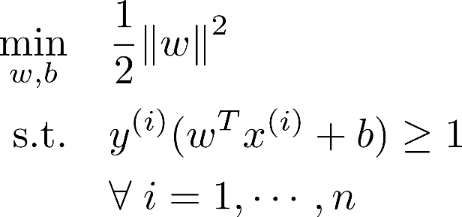







We can further show that (1) can be reformulated as (2) (by rescaling w and b); (2) has nicer properties than (1).
(1)
(2)
M
+1
+1
-1
-1

Slide 21
Soft Margin Classifier - SVM

Slide 22
Issues with Maximal Margin Classifier
We discussed so far maximal margin or optimal classifier, also known as, the hard margin classifier: no data point is allowed to violate the margin.
First issue: it might be impossible to find a hard margin classifier.

Slide 23
Issues with Maximal Margin Classifier
We discussed so far maximal margin or optimal classifier, also known as, the hard margin classifier: no data point is allowed to violate the margin.
Second issue: it is sensitive to outliers.

Slide 24
Issues with Maximal Margin Classifier
We discussed so far maximal margin or optimal classifier, also known as, the hard margin classifier: no data point is allowed to violate the margin.
Second issue: it is sensitive to outliers.

Slide 25

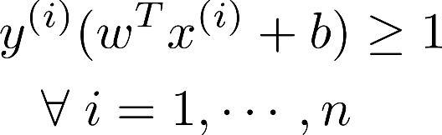
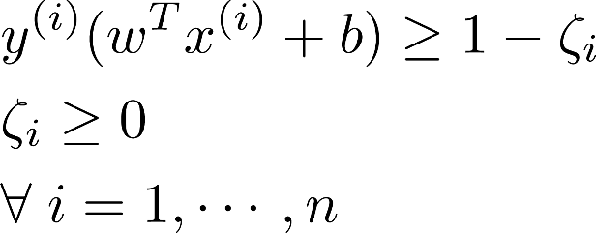
Soft Margin Classifier
A soft margin classifier (also called support vector classifier) allows some observations to violate the margin or to be on the wrong side of the separating hyperplane.
This is done by introducing slack variables for each data point and solving for them as well.
Hard margin requires: Soft margin relaxes this condition:

Slide 26









Soft Margin Classifier
The slack variable indicates the extent of margin violation or misclassification:
: data point i does not violate the margin
: data point i violates the margin
: data point i in the wrong side of the hyperplane
l
k
j
+1
-1

Slide 27
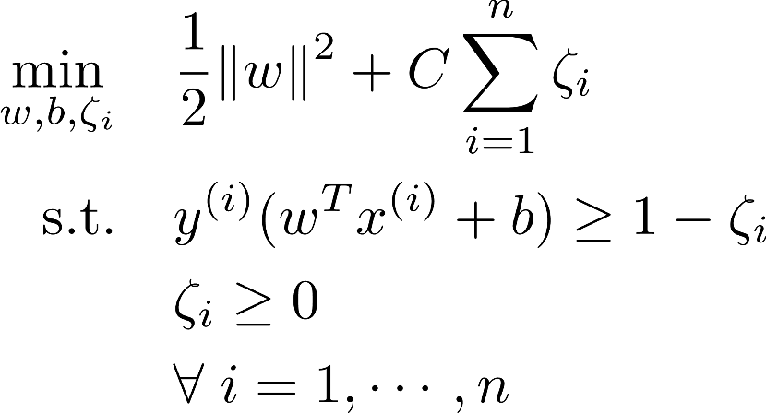
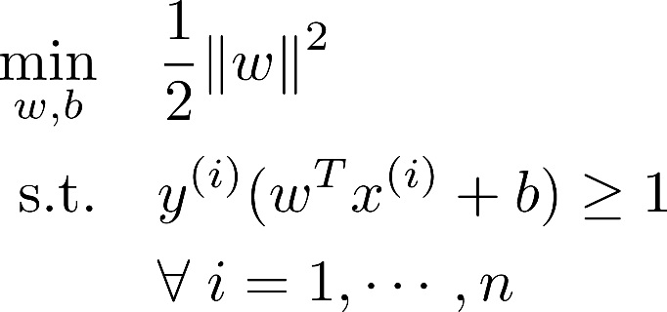
Soft Margin Classifier – Mathematical Formulation
The problem still needs to maximize the margin but it also needs to minimize the number of margin violations. This is why a penalty term is added to the objective function.
Hard Margin Soft Margin

Slide 28
Soft Margin Classifier – Mathematical Formulation
The objective now is to find a good balance between maximizing the margin and minimizing the number of margin violations:
C is a non-negative hyper-parameter that controls the strength of the penalty term: it determines the severity of margin violations that we can tolerate.
Term inversely
related to the margin
Penalty term due to margin violation

Slide 29
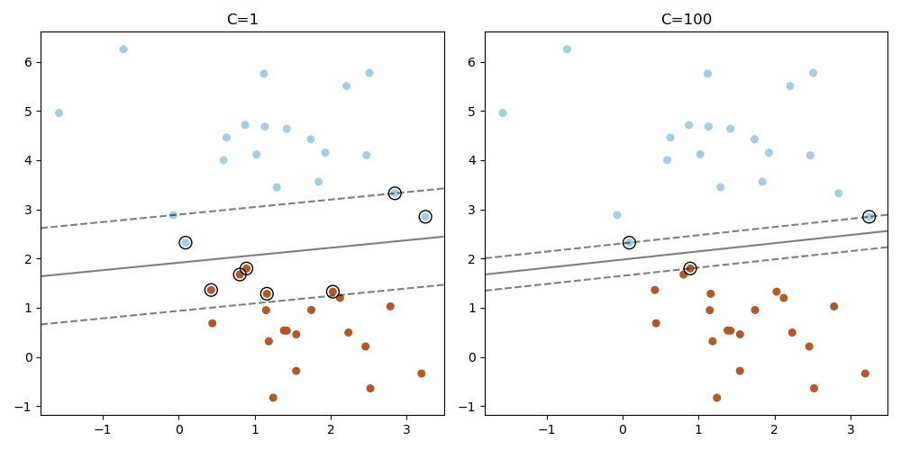
Tuning Parameter C
A large C allows fewer margin violations but leads to a tighter margin. A small C leads to a larger margin but allows more margin violations.
What happens when C=0? C=infinity?
Bias Variance Tradeoff:
A high value of C might lead to a less generalizable
model (low bias, high variance). A low value of C might
lead to an underfitted model (high bias, low variance).
scikit-learn

Slide 30
Support Vectors for Soft Margin Classifier
The training observations that lie on the dashed lines, violate the margin or lie on the wrong side of the hyperplane are all support vectors.
Support vectors are the only training data points that affect the separating hyperplane.
Support vector classifiers are less sensitive to the behavior of observations that are far way from the hyperplane.
+1
-1

Slide 31
Implementation of SVM

Slide 32
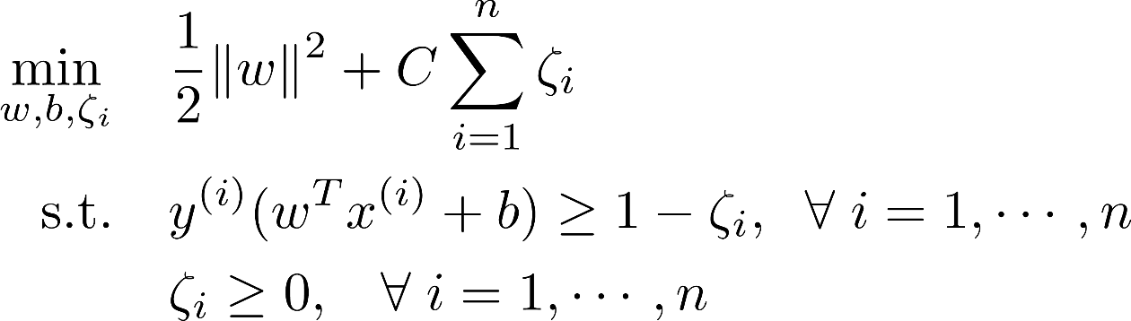
How is the soft margin classifier implemented?
We will briefly discuss three methods used to find the soft margin classifier:
The first method is based on solving this optimization problem using a specific optimization method (QP: quadratic programming)

Slide 33
Implementation of soft margin classifier – Dual Problem
The second method is based on solving the dual problem: every constrained optimization problem (primal problem) can be expressed in different but closely related way (dual problem).
The solution to the dual problem provides a lower bound to the solution of the primal problem. Under certain conditions, the solution to both problems are equal, so either problem can be solved to find the solution.
Those conditions are met for SVM; we can solve the dual form of SVM or solve the primal form.

Slide 34
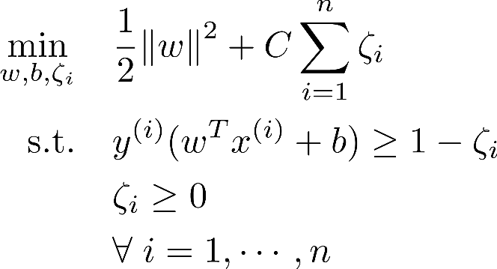
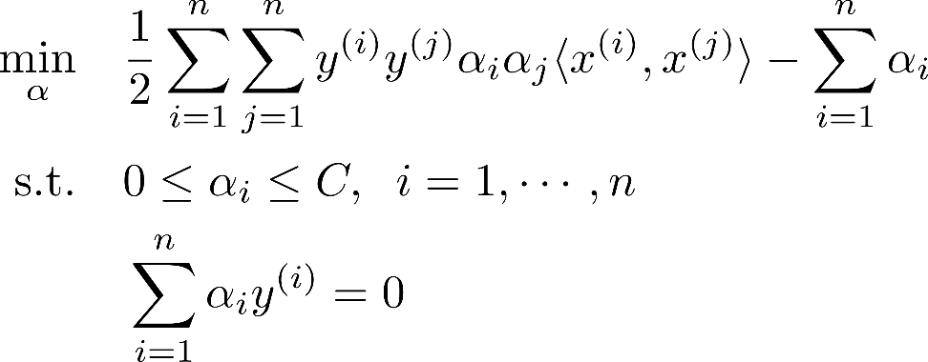

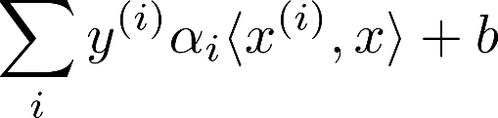
Implementation of soft margin classifier – Dual Problem
Primal Problem Dual Problem
Why dual problem? The dual problem makes the kernel trick possible!
Once the dual is solved, the dual variables are used to find w and b of the primal problem.
Only the dual variables that correspond to the support vectors will be non-zero.
For a given test example , the output of the decision function: (the decision function only depends on the support vectors).

Slide 35
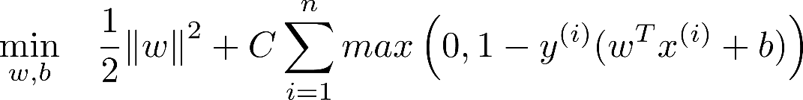

Implementation of soft margin classifier – Hinge Loss Function
The third method is based on solving an equivalent unconstrained optimization problem:
This method uses the hinge loss function: to express the cost incurred due to margin violations; minimizing this term ensures that the margin violation is as small as possible.
This implementation is suitable when there is a large number of training examples, but does not allow the use of kernel trick.
can be shown to be equivalent to

Slide 36
Hinge Loss Function
The hinge loss function:
If a data point does not violate the margin, its hinge loss is 0.
If a data point violates the margin, its hinge loss is positive.
1
t

Slide 37
Kernels

Slide 38
Non-Linear Decision Boundary
The soft or hard margin classifier, we discussed so far, separate the classes by designing a linear decision boundary.
However, data is not always linearly separable.
We need to find a non-linear decision boundary!

Slide 39
Non-Linear Decision Boundary
To find a non-linear decision boundary, one solution is to expand the feature space, i.e., add more features, such as polynomial features:

Slide 40
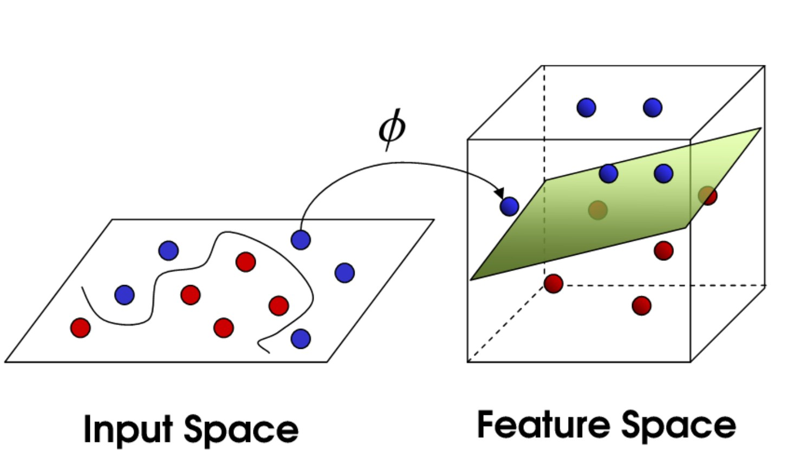
Non-Linear Decision Boundary
To find a non-linear decision boundary, one solution is to expand the feature space, i.e., add more features, such as polynomial features:
In some cases, this can result in moving the data to a higher dimensional space where the data is linearly separable.
One problem with polynomial features is that we could end up with a huge number of features, which would make computations slow or unmanageable.
Image credit

Slide 41
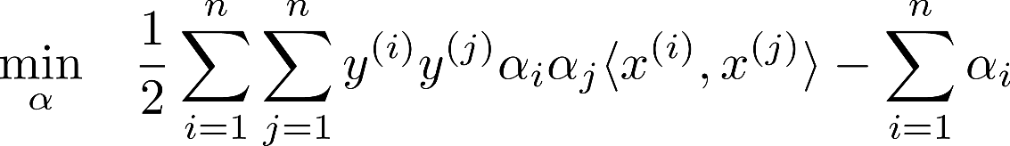


Kernel Trick
We saw that we can find the soft margin classifier by solving the dual form:
This form involves the computation of the dot product:
Let’s assume that we’ve expanded the feature space in our data by applying a feature mapping denoted by : .
Then all we need to do is to replace each dot product with the new transformed features:

Slide 42

Kernel Trick
For a given feature mapping , let’s define its corresponding kernel function as follows:
To find the dot product of the transformed features, we could first transform the features and then compute the dot product. But finding the transformed features can be expensive, especially in higher dimensional space.
What is interesting is that for a given feature mapping , if we know the closed-form of the kernel function (which might be inexpensive to compute), we can directly compute the kernel function without the need to do feature mapping.

Slide 43
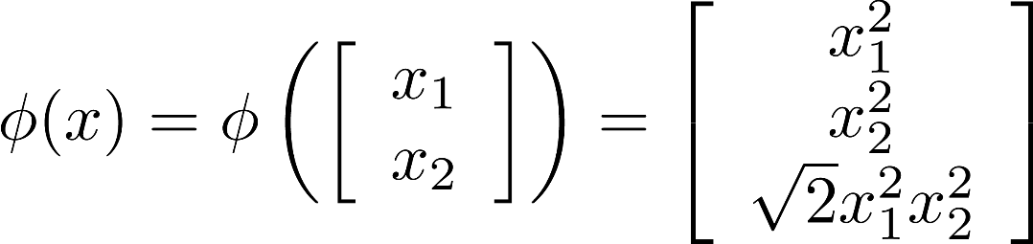

Example
Let’s assume the following feature mapping:
When doing feature transformation, the dot product in the dual form will be replaced with the dot product of the transformed features:
For this particular transformation, what is ? Does it have a closed form?

Slide 44
Example
It turns out that:
So instead of finding each transformed feature and then finding their dot product, we can directly compute the above closed-form.

Slide 45

Kernelized SVM
The kernel trick consists of replacing each dot product in the dual formulation of SVM with a kernel function of our choice.
We can use any kernel function as long as there exists some feature mapping such that:
This allows SVMs to learn in the high dimensional feature space given by , but without ever having to explicitly find .

Slide 46



Kernel Functions
Examples of common kernels:
Linear:
Polynomial:
Radial:

Slide 47
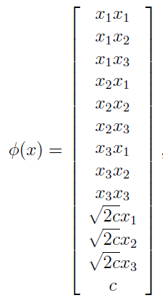


Example of a Kernel Function
Consider the following polynomial kernel:
If , then it can be shown that the given kernel corresponds to this feature mapping:
source

Slide 48

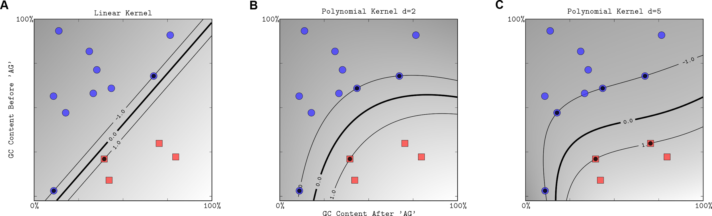
Polynomial Kernel
equivalent to the dot product of features mapped to d-order feature space
requires an extra hyper-parameter, d, for “degree”.
https://doi.org/10.1371/journal.pcbi.1000173

Slide 49


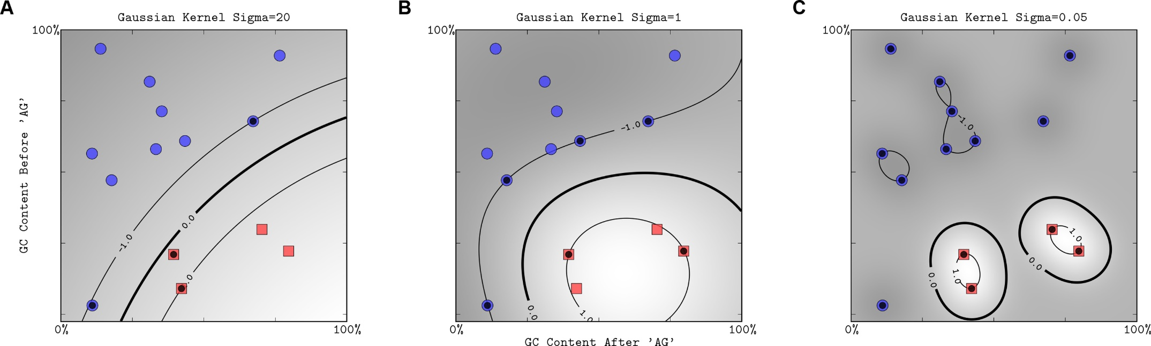
Radial Basis Function (RBF Kernel or Gaussian Kernel)
equivalent to the dot product of features mapped to infinite-dimensional space
requires an extra hyper-parameter, , “gamma”
gamma = 0.05
gamma = 1
gamma = 20
source

Slide 50
Kernel Parameters: gamma and degree
The ‘gamma’ of the radial kernel and ‘degree’ of the polynomial kernel can be tuned to control the flexibility of the decision boundary or the complexity of the model.
Decreasing gamma or degree leads to a smoother decision boundary; increasing gamma or degree leads to a more complex decision boundary.
Similarly to the margin parameter C, kernel parameters are used to control the bias-variance tradeoff.

Slide 51
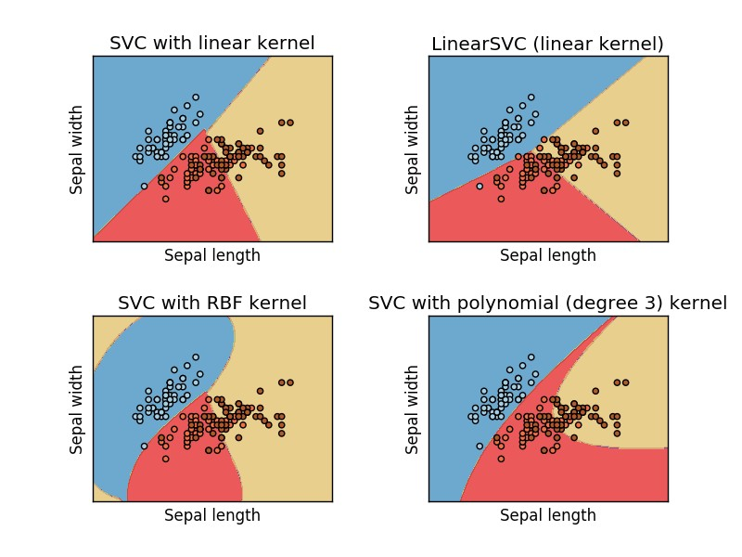
Kernels Example
scikit-learn example

Slide 52
SVM in Scikit-Learn

Slide 53
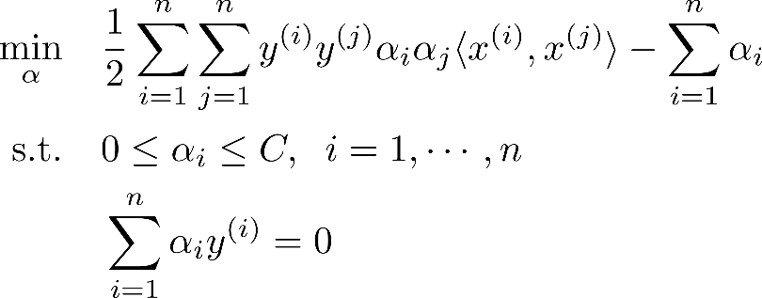
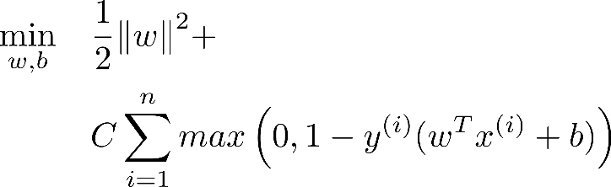
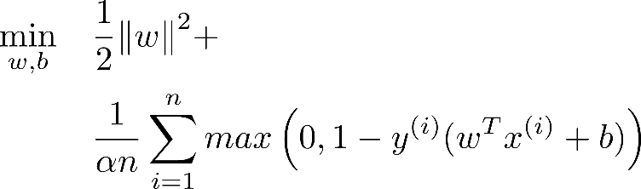
 | SVC | LinearSVC | SGDClassifier
Optimization Problem | Dual Problem: | Uses the hinge (or squared hinge) loss function: | Uses the hinge (or squared hinge) loss function:
Kernelized SVM | Yes | No | No
Hyper-parameters | C, kernel (poly, linear or rbf), gamma, degree, class_weight | C, loss (hinge or squared_hinge) | alpha ( equivalent to 1/(n*C)), loss
Time Complexity | fit time scales at least quadratically with the number of samples may be impractical beyond tens of thousands of samples O(n²p) to O(n³p) | fit time scales linearly with the number of samples can be used with large datasets O(np) | fit time scales linearly with the number of samples can be used with large datasets can be used for online learning O(np)
Multi-class | one-vs-one scheme | one-vs-the-rest scheme | one-vs-the-rest scheme
Source: book (Hands-on machine learning with scikit-learn) & scikit-learn

Slide 54
Data Preprocessing
Scaling data features before training SVM is very important.
It avoids features with large range of values dominating features with smaller range of values.
It avoids any numerical problems or difficulties that can happen during computation (it can help with faster convergence).
Test set should be scaled in the same way that the training set was scaled.

Slide 55
Tuning SVM
Given a classification task,
which kernel to choose?
which kernel parameter values to use?
which value for C to set?
Try different combinations and choose the best: use cross validation.
For C and gamma, a practical method to find the best combination is to try exponential sequences: for more details, check this SVM guide.
It is important to keep in mind that kernelized SVM is suitable for small to medium datasets: with large datasets, training a kernelized SVM becomes very slow. Moreover, If the number of features is much greater than the number of samples, kernelized SVM won’t be suitable.

Slide 56
Final Remarks
The decision function depends on a subset of training data: support vectors (memory efficient).
The regression version of SVM is also implemented in scikit-learn.
SVM does not output the probabilities of classes, but these probabilities can still be estimated (check here).
SVM was used for text categorization, image classification, hand-written characters recognition and it was also applied in the biological sciences (SVM applications).

