Slide 1
Vectors & Matrices
CSC4601 Theory of Machine Learning

Slide 2
Today’s Plan
In this lecture, we’ll review the basics of linear algebra:
Vectors & their geometric interpretation
Dot products & vector norms
Matrices & operations on matrices
We will also revisit the equation of Line (Plane, Hyperplane) & the definition of normal vectors.

Slide 3
Vectors & Matrices in Machine Learning
In machine learning, we use vectors and matrices to organize data: see them as data containers/structures.
They make notation much easier and more concise: Python supports the use of vector notations which can make computations more efficient.
We can use many tools from linear algebra in order to perform training, prediction, dimensionality reduction.

Slide 4
Vectors

Slide 5
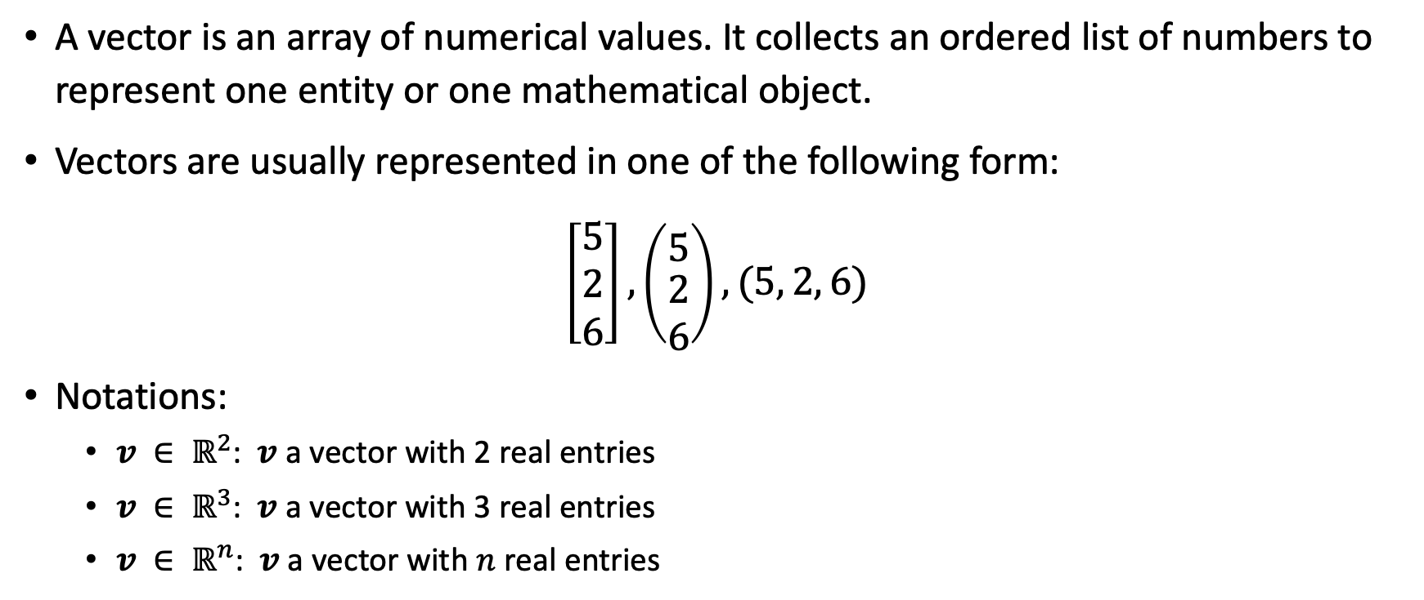
Vectors
A vector is an array of numerical values. It collects an ordered list of numbers to represent one entity or one mathematical object.
Vectors are usually represented in one of the following form:
$$\left[\begin{aligned}5 \\ 2 \\ 6\end{aligned}\right], \left({5 \atop \begin{aligned}2 \\ 6\end{aligned}}\right), (5, 2, 6)$$
Notations:
$v ∈ ℝ^{2}$: $v$ a vector with 2 real entries
$v ∈ ℝ^{3}$: $v$ a vector with 3 real entries
$v ∈ ℝ^{n}$: $v$ a vector with $n$ real entries

Slide 6


Vectors
$$v ∈ ℝ^{n}$$
$v$ a vector with $n$ real entries/elements/components
$n$ is the size/length of the vector
$v$ is denoted as follows:
$$v=\left[\begin{aligned}v_{1} \\ \begin{aligned}v_{2} \\ \begin{aligned}⋮ \\ v_{n}\end{aligned}\end{aligned}\end{aligned}\right]$$

Slide 7
Geometric Interpretation of Vectors
A vector can be interpreted geometrically as: a point in space or a geometric vector (an object with direction and magnitude).
(3, 1)
(3, 1)
1. Point
OR
2. Geometric vector:
object with direction and magnitude

Slide 8
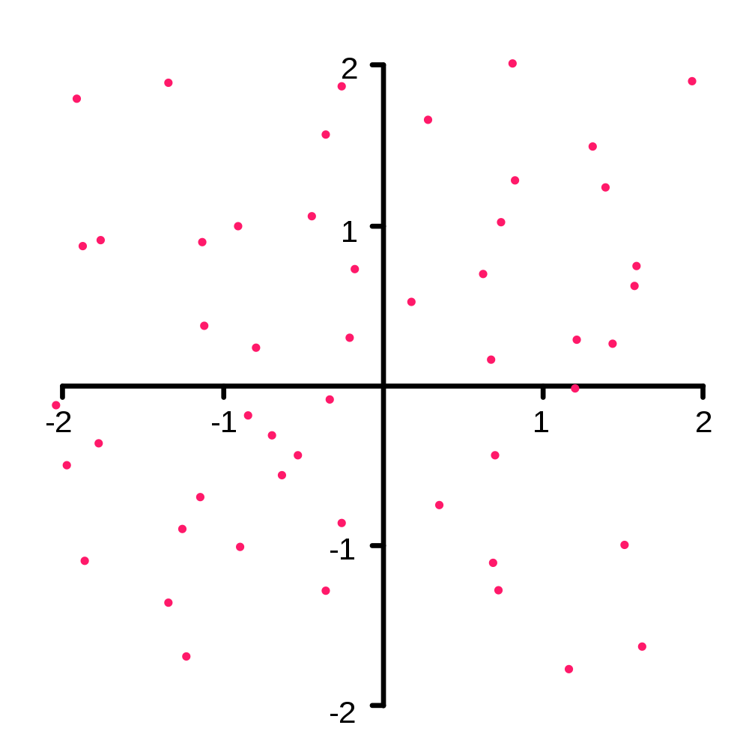
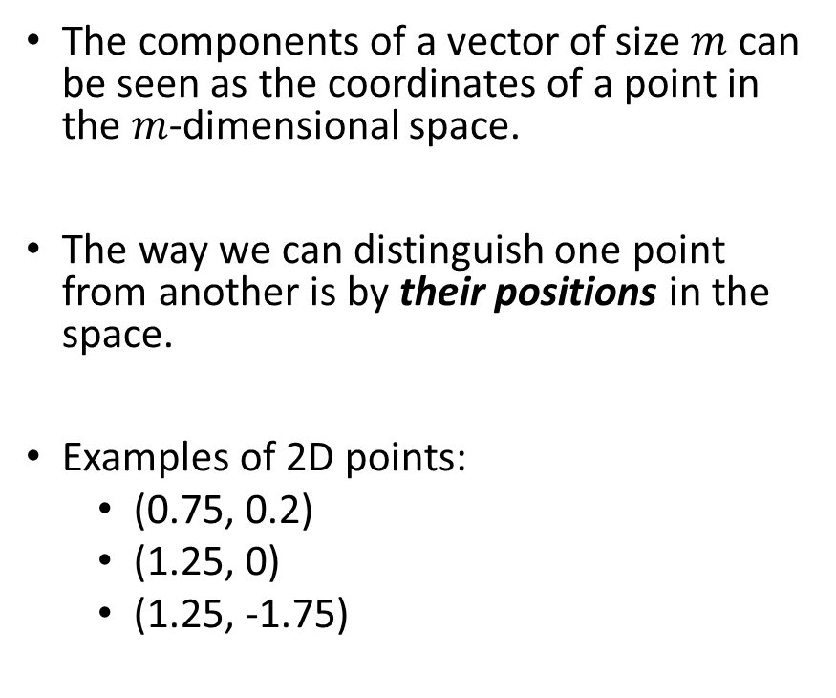
Geometry of Vectors: Points
The components of a vector of size $m$ can be seen as the coordinates of a point in the $m$-dimensional space.
The way we can distinguish one point from another is by their positions in the space.
Examples of 2D points:
(0.75, 0.2)
(1.25, 0)
(1.25, -1.75)

Slide 9
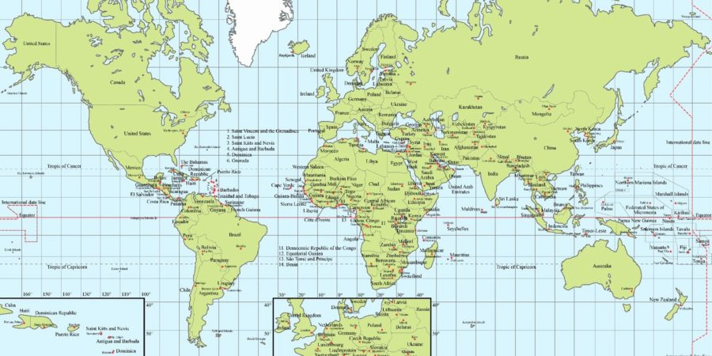
Examples of 2D points
Latitude and longitude form a 2D coordinate system or space
Used to describe locations across the globe
MSOE: (43.041070, -87.909420)
Miller Park: (43.011790, -87.967780)
Margate, FL: (26.242530, -80.204920)
https://www.ergosum.co/cooking-across-latitudes/

Slide 10
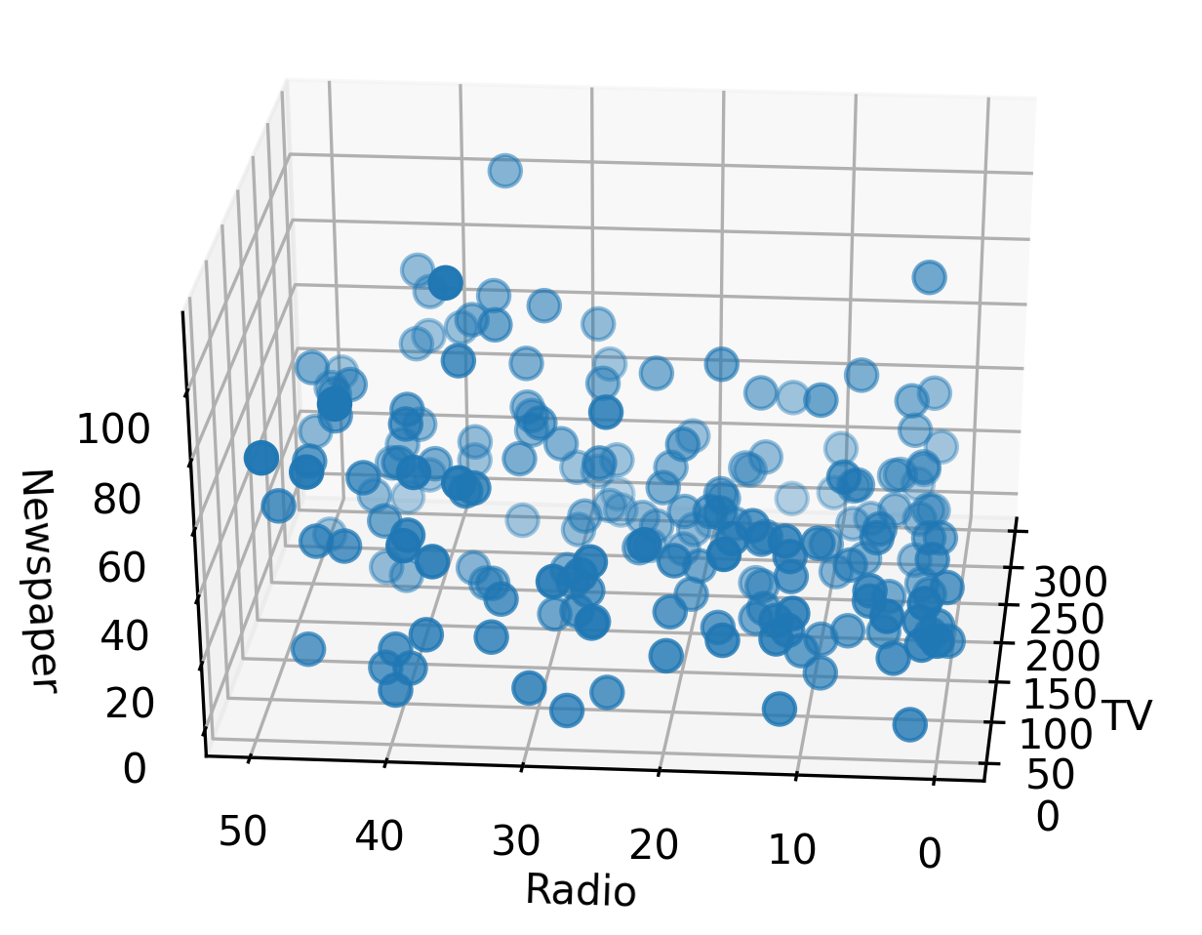
Example of 3D Points
Each point is the client of an advertising company
The coordinates refer to the number advertisements they bought
TV advertisements
radio advertisements
newspaper advertisements

Slide 11
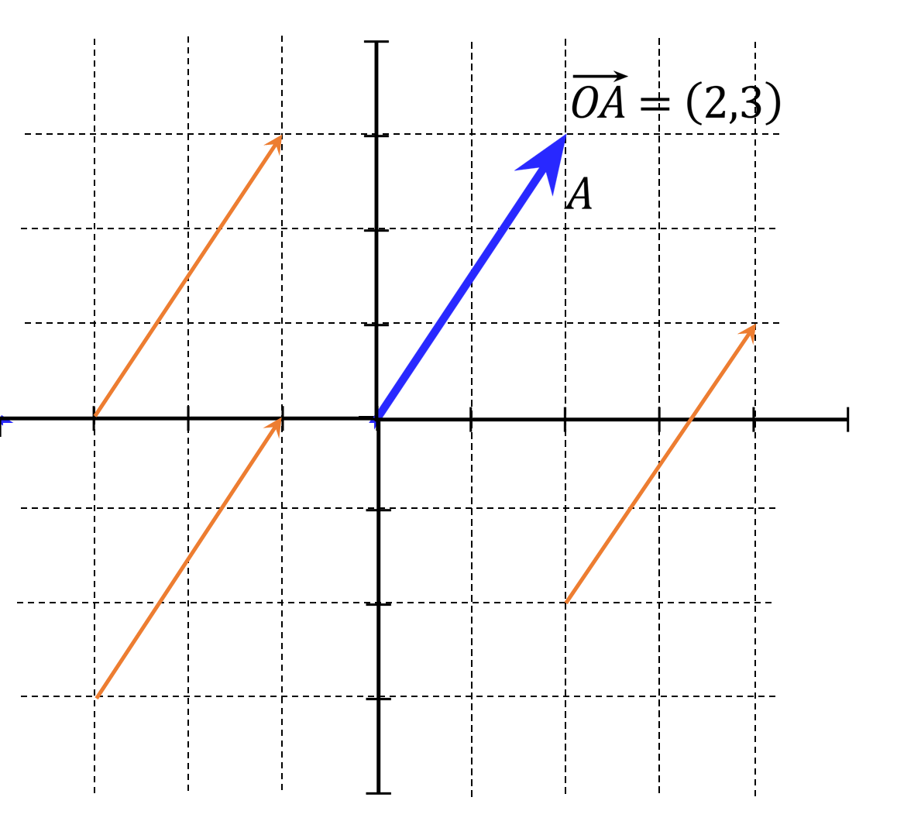
Geometry of Vectors: Geometric Vector
A m-vector can be also interpreted as an object that has magnitude and direction: geometric vector.
It can be depicted as a directed line segment going from one point to another, where the components of the vector tell us in which direction to go and how far.
To geometrically represent the vector (2, 3) , we can start from any point and then take 2 steps to the right and 3 steps up. Any of the vector drawn in the left figure can represent the vector (2, 3).
The way we can distinguish one geometric vector from another is not by their positions in the space, but by their direction and magnitude.

Slide 12
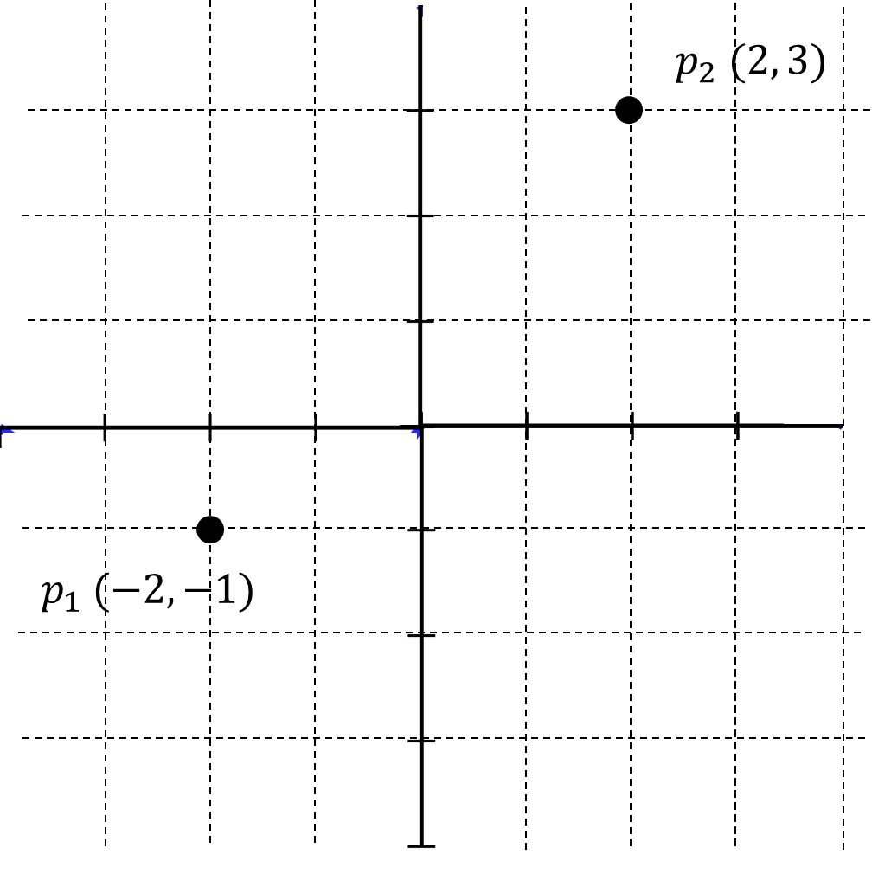
Creating a Geometric Vector
Given the position of two points, we can compute the components of the geometric vector going from one point to another.
Example:
p₁ = (-2, -1)
p₂ = (2, 3)

Slide 13
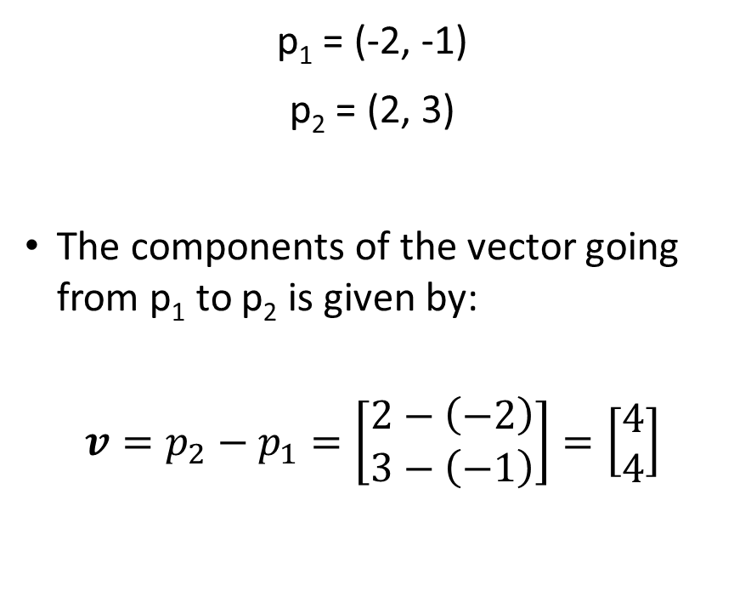

Creating a Geometric Vector
p₁ = (-2, -1)
p₂ = (2, 3)
The components of the vector going from p₁ to p₂ is given by:
$$v=p_{2}−p_{1}=\left[\begin{aligned}2−\left(−2\right) \\ 3−\left(−1\right)\end{aligned}\right]=\left[\begin{aligned}4 \\ 4\end{aligned}\right]$$
$$v$$

Slide 14
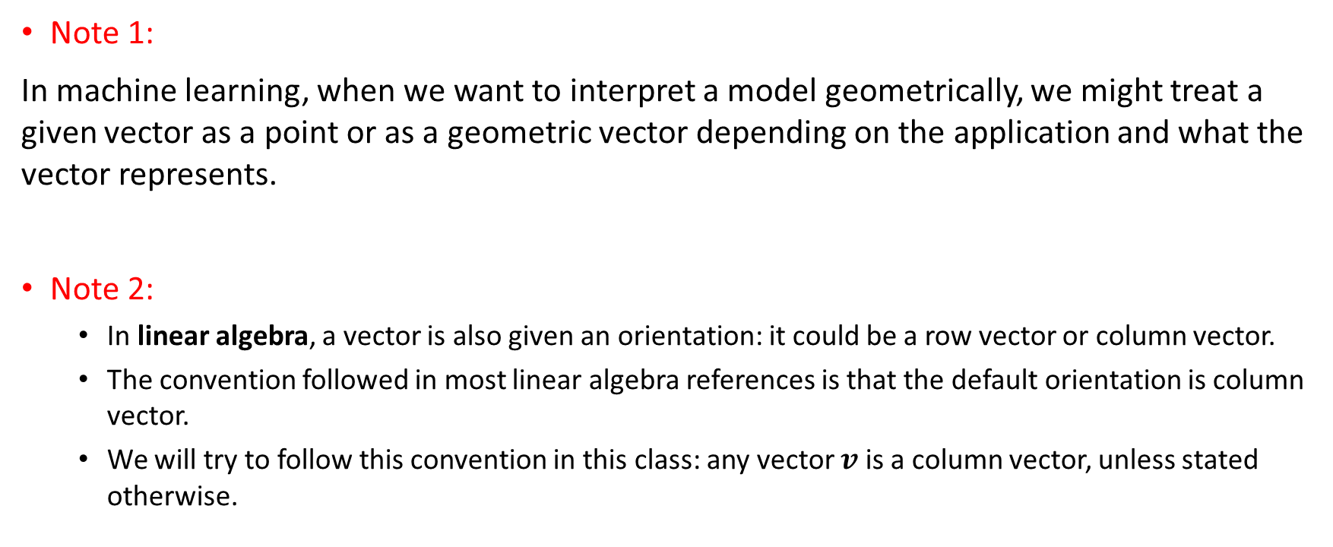
Vectors
Note 1:
In machine learning, when we want to interpret a model geometrically, we might treat a given vector as a point or as a geometric vector depending on the application and what the vector represents.
Note 2:
In linear algebra, a vector is also given an orientation: it could be a row vector or column vector.
The convention followed in most linear algebra references is that the default orientation is column vector.
We will try to follow this convention in this class: any vector $v$ is a column vector, unless stated otherwise.

Slide 15
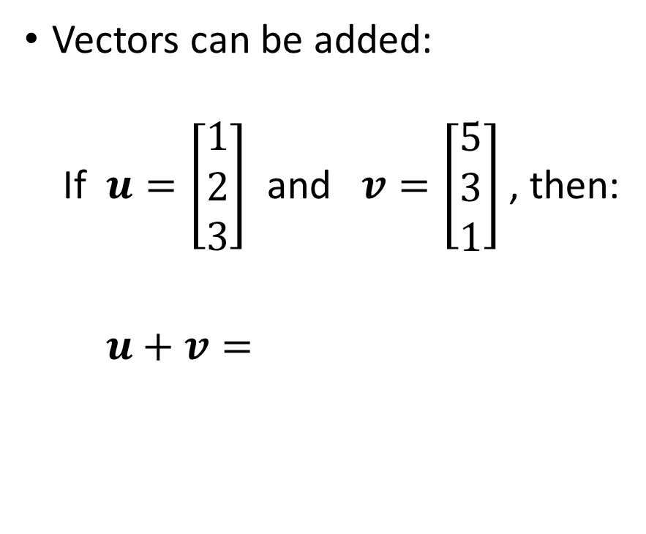

Scalar Multiplication & Vector Addition
Vectors can be multiplied by a scalar: If $v=\left[\begin{aligned}5 \\ 3 \\ 1\end{aligned}\right]$, then:
$5v=$
Vectors can be added:
If $u=\left[\begin{aligned}1 \\ 2 \\ 3\end{aligned}\right]$ and $v=\left[\begin{aligned}5 \\ 3 \\ 1\end{aligned}\right]$, then:
$u+v=$

Slide 16
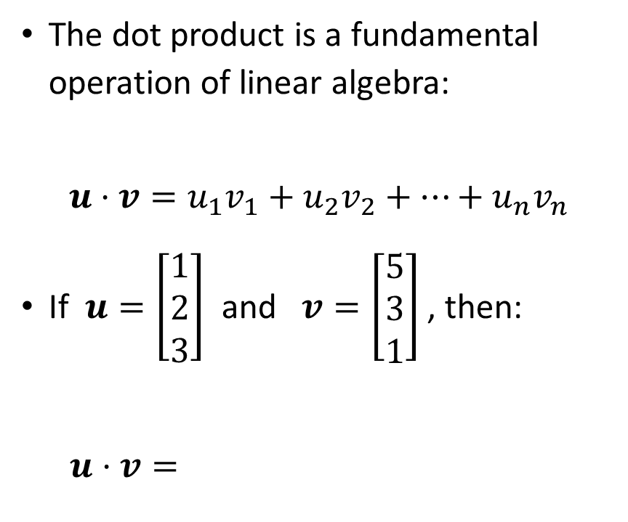
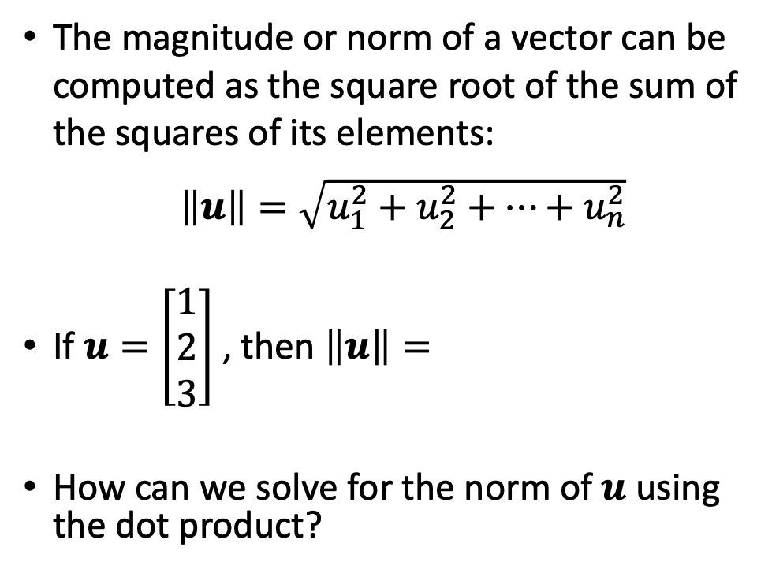
Dot Product & Norm
The dot product is a fundamental operation of linear algebra:
$$u⋅v=u_{1}v_{1}+u_{2}v_{2}+⋯+u_{n}v_{n}$$
If $u=\left[\begin{aligned}1 \\ 2 \\ 3\end{aligned}\right]$ and $v=\left[\begin{aligned}5 \\ 3 \\ 1\end{aligned}\right]$, then:
$u⋅v=$
The magnitude or norm of a vector can be computed as the square root of the sum of the squares of its elements:
$\left\|u\right\|=\sqrt{u_{1}^{2}+u_{2}^{2}+⋯+u_{n}^{2}}$
If $u=\left[\begin{aligned}1 \\ 2 \\ 3\end{aligned}\right]$ , then $\left\|u\right\|=$
How can we solve for the norm of $u$ using the dot product?

Slide 17
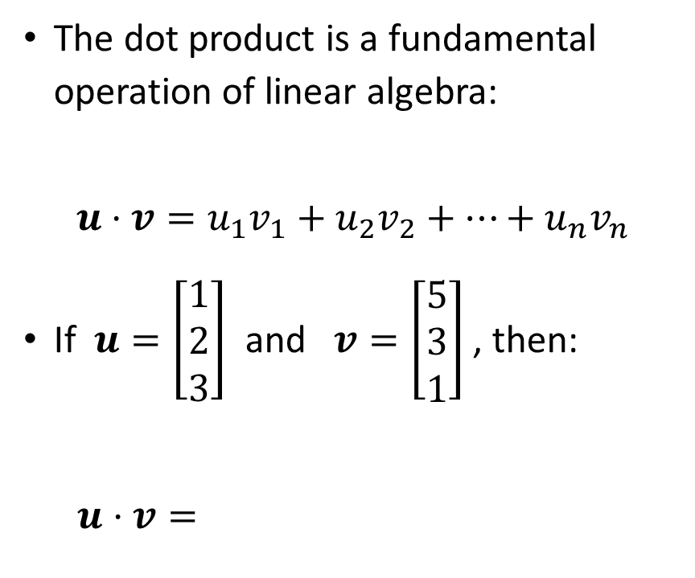
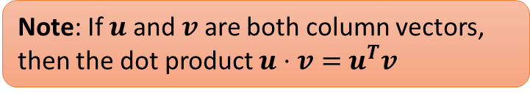
Dot Product & Norm
Note: If $u$ and $v$ are both column vectors, then the dot product $u⋅v=$ $u^{T}v$
The dot product is a fundamental operation of linear algebra:
$$u⋅v=u_{1}v_{1}+u_{2}v_{2}+⋯+u_{n}v_{n}$$
If $u=\left[\begin{aligned}1 \\ 2 \\ 3\end{aligned}\right]$ and $v=\left[\begin{aligned}5 \\ 3 \\ 1\end{aligned}\right]$, then:
$u⋅v=$
The magnitude or norm of a vector can be computed as the square root of the sum of the squares of its elements:
$\left\|u\right\|=\sqrt{u_{1}^{2}+u_{2}^{2}+⋯+u_{n}^{2}}$
If $u=\left[\begin{aligned}1 \\ 2 \\ 3\end{aligned}\right]$ , then $\left\|u\right\|=$
How can we solve for the norm of $u$ using the dot product?

Slide 18
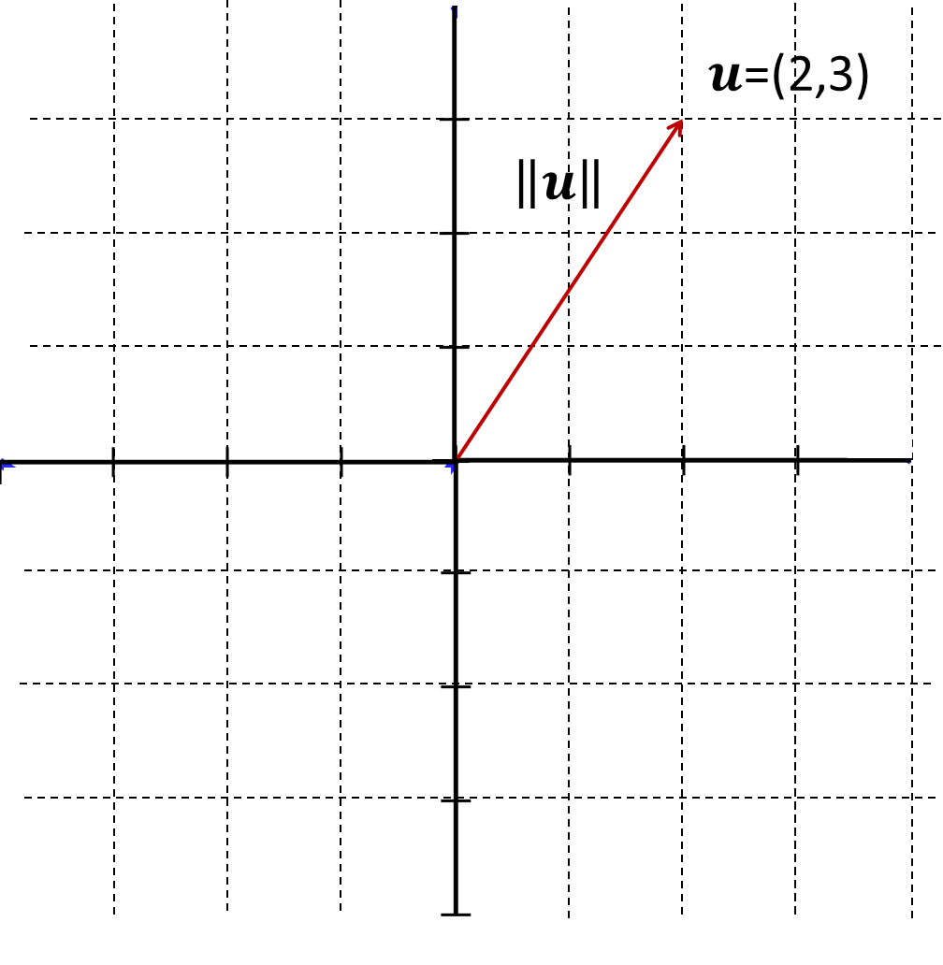
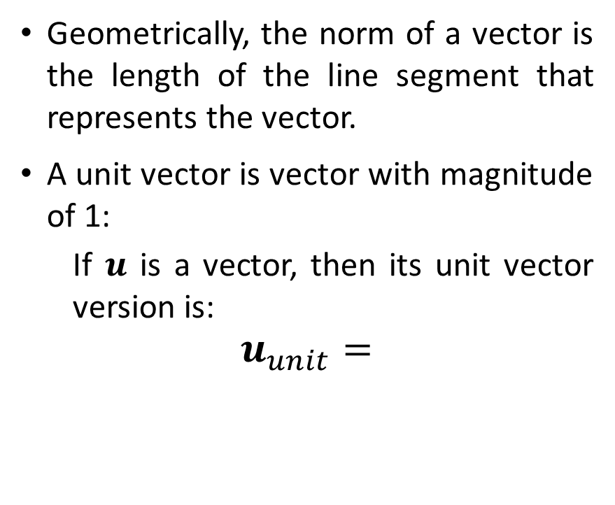
Vector Norm
Geometrically, the norm of a vector is the length of the line segment that represents the vector.
A unit vector is vector with magnitude of 1:
If $u$ is a vector, then its unit vector version is:
$$u_{unit}=$$

Slide 19
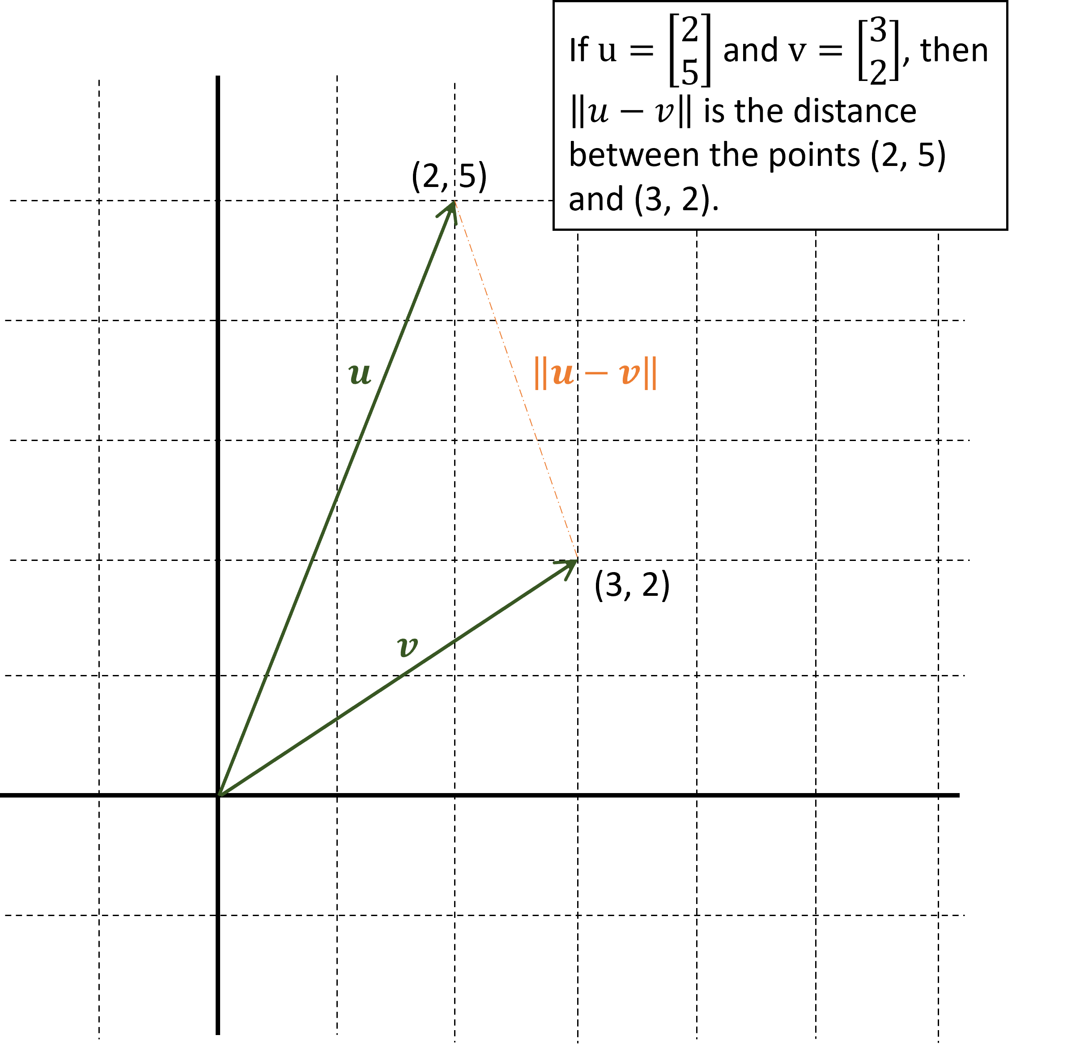
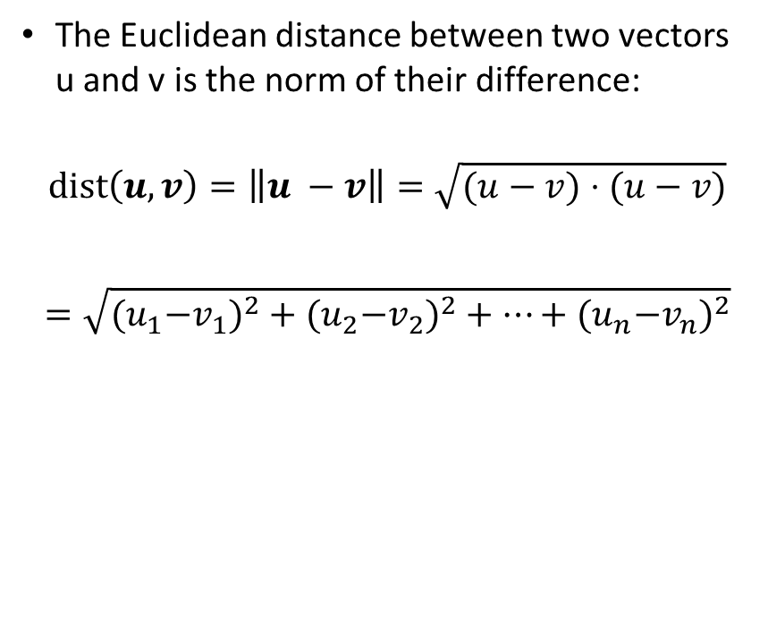
Euclidean Distance
The Euclidean distance between two vectors u and v is the norm of their difference:
$$dist\left(u,v\right)=\left\|u −v\right\|=\sqrt{(u−v)⋅(u−v)}$$
$$=\sqrt{{{(u}_{1}−v_{1})}^{2}+{{(u}_{2}−v_{2})}^{2}+⋯+{{(u}_{n}−v_{n})}^{2}}$$

Slide 20

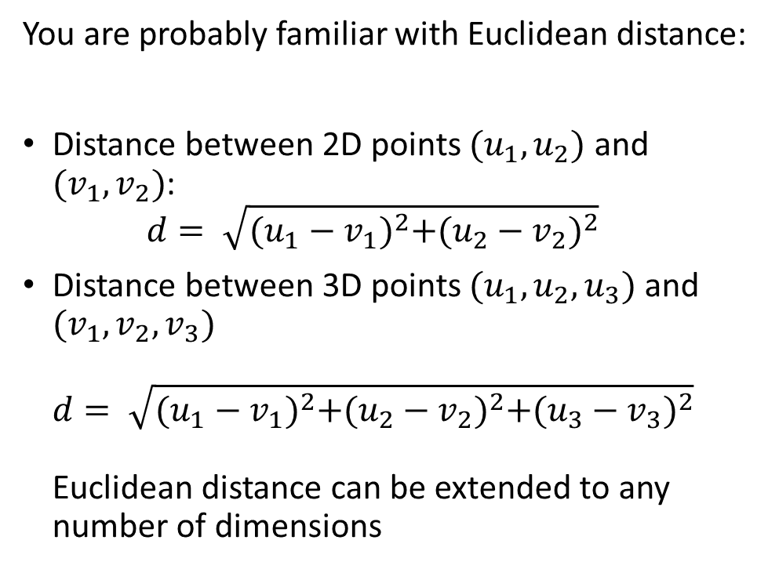

Euclidean Distance
You are probably familiar with Euclidean distance:
Distance between 2D points $(u_{1},u_{2})$ and $(v_{1},v_{2})$: $d= \sqrt{{(u_{1}−v_{1})}^{2}+{(u_{2}−v_{2})}^{2}}$
Distance between 3D points $(u_{1},u_{2},u_{3})$and $(v_{1},v_{2},v_{3})$ $d= \sqrt{{(u_{1}−v_{1})}^{2}+{(u_{2}−v_{2})}^{2}+{(u_{3}−v_{3})}^{2}}$ Euclidean distance can be extended to any number of dimensions
$$u=(u_{1},u_{2})$$
$$v=(v_{1},v_{2})$$

Slide 21

Euclidean Distance in terms of norm
$$u=(u_{1},u_{2})$$
$$d= \sqrt{{(u_{1}−v_{1})}^{2}+{(u_{2}−v_{2})}^{2}}= \left\|u−v\right\|$$
$$v=(v_{1},v_{2})$$

Slide 22
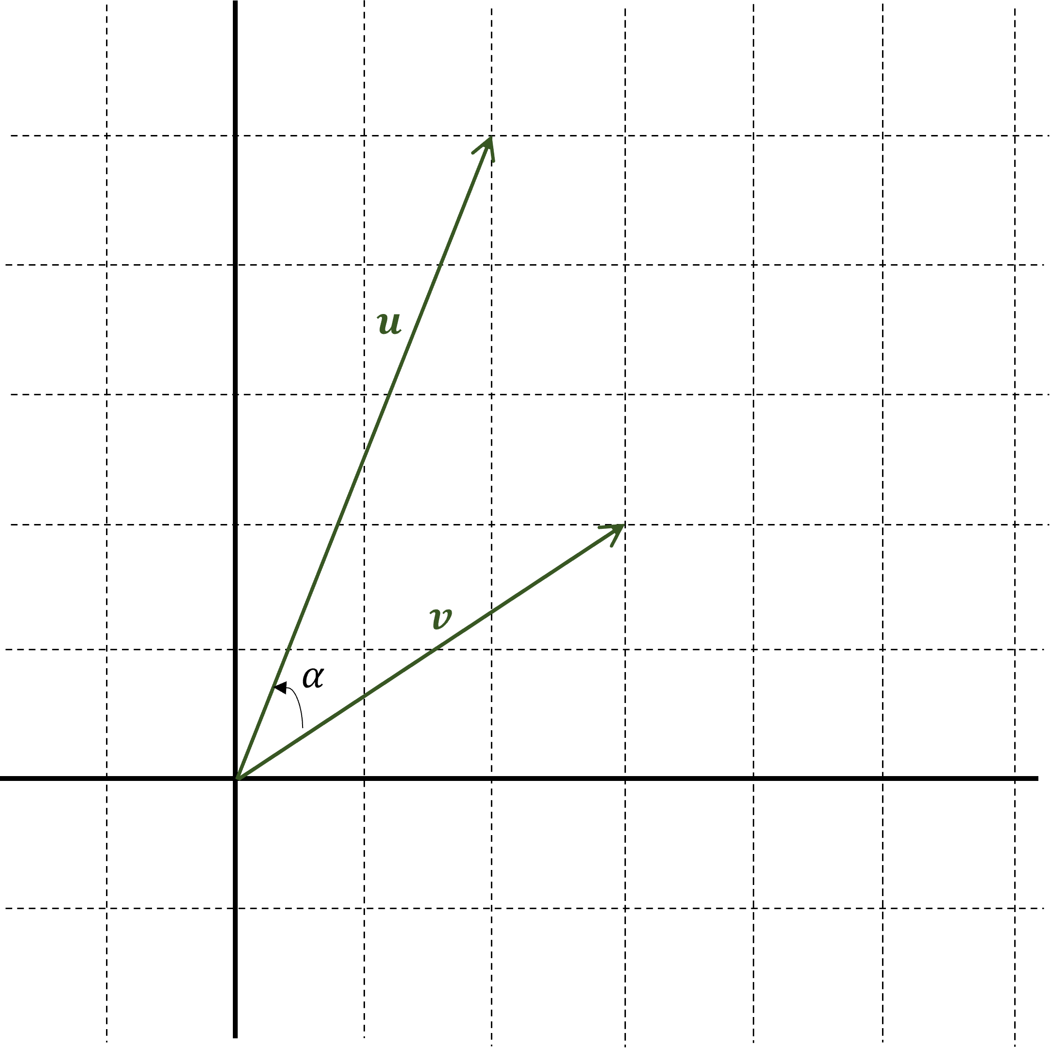
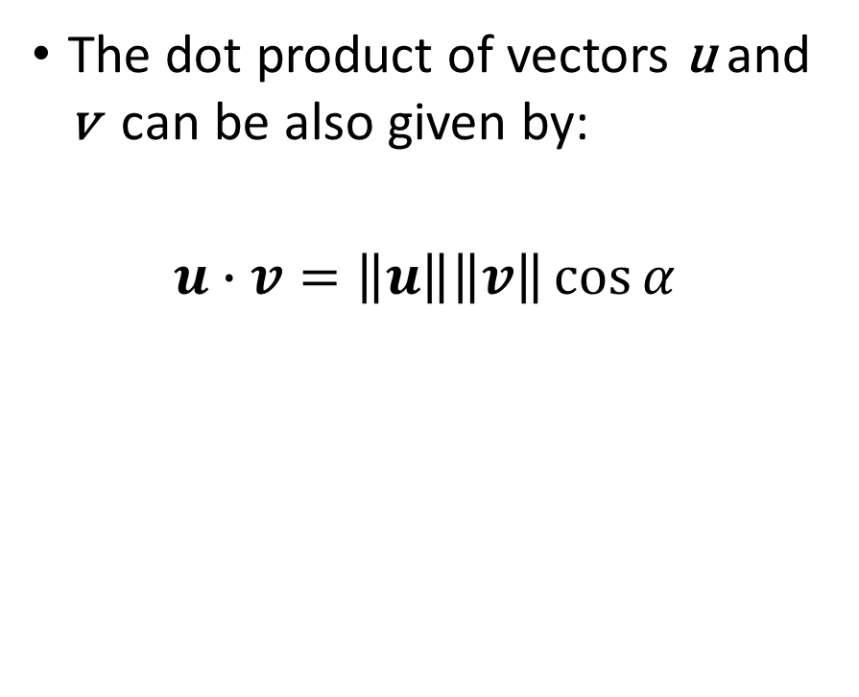
Dot Products & Vector Norms
The dot product of vectors u and v can be also given by:
$$u∙v=\left\|u\right\|\left\|v\right\|\cos{α}$$

Slide 23
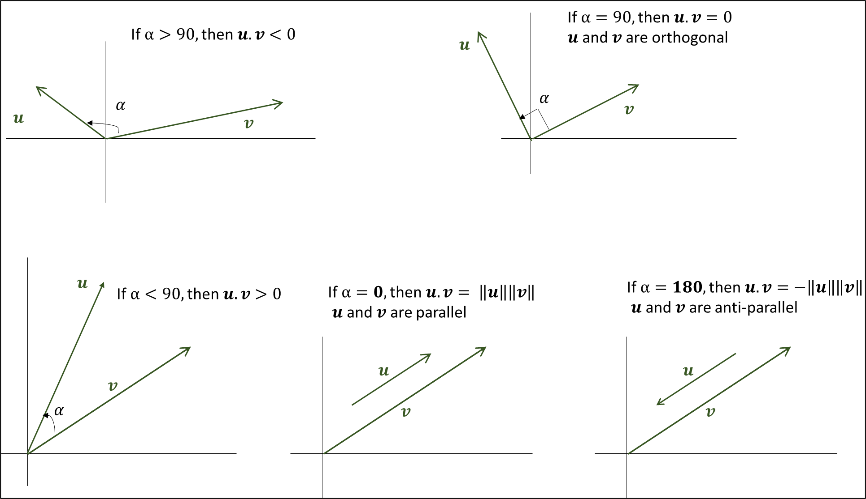

Dot Products & Vector Norms
$$u∙v=\left\|u\right\|\left\|v\right\|\cos{α}$$

Slide 24
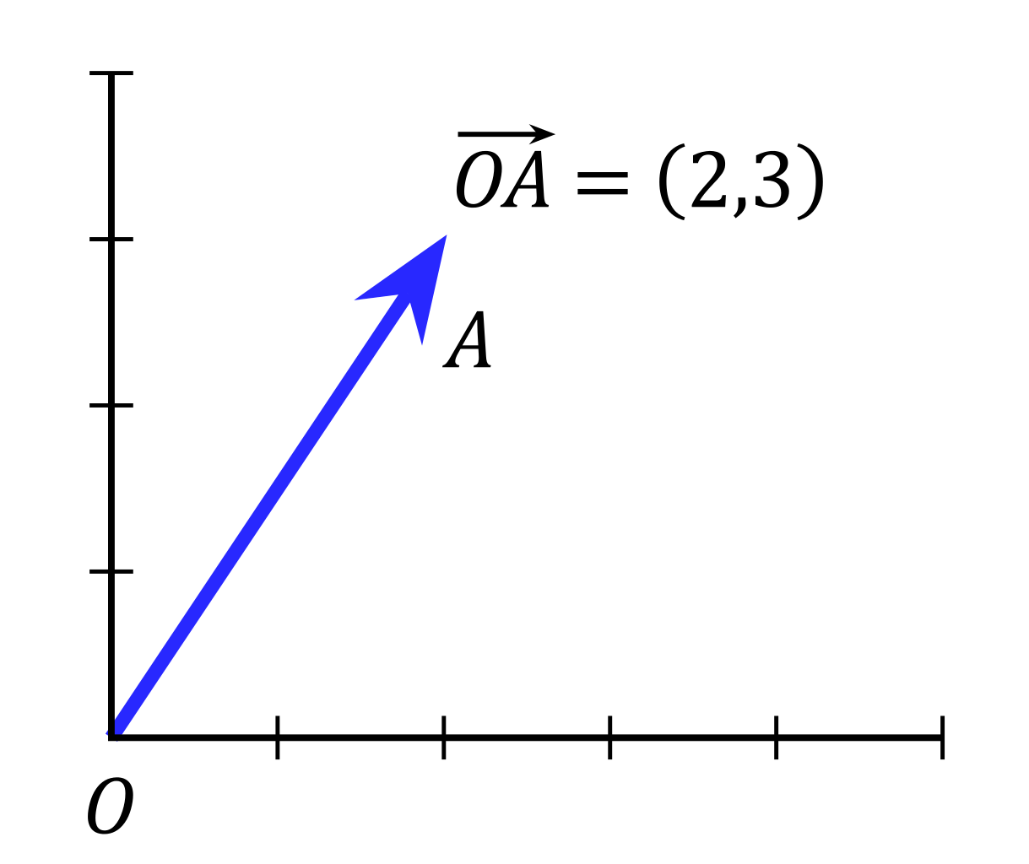

Vectors: Dot Product
If two vectors are perpendicular (orthogonal), then their dot product is 0 $$\vec{u}⋅\vec{v}=0$$

Slide 25
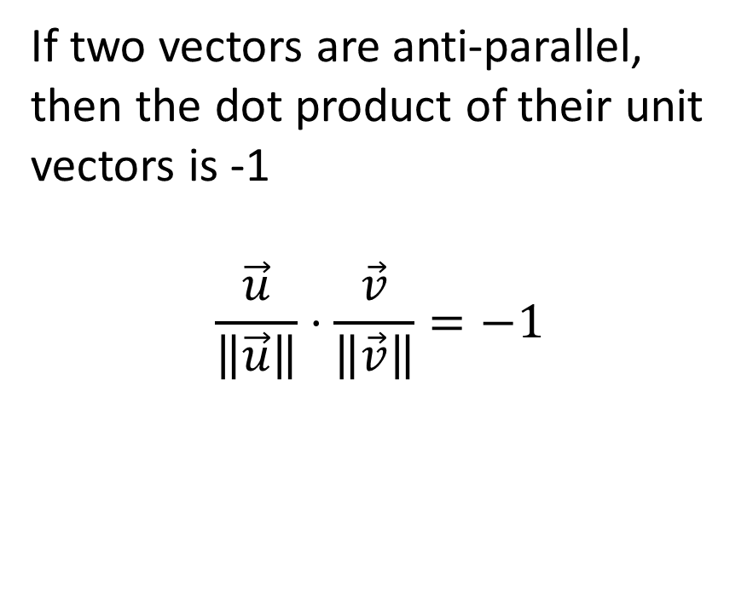
Vectors: Dot Product
If two vectors are anti-parallel, then the dot product of their unit vectors is -1 $$\frac{\vec{u}}{\left\|\vec{u}\right\|}⋅\frac{\vec{v}}{\left\|\vec{v}\right\|}=−1$$

Slide 26
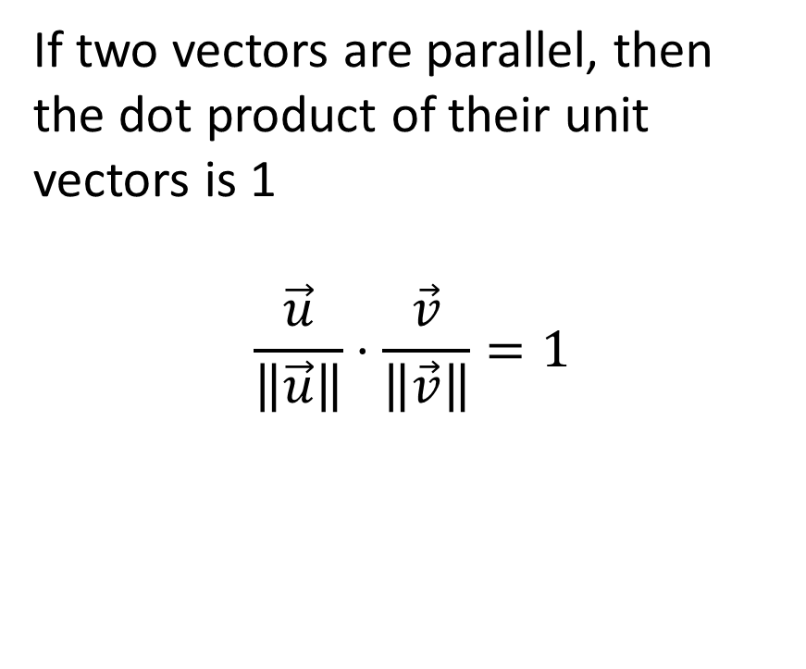
Vectors: Dot Product
If two vectors are parallel, then the dot product of their unit vectors is 1 $$\frac{\vec{u}}{\left\|\vec{u}\right\|}⋅\frac{\vec{v}}{\left\|\vec{v}\right\|}=1$$

Slide 27
Matrices

Slide 28
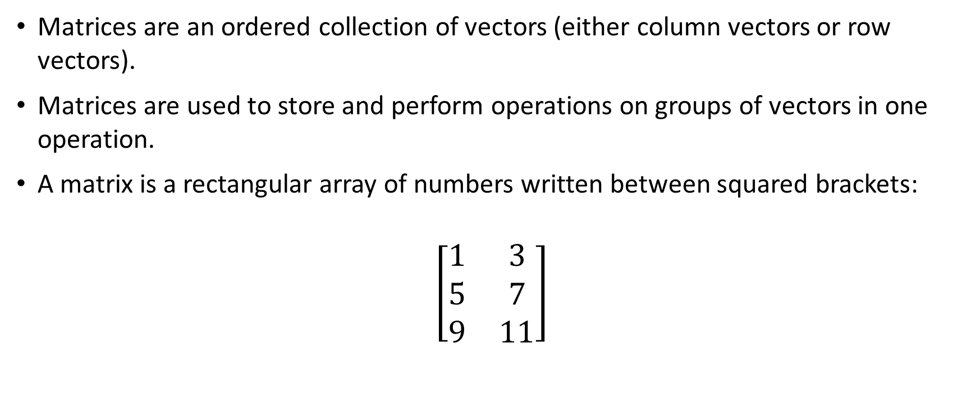
Matrices
Matrices are an ordered collection of vectors (either column vectors or row vectors).
Matrices are used to store and perform operations on groups of vectors in one operation.
A matrix is a rectangular array of numbers written between squared brackets:
$$\left[\begin{matrix}1 & 3 \\ 5 & 7 \\ 9 & 11\end{matrix}\right]$$

Slide 29


Vectors
$$A ∈ ℝ^{n×m}$$
The matrix contain real entries organized into:
n rows
m columns
$$A=\left[\begin{matrix}a_{1,1} & a_{1,2} & … & a_{1,m} \\ a_{2,1} & a_{2,2} & … & a_{2,m} \\ \begin{aligned}⋮ \\ a_{n,1}\end{aligned} & \begin{aligned}⋮ \\ a_{n,2}\end{aligned} & \begin{aligned}⋱ \\ …\end{aligned} & \begin{aligned}⋮ \\ a_{n,m}\end{aligned}\end{matrix}\right]$$

Slide 30

Vectors
$$A ∈ ℝ^{n×m}$$
The matrix contain real entries organized into:
n rows
m columns
$$A=\left[\begin{matrix}a_{1,1} & a_{1,2} & … & a_{1,m} \\ a_{2,1} & a_{2,2} & … & a_{2,m} \\ \begin{aligned}⋮ \\ a_{n,1}\end{aligned} & \begin{aligned}⋮ \\ a_{n,2}\end{aligned} & \begin{aligned}⋱ \\ …\end{aligned} & \begin{aligned}⋮ \\ a_{n,m}\end{aligned}\end{matrix}\right]$$
Matrix elements can be described using indexing like so: $a_{i,j}$. The index i refers to the row, while the index j refers to the column.

Slide 31
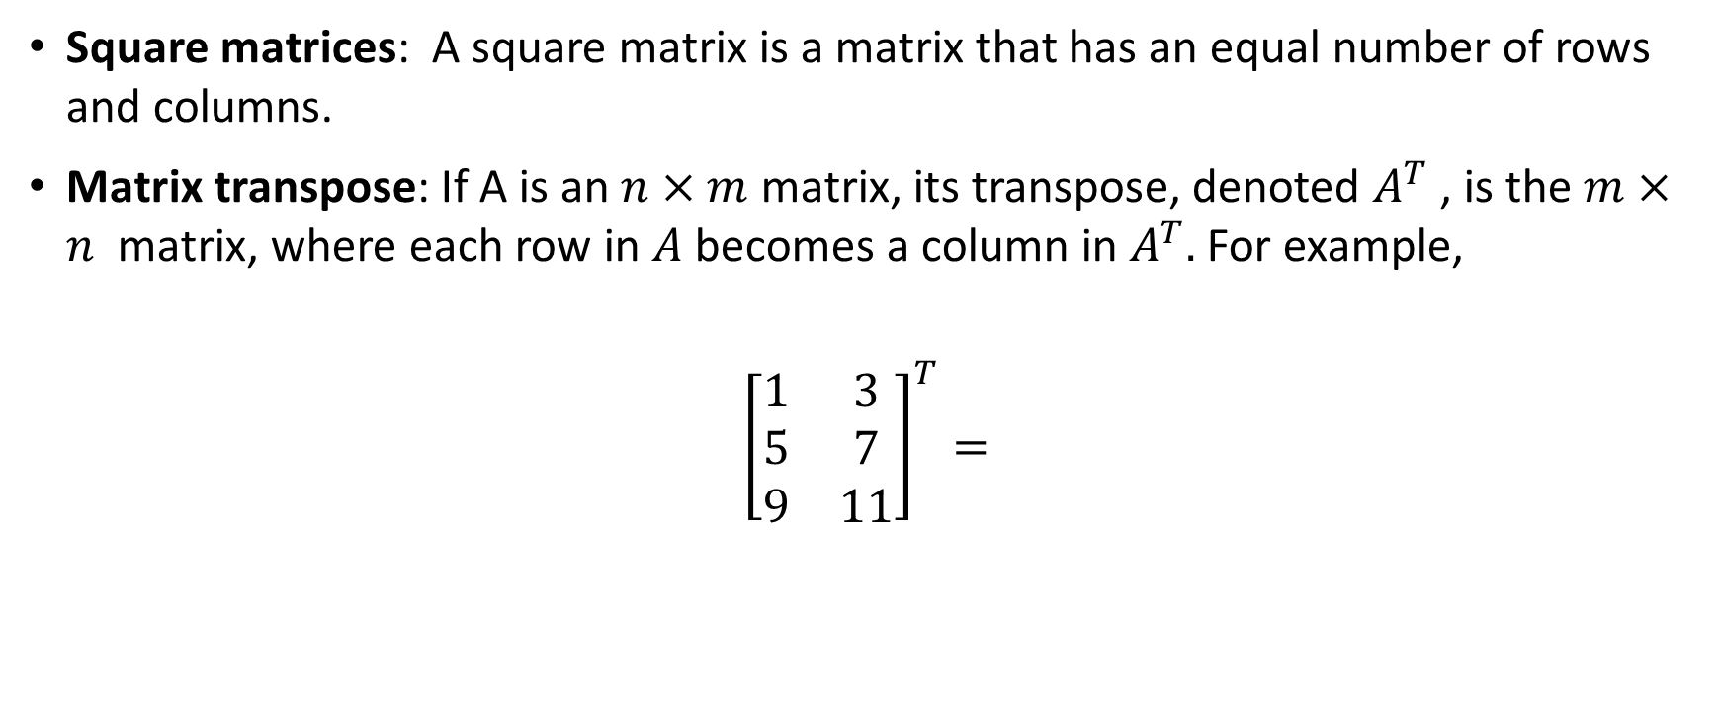
Matrices
Square matrices: A square matrix is a matrix that has an equal number of rows and columns.
Matrix transpose: If A is an $n×m$ matrix, its transpose, denoted $A^{T}$ , is the $m×n$ matrix, where each row in $A$ becomes a column in $A^{T}.$ For example,
$${\left[\begin{matrix}1 & 3 \\ 5 & 7 \\ 9 & 11\end{matrix}\right]}^{T}=$$

Slide 32

Matrix-Vector Multiplication
$$Ab=c$$
$$\left[\begin{matrix}1 & 3 \\ 5 & 7 \\ 9 & 11\end{matrix}\right]⋅\left[\begin{matrix}1 \\ −1\end{matrix}\right]= \left[\begin{aligned} \\ \\ \end{aligned}\right]$$
Multiplying a matrix and a vector produces a new vector.
To get each element of the new vector:
each row of the matrix is dotted with vector
The number of elements of b needs to be equal to the number of columns of A.

Slide 33

Matrix-Matrix Multiplication
$$AB=C$$
$$\left[\begin{matrix}1 & 3 \\ 5 & 7 \\ 9 & 11\end{matrix}\right]⋅\left[\begin{matrix}1 & −1 \\ −1 & 1\end{matrix}\right]= \left[\begin{matrix}−2 & 2 \\ & 2 \\ −2 & \end{matrix}\right]$$
We can also multiple two matrices.
To get every element in the output matrix:
we dot each row of the first matrix with every column of the second matrix.
The number of columns in the first matrix must match the number of rows in the second matrix (The dimensions of the two matrices must be compatible).

Slide 34
Matrix-Matrix Multiplication
$$AB=C$$
$$\left[\begin{matrix}1 & 3 \\ 5 & 7 \\ 9 & 11\end{matrix}\right]⋅\left[\begin{matrix}1 & −1 \\ −1 & 1\end{matrix}\right]= \left[\begin{matrix}−2 & 2 \\ & 2 \\ −2 & \end{matrix}\right]$$
We can also multiple two matrices.
To get every element in the output matrix:
we dot each row of the first matrix with every column of the second matrix.

Slide 35
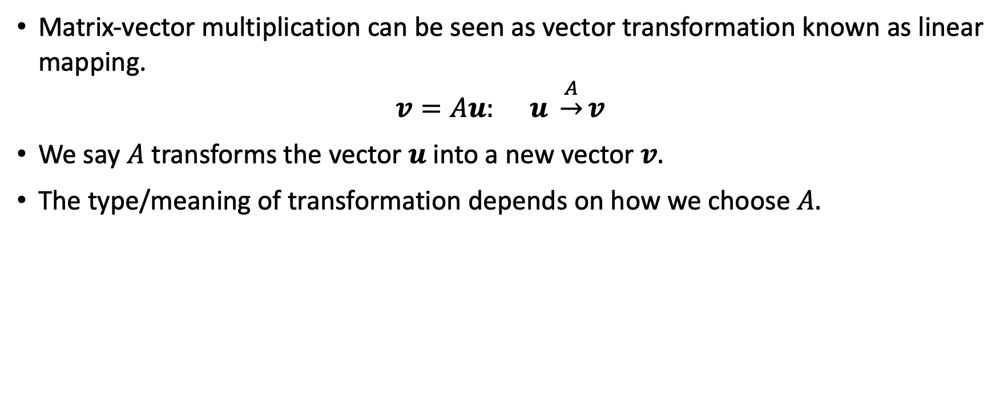
Geometric Example of Matrix-Vector Multiplication
Matrix-vector multiplication can be seen as vector transformation known as linear mapping.
$$v=Au: u \underset{→}{A}v$$
We say $A$ transforms the vector $u$ into a new vector $v.$
The type/meaning of transformation depends on how we choose $A.$

Slide 36

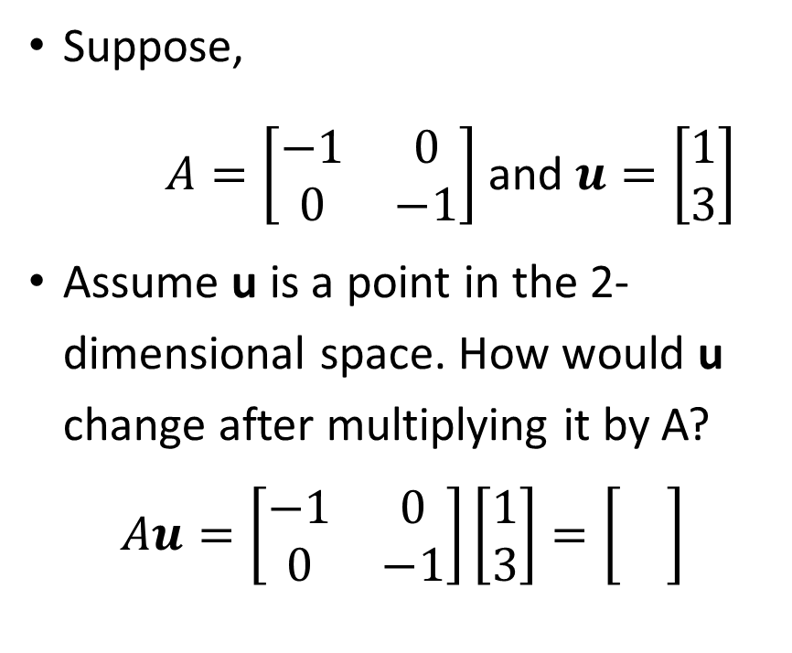
Example 1 - Negation
Suppose,
$A=\left[\begin{matrix}−1 & 0 \\ 0 & −1\end{matrix}\right]$ and $u=\left[\begin{aligned}1 \\ 3\end{aligned}\right]$
Assume u is a point in the 2-dimensional space. How would u change after multiplying it by A?
$$Au=\left[\begin{matrix}−1 & 0 \\ 0 & −1\end{matrix}\right]\left[\begin{aligned}1 \\ 3\end{aligned}\right]=\left[\begin{aligned} \\ \end{aligned}\right]$$

Slide 37

Example 1 - Negation
Now we want to apply the same transformation to two other vectors:
$A=\left[\begin{matrix}−1 & 0 \\ 0 & −1\end{matrix}\right]$ and $\left[\begin{aligned}1 \\ 3\end{aligned}\right]$, $\left[\begin{aligned}−1 \\ 2\end{aligned}\right]$, $\left[\begin{aligned}3 \\ −1\end{aligned}\right]$

Slide 38
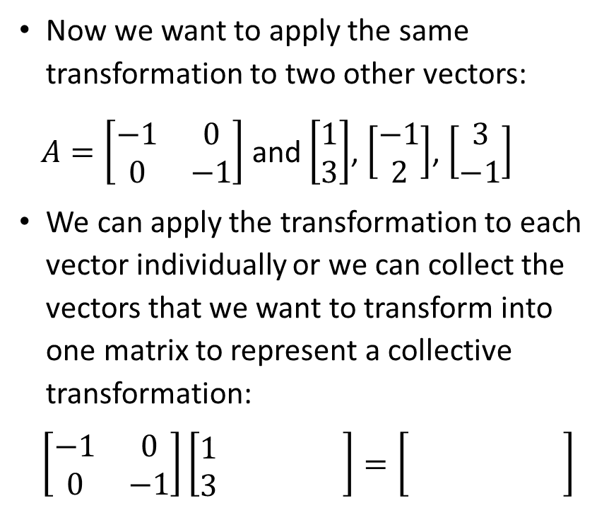
Example 1 - Negation
Now we want to apply the same transformation to two other vectors:
$A=\left[\begin{matrix}−1 & 0 \\ 0 & −1\end{matrix}\right]$ and $\left[\begin{aligned}1 \\ 3\end{aligned}\right]$, $\left[\begin{aligned}−1 \\ 2\end{aligned}\right]$, $\left[\begin{aligned}3 \\ −1\end{aligned}\right]$
We can apply the transformation to each vector individually or we can collect the vectors that we want to transform into one matrix to represent a collective transformation:
$$\left[\begin{matrix}−1 & 0 \\ 0 & −1\end{matrix}\right]\left[\begin{matrix}1 & & \\ 3 & & \end{matrix}\right]=\left[\begin{matrix} & & \\ & & \end{matrix}\right]$$

Slide 39
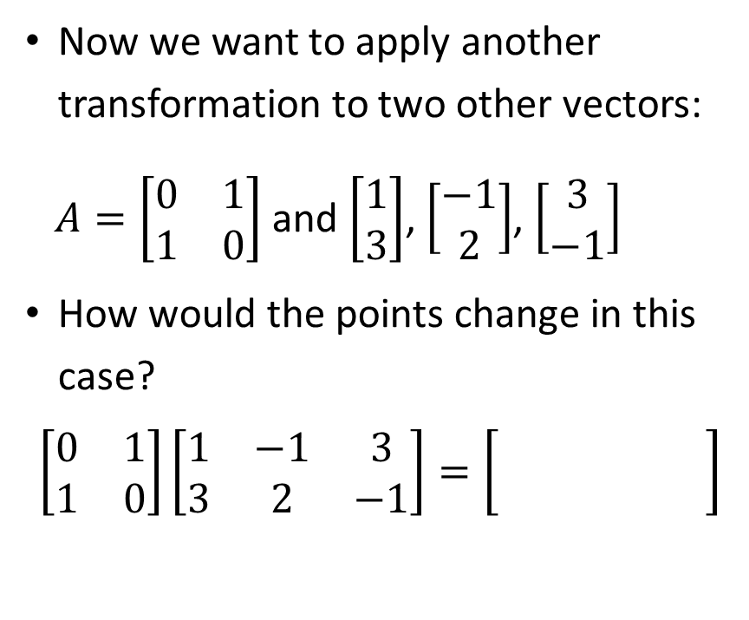
Example 2 - Permutation
Now we want to apply another transformation to two other vectors:
$A=\left[\begin{matrix}0 & 1 \\ 1 & 0\end{matrix}\right]$ and $\left[\begin{aligned}1 \\ 3\end{aligned}\right]$, $\left[\begin{aligned}−1 \\ 2\end{aligned}\right]$, $\left[\begin{aligned}3 \\ −1\end{aligned}\right]$
How would the points change in this case?
$$\left[\begin{matrix}0 & 1 \\ 1 & 0\end{matrix}\right]\left[\begin{matrix}1 & −1 & 3 \\ 3 & 2 & −1\end{matrix}\right]=\left[\begin{matrix} & & \\ & & \end{matrix}\right]$$

Slide 40
Lines, Planes, Hyperplanes

Slide 41




Line’s Equation
$$y$$
$$y=x+1$$
You’re familiar with the following form of a line’s equation:
$$y=x+1$$
$x$

Slide 42
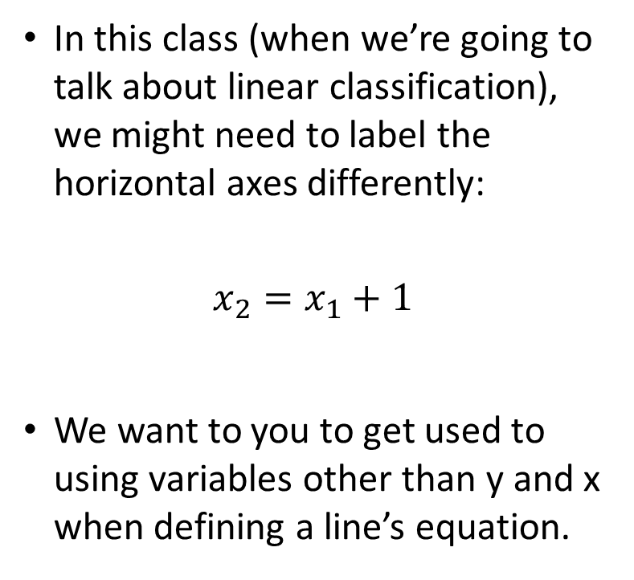



Line’s Equation
$$x_{2}$$
$$x_{2}=x_{1}+1$$
In this class (when we’re going to talk about linear classification), we might need to label the horizontal axes differently:
$$x_{2}=x_{1}+1$$
We want to you to get used to using variables other than y and x when defining a line’s equation.
$x_{1}$

Slide 43
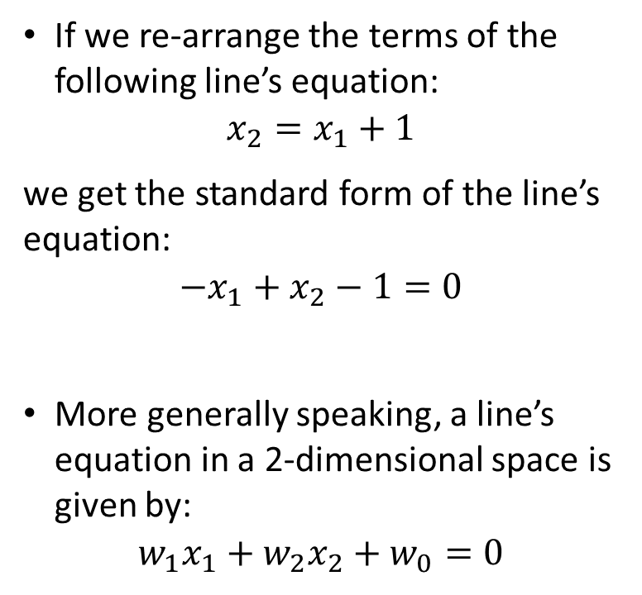

Line’s Equation
$$x_{2}$$
$$−x_{1}+x_{2}−1=0$$
If we re-arrange the terms of the following line’s equation:
$$x_{2}=x_{1}+1$$
we get the standard form of the line’s equation:
$$−x_{1}+x_{2}−1=0$$
More generally speaking, a line’s equation in a 2-dimensional space is given by:
$$w_{1}x_{1}+{w_{2}x}_{2}+w_{0}=0$$
$x_{1}$

Slide 44
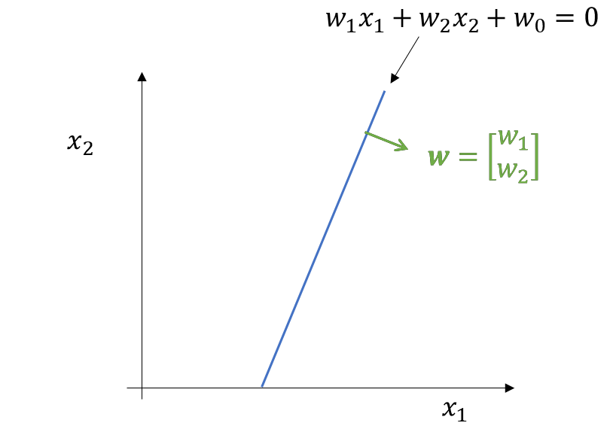
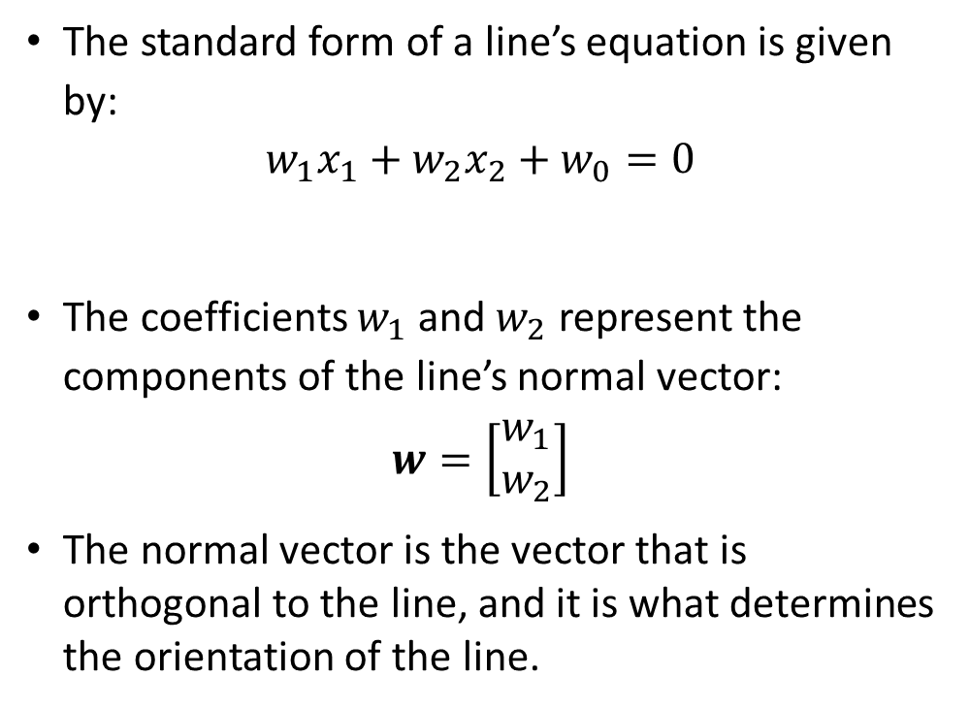
Line’s Equation
The standard form of a line’s equation is given by:
$$w_{1}x_{1}+{w_{2}x}_{2}+w_{0}=0$$
The coefficients $w_{1}$and $w_{2}$ represent the components of the line’s normal vector:
$$w=\left[\begin{aligned}w_{1} \\ w_{2}\end{aligned}\right]$$
The normal vector is the vector that is orthogonal to the line, and it is what determines the orientation of the line.

Slide 45







Line’s Equation
$x_{2}$
$$w=\left[\begin{aligned}−1 \\ 1\end{aligned}\right]$$
A line can be determined by its standard equation.
Or it can be determined using a line’s normal vector $w$ and a particular point $p$ that the line goes through.
$$p:(1, 2)$$
$$x$$
$$x−p$$
$x_{1}$

Slide 46
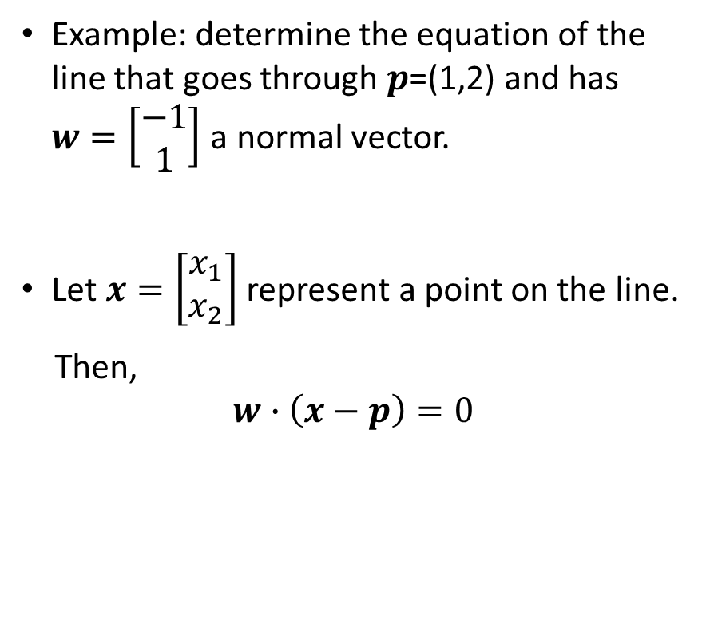
Line’s Equation
$x_{2}$
$$w=\left[\begin{aligned}−1 \\ 1\end{aligned}\right]$$
Example: determine the equation of the line that goes through $p$=(1,2) and has $w=\left[\begin{aligned}−1 \\ 1\end{aligned}\right]$ a normal vector.
Let $x=\left[\begin{aligned}x_{1} \\ x_{2}\end{aligned}\right]$ represent a point on the line.
Then,
$$w∙\left(x−p\right)=0$$
$$p:(1, 2)$$
$$x$$
$$x−p$$
$x_{1}$

Slide 47
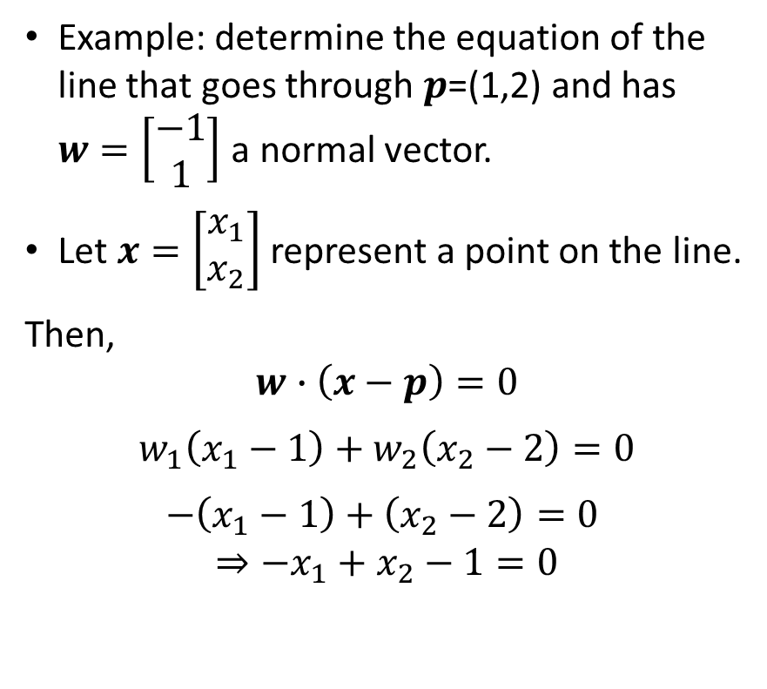
Line’s Equation
$x_{2}$
$$w=\left[\begin{aligned}−1 \\ 1\end{aligned}\right]$$
Example: determine the equation of the line that goes through $p$=(1,2) and has $w=\left[\begin{aligned}−1 \\ 1\end{aligned}\right]$ a normal vector.
Let $x=\left[\begin{aligned}x_{1} \\ x_{2}\end{aligned}\right]$ represent a point on the line.
Then,
$$w∙\left(x−p\right)=0$$
$w_{1}\left(x_{1}−1\right)+$ $w_{2}\left(x_{2}−2\right)=0$
$−\left(x_{1}−1\right)+$ $\left(x_{2}−2\right)=0$
$$⇒{−x}_{1}+x_{2}−1=0$$
$$p:(1, 2)$$
$$x$$
$$x−p$$
$x_{1}$

Slide 48



Line’s Equation
Any point $x$ that lies on the line satisfies:
$$w_{1}x_{1}+{w_{2}x}_{2}+w_{0}=0$$
Any point $x$ that lies on the same side of the normal vector satisfies:
$$w_{1}x_{1}+{w_{2}x}_{2}+w_{0}>0$$
Any point $x$ that lies on the different side of the normal vector satisfies:
$$w_{1}x_{1}+{w_{2}x}_{2}+w_{0}<0$$
We say that the line divides the space into half-planes (half-spaces).
$$w_{1}x_{1}+w_{2}x_{2}$$
$$+w_{0}<0$$
$$w_{1}x_{1}+w_{2}x_{2}$$
$$+w_{0}>0$$

Slide 49






Line’s Equation
$x_{2}$
$${−x}_{1}+x_{2}−1=0$$
$${−x}_{1}+x_{2}−1>0$$
$$w=\left[\begin{aligned}−1 \\ 1\end{aligned}\right]$$
$$x$$
Given the coordinates of a point, we can plug in the values using the line’s equation to see if the value is positive or negative.
The faster way is to check whether the point lies on the same/different side of the normal vector.
$$x−p$$
$$p:(1, 2)$$
$x_{1}$

Slide 50





Line’s Equation
$x_{2}$
$${−x}_{1}+x_{2}−1=0$$
$${−x}_{1}+x_{2}−1>0$$
$$w=\left[\begin{aligned}−1 \\ 1\end{aligned}\right]$$
The positive and negative values can be seen due to whether the angle between $w$ and $\left(x−p\right)$ is less then 90 or greater than 90.
$$p:(1, 2)$$
$$x−p$$
$$x$$
$x_{1}$
$${−x}_{1}+x_{2}−1<0$$

Slide 51






Planes
The generalization of the line to the 3-dimensional space is called the plane and is given by:
$w_{1}x_{1}+{w_{2}x}_{2}+{w_{3}x}_{3}+w_{0}=0$
$w$ is the plane’s normal vector: it is perpendicular to the surface, and it defines the orientation of the plane.
A plane is a flat geometric object that divides a space in two half-spaces.
$$x_{3}$$
$$w$$
$$x_{2}$$
$$x_{1}$$

Slide 52

Planes
The generalization of the plane to the m-dimensional space is called the hyperplane and is given by:
$w_{1}x_{1}+{w_{2}x}_{2}+⋯+{w_{m}x}_{m}+w_{0}=0$
In a space with m dimensions, a hyperplane is an m – 1 dimensional object (it has no depth)
$$x_{3}$$
$$w$$
$$x_{2}$$
$$x_{1}$$

Slide 53


Defining Hyper-planes
Planes are defined using "normal form" using a normal vector $w$and a point $p$that lies on the plane:
$w⋅\left(x −p\right)=0$
All points $x$ for which the equation is true lie on the plane
All other points are not on the plane
$$x_{3}$$
$$x$$
$$w$$
$$x_{2}$$
$$x_{1}$$

Slide 54

Defining Hyperplanes
Note the dot product in the equation:
$$w⋅\left(x −p\right)=0$$
The equation measures the angle between the normal vector and a vector between the two points
If two vectors are orthogonal, then their dot product is 0.
$$x_{3}$$
$$x$$
$$w$$
$$x_{1}$$

Slide 55

Checking where a point lies relative to a plane
If Point lies on the plane, then
$w_{1}x_{1}+{w_{2}x}_{2}+⋯+{w_{m}x}_{m}+w_{0}=0$
If Point lies on the same side of the plane as the normal vector, then
$w_{1}x_{1}+{w_{2}x}_{2}+⋯+{w_{m}x}_{m}+w_{0}>0$
If Point lies on the opposite side of the plane as the normal vector, then
${ w}_{1}x_{1}+{w_{2}x}_{2}+⋯+{w_{m}x}_{m}+w_{0}<0$
$$x_{3}$$
$$w$$
$$x_{2}$$
$$x_{1}$$

