Slide 1
Pooling Architecture Search for Graph Property Prediction in Open Graph Benchmark
Xu Wang-Huan Zhao-Lanning Wei-Quanming Yao
Ali Vefghi
Supervisor: Prof. Rahmati

Slide 2

Datasets
- Ogbg molhiv (small) and ogbg molpcba (medium):
Molecular attribute prediction data sets
Are adopted from the MoleculeNet
All molecules are pre-processed with RDKit
Each graph represents a molecule, where nodes represent atoms and edges represent chemical bonds.
Predict the target molecular characteristics as accurately as possible, i.e. whether a molecule can inhibits HIV replication.

Slide 3
Method
- PAS (Pooling Architecture Search)
is based on NAS (Neural Architecture Search)
to search for adaptive architectures for graph classification, consisting of the novel search space and the efficient search algorithm

Slide 4
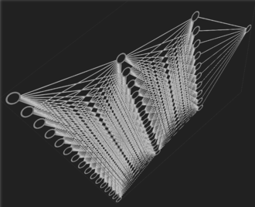
NAS (Neural Architecture Search)
is a technique for automating the design of ANNs
RL or evolution-based NAS
require thousands of GPU-days of searching/training
->>> One-shot models: To reduce computational cost, many recent NAS methods rely on the weight-sharing idea.

Slide 5
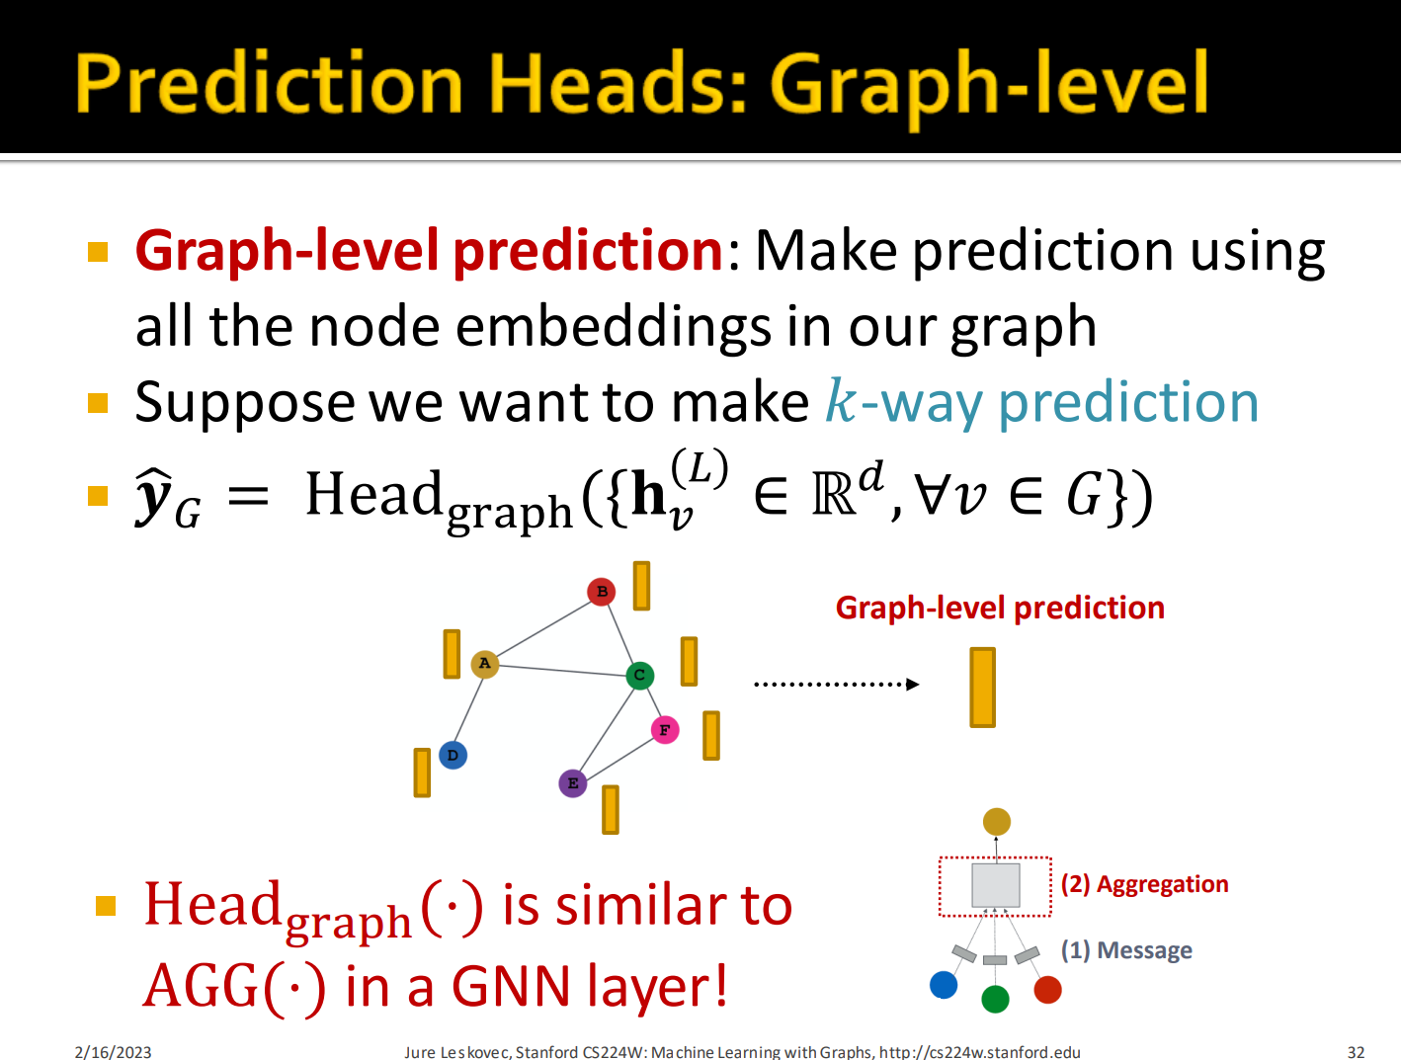

Slide 6
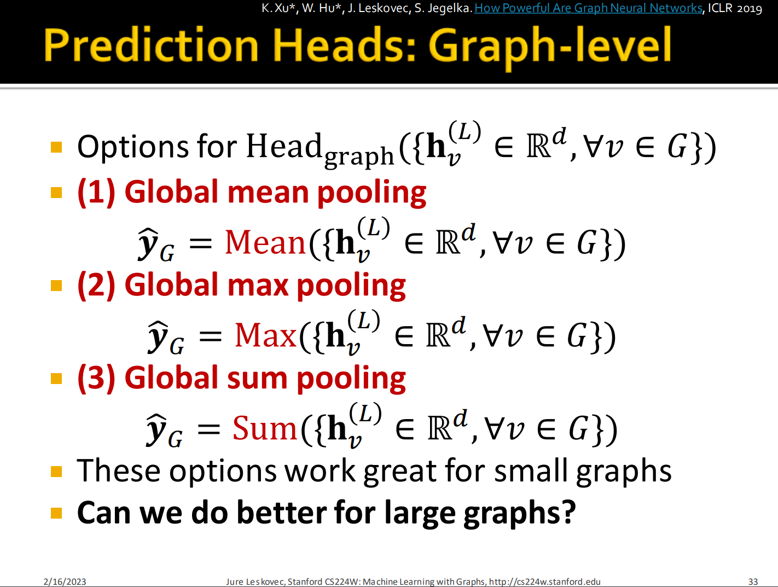

Slide 7
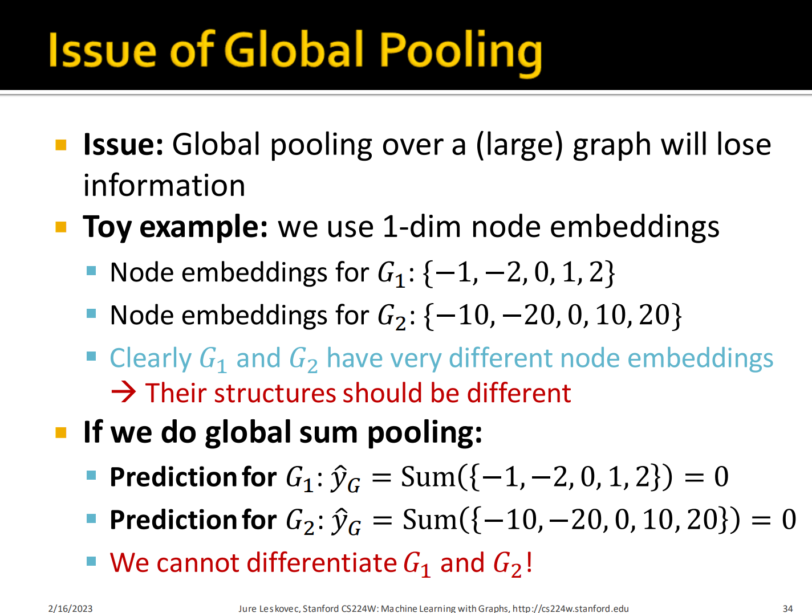

Slide 8
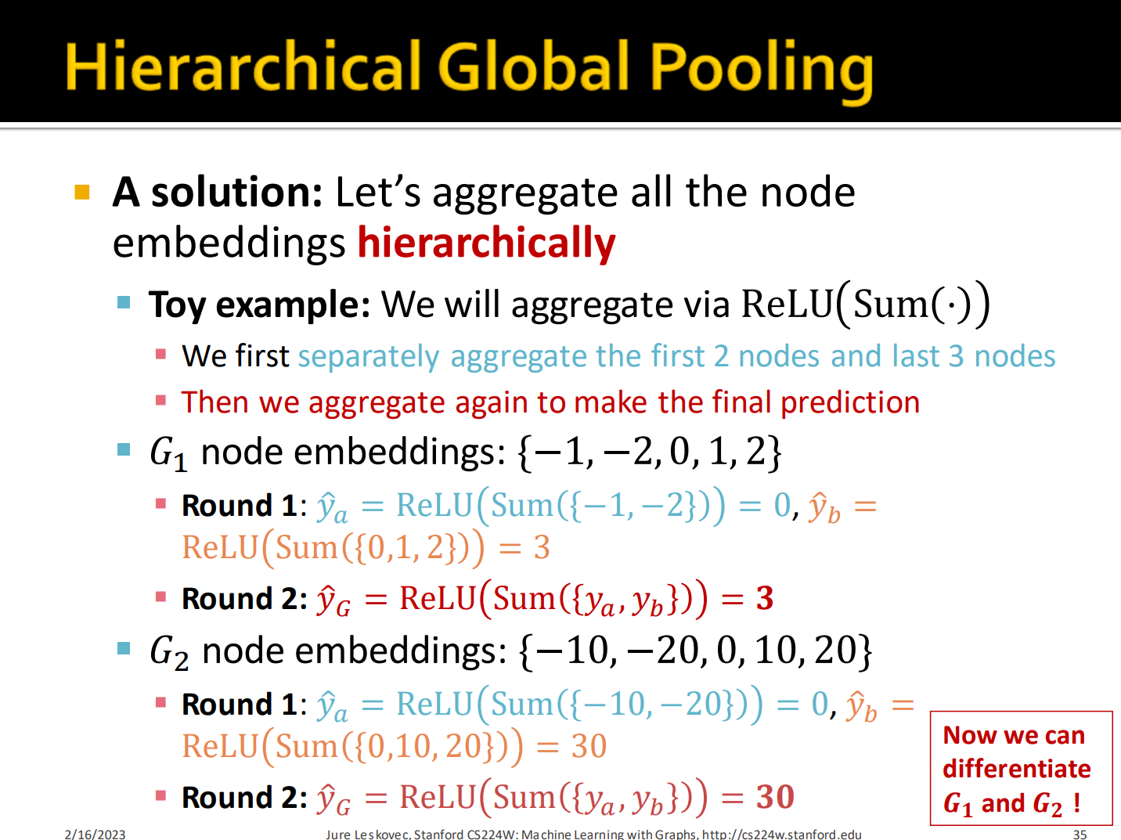

Slide 9
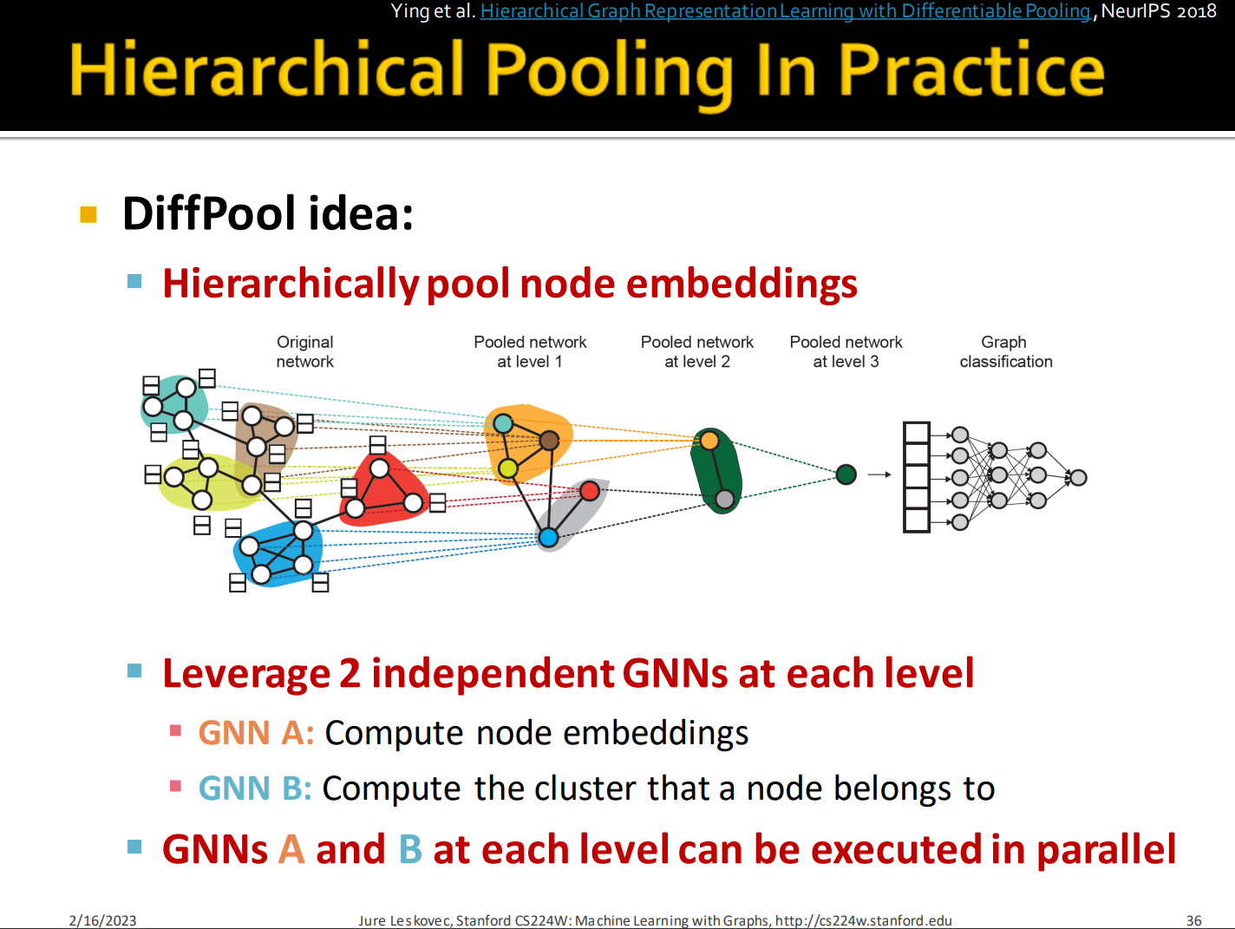

Slide 10
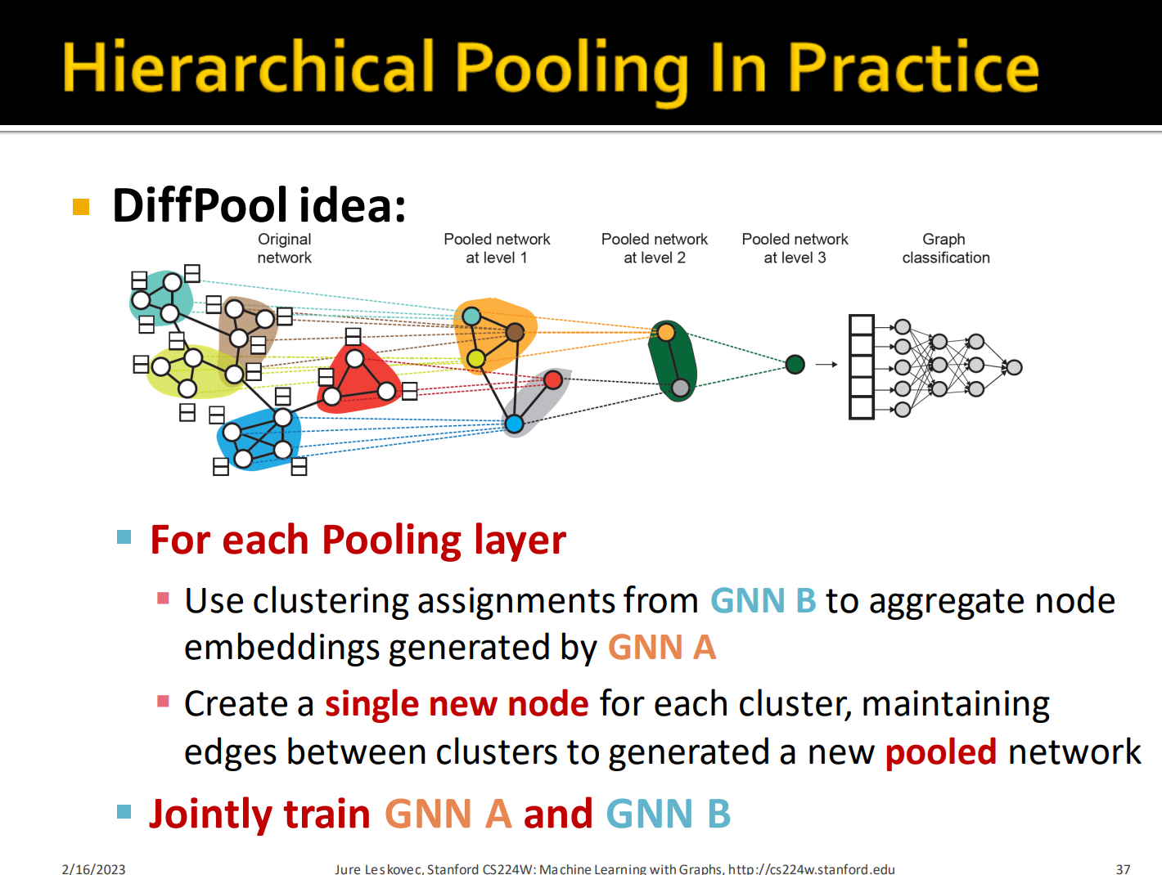

Slide 11
Issues of pooling
Global pooling methods only use node features and ignore the hierarchical information as they do not exploit the graph compositional nature leading to flat graph level representation
In reality, graphs are from highly diverse domains, human designed pooling architectures cannot adapt to diverse datasets well. it is very important to design data-specific pooling architectures for the graph classification task.

Slide 12
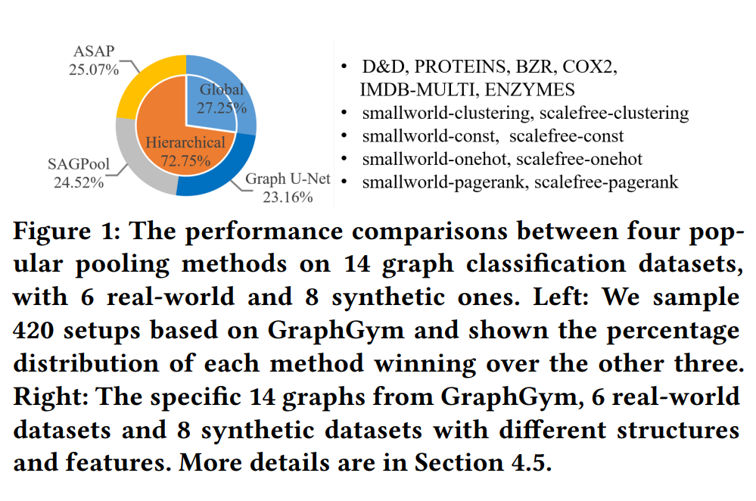

Slide 13
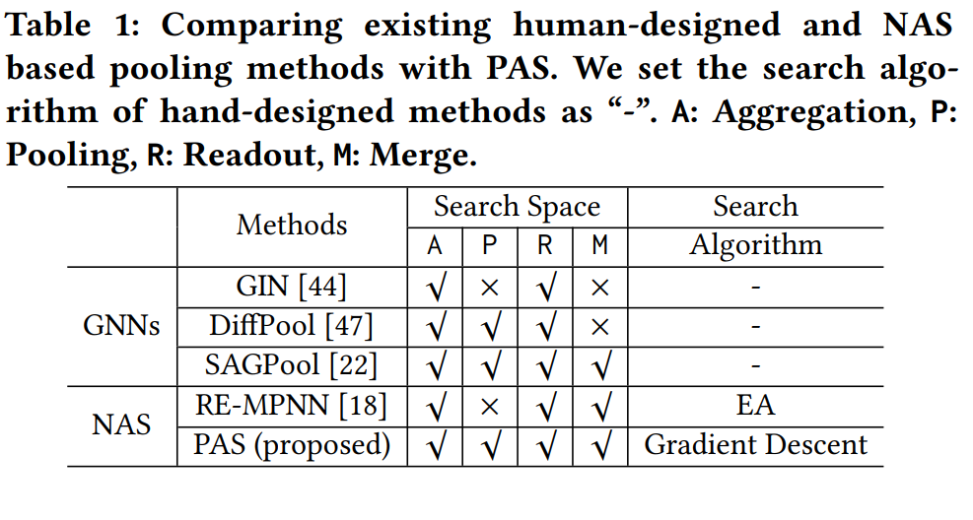
The Unified Framework
- Consists of :
Four key modules (Aggregation, Pooling, Readout and Merge Module)
Proposed search space
Differentiable search algorithm
Proposed coarsening strategy

Slide 14
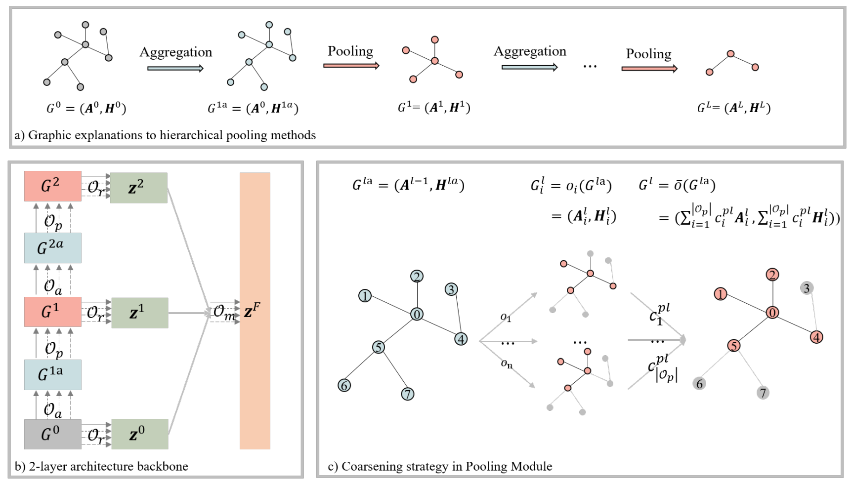
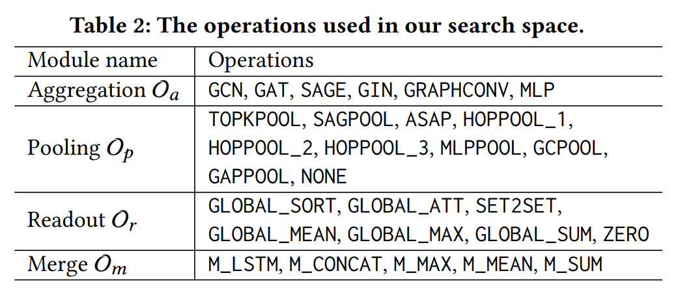

Slide 15
Differentiable search algorithm
However, it is non-trivial to apply existing differentiable search algorithms in pooling architecture search. Different pooling operations produce diverse coarse graphs consisting of different nodes and edges. How to relax the discrete coarsen graphs into continuous is still not solved in NAS. Here, to utilize the differentiable search algorithm, we design one coarsening strategy to address the pooling module relaxation problem

Slide 16
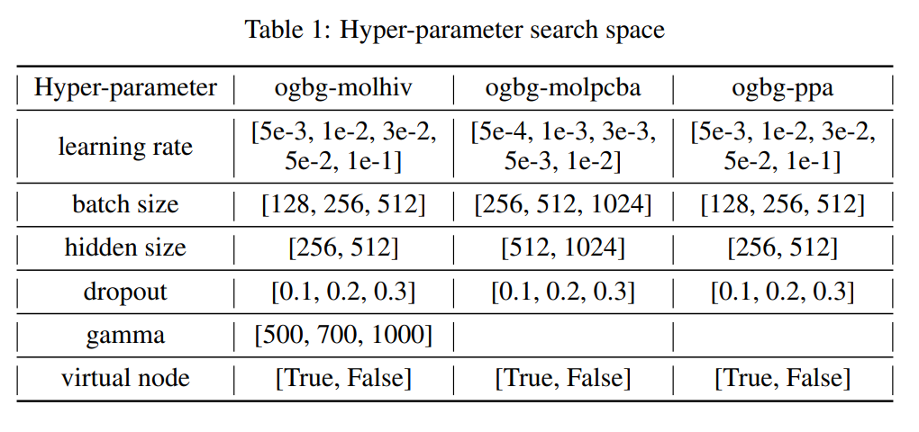

Slide 17
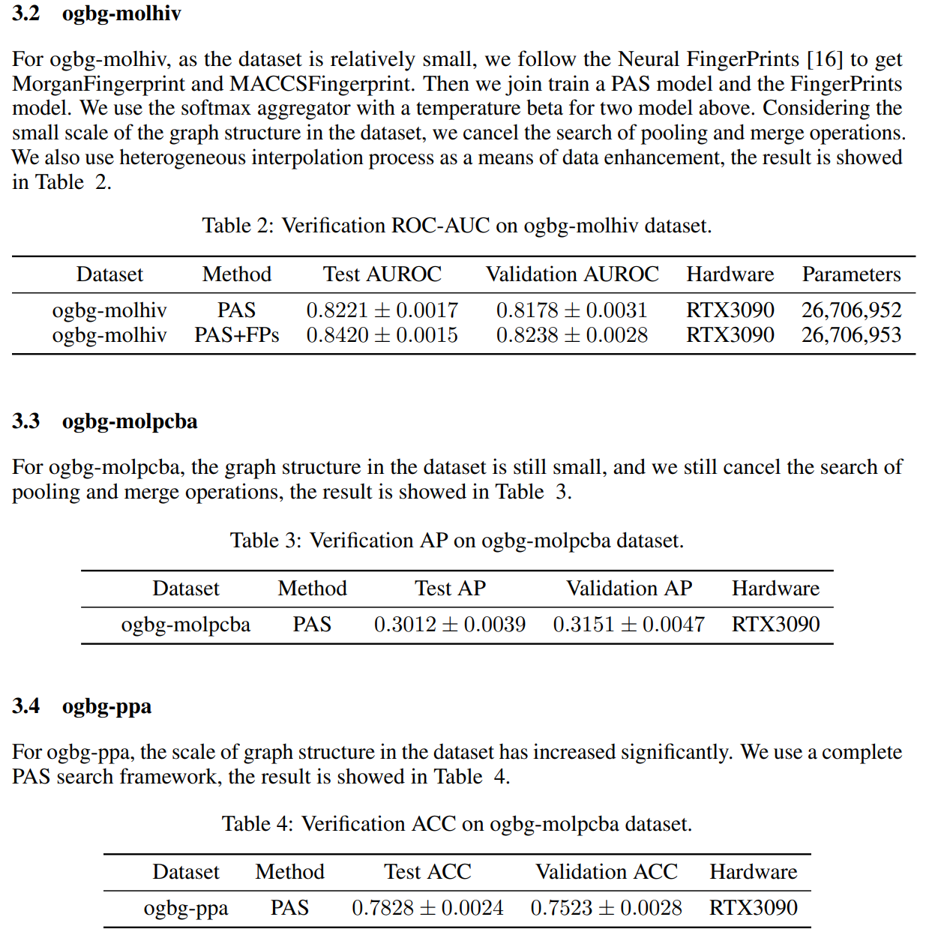

Slide 18
Thank you

