Slide 1

Predicting the popularity of the tweet
Yarin Itzhak Agam
Noam Borger

Slide 2

The idea of the project
Data Acquisition
Explore
EDA
Model
Drawing conclusions
Can we predict how popular a tweet will be based on the content?
What can affect on the popularity of the post other then the text?

Slide 3
Creating the database
We used twitter API to scrape a user’s tweets.
Twython library allows us to use Twitter API calls to collect the user’s tweets.
The function get_user_timeline() returns a list of dictionaries. Using pickle library we saved the data in a binary file.

Slide 4
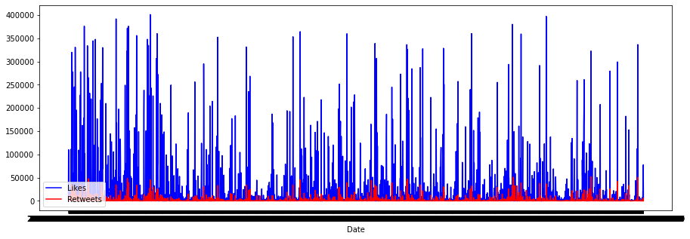
Visualization
Retweets compare to likes during time

Slide 5
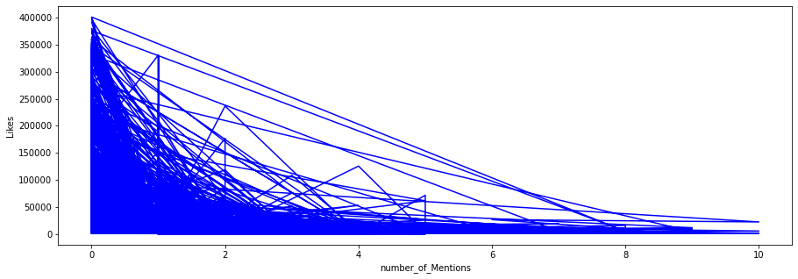
Visualization
Looking for connection between the mentions to the likes number.
There is no connection.

Slide 6
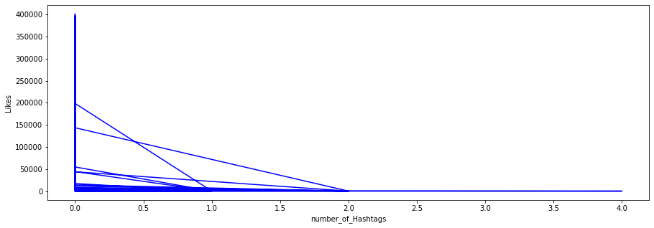
Visualization
Looking for connection between the hashtags to the likes number.
There is no connection.

Slide 7
Conclusions
Seeing the graphs helped us realize:
there is a connection between the amounts of likes and retweets
The number of mentions and hashtags has almost no affect, if any at all, on the number of likes and retweets

Slide 8
Machine learning
Our question was whether we can predict how popular a post will be by its content.
Since the computer knows how to work on numbers but not words we needed to vectorize the word using sklearn.feature_extraction.text.CountVectorizer.
To calculate the popularity of a tweet we have decided to multiply the likes count with the retweet count and divide them into bins.
Using the sklearn library we trained the model. After checking a few models we found LinearRegression to be the best fit to our needs.

Slide 9
Machine learning
Calculating the accuracy of the model we used the we summed the difference between the expected result and the predicted and divided them in the number of elements we have.
Getting the result of 2.2~ average difference.
To see if the result is not random we decided to check the accuracy with a list of random numbers which got a 3.3~ average difference.

