Slide 1

STACK OVERFLOW DEVELOPER SURVEY 2019
Part 1
Ayush Gupta
2025

Slide 2



OUTLINE
Executive Summary
Introduction
Methodology
Results
Visualization – Charts
Dashboard
Discussion
Findings & Implications
Conclusion
Appendix

Slide 3

EXECUTIVE SUMMARY
•Data contextualization and analysis goal.
•Methodology description.
• Data gathering.
• Data analysis.
• Data visualizations.
• Results presentation supported with graphs and trends.
•Discussion of overall findings and implications regarding
the results previously exposed.
• Final conclusions of the carried out research.

Slide 4

INTRODUCTION
1️⃣ Largest Developer Sentiment Survey Worldwide
2️⃣ Diverse Yet Uneven Representation
.
3️⃣ Global Tech Trends & Developer Behavior
4️⃣ Community Characterization
5️⃣ Strategic Relevance for Stakeholders

Slide 5

METHODOLOGY
Data Collection & Intake
Techniques: Web Scraping | APIs | Requests
Objective: Extract and validate raw survey data for integrity & completeness
Data Wrangling & Normalization
Actions:
Cleaned and transformed using pandas and Power Query
Standardized missing formats, mapped categories
Outcome: Reliable, analysis-ready dataset
Exploratory Data Analysis
Distribution Profiling: Salary, Age, Tech Stack
Outliers: Detected & mitigated using rule-based logic
Correlation Analysis: Pearson & Spearman for relational insights
Visual Analysis & Insight Generation
Libraries: Matplotlib | Seaborn
Focus Areas:
Composition of developer profiles
Tech trends & inter-variable relationships
Regional & cohort comparisons
Executive Dashboard
Platform: IBM Data Platform
Features:
Filter by experience, country, technology
Dynamic visual storytelling for decision-makers

Slide 6
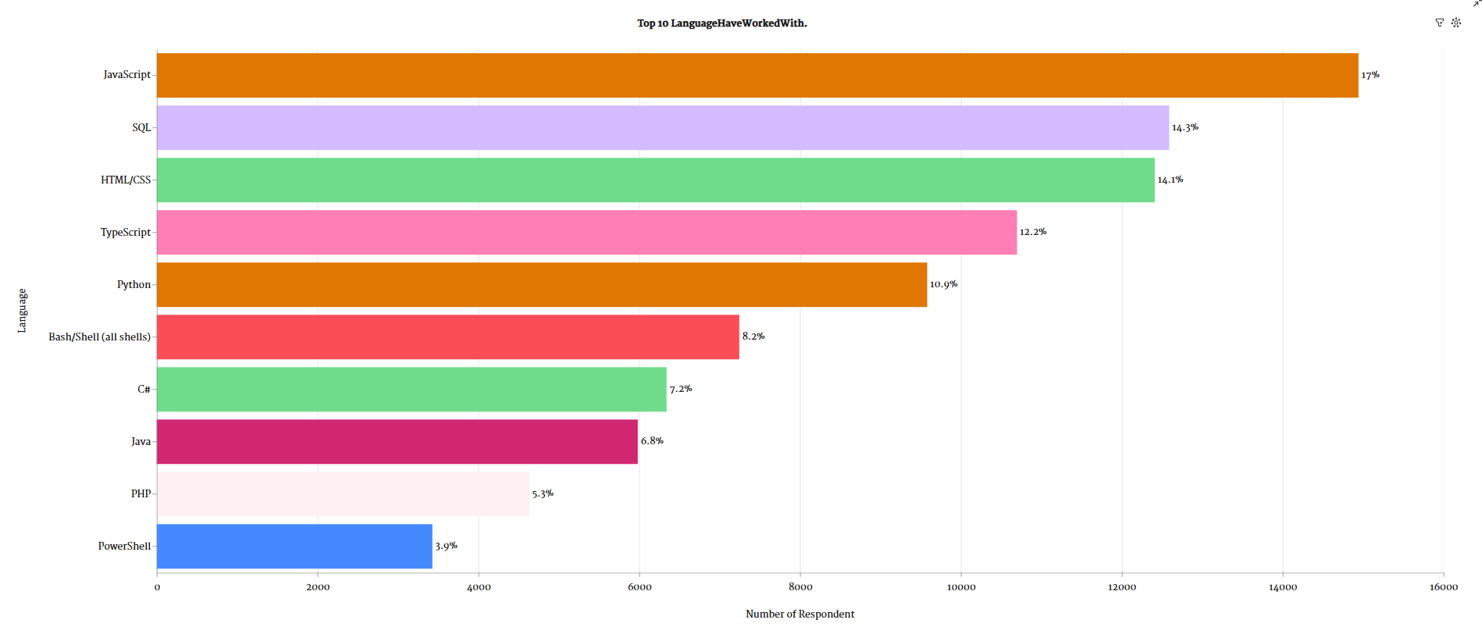
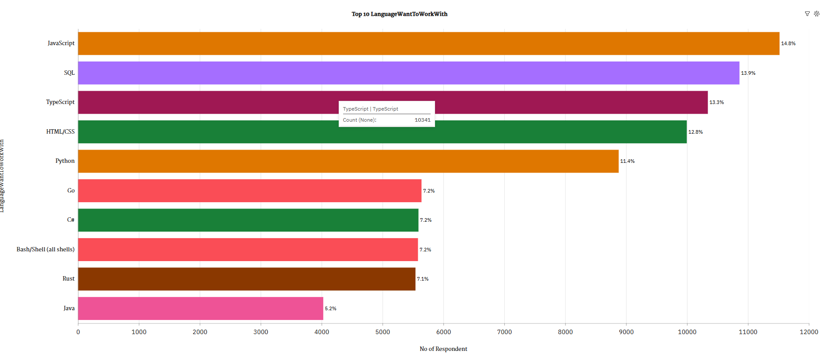
PROGRAMMING LANGUAGE TRENDS
Current Year
Next Year

Slide 7
PROGRAMMING LANGUAGE TRENDS - FINDINGS & IMPLICATIONS
Implication
📉 Legacy Hesitation: Low interest in Java and PHP suggests potential decline in their perceived relevance, especially among newer developers.
🚀 JavaScript Dominance: Its high usage and desirability point to continued demand across both frontend and backend roles.
🧠 SQL’s Enduring Value: SQL maintains strong preference and usage—indicating sustained importance for data-centric roles.
🔄 Rust’s Rise, Not Yet Mainstream: Developer interest is growing, but adoption is still trailing—signaling a need for skilling and community support.
⚙️ PowerShell's Niche Use: Minimal exposure could highlight gaps in DevOps training or indicate specialization in enterprise environments.
Findings
LanguageWantToWorkWith Java has the lowest Count at over 4 thousand, followed by Rust at over 5500.Finding 2
LanguageWantToWorkWith JavaScript has the highest Count at nearly 12 thousand, followed by SQL at nearly 11 thousand.
LanguageHaveWorkWith PowerShell has the lowest Count at almost 3500, followed by PHP at over 4500.
LanguageHaveWorkWith JavaScript has the highest Count at nearly 15 thousand, followed by SQL at nearly 13 thousand.

Slide 8
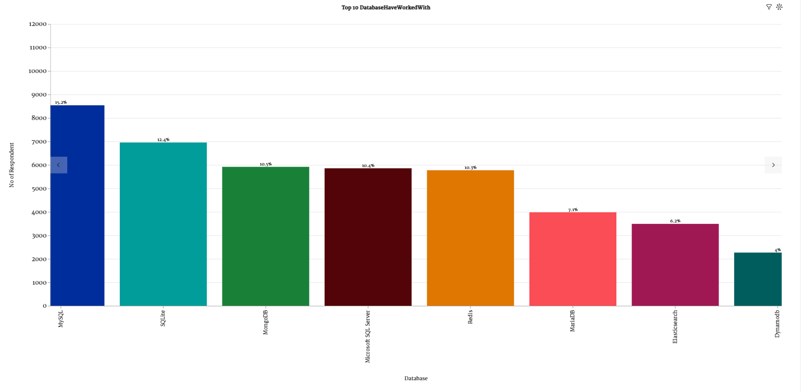
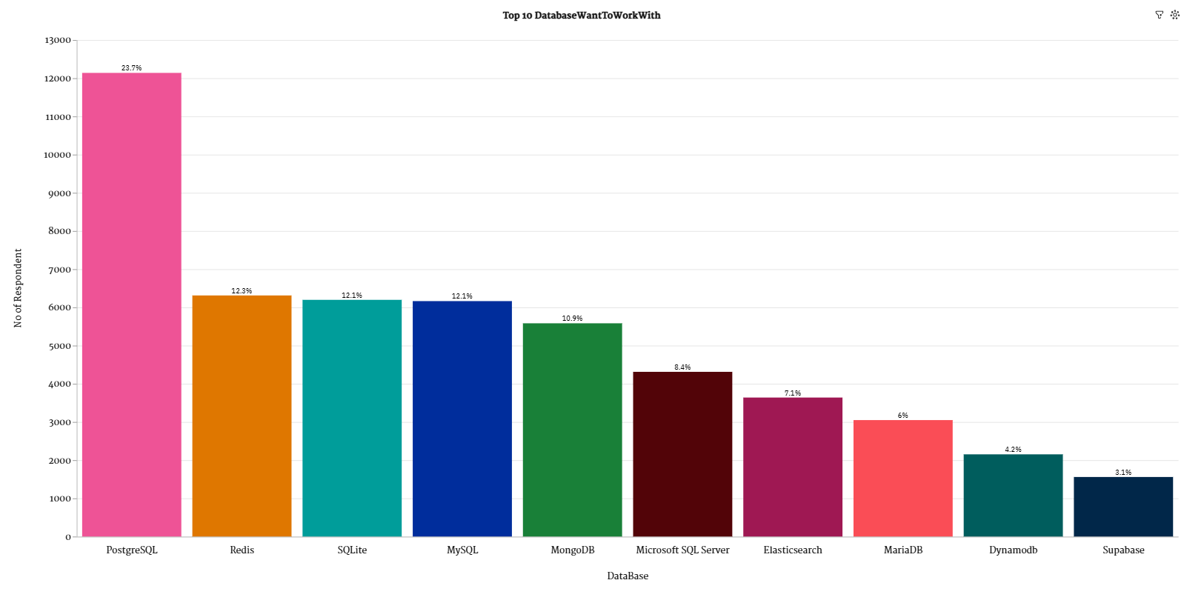
DATABASE TRENDS
Current Year
Next Year

Slide 9
DATABASE TRENDS - FINDINGS & IMPLICATIONS
Finding | Implication
PostgreSQL is both the most used (20.4%) and most desired (23.7%) database. | PostgreSQL’s strong open-source support and features make it a top choice for current and future use.
MySQL, SQLite, and MongoDB are common in both usage and preference rankings. | These databases offer flexibility across different use cases—training and tool support should continue.
Redis ranks much higher in preference (2nd) than in actual usage (6th). | Redis is gaining interest for real-time and caching solutions—suggesting a shift toward performance-based architectures.
Elasticsearch, DynamoDB, and MariaDB show moderate use and future interest. | Niche or specialized databases are gaining ground—organizations should evaluate them based on specific project needs.
Traditional enterprise databases like Oracle rank low in both usage and preference. | There’s a clear shift away from proprietary databases—companies should consider open-source alternatives.

Slide 10

DASHBOARD
<Please present your dashboard in the following slides.>

Slide 11
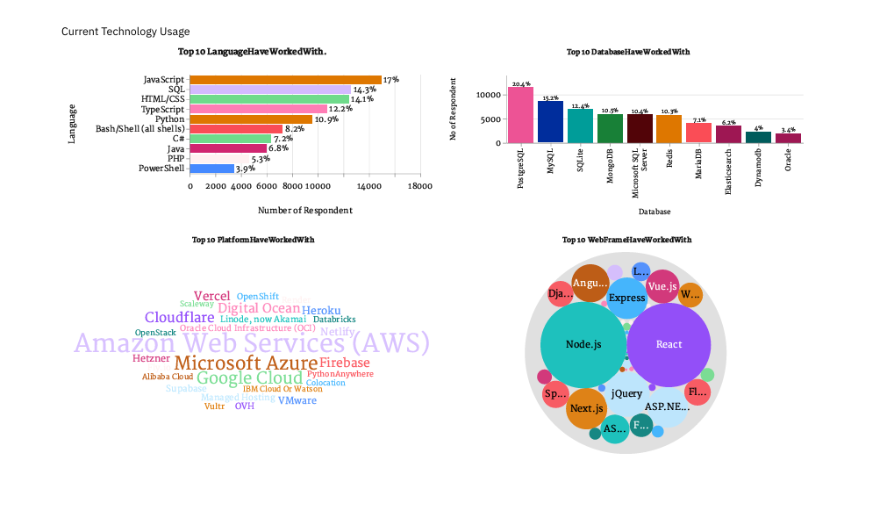
DASHBOARD TAB 1

Slide 12
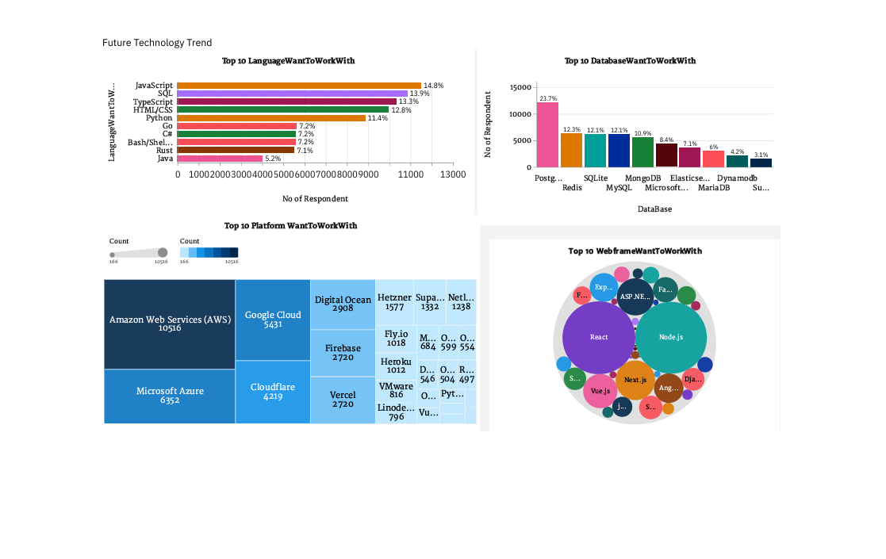
DASHBOARD TAB 2

Slide 13
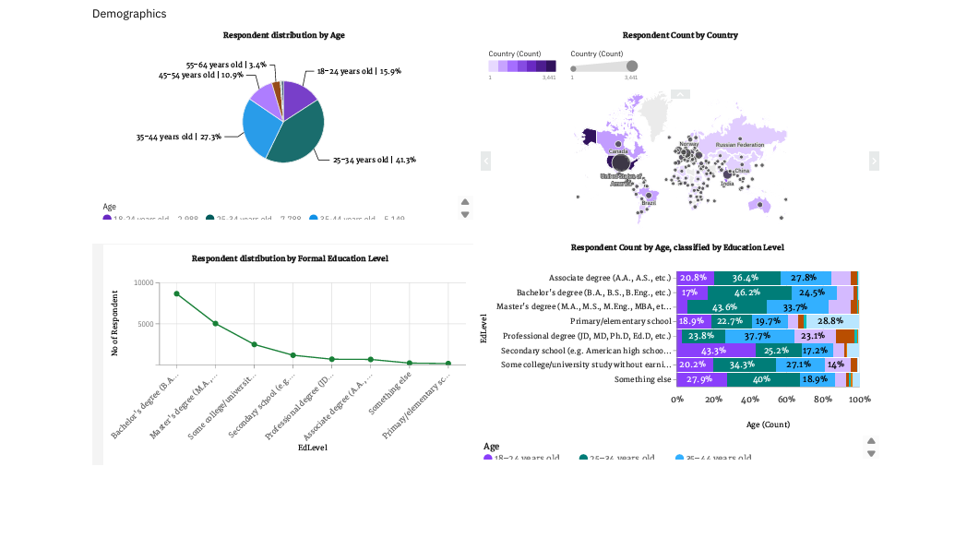
DASHBOARD TAB 3

Slide 14
DISCUSSION

Slide 15
OVERALL FINDINGS & IMPLICATIONS
Finding | Implication
JavaScript, SQL, and Python are the top languages used and desired. | These languages are essential for both backend, frontend, and data roles—training should focus on them.
PostgreSQL is the most used and most preferred database. | Organizations should prioritize PostgreSQL for new projects and upskill teams accordingly.
AWS, Azure, and Google Cloud are the most common and desired platforms. | Cloud skills are no longer optional—certifications and experience with these platforms are crucial.
React, Node.js, and Django are dominant web frameworks. | Projects should consider these frameworks for faster development and better developer availability.
Majority of developers are aged 25–44, with Bachelor’s or Master’s degrees. | Hiring strategies should focus on mid-career professionals and support continuous learning paths.

Slide 16

CONCLUSION
Skill Demand Continuity: Skills in JavaScript, SQL, Python, and PostgreSQL remain critical. These are both widely used and highly desirable.
Cloud is Central: AWS, Azure, and GCP dominate both experience and aspiration—cloud skills are essential.
Framework Fragmentation: Developers are spread across many web frameworks, but React, Node.js, and Django have lasting power.
Young and Evolving Workforce: A younger demographic means a need for learning-centric tools, onboarding-friendly platforms, and community support.
Shift to Open Source: Open-source technologies (PostgreSQL, Python, React) are not only used widely but also preferred for future work.
Developer Preferences Shape Trends: The future technology stack will likely reflect a mix of performance-oriented (Go, Rust), and productivity-centric tools (React, Firebase).

Slide 17

APPENDIX
Include any relevant additional charts, or tables that you may have created during the analysis phase.

Slide 18
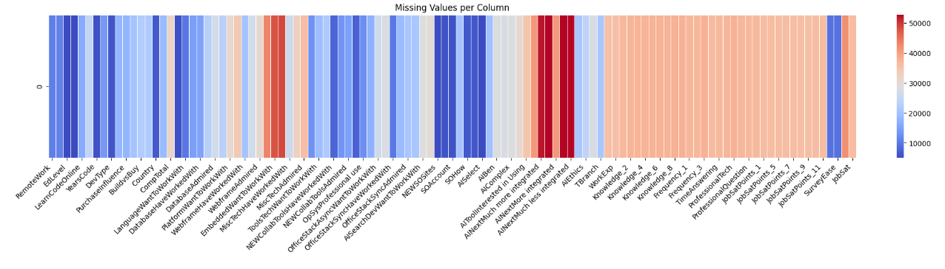

Slide 19
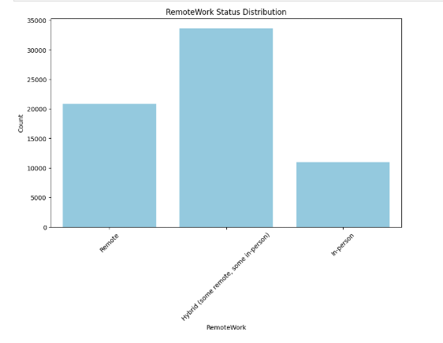
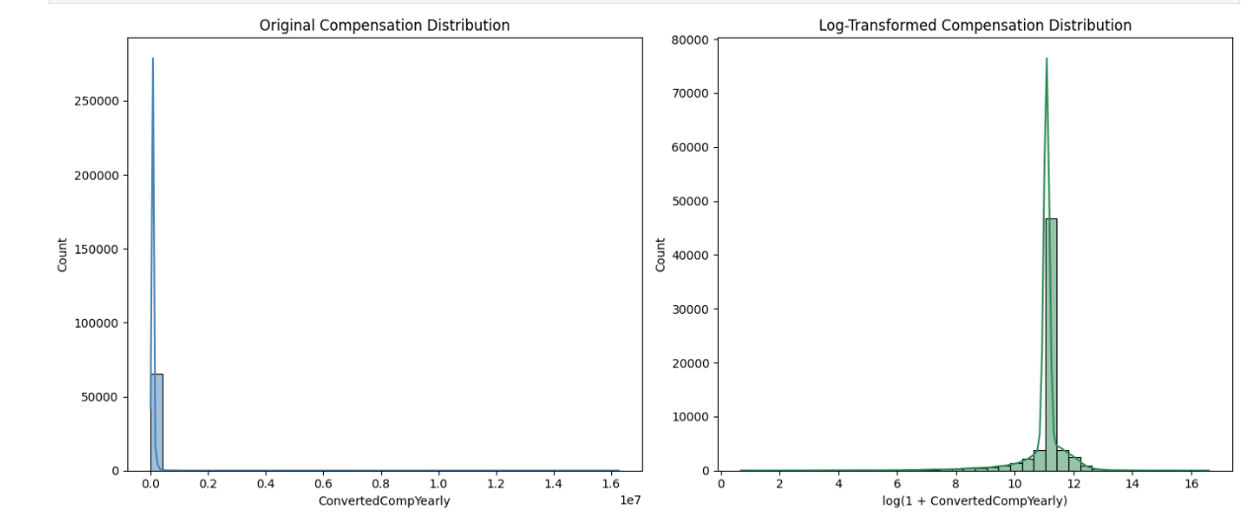

Slide 20
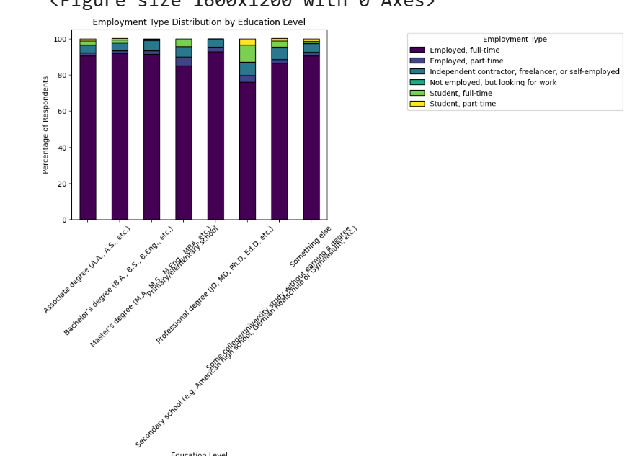

Slide 21
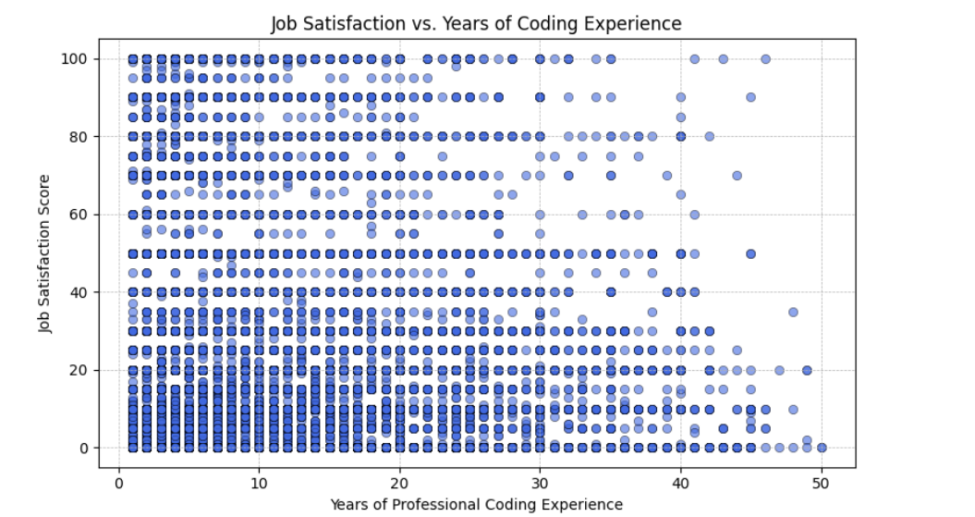
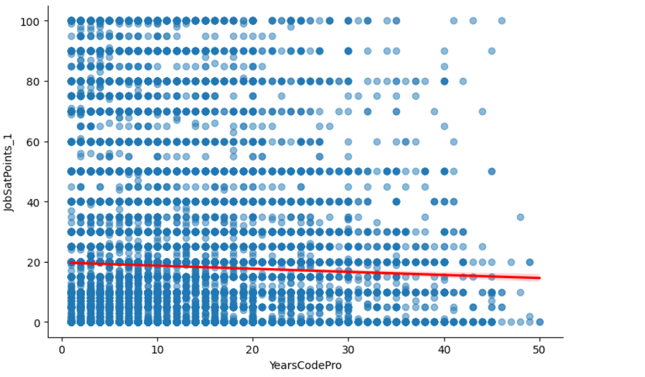

Slide 22
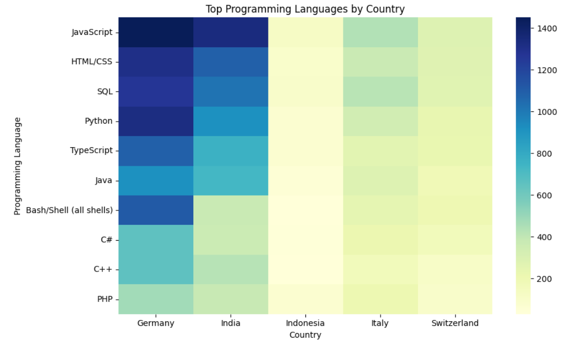

Slide 23
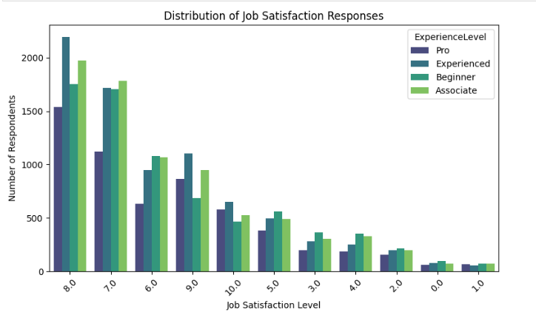

Slide 24
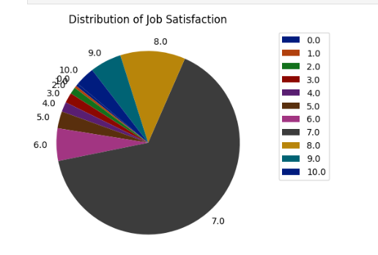

Slide 25
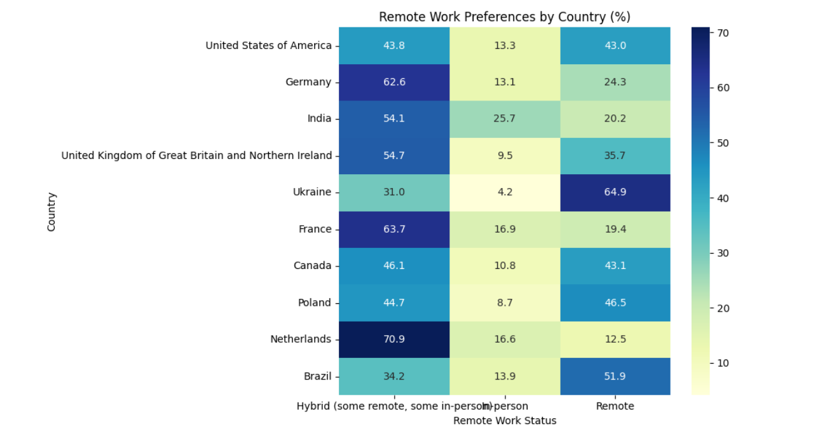

Slide 26
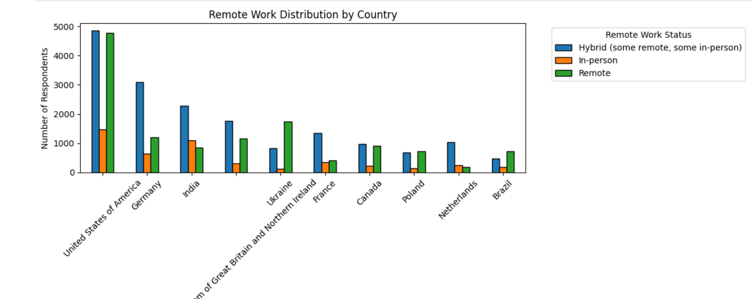

Slide 27
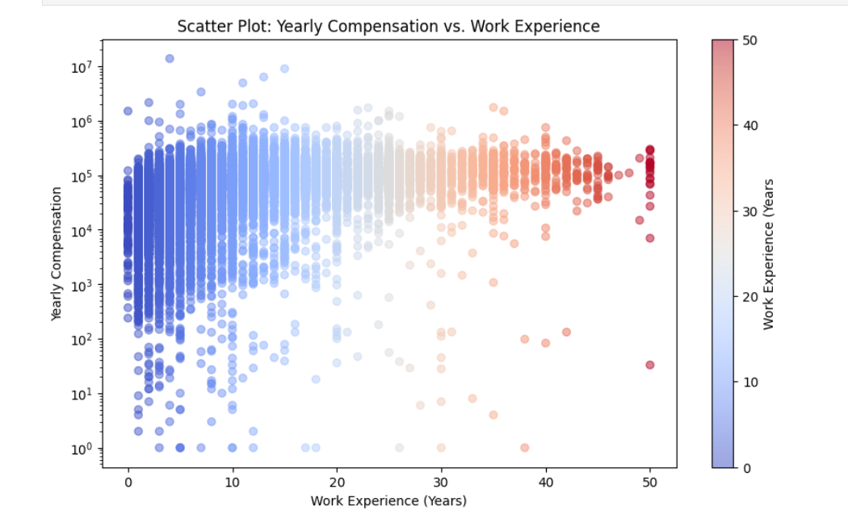

Slide 28
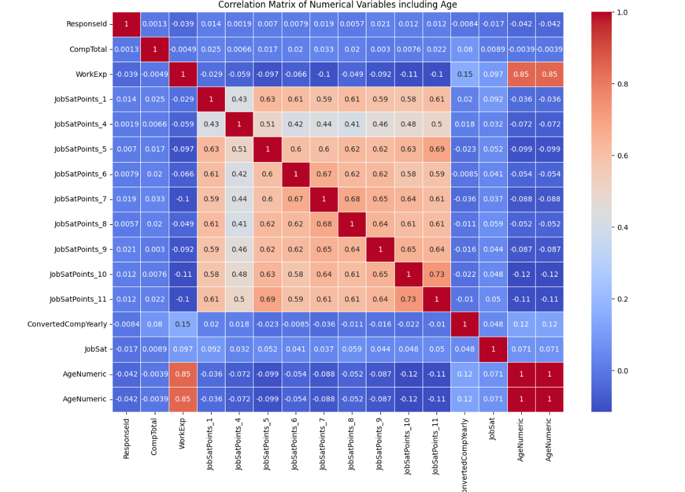

Slide 29
JOB POSTINGS
In Module 1 you have collected the job posting data using Job API in a file named “job-postings.xlsx”. Present that data using a bar chart here. Order the bar chart in the descending order of the number of job postings.

Slide 30
