Slide 1
Catastrophically great results
Statistical analysis of university (UNAM) entrance exam when they are made remote
Dr. Artem Aguichine (Instituto de Astronomía, UNAM)
OWL 2026 - UCSC

Slide 2
Context
What? Entrance exam to licenciatura (undergrad) at UNAM (Universidad Nacional Autónoma de México)
Why? In-person before 2025. Remote in 2026.
Who? 167,094 students from STEM, Medical, Social and Human/Art fields.

Slide 3
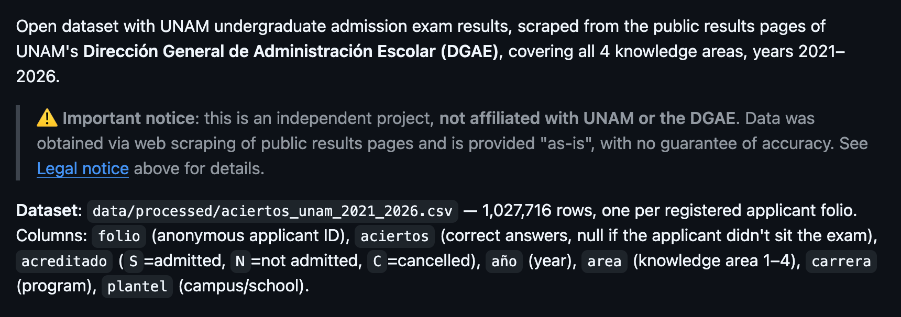
Source
Data obtained from https://github.com/agn3si/ResultadosUNAM---data
My fork: https://github.com/an0wen/ResultadosUNAM

Slide 4
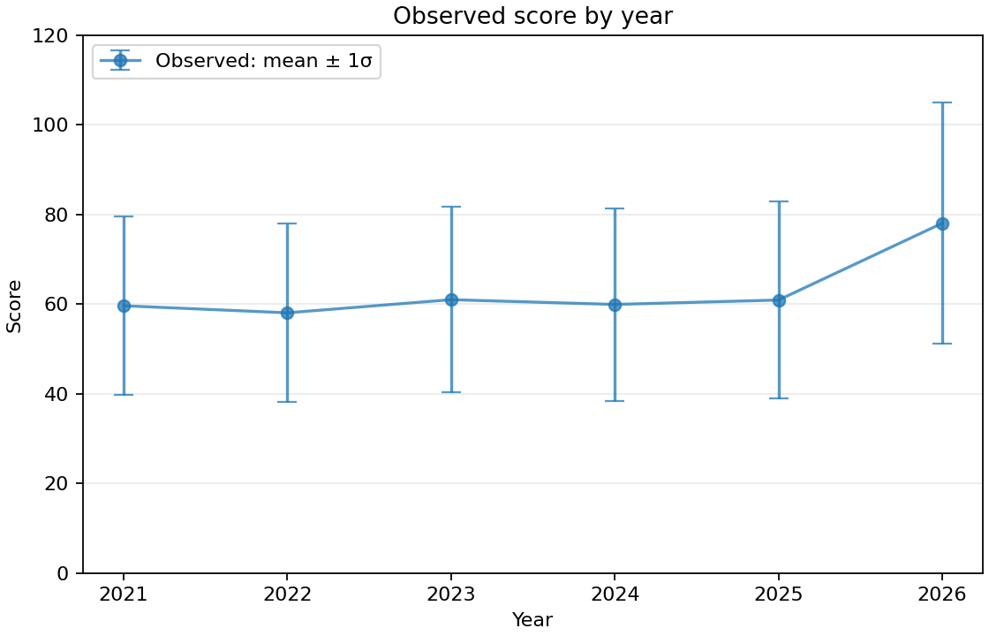
Surgery
~23,000 students every year
Note: 120 is the max grade.
Somehow better students this year 🤩
Error bar is stdev, not uncertainty.

Slide 5
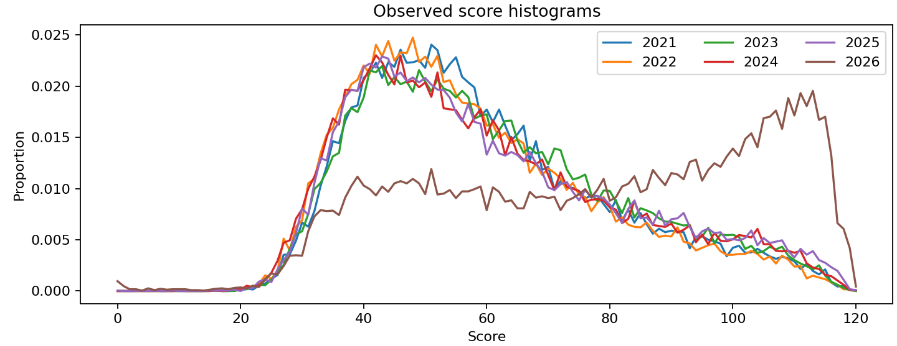
Surgery
~23,000 students every year
Correction:
some students stayed the same
some became expert surgeons
reminder: these are ~18 year old high-schoolers 😅
Note: 120 is the max grade.

Slide 6
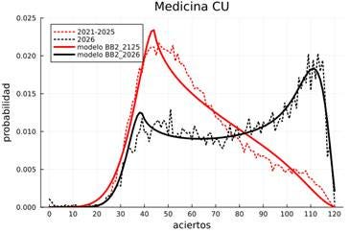
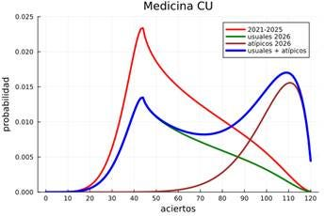
Surgery
~23,000 students every year
2 populations model heavily inspired by Arturo Erdély: 1) fit single beta-binomial on 2021-2025, 2) fit double beta-binomial on 2026, keeping first parameters constant.
Original work: medicine; my work: all ~100 fields individually.

Slide 7
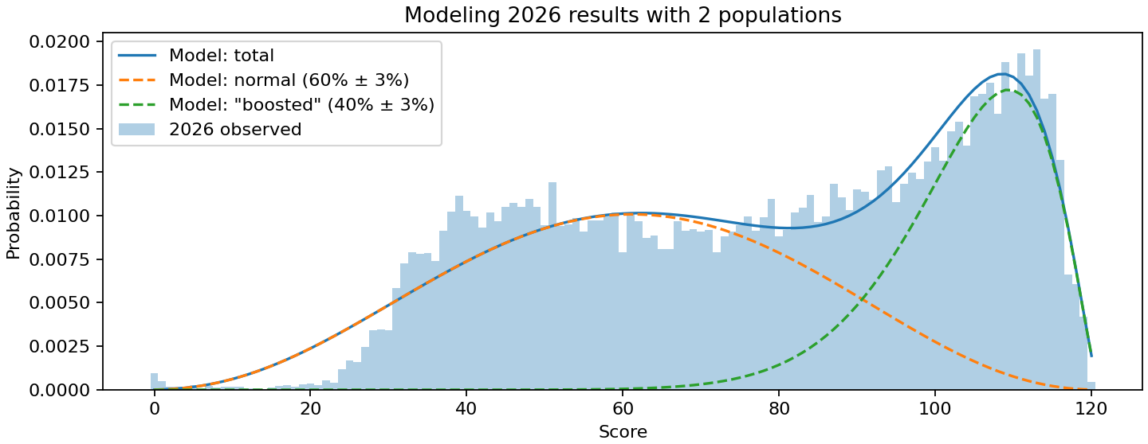
Surgery
~23,000 students every year
2 populations model:
normal and « boosted »
not perfect, but checks out 💯
40% of students have « Boosted » scores 😬

Slide 8
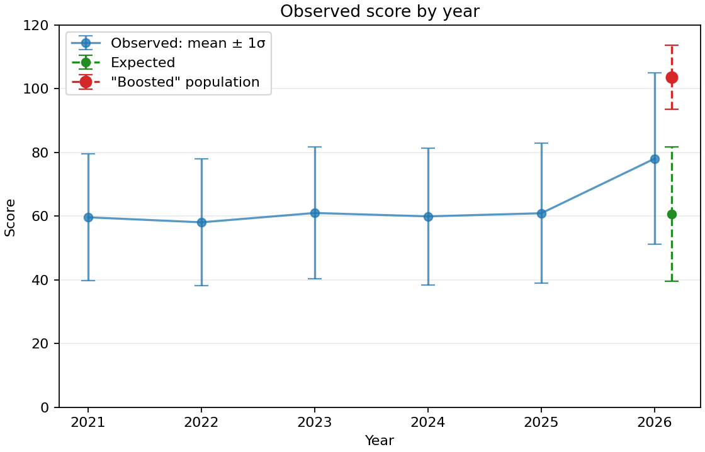
Surgery
~23,000 students every year
« Boosted »: 40%
Yeah… 😑
Expected: 60%
Error bar is stdev, not uncertainty.

Slide 9
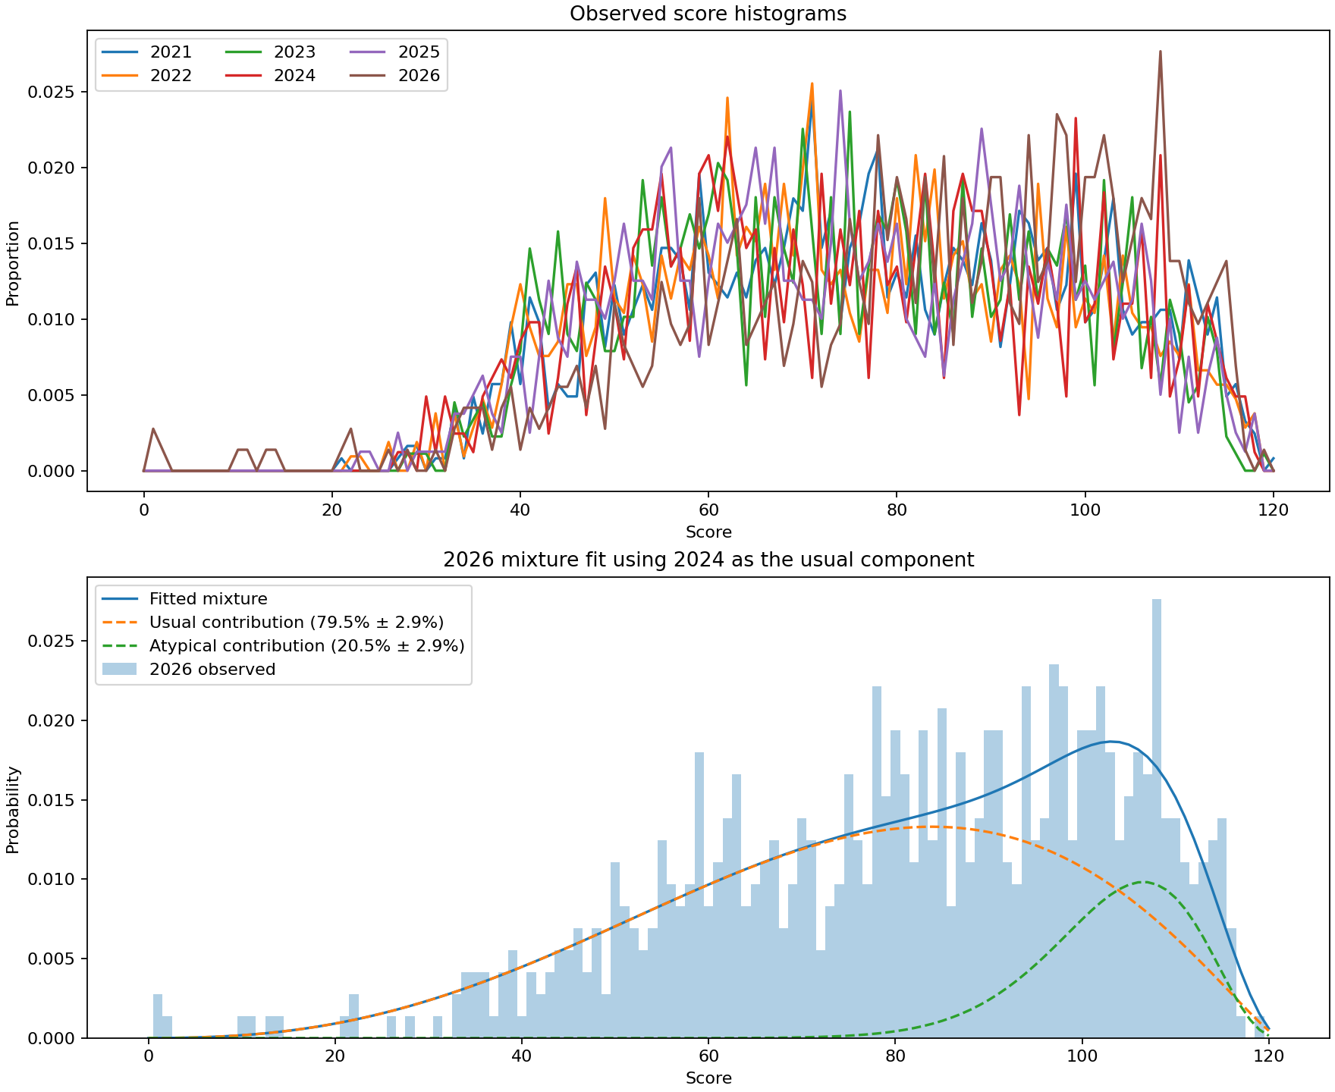
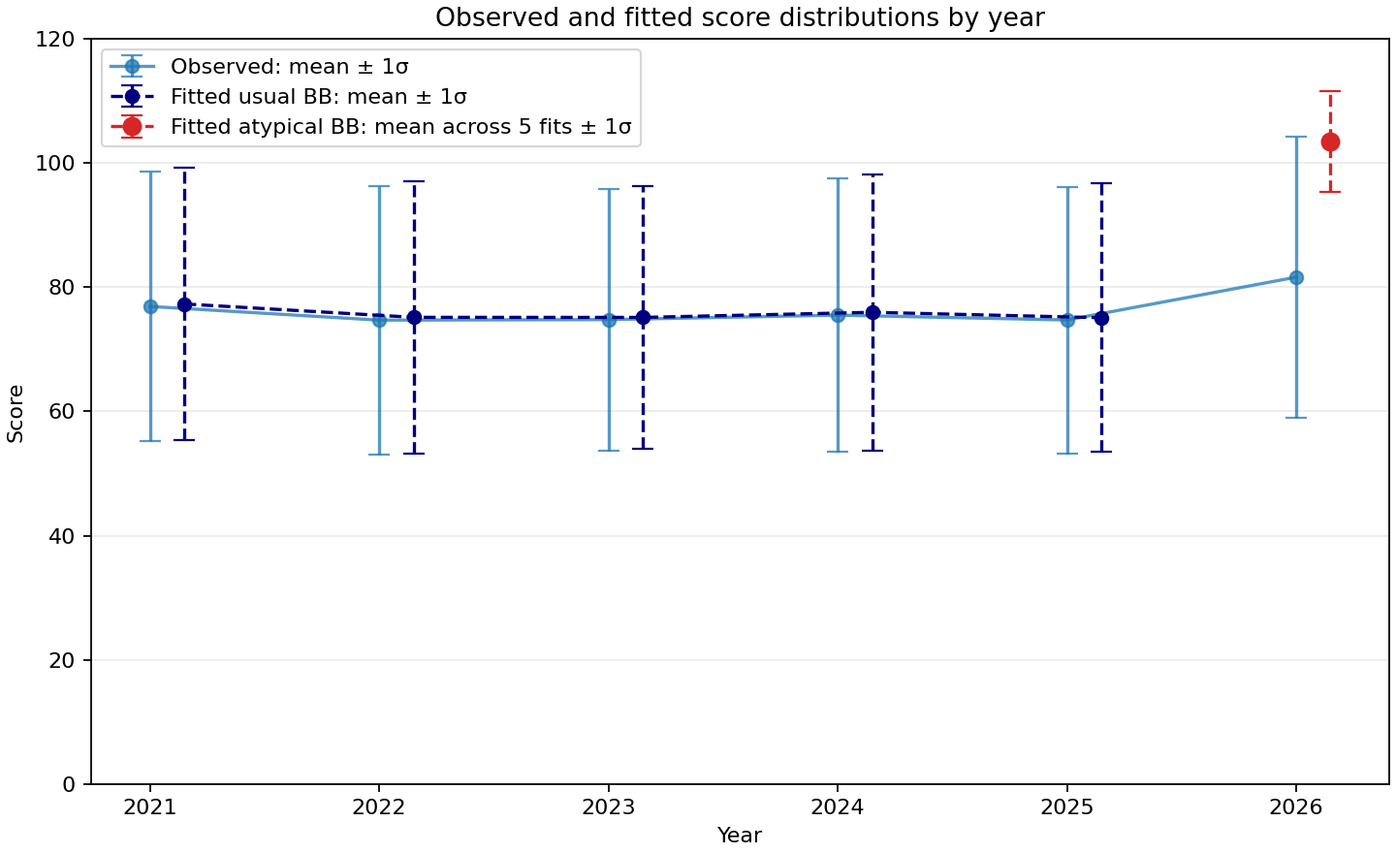
Physics
723 students in 2026

Slide 10
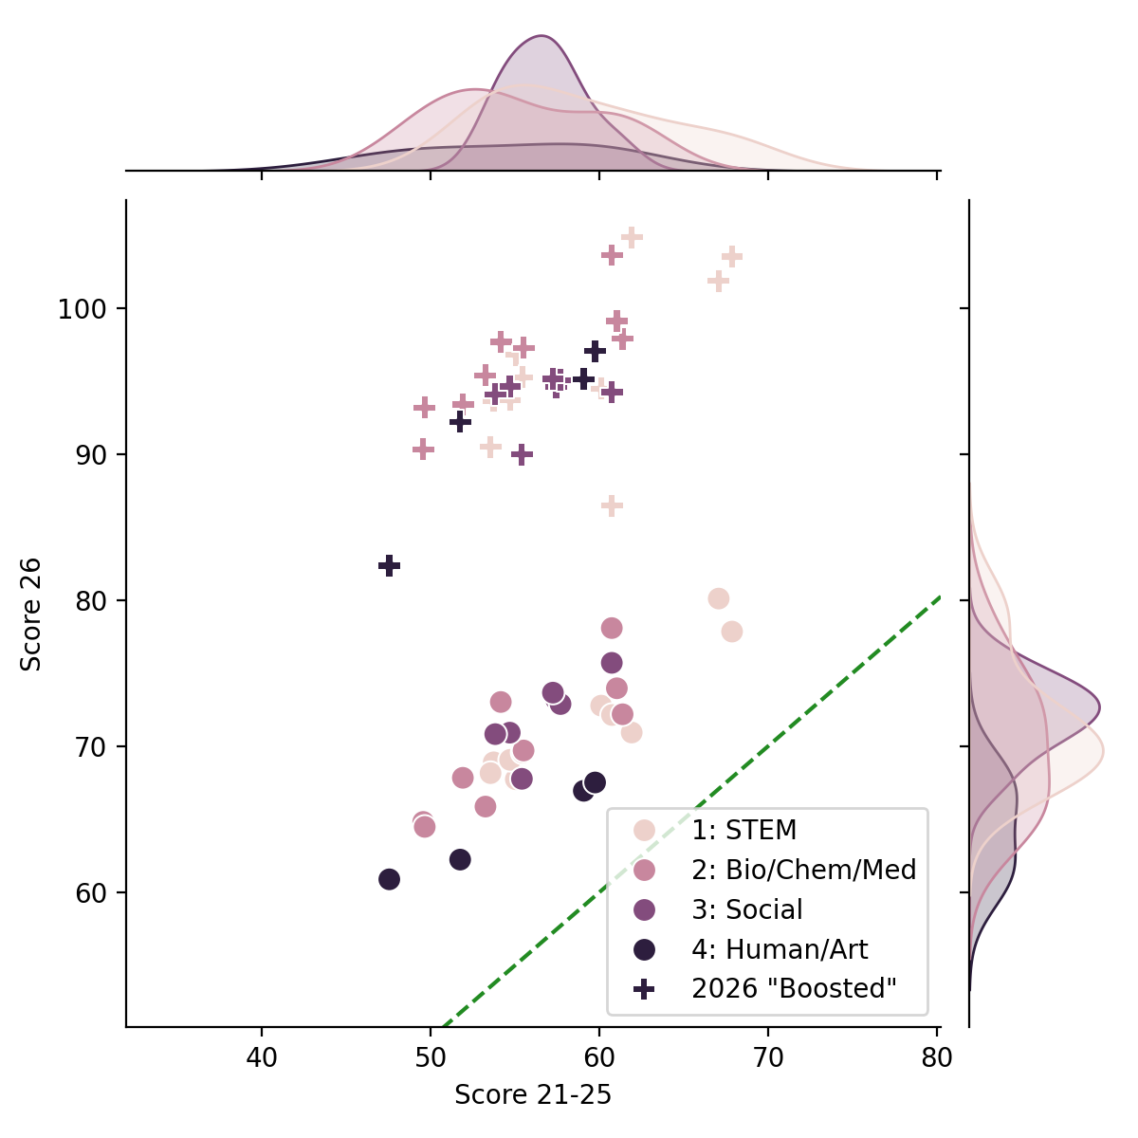
Same in all fields ¯\_(ツ)_/¯
Showing only fields with N>1000 for robustness
« Boosted »
Observed results are ~10 points higher than expected (anomaly at order 0).
Boosted results are ~35 points higher than expected (anomaly from 2 pop model).
Expected
Observed

Slide 11
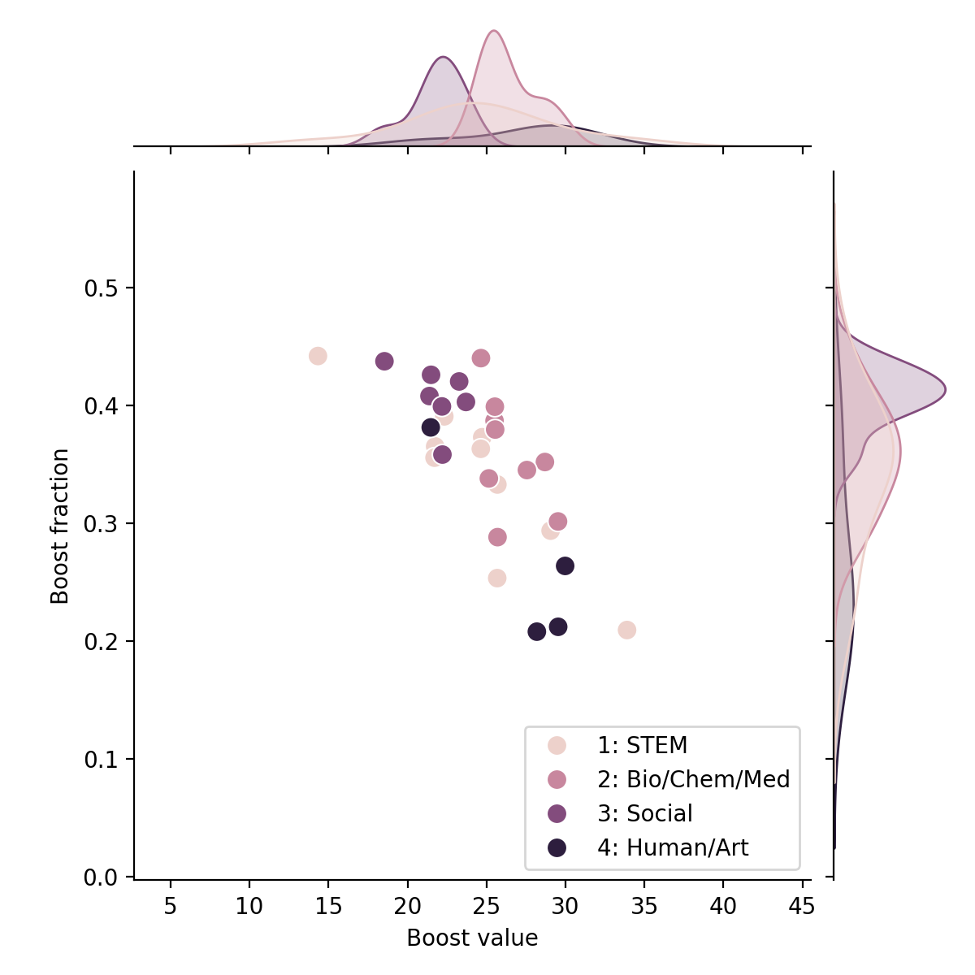
Same in all fields ¯\_(ツ)_/¯
Showing only fields with N>1000 for robustness
Almost 1 in 2 students had an « advantage » 😱
Chem eng.
Surg. dent.
Economy
Pedagogy
Computer science
More honest on average, but more agressive individually? 🤔

Slide 12
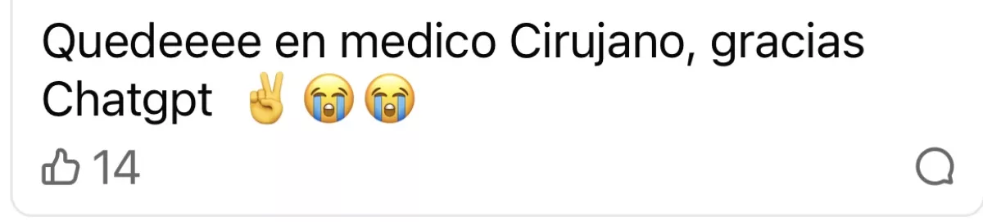
Did students cheat?
Yes
« I got into medical school, thanks chatgpt »
first takers sold answers to late takers
But…
innocent until proven guilty: individual results require individual investigation
a probability is not sufficient to incriminate
this (simplistic) model proves there are 2 populations, not what they are and why
remote = less stress = better grades?

Slide 13
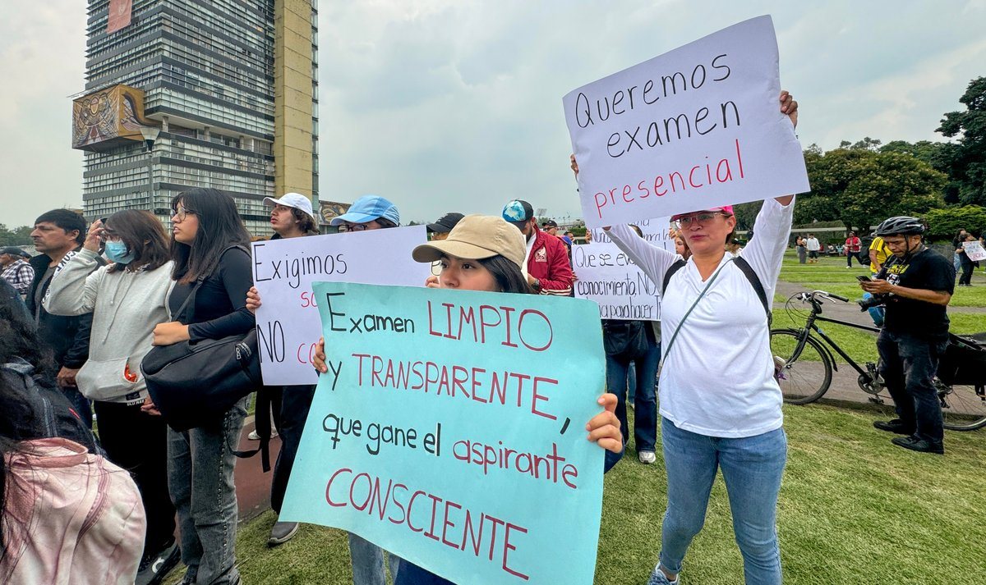
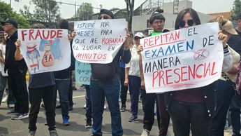
National scandal: UNAM’s responsibility
A stands for « Autonomous »
Independent from gov, very bad for UNAM’s reputation
Very expensive lesson for UNAM
Was it worth it…?
Students went on strike: demands to retake in-person
If not, taking the best students results in >90% of « boosted »
Granted!

Slide 14
The role of AI
Yes, AI enables and facilitates cheating
Banning AI will not solve our problems
My hot take: we need to stop using AI as a scapegoat, and face and solve the real problem(s).
Cheating existed forever
We already knew about this since COVID (exams turned remotely), now we have statistics
Histogram of final exam grades during COVID (May 2020, France): physics, junior (L3), 19 students. Stacked histogram showing bimodal distribution. 2021 and 2022 do not have bimodality.
Cheaters were identified case by case, and reported.

Slide 15
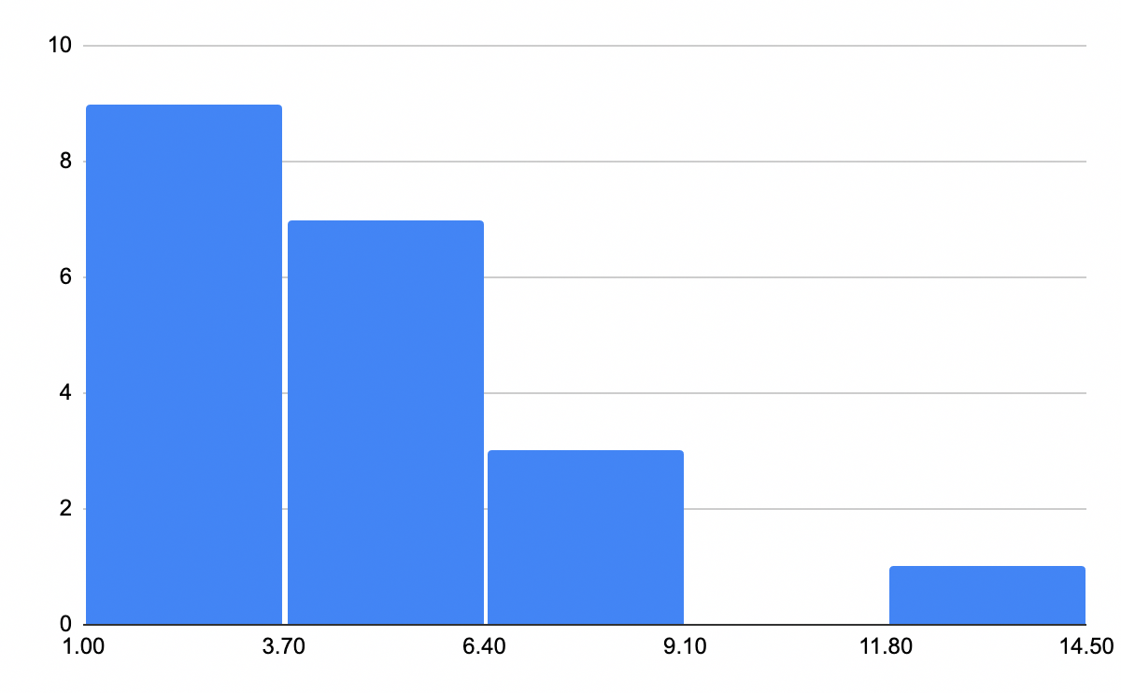
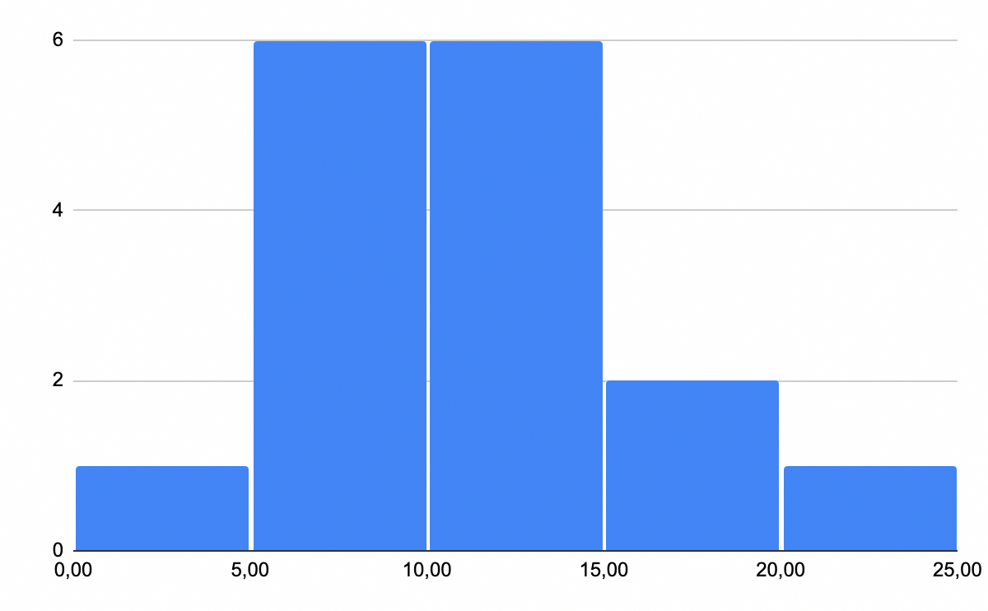
2020 vs 2021 vs 2022
2021
Same class, same instructor (me), different years.
2020
2022

Slide 16
What happened?
UNAM is the most prestigious university in the country. Would you pass, or would you take the chance if it meant bending the rules a bit?
Huge pressure on young students.
Opportunity for a (much) better life for many…
167k students is about 15% of the population of 18 year olds. 10% entrance means UNAM truly is the 1%.
In 2026: ~200k undergrads at UC. CA counts ~3M people age 15-20.

Slide 17
Challenging truth
Difficult to accept for many:
Family
Friends
Academics
Loss of trust: « these are the people we work with ».

Slide 18
Bigger picture
The origin of the scandal was UNAM publishing results
Other exams happened earlier this year with similar issues
This is just one measurement. The same can happen with any exam at any institution and with any takers.
My (pessimistic) takeways:
Ethics and integrity is NOT a granted.
It is time to rethink our society: are we truly OK with this? Sad part: more cheaters than places available. What kind of society has an elite exclusively composed of liars and cheaters? (wink wink)
If this is the next generation of doctors and surgeons, better start eating healthy and exercise…

Slide 19
What’s next?
We are the society, we chose what we want to be.
Idk, but below is food for thoughts.
Whose role is it to teach society ethics and integrity?
When and how?
Should we in the first place?
How should we decide to make exams remote or in-person?

Slide 20
Disclaimer
This merely supports the idea that there are 2 populations, one having better performance.
This is a model, and a very simplistic one.
This only applies to populations, it does not say anything about individual performance.
All code, figures, pptx is open source: github.com/an0wen/ResultadosUNAM

Slide 21
(my) takeways
UNAM paid a huge price for a lesson that everybody already knew. Anyone who was teaching during COVID (myself included) knows how desperate students are to get good results.
People talk about AI, but cheating existed forever. During COVID, students were looking for private tutors for « help on an exercise in limited time ». Students from engineering schools were asking me to take their online exam for them (it’s not a joke).
I expected external help, but I am disappointed in the scale (sociology has 80% of « boosted » grades!!! 453 students = not shown on figures).
My conclusions:
Ethics and integrity is NOT a granted. But like any skill it can be improved. Educators must show the example, and educatees must do the effort of following it.
It is time to rethink our society: are you OK with a society where 1 in 3 person is a liar? Are you OK with a society where, given the chance, 1 in 3 person will steal? The saddest part is: in the exams, there were more cheaters than places available. Is this the society you want to live in? Do we not learn anything from (recent) history?
If this is the next generation of doctors and surgeons, better start eating healthy and exercise…

