Slide 1
Catastrophically great results
Detailed analysis of what happens when the entrance exam to univeristy is remote
With beautiful plots :-)

Slide 2
Context
What? Entrance exam to licenciatura (undergrad) at UNAM (Universidad Nacional Autónoma de México)
Why? In-person before 2025. Remote in 2026.
Who? 167,094 students from STEM, Medical, Social and Human/Art fields.

Slide 3
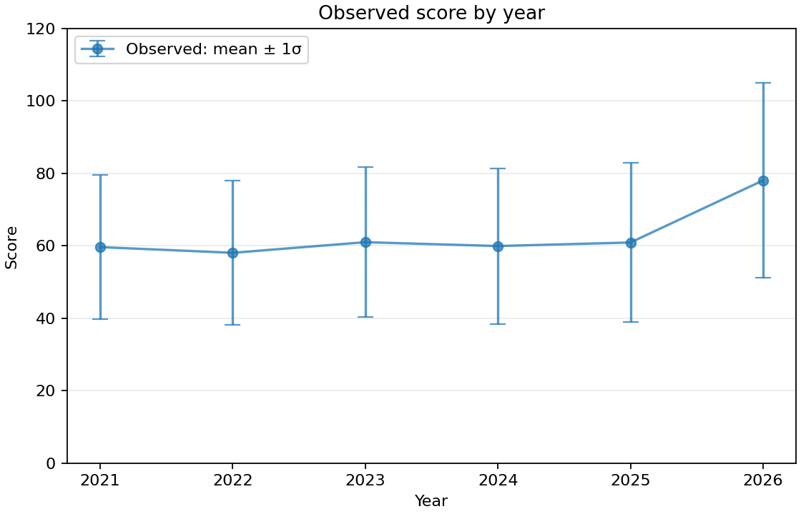
Surgery
~22,000 students every year
Somehow better students this year 🤩

Slide 4
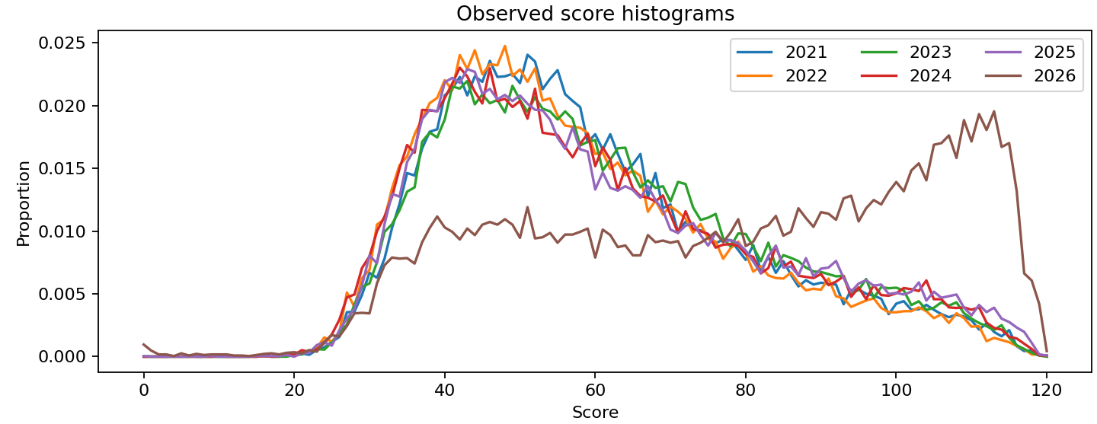
Surgery
~22,000 students every year
Correction:
some students stayed the same
some became expert surgeons
reminder: these are ~18 year old high-schoolers 😅
Wunderkind genius teenage surgeons

Slide 5
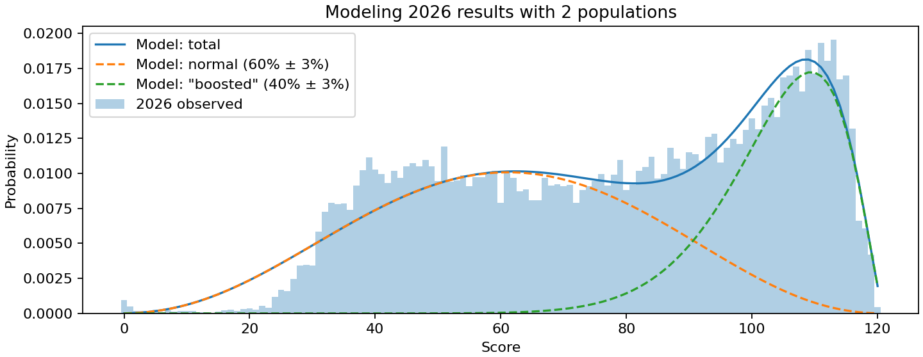
Surgery
~22,000 students every year
2 populations model:
normal and « boosted »
not perfect, but checks out 💯
40% of students have « Boosted » scores 😬

Slide 6
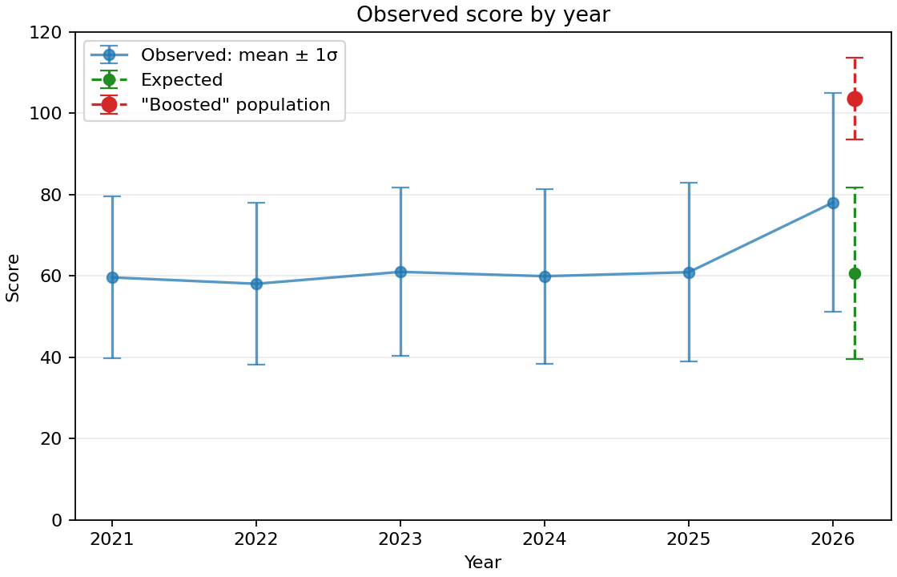
Surgery
~22,000 students every year
« Boosted »: 40%
Yeah… 😑
Expected: 60%

Slide 7
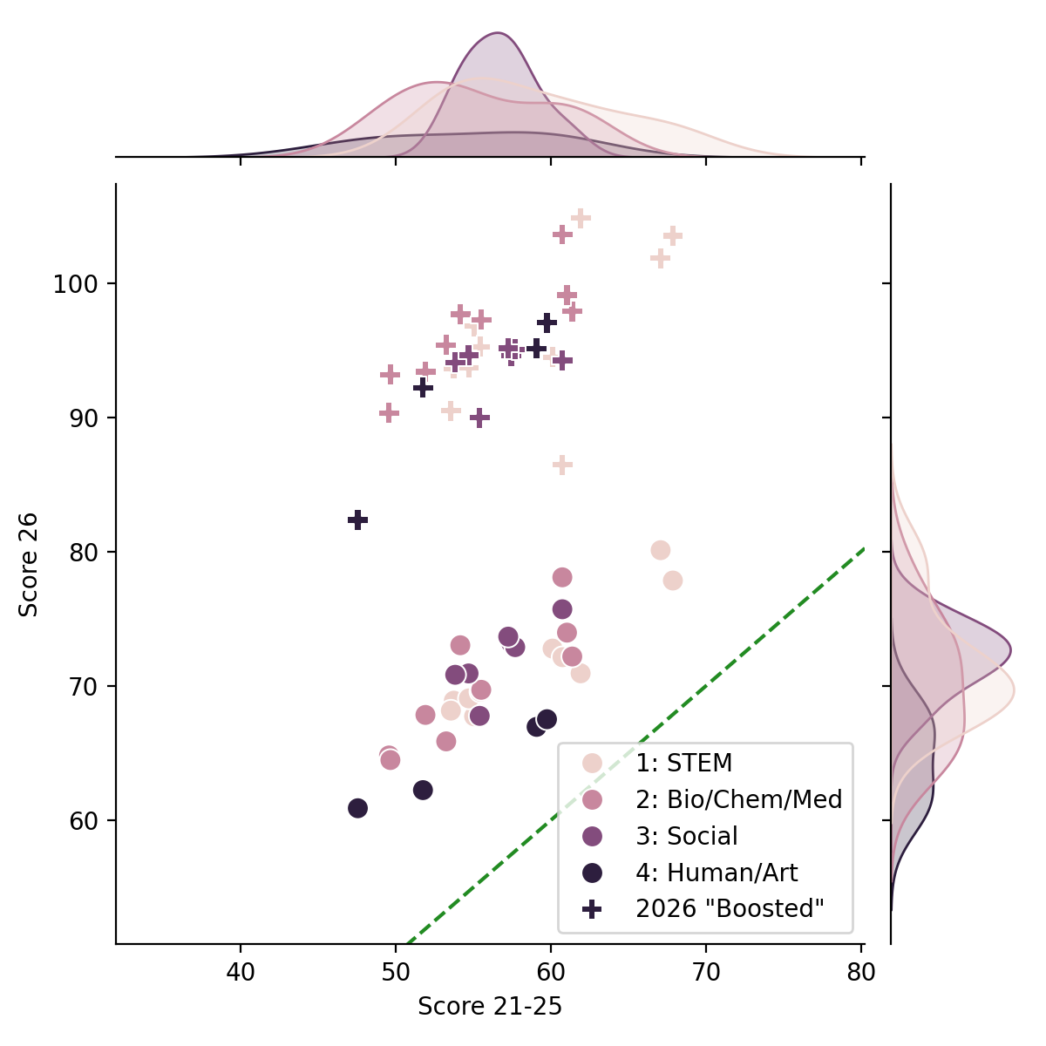
Same in all fields ¯\_(ツ)_/¯
Showing only fields with N>1000 for robustness
« Boosted »
It’s hard to say no to improve your grade by 20% 😕
Expected
Observed

Slide 8
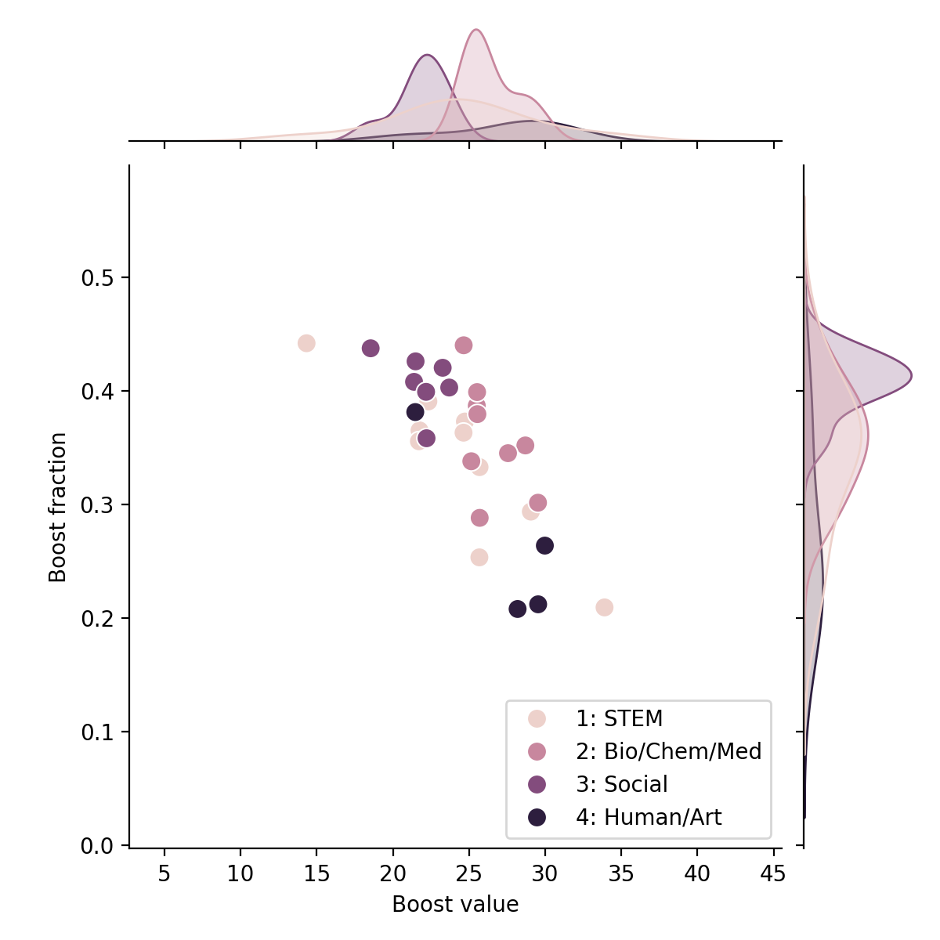
Same in all fields ¯\_(ツ)_/¯
Showing only fields with N>1000 for robustness
Almost 1 in 2 students had an « advantage » 😱
More honest on average, but more agressive individually? 🤔

Slide 9
Disclaimer
This merely supports the idea that there are 2 populations, one having better performance.
This is a model, and a very simplistic one.
This does not say anything about why one population has better grades. (maybe remote = less stress = better grades?)
This only applies to populations, it does not say anything about individual performance.
All code and material is open source: github.com/an0wen/ResultadosUNAM

Slide 10
(my) takeways
UNAM paid a huge price for a lesson that everybody already knew. Anyone who was teaching during COVID (myself included) knows how desperate students are to get good results.
People talk about AI, but cheating existed forever. During COVID, students were looking for private tutors for « help on an exercise in limited time ». Students from engineering schools were asking me to take their online exam for them (it’s not a joke).
I expected external help, but I am disappointed in the scale (sociology has 80% of « boosted » grades!!! 453 students = not shown on figures).
My conclusions:
Ethics and integrity is NOT a granted. But like any skill it can be improved. Educators must show the example, and educatees must do the effort of following it.
It is time to rethink our society: are you OK with a society where 1 in 3 person is a liar? Are you OK with a society where, given the chance, 1 in 3 person will steal? The saddest part is: in the exams, there were more cheaters than places available. Is this the society you want to live in? Do we not learn anything from (recent) history?
If this is the next generation of doctors and surgeons, better start eating healthy and exercise…

