Slide 1
Introduction to computer science
History of computing

Slide 2
History of computing
Not just a history of computers
We will be covering both the history of machines as well as the people in computer science
some overlap with material in "Tölvuhögun"
Note: programming languages will be covered separately later, as well as their creators
Also, the history of open source software is covered separately later

Slide 3
History of computers
The history of computing machines (computers) is usually split up into the following "sections":
Generation Zero: Mechanical calculating machines (1642 - 1945)
The 1st generation: Vacuum tube computers (1945-1953)
The 2nd generation: Transistorized computers (1954-1965)
The 3rd generation: Integrated circuit computers (1965-1980)
The fourth generation: VLSI (Very Large Scale Integration) (1980 - present day)
See also History of computing hardware

Slide 4
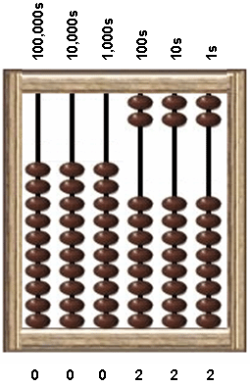
Abacus
The first computing devices were mostly used for counting
The first abacus was probably created in 2700-2300 BC
Comes in various types: Chinese, Egyptian, Greek....

Slide 5
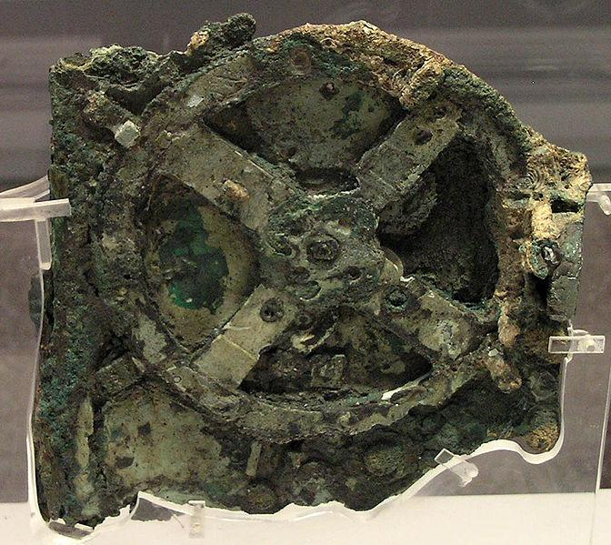
Antikythera machine
Probably built in 150-100 BC
Used to calculate astronomical positions
Was discovered in 1902 outside the island Antikythera, just outside of Greece in a shipwreck known as the Antikythera wreck
"The first analog computer"
Source

Slide 6
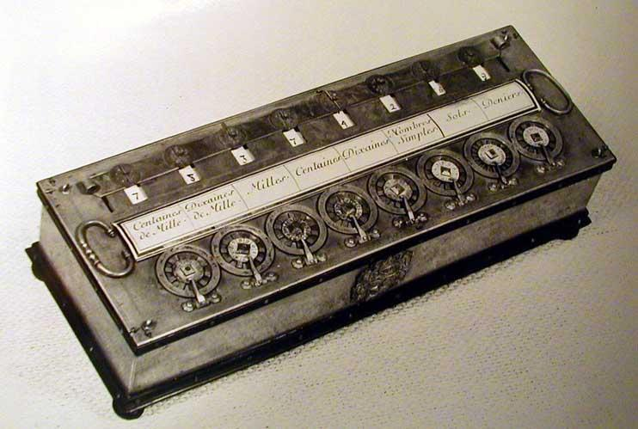
Pascaline
Mechanical calculator invented by Blaise Pascal in 1642
He was involved in many sciences, such as mathematics, hydrodynamics, philosophy etc.
Pascaline was created to help his father in his work as a tax commissioner
The Pascal programming language is named after him
Leibniz built a "Mechanical multiplier" based on Pascaline in 1694

Slide 7
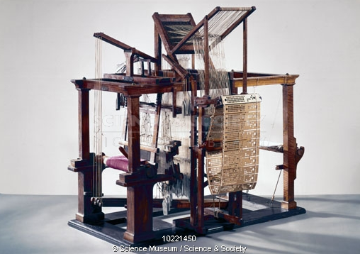
Jacquard's loom
Built in 1804
"Programmable", by changing cards in the machine - produced different patterns
Source

Slide 8
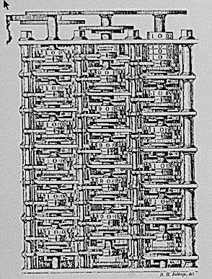
The difference engine
Machine used to calculate polynomial functions
The idea was first conceived in 1786 by J.H.Müller
Properly designed by Charles Babbage
first version in 1822
second version between 1847 and 1849
Never really functional, since Babbage had lost the interest in this machine

Slide 9
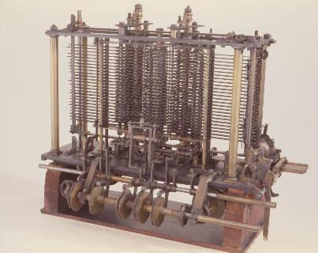
The analytical engine
The analytical engine was much more general - could in theory perform any calculation, not just useful for calculating tables
Had many elements of a modern computer:
CPU ("mill")
Memory store
Conditional branching
This machine was not built while Babbage was alive

Slide 10
ABC
The Atanasoff-Berry Computer (ABC) was built in 1942, but work began in 1937
It was the first electronic digital computer
the first to use binary numbers
used vacuum tubes
was not programmable
did not reach production - only a prototype was built
never really worked...
The design of ENIAC was heavily influenced from ABC (if not stolen)
Links:
http://en.wikipedia.org/wiki/Atanasoff-Berry_Computer
http://www.thocp.net/biographies/atanasoff_john.html

Slide 11
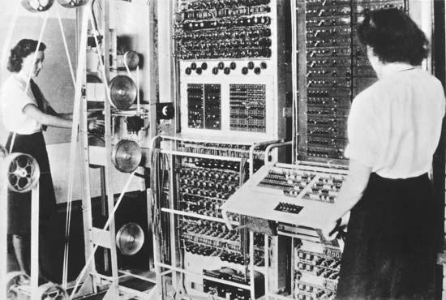
Colossus
Colossus was built and operated in Bletchley Park (see later)
Used exclusively to break the German ZS40/42 codes
Not Turing-complete (see later)
Was dismantled after the war and its existence wasn't publicly known until much later (after 1970)
http://ei.cs.vt.edu/~history/colossus.rebuilt.html
Source

Slide 12
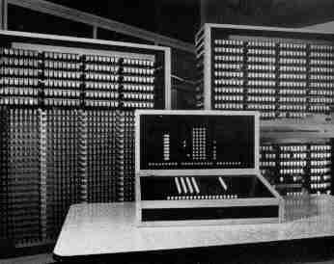
Z3
Built by Konrad Zuse in 1941
The first programmable, Turing-complete computer (see later about Turing completeness)
Links:
http://en.wikipedia.org/wiki/Z3_(computer)
Source

Slide 13
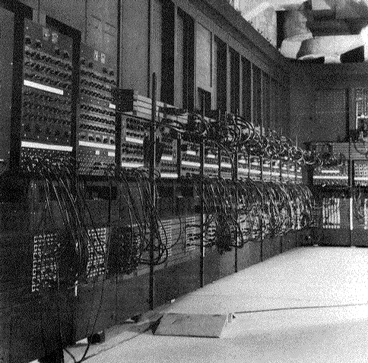
ENIAC
Mauchly and Eckert built ENIAC (with some help from John von Neumann)
Completed in 1946, but was then already outdated
Weighted 30 tons and contained 18.000 vacuum tubes
Only programmable by rewiring
Before it was completed, they had already begun working on EDVAC

Slide 14
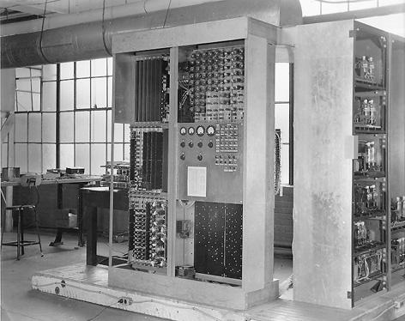
EDVAC
EDVAC - or "Electronic Discrete Variable Automatic Computer" - was the successor of ENIAC
Had several improvements:
Used binary numbers instead of decimal
Allowed for stored programs (not the first one, the Manchester Mark I was the first to do that)
Was completed in 1949

Slide 15
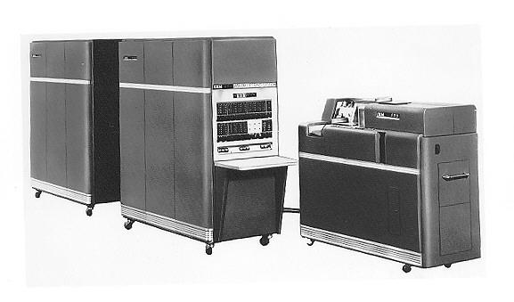
Transistor computers
The transistor was invented in 1951 by William Shockley et al.
similar designs had been created earlier
Made it possible to create much smaller and more powerful computers
no need for vacuum tubes any more!
The IBM 650 was thefirst mass-produced computer (1954)

Slide 16
... and lots of other machines...
Obviously, this is not an exhaustive list!
Other machines were built during the early years, and the number of machines kept growing

Slide 17
The people
We will mention a few persons that contributed to the history of computing
Many names could be added to this discussion
Links:
http://en.wikipedia.org/wiki/List_of_pioneers_in_computer_science
http://www.thocp.net/biographies/biographies.htm

Slide 18
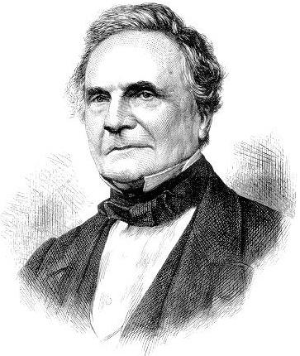
Charles Babbage
Charles Babbage is often referred to as "the father of computing"
Was involved in two machines:
the difference engine (a prototype was built)
analytical engine - designed but not built in his lifetime
Babbage was quite eccentric, hated music and musicians, invented the cow-catcher for trains, and created the method of tree-ring dating
Source

Slide 19
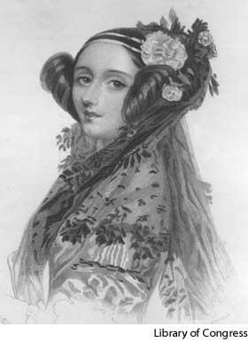
Ada Lovelace
The daughter of Lord Byron
Worked with Charles Babbage on the analytical engine, and is often referred to as the first programmer
Designed and published the first computer program in 1843 (a program to calculate Bernoulli numbers)
Recognized the potential of the analytical engine much better than Babbage did
The Ada programming language was named after her
Links:
http://www.sdsc.edu/ScienceWomen/lovelace.html
http://en.wikipedia.org/wiki/Ada_Lovelace
Source

Slide 20
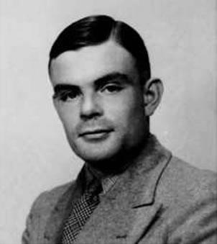
Alan Turing
Very influential in the history of computing
Plays and movies have been made about him:
Breaking the code
Decoding Alan Turing
The Imitation Game (2014)
Links:
http://ei.cs.vt.edu/~history/Turing.html
www.alanturing.net
http://www.thocp.net/biographies/turing_alan.html
Source

Slide 21
Alan Turing & Enigma
Worked in Bletchley Park, and worked in the team which broke the code used by the German Navy (Enigma)
will be covered in more detail when we take a look at privacy and encryption
Some claim that the war would have gone on for at least two more years without this achievement
how many lives did that save?

Slide 22
The Halting problem
The Halting problem is quite simple:
"Given a program and some input, will the program halt when executed with this input?"
Alan Turing proved that no algorithm exists which can always answer this question

Slide 23
Turing machine
1935: Alan Turing develops the idea behind the Turing machine
He created this model while working on the Entscheidungsproblem (e. decision problem)
A Turing machine reads data from a (possibly) infinitely long tape, and can write back to the tape
The Turing machine is a theoretical model, but real-life machines have been built
a LEGO version
Note: Turing machines will be covered better later in "Stöðuvélar og reiknanleiki" (e. Theory of computation)

Slide 24
Turing completeness
Computers today are compared to the Turing computer
All computers equally powerful as the Turing machine (i.e. if they can perform the same computations) are said to be Turing complete
No machine exists (yet) which is more powerful than the Turing machine
the may be quicker, but there is nothing they can do which the Turing machine cannot do

Slide 25
The Turing test
The Turing test was formulated by Alan Turing, and is used to determine if a machine has gained artificial intelligence (AI)
note: Turing neither gave the test this name, nor did he give AI its name
The test is simple:Person A sits in front of a computer screen, which contains two "chat" windows. One such window is controlled by another person B, the other by a computer. Person A can chat with both parties. If person A cannot determine which chat window is controlled by the computer, it has passed the Turing Test.
This test is simple but not very scientific
Has Cleverbot passed the test?

Slide 26
The Turing award
No Nobel prize awarded in computer science
However, the Turing award has been awarded since 1966

Slide 27
Alan Turing - personal life
Turing was very socially awkward
instead of asking his colleagues to leave his coffee cup alone, he chained it to the radiator
Was athletic, nearly made it into the British Olympic team in long distance running
He was gay, which was illegal at the time (!)
After this became public, he was forced to undergo a treatment to "cure his homosexuality"
Officially, he committed suicide by eating a poisoned apple in 1954 - but this has actually never been proven
Gordon Brown issued a public apology in 2009 to the way Turing was treated by the British government

Slide 28
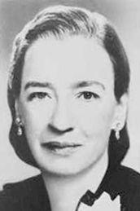
Grace Murray Hopper
Grace Hopper was involved in building Harvard Mark I, and was involved in creating the COBOL programming language
She wrote the first compiler
Had a ship named after her: USS Hopper
The Grace Murray Hopper Awards have been given to young computer scientists since 1971
Quotations:
"A ship in a harbor is safe, but that is not what a ship is built for"
"It's easier to ask forgiveness than it is to get permission"
Source

Slide 29
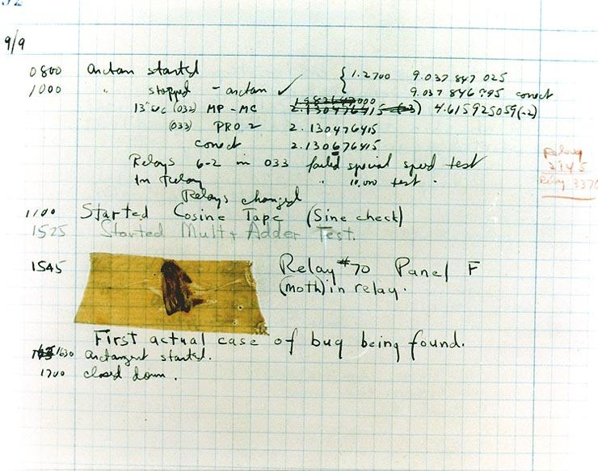
The first bug?
Hopper is sometimes (erroneously) said to have found the first bug while working with the Mark II machine
From Wikipedia

Slide 30
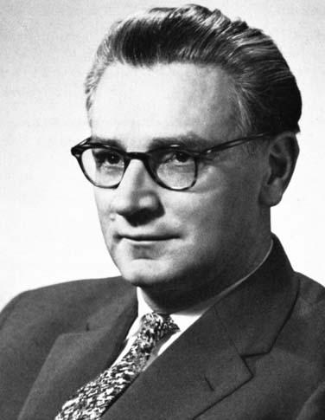
Konrad Zuse
Konrad Zuse built the Z1 computer in 1935 - 1938 and subsequent computers (Z2, Z3 and Z4) later
Z1 used binary but was mechanical
literally built in his living room
never very reliable
Designed one of the first programming languages: "Plankalkül"
Links:
http://ei.cs.vt.edu/~history/Zuse.html
http://www.thocp.net/biographies/zuse_konrad.html

Slide 31
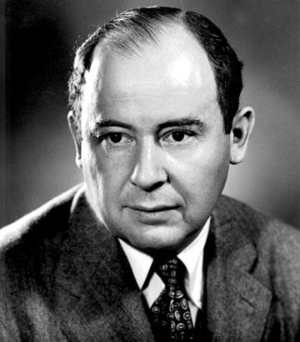
John von Neumann
Co-author of ENIAC
The author of the modern computer architecture
Created the minimax theory
Links:
http://ei.cs.vt.edu/~history/VonNeumann.html
Source

Slide 32
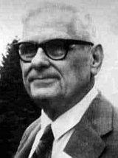
Alonso Church
Co-author of the famous "Church-Turing thesis"
Created the lambda calculus
Church's theorem, which is closely related to the halting problem
Links:
http://en.wikipedia.org/wiki/Alonzo_Church
http://www.church-project.org/alonzo-church.html
Source

Slide 33
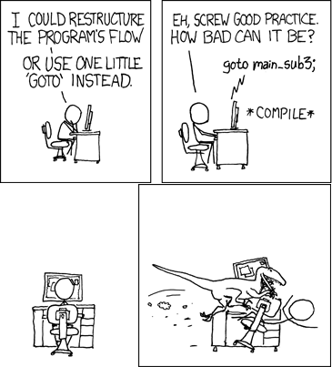
Edsger Dijkstra
Wrote the Dijkstra's algorithm for finding the shortest path in 1956
Also wrote the famous "considered harmful" article (althought the title came from Niklaus Wirth)
Formulated the "dining philosophers problem"
Links:
http://www.thocp.net/biographies/dijkstra_edsger.htm
http://en.wikipedia.org/wiki/Edsger_Dijkstra
Source

Slide 34
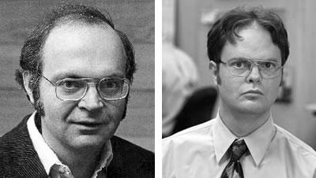
Donald Knuth
Donald Knuth got the Turing award in 1974 for his contibutions to computer science
Wrote the book "The Art of Computer Programming"
Created the TeX typesetting language (LaTeX)
A bit of a humourist
Famous quote: "We should forget about small efficiencies, say about 97% of the time: premature optimization is the root of all evil"
Note: Knuth is on the left. Source

Slide 35
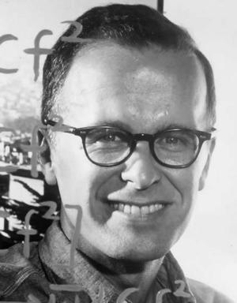
John Backus
John Backus was the inventor of the Backus-Naur form
Lead the team at IBM which created FORTRAN (FORmula TRANslation), the first high-level programming language
Backus found it boring to code in assembly language
Famous quote: "Much of my work has come from being lazy"
Source

Slide 36
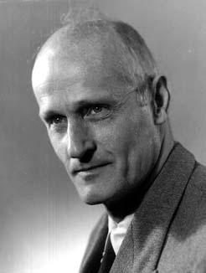
Stephen Kleene
Stephen Kleene was one of the pioneers along with Turing, Church etc.
Recursion theory
Invented regular expressions
Has many entities named after him, such as the Kleene star (used in regular expressions)
Source

Slide 37
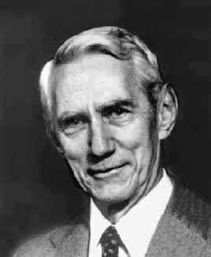
Claude Shannon
Claude Shannon wrote "the most important master's thesis paper" in 1936
Realized that the work of George Boole could be used to create the first computers
Built The most useless machine ever
Links:
http://www.thocp.net/biographies/shannon_claude.htm
Source

Slide 38
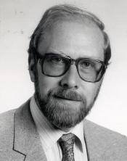
Niklaus Wirth
Niklaus Wirth created several programming languages, such as Pascal, Euler, Algol and Modula
Won the Turing award in 1984
Source

Slide 39
... plus lots of others
We could name lots of other computer scientists, such as:
Tony Hoare - created Quicksort, the most popular sorting algorithm
John McCarthy - coined the term "Artificial Intelligence" (AI)
Marvin Minsky - one of the pioneers in AI
Edgar Codd - invented the relational model for databases (see later on SQL and databases)
etc. etc. (also check out thelist of Turing award recipients)
Note: several inventors of computer languages will be covered later, when we study programming languages

Slide 40
... and a other scientists
A few scientists, mostly mathematicians, contributed to the foundations of computer science:
Georg Cantor - counting and set theory
Kurt Gödel - incompleteness theory
George Boole - created Boolean logic

Slide 41
Famous quotes
I think there is a world market for maybe five computers.
Thomas Watson, chairman of IBM, 1943
Computers in the future may weigh no more than 1.5 tons.
Popular Mechanics, 1949
There is no reason anyone would want a computer in their home.
Ken Olson, CEO, Digital Equipment Corp., 1977
... and a bunch of others...

Slide 42
A few interesting dates
Just a handful of interesting dates - a lot more can be seen at:http://en.wikipedia.org/wiki/Timeline_of_computing and http://www.thocp.net/timeline/timeline.htm
618: The number 0 is used in India
1202: The word "algorithm" first used
1588: Logarithm tables developed by Joost Buerghi
1646: The word "Computer" (or a close approximation) is introduced
1694: Binary calculus developed by Leibnitz, only to be forgotten

