Slide 1
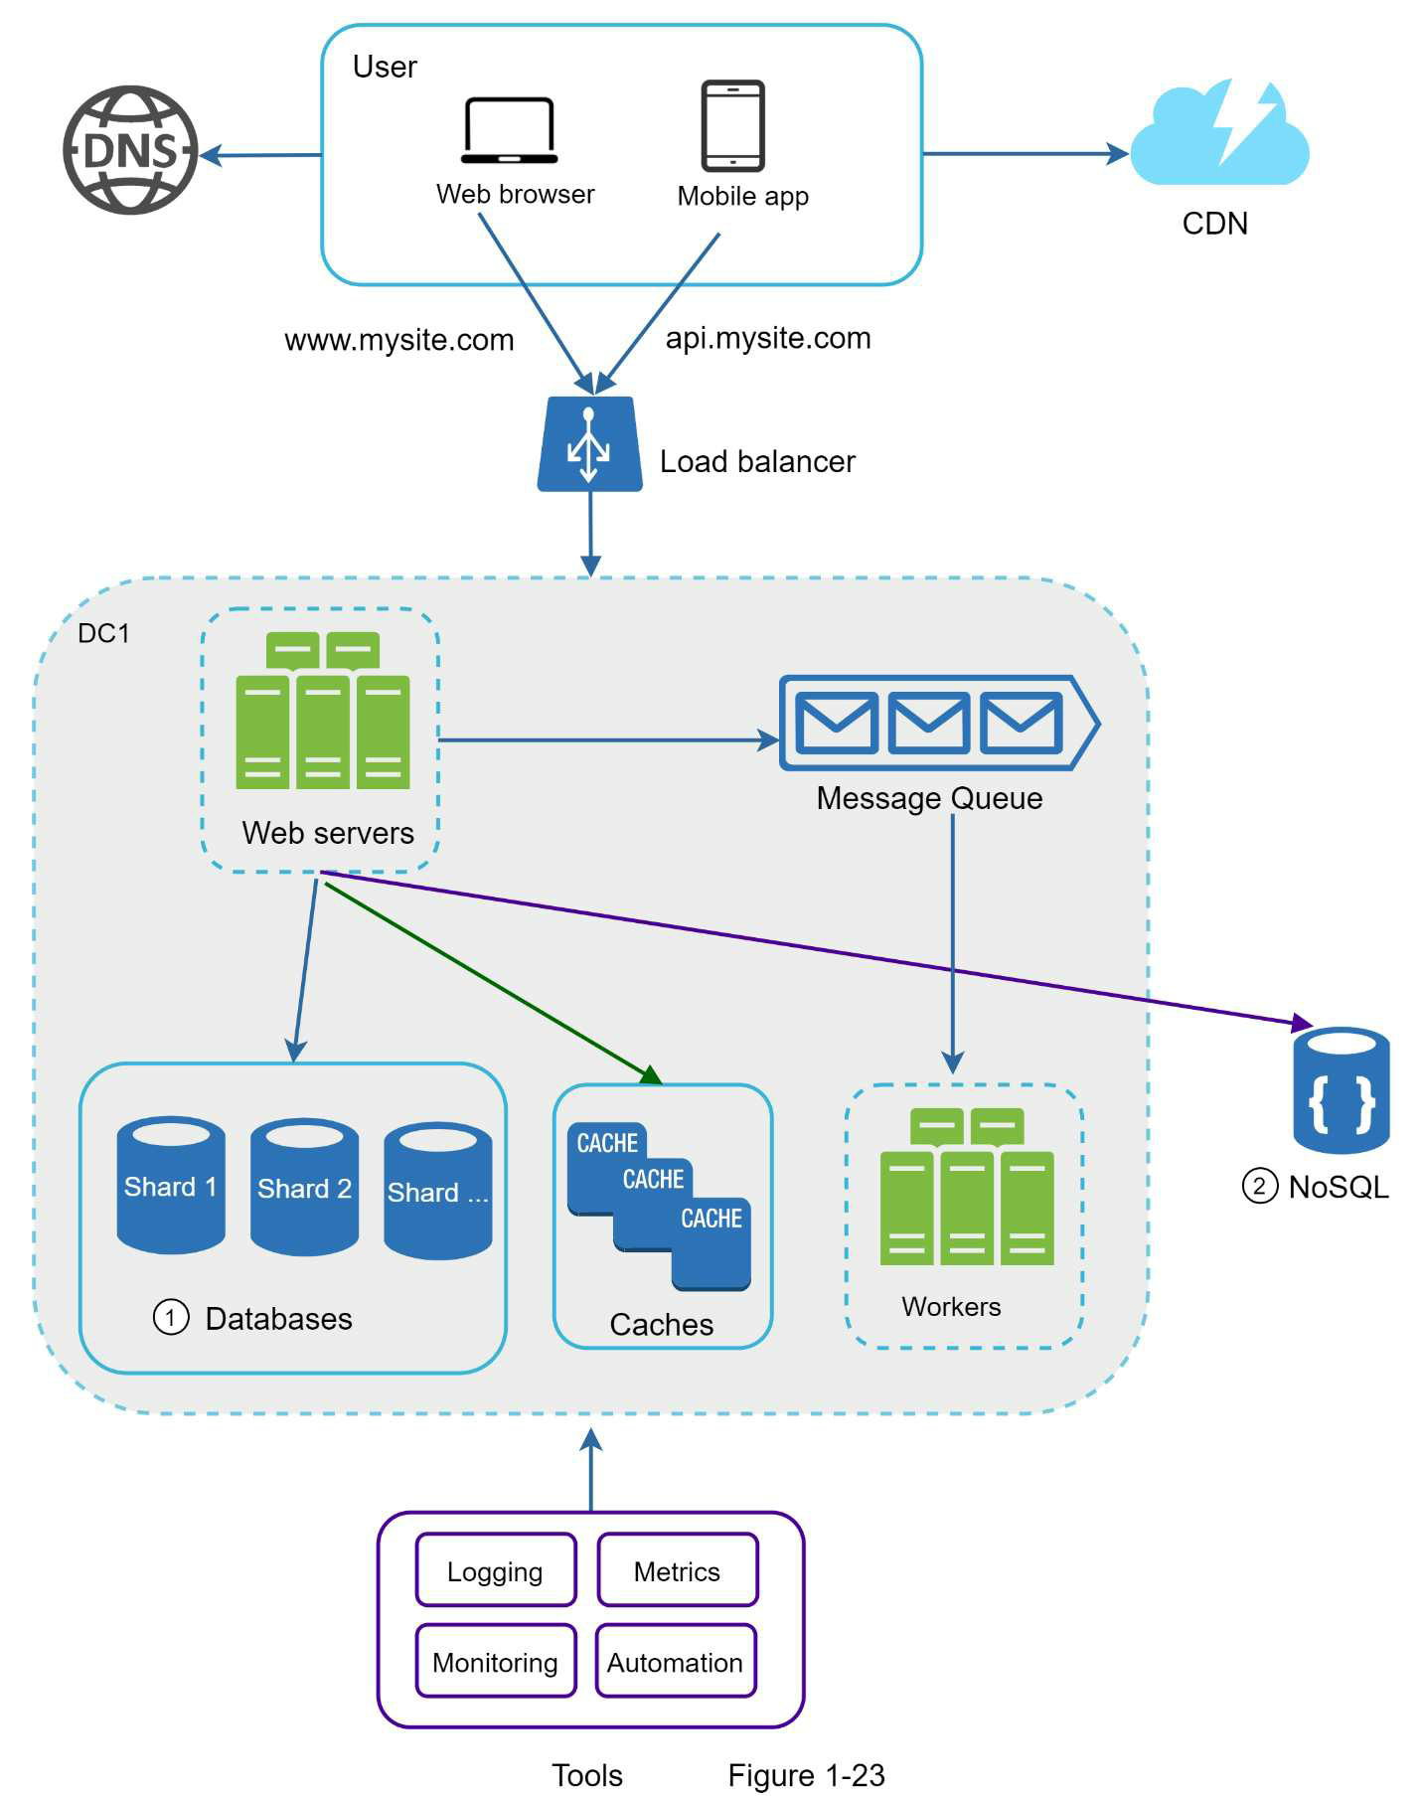
Scaling to Millions of Users
Domain name service –
converts api.mysite.com into IP address
WEB APP
Server-side langs (Java, Python) for backend, storage, business logic + client-side langs (HTML and JavaScript) for presentation
MOBILE APP
HTTP for communication, JSON – API response format for data transfer

