Slide 1
Artificial Intelligence-Based System for Boosting Automated Code Generation from Natural Language Descriptions
By Andrew Nedilko (2025)
Praxis directed by
Dr. Kevin Abreu-Castellanos, D.Eng.

Slide 2
Research Motivation
High labor costs in software development drive the push for automated code generation.
LLM-powered tools can cut coding time by up to 45–55%, improve consistency, reduce bugs, and accelerate time-to-market, giving companies a competitive edge.
Widespread adoption: over 62% of developers actively use AI coding tools, and Google reports >25% of its new code is AI-generated.
Data privacy and security risks of proprietary LLMs (sending confidential code to third-party servers) motivate in-house alternatives.
Deploying small language models (SLMs) in secure in-house environments offers a cost-effective, privacy-preserving way to automate routine coding tasks and boost productivity.
Cost and resource advantages of SLMs: lower licensing fees, smaller disk footprint, and no need for large GPU clusters to fine-tune.
Agent-enhanced SLMs enforce coding best practices, cut human errors, speed development cycles, and enable understaffed teams to automate routine tasks without extra hires.

Slide 3
Initial Assumptions
Problem Statement: Using proprietary large language models (LLMs) to automatically generate code is costly and not safe from the sensitive data protection and intellectual property standpoints forcing developers to spend twice as much time writing code manually
Thesis Statement: Agents based on open-source small language models (SLM) deployed in resource-constrained environments for automated code generation will ensure lower costs and sensitive data protection, reducing the manual coding time and speeding up development cycle
Research Objectives: The main objective of this research is to develop and evaluate an agent-based system utilizing SLMs to automatically generate code from natural language descriptions. The study aims to bridge the performance gap between SLMs and proprietary LLMs in code generation tasks while ensuring data privacy and cost efficiency

Slide 4
Research Questions and Hypotheses
Research question 1: Will the use of agentic workflows, such as reflection or multi‐agent collaboration, improve code‐generation quality, as measured by test‐case pass rates across multiple benchmarks?
Research question 2: Will adjusting SLM inference parameters, such as temperature and top-p, ensure greater code-generation quality, as measured by test-case pass rates across multiple benchmarks?
Research question 3: Will fine-tuning SLMs enhance code-generation quality, as measured by test-case pass rates across multiple benchmarks?
Hypothesis 1: Agentic workflows will result in higher test-case pass rates than single-pass SLM inference, as measured across multiple benchmarks.
Hypothesis 2: Adjusting SLM parameters, such as temperature and top-p, will improve code generation quality, as measured by test-case pass rates across multiple benchmarks.
Hypothesis 3: Fine-tuning SLMs on domain-specific data will increase test-case pass rates across multiple benchmarks compared to using SLMs without fine-tuning.

Slide 5
Scope of Research (merge w/methodol?)
Scope
Establish code generation benchmarks using public leaderboards.
Select several SLMs for code generation experiments.
Enhance SLMs with agents, vary model parameters, fine-tune models
Conduct systematic experiments to assess the quality of generated code using quantifiable metrics
Document the experiments.
Limitations
Due to smaller size (fewer training parameters) SLMs may not achieve the same level of sophistication, contextual understanding, and code generation quality as LLMs, no direct LLM experiments - using benchmarks.
Scope constraints: limited hardware and computational resources – imitating resource-constrained environments which restricts model fine-tuning capabilities, evaluation and training dataset size, and depth of evaluation
One-year timeframe => focus on Python and two agentic workflows.
Rapidly evolving AI landscape - new models or methods may emerge before publication, affecting the relevance of the findings.

Slide 6
Literature: Important Sources
Ciniselli et al. (2024) - transition from human-led coding toward orchestrating AI-driven ecosystems leading to more efficient, secure, and sustainable software engineering.
Chen & Varoquaux (2024) “Small vs. Large Models for Code Generation” Establishes the core argument that SLMs—when paired with prompt optimization and domain-specific tuning—can match LLM performance on code tasks, laying the foundation for all follow-on SLM work.
Williams, 2024 - explores the growing popularity of locally hosted SLMs for coding tasks with such advantages as cost savings, customization, optimized speed, lower hardware requirements, providing developers with control, privacy, and flexibility. The study covers ways to evaluate these models including HumanEval, MBPP, BigCodeBench, LiveCodeBench and lists several top contenders: Qwen2.5-Coder-32B-Instruct (by Alibaba), Nxcode-CQ-7B-orpo, OpenCodeInterpreter-DS-33B, Artigenz-Coder-DS-6.7B, etc.
Hong et al. (2023) “MetaGPT: SOP-Driven Multi-Agent Code Generation” Demonstrates a modular, role-based multi-agent framework—product managers, architects, engineers, testers—each handling a slice of the code workflow, and shows clear gains in coherence and reliability over monolithic prompts.
Zhang et al. (2024) introduces CODEAGENT, a framework designed to tackle code generation tasks at the level of entire software repositories, going beyond the simpler function- or statement-level generation. This work highlights the importance of an agent-based approach paired with domain-specific tools for enabling LLMs to handle more complex, context-rich code generation scenarios.

Slide 7
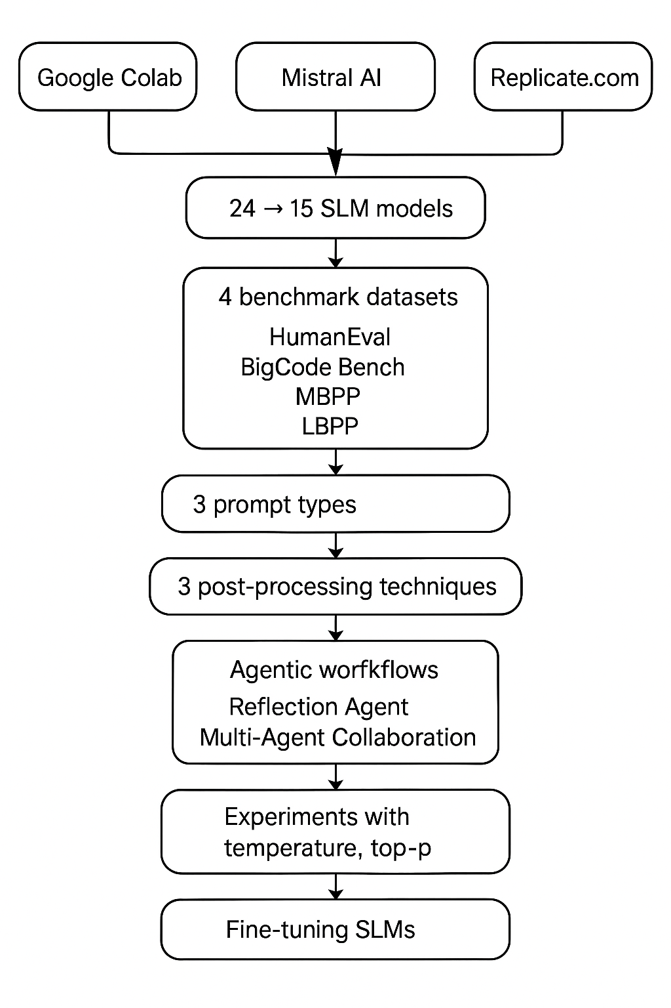
Methodology

Slide 9
Results

