Slide 1
Artificial Intelligence-Based System for Boosting Automated Code Generation from Natural Language Descriptions
By Andrew Nedilko (2025)
Praxis directed by
Dr. Kevin Abreu-Castellanos, D.Eng.

Slide 2
Research Motivation
High labor costs in software development drive the push for automated code generation.
LLM-powered tools can cut coding time by up to 45–55%.
Widespread adoption of automatic code generation: over 62% of developers actively use AI coding tools, and Google reports >25% of its new code is AI-generated.
On the other hand
Data privacy and security risks of proprietary LLMs (sending confidential code to third-party servers) motivate in-house alternatives.
Deploying small language models (SLMs) in secure in-house environments offers a cost-effective, privacy-preserving way to automate routine coding tasks and boost productivity.
Agent-enhanced SLMs will enforce coding best practices, cut human errors, speed development cycles, and enable understaffed teams to automate routine tasks without extra hires.
Notes:
READ FAST

Slide 3
Initial Assumptions
Problem Statement: Using proprietary large language models (LLMs) to automatically generate code is costly and not safe from the sensitive data protection and intellectual property standpoints forcing developers to spend twice as much time writing code manually
Thesis Statement: Agents based on open-source small language models (SLM) deployed in resource-constrained environments for automated code generation will ensure lower costs and sensitive data protection, reducing the manual coding time and speeding up development cycle
Research Objectives: The main objective of this research is to develop and evaluate an agent-based system utilizing SLMs to automatically generate code from natural language descriptions. The study aims to bridge the performance gap between SLMs and proprietary LLMs in code generation tasks while ensuring data privacy and cost efficiency
Notes:
READ FAST ONLY THE FIRST SENTENCE

Slide 4
Research Questions and Hypotheses
Research question 1: Will the use of agentic workflows, such as reflection or multi‐agent collaboration, improve code‐generation quality, as measured by test‐case pass rates across multiple benchmarks?
Research question 2: Will adjusting SLM inference parameters, such as temperature and top-p, ensure greater code-generation quality, as measured by test-case pass rates across multiple benchmarks?
Research question 3: Will fine-tuning SLMs enhance code-generation quality, as measured by test-case pass rates across multiple benchmarks?
Hypothesis 1: Agentic workflows will result in higher test-case pass rates than single-pass SLM inference, as measured across multiple benchmarks.
Hypothesis 2: Adjusting SLM parameters, such as temperature and top-p, will improve code generation quality, as measured by test-case pass rates across multiple benchmarks.
Hypothesis 3: Fine-tuning SLMs on domain-specific data will increase test-case pass rates across multiple benchmarks compared to using SLMs without fine-tuning.
Notes:
READ ONLY THE HYPOTHESIS

Slide 5
Literature: Important Sources
Ciniselli et al. (2024) “From Today’s Code to Tomorrow’s Symphony: The AI Transformation of Developer’s Routine by 2030” Transition from human-led coding toward orchestrating AI-driven ecosystems leading to more efficient, secure, and sustainable software engineering.
Chen & Varoquaux (2024) “Small vs. Large Models for Code Generation” Establishes the core argument that SLMs—when paired with prompt optimization and domain-specific tuning—can match LLM performance on code tasks, laying the foundation for all follow-on SLM work.
Williams, 2024 “Coding With SLMs and Local LLMs: Tips and Recommendations” Explores the growing popularity of locally hosted SLMs for coding tasks with such advantages as cost savings, customization, optimized speed, lower hardware requirements, etc.
Hong et al. (2023) “MetaGPT: SOP-Driven Multi-Agent Code Generation” Demonstrates a modular, role-based multi-agent framework—product managers, architects, engineers, testers—each handling a slice of the code workflow, and shows clear gains in coherence and reliability over monolithic prompts.
Zhang et al. (2024) “CODEAGENT: Enhancing Code Generation with Tool-Integrated Agent Systems for Real-World Repo-level Coding Challenges” Introduces a framework designed to tackle code generation tasks at the level of entire software repositories, going beyond the simpler function- or statement-level generation.
Notes:
DO NOT READ TITLES – JUST AUTHOR + FIRST PHRASE OF DESCRIPTION

Slide 6
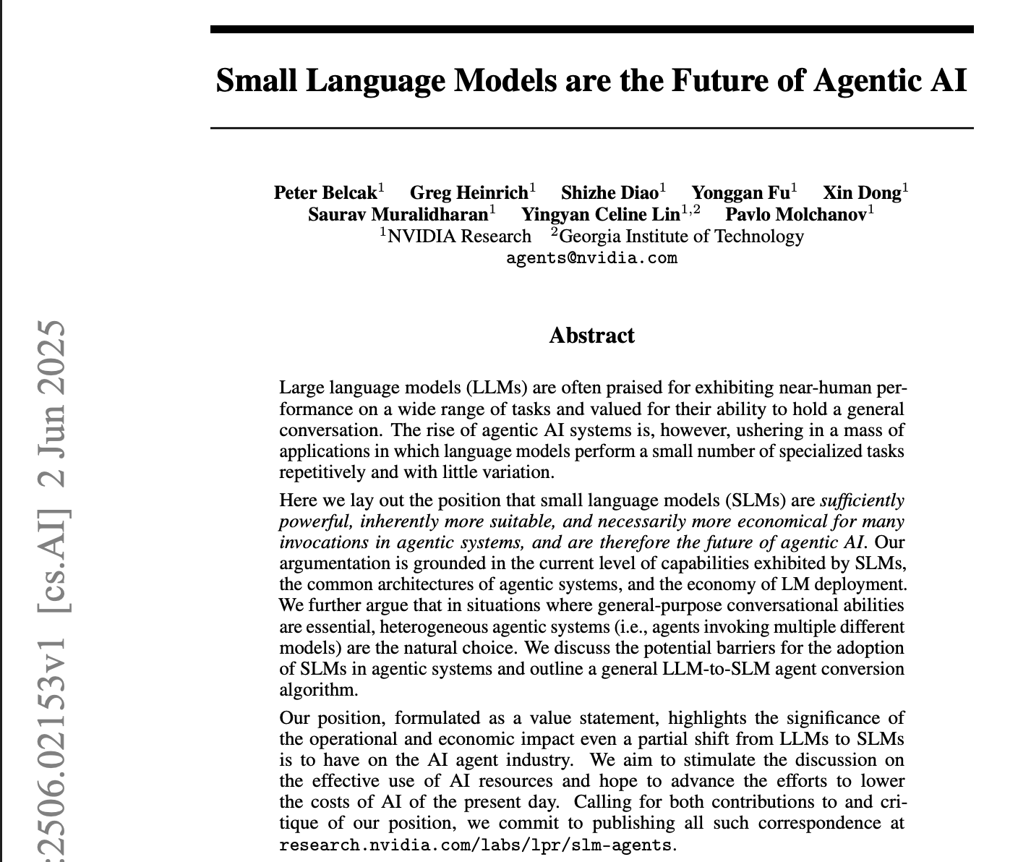
Literature: Important Sources (2)
A group of researcher from NVIDIA Research and Georgia Institute of Technology argue that SLMs are not only sufficiently capable but also more efficient and cost-effective for repetitive, specialized tasks
Notes:
DO NOT READ TITLES – JUST AUTHOR + FIRST PHRASE OF DESCRIPTION

Slide 7
Methodology

Slide 8
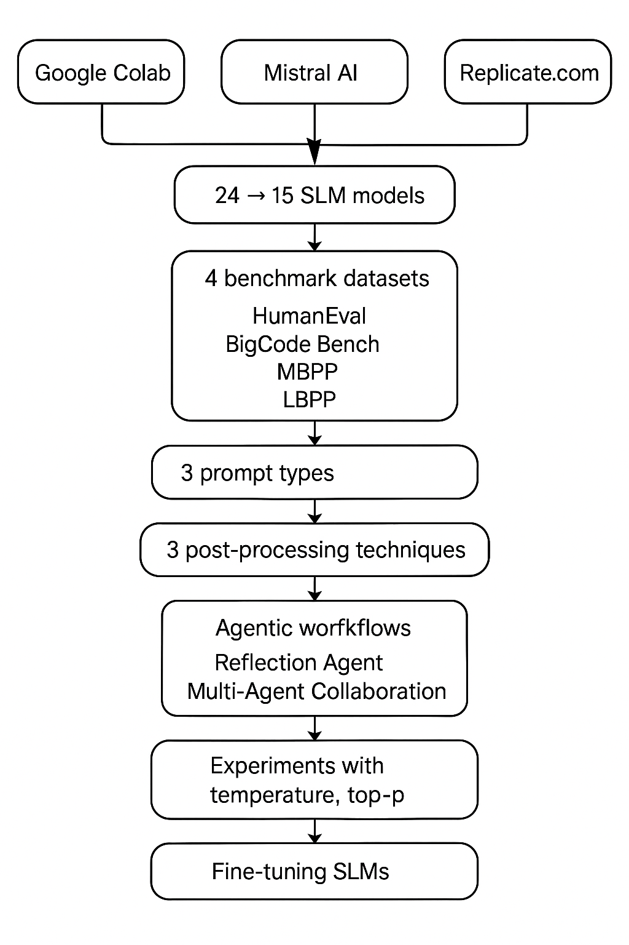
Overview and Environments
Google Colab Pro+
A premium Jupyter‑notebook tier. Compared with free Colab, it has longer runtimes (up to 24 h even when the browser is closed), high‑memory VMs (52 GB RAM), and priority access to GPUs including A100—ideal for large‑scale SLM experiments in Hugging Face transformers without session interruptions.
Mistral AI
Next‑generation SLM platform w/permissively licensed 7B transformer models (8K–32 K token context) via a simple API. Faster code‑generation performance than Google Colab by offloading inference to optimized hosted endpoints.
Replicate
A cloud‑based model‑hosting and inference service with on‑demand, auto‑scaling and pay‑as‑you‑go pricing. Hosts thousands of community models (e.g. Nous‑hermes‑2‑solar‑10.7b, Phixtral‑2x2_8, Qwen1.5‑7b), enabling easy and large-scale fine‑tuning and deployment.

Slide 9
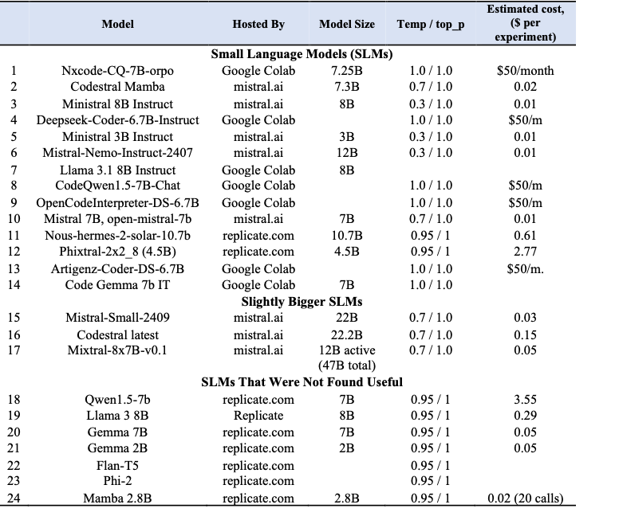
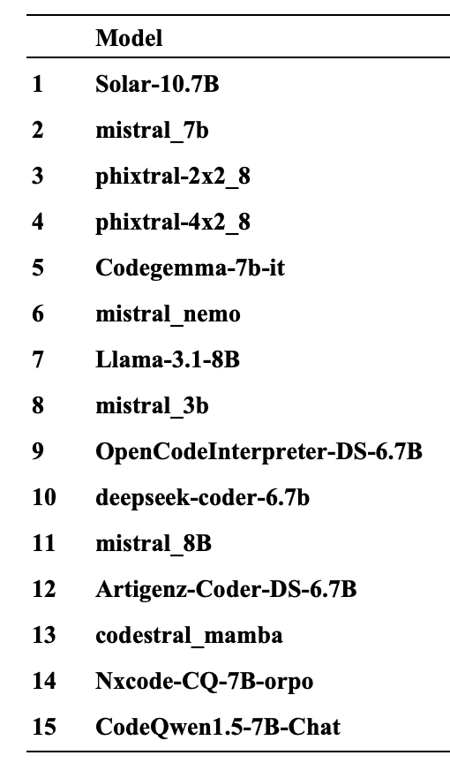
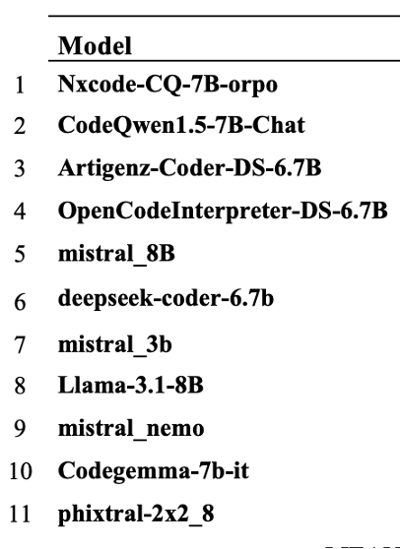
Models
SLMs Used in Agentic Experiments
SLMs Used in Initial Experiments
SLMs with more reasonable
performance and latency for
single-model experiments

Slide 10
Benchmark Datasets
HumanEval: 164 hand‑crafted Python problems (function signature + docstring) each with ~7.7 hidden unit tests, designed to measure both syntactic accuracy and semantic correctness for LLM‑driven code generation.
MBPP: 974 entry‑level Python tasks (average 6.8 lines of code) split into few‑shot, 500‑test, 374‑fine‑tune, and 180‑validation subsets; each problem includes a description, function signature, and three assert‑based tests.
LBPP: 161 uncontaminated Python coding tasks with canonical solutions and tests, curated to avoid overlap with popular benchmarks and provide a more trustworthy, challenging measure of true generalization.
BigCodeBench: selected 500 out of 1,140 tasks, covering 139 libraries in 7 domains with ≈5.6 tests per task and 99% branch coverage to emulate real‑world compositional and tool‑use challenges.
Discarded:
LiveCodeBench has a huge size (~10GB) and an excruciating number of test cases: some don't even fit into a Jupyter Notebook cell causing output errors. Private test cases are scrambled and look unusable.
Taco has a huge size (5GB); there are no test cases per se, but only inputs and expected outputs. Since they come from different sources, it may take time to parse them properly and write assert statements or test cases for them.

Slide 11
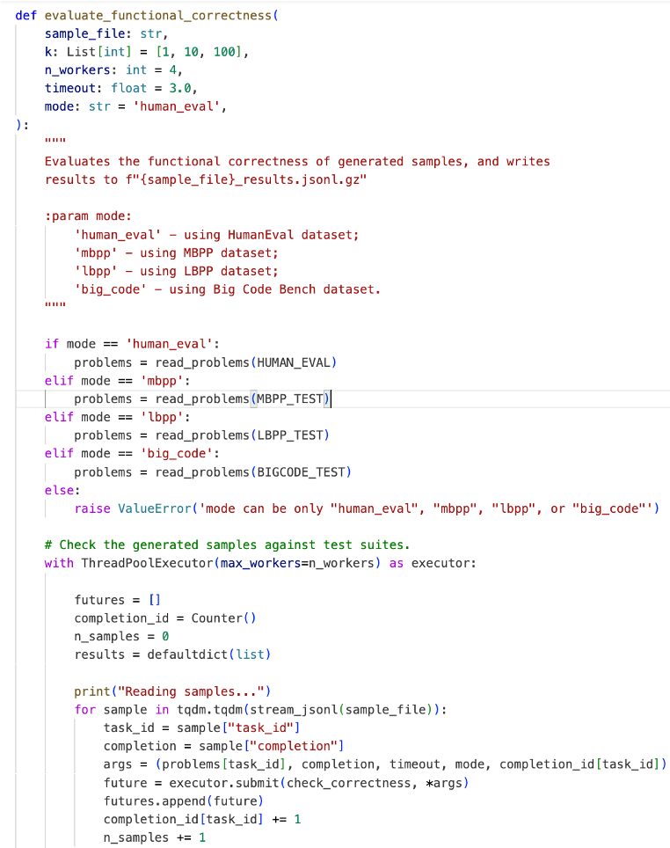
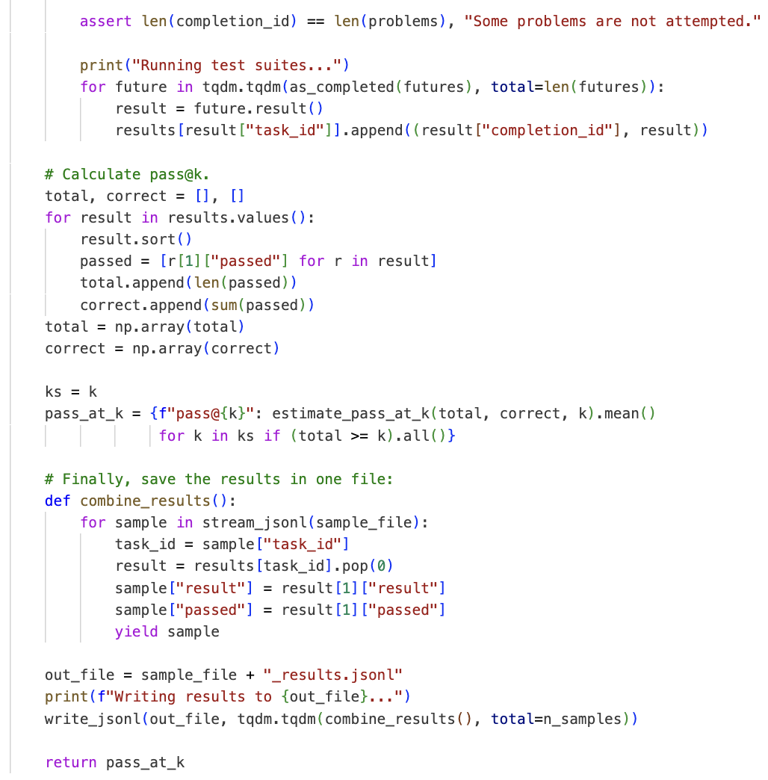
Metric
The pass@k score was used to evaluate performance across all four datasets - the probability that at least one of the top k generated code samples correctly passes all tests.
In other words, for k=1 it’s the percentage of passed test cases when the model had only one chance to generate the code based on a natural language description.
OpenAI wrote the testing code in Python for the HumanEval dataset.
The author expanded the functionality to cover the other three datasets: MBPP, LBPP, BigCodeBench.

Slide 12
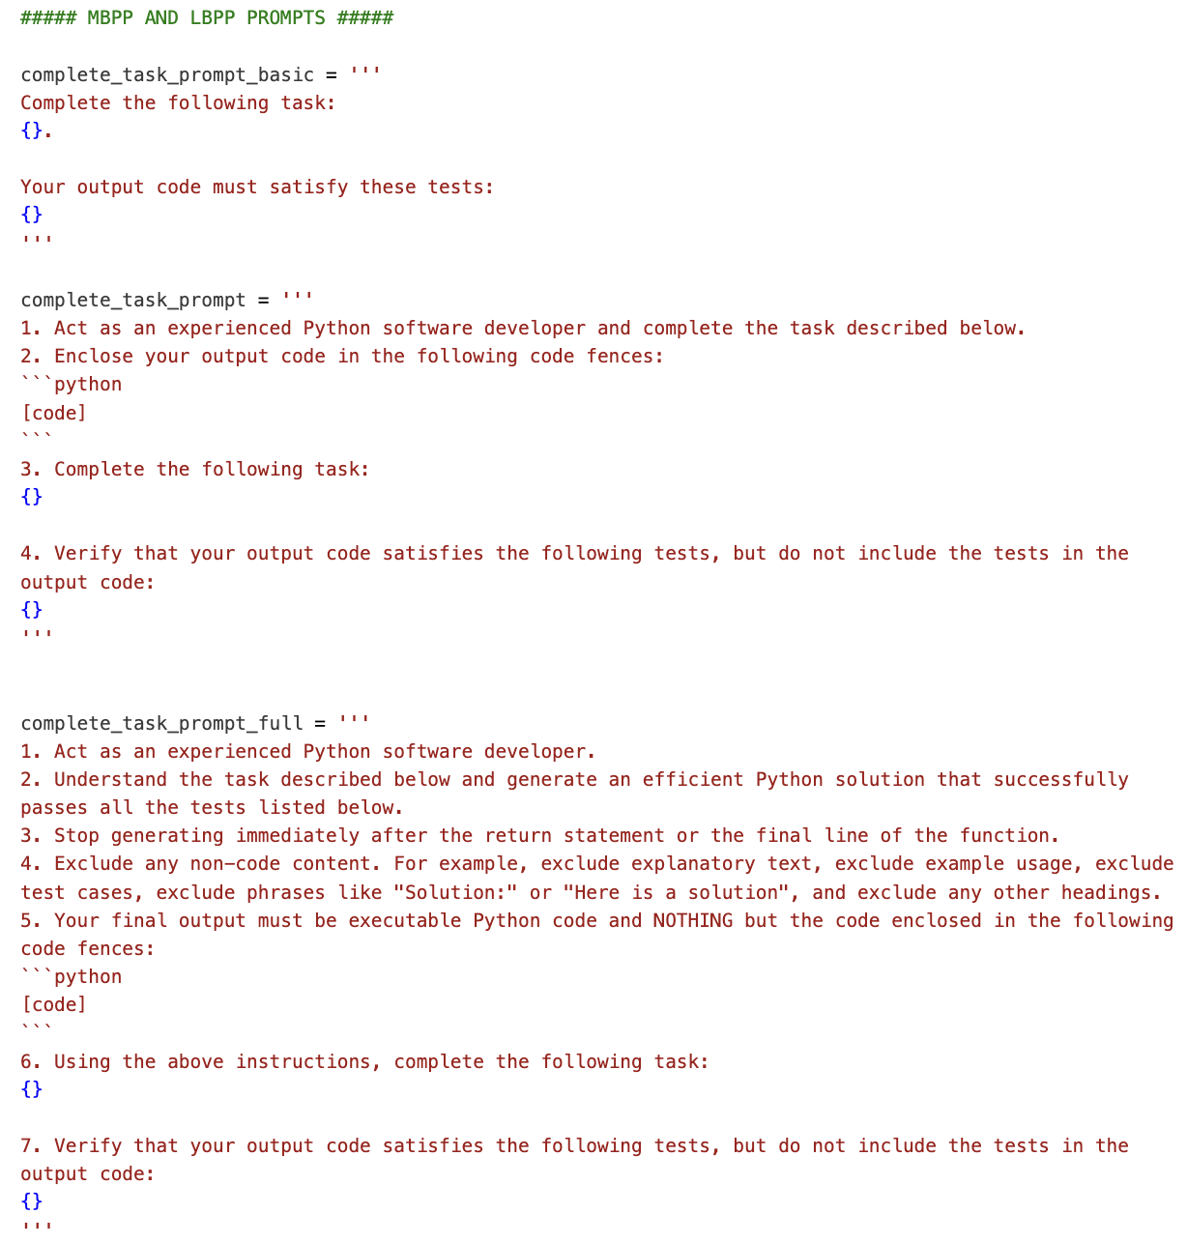
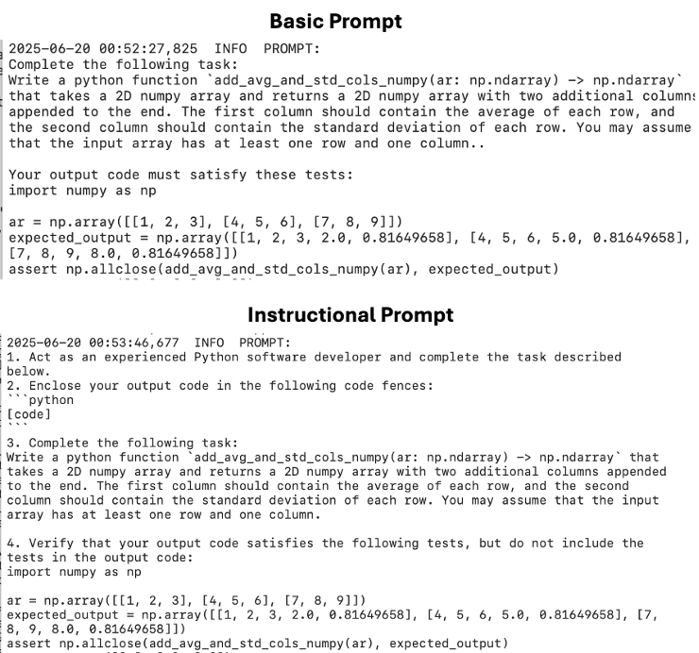
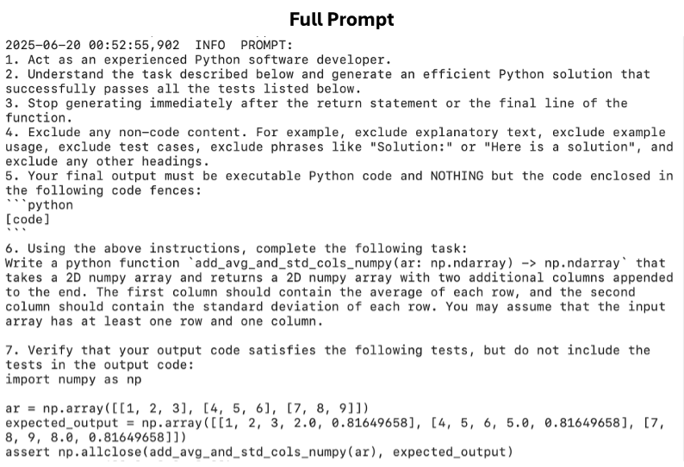
Prompts
HumanEval & BigCodeBench: model completes the starter code (function headers and docstrings) to satisfy hidden tests.
MBPP & LBPP: Natural-language descriptions of tasks are followed by explicit test cases in the prompt.
Actual
Templates
from Logs
Prompt Templates
Notes:
Basic: a minimal directive such as a request to complete a starter code. This bare prompt establishes a performance baseline under unconstrained generation.
Instructional: incorporates a developer persona and formatting constraints, such as to act as an experienced Python software developer, enclose the output in code fences. etc. By specifying role and formatting stopping criteria, this level aims to reduce spurious text.
Full: adds a step-by-step procedure plus strict “no non-code content” rules, such as to Read and understand the starter code, integrate the completion with correct syntax and indentation, exclude any explanations or test cases, stop immediately after the final line of the function, output only valid Python code within fenced blocks. These guardrails enforce maximum consistency and minimize post-processing.

Slide 13
Post-processing
Raw Output - no post‑processing: the model’s entire unchanged response is passed through the generated code evaluation pipeline.
Fence Extraction Only: lightweight cleaning is done before the generated code is evaluated to capture just the first Python-style code block (from “```python” to the next closing backticks), stripping away preamble and trailing prose while potentially leaving assertions and print calls.
Full Cleaning Pipeline: Apply a sequence of edits—extract fenced code, remove any if __name__ == "__main__" blocks, prune assert and print(...) lines, discard stray fence markers, reattach missing function signatures and imports, and inject from typing import *—to produce a self‑contained, executable Python snippet.

Slide 14
Agentic Workflows
Reflection agents use a two‑step loop—generate code, then immediately review and revise it—to iteratively clean up errors and improve structure, much like an author self‑edits. This simple self‑critique workflow can boost performance dramatically: for example, it achieved a 91 % pass@1 rate on HumanEval versus GPT‑4’s previous best of 80 %.
Initial Code Generation Prompt: The agent is given a problem statement and generates a first-pass solution in code form.
Reflection Prompt: The agent receives its own code output, along with an instruction to optimize it: fill missing imports, remove extraneous text, fix logic errors, etc. The agent then outputs a revised solution, presumably more accurate
Multi-Agent Collaboration Agents generalize the idea of iterative refinement by introducing multiple specialized agents that coordinate to improve the generated code. In this Praxis such frameworks orchestrate a sequence of agents, each responsible for a specific cleanup or verification step:
Code Fence Removal
Extraneous Text Removal
Import Checker Agent
Potential Code Execution Agent (if plausible)
Test-Case Removal

Slide 15
Experiments with Temperature and Fine-Tuning
Experimenting with 2 main SLM parameters:
Temperature: regulates the randomness for sampling the next token. A higher temperature (e.g., 1.0–1.2) makes the output more variable, while a lower value (e.g., 0.2–0.5) leads to more deterministic results and can reduce hallucinations and extraneous text, particularly in coding tasks.
Top-p (Nucleus Sampling): represents the overall probability threshold for sampling the next token, limiting the token distribution to the highest-probability subset. Setting top_p below 1.0 prunes the “long tail” of unlikely tokens. This can yield more coherent outputs and reduce random code fragments, but if set too low (e.g. 0.5), the coverage of probable tokens may diminish which can impact the functional correctness.
Fine-Tuning SLMs:
Higher correctness & reduced hallucinations: Fine‑tuning on curated, domain‑specific code datasets teaches the model common libraries, patterns, and edge cases—resulting in fewer errors and more reliable, executable output.
Better instruction following: Training on step‑by‑step code prompts sharpens prompt sensitivity, so SLMs produce concise, well‑structured solutions without extra commentary.
Resource‑efficient adaptation: Techniques like LoRA or prefix tuning let you fine‑tune SLMs on a single GPU, cutting memory and training time while enabling seamless integration of specialized frameworks and coding styles.

Slide 16
Results

Slide 17
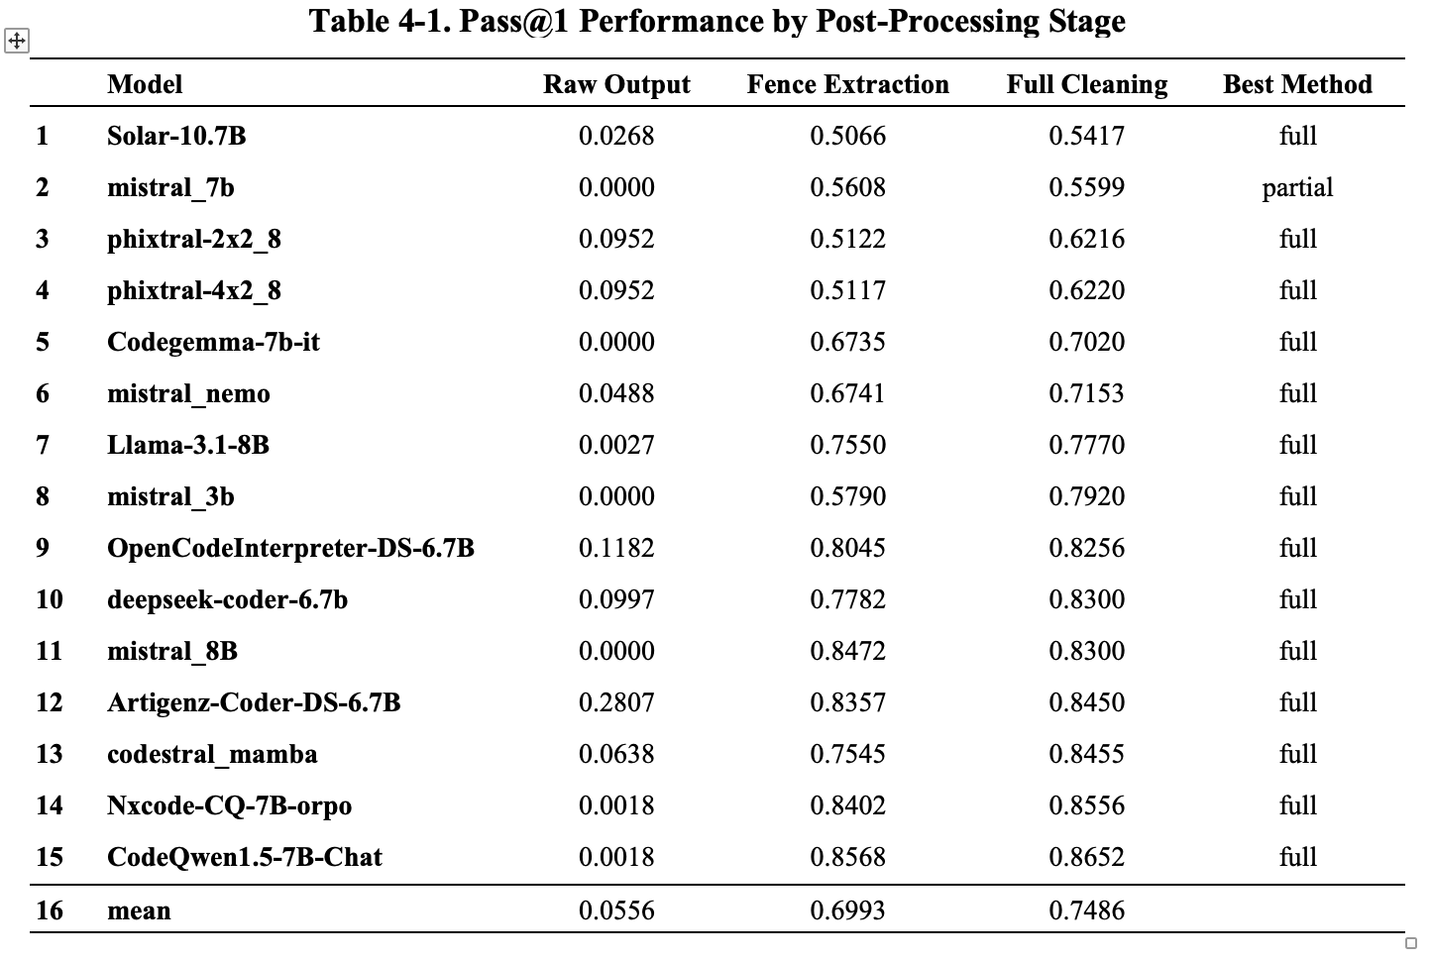
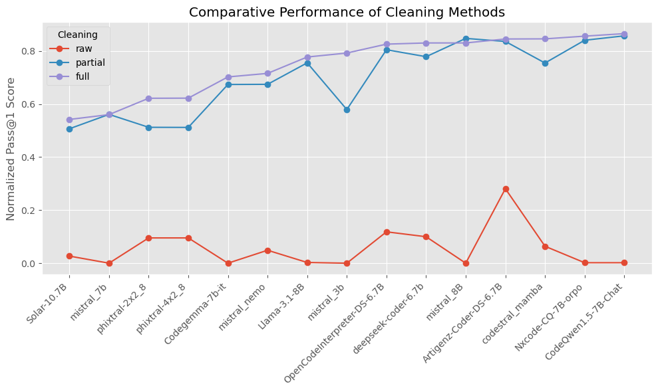
Cleaning Effectiveness
Notes:
Table 4-1 compares mean pass@1 scores across the three cleaning tiers:
Raw Output: no cleaning; the results are not useful - there are ~94% of non-executable code (syntax errors or human-like output).
Fence Extraction: stripping to first code block – much better as there are only ~30% of syntax errors. The overall improvement over raw output is almost 70%.
Full Cleaning: Comprehensive artifact removal – this method improves the pass@1 scores on average by ~5%.
The full cleaning pipeline improved executable code yield and accounted for nearly three-quarters of the syntax-error reduction, underscoring the paramount importance of post-processing in the automated evaluation of generated code.

Slide 18
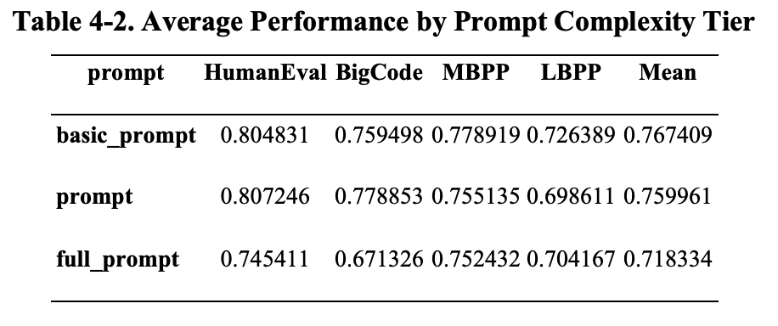
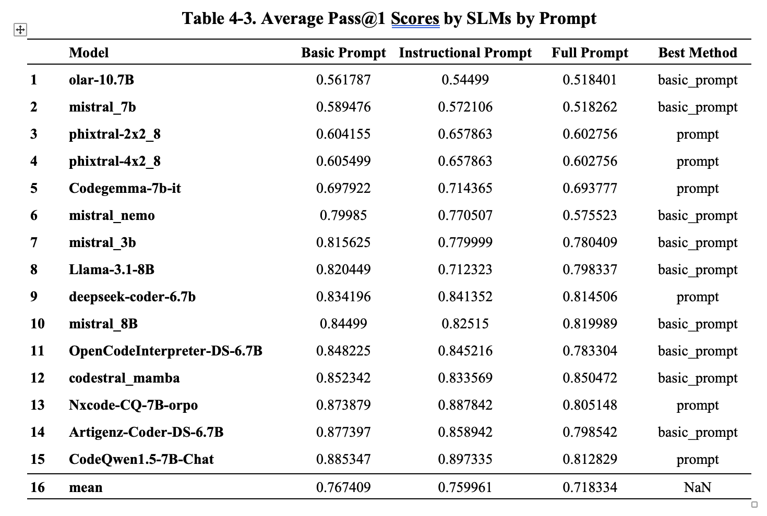
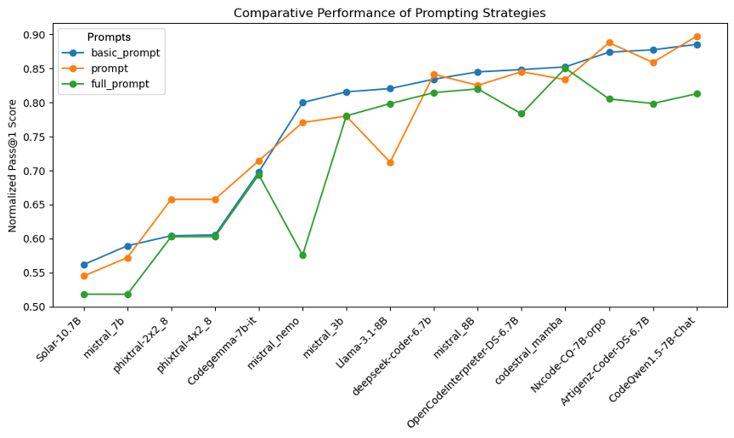
Prompt Engineering Results
Notes:
Table 4-2 reports mean pass@1 scores under three prompt tiers (Basic, Instructional, Full) on the four benchmarks
Basic prompts demonstrate the best pass score with a mean value of 0.77 across all models.
Instructional prompts are the next best option with a slightly lower mean value of 0.76 across all models.
Full prompts (strict “code-only” rules and stepwise instructions) shows a performance that is by ~6% lower than the basic prompt results.
Table 4-3 shows the most efficient prompt for each model. The basic prompt wins both by the count in the Best Method column and based on the mean score in the mean row.
These results demonstrate that
simpler prompt can do a relatively good job in code generation.
One would probably need a lot of experiments to produce an efficient full prompt that would contain many rules and that would beat a simple prompt.
Also, it should be noted that the prompt performance varies from model to model: the basic prompt works best for some models, while the instructional prompt works better for other models.
In addition, the agentic workflow results demonstrate that the full prompt is most efficient for select models.

Slide 19
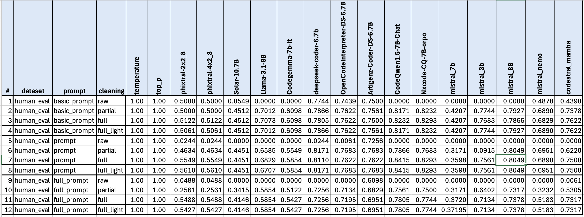
Overall Performance Across Benchmark Datasets
This is an example of a results table that was obtained for each benchmark dataset per:
each single-pass run,
each reflection and multi-agent run,
each temperature setting run, and
each top p setting run.
Overall, there is a total of 18 such tables to analyze.

Slide 20
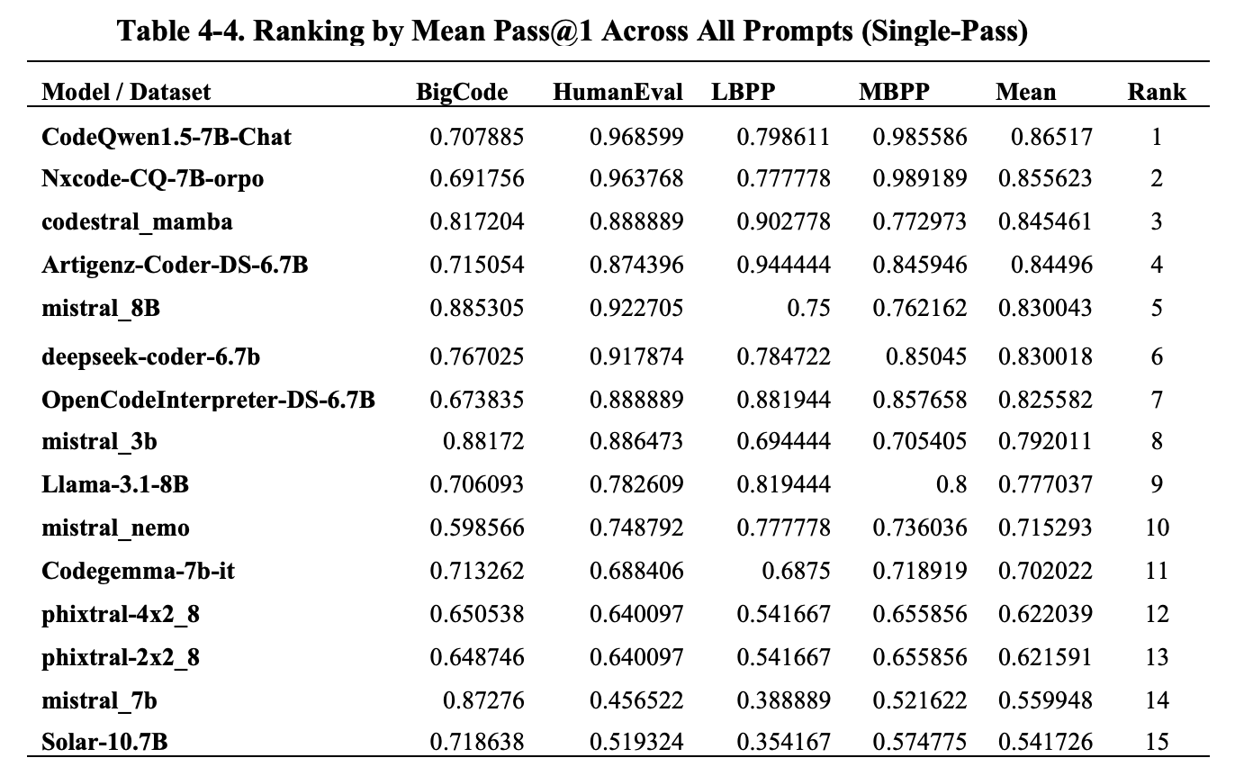
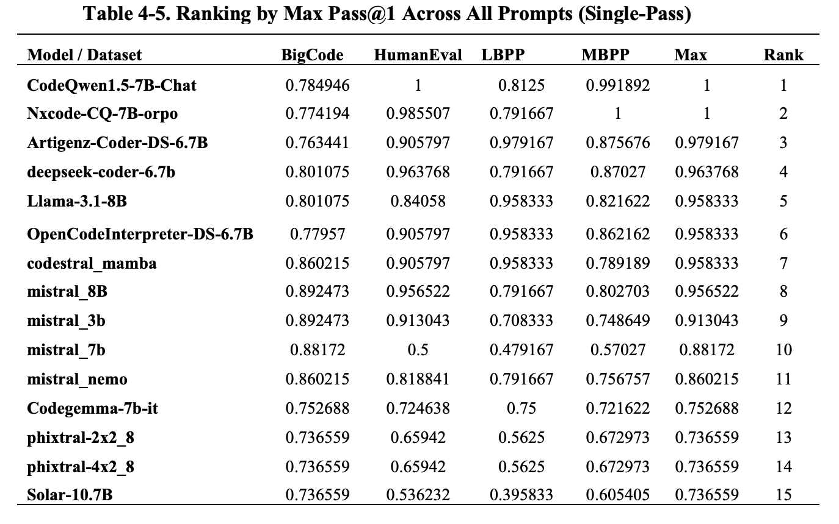
Single-Pass Results
Table 4-4 ranks SLMs by their mean scores across all prompts for each dataset.
Table 4-5 does the same using the maximum pass@1 scores.
Notes:
The table displays the normalized average Pass@1 scores of 15 SLMs evaluated across the four datasets. The models are ranked based on their average performance.
The results demonstrate significant variation in performance both across models and datasets, with several key patterns emerging from the evaluation. As expected, larger models tended to achieve higher accuracy on the public datasets, but all models suffered substantial drops on the uncontaminated LBPP and BigCode datasets, confirming concerns about data leakage in more popular datasets. This fact is especially noticed when looking at the raw pass scores before normalization – and this was the main reason for normalizing scores because they LBPP and BigCode scores were much lower.
At the top of the ranking is CodeQwen1.5-7B-Chat, Nxcode-CQ-7B-orpo and codestral_mamba.
Mid-ranking models such as mistral_8B, deepseek-coder-6.7b, OpenCodeInterpreter-DS-6.7B perform well on certain datasets (e.g., HumanEval and MBPP) but have slightly lower scores on LBPP or BigCodeBench, which brings down their average.
In the lower tier, models like mistral_3b, Llama-3.1-8B, and mistral_nemo show more variation in performance across datasets, leading to lower average scores.
At the bottom of the ranking, Solar-10.7B and the phixtal variants score significantly lower.
The analysis suggests that certain models, particularly those tuned for code (e.g., CodeQwen, Nxcode, Codestral), offer significantly better performance across benchmarks, while others lag behind likely due to weaker specialization or less effective fine-tuning for coding tasks.
Model Size vs. Performance Correlation
Small models can be surprisingly competitive: mistral_3B (3B) ranks 8th overall with a mean score of 0.792, outperforming larger models like mistral_nemo (mean: 0.715), Solar-10.7B (mean: 0.541), and even some mid-sized models.
The largest models perform relatively poorly: Solar-10.7B, a larger model than 7B models, ranks 15th (last), with the lowest mean score (0.541), mistral_nemo, another large model, ranks 10th with a moderate score (0.715), underperforming compared to many 7B models.
Sweet spot mid-sized (~7B) models dominate. The top 7 models — including CodeQwen1.5-7B-Chat, Nxcode-CQ-7B-orpo, codestral_mamba, and others — are all around 7 billion parameters. These models consistently achieve mean scores above 0.82, with the top model scoring 0.865.
Conclusion: model size is not the sole determinant of performance - larger size does not guarantee better performance.

Slide 21
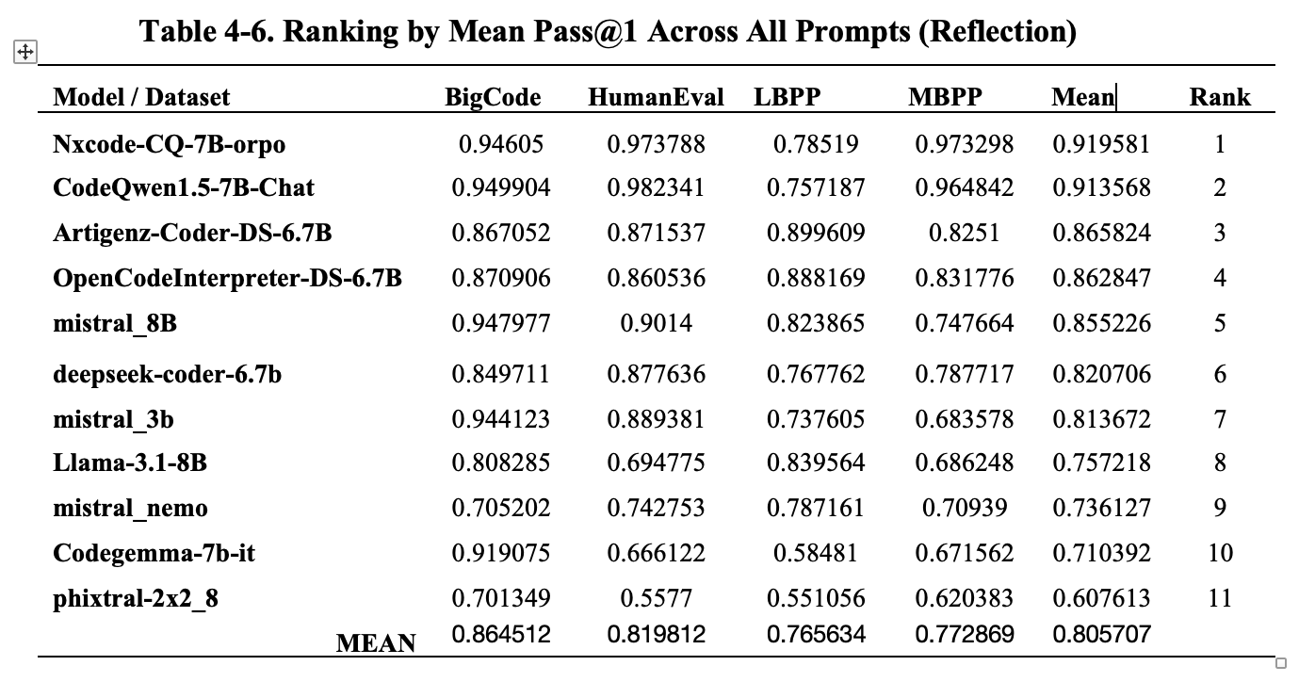
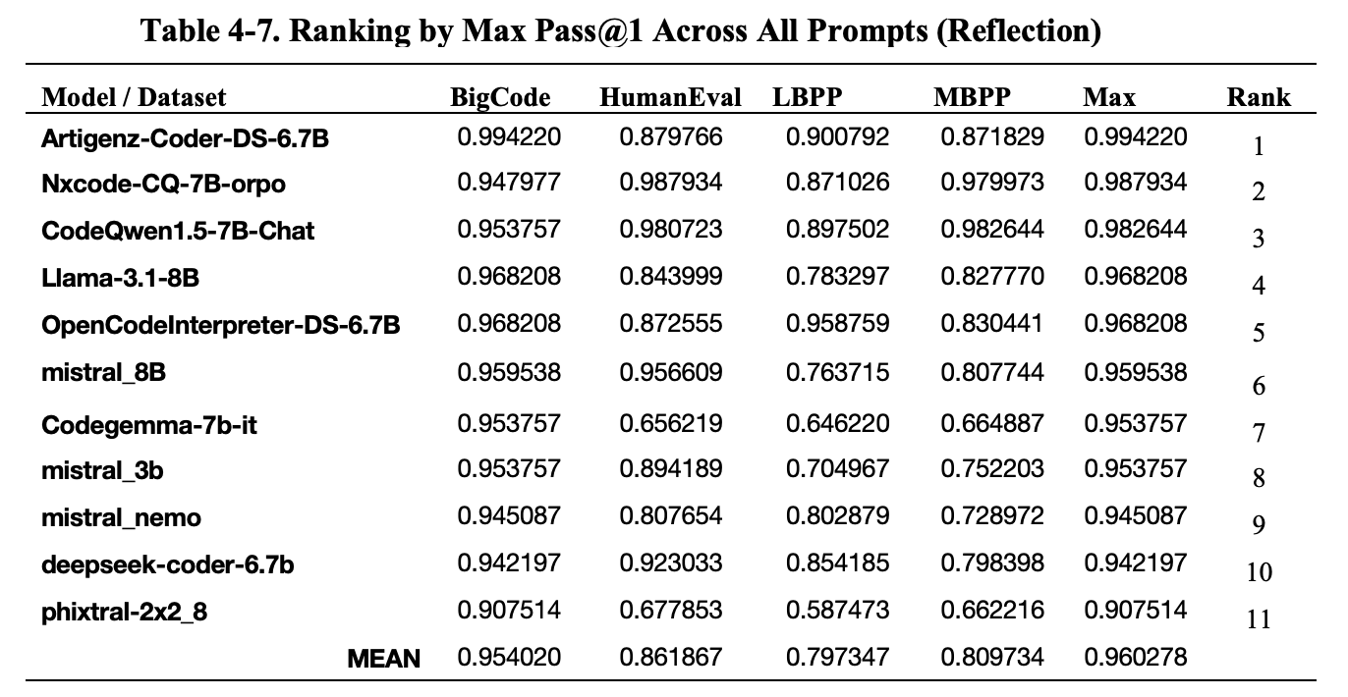
Reflection Agent Results
Normalized Results
Notes:
Table 4-6 and 4-7 present the results of ranking SLMs by their mean scores across all prompts and datasets and by their maximum scores, respectively.
The reflection agent approach demonstrated an improvements over baseline single-pass generation. On average, reflection agents increased pass@1 by +6 pp over the baseline (mean pass@1 score across all models is 0.805707, while for single-pass models it is 0.748568)
These results prove Hypothesis 1 of this Praxis confirming that agentic workflows result in higher test-case pass rates than single-pass SLMs, as measured across multiple benchmarks.

Slide 22
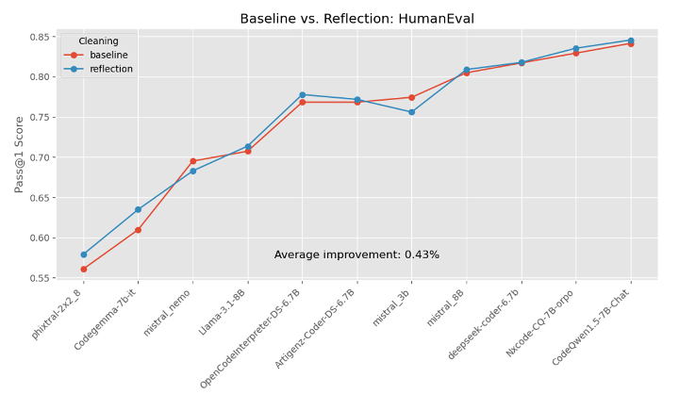
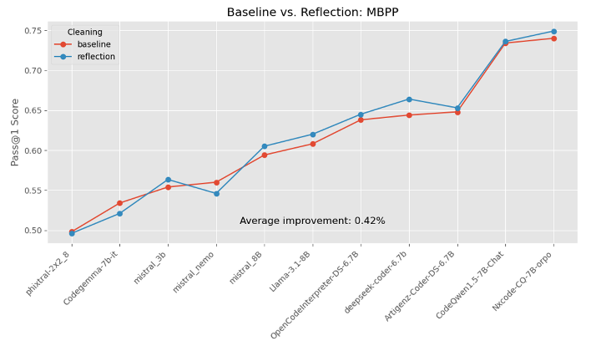
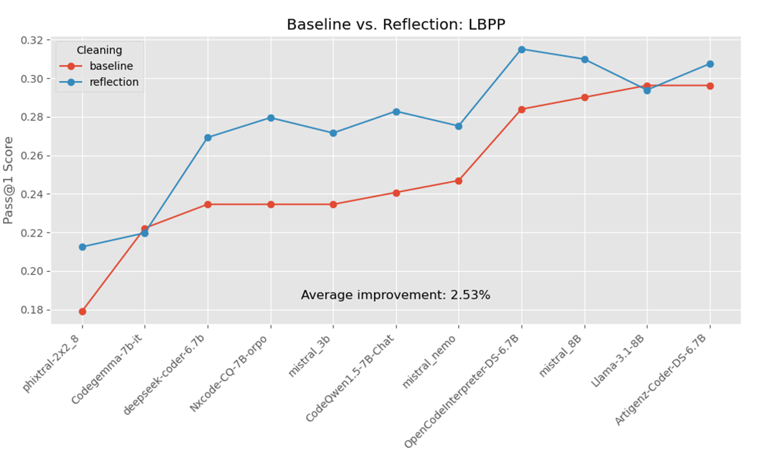
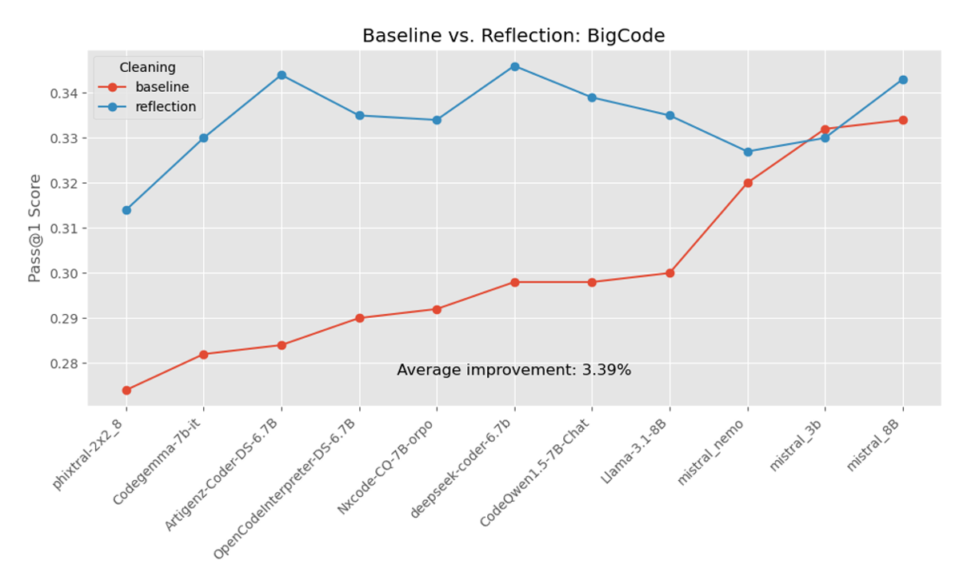
Reflection Agent Results (2)
Notes:
These four figures show a comparison of baseline single-pass results and reflection agentic workflow on a per-dataset basis.
They show that using a reflection-based agentic approach consistently improves Pass@1 performance, though the degree of improvement varies by dataset.
On HumanEval and MBPP, improvements are modest but consistent.
The effect is more pronounced in LBPP, where the reflection workflow results in a 2.53% average improvement and BigCodeBench, with an average improvement of 3.39%.
It is a critical correlation that the effect from the reflection is considerably greater in the less contaminated datasets. This can simply mean that if SLMs were trained on HumanEval and MBPP, they get the right answers right away and they don’t need improvements in the form of agents. While agents really help with newer datasets as it should be.

Slide 23
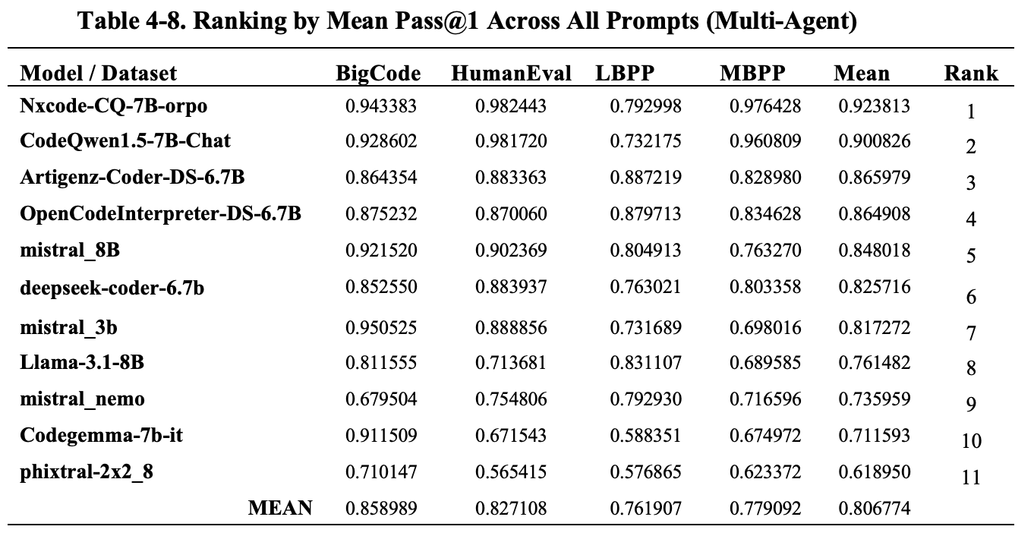
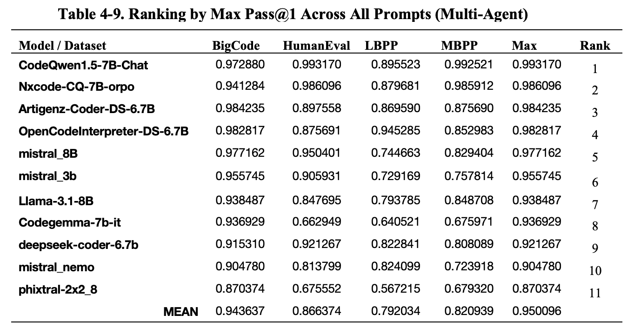
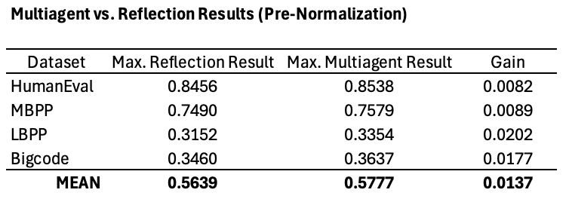
Multi-Agent Collaboration Results
Normalized Results
Max. Results Before Normalization
Notes:
Building on reflection, the multi-agent pipeline further improved pass@1 by +0.2pp?? (normalized results) OR +1.4pp (before normalization) compared to the reflection agent results
This is a marginal improvement, and it means that one needs to spend more time
improving the design of the multi-agent system and,
doing additional prompt engineering.
These tables are not very much different from the reflection agent results.
These results also prove Hypothesis 1 - agentic workflows result in higher test-case pass rates than single-pass SLMs, as measured across multiple benchmarks.

Slide 24
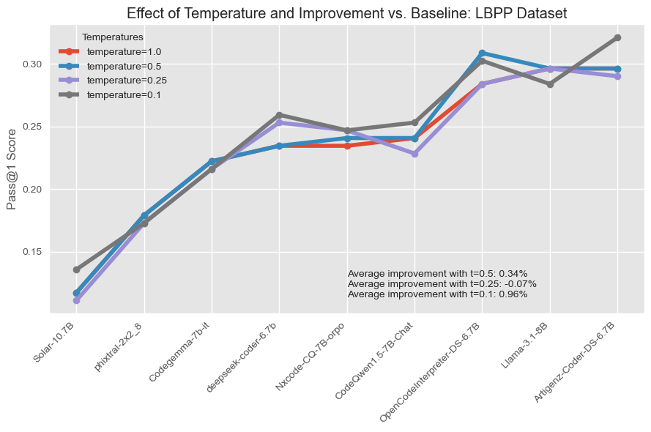
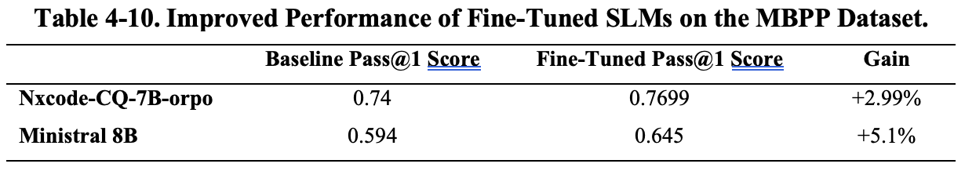
SLM: Inference Parameter Optimization and Fine‑Tuning
Temperature and Top p
Several values for top-p (p∈{1.0, 0.9, 0.8}) were attempted without any improvements in the pass@1 scores
SLM Fine-Tuning
Notes:
Temperature Optimization at Inference Time
Temperature range: Tested at 1.0 (baseline), 0.5, 0.25, and 0.1 across all SLMs on the LBPP dataset.
Average Gains: Lowering to t = 0.5 gave a modest +0.34 % boost, t = 0.25 slightly –0.07 %, and t = 0.1 delivered the largest +0.96 % improvement.
Low‑Performers Benefit Most: Models like Solar‑10.7B and phixtal‑2x2_8 steadily improved as temperature decreased, showing that reduced sampling entropy helps weaker generators.
Model‑Dependent Optima: Some strong models (e.g. Llama‑3.1‑8B) peaked at the default t = 1.0 and declined at lower temperatures, indicating they’re already well‑tuned for diverse outputs.
Top Performer at Low Temp: Even high‑performers such as Artigenz‑Coder‑DS‑6.7B saw their best pass@1 at t = 0.1, confirming that aggressive temperature scaling can benefit many architectures
Top P Optimization at Inference Time
Several values for top-p (p∈{1.0, 0.9, 0.8}) were attempted and an analysis of results didn’t confirm any improvements in the pass@1 scores for any of the SLM models when top-p decreases
SLM Fine-Tuning
Fine‑tuning on a single GPU boosted pass@1 on MBPP by +2.99 pp for Nxcode‑CQ‑7B‑orpo (from 0.74 → 0.7699) and +5.1 pp for Mistral 8B (from 0.594 → 0.645).
This was achieved with a lightweight PEFT pipeline (QLoRA quantization, transformers, torch, peft, trl) that compresses weights to 4 bit and updates only a small subset of parameters—enabling efficient fine‑tuning on modest hardware.
These results confirm Hypothesis 3: targeted, domain‑specific fine‑tuning substantially improves SLM code‑generation quality. What’s more important – this is achieved even in low‑compute environments.

Slide 25
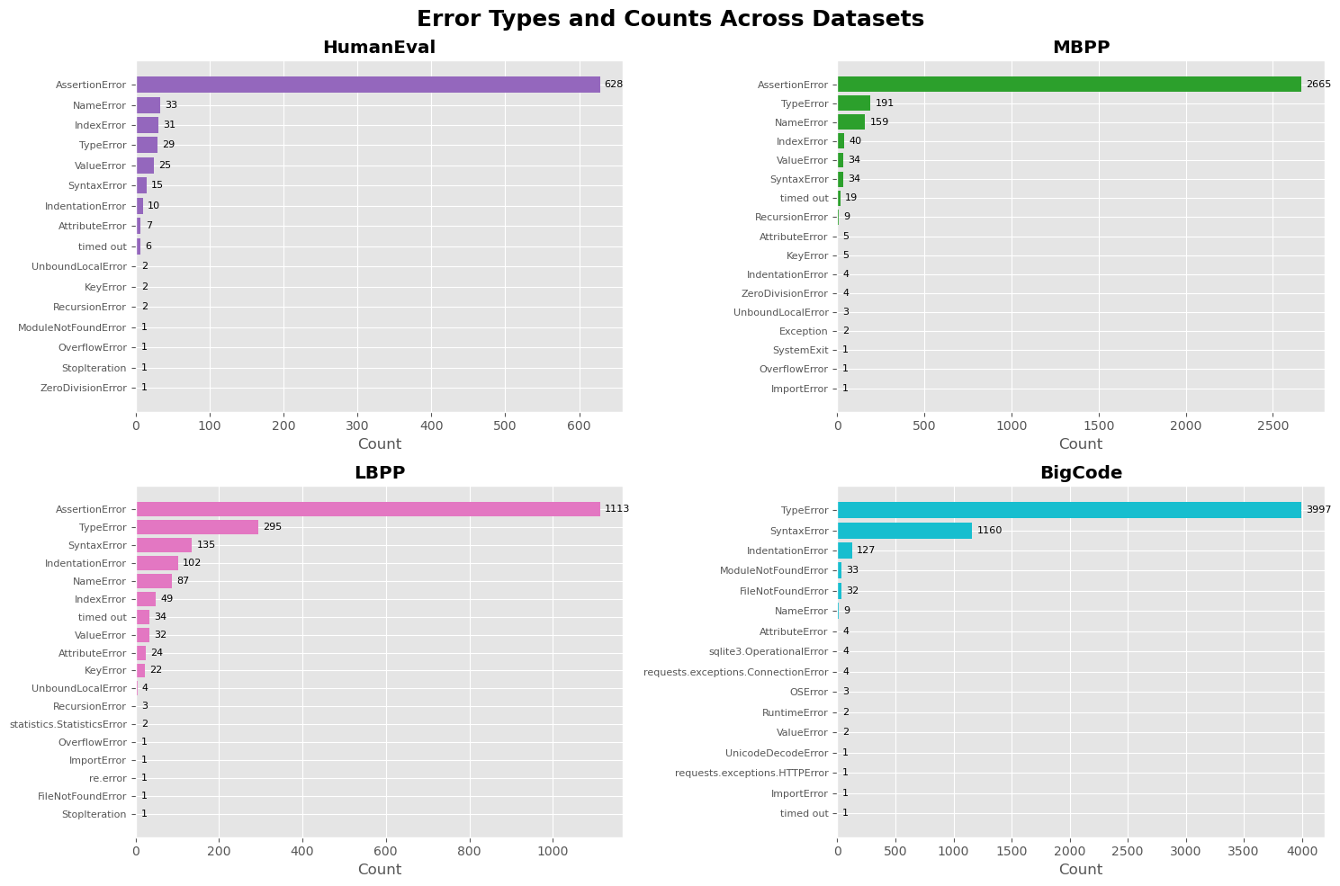
Error Analysis
Notes:
The most frequent exception by far for three out the four benchmark datasets is AssertionError, which simply indicates that the generated code failed one or more test cases. Unfortunately, no further detail is available because the asserts did not include custom messages (they were written as assert <condition>).
In addition, TypeError appears near the top in every dataset and becomes the number-one error on BigCodeBench, underscoring that argument mismatches and improper type usage are a universal weakness in autoregressive code models.
SyntaxError and IndentationError show up most when the tasks require more elaborate code constructs (LBPP, BigCodeBench)

Slide 26
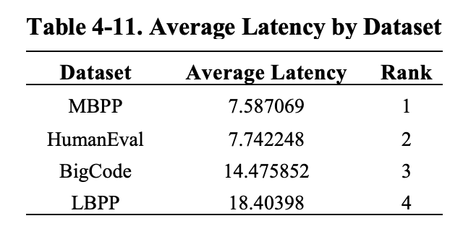
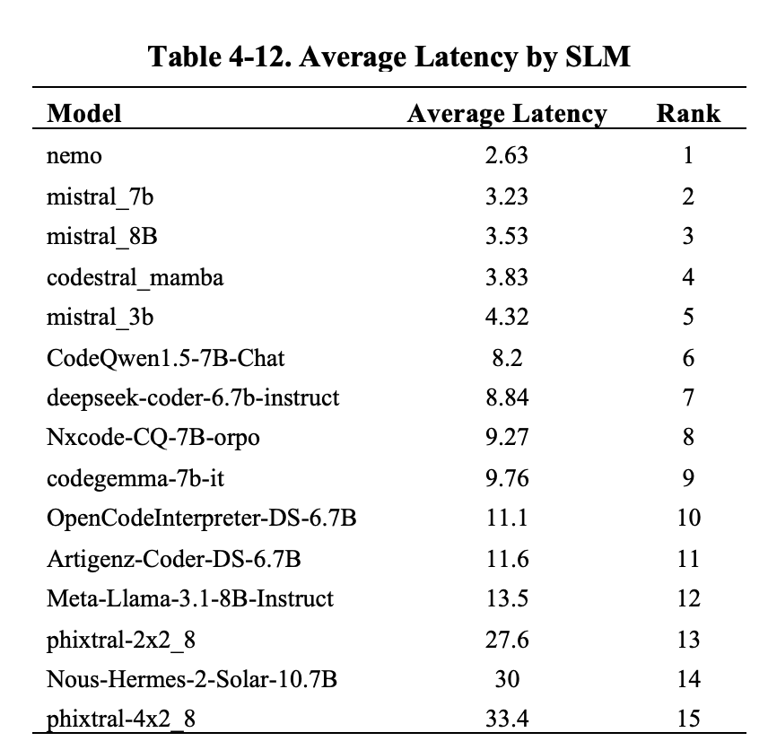
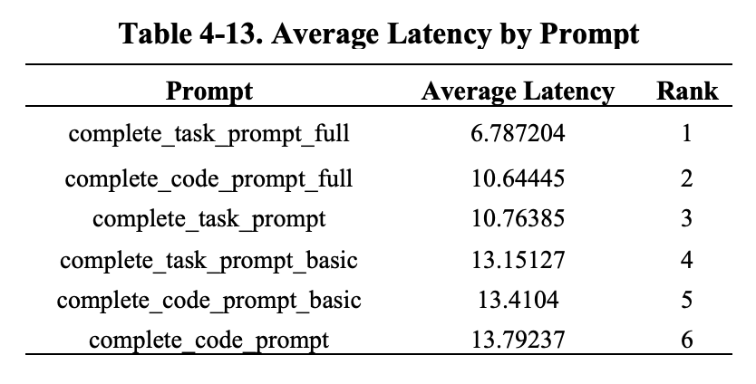
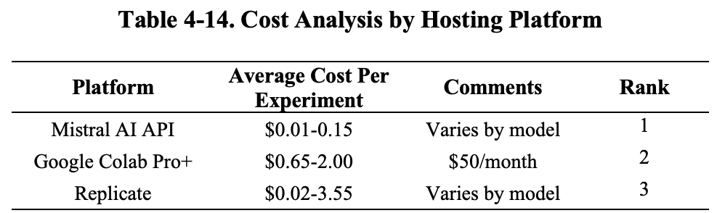
Latency and Cost Analysis
Notes:
Table 4-11 shows the four benchmark datasets ranked by the average latency of one inference call. This information was parsed from the logs for each API call and then aggregated.
Across the four code-generation benchmarks, one can see a clear rise in latency as tasks become longer, more complex, and—critically—uncontaminated.
MBPP runs fastest at 7.59 s per average sample and HumanEval at 7.74 s, both of which include some publicly exposed examples.
In contrast, BigCodeBench (a non-contaminated, real-world code suite) averages 14.48 s, and LBPP (a strictly held-out, non-contaminated benchmark) is slowest at 18.40 s—reflecting their heavier test harnesses and the extra sandboxing overhead required to enforce clean evaluation.
Table 4-12 ranks SLMs by the average latency of one inference call. Inference latency varies dramatically by model.
The Mistral models (Nemo, 7B, 8B and Codestral Mamba) called via the Mistral AI API achieved the quickest turn-around (2.6–3.8 s) thanks to highly optimized remote endpoints
In contrast, all other 7B-scale models—CodeQwen1.5-7B-Chat (8.2 s), DeepSeek-Coder-6.7B (8.8 s), Nxcode-CQ-7B-orpo (9.3 s), Codegemma-7B-it (9.8 s) and Meta-Llama-3.1-8B-Instruct (13.5 s)—were run in Google Colab, where the inference on the A100 GPUs roughly double their per-sample times.
Heavier or quantized variants like Phixtral-2x2_8 (27.6 s) and Nous-Hermes-2-Solar-10.7B (30 s) suffered additional API and compute overheads.
Inference via Replicate.com proved the slowest: models like Qwen1.5-7B and Phixtral often required 200–300 seconds per call. This bottleneck dramatically extended the overall runtime, especially on larger benchmarks such as MBPP (≈500 samples), where the total evaluation time became prohibitive.
Table 4-13 ranks prompts by the average latency of one inference call – we can see something very interesting
The full-instruction templates run fastest.
Dropping the “full” guardrails slows things down, and the slowest are the basic prompts.
Reasopn: almost all of the wall-clock delay in these calls is in the token generation step (not “reading” the prompt). Therefore, a longer, more detailed “full” prompt shrinks the model’s output by telling the model to emit only the exact code and nothing else—so it ends up generating far fewer tokens overall. On the contrary, a vague basic brief prompt causes the model to ramble, repeat itself, or wrap code in extra explanation.
VERY IMPORTANT FOR ACCURACY VS. COST TRADE-OFF – shorter prompts generated higher pass rates.
Table 4-14 highlights costs by experiment by hosting platform.
The Mistral AI API is by far the most cost-effective way to run code-generation experiments (just $0.01–0.15 per full benchmark run, depending on model).
Widely used Google Colab Pro+ comes next at an estimated $0.65–2.00 per experiment followed by Replicate ($0.02–3.55).
This breakdown underscores that for large-scale or frequent benchmarking, API-based access to optimized hosted endpoints can slash your bill compared to general-purpose notebook subscriptions or ad-hoc cloud calls

Slide 27
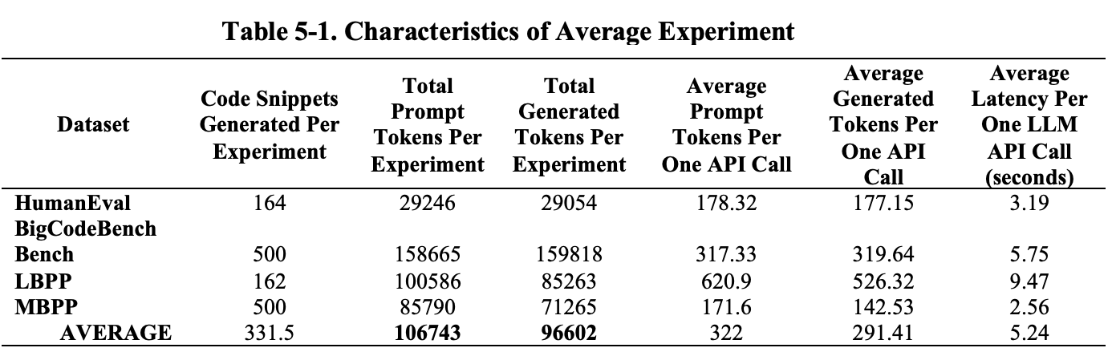
Efficiency Gains from SLMs
Mistral API is roughly 92% cheaper than the OpenAI o3 model
Mistral AI API charges between $0.01 and $0.15 per experiment (Table 2-12), with a midpoint of $0.08.
Based on OpenAI o3 pricing [OpenAI 2, 2025] - $2 per 1 M input tokens and $8 per 1 M output tokens - 331 code completions cost: 106,743*2 + 96,602*8)/1M = $0.99.
With $0.08 vs. $0.99 per run, the Mistral API is 92% cheaper.
Infrastructure Cost Reduction
On-demand AWS instance g4dn.12xlarge (4 GPUs) costs $3.90/hour vs. $0.75/hour for a single-GPU instance g4dn.2xlarge. Expenses are reduced by roughly 84%.
Latency
Average latency of GPT4 - 18 ms per generated token => each GPT-4 inference takes about 5.25 seconds vs. 3.5s by Mistral 8B which makes it 33% faster than GPT-4.
Other Improvements
Reflection agentic workflow improves pass rates by an average of 6% while fine-tuning an SLM can improve pass rates by additional 5%. All these performance gains lead to a better quality of generated code and, therefore, to a shorter time the developers need to debug the generated code. This translates into additional savings
Notes:
Table 5-1 shows the total and average numbers of input (prompt) and output (generated) tokens per one experiment under this Praxis.
An 8B-parameter SLM model can be fine-tuned on a single GPU, as demonstrated in this Praxis. By contrast, a 70B-parameter LLM holds about 140 GB of weights in FP16 (16-bit floating-point - bytes per parameter) and therefore requires four 40 GB A100 GPUs to fine-tune. According to Amazon (2025), an on-demand g4dn.12xlarge instance (4 GPUs) costs $3.90/hour, while a single-GPU g4dn.2xlarge instance (32 GB RAM) costs around $0.75/hour. Hardware cost savings: deploying or fine-tuning an SLM on one GPU instead of the multi-GPU setup needed for a 70B LLM cuts hardware expenses by roughly 84%.
Faster latency by 33% directly reduces developer wait times and thus boost productivity.

Slide 28
Substantiating the Thesis Statement and Validating Hypotheses
Substantiating the Thesis Statement
My Thesis Statement stated that SLM-based agents deployed in resource-constrained environments for automated code generation will ensure lower costs and sensitive data protection, speeding up development cycle
The results of this Praxis have clearly demonstrated that SLMs ensure lower costs as compared to the use of LLMs. SLMs also provide sensitive data protection through deployment in private cloud or in a local resource-constrained environment.
Hypotheses Validation
Hypothesis 1 states that agents will lead to higher test-case pass rates, as measured across multiple benchmarks. The results described in Section 4.6 of this research showed that agentic workflows resulted in higher model performance vs. single-pass SLMs.
Hypothesis 2 asserts that adjusting SLM parameters, such as temperature and top-p, will improve code generation quality. Section 4.8 proved this hypothesis for temperature as reducing it to 0.1 yielded measurable improvements in the code generation task, however there was not enough evidence to consider it proved for top-p.
Finally, Hypothesis 3 says that fine-tuning SLMs on domain-specific data will increase test-case pass rates across multiple benchmarks. Section 4.9 of this research proved this statement.

Slide 29
Key Findings
Post-processing is critical: raised pass@1 score from 5.6% (raw) to 70.0% (fence-extracted) and 74.9% (full cleaning).
Simpler prompts often win: basic prompts achieved a mean pass@1 of 0.767 versus 0.760 for instructional and 0.718 for “full” prompts.
7 B models dominate the leaderboards, while very small (< 4 B) and larger (> 10 B) models perform worse.
Data-leakage penalty: all models suffer steep drops on the uncontaminated LBPP and BigCodeBench datasets, validating the need for held-out benchmarks.
Reflection boosts quality: a two-stage self-critique workflow adds +6 pp on average.
Fine-tuning proves effective: QLoRA-based adaptation on MBPP gave +3 pp (Nxcode) and +5 pp (Mistral 8B).
Temperature tuning helps selectively: lowering temperature to 0.1 yields up to +0.96% on LBPP, though optimal settings vary by model; nucleus sampling (top_p) showed no consistent benefit.
Error modes expose weaknesses: AssertionError dominates unit-test failures for HumanEval, MBPP, and LBPP, while TypeError leads on BigCodeBench.
Latency scales with complexity: per-sample inference takes ~7.6 s on MBPP/HumanEval, ~14.5 s on BigCodeBench, and ~18.4 s on LBPP, reflecting longer prompts and heavier test harnesses.
Execution environment matters: Mistral-API models are fastest (2.6–3.8 s), Colab-hosted 7 B models run in ~8–13 s, and Replicate calls can spike to 200–300 s—crucial for throughput planning.
Cost trade-offs: Mistral AI API is most economical at $0.01–0.15 per full run, Google Colab Pro+ (500 compute units/month) costs $0.65–2.00 per experiment, and Replicate varies $0.02–3.55, guiding platform choice for scale.
Notes:
Post-processing is critical: the three-stage pipeline raised average pass@1 from 5.6% (raw) to 70.0% (fence-extracted) and 74.9% (full cleaning), with full cleaning yielding the best executability across all models.
Simpler prompts often win: basic prompts achieved a mean pass@1 of 0.767 versus 0.760 for instructional and 0.718 for “full” prompts, underscoring that concise, clear directives can outperform elaborate guardrails.
7 B models dominate: CodeQwen1.5-7B-Chat (mean 0.865) and Nxcode-CQ-7B-orpo (0.856) top the leaderboards, while very small (< 4 B) and very large (> 10 B) models underperform, revealing a “sweet spot” around 7 B parameters.
Data-leakage penalty: all models suffer steep drops on the uncontaminated LBPP and BigCodeBench datasets (e.g. top models fall from ~98% on MBPP/HumanEval to ~80% on LBPP), validating the need for held-out benchmarks.
Reflection boosts quality: a two-stage self-critique workflow adds +6 pp on average.
Temperature tuning helps selectively: lowering temperature to 0.1 yields up to +0.96% on LBPP, though optimal settings vary by model; nucleus sampling (top_p) showed no consistent benefit.
Fine-tuning proves effective: QLoRA-based adaptation on MBPP gave +3 pp (Nxcode) and +5 pp (Mistral 8B), demonstrating that even lightweight, domain-specific tuning materially improves pass@1.
Error modes expose weaknesses: AssertionError dominates unit-test failures on structured benchmarks (HumanEval 628, MBPP 2665, LBPP 1113), while TypeError leads on BigCodeBench (3997), highlighting universal challenges with test-case correctness and type handling.
Latency scales with complexity: per-sample inference takes ~7.6 s on MBPP/HumanEval, ~14.5 s on BigCodeBench, and ~18.4 s on LBPP, reflecting longer prompts and heavier test harnesses.
Execution environment matters: Mistral-API models are fastest (2.6–3.8 s), Colab-hosted 7 B models run in ~8–13 s, and Replicate calls can spike to 200–300 s—crucial for throughput planning.
Cost trade-offs: Mistral AI API is most economical at $0.01–0.15 per full run, Google Colab Pro+ (500 compute units/month) costs $0.65–2.00 per experiment, and Replicate varies $0.02–3.55, guiding platform choice for scale.

Slide 30
Model selection recommendations
If absolute correctness is the only goal:
CodeQwen1.5-7B-Chat (mean 0.865 pass@1) and Nxcode-CQ-7B-orpo (mean 0.856) clearly lead the 15-model experiments, topping every public benchmark (HumanEval, MBPP) and holding the #1–2 spots even on held-out tests.
Codestral Mamba (#3, mean 0.845) complements this “best-of-breed” triad.
For the lowest latency, the Mistral-family dominates on speed using the Mistral AI API (under 4 s per sample):
Mistral Nemo (2.6 s),
Mistral 7B (3.2 s),
Mistral 8B (3.5 s), and
Codestral Mamba (3.8 s).
The best performance vs. cost trade-off:
Codestral Mamba (mean 0.845, 3.8 s, $0.02–0.15/run) performs well and fast enough.
Mistral 8B sits squarely in the middle—≈0.83 pass@1, 3.5 s latency, $0.01–0.15/run

Slide 31
Contributions to Body of Knowledge
Validated a tiered cleaning pipeline: simple extraction of code from the first code fences improves results by ~70 pp; the full cleaning pass yields a further ~5 pp gain. Full cleaning should be the standard for automated code evaluation.
Clarified prompt-complexity trade-offs: showed that, on average, a succinct “basic” prompt outperforms more elaborate “instructional” or “full” prompts—saving tokens, time, and developer effort.
Identified a 7 B-parameter sweet spot: empirically ranked CodeQwen1.5-7B-Chat, Nxcode-CQ-7B-orpo, and Codestral Mamba at the top of the four diverse benchmarks.
Exposed data-leakage effects by comparing performance on public (HumanEval/MBPP) vs. uncontaminated (LBPP/ BigCodeBench) datasets.
Measured agentic workflow gains
Discovered the error-mode distributions by aggregating thousands of failure cases
Characterized latency vs. task complexity
Compared cost/throughput trade-offs
Provided temperature and top_p tuning insights
Demonstrated lightweight fine-tuning gains validating that QLoRA on a single GPU can yield +3–5 pp improvements - a viable path for domain-specific code-generation enhancements

Slide 32
Recommendations for Future Research
Explore other options beyond the current time and scope limitations:
Improve the agentic performance by:
Improving the prompt engineering based on the current results.
Conducting error analysis to improve the post-processing of generated code to achieve better code executability.
Improving the results via the efficient use of the LangChain and LangGraph frameworks to organize multi-agent workflows where each agent is defined as a step in a pipeline.
Fine-tuning an SLM as part of agentic workflow.
Repeat the temperature and top_p experiments on the other three datasets and maybe modifying other inference-time parameters of the model.
Repeat the fine-tuning experiment with other SLMs and using other training datasets.
Other recommendations meant to improve the overall results:
Adjust other SLM inference parameters in addition to the temperature and top_p.
Fine-tuning SLMs using the Mistral AI API (lower latency).
Analysis of performance stability across multiple evaluation runs.
Comparison of results obtained from the same models hosted on different platforms.
Analysis of errors at a deeper level than datasets (per model and/or per prompt) for further insights.

Slide 33
Back Up Slides

Slide 34
Scope of Research
Scope
Establish code generation benchmarks using public leaderboards.
Select several SLMs for code generation experiments.
Enhance SLMs with agents, vary model parameters, fine-tune models.
Conduct systematic experiments to assess the quality of generated code using quantifiable metrics
Document the experiments.
Limitations
Due to smaller size (fewer training parameters) SLMs may not achieve the same level of sophistication, contextual understanding, and code generation quality as LLMs, no direct LLM experiments - using benchmarks.
Scope constraints: limited hardware and computational resources – imitating resource-constrained environments which restrict model fine-tuning capabilities, evaluation and training dataset size, and depth of evaluation
One-year timeframe => focus on Python and two agentic workflows.
Rapidly evolving AI landscape - new models or methods may emerge before publication, affecting the relevance of the findings.

