Slide 1
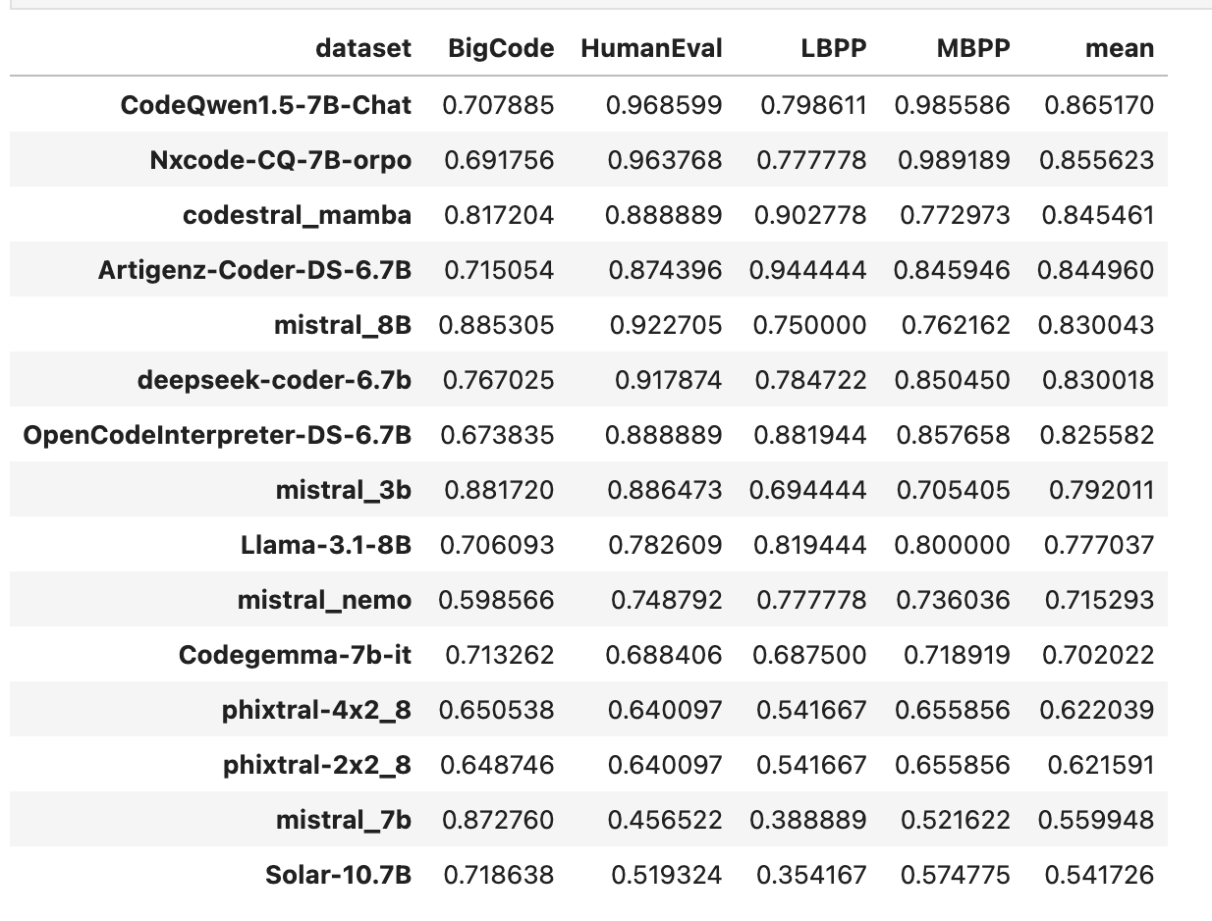
Mean
Max
Cleaning: full
Prompt: basic_prompt
Cleaning: full
Prompt: basic_prompt

