Slide 1


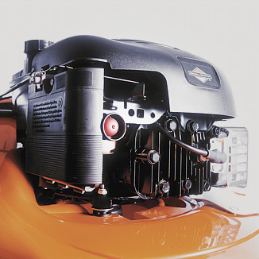
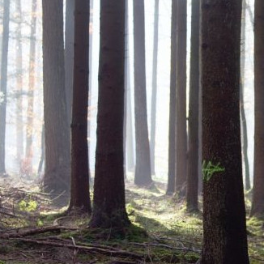
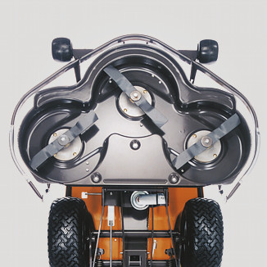
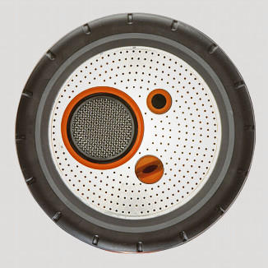
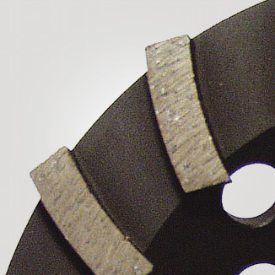
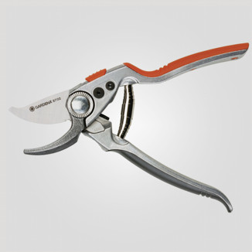
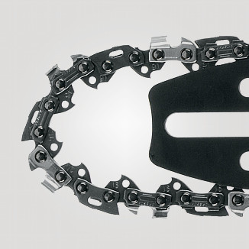
Husqvarna Research Platform

Slide 2
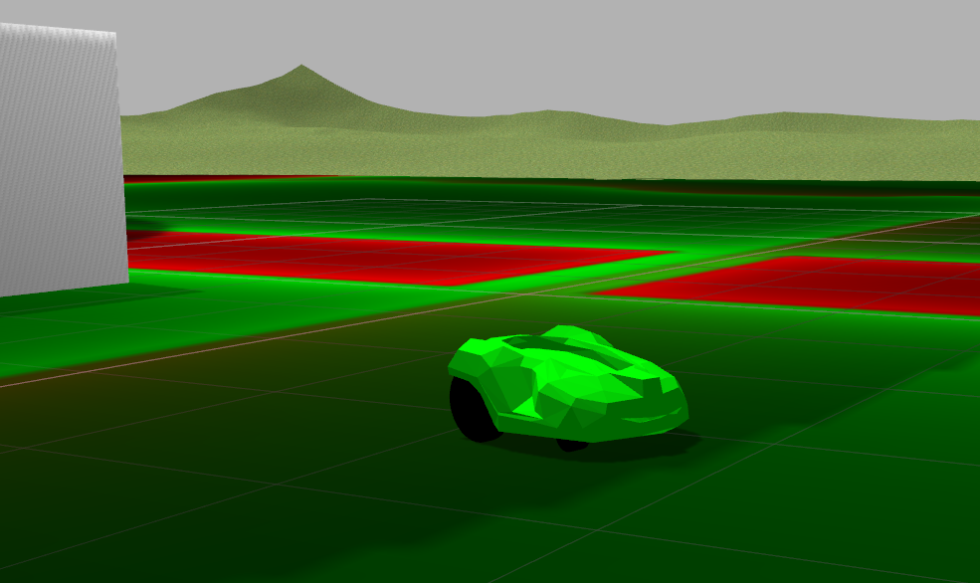
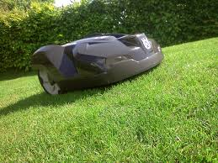
What is the Husqvarna Research Platform?
ROS enabled durable outdoor robot
Operates in all weathers
Operates 24/7 with automatic charging
Includes Gazebo models for simulated environment
Simple ros interface via provided driver (velocity in, odometry out)
Add your own computing platform and sensors depending on research

Slide 3
Standard Automower 330X
Bumper (collision) with all directions of chassis. Will also detect “lift” for safety reasons.
Wire sensors Bad at distance but very good close to wire.
Pivoting wheels (2) + 2 rear wheels

Slide 4
Standard Automower 330X
Battery
Main board (STM32-based)
GUI board (STM32-based) Includes buttons/display
”Standard Mower SW”
Accel
Wheel Motor
Encoder
Wheel Motor
Encoder
Wire Sensor
Collision Sensor
Wire Sensor
Collision Sensor
Wire Sensor
GPS

Slide 5
Research Automower 330X
Battery
Main board (STM32-based)
GUI board (STM32-based) Includes buttons/display
”Standard Mower SW”
With special research mode.
Accel
Research/ROS (Target Computer)
Serial port
roscore
Wheel Motor
Encoder
am_driver
Wheel Motor
Encoder
”magic ros node”
am_mpu9150
Wire Sensor
Collision Sensor
Wire Sensor
Collision Sensor
”magic ros node”
Wire Sensor
Serial port
”magic ros node”
IMU
(9150)
WIFI HW (Access Point)
Magic
sensor
GPS*
Host Computer (Ubuntu + ROS)
* Not exposed to ROS

Slide 6
HRP Driver Package Descriptions
am_driver
Description: Interface to the Automower via serial port.
Published topics:
/odom - position of robot given encoder data
/loop - status of boundary loop sensors
/sensor_status - status of collision sensors
/wheel_encoder - ticks read from the automower
Subscribed topics:
/cmd_vel - speed to assign to mower (linear and angular) /cmd_mode - mode of control for mower
am_mpu9150
Description: Interface to the mpu9150 imu via i2c.
Published topics:
/imu - fused quaternion and raw data (no covariance)
/imu_euler - fused heading in +-pi
Subscribed topics: none

Slide 7
Getting Started
Unpack delivery file into the source folder of a catkin workspace (tar -xvf [delivery file])
Build using catkin_make
Simulator:
setup the model path: export GAZEBO_MODELPATH= [the source folder]/hrp/am_gazebo/models:GAZEBO_MODELPATH
Launch simulator using roslaunch am_gazebo am_gazebo_vslam.launch gui:=true
Launch keyboard control with rosrun am_control keyboard_teleop.py
You can now hopfully drive around in the simulated garden in gazebo!
Target:
unpack and build the delivered software on the target computer
make sure that the serialPort and i2cbus defined in the launch file (am_driver/launch/automower_vslam.launch)match those on your target computer.
Launch target with roslaunch am_driver automower_vslam.launch
Tell host that ros master is on target by exporting correct ROS_IP, ROS_HOSTNAME and ROS_MASTER_URI
Launch keyboard control on host with rosrun am_control keyboard_teleop.py

Slide 8

www.husqvarnagroup.com

