Slide 1
Call Center Quality Analytics
Executive Insights, Operational Bottlenecks, & SLA Optimization
Prepared by: Agnelo Lobo
Date: July 2026

Slide 2
The Business Problem & Objectives
The Pain Point: Customer Satisfaction (CSAT) dropped by 15% over two quarters due to unmanaged call volume spikes.
The Visibility Gap: Management lacked automated tracking for queue bottlenecks, SLA breaches, and agent performance.
The Solution: Developed a fully functional, two-page proof-of-concept dashboard framework to model customer interaction tracking and compliance metrics.

Slide 3
Technical Architecture & Data Pipeline
Data Integration: Engineered a structured relational schema modelling call metrics, agent attributes, and baseline SLA targets.
Data Transformation: Utilized Power Query to handle missing fields, unpivot dynamic dates, and clean metric data types.
Data Modeling: Designed a fast, highly optimized Star Schema with robust relationship for seamless filtering.
Advanced Analytics: Wrote custom DAX measures to calculate rolling satisfaction scores and real-time SLA breach rates.

Slide 4
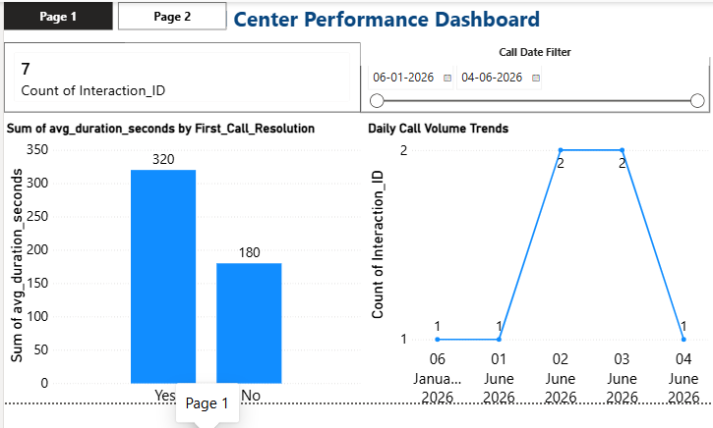
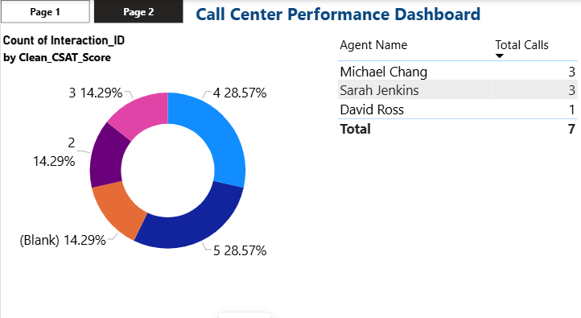
Interactive Dashboard Previews

Slide 5
Analytical Framework & Key Outcomes
Dynamic Tracking: Designed scalable visual containers to monitor daily call volume trends and handle duration metrics.
Granular Filters: Implemented operational page-level slicing to isolate metrics by specific communication dates.
Scalable Blueprint: Built a portable, production-ready data schema easily upscaled to handle millions of transaction rows.

