Slide 1
AWS Datawarehouse Proposed Architecture
For an Insure-Tech Company

Slide 2
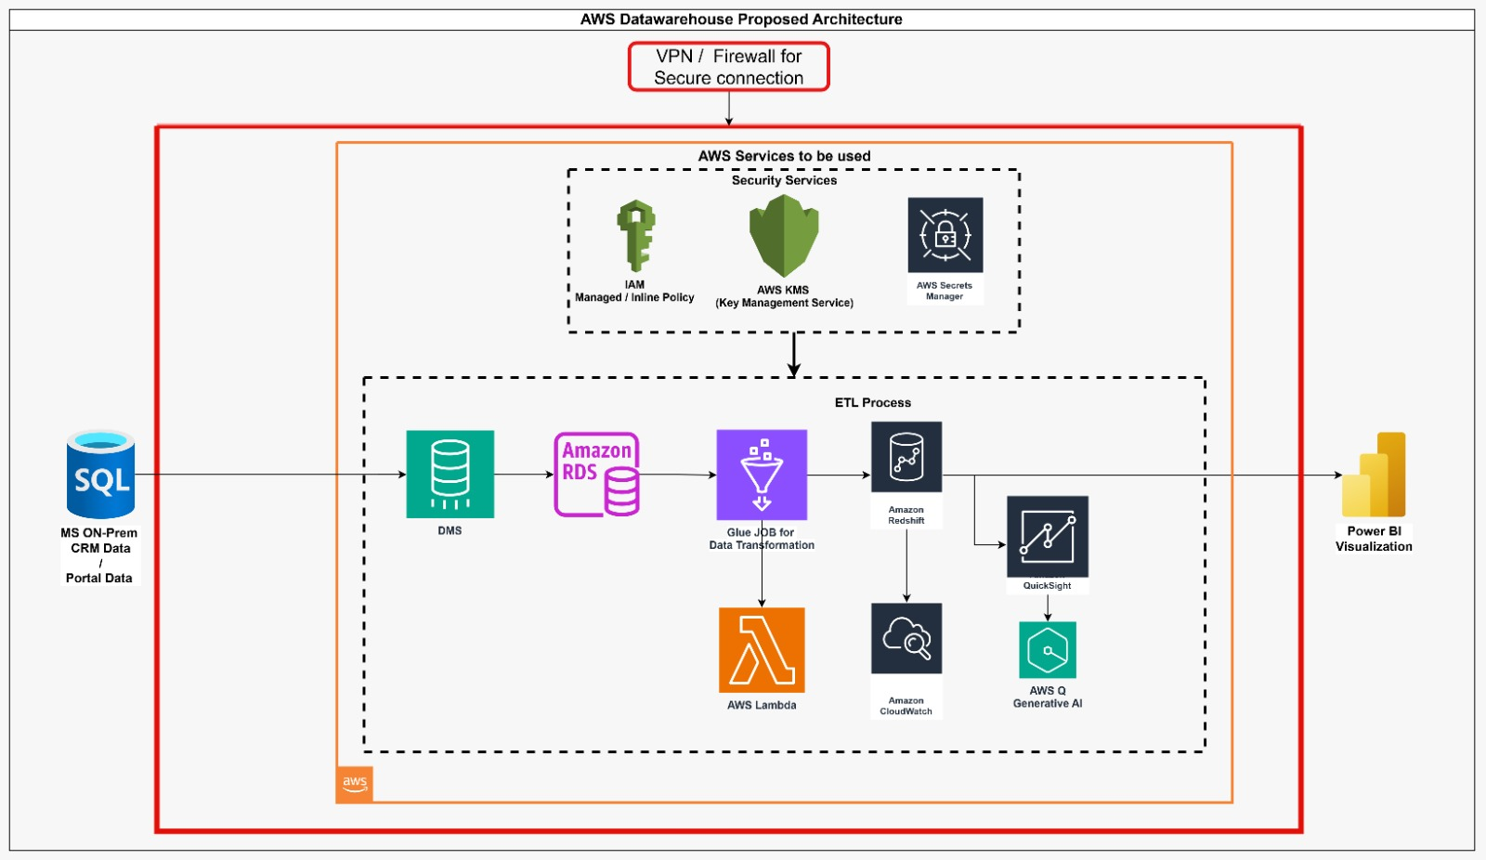
Architecture Diagram

Slide 3
High-Level Flow
MS SQL Server (On-Prem)
⬇
AWS DMS
⬇
Amazon RDS
⬇
AWS Glue
⬇
Amazon Redshift
⬇
Power BI / Quick Sight / AWS Q (AI)

Slide 4
Step-by-Step Data Flow
1. On-Premises Data Source
2. Migration via AWS DMS
3. Staging in Amazon RDS
4. ETL Transformation with AWS Glue
5. Storage in Amazon Redshift
6. Monitoring using CloudWatch
7. Visualization using Power BI & QuickSight
8. AI-driven insights via AWS Q

Slide 5
ETL Process Details
• AWS DMS: Secure migration from SQL Server
• Amazon RDS: Staging Layer
• AWS Glue: Data Transformation
• Amazon Redshift: Data Warehouse for Analytics

Slide 6
Security Services Overview
• AWS IAM for Access Management
• AWS KMS for Data Encryption
• AWS Secrets Manager for Secure Credentials
• VPC Private Subnets for Isolation

Slide 7
Monitoring and Alerting
• Amazon CloudWatch for Monitoring Glue, Redshift
• DMS Event Subscriptions for Failure Alerts
• CloudTrail for Audit Logs

Slide 8
Visualization and AI Insights
• Power BI for Advanced Dashboards
• Amazon QuickSight for AWS-native Reporting
• AWS Q (Generative AI) for Intelligent Narratives

Slide 9
Final Summary
• Secure, scalable, and fully managed architecture.
• Real-time monitoring and AI-powered insights.
• Ready for business-critical analytics and reporting.

