Slide 1



Sentiment Analysis
BRITISH AIRWAYS

Slide 2





Introduction
British Airways (BA) – the UK's premier flag carrier airline – serves as the global link for thousands of passengers daily. This expansive operation involves meticulous planning, precision, and a commitment to top-tier customer service.

Slide 3


The method
03
Text Analysis
01
Web Scraping and analysis
Description
04
Visualization
02
Data Preprocessing
Description
Data Collection, Data Cleansing, Filtering, Case Holding, Remove punctuation, remove multiple whitespace, Lemmatizing,
05
Evaluation
Description

Slide 4
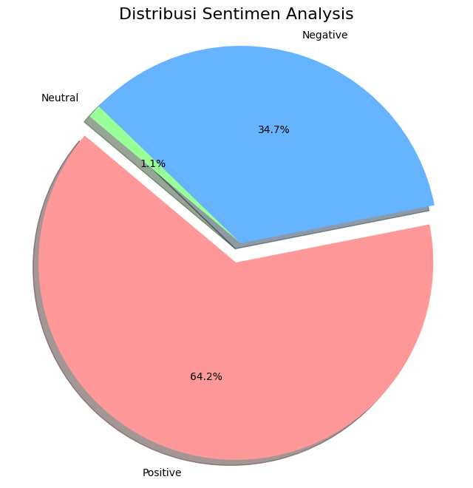

Distribution Sentiment Analysis
Based on the pie chart, British Airways received approximately 64.2% positive sentiment, but around 34.7% negative sentiment also provides valuable feedback to consider.

Slide 5


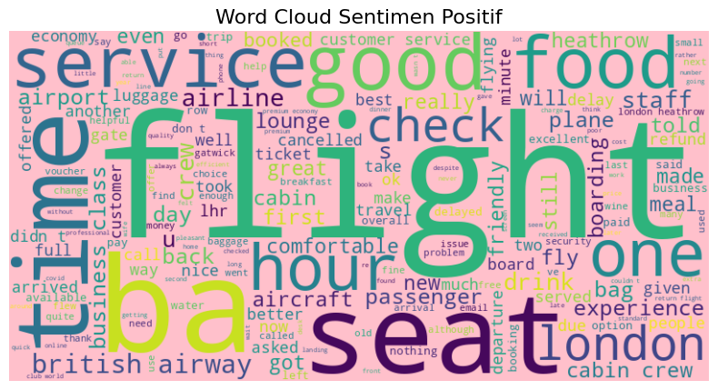

Positive Sentiment Analysis
Customers have positive sentiments towards British Airways in various aspects, including seat comfort, service quality, overall experience, staff friendliness, cabin condition, and the airline as a whole.

Slide 6
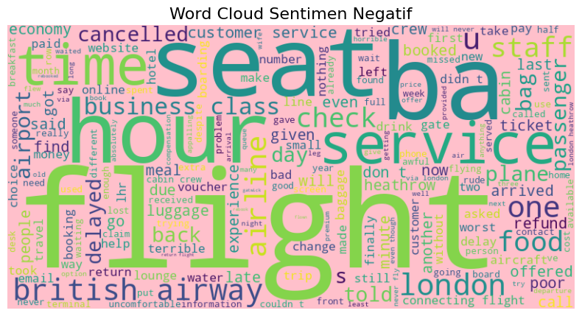
Negative Sentiment Analysis
The negative sentiment analysis indicates that customers have expressed concerns and dissatisfaction regarding various aspects of their experience with the airline. These concerns include problems they encountered, issues with meal quality, experiences they found terrible, dissatisfaction with the airline's services, flight delays and cancellations, poor customer service, uncomfortable situations during their journey, and overall dissatisfaction with their experience as passengers.

Slide 7

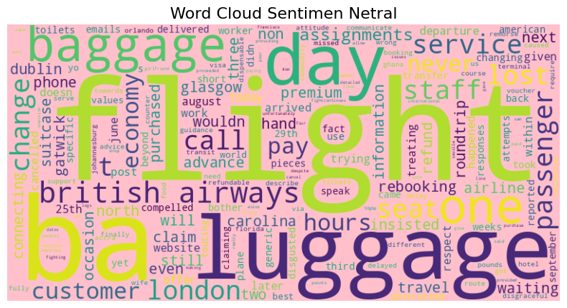
Neutral Sentiment Analysis
Neutral sentiment analysis indicates that some customers have provided feedback that is neutral regarding various aspects of their experience with the airline. This includes topics such as luggage, travel, staff, payment, service, economy class, arrival, premium ticket booking, information about the next trip, advance ticket purchase, claiming processes, and experiences that are considered "complete" or "finished" after the journey. Neutral sentiment typically means that customers may feel indifferent or not have strong feelings about the mentioned topics.

Slide 8
Evaluation
Based on the data presented above, the sentiment analysis reveals a mixture of positive, negative, and neutral sentiments from customers.
1. Positive Sentiment: Customers have expressed positive sentiments mainly related to aspects such as good service, food, staff, cabin crew, and the airline in general. They appreciate these aspects of British Airways.
2. Negative Sentiment: Negative sentiments are associated with problems, terrible experiences, delays, cancellations, poor service, and other issues. Customers have highlighted areas that need improvement, such as meals, vouchers, and flight experiences.
3. Neutral Sentiment: Some customers have provided feedback that is neutral, indicating a lack of strong positive or negative feelings. Topics include luggage, travel, staff, payment, and various aspects of the travel experience.
This sentiment analysis is valuable for understanding customer feedback and can serve as a foundation for making data-driven decisions. By analyzing these sentiments, British Airways can address areas of concern, enhance positive aspects, and ultimately improve the overall customer experience. Data-driven recommendations, tools, and models will play a pivotal role in reducing costs and increasing revenue, thereby making a substantial impact on the business.

