Slide 1

ACADEMIC MANAGEMENT SYSTEM
TRIEU TIEN QUYNH
LE THI KIEU TRANG
QUACH HUU NAM
05/02/2026

Slide 2

OVERVIEW
This project develops an Academic Management System using a microservices architecture to manage students, courses, and grades.
The system focuses on modular design and scalable service-based communication.
01
04
Introduction
C4 model
02
Microservices Architecture.
05
Testing & Verification
03
06
Use case
Conclusion

Slide 3


INTRODUCTION
- System Name: Academic Management System.
- Context: Managing credit-based education demands high precision, real-time updates, and the capability to handle high traffic loads during course registration periods.
- System Objectives:
+ Digitization: Digitize the entire workflow, from student and lecturer management to course registration and grade entry.
+ Transparency: Ensure information transparency, allowing students to track their academic progress (GPA/CPA) instantly.
+ Automation: Automate grade calculations, academic warning assessments, and notification dispatching.
- Scope: Administrator, Lecturer, and Student Modules.

Slide 4
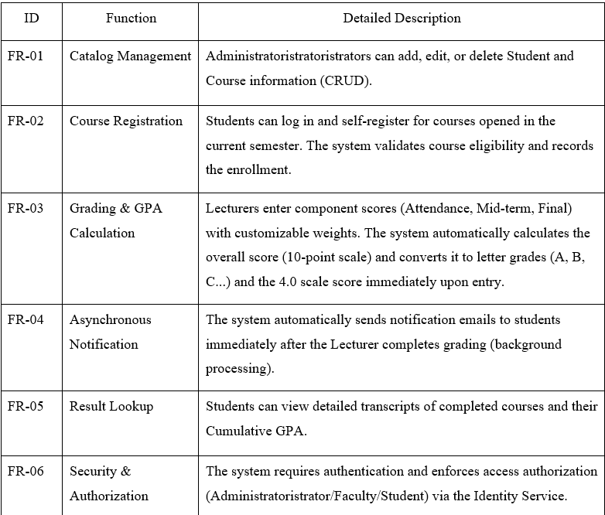
INTRODUCTION
Core Functional Requirements

Slide 5
INTRODUCTION
Architectural Goals
Performance
    < 2s for read operations
    < 3s for write operations
Scalability
    500–1000 concurrent users
Security
    JWT Authentication
    Role-Based Access Control (RBAC)
Reliability
    99% uptime
    Service isolation

Slide 6
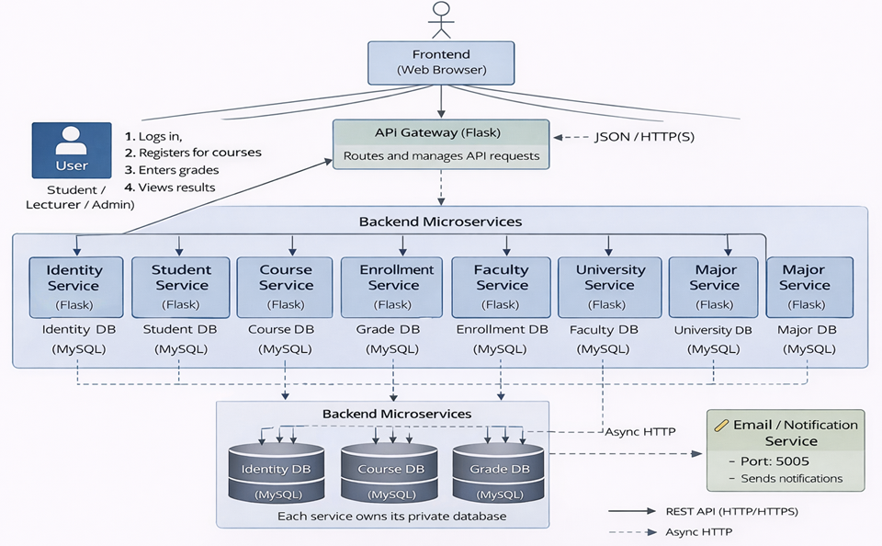
MICROSERVICES ARCHITECTURE
System Services
+ Identity Service – Authentication & Authorization
+ Student Service – Student information
+ Course Service – Course management
+ Enrollment Service – Course registration
+ Grade Service – Grading & GPA
+ Email Service – Asynchronous notifications
Each service runs on a separate port

Slide 7
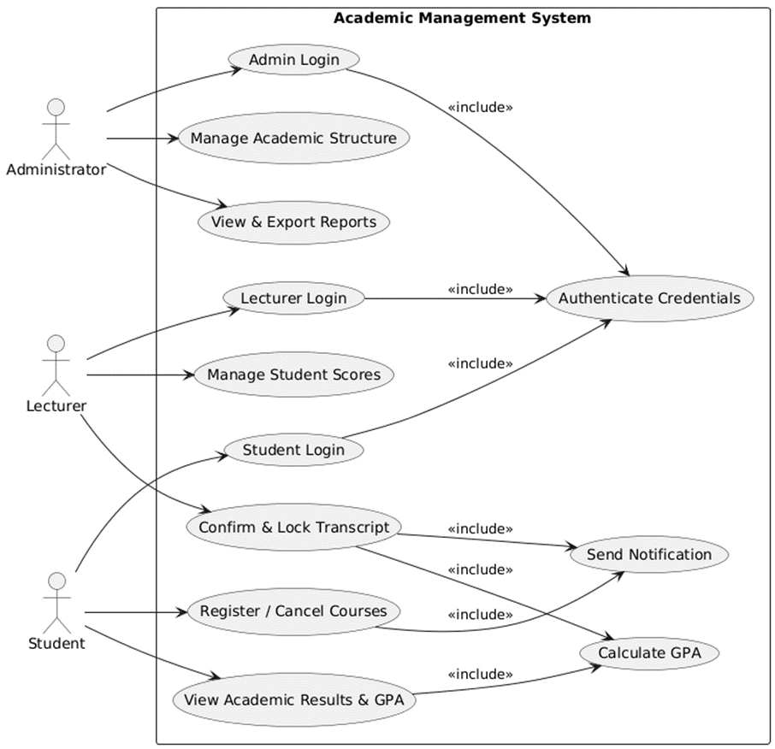
USE CASE
Main Actors & Use Cases
- Administrator
    Manage academic structure
    View & export reports
- Lecturer
    Enter grades
    Lock grade sheets
- Student
    Register courses
    View grades & GPA
Use cases focus on architecturally significant interactions

Slide 8
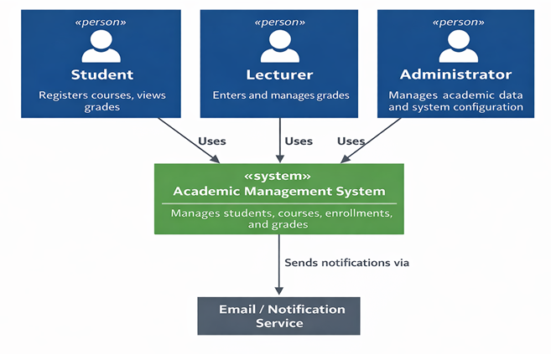
C4 MODEL
SYSTEM CONTEXT
USERS INTERACT WITH THE ACADEMIC MANAGEMENT SYSTEM
- Objective: Define the system scope and boundaries.
- Central System:
Academic Management System: Handles all core business operations (Student, course, and grade management).
- Actors:
Student, Lecturer, Administrator: Interact directly with the system to perform business tasks.
- External Systems:
Email/Notification Service: An independent system responsible for sending notifications (grades, schedules) to users.

Slide 9
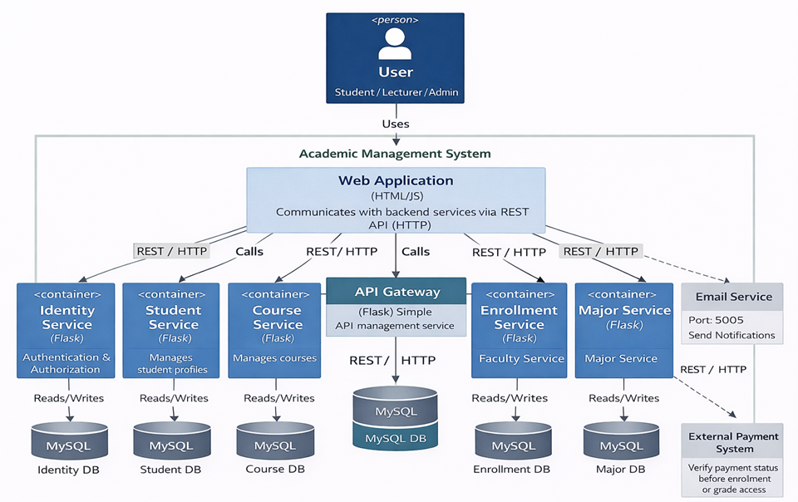
C4 MODEL
CONTAINER
+ FRONTEND (VANILLA JS)
+ MULTIPLE BACKEND MICROSERVICES
+ SHARED MYSQL DATABASE
- Architecture: Microservices.
- Core Technologies:
Frontend: Web Application (HTML/JS) consuming REST APIs.
Backend: Python (Flask) decomposed into independent microservices (Identity, Course, Enrollment, etc.).
Database: MySQL (Implementing the Database-per-Service pattern - Each service has a dedicated database).
- Processing Flow: Web App => API Gateway => Specific Microservice => Dedicated Database.

Slide 10
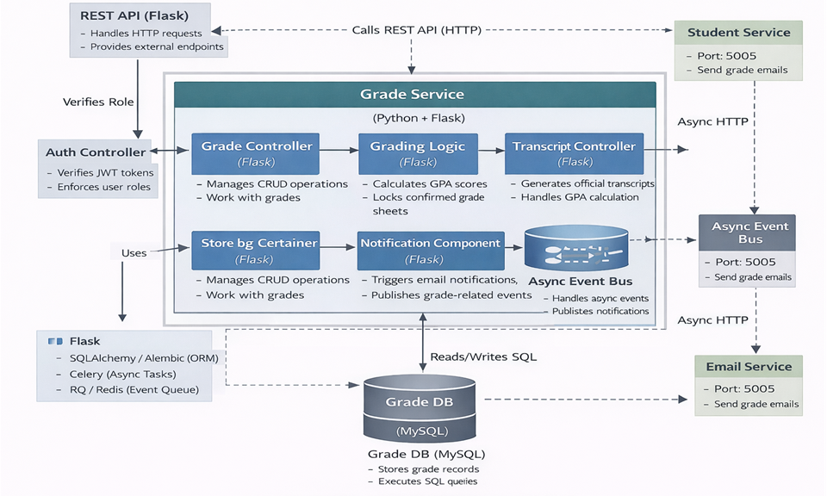
C4 MODEL
COMPONENT
CONTROLLER, REPOSITORY, MODEL INSIDE EACH SERVICE
- Objective: Deep dive into the internal structure of a specific service.
- Key Components:
API Controllers: Request handling entry points (Grade Controller, Transcript Controller).
Domain Logic: Executes complex business logic (e.g., GPA calculation, transcript locking).
Data Access: Direct interaction with the Grade DB (MySQL).
Async Event Bus: Asynchronous mechanism for notification dispatch (Email) to prevent system blocking.

Slide 11
TESTING & VERIFICATION
01
Unit Testing (Model, Repository)
- Objective: Test the smallest components within each Microservice to ensure internal logic functions correctly before integration.
- Model Testing (models.py):
Verify the initialization of Entities (Student, Course, Grade) and the accurate conversion of data to JSON format (to_dict).
- Repository Testing (repository.py):
Validate CRUD operations with MySQL and handle potential errors (connection failures, query errors).
- Significance:
Facilitates early bug detection and debugging, aligning perfectly with the independent nature of Microservices architecture.

Slide 12
TESTING & VERIFICATION
02
Integration Testing (API, Inter-service)
- Objective: Verify the coordination and interaction between internal components and external Microservices via RESTful APIs.
- API Testing:
Execute HTTP Requests (GET, POST, PUT, DELETE) to validate that Status Codes and JSON Responses align with design specifications.
- Inter-service Testing:
Validate communication flows between Services (e.g., Grade Service $\rightarrow$ Email Service) and verify asynchronous processing logic.
- Significance:
Ensures accurate service integration and stable communication within the distributed Microservices architecture.

Slide 13
TESTING & VERIFICATION
03
Tools: Postman, cURL
- Postman:
Used to test the system's RESTful APIs by sending HTTP Requests (GET, POST, PUT, DELETE) and verifying HTTP Status Codes along with the JSON Response structure.
- cURL:
A command-line tool that supports sending HTTP Requests directly from the Terminal, suitable for rapid testing and verifying low-level API behavior.
Scope of Application:
Utilized in API Testing and Inter-service Testing between Microservices.
- Purpose:
To ensure that APIs function correctly according to the design and that communication between Services remains stable within the Microservices architecture.

Slide 14
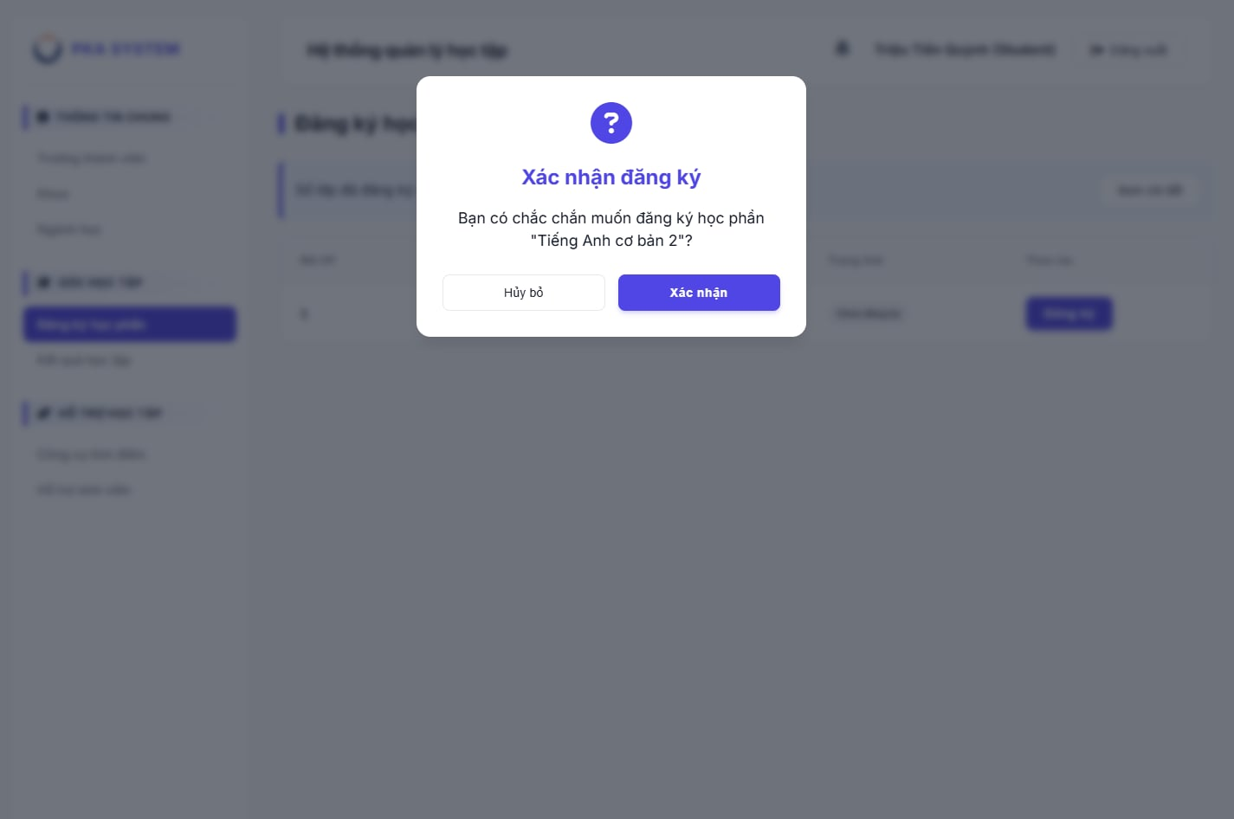
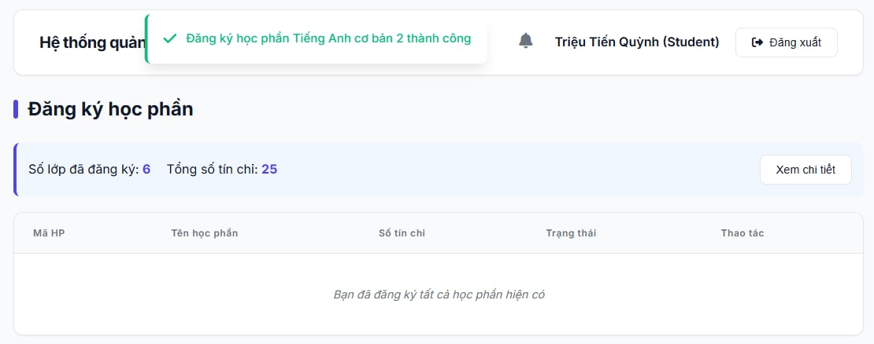
TESTING & VERIFICATION
Course Registration Interface (Student View)
"Registration Successful" notification on web interface

Slide 15
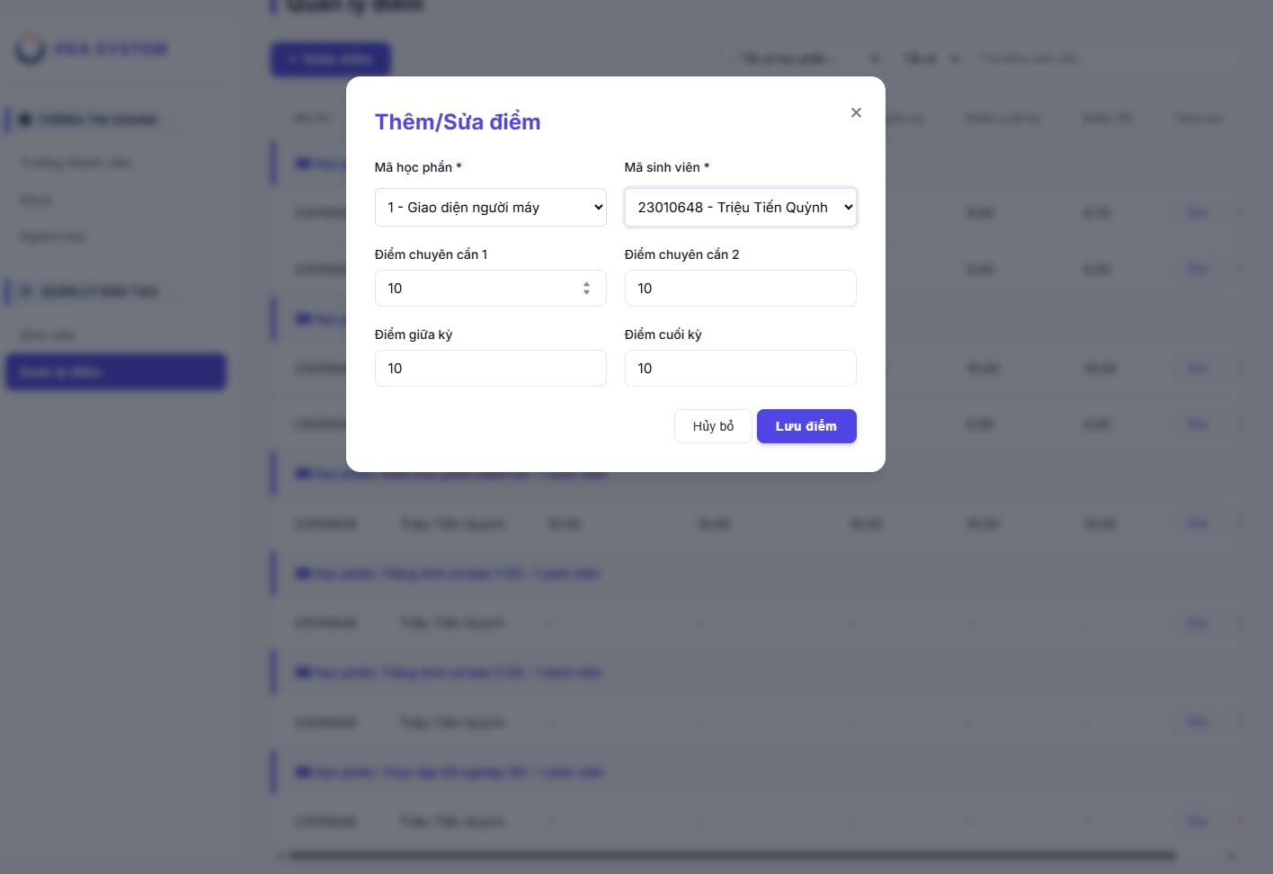
TESTING & VERIFICATION
Lecturer's Grade Entry Interface (Lecturer View)

Slide 16
CONCLUSION
Lessons Learned
- Microservices Trade-offs: Understood the balance between Scalability and Complexity.
- Distributed Systems: Mastered Data Consistency, Fault Tolerance, and Database-per-Service patterns.
- Critical Priorities: Security (JWT, RBAC) and Performance are core design pillars.
- Standardization: Importance of clear API Contracts for effective teamwork.
Future Improvements
- Architecture: Adopt Message Brokers (RabbitMQ/Kafka) for robust async processing.
- DevOps: Implement Docker & Kubernetes for auto-scaling and deployment.
- Observability: Deploy centralized monitoring (Prometheus, Grafana).
- Expansion: Integrate Online Payments and connect with external LMS.

Slide 17
THANK YOU!
TRIEU TIEN QUYNH
LE THI KIEU TRANG
QUACH HUU NAM
05/02/2026

