Slide 1

Case Study: Predicting Profit from Sales
Consumer Retail Company, Texas
Prepared by: Agnishwar Das

Slide 2

1. Objective
Determine
Determine if profit can be predicted using only sales data
Provide
Provide a simple model for Finance and Strategy teams
Evaluate
Evaluate model using R² and MAPE
Test
Test linear regression assumptions

Slide 3

2. Exploratory Data Analysis (EDA)
Moderate positive correlation (r = 0.81) between Sales and Profit
No missing values in the dataset. The avg of sales is 50730 dollars and the avg of profit is 10271 dollars.
Scatterplot suggests linearity with some heteroscedasticity (Higher sales generally lead to higher profits).
Profit variance increases with higher sales
Outlier removal

Slide 4
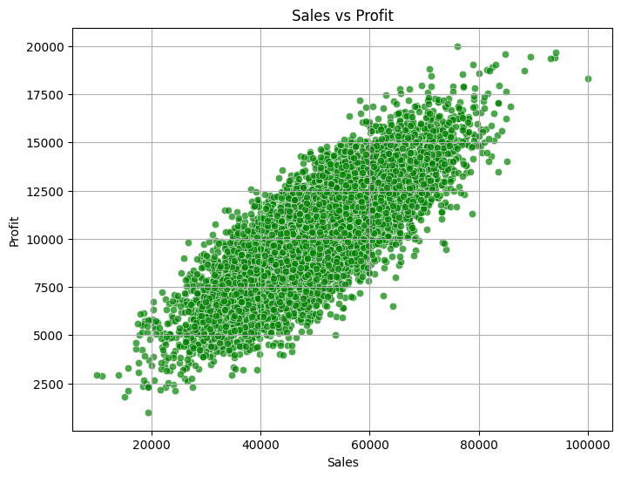
Scatter plot: Sales vs Profit

Slide 5
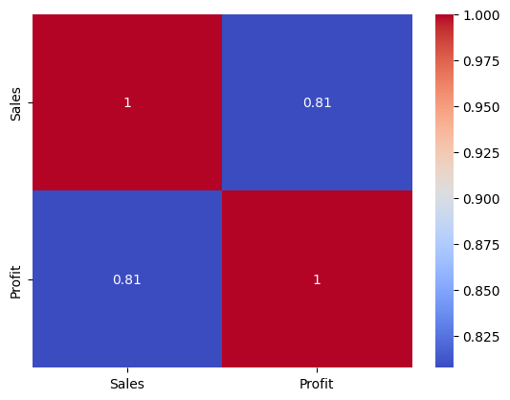
Sales vs Profit Correlation Heatmap

Slide 6

3. Simple Linear Regression Model
Model: Profit = β₀ + β₁(Sales)
β₀ : Intercept
β₁ =Coefficients for each independent variable
R-squared = 0.6543 → ~65% variance in Profit explained (Good Fit Model).
MAPE = 12.96% → Predictions within 13% of actual profit
Straightforward and interpretable model

Slide 7
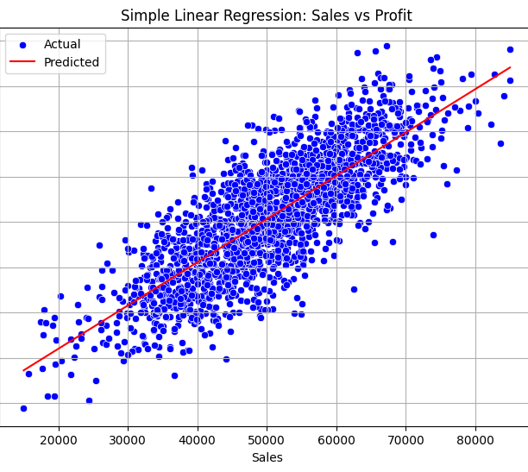
Simple Linear Regression: Sales vs Profit

Slide 8

4. Assumption Testing
Durbin-Watson Test: 1.96 → ✅ Residuals are independent
Goldfeld-Quandt Test: p = 0.54 → ✅ Homoscedasticity holds (the residuals have constant variance)
Bartlett’s Test: p = 0.86 → ✅ Equal variance confirmed
Cook’s Distance: ⚠️ Some outliers detected, minimal impact

Slide 9
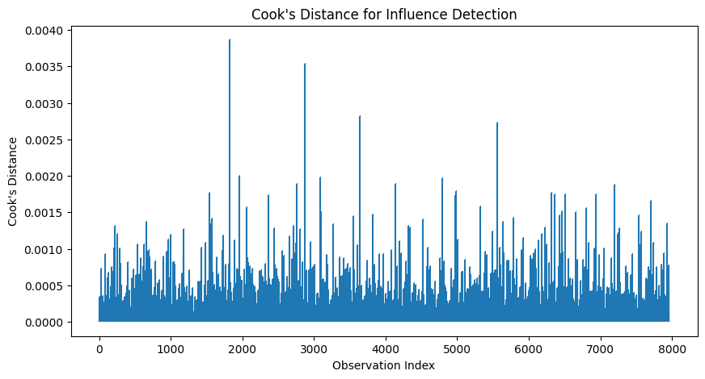
Cook's Distance Plot

Slide 10
5. Model Improvement Attempts
Polynomial Regression (Degree 2): No improvement
- R² = 0.6450, MAPE = 13.66%
Log-Transformed Model: Slightly worse than baseline
- R² = 0.6424, MAPE = 13.48%
Conclusion: Enhancements increased complexity without gains

Slide 11
5. Model Improvement Attempts
Multiple Linear Regression: Major improvement using Sales, Discount, Category & Region
- R² = 0.99, MAPE = 2.60%
Conclusion: Sales alone is not sufficient, but adding key business features leads to reliable and accurate profit prediction

Slide 12
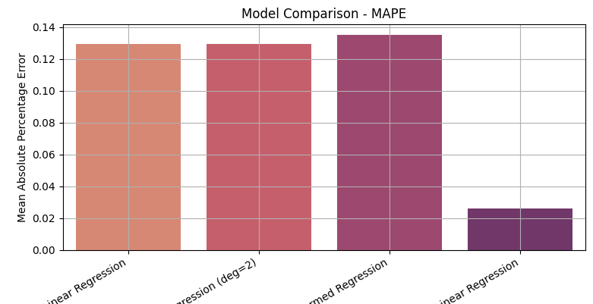
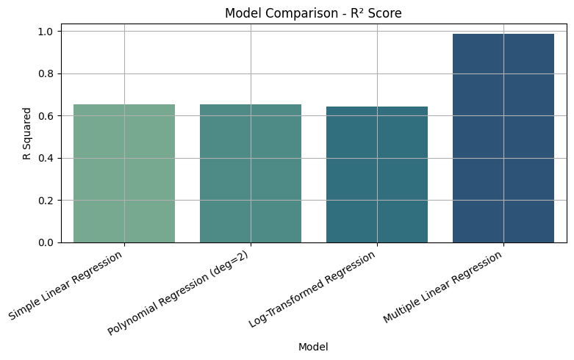
6. Model Comparison
Multiple Linear Regression clearly outperforms the others in both R² and MAPE.
Polynomial and Simple Linear models perform similarly.
Log-transformed model shows slightly weaker performance.

Slide 13
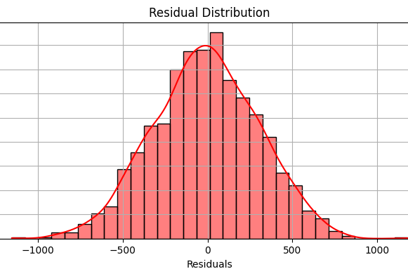
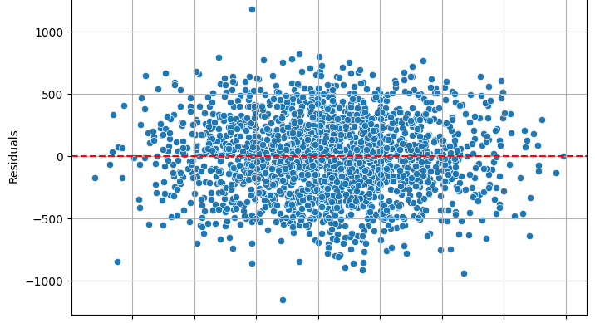
7. Residual Analysis Confirms Model Validity
✅ Normal Distribution: Residuals form a symmetric bell curve, indicating normally distributed errors, which supports a valid regression model.
✅ No Pattern in Residuals: The residuals are randomly scattered around zero across predicted profit values, showing linearity and constant variance (homoscedasticity).
🔍 No major outliers or bias detected, confirming a good model fit.

Slide 14
8. Conclusion & Recommendation
Conclusion:
Simple Linear Regression model is effective and easy to use
Sales alone gives moderate accuracy (R² = 0.65, MAPE = 12.96%).
Meets key statistical assumptions.
Not sufficient for reliable profit prediction on its own.

Slide 15

8. Conclusion & Recommendation
Recommendation:
Use a Multiple Linear Regression model with: Sales, Discount, Product Category & Region
Achieves high accuracy (R² = 0.99, MAPE = 2.6%).
Suitable for strategic decision-making and profit forecasting.

Slide 16
9. Future Scope
Accurately forecast profit for each new order based on real-time data.
Identify high-margin product categories and optimize the product mix.
Fine-tune discount strategies by simulating their impact on profit.
Target profitable regions with tailored pricing and promotions.
Integrate into dashboards for automated, data-driven decisions across finance and strategy teams.

Slide 17

THANK YOU

