Slide 1
Insulin response of white adipose tissue in Post-Obese cohort
Bioinformatics Analysis and Visualization of Medical Genomics Data Course
Joint course RIKEN-Karolinska Institutet
Agnia Vibriani
-Group 6-

Slide 2
Overall aim:
What are the transcriptomic changes in white adipose tissue (WAT) that correspond to the insulin response in individuals who had undergone bariatric surgery (POB) ?

Slide 3
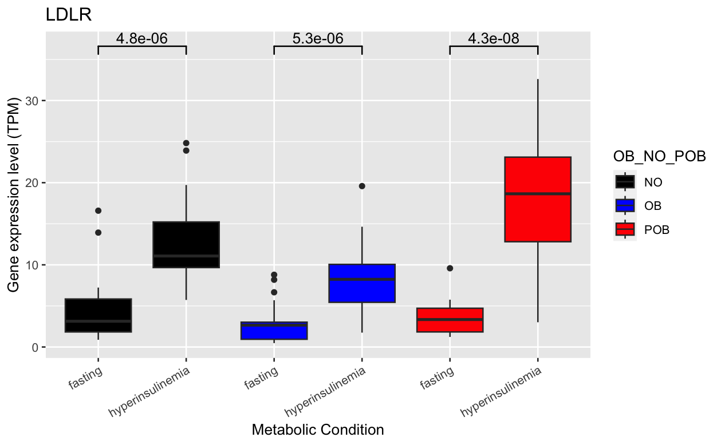
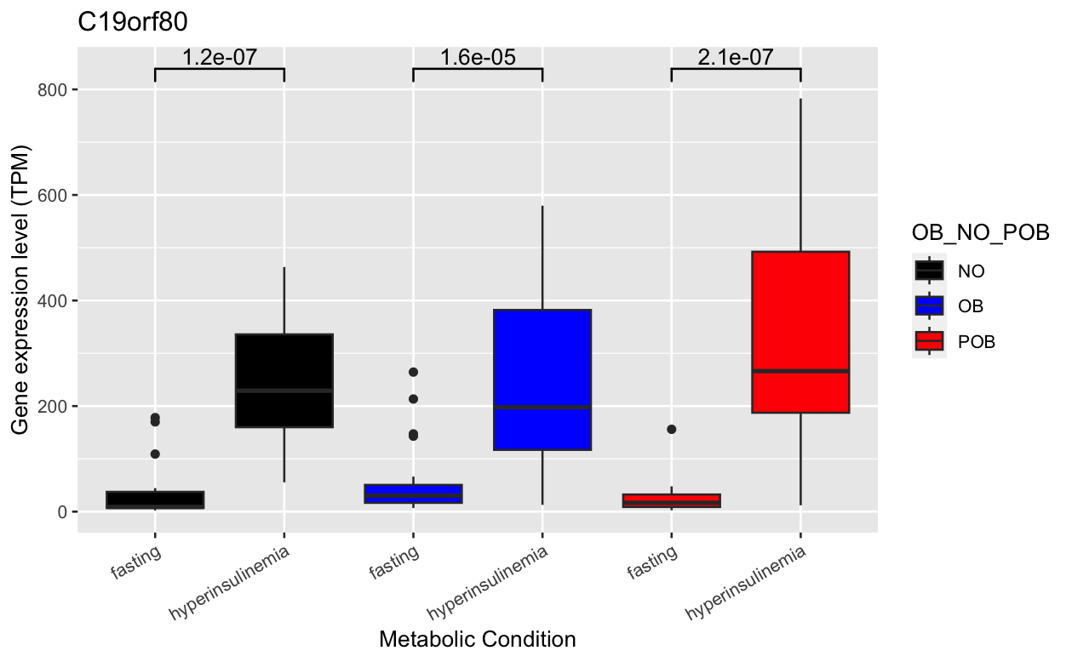
Specific aim 1:
Insulin response of LDLR and C19orf80 gene (insulin target) in 3 conditions:
Never Obese (NO), Obese (OB), Post-Obese (POB)
LDLR gene is low density lipoprotein/cholesterol receptor
C19orf80 gene involved in regulation of lipid metabolic processes
Notes:
- Both genes are responding to the insulin as indicated by significance p value between fasting and hyperinsulinemia condition

Slide 4
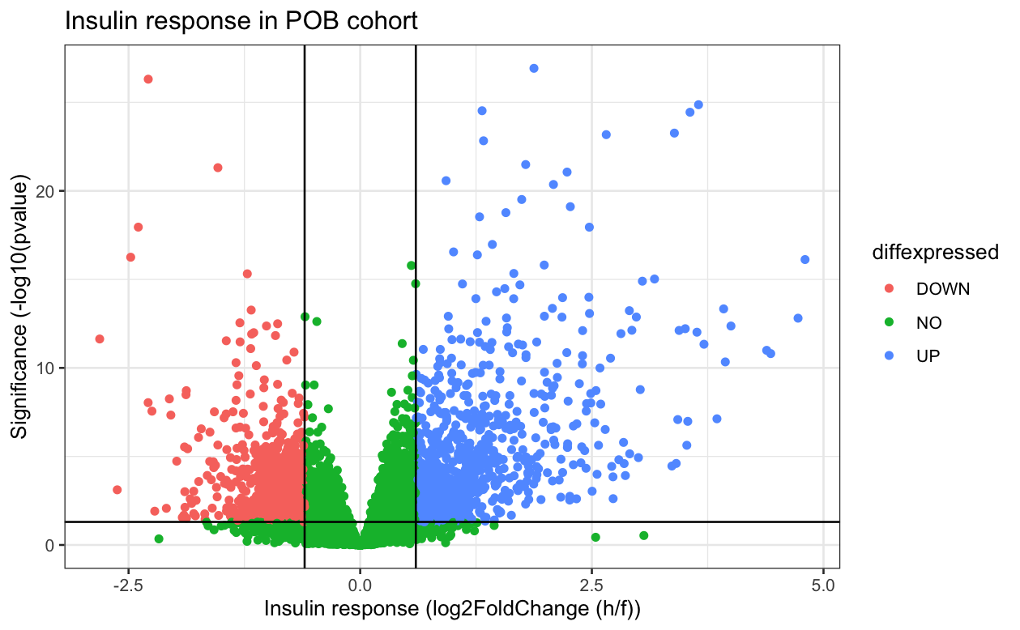
Specific aim 2:
Differentially expressed genes in POB conditions responding to insulin
(fasting vs hyperinsulinemia)
 | Downregulated | Upregulated | No change
Total genes | 1154 | 943 (LDLR, C19orf80) | 24230
Do MMA plot

