Slide 1

HACKATHON
IDENTIFY NEW BIKES
Group 1
Agnibha Biswas-873451
Jagpreet Singh-873216
Sagnik Dutta-873206
Debopam Roy-873129
Dibyarup Basak-873181
Sayante Chowdhury-873202
COHORT CODE – QEA20QE007

Slide 2
PROBLEM STATEMENT
Display Upcoming bike details like bike name, price and expected launch date in India, for manufacturer ‘Honda' & Bike price should be less than 4Lac.
For Used cars in Chennai, extract all the popular models in a List, Display the same.
Try to login with google, give invalid account details & capture the error message.

Slide 3

TESTING
TOOLS/SOFTWARES USED:
JAVA – Programming Language
ECLIPSE - Integrated Development Environment
SELENIUM – Portable Framework for testing Web Applications
TestNG – Open source testing framework
MAVEN – Software and project management tool
Apache POI – JAVA Library for reading and writing in Microsoft Formats
Jenkins-to execute the test scripts periodically on Selenium Grid
Extent Report – Used to generate HTML report
WEBSITE USED:
www.zigwheels.com

Slide 4
TEST ENVIRONMENTS
DEVICE | LAPTOP | DEVICE | LAPTOP | DEVICE | LAPTOP
Browser | Google Chrome | Browser | Mozilla Firefox | Browser | Microsoft Edge
Browser Version | 86.0.4240.111 | Browser Version | 81.0.1 | Browser Version | 86.0.622.61
Platform | Windows | Platform | Windows | Platform | Windows
Platform Version | 20H2 (19042.572) | Platform Version | 20H2 (19042.572) | Platform Version | 20H2 (19042.572)

Slide 5
TEST CASES
SL. No. | TEST SCENARIOS | TEST CASES
TS-001 | ZigWheels Homepage | 1. Assert homepage title.(Regression) 2. Check the functionality of Search Button.(Smoke)
TS-002 | Login Functionality | 3. Check the functionality of 'Login/SignUp' button. (Smoke) 4. Check the functionality of 'Continue with Google' option. (Smoke) 5. Check the functionality of 'Email-id' input field. (Regression and Smoke) 6. Check the functionality of 'Password' input field. (Regression and Smoke) 7. Check the functionality of 'Sign-in' input field. (Smoke)
TS-003 | New Bikes(Upcoming) Functionality | 10. Check the functionality of 'New Bikes' and 'Upcoming Bikes'. (Smoke) 11. Check the placeholder value of '-Select Manufacturer-' and click on 'Honda'. (Regression)
TS-004 | 'Used Cars' Functionality | 12. Check the functionality of 'Used Cars' and 'Chennai'. (Smoke) 13. Check the dropdown value for '5-10 Lakhs' functionality. (Regression) 14. Check the dropdown value for '10-15 Lakhs' functionality. (Regression)

Slide 6
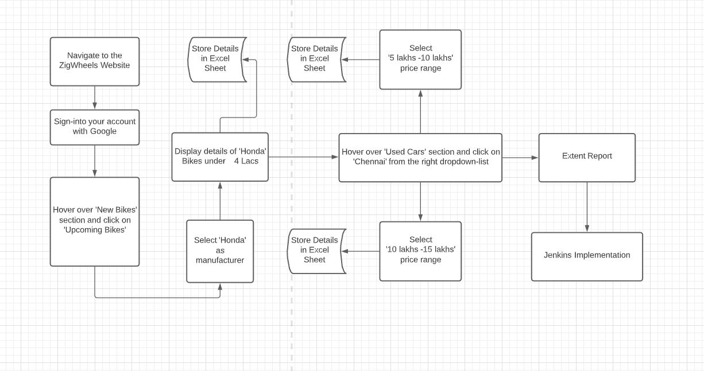
PROJECT WORKFLOW

Slide 7
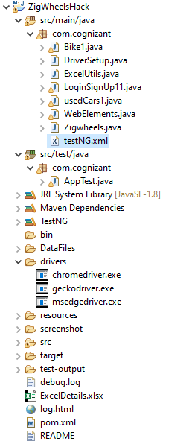
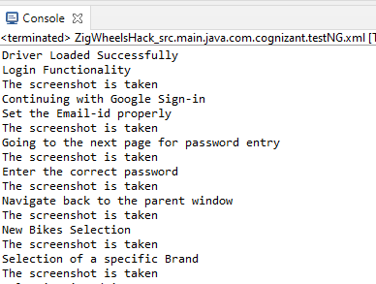
BASIC FRAMEWORK AND RESULTS
SNAPSHOT OF
THE BASIC
FRAMEWORK
USED
CONSOLE OUTPUT

Slide 8
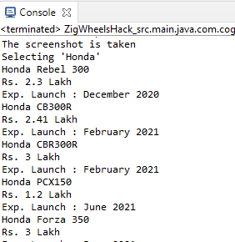
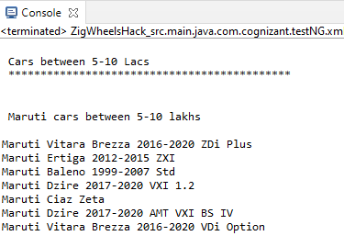

BASIC FRAMEWORK AND RESULTS
UPCOMING HONDA BIKE DETAILS
USED CARS IN
CHENNAI DETAILS
SUCCESFULL COMPLETION
OF ALL TEST CASES

Slide 9
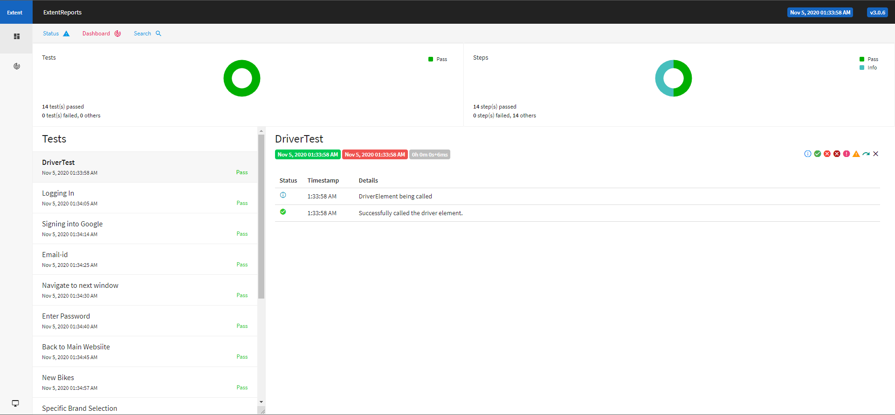
EXTENT REPORT

Slide 10
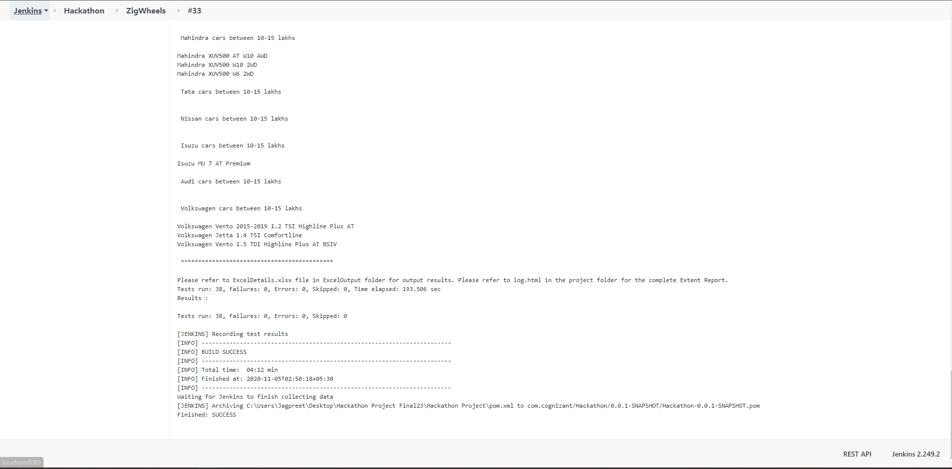
JENKINS RESULT

Slide 11
CHALLENGES FACED
SL. NO. | CHALLENGE | SOLUTION
1. | Despite setting up no verification methods, there were random requests for external verification while logging in via the Google Sign In method. | The issue was found out to be a Google Server issue and once logged in using a verification method manually, it was resolved.
2. | Despite logging into the website using a registered Google account, the Used Cars page on the website kept asking for login. | The issue was found to be on the website’s server side at the backend.
3. | Honda manufacturer in the Upcoming Bikes section was randomly removed from the website and then again made available. | Due to the dynamic nature of the website, another brand (Suzuki) was chosen for the time being. Later on the Honda manufacturer was reintroduced by the website and subsequently utilized in the project as well.

Slide 12
THANK YOU

