Slide 1
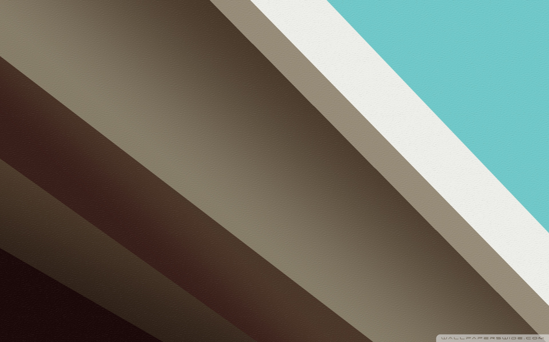
Delightful Queen
„Animation is the process of creating motion and shape change” ~ inż. Mariusz Brona

Slide 2
Agenda
Introduction
View Animations
List Animations
Lollipop Animations

Slide 3
Introduction
The main purpose of animation is to create outstanding user experience.
Animations should add subtle visual cues that notify users about what’s going on in your app.
Animations are especially useful when the screen changes state – when content loads or new actions become available.
Don’t overuse them! It will cause a reverse effect!

Slide 4
Introduction c.d.
We can animate EVERYTHING – views, fragments, activities, lists
We can manipulate EVERYTHING – showing, hiding, translating, rotating, scaling.
We can do it IN EVERY WAY – playing them together, playing them sequentially, after start, before end
But we CAN’T OVERUSE THEM!!!

Slide 5


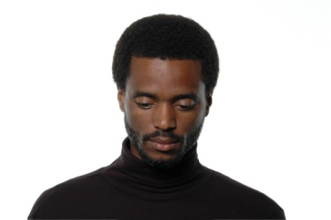
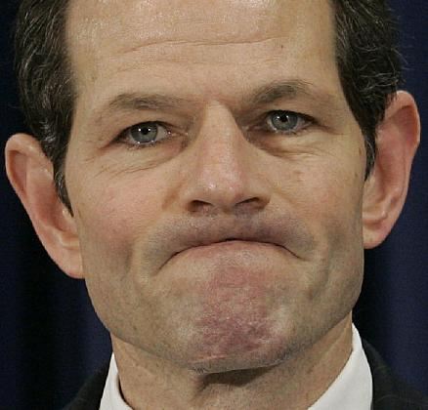


Introduction c.d.
THEY OVERUSED THEM

Slide 6

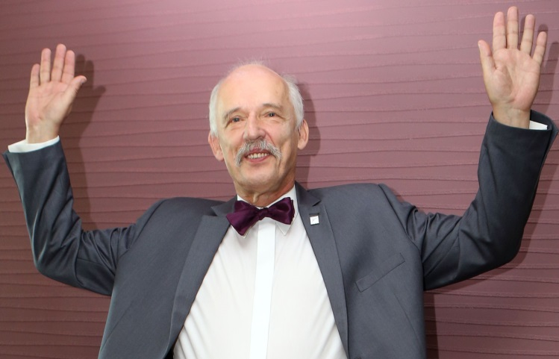
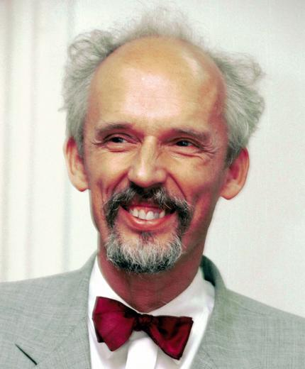



Introduction c.d.
THEY USED ENOUGH ANIMATIONS

Slide 7
View Animations
Android provides us a set of different views – TextViews, ImageViews, ProgressBars, Buttons, EditTexts etc.
Android also provides us an opportunity to change their state.
The great thing about Java is inheritance. With this tool we can create cool custom view for our purpose – we just need to extend proper class.

Slide 8
View Animations
To create a custom view we have to follow two steps:
1. Extend View class and call super()
2. Draw something on canvas.

Slide 9
View Animations
View Animator vs. Property Animator
1. View animator let us scale, translate, rotate, etc. ; but it won’t let us animate background color for instance.
2. View animator needs less code than Property animator
3. Property animator should be used in more advanced UI behaviours

Slide 10
View Animations
Animator Set
1. We can manipulate view with a set of animations! In the same time!
2. We can play animations together, sequentially or after special delay
3. We should avoid circular dependencies!

Slide 11
View Animations
Animator Listener
1. Helps us follow the state of the view’s animation, especially when we have sequence of animations.
2. We can manipulate a view in every state.
3. Lets us to provide communication between our custom view and activity or fragment.

Slide 12
View Animations
Interpolators
1. Awesome feature, we can manipulate dynamic of an animation.
2. We can choose one interpolator to every animation in set or different interpolators for each animation.
3. Most popular: Linear, Accelerate, Decelerate, AccelerateDecelerate, Bounce, Overshoot

Slide 13
List Animations
It is a fact, that lots of applications have lists in their main activity.
It is very important, to encourage user to use our app in the first minutes after first opening.
Making a nice animation for loading items is a clue!

Slide 14
List Animations
With Recycler View we have a really wide field of what we can do with items.
Also there is a big responsibility for developer to implement animations that won’t cause any UI troubles – binding to the wrong item, causing loading errors, etc.
We can use ItemAnimator class for animating items!

Slide 15
Lollipop Animations
With the new version of Android called Lollipop, there came up a brand new design – Material Design
Material Design brought new awesome animations
However! There were no good quality documentation, tutorials that shows how to properly implement those animations.
There’s still very little amount of documents that describe Lollipop Anims.

Slide 16
Lollipop Animations
The core of the Lollipop Animation is a Transition API.
Activity and Fragment transitions were introduced in 4.4 KitKat revision.
It brought Scenes and Transitions. Scene is a state of app’s UI, Transition is an animated change between UI interfaces.
The biggest difference is that before Lollipop we only could animate whole layout. With Lollipop we can animate single views and shared views from one activity/fragment to another!

Slide 17
Lollipop Animations
The core of the Lollipop Animation is a Transition API.
Activity and Fragment transitions were introduced in 4.4 KitKat revision.
It brought Scenes and Transitions. Scene is a state of app’s UI, Transition is an animated change between UI interfaces.
The biggest difference is that before Lollipop we only could animate whole layout. With Lollipop we can animate single views and shared views from one activity/fragment to another!

Slide 18
Lollipop Animations
Reveal
Fade
Explode
Move
Slide

Slide 19

Thank you!
Lyndon Pan, 12/2014

