Slide 1
Zero knowledge proofs and Applications

Slide 2
Why ZKPs ?
Zero-knowledge” proofs allow one party (the prover) to prove to another (the verifier) that a statement is true, without revealing any information beyond the validity of the statement itself.

Slide 3
Types of ZK proofs :
1.Interactive.
Fiat Shamir
2. Non Interactive.
ZK snarks
ZK starks
Bulletproofs

Slide 4
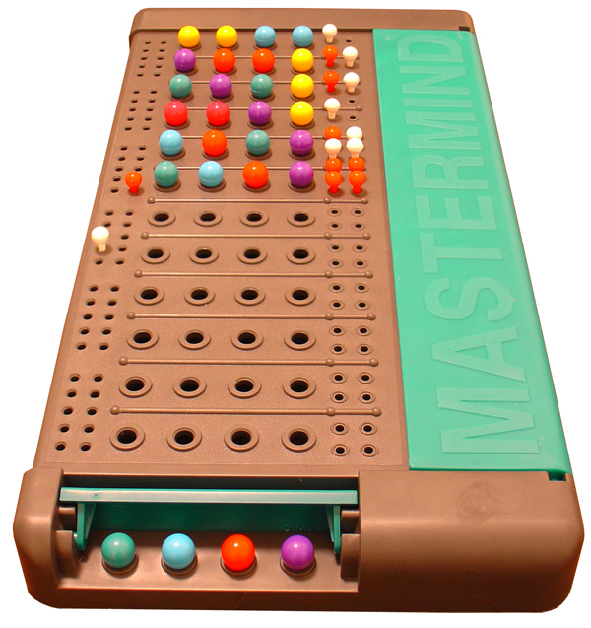
Building applications using zk snarks:

Slide 5
Pedersen commitment
Its homomorphic property has been leveraged
Cr(x)a=Car(ax)
Cr(x)Cr0(x0)=Cr+r0(x+x0)

Slide 6
Logging into website
Rather than typing the password into a potentially unsafe website, you can simply send a proof that you know the password

Slide 7
Core identity
Users can create a core identity from which derived identities are created for various services and activities.

Slide 8
Risk assurance
Hedge funds seek high returns by exploiting arbitrage opportunities and keeping them secret.
An investor would like a fund’s composition to reflect his own risk preferences while providing him with high returns

Slide 9
Price discovery
Discovering the price based on the asset values .

