Slide 2
Comparison of Results
Dataset | True K | Silhouette | Dunn Index | New Dunn
Atom | 2 | 6 | 2 | 2
Hepta | 7 | 4 | 4 | 4
Lsun | 3 | 4 | 3*** | 4*
Target | 6 | 2 | 2 | 5
Tetra | 4 | 4* | 4*** | 4***
TwoDiamonds | 2 | 2*** | 2 | 7
WingNut | 2 | 2 | 2*** | 5
*** Exact Match * Close Match

Slide 3
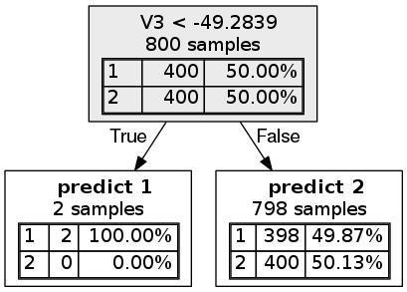

Slide 4
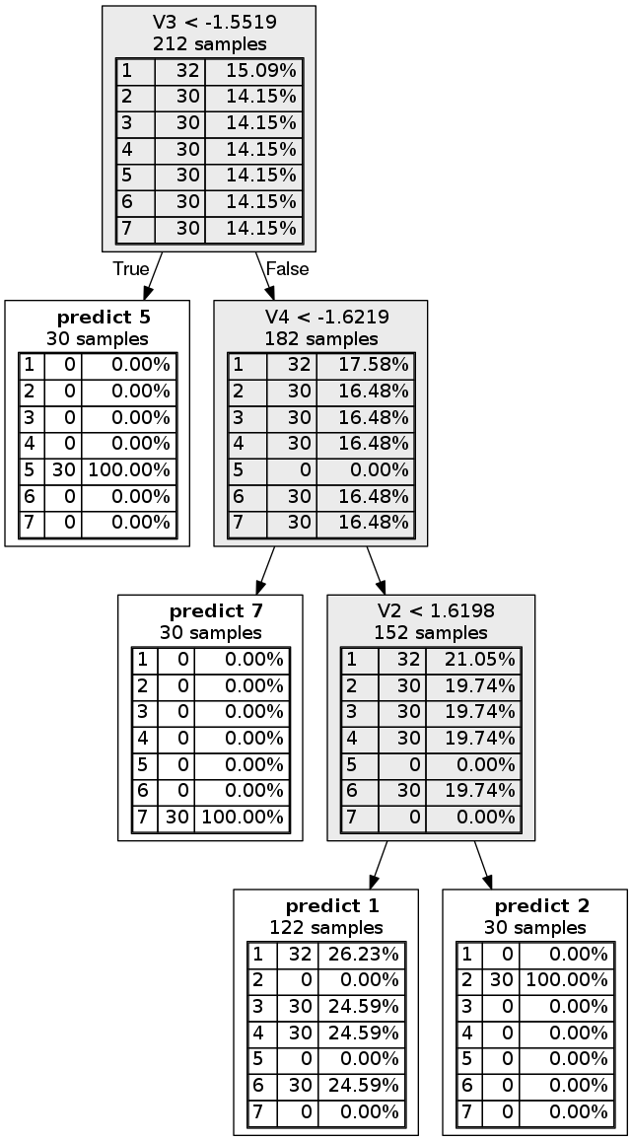

Slide 5
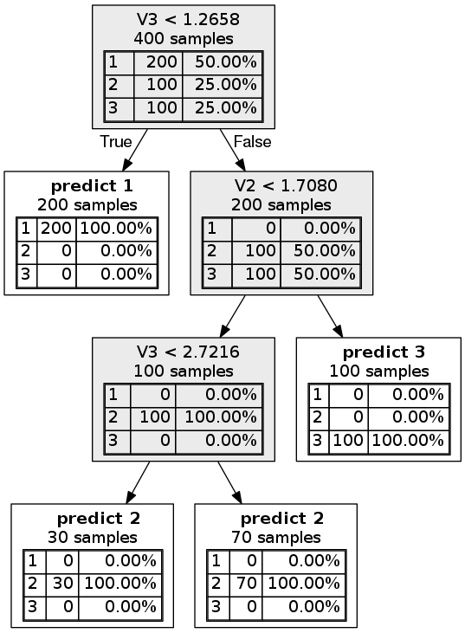

Slide 6
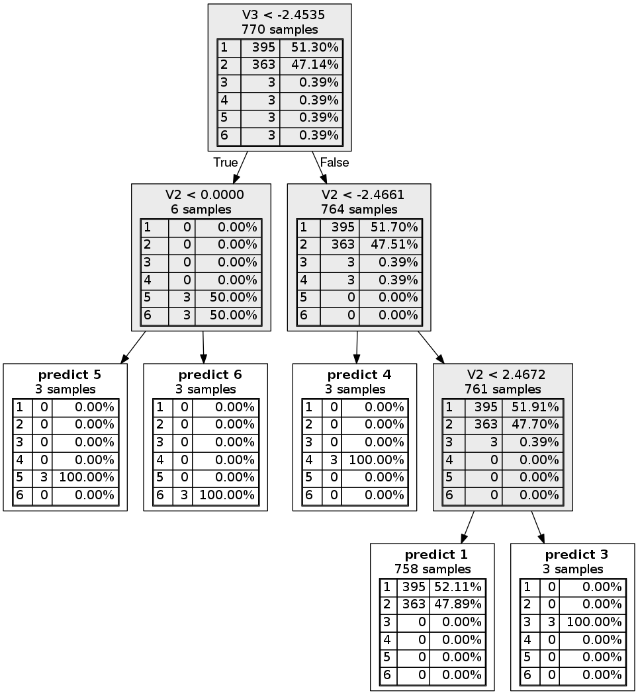

Slide 7
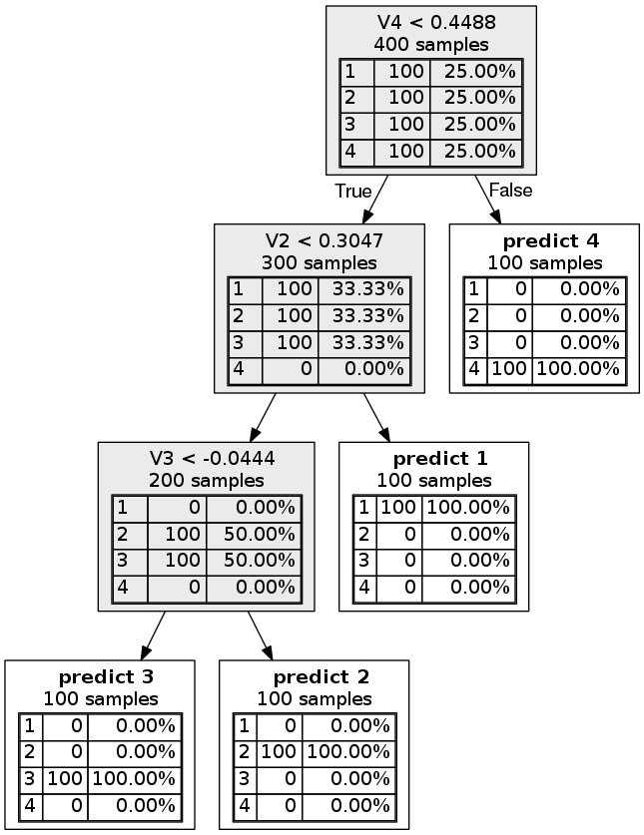

Slide 8
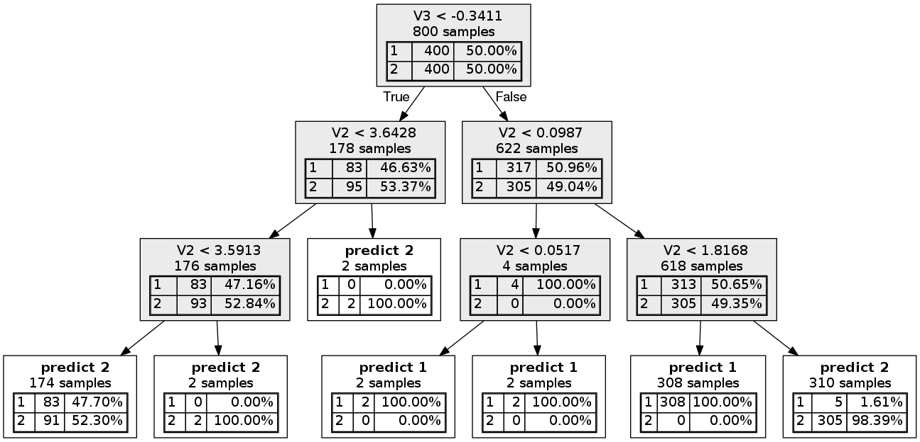
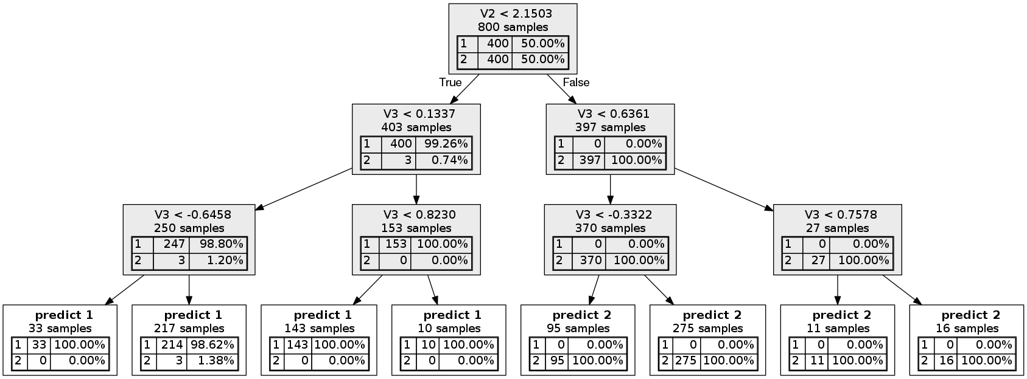

Slide 9
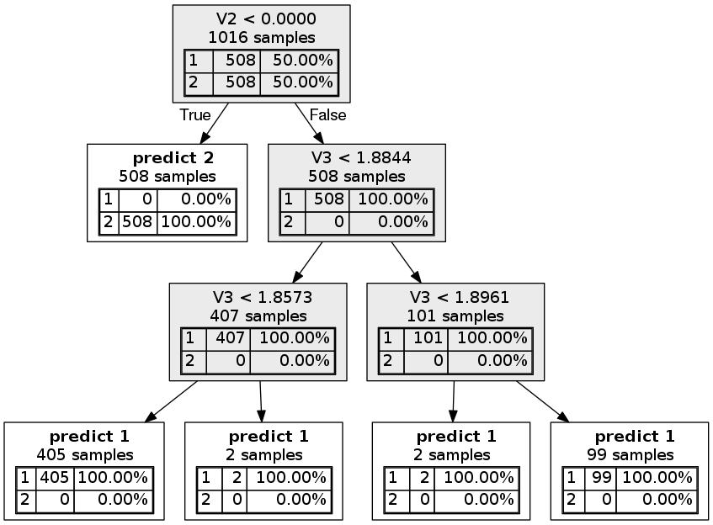

Slide 10
To Discuss
ML Class
Lecture slides
Reading material?
Progress:
New criterion
Evaluation of results (comparison of methods)
Next steps:
Making faster (in progress!)
Testing on real world datasets (how to evaluate)
Choosing between criterion

