Slide 1
CBIR using Autoencoders
TEAM MEMBERS
AGNISH SAHU :- 18BCE1023
SHARON KEERTHANA:- 19BCE1766
V GOPALAKRISHNAN:-19BCE1155

Slide 2
Content-based image retrieval
Content-based image retrieval, also known as query by image content (QBIC) and content-based visual information retrieval (CBVIR), is the application of computer vision techniques to the image retrieval problem, that is, the problem of searching for digital images in large databases (see this survey[ for a scientific overview of the CBIR field). Content-based image retrieval is opposed to traditional concept-based approaches (see Concept-based image indexing).
"Content-based" means that the search analyzes the contents of the image rather than the metadata such as keywords, tags, or descriptions associated with the image. The term "content" in this context might refer to colors, shapes, textures, or any other information that can be derived from the image itself. CBIR is desirable because searches that rely purely on metadata are dependent on annotation quality and completeness.

Slide 3
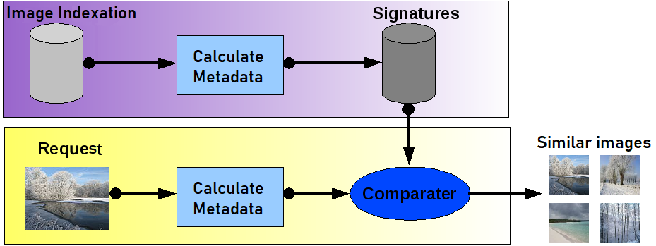

Slide 4
Autoencoders are eﬀective unsupervised learning models that ﬁrst encode an input into a lower dimensional representation. This representation, which constitutes the features in the input, can be particularly useful in the domain of image processing. Contents of a picture can be encoded to a compressed representation, which can be used to build eﬀective image retrieval applications

Slide 5
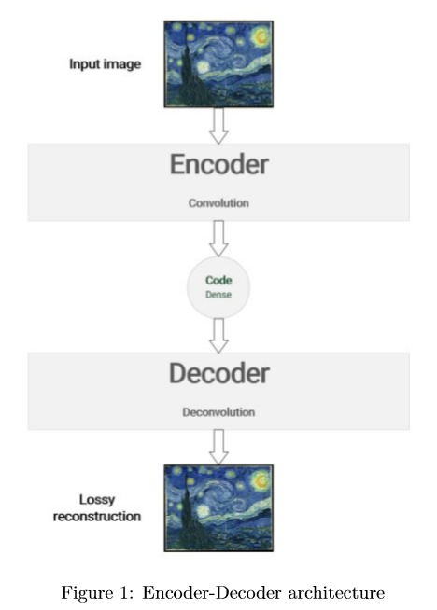

Slide 6
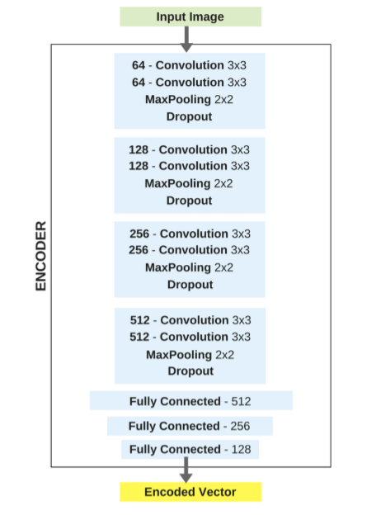

Slide 7
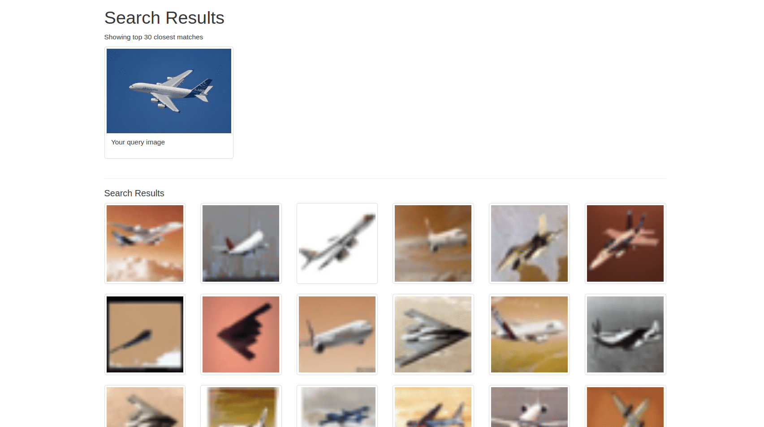

Slide 8
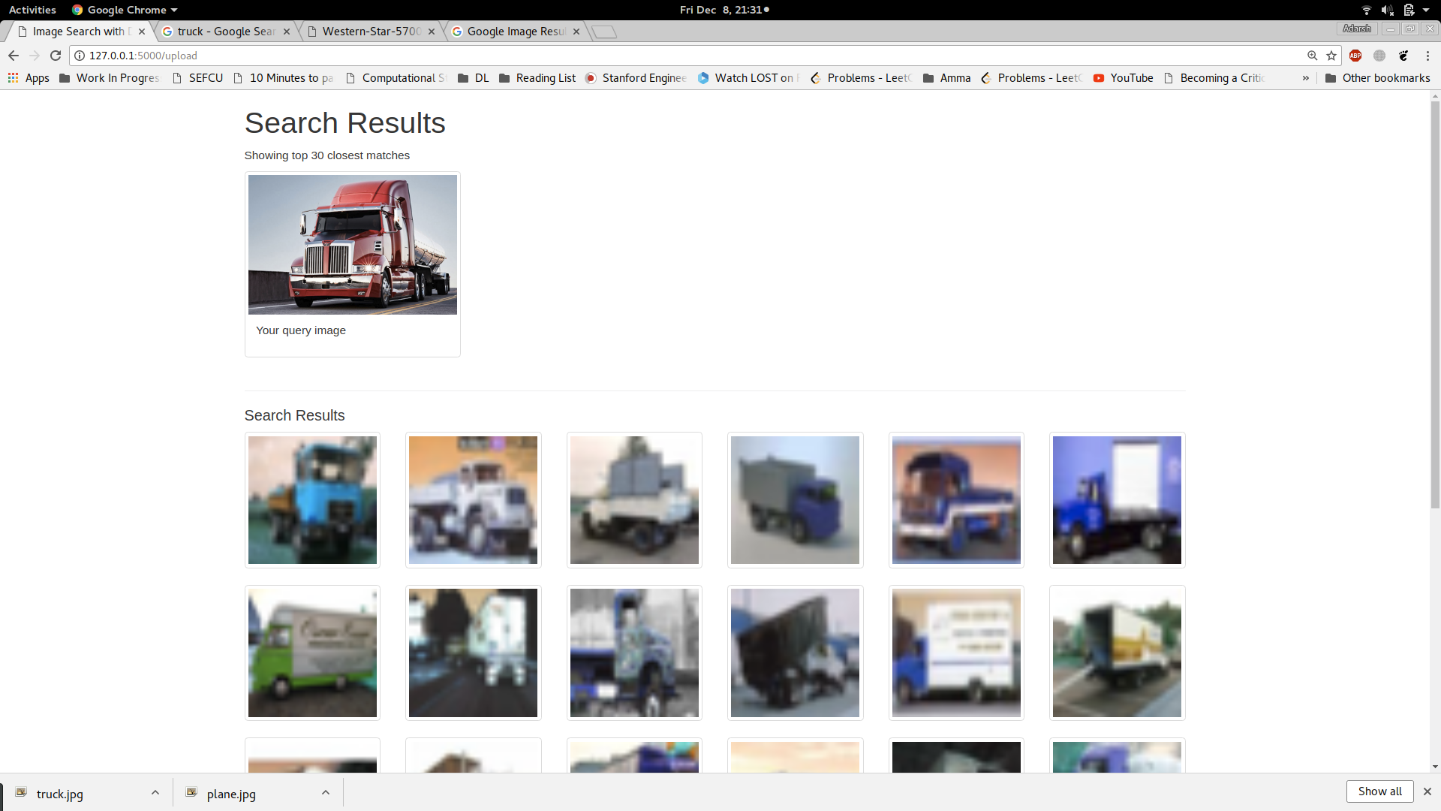

Slide 9
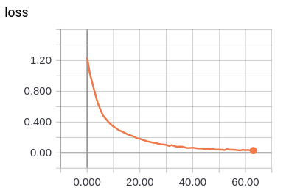
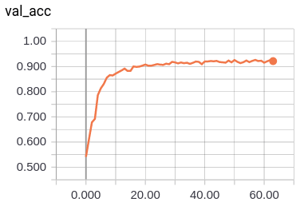
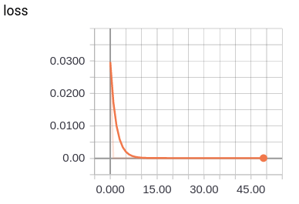

Slide 10
CONCLUSIONS
Three diﬀerent autoencder models were built and evaluated to quantify the eﬀectiveness of Convoluational Autoencoders when compared to Simple and Deep Autoencoders for image data.
• Two types of approaches to training Convolutional Autoencoders were compared and evaluated.
• A classiﬁcation model was built to pre-train Convolutional layers to extract features with an accuracy of 92.5% on CIFAR4.
• Pre-trained Convolution layers and fully connected layers were combined and an autoencoder was trained to transform images to compressed vector. • A search index of compressed vectors was created using Approximate Nearest Neighbor.
• An end-to-end web application was built to query this index.

