Slide 1

Digital Enterprise Design & Operational Blueprint
A Unified Odoo ERP Architecture for CampusKart Omni-Channel Retail Operations | Comprehensive Capstone Synthesis across Phases 1–6.
Agnitra Ray Roll No: FT261080R | Group 15
Course: ERP & Industry 4.0 – From Strategy to Execution Institution: Great Lakes Institute of Management Email: agnitra.ft261080@greatlakes.edu.in | Mobile: +91 7595058190

Slide 2


Presentation Structure & Project Metadata
Academic & Project Info
6-Phase Transformation Roadmap
Course Title: ERP & Industry 4.0 – From Strategy to Execution
Phase 1: Company Profile, Bottlenecks & Growth Goals
Institution: Great Lakes Institute of Management
Phase 2: Bizagi BPMN 2.0 Process Engineering (O2C, P2P, M2O)
Consulting Lead: Agnitra Ray (Roll: FT261080R)
Phase 3: ERP System Architecture & Odoo Modules
Assigned Client: CampusKart (College Merchandise Store - Group 15)
Phase 4 & 5: Master Data Configuration & Live Transaction Proof
Database Instance: campuskart.odoo.com
Phase 6: Executive Governance, Dashboards, Industry 4.0 & AI

Slide 3


Phase 1 – Business Context & Ecosystem
Business Overview & Target Segments
Operational Network & Structure
Core Business: CampusKart is the official omni-channel retail and enterprise distribution partner for the university ecosystem, operating via a physical campus storefront and a cloud e-commerce portal.
Supply Network: Contracted wholesale distributors and garment manufacturers supplying prefabricated apparel, academic instruments, and lifestyle goods (bypassing raw manufacturing).
B2B Segment: University departments, student event committees, athletic teams, and academic fest organizers settled via internal university budget clearings.
Key Departments: Sales & Front-End Operations, Procurement & Sourcing, Inventory & Logistics Control, and Finance & Corporate Accounting.
Strategy: Standardizing dual-channel operations on a unified cloud ERP to achieve real-time inventory synchronization and automated B2B budget clearings.
B2C Segment: Individual retail buyers (walk-in students, faculty, guests) and remote alumni/donor networks.

Slide 4


Phase 1 – Strategic Drivers & Goals
Core Operational Bottlenecks
Target ERP Objectives
Erratic Demand Spikes vs. Dead Stock: 400% demand surges during orientation and graduation fests lead to immediate stockouts, followed by capital tied up in slow-moving inventory due to manual forecasting.
Absolute Inventory Synchronization: Establish a single real-time database source so every POS or digital checkout instantly updates global stock levels across all channels.
Disjointed Cross-Channel Inventory: Fragmented POS and e-commerce databases cause un-synchronized stock, leading to online overselling and customer cancellations.
Data-Driven Automated Replenishment: Configure automated minimum safety-stock reorder rules that auto-generate vendor RFQs to protect shelf availability during peak cycles.
Manual B2B Clearance Latency: Physical sign-off sheets and email chains for institutional bulk orders delay budget verification and disrupt event delivery schedules.
Automated B2B Budget Clearance: Digitize internal university cost-centre approval flows to reduce bulk order processing times from 5 business days down to < 24 hours.

Slide 5
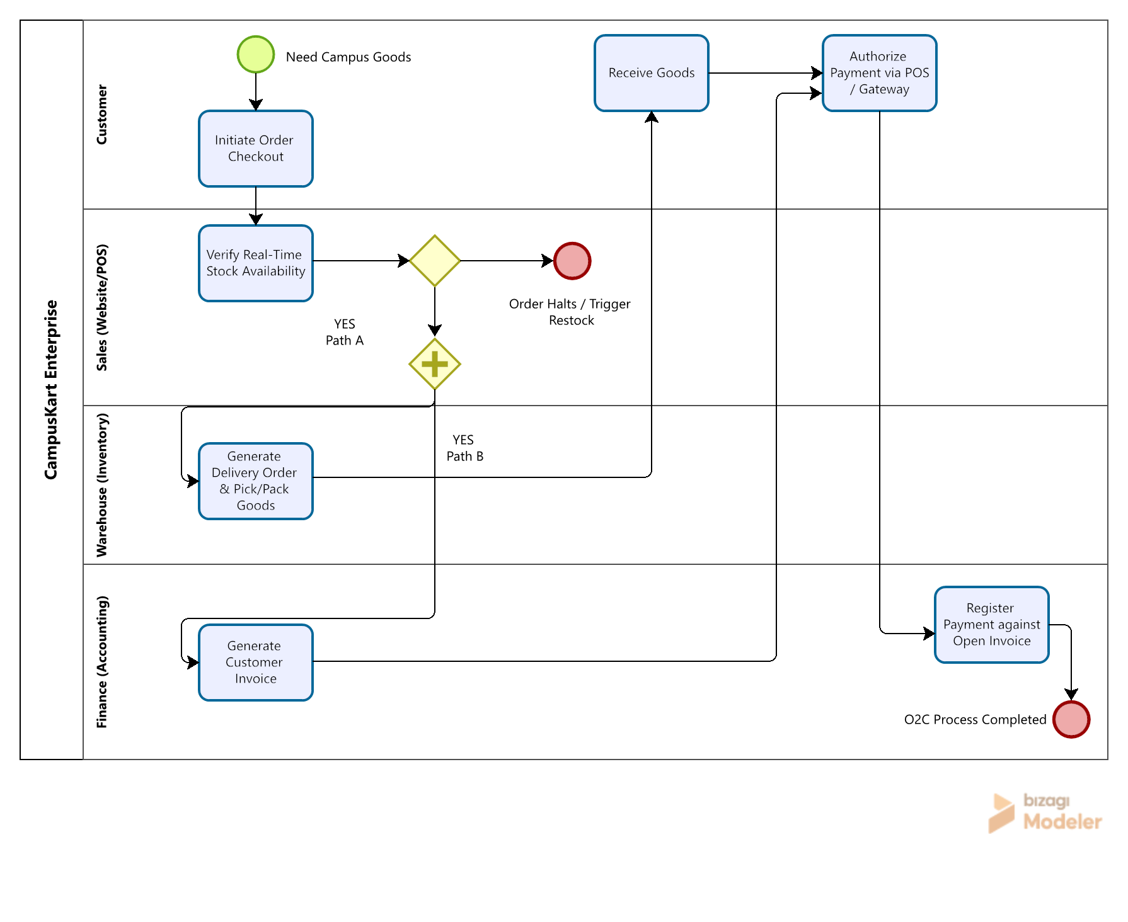


Phase 2 – BPMN Workflow Engineering
Standardized Process Architecture
Order-to-Cash (O2C) Workflow: Standardizes retail & online checkouts across Customer, Sales (POS/Web), Warehouse, and Accounting lanes with real-time stock verification.
Procure-to-Pay (P2P) Workflow: Automates stock replenishment when inventory hits minimum safety thresholds, driving vendor RFQs, goods receipts, and 3-way match billing.
Market-to-Order (M2O) Bulk Workflow: Structures institutional bulk requests via CRM leads, enforcing mandatory University Finance cost-center budget authorization sign-offs.

Slide 6





Phase 3 – System Architecture & Odoo Modules
Omnichannel Front-End Engine
Supply Chain & Operational Core
Financials & Governance
WEBSITE / E-COMMERCE • CRM • SALES
PURCHASE • INVENTORY CONTROL
ACCOUNTING • EMPLOYEES • DASHBOARDS
•
Powers live sales synchronization across physical POS and web portal.
•
Maintains double-entry real-time stock tracking across campus warehouse.
•
Executes 3-way match verification (PO vs. Receipt vs. Bill) before payment.
•
Captures institutional inquiries automatically as CRM leads.
•
Monitors minimum safety thresholds to auto-draft vendor RFQs.
•
Implements RBAC to enforce Separation of Duties across departments.
•
Enforces dynamic tier pricing and 15% institutional discounts.
•
Manages inbound vendor receipts and outbound logistics orders.
•
Consolidates real-time executive metrics across sales and cash flow.

Slide 7
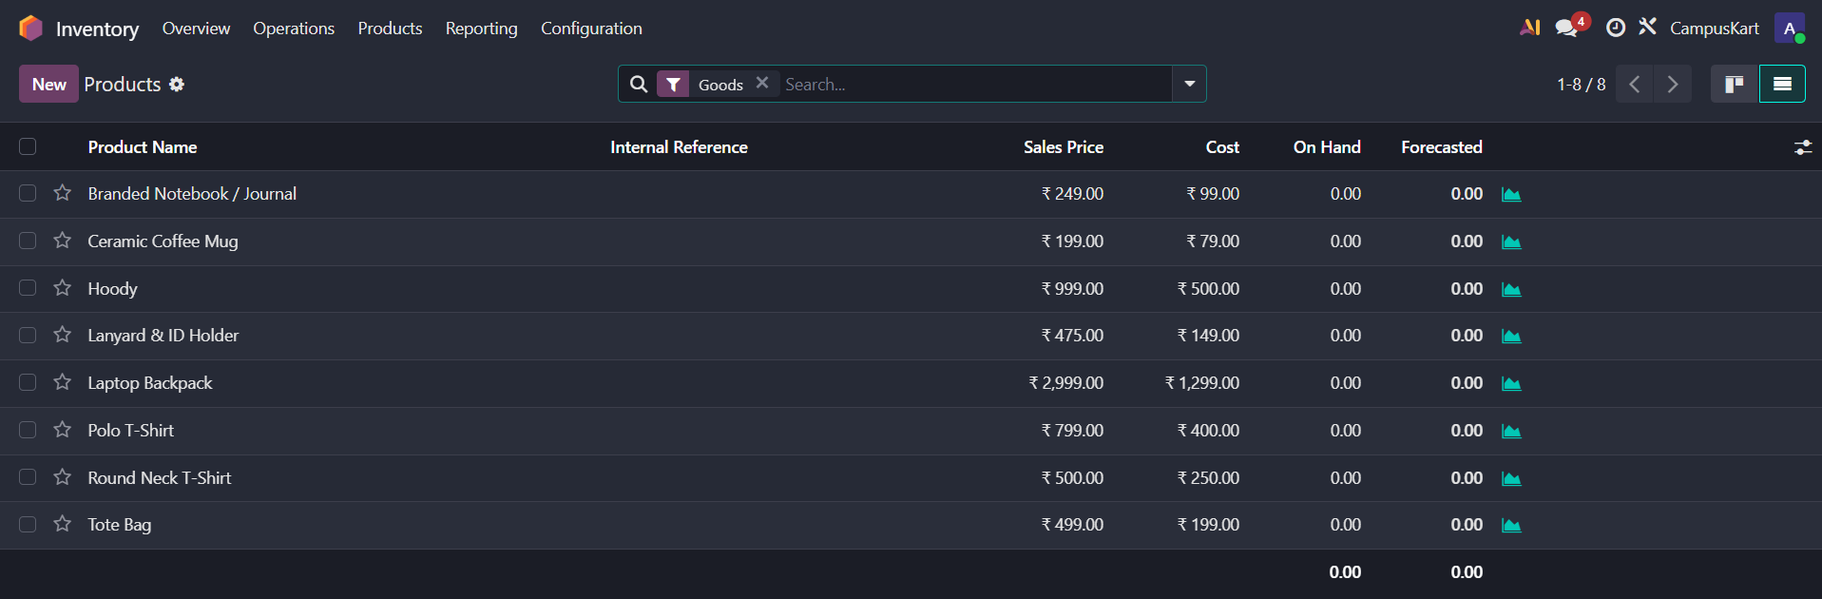
Phase 4 – Odoo Setup & Master Data
System Configuration & Master Data
Finished Goods Product Catalog: Structured into 3 finished-goods categories: Apparel & Wearables (Hoodies, Regalia), Academic Supplies (Notebooks, Gear), and Lifestyle Gifts (Flasks, Tech).
Chart of Accounts & Tax Localization: Configured Indian Chart of Accounts (COA) with specialized journals for automated sales invoicing and 3-way vendor bill matching (210700 Purchase Expense).
Vendor Network & RBAC Infrastructure: Onboarded wholesale supplier master profiles (e.g., Everblye Apparel Limited) and established role-based security access rights across internal departments.

Slide 8
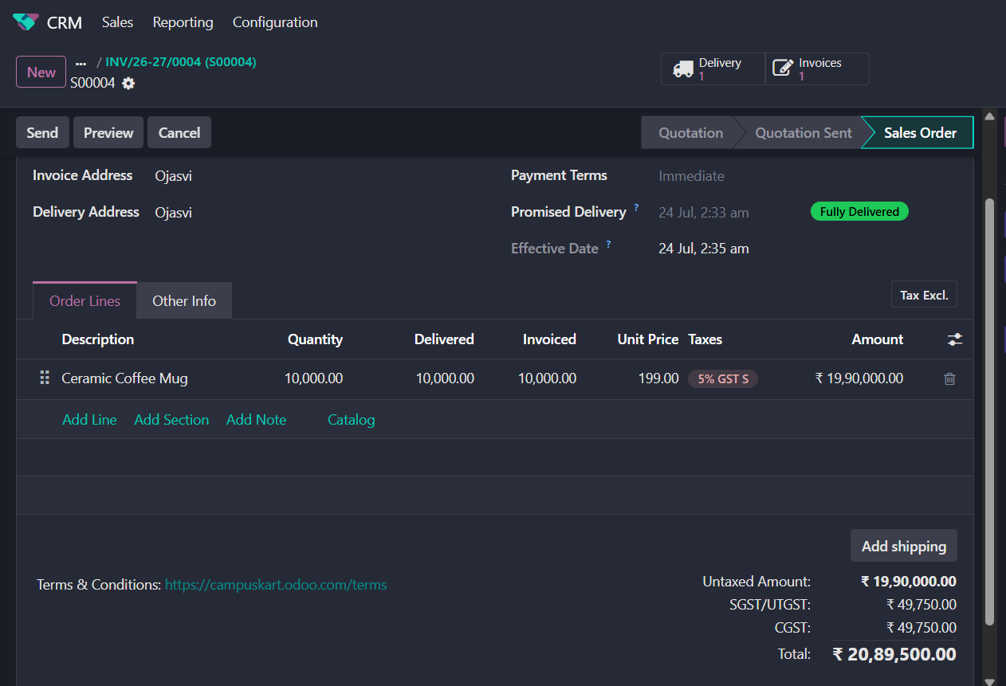
Phase 5 – Live Transactional Proof
End-to-End Cycle Execution
Procurement (P00004): Executed purchase order for Ceramic Coffee Mugs (10,000 units @ ₹79) from contracted vendor.
Goods Receipt & Vendor Bill (BILL/2026/07/0004): Received physical shipment into main warehouse and posted matched vendor bill worth ₹7,90,000 via 3-way matching.
Customer Sales Orders (S00004): Confirmed and posted dual-channel customer sales orders, automatically deducting inventory and recognizing revenue.

Slide 9
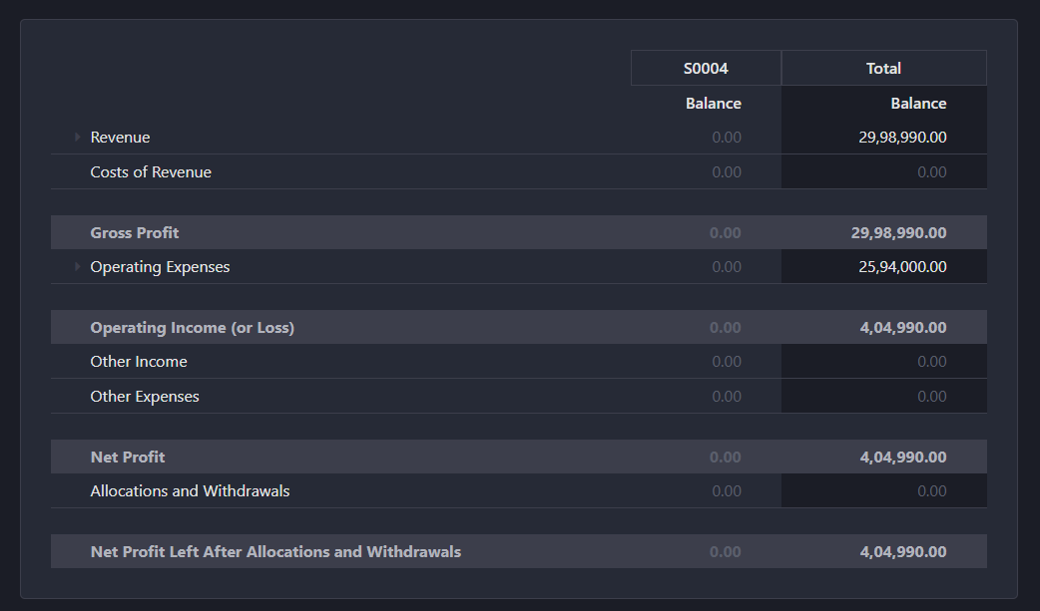
Phase 6 – CEO & Financial Performance
Executive P&L Insights
Direct Revenue: ₹29,98,990.00 realized across posted B2B institutional orders and B2C sales channels.
Operating Cost: ₹25,94,000.00 in direct vendor procurement costs and operational logistics expenses.
Net Profit Contribution: ₹4,04,990.00 net bottom-line profit tracked via analytic cost-center allocation (dummy 24th - CampusKart).

Slide 10
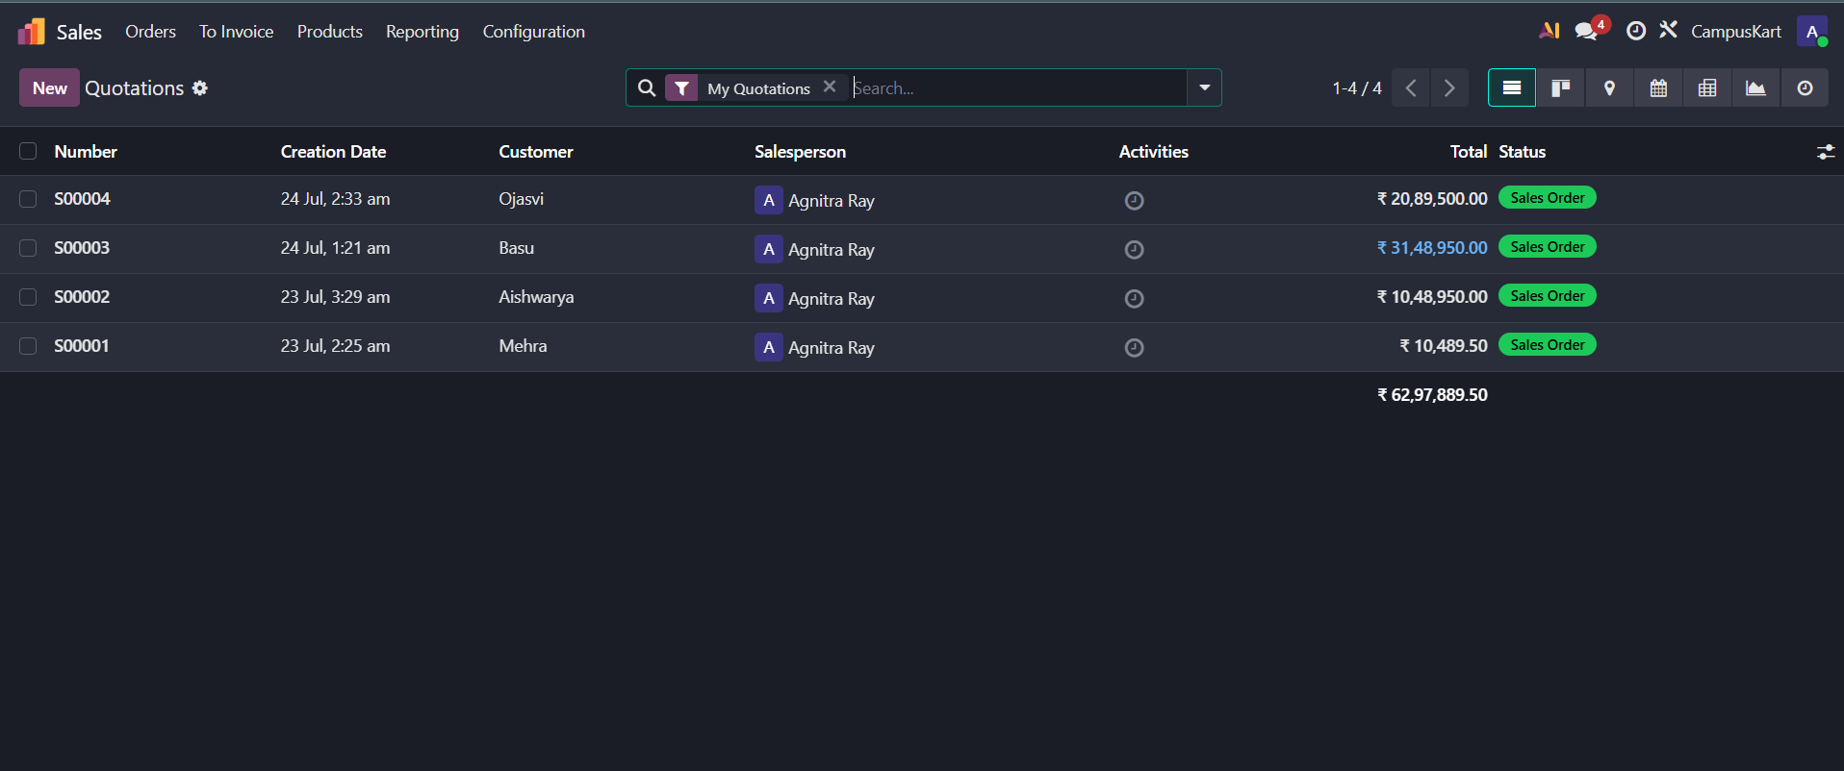
Phase 6 – Commercial Sales Performance
Sales Breakdown & Metrics
Total Revenue Pipeline: ₹62,97,889.50 realized across posted orders (S00001 – S00004).
Top Revenue Drivers: Ceramic Coffee Mugs (S00004) and Laptop Backpacks (S00003).
Sales Velocity & Delivery: Real-time tracking of order fulfillment states and multi-channel revenue distribution.

Slide 11
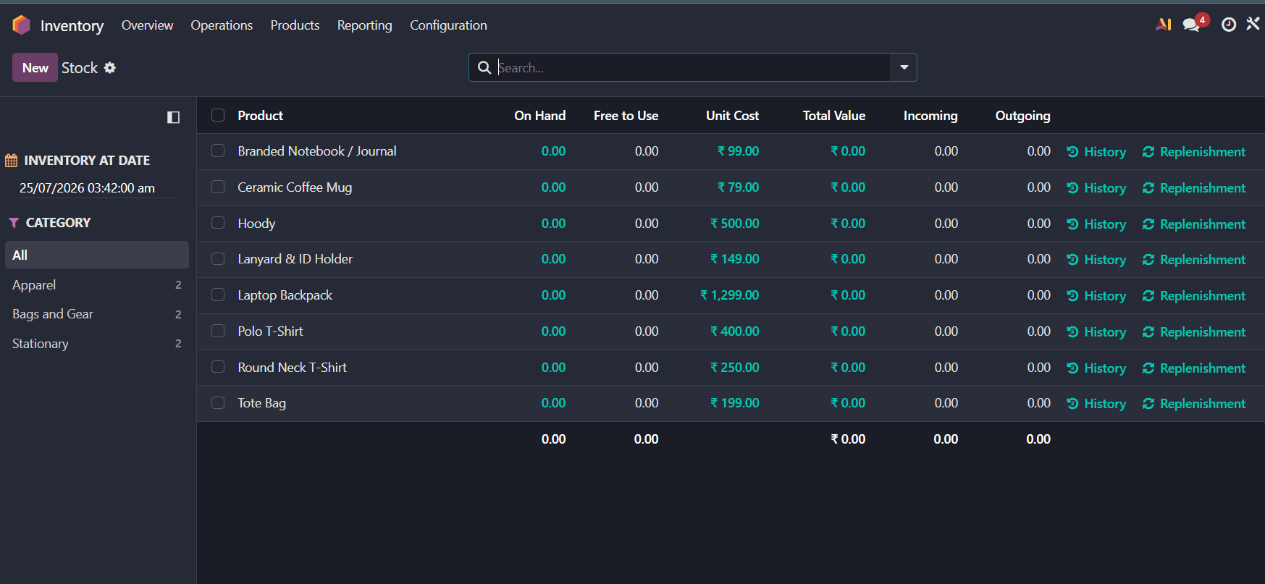
Phase 6 – Inventory & Logistics Control
Stock Valuation & Replenishment
Inventory Valuation: Real-time perpetual automated valuation tracking unit costs across all merchandise.
Category Management: Categorized into Apparel & Wearables, Academic Supplies, and Lifestyle Gifts.
Stock Movements: Automated inventory history recording incoming/outgoing merchandise.

Slide 12
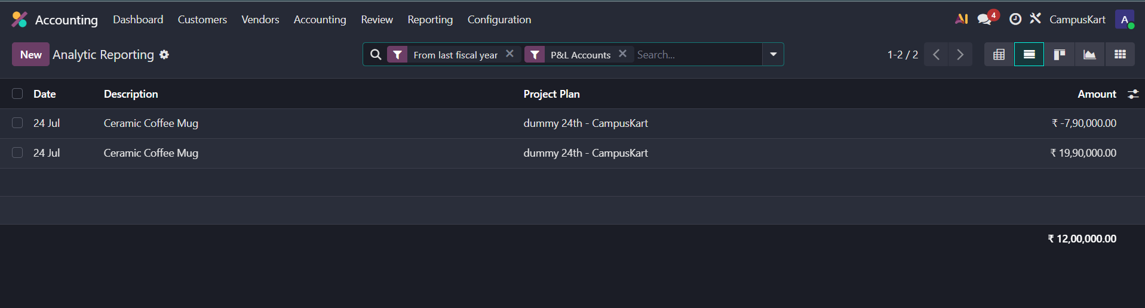
Phase 6 – Analytic Budget Allocation
Project-Level Cost Tracking
Analytic Cost Center: Configured dedicated analytic account dummy 24th - CampusKart for campaign tracking.
Committed & Achieved Budget: Tracked performance against allocated budget baselines.
Ledger Transparency: Automatic analytic tagging across revenue (₹19.90L) and purchase cost (₹7.90L) journal entries.

Slide 13
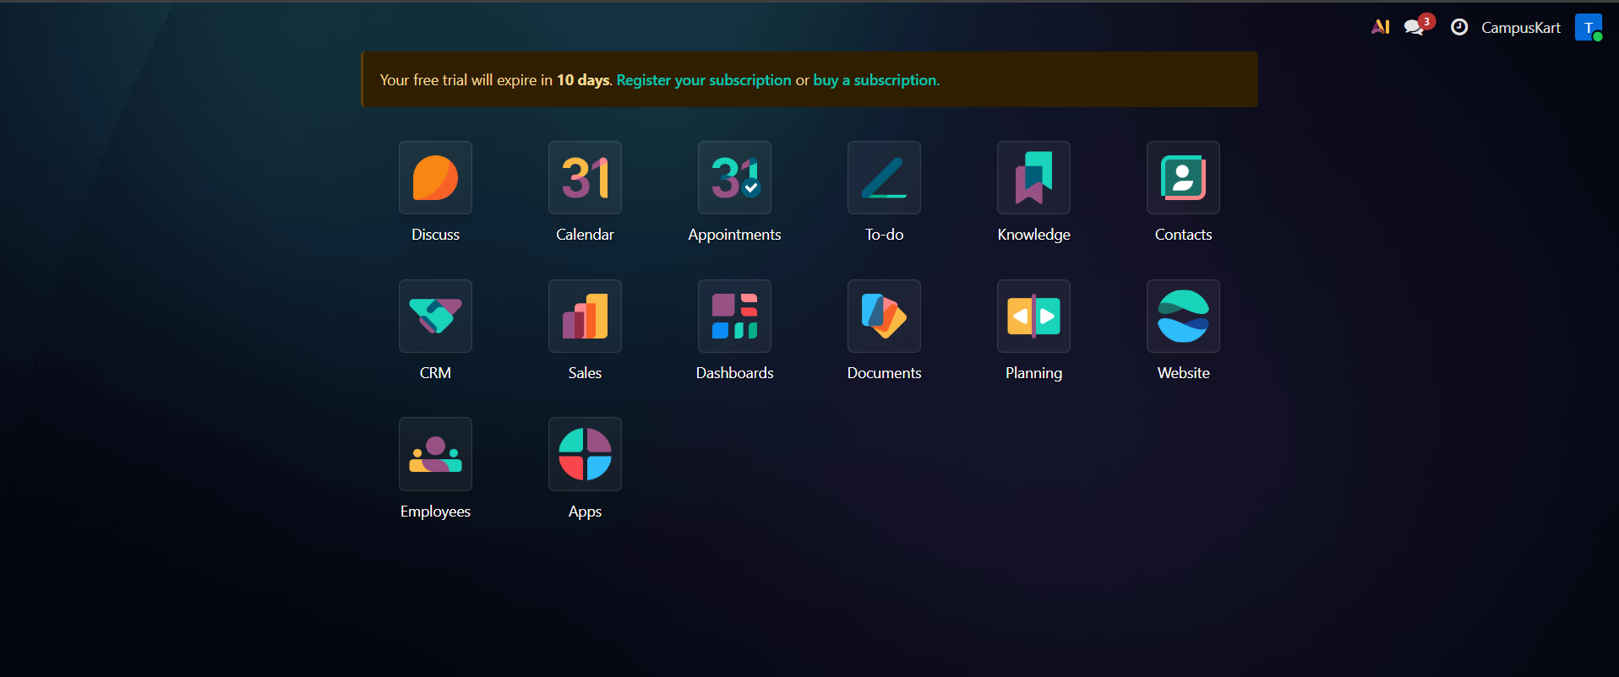
Phase 6 – Enterprise Access Control (RBAC)
Separation of Duties (SoD) Strategy
Administrator Access: Full visibility across Sales, Accounting, Inventory, and System Configuration.
Sales Representative (testrep@mail.com): Restricted view limited exclusively to Sales, CRM, and basic operational apps.
Security Benefit: Protects margins, vendor pricing, and executive reporting from non-finance roles.

Slide 14
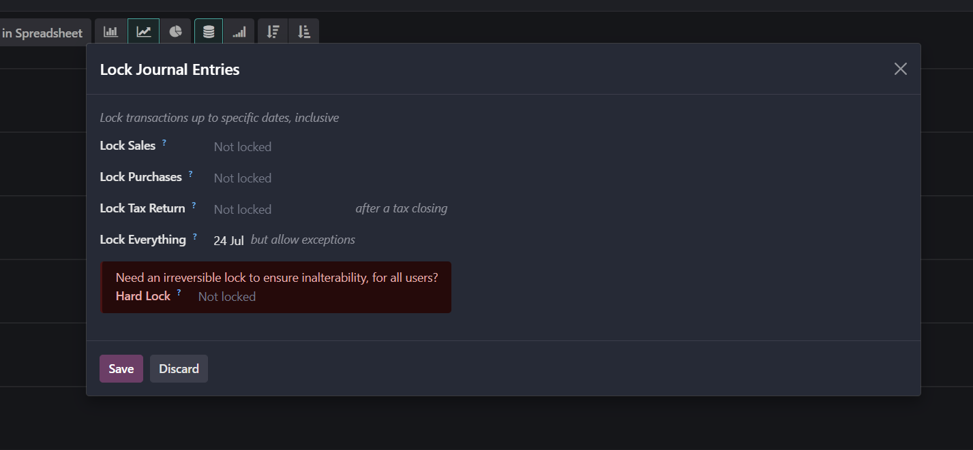
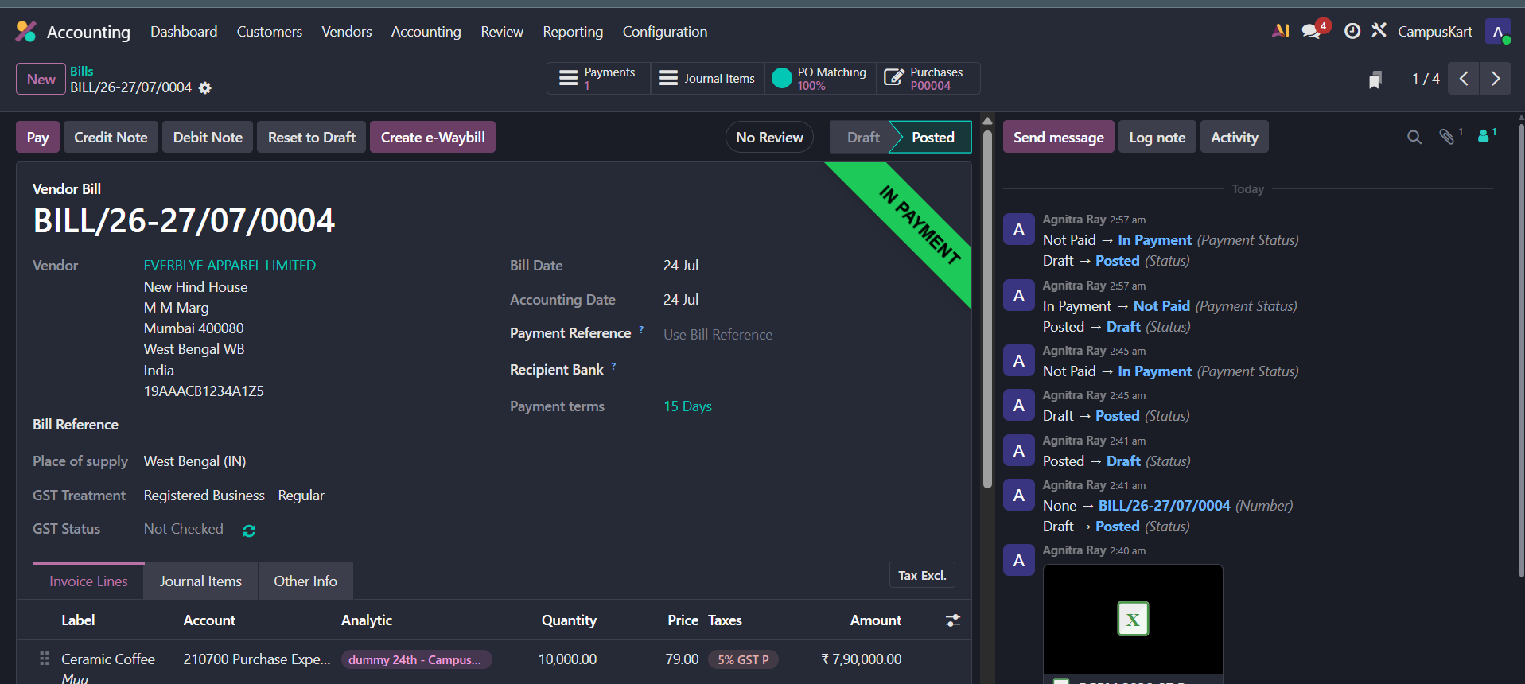
Phase 6 – Audit Trail & Period Closing
Governance & Compliance Controls
Time-Stamped Audit Trail: Chatter log records every document state change (Draft → Posted → In Payment).
Accounting Lock Date: Locked transactions up to 24/07/2026 to prevent backdated edits.
Regulatory Compliance: Ensures audit readiness and financial reporting integrity.

Slide 15


Phase 6 – Industry 4.0 & AI Strategy
🚀 Industry 4.0 Initiatives
🤖 AI Use Cases
1. Smart RFID Inventory: Real-time tracking of batch merchandise at warehouse gates.
1. Demand Forecasting: ML algorithms predicting seasonal event stock demand.
2. Automated IIoT Reordering: Shelf weight sensors triggering automated RFQs in Odoo.
2. Dynamic Pricing Engine: AI adjusting discounts based on inventory age and demand.
3. Logistics Digital Twin: Simulation of campus delivery routes to minimize lead times.
3. AI Customer Support: LLM assistant linked to Odoo backend for order tracking.

