Slide 1

EMERGING TECH & BUSINESS · PROOF OF CONCEPT
BoostCTC AI Voice Agent
Conversational AI for EdTech onboarding and re-engagement
Agniva Mondal · Sughosh Durg · Thanushree Keshava Murthy

Slide 2
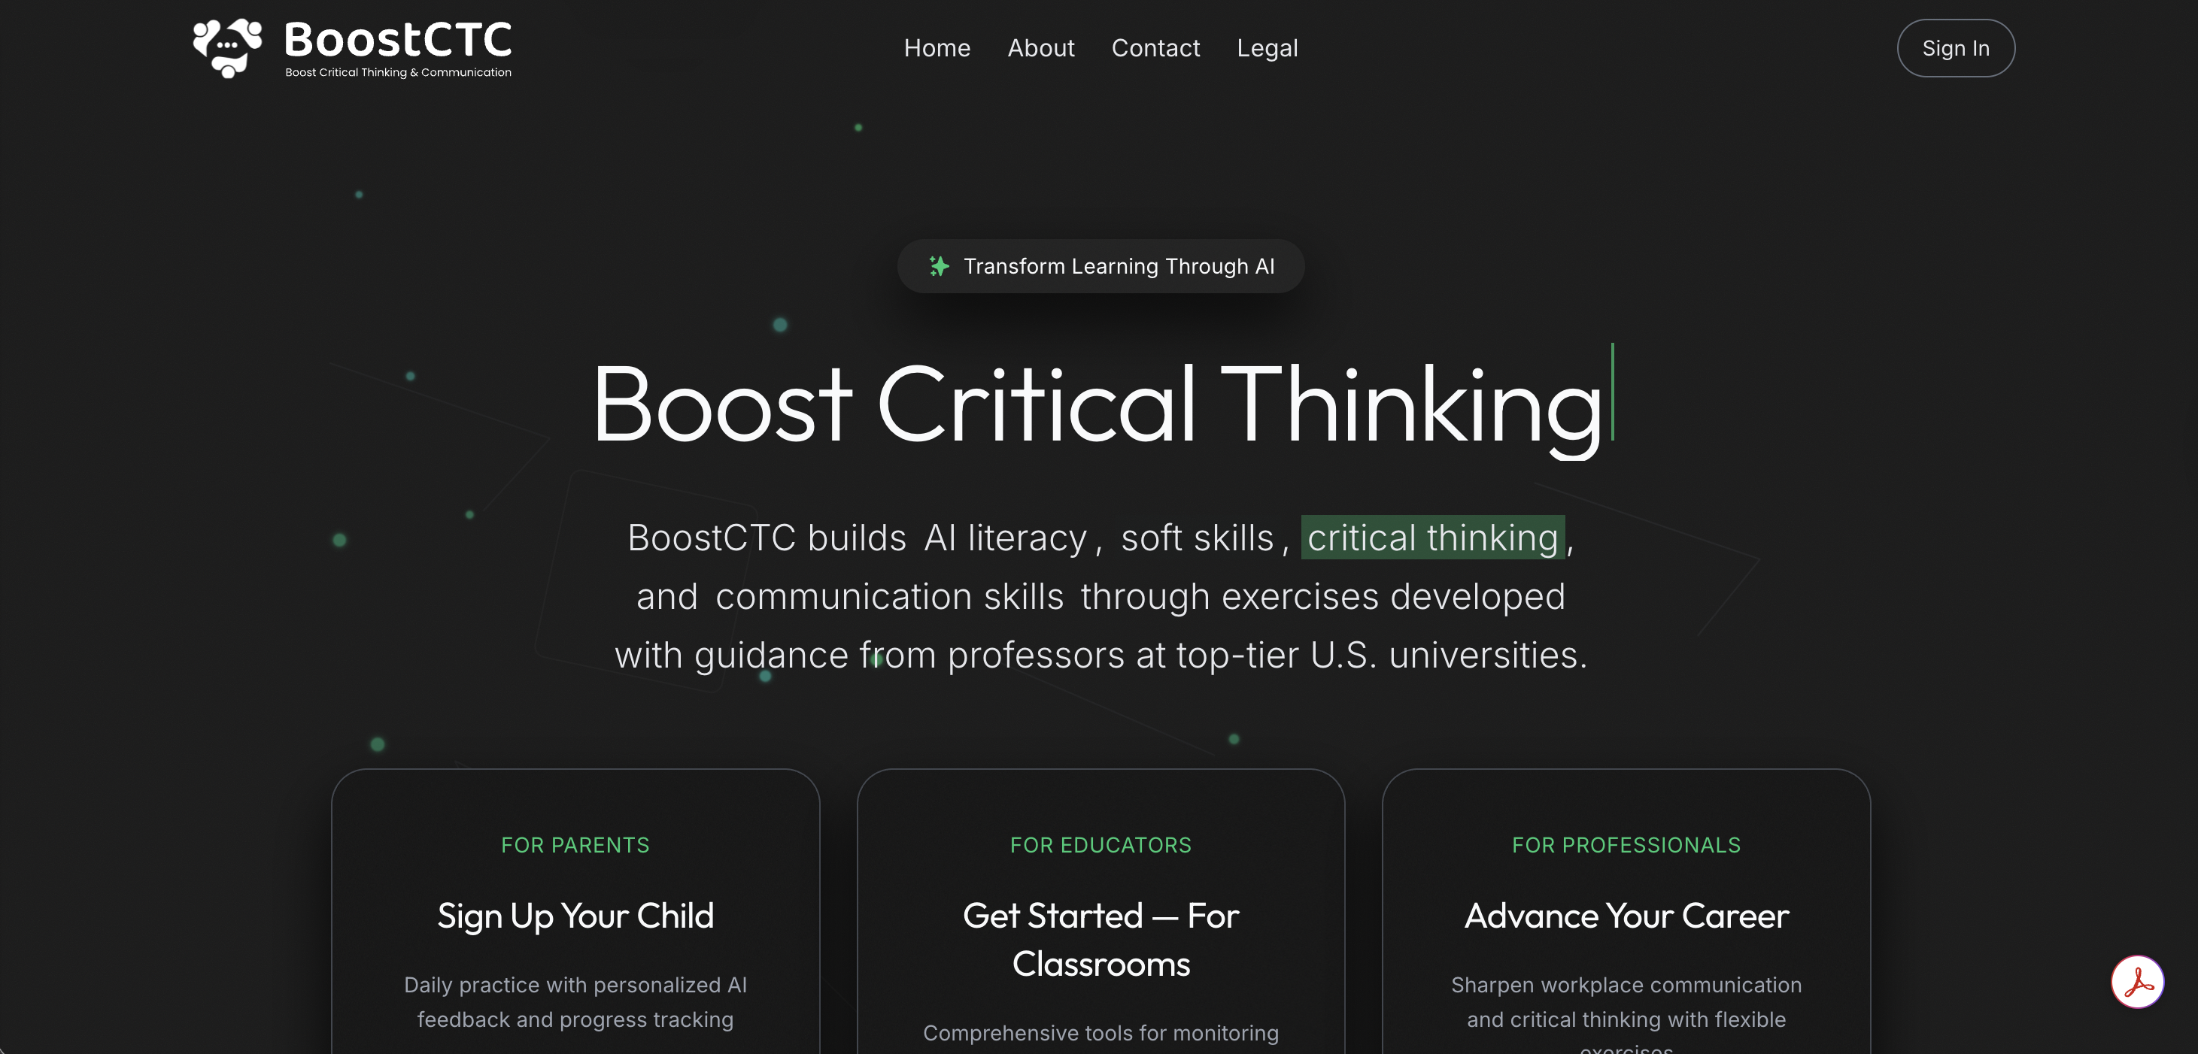
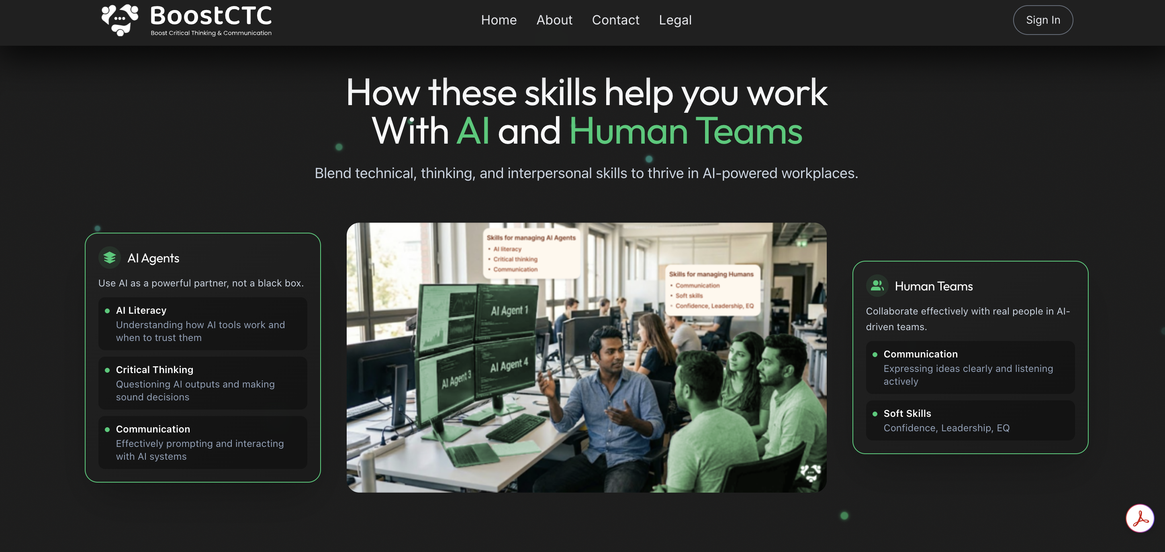
LIVE WALKTHROUGH
What’s BoostCTC.com

Slide 3


WHAT WE BUILT
A voice agent that actually listens!
A conversational AI for BoostCTC that guides new visitors through discovery and brings returning users back to the skills they have been avoiding built to feel like a supportive peer, not a sales script.
MODE A · ENGAGEMENT
MODE B · ADVOCACY
Onboarding new visitors
Re-engaging existing users
Identifies career stage and context in the first exchange
Adapts tone and vocabulary per persona
Runs a live Socratic reflection as a value demo
Branches to lead capture or graceful wrap-up
Welcomes returners by name with progress context
Conducts a Socratic performance review
Helps user self-identify a skill gap
Recommends a specific exercise and asks for a micro-commitment

Slide 4




WHO THE AGENT TALKS TO
Four personas, one adaptive voice
PROFESSIONAL
STUDENT
The Early-Career Engineer
The High School Student
Can execute the work but hits a ceiling in meetings. Tone is collegial and peer-to-peer, with reflection questions that connect their own experience to the platform.
Curious but easily disengaged. The agent uses simpler framing and higher energy, leading with the Socratic exercise as the central hook.
GUARDIAN
RETURNING USER
The Parent Signing Up a Child
The User With a Skill Gap
Concerned about safety, efficacy, and value. The agent leans on outcome clarity and trust signals like COPPA and FERPA compliance.
Already has an account and a dashboard history. The agent does not re-sell — it helps the user arrive at their own insight about where to improve.

Slide 5
TECHNICAL DESIGN
Technical Stack
Layer
Technology
Why It Matters
Voice Infrastructure
Vapi + Deepgram nova-2
WebRTC, STT/TTS, turn management — we override with our own LLM endpoint
LLM Orchestration
LangGraph (TypeScript)
Separates extraction, routing, and generation
Analyzer LLM
GPT-4o-mini
Fast, cheap, deterministic field extraction from every user utterance
Speaker LLM
GPT-4o
Best instruction-following for nuanced, persona-consistent voice responses
Embeddings / RAG
text-embedding-3-small
Cosine search over vectors.json — no external vector DB
Backend
Express.js + TypeScript
Custom-LLM webhook, in-memory state cache, lead CSV API
Validation
Zod schemas
Runtime type safety — catches LLM output mismatches before corrupting state
Dev Tunnel
Cloudflare Tunnel
Free HTTPS URL auto-patched into Vapi on every dev restart
Lead Storage
CSV (leads.csv)
Zero-dependency. Timestamp, call ID, name, email, persona, reflection data

Slide 6
TECHNICAL DESIGN
System Architecture
User Speaks
Vapi
Express Server
Analyzer
Browser / WebRTC
Deepgram STT + TTS
/v1/chat/completions
gpt-4o-mini
Orchestrator
Speaker
RAG Layer
Conv. State
Pure logic
gpt-4o
15 docs · cosine search
Zod-validated
Mode A
Mode B
Lead Capture
Cloudflare Tunnel
New Visitor Phases
Returning User Phases
leads.csv
Public HTTPS URL

Slide 7
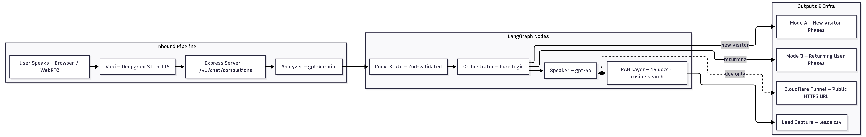
TECHNICAL DESIGN
System Architecture

Slide 8
TOOL DEMO
See the Agent in Action

Slide 9


STATUS & ROADMAP
Working today, polished for final submission
Working Today
Next for Final Submission
End-to-end voice conversation
Deploy to a public production URL
Tap mic, agent opens the call, responds in ~2s
Demo from any device, no local setup
Persona-aware onboarding (Mode A)
Smoother phase transitions
Invisible bridges between stages
Identifies stage, adapts language, runs Socratic demo
Lightweight persona classifier
Returning user flow (Mode B)
Infer type from ambiguous first answers
Reads progress, surfaces skill gap, recommends exercise
RAG over platform knowledge
Grounded answers from real BoostCTC content
5 / 6

Slide 10
REFLECTIONS
Lessons Learnt
01
Conversation Design Is the Hardest Part
04
State Must Flow Forward
Technical pieces came together quickly. The Socratic phase took many iterations to feel insightful rather than generic.
Early versions re-asked for info already collected. Fix: explicitly pass context from earlier phases forward.
02
Voice Transitions ≠ Text Transitions
05
Silence Calibration Is Non-Trivial
In text, a heading handles a topic shift. In voice, an abrupt change sounds wrong. Bridging language required careful writing.
A 2–3 sec pause is natural in conversation. Silence detection needed careful tuning to avoid premature phase advances.
03
One System, Many Personas
06
Momentum Prevents Drop-Off
Same phrasing lands differently for a 14-year-old vs a worried parent. Tone adaptation needed multiple rounds of testing.
Light storytelling, reflecting user's own words, and forward-looking lines between phases keep engagement high.

Slide 11
REFLECTIONS
Challenges
01
Conversation Design Is the Hardest Part
03
Feeling natural and helpful
Names and emails are easy to mishear or spell wrong, so we collect them in a simple on-screen form instead.
Balancing a clear signup ask with a natural, supportive tone is harder than it sounds.
02
Keeping the conversation on track
04
Matching the story to the person
The voice agent often repeated questions or skip ahead unless the flow is designed and tested carefully.
The same script doesn’t work for a student, a parent, and a senior hire we had to tune how the agent listens and responds.

Slide 12
Thank You!
Questions & Discussion

