Slide 1
Lending Club Case Study
Presented By – Agniva Chakraborty

Slide 2
Objective
The company wants to identify risky loan applicants and reduce the amount of credit loss.
Identification of such applicant’s using EDA is the aim of this case study.
To understand the driving factors (or driver variables) behind loan default, i.e. the variables which are strong indicators of default.

Slide 3
Data Cleaning
In this section the data was cleaned to remove any columns/rows which do not help with our analysis
Columns having all Nan’s were identified and deleted
Columns having all zeroes were identified and deleted
Columns with <3 unique values were deleted as they had very less information for our analysis.
Keeping the ‘ID’ column rest all columns having count same as ID was deleted as ‘ID’ gives us the distinct count
Other columns were analysed and deleted as they didn’t help with the analysis on loan defaulters.
Rows where Loan Status = ‘Current’ were removed as the applicants had already started paying their loans and this did not help with our analysis.

Slide 4
Data Standardization
In this section the data was standardized to get rid of inconsistencies and create categories for proper analysis
Removing % from ‘int_rate’ column
‘Verified’ & ‘Source Verified’ meant the same in verification_status column so ‘Source Verified’ was replaced with ‘Verified’ .
4 new Columns were added to create buckets for ‘int_rate’, ’dti’ , ’annual_inc’ & ‘loan_amnt’.

Slide 5
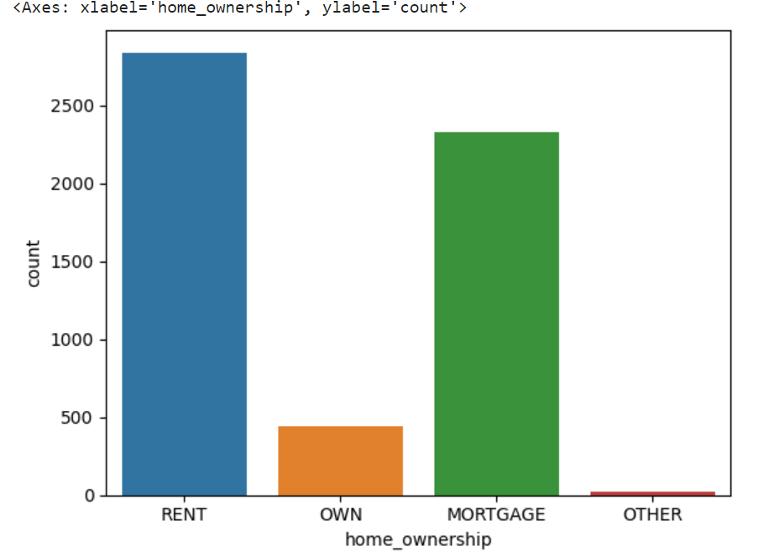
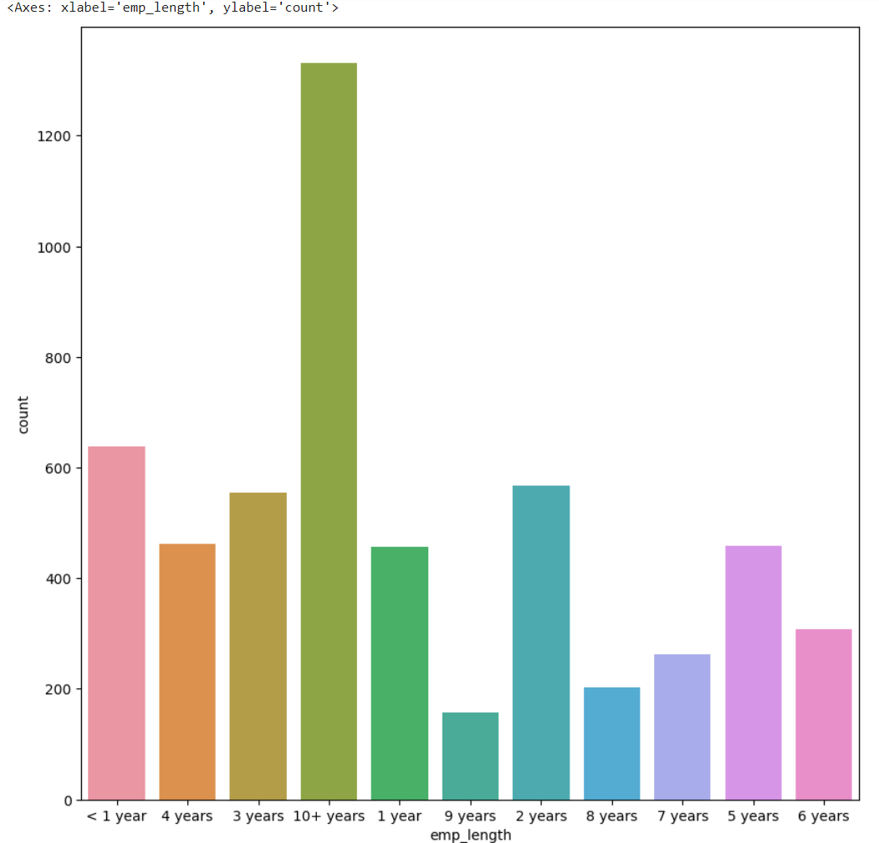
Home Ownership
Employment Length
Home Ownership: Most defaulters are having 'RENT' followed by 'MORTGAGE' as home ownership
Employment Length : 10+ Years of experience have the highest defaulters.

Slide 6
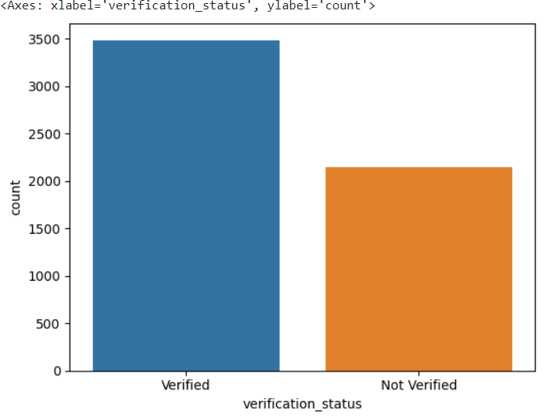
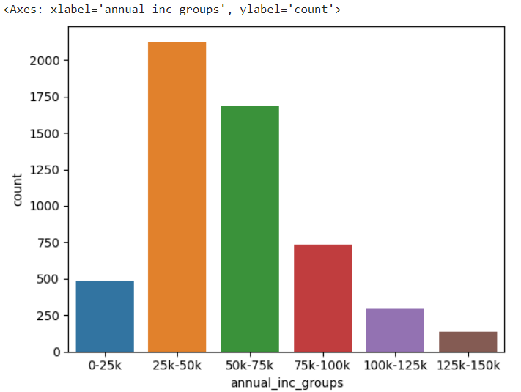
Verification Status
Annual Income
Verification Status: 'Verified’ applicants are the highest defaulters
Annual Income: Annual Income range between 25-50k have the highest defaulters.

Slide 7
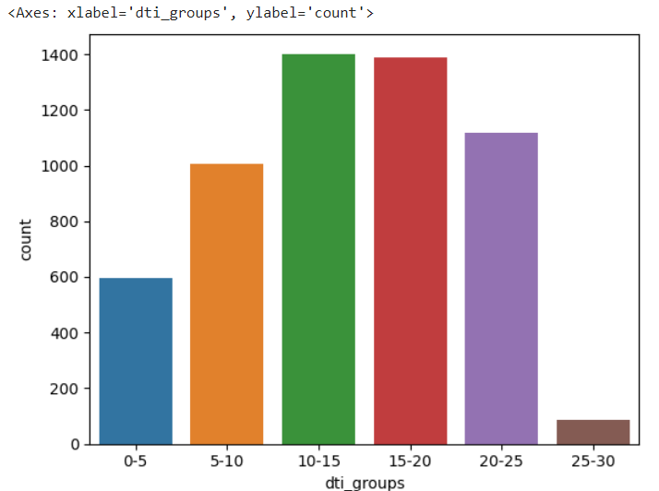
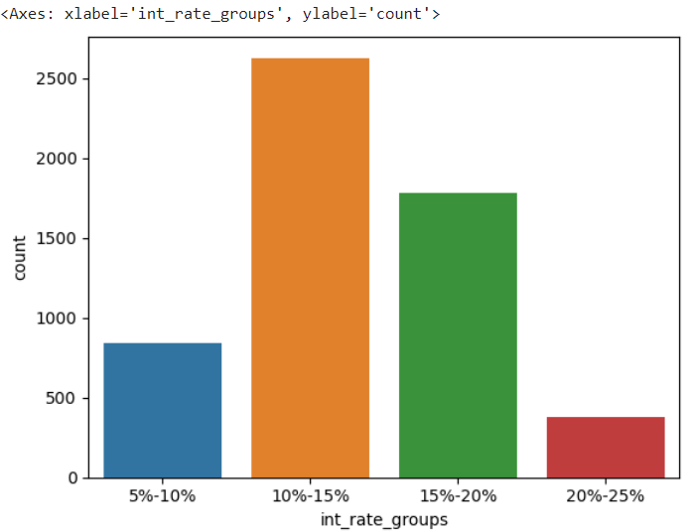
DTI
Interest Rate
DTI: DTI range between 10-20 have the highest number of defaulters.
Interest Rate: Interest Rate range between 10-15% have the highest defaulters.

Slide 8
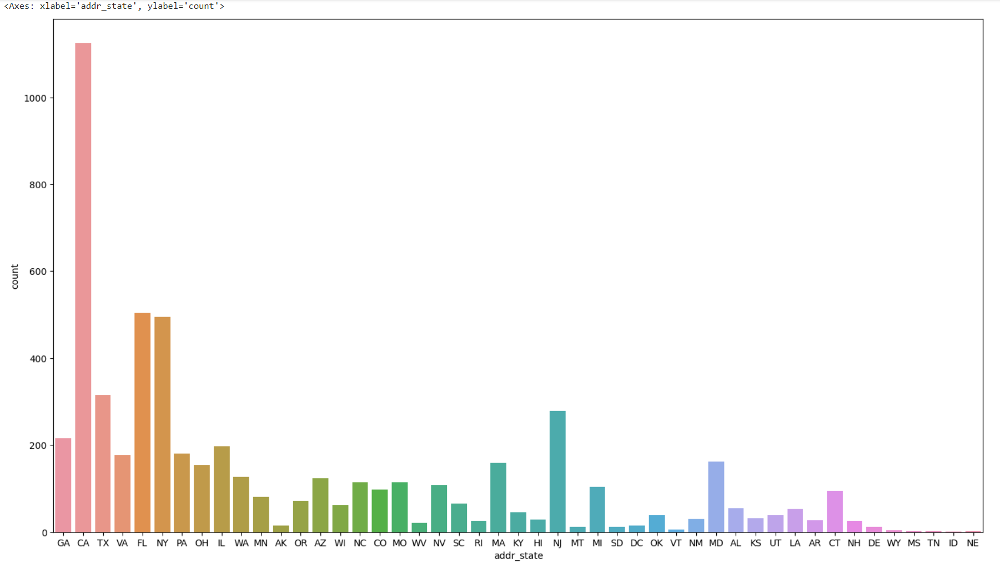
Address State
Address State : CA/California have the highest number of defaulters.

Slide 9
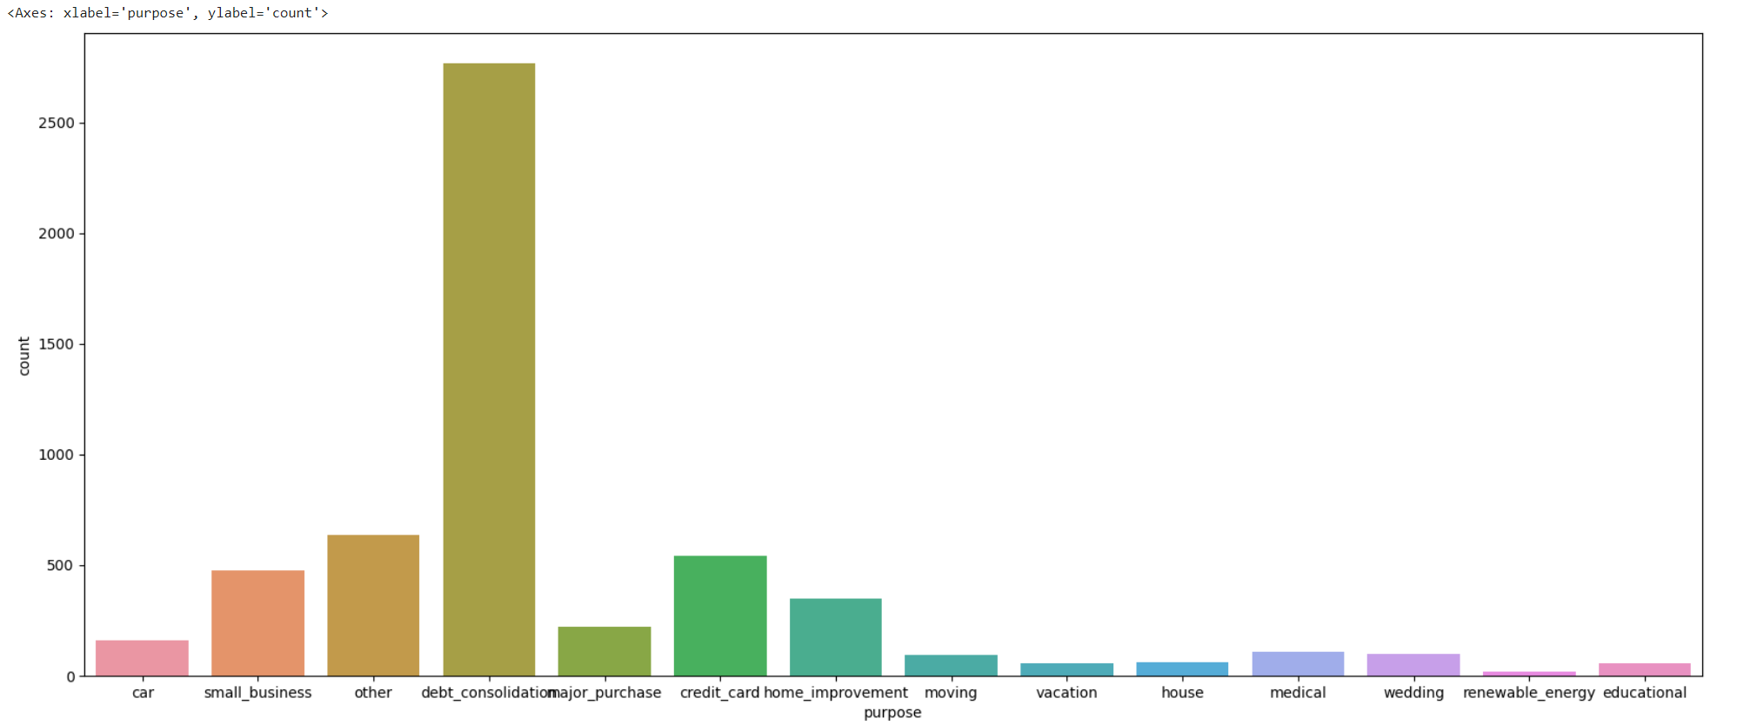
Purpose
Purpose : Loan taken with the purpose of ‘Debt consolidation’ have the highest number of defaulters.

Slide 10
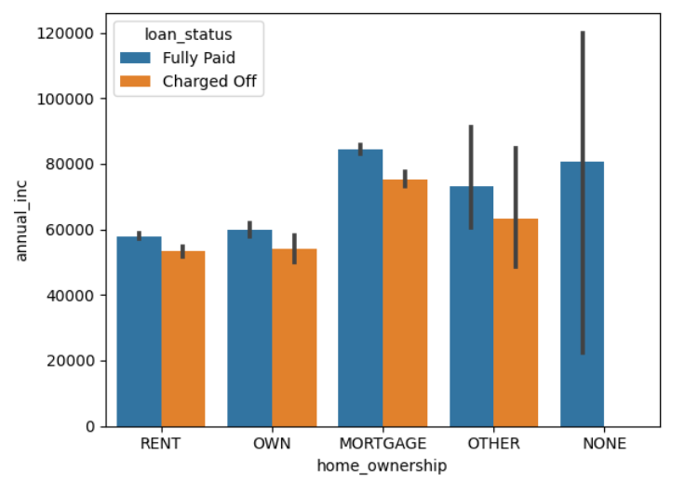
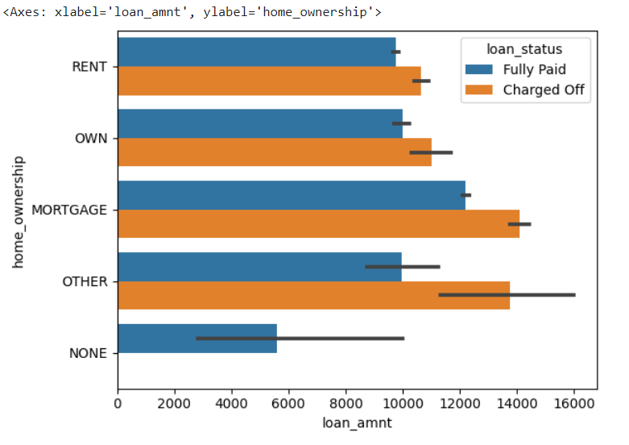
Home Ownership Vs Annual Income
Home Ownership Vs Loan Amount
Home Ownership is 'Mortgage’ & Annual Income between 60-70k and Loan Amount between 12k-14k is showing the highest number of defaulters.

Slide 11
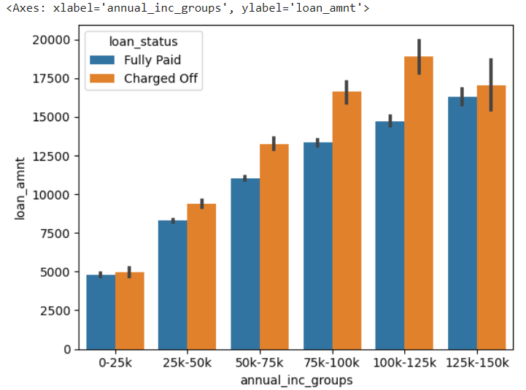
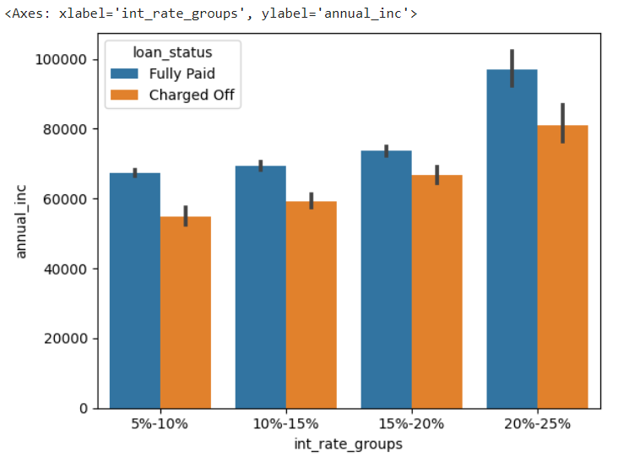
Loan Amount Vs Annual Income
Interest Rate Vs Annual Income
Annual income between 100k-125k having Loan Amount >150k has higher defaulters.
Annual income between 60k-80k having Interest Rate between 20-25% has higher defaulters.

Slide 12
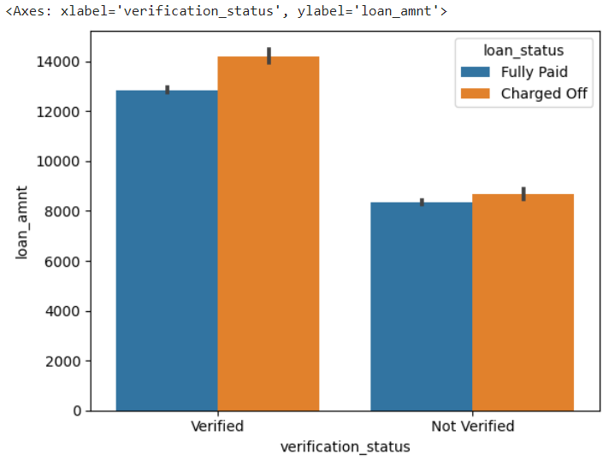
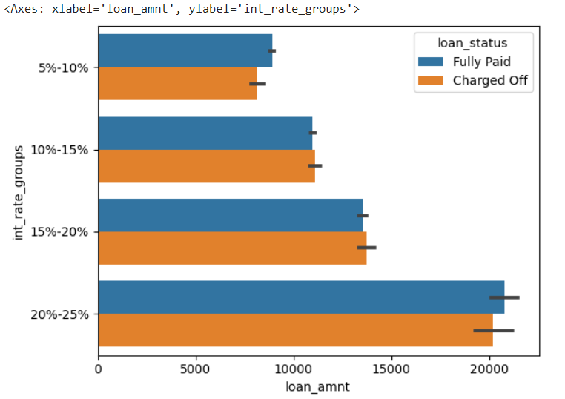
Loan Amount Vs Verification Status
Interest Rate Vs Loan Amount
Loan Amount between 12k-14k having Verification Status as ‘Verified’ has higher defaulters.

Slide 13
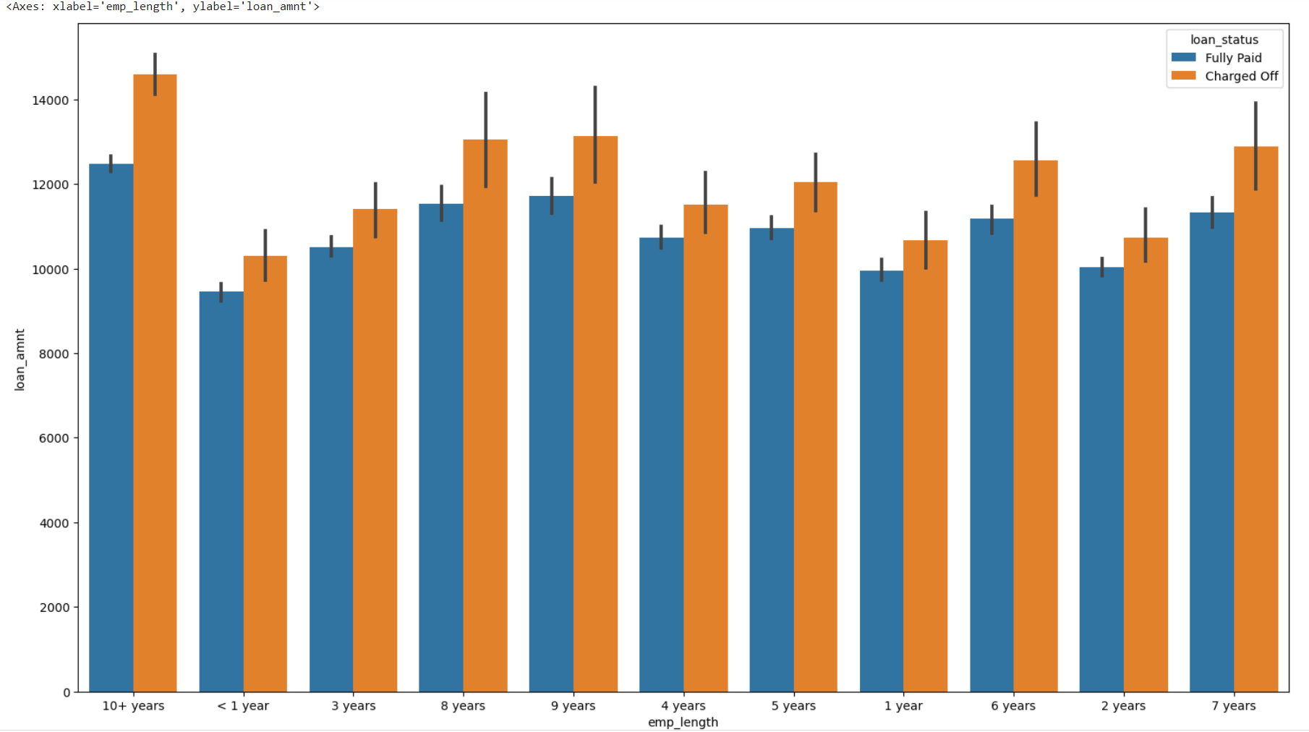
Loan Amount Vs Employment Length
Loan Amount between 120k-150k having Employment Length 10+ years has higher defaulters.

Slide 14
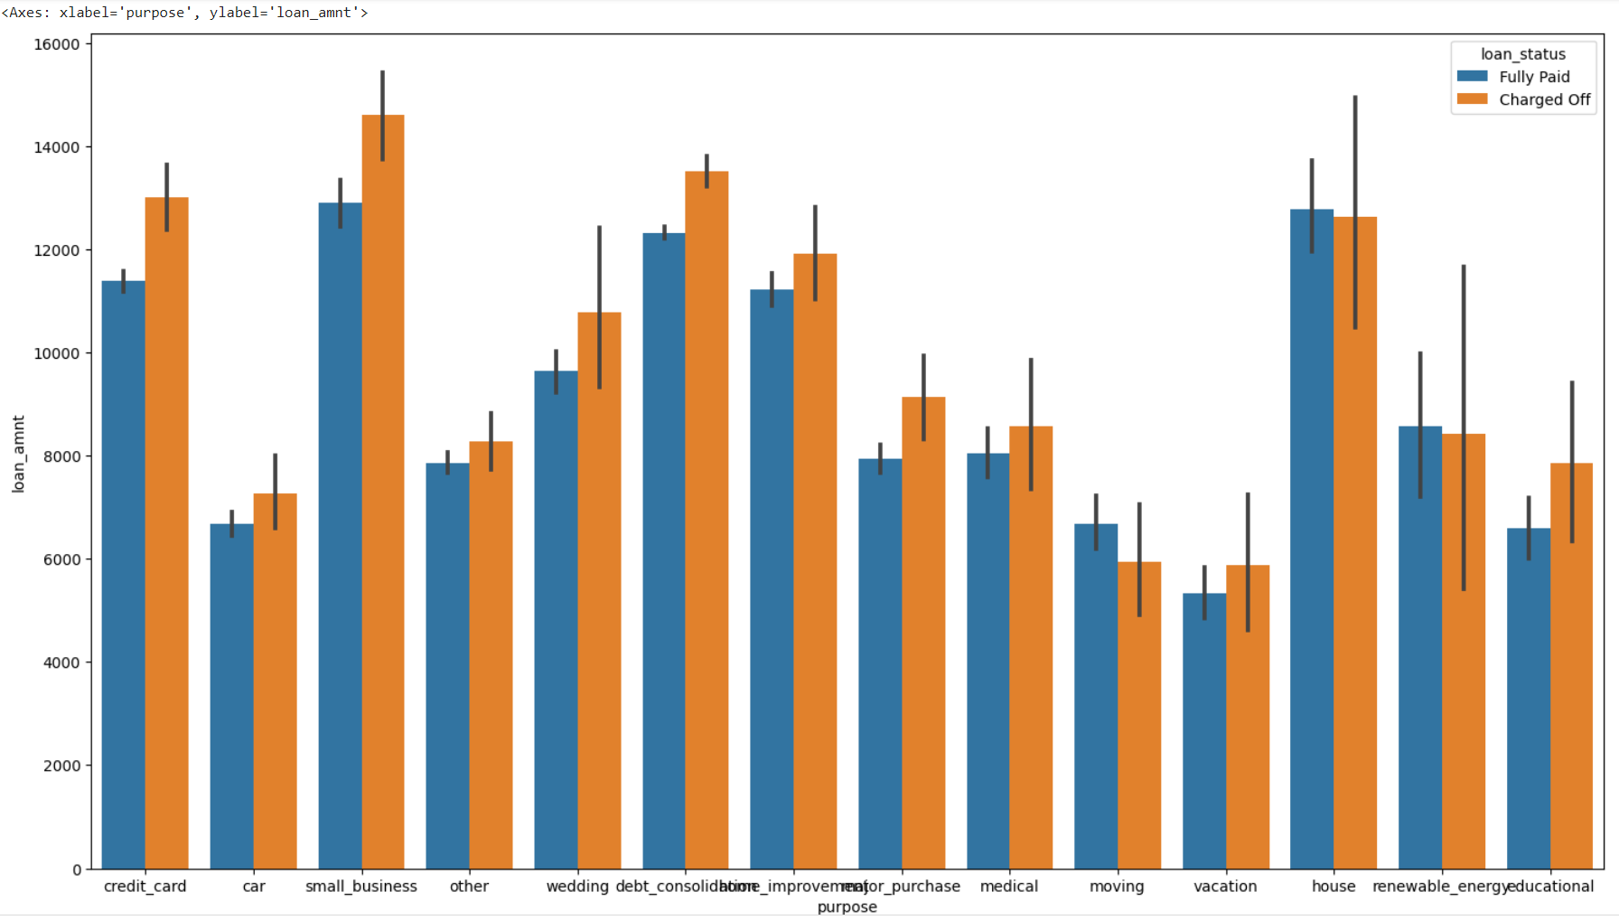
Loan Amount Vs Purpose
Loan Amount between 13k-15k taken with the Purpose of ‘Small Business’ has higher defaulters.

Slide 15
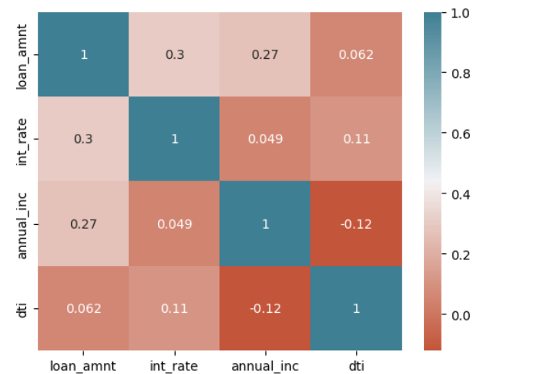
Correlation
Loan Amount, Interest Rate, Annual Income & DTI are showing a strong correlation implying that if all the components are increased it will lead to more ‘Charged Off’ scenarios.

Slide 16
Observations
Most defaulters are having 'RENT' followed by 'MORTGAGE' as Home Ownership
Employment Lenth 10+ Years have the most no. of defaulters
Most no. of defaulters have Verification Status as 'Verified'
Most no. of defaulters have Interest Rate between 10-20%
Most no. of defaulters have Annual Income range between than 25k-50k
Most no. of defaulters have Address State as California
Loan taken with the Purpose of 'debt consolidation’ have the most defaulters.
Most no. of defaulters have DTI between 10-20.
Other Possibilities of Default
Home Ownership = 'Mortgage’ & Annual Income between 60-70k and Loan Amount between 12k-14k has highest defaulters.
Annual income between 100k-125k having Loan Amount >150k has higher defaulters.
Annual income between 60k-80k having Interest Rate between 20-25% has higher defaulters.
Loan Amount between 12k-14k having Employment Length 10+ years has higher defaulters.
Loan Amount between 13k-15k taken with the Purpose of ‘Small Business’ has higher defaulters.
Loan Amount between 12k-14k having Verification Status as ‘Verified’ has higher defaulters.

