Slide 1

SENTINEL QA AGENT
The AI Release Guardian for UiPath Test Cloud
TRACK
UiPath AgentHack | Track 3: Test Cloud
FOCUS
Security + QA + Release Governance

Slide 2

THE TRUST GAP
Why Autonomous Agents Fail in Enterprise Environments
AI generates workflows, but enterprises lack the auditable evidence chain required for safe production releases. Unchecked autonomy leads to catastrophic failures without human oversight.
TYPICAL AGENT DEMOS
ENTERPRISE REALITY
Task completion focused
Risk-ranked test coverage
No evidence chain or audit trail
Execution evidence & proof
No clear test ownership
Human review & approval gates
No exception handling route
Auditable release decisions
No formal release decision
Sentinel starts where the "happy path" ends: handling failed tests and accountable review.

Slide 3

THE SENTINEL THESIS
The best enterprise agent is the one a release team can safely trust. Winning agents are Safely Deployable, not just autonomous.
1. BOT
2. FILECHECK
3. USERCHECK
Autonomous action and intelligent recommendation engine. The agent identifies risk and proposes the path forward.
UiPath Test Cloud captures proof, screenshots, results, and execution traces. No action without auditable evidence.
Strategic human intervention. High-risk or failed releases route to approval gates before reaching production.
SAFE RELEASE CONTROL PLANE: The enterprise story UiPath can own.

Slide 4

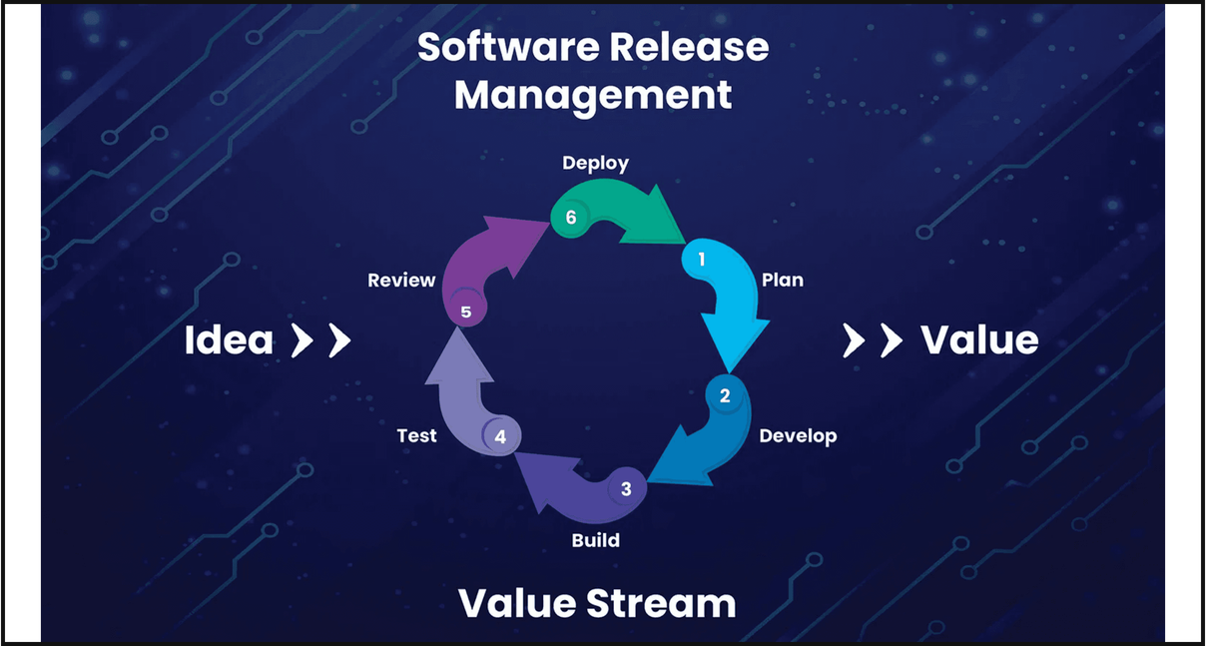
ARCHITECTURAL BLUEPRINT
From Code Change to Accountable Release Gate
1. RISK CLASSIFIER
Analyzes GitHub PRs, release notes, and diff excerpts to identify high-risk signals (Payment, Auth, AI).
2. TEST PLANNER
Generates risk-ranked UiPath Test Cloud cases mapped directly to identified change signals.
3. UIPATH TEST CLOUD
Executes generated tests and captures immutable evidence, screenshots, and results.
SAFETY RULE: NO SILENT PUSH AFTER FAILED EVIDENCE
4. ACTION CENTER GATE
Routes failed or high-risk releases to a human approval task for a final release decision.

Slide 5
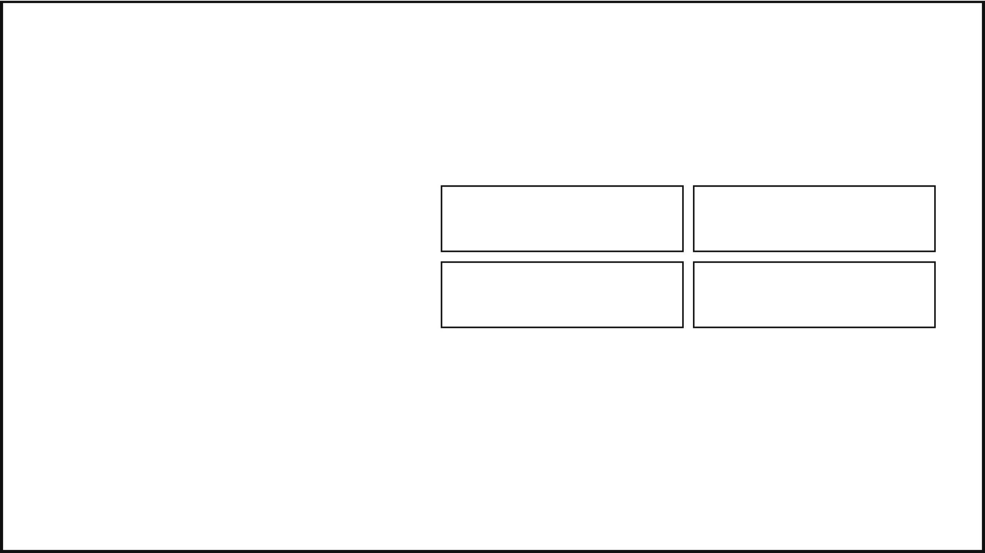
REAL-WORLD STRESS TEST
Scenario: AI-Assisted Invoice Refunds
CHANGE PACKAGE
CRITICAL RISK SURFACES
app/auth/roles.py
Payment Logic
Auth Roles
app/billing/refunds.py
Duplicate invoices, refund abuse, and transaction atomicity.
Privilege bypass and unauthorized access to admin functions.
app/integrations/erp_webhook.py
AI Integrity
System State
app/agents/refund_agent.py
Prompt injection triggering unsafe or irreversible tool use.
Human approval state drift and ERP webhook synchronization.
app/ui/review_dashboard.tsx
This is not a contrived toy flow: it is a real enterprise release-risk shape that demands auditable evidence.

Slide 6

THE RISK ENGINE
Converting Vague Uncertainty into Testable Signals
Payment Logic
78%
AI Agent Integrity
56%
RELEASE RISK SCORE
Authentication Roles
56%
96/100
External Integrations
52%
Signals: 6
Tests: 6
User Experience
39%
Tasks: 2
Status: BLOCK
Every generated test is anchored to evidence from the change package.

Slide 7

TEST CLOUD EXECUTION PLAN
Mapping Identified Risks to Executable Evidence
P1
P1
P1
SQA-001-PAYMENT
SQA-002-AUTH
SQA-003-AI-AGENT
Verify failed payment and retry states do not duplicate orders or invoice records.
Verify lower-privilege users cannot call admin or owner-only actions via API or UI.
Verify prompt injection cannot trigger unauthorized tool use or data exfiltration.
P2
P2
P2
SQA-004-WEBHOOK
SQA-005-STATE
SQA-006-UI
Verify retry, timeout, duplicate-event, and partial-failure handling in ERP sync.
Verify rollback and error handling produce a clear, human-visible state in the dashboard.
Verify audit logs include actor, action, timestamp, and changed object for all events.
OUTPUT: demo_output/uipath_test_set_payload.json

Slide 8

CATCHING THE CRITICAL FAILURE
The Demo Wins Because it Shows the Failure Path
FAILED TEST
RELEASE DECISION: BLOCK
SQA-001-PAYMENT
WHY IT MATTERS
Revenue Risk: Duplicate invoices = real business failure and customer friction.
Observation:
Checkout retry produced two invoice records for one approved payment.
Audit Integrity: Immutable evidence prevents "silent pushes" of broken code.
Recommended Action: Block release and create a high-priority human review task in Action Center.
NO SILENT RELEASE AFTER FAILED EVIDENCE

Slide 9

ACTION CENTER
Where Autonomy Becomes Accountable
TASK 1
TASK 2
Approve or Block Release
Review Failed Test
Sentinel QA scored this release 96/100 and returned BLOCK_RELEASE_PENDING_HUMAN_REVIEW. Owner: Finance Release Owner
Failed payment case: checkout retry produced duplicate invoices for one approved payment. Evidence: SQA-001-PAYMENT Trace
Decision Required: Explicit override or final block based on risk signals.
Outcome: Fix plan, explicit override, or block production push.
INTEGRATION: demo_output/uipath_action_center_tasks.json

Slide 10

THE UIPATH POWERHOUSE
UiPath is the Operating Model, Not Just a Logo
TEST CLOUD
ORCHESTRATOR
Owns generated cases, execution evidence, failed/passed status, and immutable test history for every release candidate.
Runs robots and test sets, ensuring execution is repeatable, scalable, and consistent across environments.
ACTION CENTER
AUTOMATION CLOUD
Routes high-risk or failed releases to named human owners for accountable approval before production deployment.
Houses the connected control plane for the entire test, run, review, and audit workflow in a single unified interface.
SUBMISSION STRATEGY: Local proof today, live UiPath Labs evidence for final submission.

Slide 11

WHY SENTINEL WINS
Attacking Four Prize Surfaces Simultaneously
1. TRACK FIT
2. DEMO HOOK
Primary submission for Test Cloud. Directly addresses the core challenge of AI-driven testing and release governance.
The Failure Path. Most demos end at success; Sentinel wins by proving it can catch and block real business regressions.
3. INTEGRATION
4. PRODUCT FEEDBACK
Cross-platform synergy. Connects GitHub change signals to the full UiPath Control Plane (Test Cloud + Action Center).
Actionable insights. Built to provide specific, technical feedback for the UiPath product team based on real-world enterprise needs.
AWARD TARGETS: BEST OF TEST CLOUD | BEST DEMO | CROSS-PLATFORM INTEGRATION | PRODUCT FEEDBACK | CODING-AGENT BONUS

Slide 12

NEXT STEPS
From Local Proof to Live Release Gate
NOW
ACCESS ARRIVES
FINAL SUBMISSION
Local demo, dashboard, and JSON payloads are fully functional. The repository and initial deck are ready for review.
Transition handoff payloads to live UiPath Test Cloud test sets and Action Center review flows once Labs access is granted.
Record live UiPath evidence, update Devpost links, and finalize the technical documentation for the judges.
Sentinel QA Agent makes UiPath the Trust Layer for AI-built software.
SHIP FASTER. BLOCK SMARTER. PROVE EVERY RELEASE.

