Slide 1

SwipeSolve Swipe Solve ball game
Presented by-
Team Leader : Pradeep Ravindran
Team Members : Opeyemi Oyedepo
Tianyu Yang
Xiaojing Yang
Yixin Yao

Slide 2

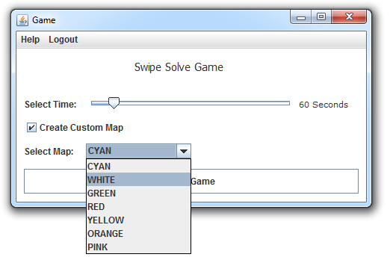
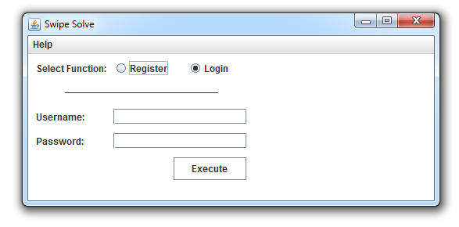
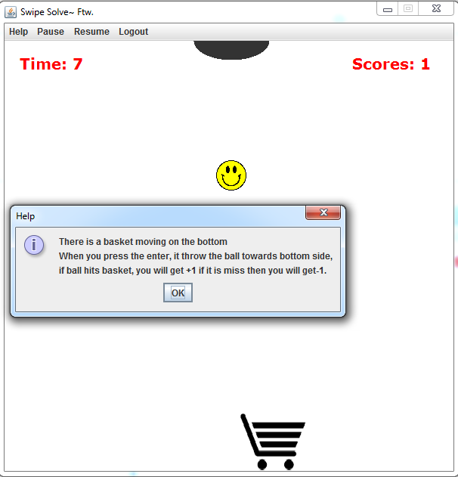
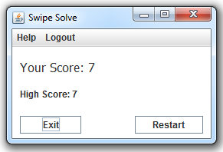
Game snaps

Slide 3
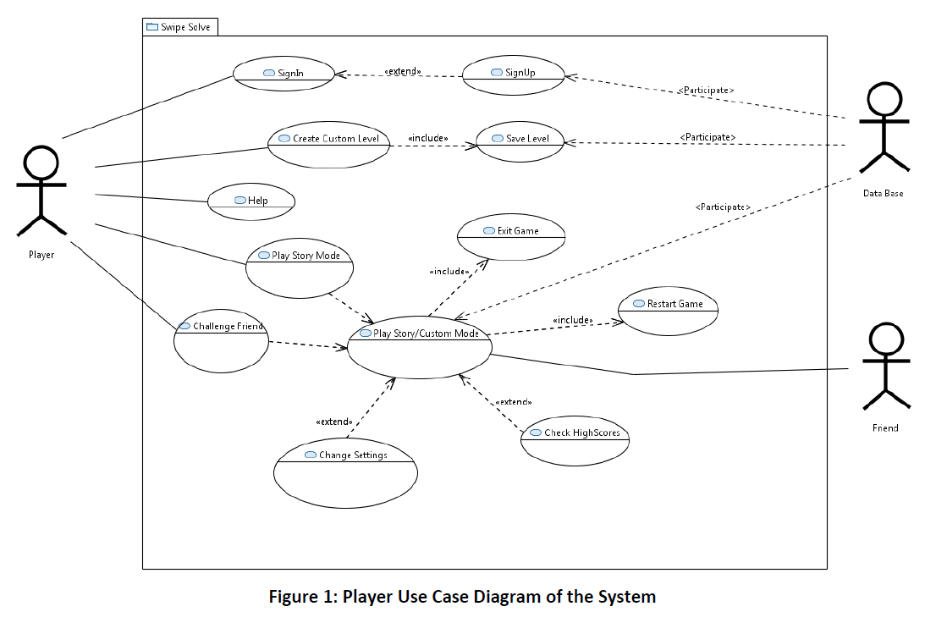

Use Case Diagram

Slide 4
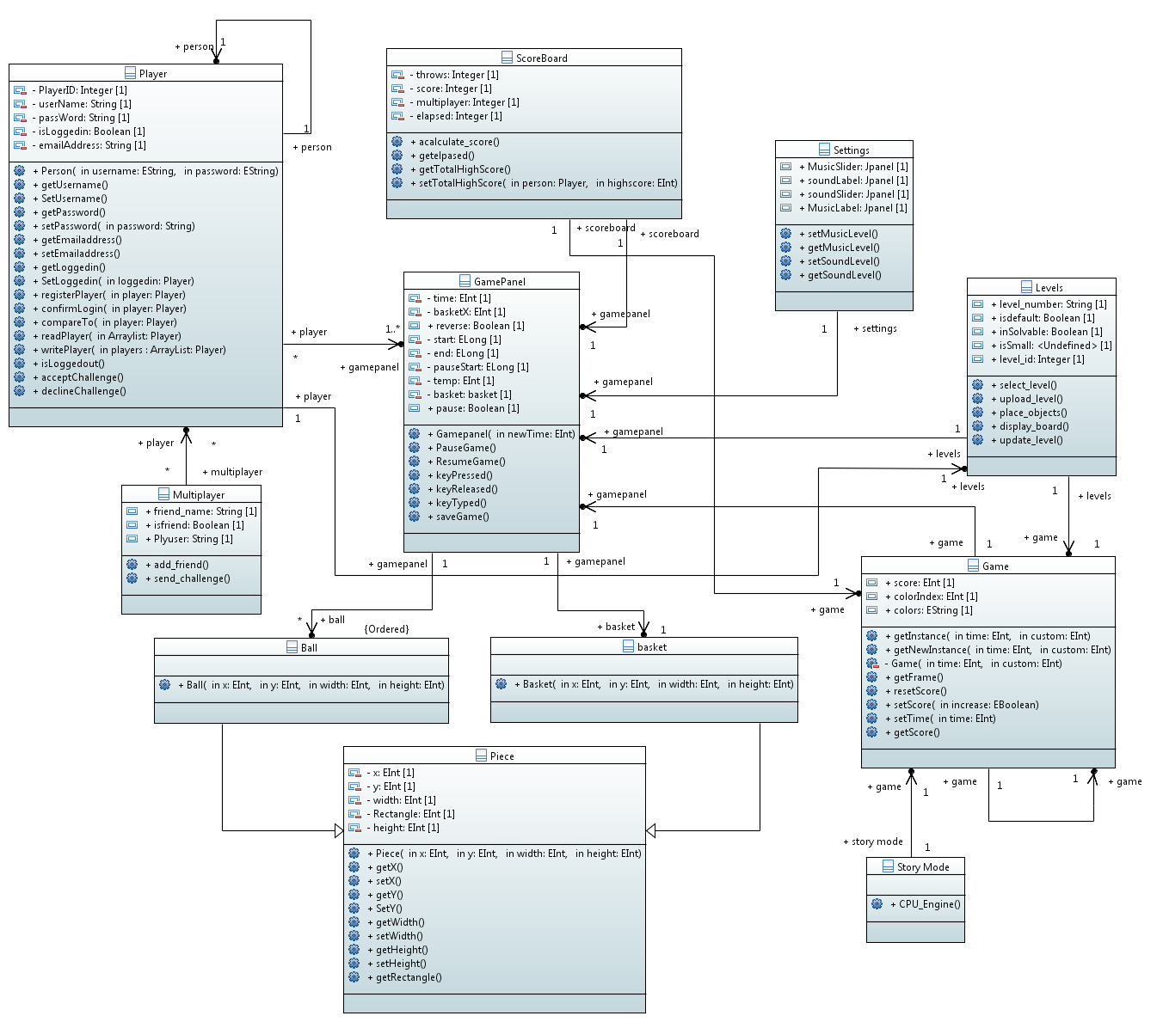
Class Diagram

Slide 5
OCL`s
Context: Player
Invariant: self.allinstances()->forall(P1,P2:Player | P1 < > P2 implies P1.PlayerID < > P2.PlayerID);
Each player who logs in to the system to play a game must have a unique ID
Context Multiplayer: sendChallenge()
Pre: Multiplayer::isFriend Boolean: true
Post: context Multiplayer::isFriend Boolean: false
Constrain specified for a player to send a challenge to play with a friend

Slide 6
State Diagrams

Slide 7
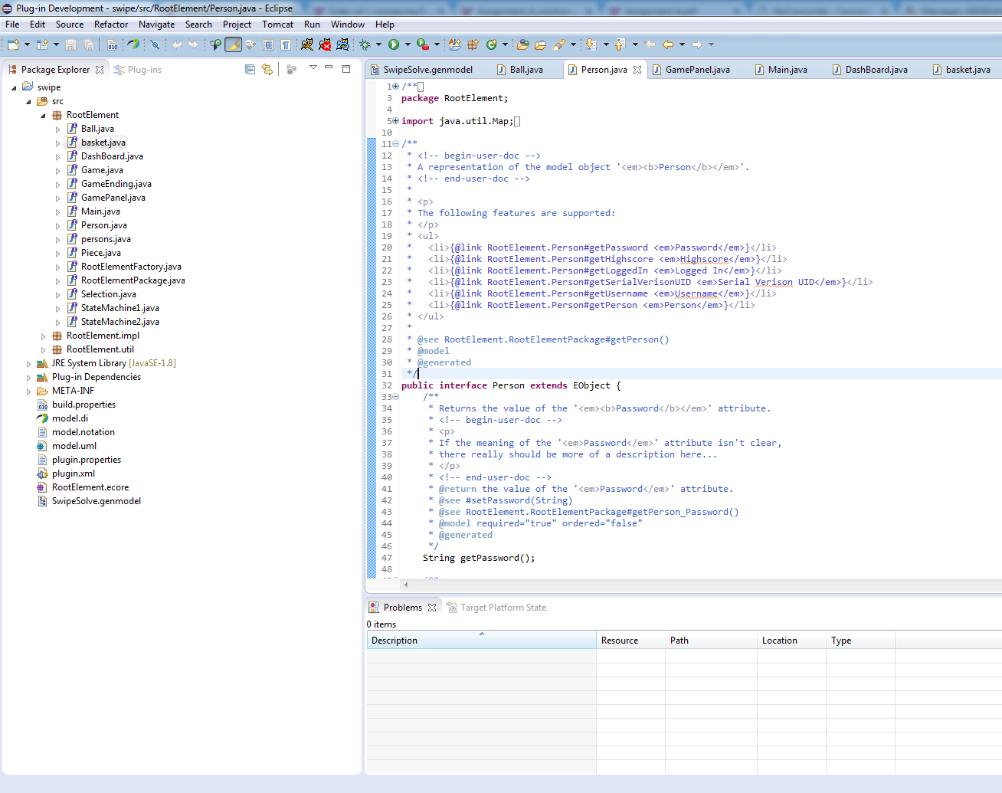
Code Generated using EMF

Slide 8





Collaboration Tools
Tools Used

Slide 9
Lessons Learnt :
Model Driven Software Engineering
Executable UML modeling in Papyrus
Code Generation by EMF
Team Work and Collaborations
Power of OCL and Alf
Project management and Time management

Slide 10

Thank You !!

