Slide 1
Sparrow.Waiter

Slide 2
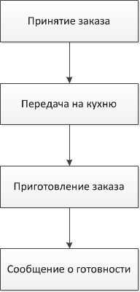

Slide 3
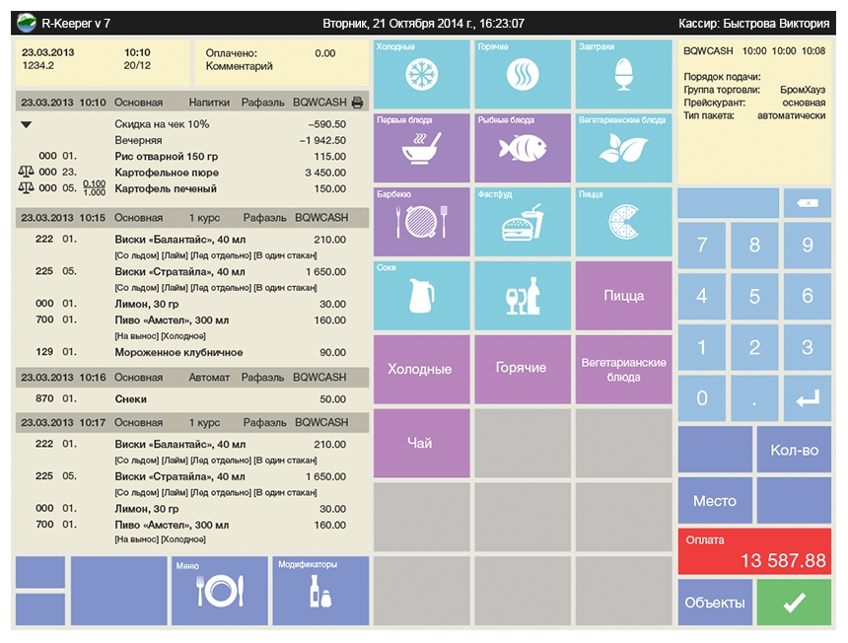
R-keeper

Slide 4

R-keeper

