Slide 1
ITAS 164 ARDUINO BLUETOOTH MUSICAL FOOD ANGEL PILOR, WALKER DUDECK, BRYAN MERCER

Slide 2
GROUP MEMBER ROLES
Order Parts | Walker
Research + Gather Resources | Walker + Angel
Breadboard Assembly | Walker + Bryan
Programming Arduino | Everyone
3D Printing Case | Bryan
MS Project | Everyone
PowerPoint Presentation | Angel

Slide 3
PROJECT TIMELINE
 | October 4 – November 5 |  |  |  | November 8 – December 6
 | 1 | 2 | 3 | 4 | 5 | 6 | 7 | 8 | 9
Order Parts
Research
Breadboard Assembly
Programming
Testing + Final Touches
3D Case Printing
Powerpoint
Class Demo

Slide 4
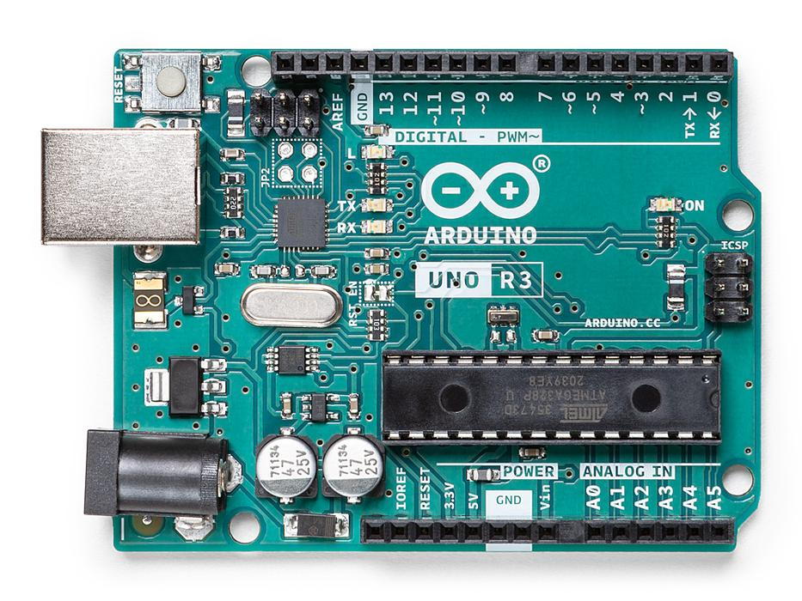
THE Project
Creating a touchpad sensor that can create musical sounds when connected to food. We created the touchpad by using an Arduino Bluetooth module.

Slide 5
ISSUES
Our main issue was not being able to find a compatible phone app that can connect to our Arduino touchpad.
Had to watch several YouTube videos, read through forum posts, to find an answer
We kept trying 3rd party phone apps, different software on windows, but none of them worked. We also tried to connect the Arduino touchpad to a MacBook but that didn’t work
Solution: Arduino IoT Cloud Remote App

Slide 6
STAKEHOLDERS, SCOPE, RESOURCES
Stakeholders
The entire group – Angel, Walker, Bryan
Investors –
Walker, Bryan
Scope
Creating a bluetooth midi controller using the Adafruit Feather Bluefruit LE.
By using the Adafruit we configured the code to be able to connect to a phone app that can detect inputs when we attach the touch sensors to food
Resources
-Adafruit Feather
-Wires
-Laptop Software
-Phone App (Adafruit)
-Fruit

Slide 7
MILESTONES
Breadboard
assembly
Finding app compatible with arduino to play sounds
Assembly of Arduino with case

Slide 8


WHAT IF WE HAD MORE TIME?
Fix the code so that after a certain amount of inputs/tapping the fruit the code will still detect input and keep playing sounds
Current version: Code gets “messed up” after a certain number of inputs, which stops the touchpad from detecting any inputs

Slide 9
THANKS!
Any questions?

