Slide 1
Reducing the Network Load in Distributed Machine Learning
Max Lam, Edward Look, Jesslyn Whittell

Slide 2
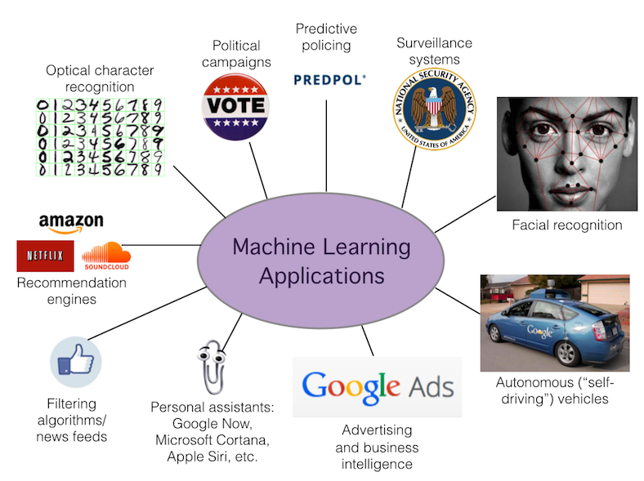
Introduction

Slide 3
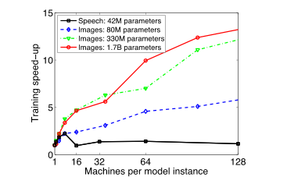
Scaling Distributed Training
“Large Scale Distributed Deep Networks” [Dean et al., NIPS 2012]

Slide 4
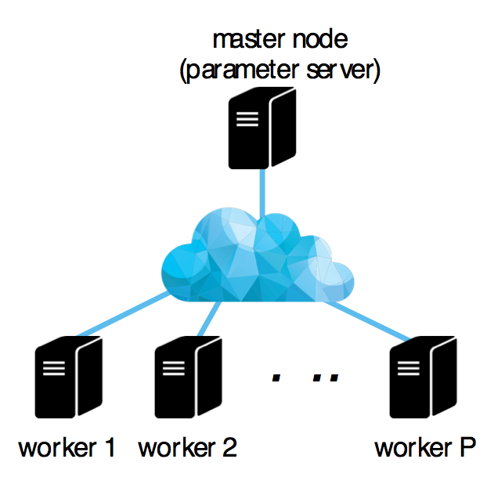
Why is Distributed Training Slow?
Stores the model
Gradient Computations
Thanks to Professor Papailiopoulos for the amazing pictorial!

Slide 5
Why is Distributed Training Slow?
1. Model Sync.
Thanks to Professor Papailiopoulos for the amazing pictorial!

Slide 6










Why is Distributed Training Slow?
2. Gradient Comp.
+
+
+
Thanks to Professor Papailiopoulos for the amazing pictorial!

Slide 7


Why is Distributed Training Slow?
3. Gradient Agg.
+
Thanks to Professor Papailiopoulos for the amazing pictorial!

Slide 8
Why is Distributed Training Slow?
Network Communication
+
Thanks to Professor Papailiopoulos for the amazing pictorial!

Slide 9
SparsifyGradients
Reduce gradient data in aggregation phase

Slide 10
SparsifyGradients
Reduce gradient data in aggregation phase
Drop gradient values with small magnitudes!

Slide 11
SparsifyGradients
Reduce gradient data in aggregation phase
Drop gradient values with small magnitudes!
Drop 90% of gradient values

Slide 12
Experiment Setup
14 c3.xlarge EC2 machines
4 virtual CPU cores
500 mbps connection
7.5 MiB memory
Cifar10 Image Classification
Cuda-Convnet style neural network

Slide 13
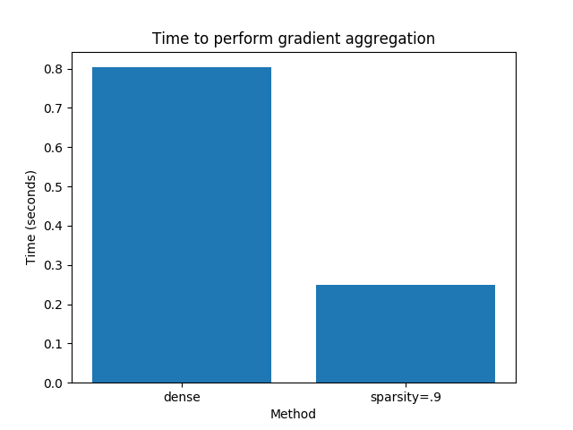
Results

Slide 14
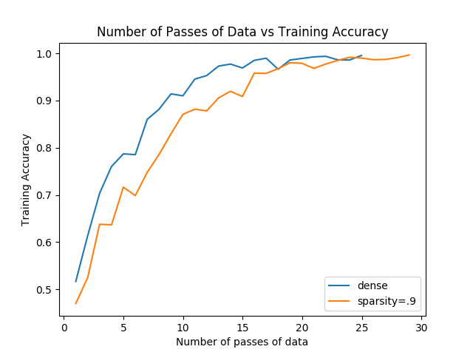
Results

Slide 15
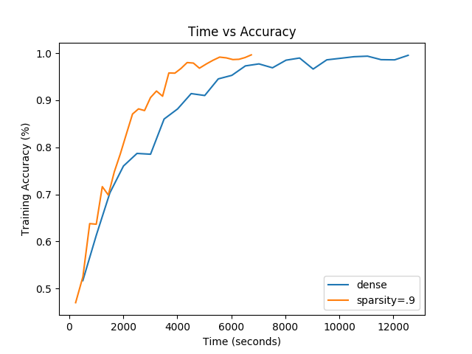
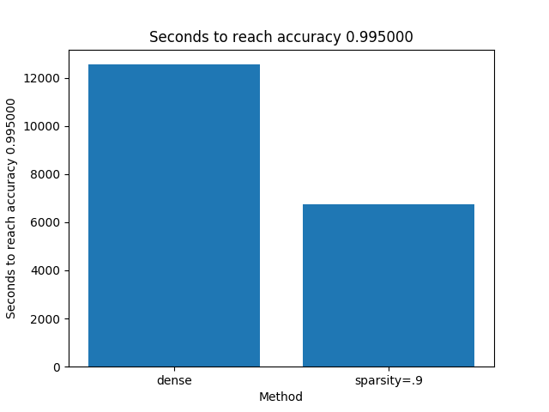
Results

Slide 16
Results
2X SPEEDUP!

Slide 17
Convergence not Affected?

Slide 18
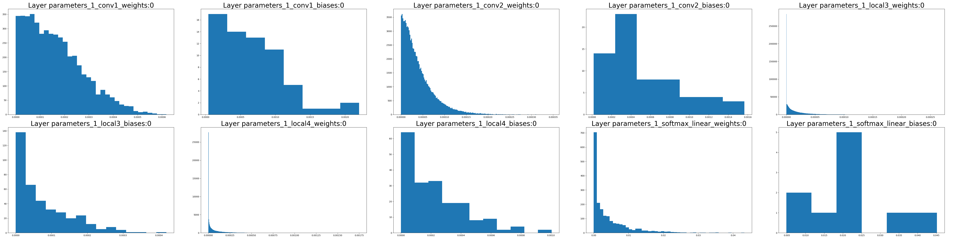
Convergence not Affected?
1. Most gradient values are “noise”

Slide 19
Convergence not Affected?
2. Stochastic Gradient Descent is robust and compensates

Slide 20
Conclusion
Speedup by reducing network load
2x speedup in time to 99.5% train accuracy
Not all gradient values are equal
Most might just be noise

Slide 21
Thanks!

