Slide 1


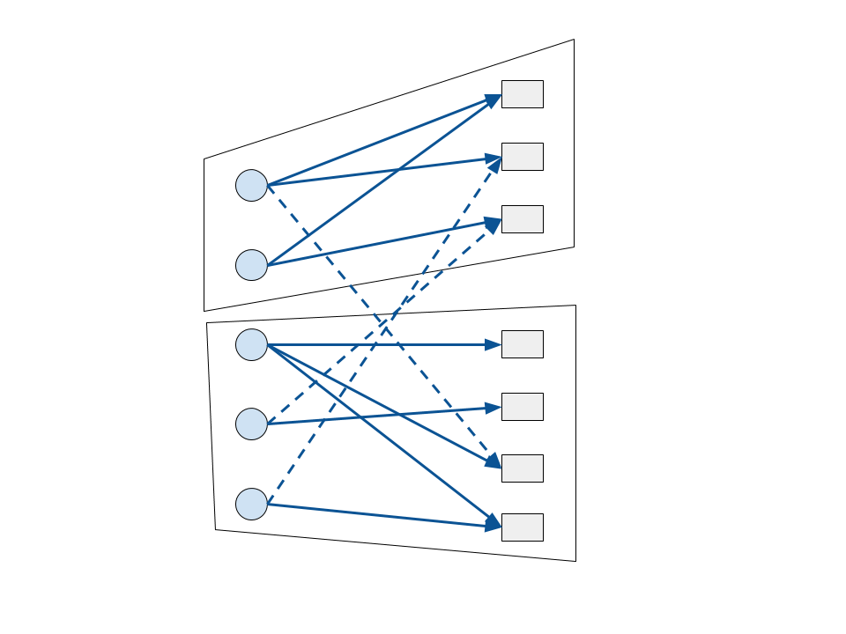
Cache Friendly Shuffles for Machine Learning
Maximilian Lam, Horia Mania, Maxim Rabinovich
The Problem
Least Squares
Word2vec
Goal: Understand the scalability of asynchronous stochastic optimization in machine learning problems in terms of the parameter dependence graph. We use partitions of the parameter dependence graph to increase performance.
HogWild![1]
Data points
Variables
Given data-points with and , we want to find a model that minimizes the loss:
Given context counts we want to find word embeddings that minimize the loss:
We measure the performance of Hogwild! on several synthetic data-sets, with different structures of the access pattern graph. We show experimental results one NUMA node with 12 cores.
In the access pattern graph each data point has degree 200. We show experimental results on one NUMA node on the Edison supercomputer.
loss for data point i
Idea: Partition the parameter dependence bipartite graph to find subsets of data-points that depend on small subsets of parameters.
Example: Stochastic Block Model
Block 1
Acknowledgements. We would like to thank Dimitris Papailiopoulos and Xinghao Pan for fruitful discussions.
Block 2
[1] Feng Niu, Benjamin Recht, Christopher Re, and Stephen Wright. Hogwild: A lock-free approach to
parallelizing stochastic gradient descent. In Advances in Neural Information Processing Systems , 2011.
[2] Rie Johnson and Tong Zhang, Accelerating stochastic gradient descent using predictive vari-
ance reduction, in Advances in Neural Information Processing Systems, 2013, pp. 315–323.

