Slide 1


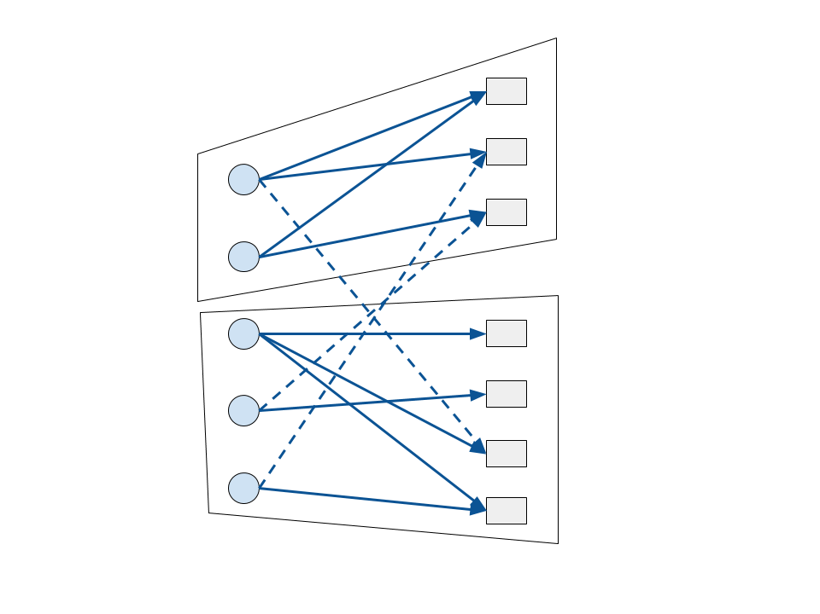
Cache Friendly Shuffles for Machine Learning
Maximilian Lam, Horia Mania, Maxim Rabinovich
The Problem
Least Squares
Word2vec
Goal: Improve memory access performance of asynchronous stochastic optimization by exploiting the parameter dependence graph.
HogWild![1]
Data points
Variables
Given data-points with and , we want to find a model that minimizes the loss:
Given context counts we want to find word embeddings that minimize the loss:
We measure the performance of Hogwild! on several synthetic data-sets, with different structures of the access pattern graph. We show experimental results on one NUMA node with 12 cores.
In the access pattern graph each data point has degree 200. We show experimental results on one NUMA node on the Edison supercomputer.
loss for data point i
Idea: Partition the parameter dependence bipartite graph to find subsets of data-points that depend on small subsets of parameters.
Example: Stochastic Block Model
Block 1
Acknowledgements. We would like to thank Dimitris Papailiopoulos and Xinghao Pan for fruitful discussions.
Block 2
[1] Feng Niu, Benjamin Recht, Christopher Re, and Stephen Wright. Hogwild: A lock-free approach to
parallelizing stochastic gradient descent. In Advances in Neural Information Processing Systems , 2011.
[2] Jeffrey Dean, Greg Corrado, Rajat Monga, Kai Chen, Matthieu Devin, Mark Mao, Andrew Senior,
Paul Tucker, Ke Yang, Quoc V Le, et al. Large scale distributed deep networks. In Advances in Neural
Information Processing Systems , pages 1223–1231, 2012.
[3] Ce Zhang and Christopher Re. DimmWitted: A Study of Main-Memory Statistical Analytics. VLDB 2014.

