Slide 1

GAMENET EVALUATION
Name : Taha Hussain , David Aderibigbe

Slide 2
TABLE OF CONTENTS
GameNet
Introduction
Model description
Data
Results and Discussion
Model comparisons
Conclusions

Slide 3
INTRODUCTION AND MOTIVATION
Graph Augmented MEmory networks for recommending medication combination
Tackles the limitation of instance-based recommendations
Uses previous work that uses memory banks augmented by DDI graphs and dynamic memory based on patient history.
The papers claim that this approach outperforms all current baselines in effectiveness measures, and achieved 3.60% DDI rate reduction.

Slide 4
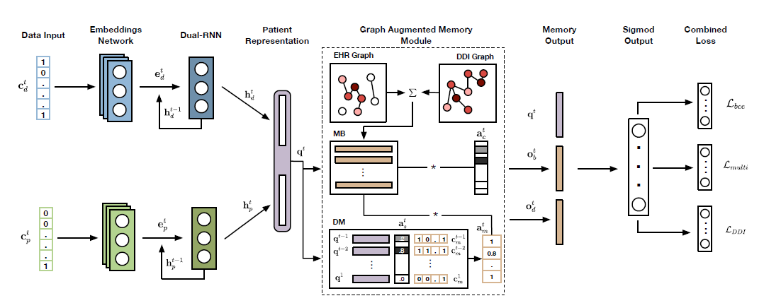
MODEL DESCRIPTION – HIGH LEVEL

Slide 5
DATA - SOURCES
The data raw data is the diagnoses, prescriptions, procedure data from MIMIC-3
The data also includes drug-drug interaction (TWOSIDEs dataset)

Slide 6
DATA –CLEANING AND FILTERING
we will remove duplicate entries from the 3 datasets
the values will be sorted by subject_id
there will be one row for each visit in the input dataset to the model
we will convert NDC to ATC
we might do some limits on the number of procedures, medications, and diagnoses to keep in our testing due to processing constraints

Slide 7
DATA - OUPUT
Feature dictionary sample : { "diag_1" : 1, "diag_2" : 2, "diag_3" : 3 }
Patient Record format : [ [Diagnosis] , [Procedures] , [Medications] ]
Patient record samples : patient 1 : [ [1,2,3,7] , [6,7,5,4] , [3,4,6,8] ] patient 2 : [ [3,7] , [7,5] , [4,6,8] ]

Slide 8
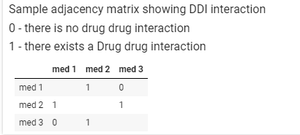
DATA – ADJACENCY MATRIX

Slide 9
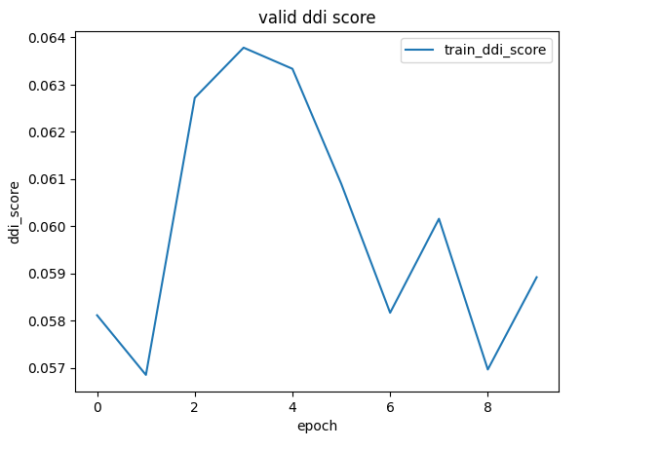
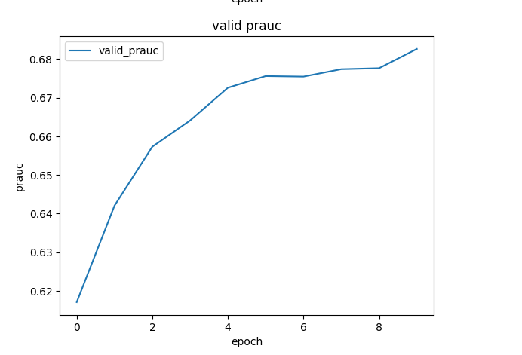
RESULTS OF EVALUATION

Slide 10
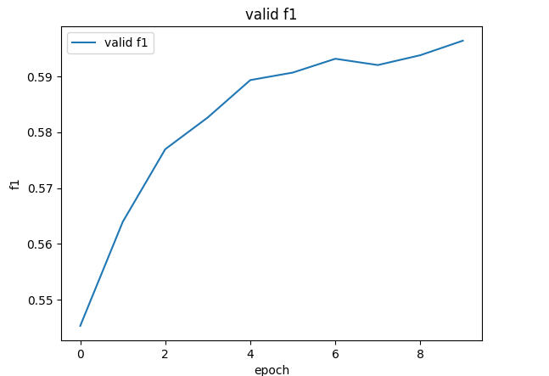
RESULTS - CONTINUED

Slide 11
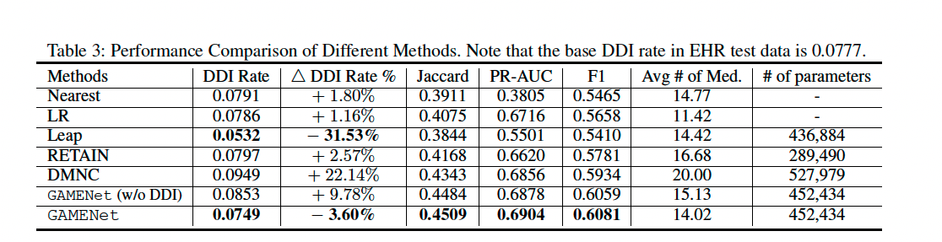
MODEL COMPARISON DISCUSSION Results Consistent with Paper Results.

Slide 12
GameNet Results Discussions
Epoch 8
Metric | Result
DDI Rate | 0.057
Jaccard | 0.44
PRAUC | 0.675
AVG_PRC | 0.630
AVG_RECALL | 0.595

Slide 13
MODEL COMPARISON - Logistic Regression
Metric | Result
DDI Rate | 0.0782
Jaccard | 0.4087
PRAUC | 0.6739
AVG_PRC | 0.6730
AVG_RECALL | 0.5224
AVG_F1 | 0.5669

Slide 14
MODEL COMPARISON - Leap
7th Epoch (LR .0002)
Metric | Result
DDI Rate | 0.053
Jaccard | 0.3551
PRAUC | 0.5142
AVG_PRC | 0.4930
AVG_RECALL | 0.5489
AVG_F1 | 0.5006

Slide 15
CHALLENGES
Understanding the paper took time as there were a lot of elements
Paper had a lot of nuances and details that can only be understood after reading the code (Key value store , Mean Embedding, initializing the memory banks etc)
Training is very time consuming
Model comparison code does not run out of the box (Leap, LR)

Slide 16
CONCLUSION
Our results are consistent with the Paper.
Leap tends to contain lower DDI, and lower Precision.
More analysis should be done to determine if underlying relationships between indication and prescription is actually better in Leap, as ddi is lowest, and this represents safer prescriptions.
Further expert review is needed, to confirm if which drugs might be more efficacious.
Tweaks to the loss function could lead to greater safety, while optimizing for the latent representations found in the EHR.

