Slide 1
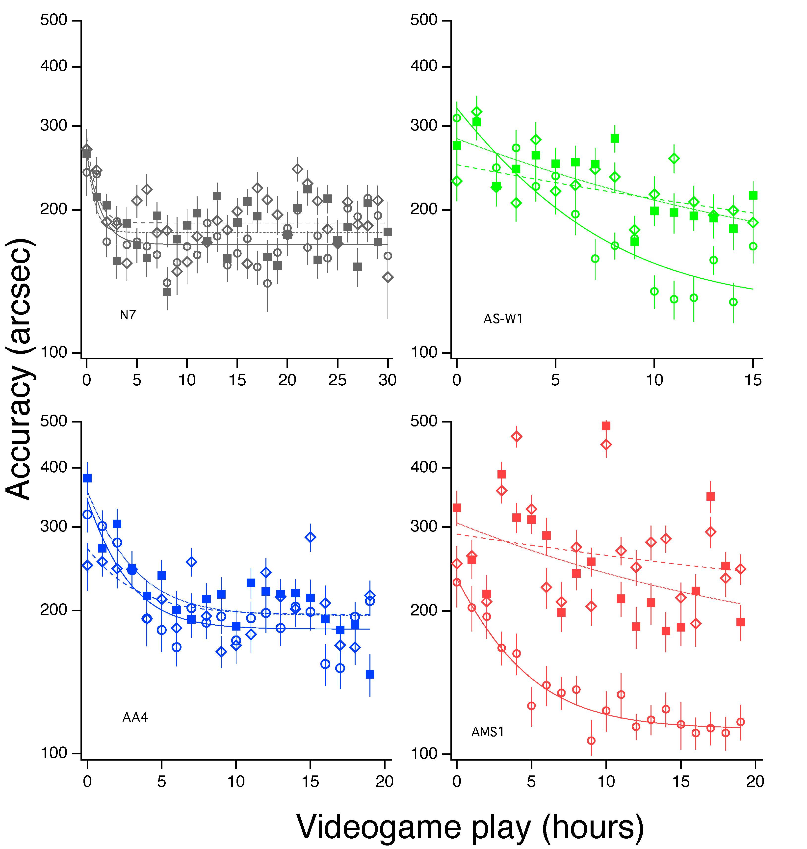
A
B
Cond. 1: All cues
Cond. 2: No shadows/perspective
Cond. 3: Disparity only
C
D

