Slide 1
An Autonomous Robot that Works in Warehouse
Group 12 - Robocop
• Ahmet Gökçe, 150180076
• Mehmet Karaaslan, 150180053
• Emre Güler, 040150342

Slide 2
Problem Description
There are products stored in warehouses. In our project, we use robots in warehouses to find, take and deliver the products to the distribution point of the warehouse. Thus, storage costs are reduced, and the delivery is realized in a smart, fast and efficient way.

Slide 3
Roles
 | Ahmet Gökçe | Emre Güler | Mehmet Karaaslan
Ros Environment Setup | X | X | X
Map Design | X
Speech Command and Interpretation |  |  | X
Movement Between Room and Destination |  | X
Searching and Grabbing Object | X
Testing | X | X | X
Presentation |  | X
Video |  |  | X

Slide 4
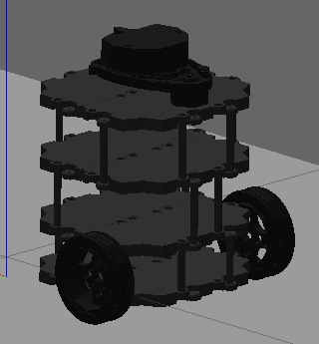

Technologies
TurtleBot3 (burger)
Gazebo Simulation
SpeechRecognition
PyAudio

Slide 5
Approach to the problem
In our environment, there are several rooms.
Each room is used to store only one kind of product and each room has an ID.
The robot takes this ID via voice command and interprets this command to specify the room.
Then, the robot takes the product in the specified room and brings it to the distribution point in the environment.

Slide 6
Success of the Robot
Robot is determined as successful if,
Robot understands the voice command
Robot goes to desired room
Robot picks the product
Robot delivers the product

Slide 7
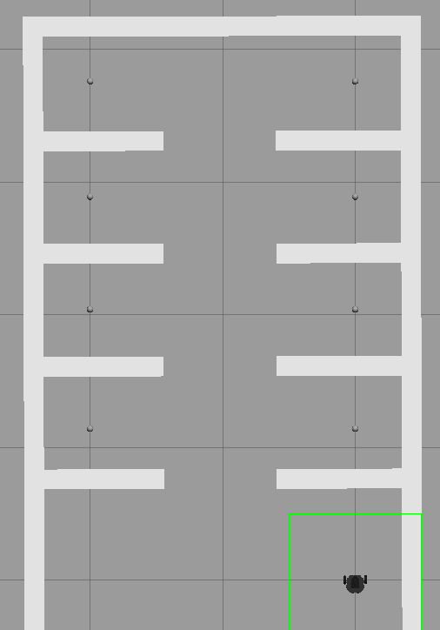
Progress:
Map is designed
Objects are modeled and placed
Robot is created and placed
Voice command system implemented
Next:
Path to rooms (completed after presentation)
Object transportation (completed after presentation)

Slide 8
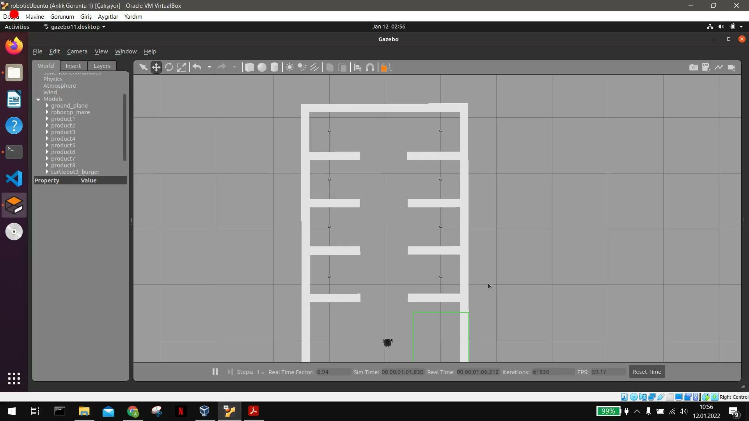
Short Demo (Recorded for Presentation 12.01.2022)

Slide 9
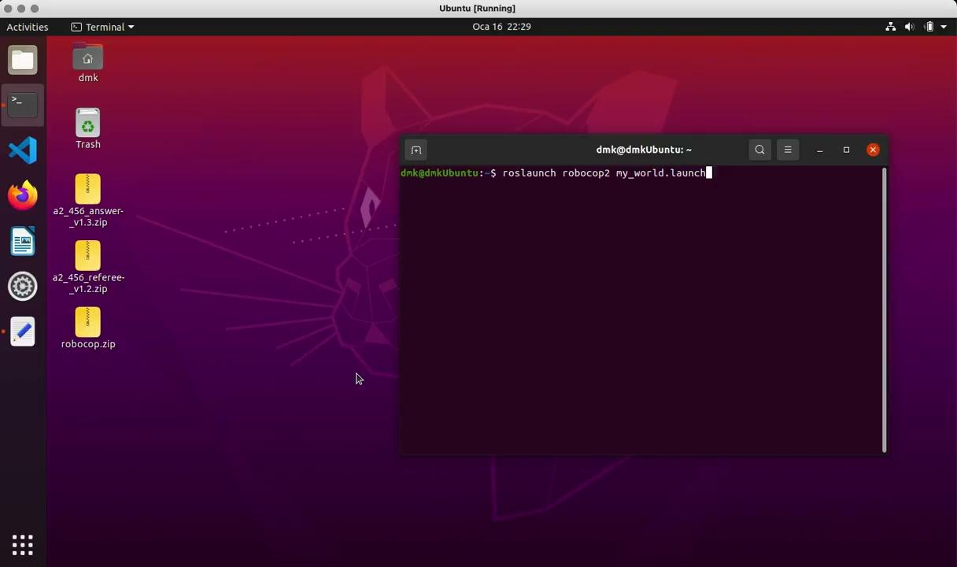
Demo Video
Notes:
sorry for background noises

Slide 10
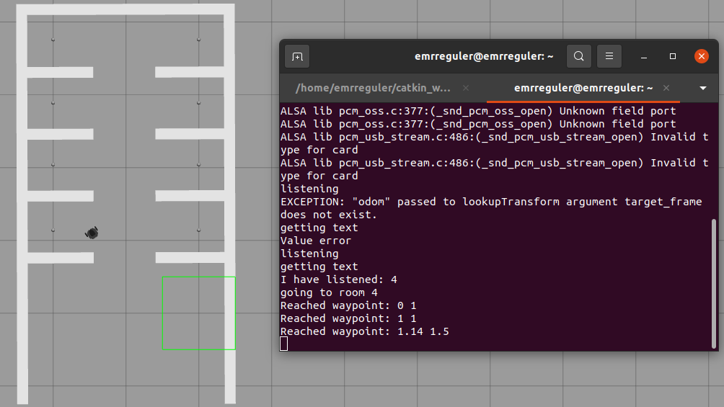
Robot Goes to Room 4

Slide 11
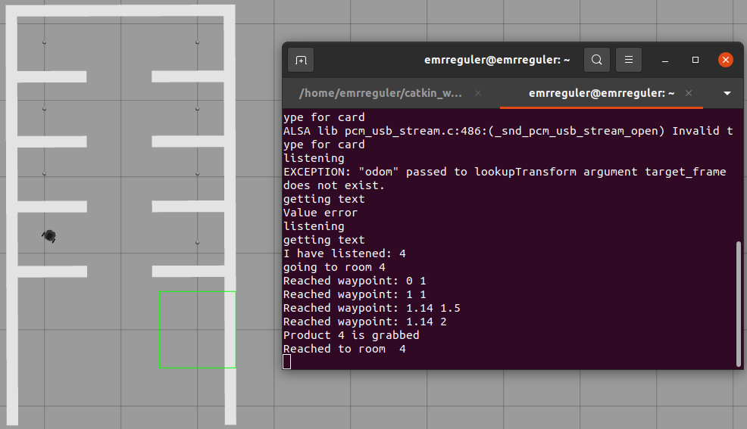
Robot Grabbed Product 4

Slide 12
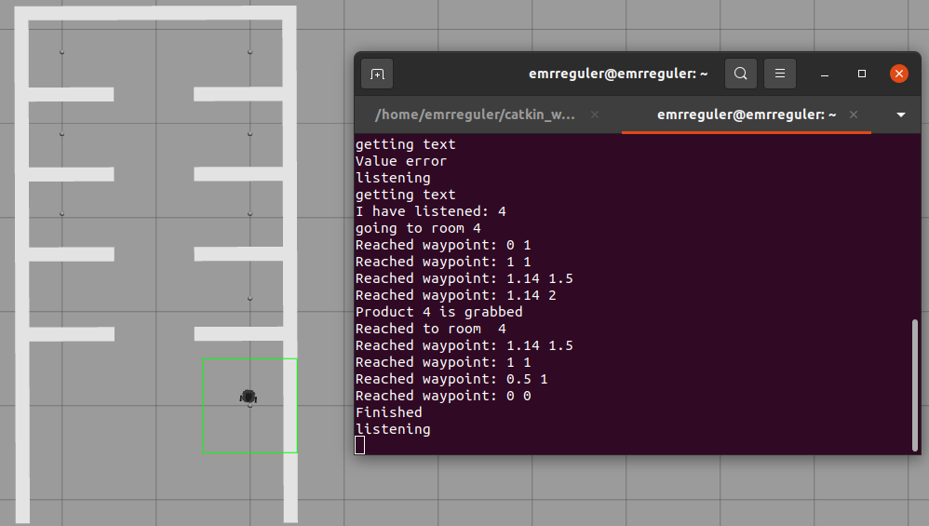
Robot Drops Product 4 in Distribution Point

Slide 13
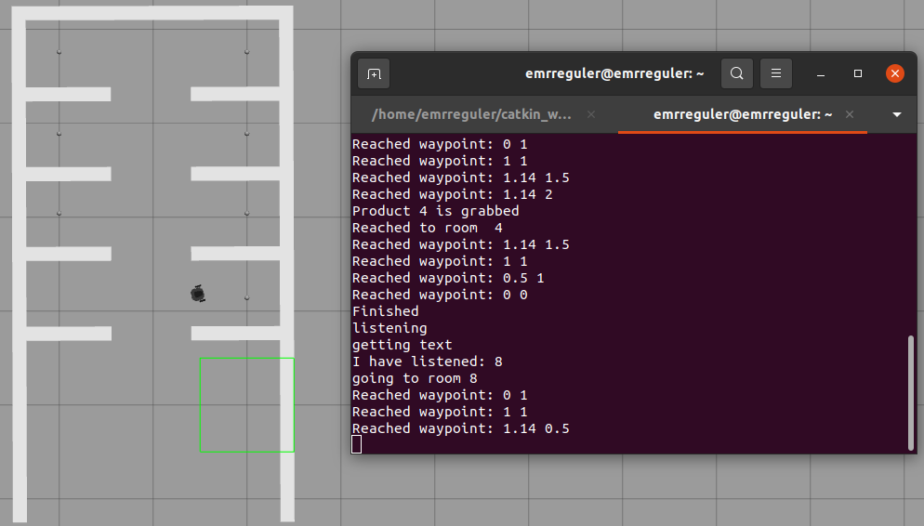
Robot Goes to Room 8, Product 4 is Sent from Distribution Point

Slide 14
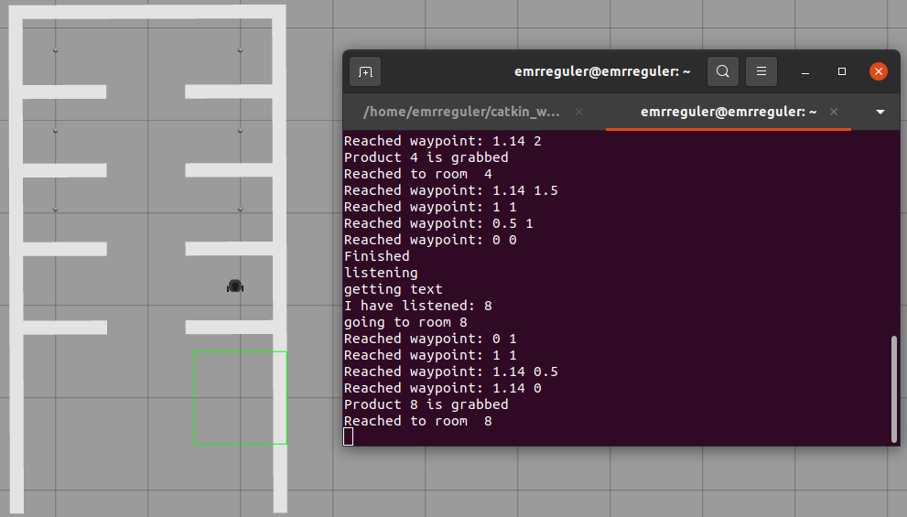
Robot Grabbed Product 8

Slide 15
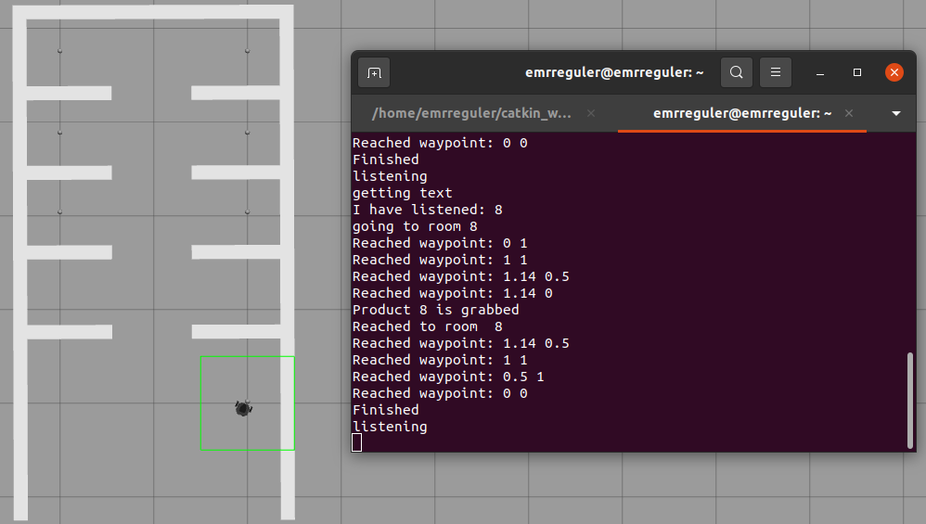
Robot Drops Product 8 in Distribution Point

