Slide 1

Ankush Gola
Riley Thomasson
Sam Payne
Aaron Himelman
Akshaya Uttamadoss
Notes:
Sam:
% of visits not time
choose better site to go to
dip in history = GDC
Preload:
-Friends
-Explore
-Settings
Riley:
Apache
Mah box
Mod_wsgi
SSL/HTTPS
Akshaya:
-TALK FOREVER
-explain bubble before example
-don’t even go to digraph
-don’t break bubble
-new tabs

Slide 2
Motivation
Inconvenient to understand browsing history
Weak content discovery tools
Notes:
Sam:
% of visits not time
choose better site to go to
dip in history = GDC
Preload:
-Friends
-Explore
-Settings

Slide 3
Why Use Histograph?
Visualize how you use the web using graphs
Discover new content tailored to your browsing habits
Notes:
Sam:
% of visits not time
choose better site to go to
dip in history = GDC
Preload:
-Friends
-Explore
-Settings

Slide 4
Demo: Typical User Flow
histograph.us
Notes:
Show:
Login
Extension installation
Show Sunburst + time selection
Show Digraph
Show Line plot + time selection

Slide 5
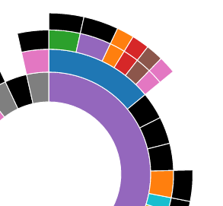
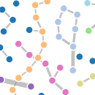
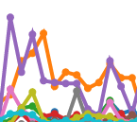
System Overview
Ext
Server
DB
Front End
Notes:
What server is running
Where it is
What DB is running
Riley:
Apache
Mah box
Mod_wsgi
SSL/HTTPS

Slide 6
Discover
Friends Graph Demo
Suggestions
Notes:
Show Friends Graph
Show Suggestions Page

Slide 7
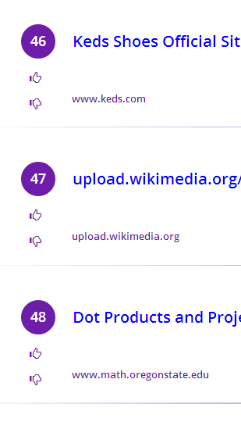
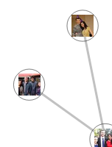
System Overview + Friends
Ext
Server
FB
Front End
DB

Slide 8
User Options
Time Filtering
URL Filtering
Upvote/Downvote
Notes:
Akshaya:
-TALK FOREVER
-explain bubble before example
-don’t even go to digraph
-don’t break bubble
-new tabs

Slide 9
URL Recommendation Algorithm
Collaborative filtering algorithm based URL frequencies at each level.
Hierarchical URL tree designed for efficiency.
Notes:
Histograph in unique in that it recommends websites specifically for YOU. Let’s take a closer look at how it does recommendations.
Collaborative filtering = “user’s who liked this also liked this” adapted to URLs.
Core data structure: Hierarchical tree (show next) organizes websites based on URL structure

Slide 10
URL Recommendation Algorithm
Recommend URLS for User A
Construct a tree of the User A’s URLs, another user’s URLs.
Recursively traverse tree and accumulate scores. If node is leaf, store in a Rank Table.
Repeat for each other user in the system.
Filter out websites User A has already seen.
Notes:
Flip back and forth between next slide.

Slide 11
Hierarchical Tree
User A
User B
Level
google
40%
…
google33%
…
1
reddit
30%
reddit 20%
reddit/funny
33%
reddit/gifs
67%
2
reddit/politics
50%
reddit/
sports
50%
Notes:
Also used for sunburst
And so on and so forth
Two frequency distributions.

Slide 12
Scoring
Final scores for URL is accumulated by traversing tree: score at each level is prop to Bhattacharrya Distance, your frequency, weights from up/down vote.

Slide 13
Challenges in Design
Chrome Extension Limitations
Extremely Large Datasets (~40,000 nodes per user)
Processing
Efficient Display
Hierarchical tree uses hashing to find children

Slide 14
Future Steps
Content Aware Suggestions
Get More Users
Improved Server Platform
More Options
Time period selection
Algorithm adjustment
Search Functionality
Firefox extension
Map Reduce

Slide 15
Questions
Sam Payne:
paynelsam@gmail.com
www.paynelsam.com
Riley Thomasson:
riley.thomasson@gmail.com
Ankush Gola
ankush.gola@gmail.com
Aaron Himelman
ahimelman@gmail.com
Akshaya Uttamadoss
akshaya.uttamadoss@gmail.com

