Slide 1
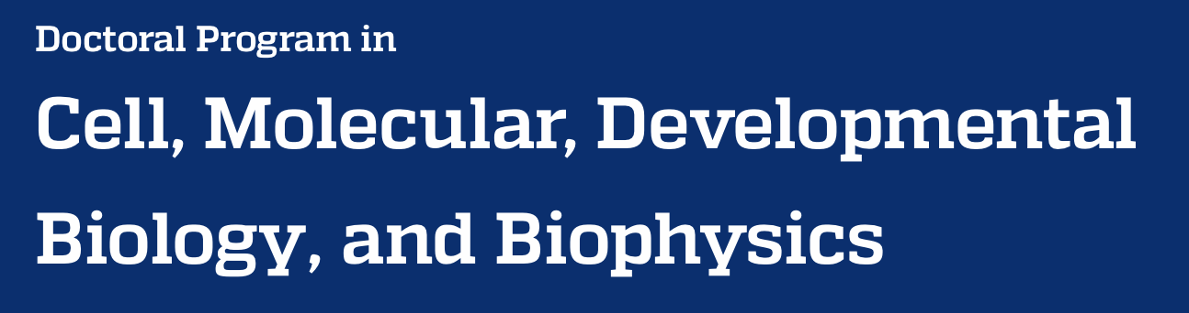




The Basics of Python

Slide 2
Learning Objectives
Why you should use Python
Basic data types
Basic data structures
Running Python scripts from the command line
Passing arguments to your scripts
Notes:
Welcome to learning basic Python concepts.
The main objectives of this lecture are to
Understand what Python is good for.
Learn what are the fundamental data types in Python.
How to combine data objects in more complex data structures.
Executing python scripts using the command line interface.
And passing information to your scripts at runtime.

Slide 3
Why use Python?
Notes:
So, why use python?

Slide 4
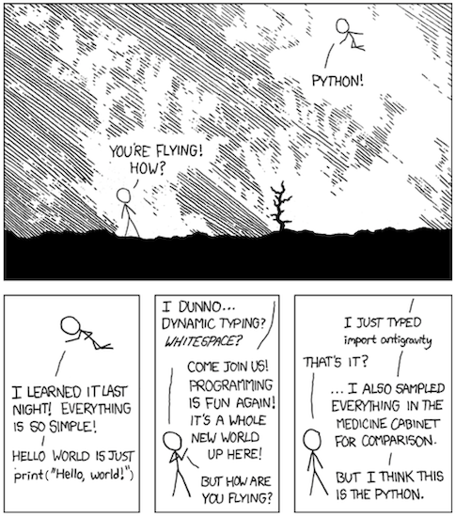
Randall Monroe https://xkcd.com/353/
Notes:
While you may not have dealt with Python before this course, hopefully you will recognize why it is so widely used for bioinformatics. It is plain to read, the syntax is easy to remember, and there are countless modules written for applications from basic statistics to plotting to machine learning.

Slide 5
The Zen of Python
Beautiful is better than ugly.
Explicit is better than implicit.
Simple is better than complex.
Complex is better than complicated.
Flat is better than nested.
Sparse is better than dense.
Readability counts.
Special cases aren't special enough to break the rules.
Although practicality beats purity.
Errors should never pass silently.
Unless explicitly silenced.
In the face of ambiguity, refuse the temptation to guess.
There should be one — and preferably only one — obvious way to do it.
Although that way may not be obvious at first unless you're Dutch.
Now is better than never.
Although never is often better than *right* now.
If the implementation is hard to explain, it's a bad idea.
If the implementation is easy to explain, it may be a good idea.
Namespaces are one honking great idea -- let's do more of those!
Notes:
Writing code that works is fairly straightforward. However, writing good code can be rewarding and makes it easier to read, adapt, and use.

Slide 6
The Zen of Python
Beautiful is better than ugly.
Explicit is better than implicit.
Simple is better than complex.
Complex is better than complicated.
Flat is better than nested.
Sparse is better than dense.
Readability counts.
Special cases aren't special enough to break the rules.
Although practicality beats purity.
Errors should never pass silently.
Unless explicitly silenced.
In the face of ambiguity, refuse the temptation to guess.
There should be one — and preferably only one — obvious way to do it.
Although that way may not be obvious at first unless you're Dutch.
Now is better than never.
Although never is often better than *right* now.
If the implementation is hard to explain, it's a bad idea.
If the implementation is easy to explain, it may be a good idea.
Namespaces are one honking great idea -- let's do more of those!
Notes:
Hopefully, you will see with a few guidelines how to make your life and those of future colleagues, collaborators, and reviewers easier.

Slide 7
Python basic features
Notes:
Python has many features that make it an attractive language for beginner programmers.

Slide 8
Python basic features
It is an interpreted language - no compiler needed
Notes:
There is no need to compile, or post-process, your code to make it executable. This simplifies development and allows you to write and execute code on the fly.

Slide 9
Python basic features
It is an interpreted language - no compiler needed
It is a dynamically typed and strongly typed language
Notes:
Variables can be declared as you go without needing to specify the types. Python is smart enough to implicitly determine what type each variable is.

Slide 10
Python basic features
It is an interpreted language - no compiler needed
It is a dynamically typed and strongly typed language
Whitespace is significant - always indent with four spaces
Notes:
The formatting of the code is significant. This can be a downside but results in more readable code and makes following nested statements easier.

Slide 11
Python basic features
It is an interpreted language - no compiler needed
It is a dynamically typed and strongly typed language
Whitespace is significant - always indent with four spaces
It is object oriented - everything is an object
Notes:
Because everything in python is an object, even basic data types, each contains attributes and associated methods, or internal functions, that extend their utility.

Slide 12
Python basic features
It is an interpreted language - no compiler needed
It is a dynamically typed and strongly typed language
Whitespace is significant - always indent with four spaces
It is object oriented - everything is an object
It is multi-paradigm
Notes:
There are different ways of approaching programming. Python is amenable to a wide variety of approaches, making it a versatile language.

Slide 13
Python data types
Notes:
Now let’s look at the data types that exist in Python.

Slide 14
All Python data types
Data Types
Numeric
Dictionary
Boolean
Set
Sequence
Type
Integer
Float
String
List
Complex
Number
Bytes
Tuple
Notes:
Python has a variety of data types built in.

Slide 15
Basic Python data building blocks
Data Types
Numeric
Dictionary
Boolean
Set
Sequence
Type
Integer
Float
String
List
Complex
Number
Bytes
Tuple
Notes:
Some of these are atomic, meaning that they act as the irreducible building blocks of all other data types and structures in python.

Slide 16
Basic data types
 | Integer | Float | String | Boolean
Python Name | int | float | str | bool
Size (bits) | 32 or 64 | 32 or 64 | 8 * # chars | 1
Example | 5 | 1.01 | ‘abc’ | True
Notes:
We will almost exclusively be using four of these data types, most of which should be familiar to you. These types are integers, floats, or decimal numbers, strings, and booleans, or true and false values.
Note that each of these data types is immutable. In other words, once created it cannot be changed but can be overwritten.
In the case of integers and floats, they can be specified as 32 or 64 bits, although by default they will be created as 64 bit values. Integers can also be specified as signed (positive and negative values) and unsigned (positive values only), although they default to signed.

Slide 17
Variable promotion
32-bit + 32-bit = 32-bit
32-bit + 64-bit = 64-bit
bool + int = int
int + float = float
unsigned + unsigned = unsigned
unsigned (32-bit) + signed (32-bit) = signed (64-bit)
bool < unsigned < signed < integer < float
Variables always get promoted to the highest level present in the equation unless explicitly specified
Notes:
When you do math in Python, the result is assigned a specific data type, or typed, in the simplest form that doesn't lose information. For example, adding a 32 bit and 64 bit number will return a 64 bit value. An integer and float added together will return a float.

Slide 18
Float vs. integer division
int divided by int = ?
Notes:
Because we are using Python 3, there is one pitfall that you need to watch out for. Doing division with integers can result in an integer or a float, depending on how it is performed.

Slide 19
Float vs. integer division
int divided by int = ?
/ means float division
5 / 2 = 2.5
5.0 / 2.0 = 2.5
// means floor division
5 // 2 = 2
5.0 // 2.0 = 2.0
Notes:
A single slash denotes float division and will result in a float result. A double slash denotes integer, or floor, division, which will drop the division remainder and return a whole value, either an integer or float depending on the types of the variables being divided.

Slide 20
Basic data structures
Data Types
Numeric
Dictionary
Boolean
Set
Sequence
Type
Integer
Float
String
List
Complex
Number
Bytes
Tuple
Notes:
Now let’s look at some of Python’s data structures.

Slide 21
Basic data structures
 | Tuple | List | Set | Dictionary
Python init | tuple() or () | list() or [] | set() or {} | dict() or {}
Size in memory | smallest | small | large | largest
Example | (1, 2, 3) | [1, 2, 3] | {1, 2, 3} | {‘a’: 1, ‘b’: 2}
Ordered | Yes | Yes | No | No
Immutable | Yes | No | No | No
Duplicate entries | Yes | Yes | No | Key: No Value: Yes
Can contain | Any object | Any object | Immutables | Key: Immutables Value: Any object
Notes:
Python has several basic types of data structures that act as containers for almost any data types: tuples, lists, sets, and dictionaries.
Tuples and lists are ordered sets of objects, the difference being that tuples, once created, cannot be changed. Sets are an unordered collection of unique immutable objects. Dictionaries are like sets, but each object acts as a key, giving you access to an associated object, the value.
Each has specific uses for which it is best suited. For example, in order to determine whether something is in the data structure, lists and tuples start at the first element and checks sequentially, making it a slow process. Sets and dictionaries use a lookup table making them much faster. Because lists and tuples are just an ordered series of objects, they can hold duplicate entries, whereas sets and dictionary keys cannot but dictionaries values can.
We will go into further detail about most of these structures later, but for now we will focus on lists.

Slide 22
Running Python scripts
Notes:
Rather than writing code in the interpreter, it is usually more useful to write scripts that can be executed as standalone programs.

Slide 23
Executing Python scripts from the interpreter
$ python my_script.py
Notes:
Once you’ve write a piece of code in Python, how can you execute it? There are a couple of ways to accomplish this. The first is to call the Python interpreter to run your code. In the same way that you would call Python to start an interactive session, you call the program but also give it your script name as an argument. This should work for any python code in a text file.

Slide 24
Executing Python scripts as standalone programs
Make our code executable
Run program locally
$ chmod u+rwx my_script.py
$ ./my_script.py
Notes:
Another way you can execute a Python script is to make it act as a standalone program. This requires you to do a couple of things to your code to work. If you simply tried to call the script similar to the Python interpreter, the computer wouldn't know where to look. That is because for programs, the computer searches the folders listed in your PATH environmental variable, not the folder you are in. If you moved the script to one of those folders, for example '/usr/bin', then the computer would find it and could even tab-complete the name for you.
However, there is one more step needed, and that is to make the script executable. To do this, you can use the 'chmod' command. Basically, you are telling the computer with this command who is allowed to do what with your script: read, write, and/or execute it. In this case, it is specifying that the user (you) can read, write, and execute the script.
Now the code is executable. But instead of moving it into your PATH, leave it in place and run it locally. To do this, you tell the computer to look in the current working directory with a single dot.

Slide 25
But the script won’t run...
Assuming the script contains the following to simply print to the terminal
and we’ve made it executable, why doesn’t this work?!?
print(“hello”)
$ ./my_script.py
./my_script.py: line 1: syntax error near unexpected token `”hello”`
./my_script.py: line 1: `print(“hello”)`
Notes:
There is one thing missing from the script. When you try to run your script, the computer has no idea what it is, so it assumes that it is a shell script, or a series of commands that you could simply type in your terminal. You need a way to let the computer know that this is Python code and to read it as such. This is where the shebang comes in. But what's a shebang?

Slide 26
The shebang
#!
#!/bin/bash A bash script
#!/bin/sh A shell script
#!/usr/bin/env python3 A Python3 script
Notes:
The shebang is a special character combination that tells the computer which interpreter to use when trying to run this program. You could tell it that you have written a bash script, a shell script, or a Python script, for example.
In this case, you want to specify that this is a python 3 script, since if someone has python 2 as their default python, some of your syntax or functions might not work as expected. To do this, you include this line.

Slide 27
Your first successful script!
my_script.py
#!/usr/bin/env python3
print(“hello”)
$ ./my_script.py
hello
Notes:
And that is all you need to start writing and running python scripts. Now you can jump into actual programming aspects.

Slide 28
Passing arguments from the command line
Both of the strings ”my_file.txt” and “3” can be accessed within my_script.py
$ ./my_script.py my_file.txt 3
Notes:
One last step is to understand how to get data into your program from the command line. Like most programs, your python script can have additional arguments passed to it when it is called. This just means including additional values, filenames, et cetera after our script name.

Slide 29
Accessing command line arguments in a script
my_script.py
#!/usr/bin/env python3
import sys
print(sys.argv)
print(sys.argv[1])
$ ./my_script.py my_file.txt 3
[‘./my_script.py’, ‘my_file.txt’, ‘3’]
my_file.txt
Notes:
In order to access the arguments that you have passed, you need to import one of python's built-in modules, sys. This gives you access to the attribute arg-v, which is a list of all of the command line arguments, including the name of the script. You can use the complete list or access individual elements, one at a time.

Slide 30
Contributions
Michael Sauria
Notes:
Thank you to all the people that helped!

