Slide 1
Musical Therapeutics
Alexander Golin
March 9th, 2015
ENP 61 Chronological Research Presentation:
A Summary of Four Scientific Articles to Better Understand How Research Develops Over Time

Slide 2
Article #1 Effects of music preference and selection on stress reduction
Gail C. Mornhinweg, Ph.D., R.N.
June 1992

Slide 3
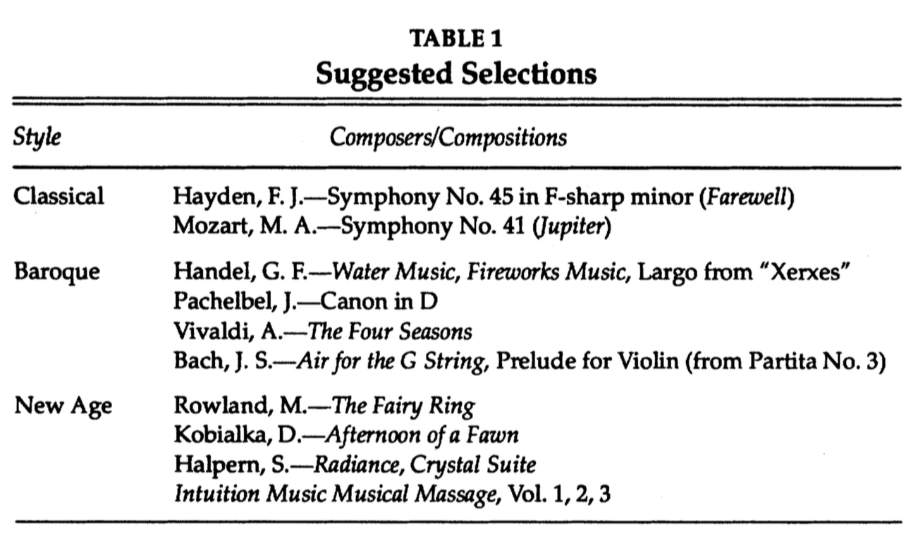
The questions
Mornhinweg, 1992
Do different styles of music have different effects on the stress levels of listeners?
If so, do individual style preferences affect the efficacy of different musical styles?

Slide 4
The Procedure
Mornhinweg, 1992
Subjects indicated preference for one musical style:
Easy Listening
Popular
Country/Western
Hard Rock
New Age
Classical
Other
Subjects listened to 20 minutes each of classical/baroque, popular, and new age music with breaks in between listening.
Before and after each style, subjects completed a self report stress test.
One subgroup measured their pulse before and after each style as well.

Slide 5
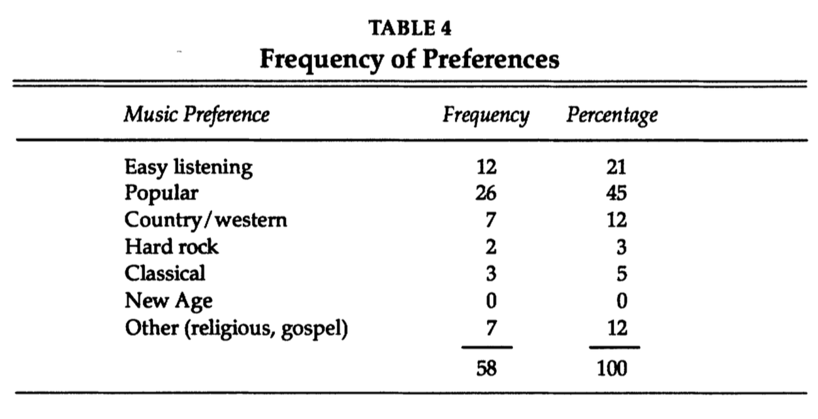
The Results
Mornhinweg, 1992
New age and classical/baroque music both had a stress relieving effect on participants and also lowered heart rate.
Popular music caused a decrease in relaxation and increased heart rate.
Despite the fact no one liked new age and many liked pop, new age was relaxing and pop was not relaxing.

Slide 6
The Future
Mornhinweg, 1992
Implications
It is clear music could have a significant effect on relaxation and stress, possibly even physiological factors such as heart rate.
Suggests that music could be used to control things like pain, sleep, nausea, or anxiety.
Limitations:
Sample was not random, it was a convenience sample in which subjects personally knew the experimenter.
Highly reliant on self reporting, which is a less reliable observational technique.
Ultimately only focused on subjective reporting of feelings and could not draw larger conclusions due to small sample size.

Slide 7
Article #2 Immediate physiological responses of healthy volunteers to different types of music: cardiovascular, hormonal, and mental changes
M. Möckel
L. Röcker
T. Störk
J. Vollert
O, Danne
H. Eichstädt
R Müller
H. Hochrein
March 1994

Slide 8
The Questions
Möckel,1994
What are the physiological and mental effects of drastically different types of music on subjects?
Hypothesis:
A waltz by Johann Strauss would cause some amount of arousal and stress.
A meditative raga by Ravi Shankar would cause relaxation and stress reduction.
A modern classic by Hans Werner Henze would cause varied effects depending on the listener’s personal tastes.

Slide 9
The Procedure
Möckel 1994
Subjects were each exposed to three pieces from Johann Strauss, Ravi Shankar, and Hans Werner Henze.
Before and after each piece, subjects had to take a Zerssen test to evaluate their mental state.
Throughout the three pieces, measurements were recorded for heart rate, blood pressure, Doppler mitral flow, and hormone levels in the blood.

Slide 10
The Results
Möckel 1994
Regardless of the mental state of the listener, there were significant physiological changes according to the music being listened to.
Effects of music occurred regardless of personal preferences of the listener.
Strauss’ music increased stress hormone levels even though it also increased mental state.
Shankar’s music lowered stress hormone levels even though there was no change in mental state.
Henze’s music had a varied effect on subjects depending on their personal tastes.

Slide 11
The future
Möckel 1994
Implications:
Properly selected music can have notable effects on physiological measures of stress, and there is a lot of potential to use music as a means of managing stress and anxiety.
People might not willingly choose music that is the most physiologically beneficial to them.
Limitations
Minimal effort spent operationalizing selected songs, as in it is unclear what aspect of each song induced the observed effects (e.g. tempo, melodic line, harmony).
Notable confounding variables between subjects that were accounted for, but not further explored.

Slide 12
Article #3 Cardiovascular, cerebrovascular, and respiratory changes induced by different types of music in musicians and non-musicians: the importance of silence
L. Bernardi
C. Porta
P. Sleight
August 2005

Slide 13
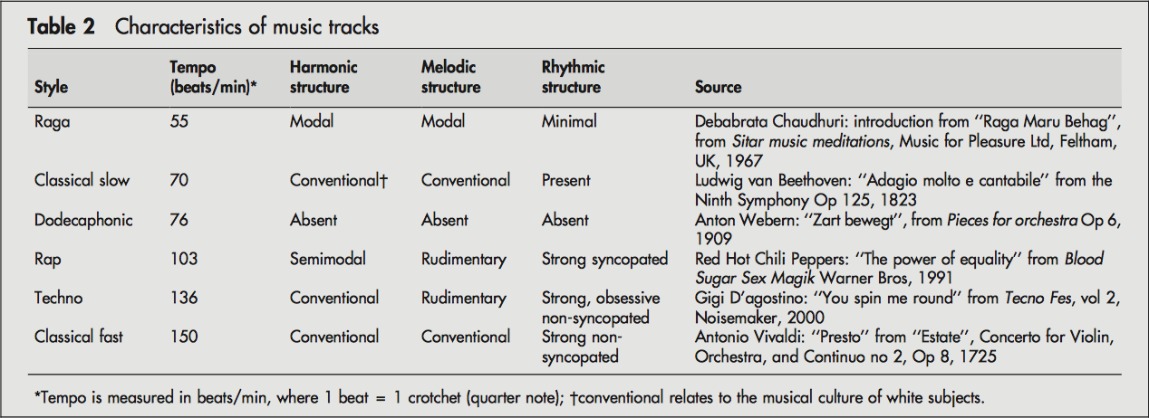
The Questions
Bernardi, 2005
What are the physiological effects of listening to different types of music?
What aspects (tempo, melody, harmony, syncopation, etc.)of a given piece of music makes it stress inducing or reducing?
Are the effects reproducible, or can you become habituated?
Are musicians and non-musicians susceptible to different degrees?

Slide 14
The Procedure
Bernardi, 2005
Subjects were exposed to randomly ordered, 2 minute periods of music from each of six genres: slow classical, fast classical, dodecaphonic, techno, rap, or raga music.
Followed by new random order of songs, this time played for four minutes each.
Two minutes of silence randomly played amongst the twelve songs.
Measures of breathing rate, heart rate, blood pressure, and baroreflex sensitivity recorded throughout procedure, including baseline measurement prior to playing music.

Slide 15
The Results
Bernardi, 2005
The genre of music was far less important than the tempo of the music.
Faster tempi associated with increased breathing rate, blood pressure, and heart rate. Slower tempi associated with decreased breathing rate, blood pressure, and heart rate.
The 2 minutes of silence produced the most drastic period of relaxation.
Effects were reproducible, and habituation was not apparent.
Musicians and non-musicians varied very minutely, though musicians’ breathing rate seemed to more closely follow tempo.

Slide 16
The future
Bernardi, 2005
Implications
These findings could prove useful in reducing physiological stress symptoms during operations and for sufferers of cardiovascular disease.
Tempo seems to play a crucial role in regulation of breathing, which could affect the sympathetic nervous system’s functioning.
Quietude can be the most relaxing thing if properly placed.
Limitations
More research still must be done on actually applying music’s alleged therapeutic effects to a real affliction.

Slide 17
Article #4 Pleasant music as a countermeasure against visually induced motion sickness
Behrang Keshavarz
&
Heiko
Hecht
May 2014

Slide 18
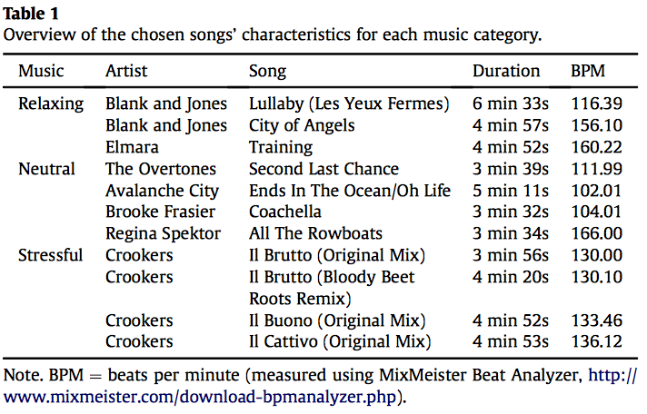
The Questions
Keshavarz, 2014
Can music be an effective aid in reducing the onset and severity of visually induced motion sickness (VIMS)?
What type of music is the best candidate for reducing the symptoms of VIMS?

Slide 19
The Procedure
Keshavarz, 2014
Each subject placed randomly into one of four experimental groups.
Prior to stimulus onset, subjects filled out the simulator sickness questionnaire (SSQ).
Subjects watched a 14 minute video of a bike ride through city streets.
Every minute subjects used the fast motion sickness scale (FMS) to verbally report how sick they felt.
After the stimulus finished, subjects filled out another SSQ and also rated the music selection on pleasantness and stressfulness.

Slide 20
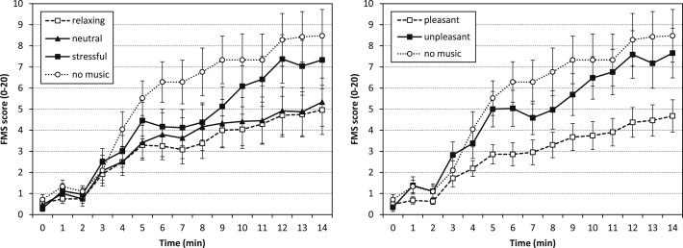
The Results
Keshavarz, 2014
Music proved to be an effective tool in reducing the onset and severity of VIMS.
The most effective music for an individual was music the individual found to be pleasant.
The objective genre or categorization was not important, all that mattered was how someone perceived the music.

Slide 21
The future
Keshavarz, 2014
Implications:
Music could be a very effective method of reducing VIMS. It is cost effective and easy to implement.
Could assist with visually aided rehab, entertainment, and training.
Limitations:
Not sure why music is effective, several theories: music is a distraction, music alters the listener’s mood, or music has a physiological effect on the autonomic nervous system. Could be some combination.

Slide 22
Connections

Slide 23
Summary
Article #1: Effects of Music Preference and Selection on Stress Reduction
1992
Article #2: Immediate Physiological Responses of Healthy Volunteers to Different Types of Music: Cardiovascular, Hormonal, and Mental Changes
1994
Article #3: Cardiovascular, Cerebrovascular, and Respiratory Changes Induced by Different Types of Music in Musicians and Non-Musicians: The Importance of Silence
2005
Article #4: Pleasant Music as a Countermeasure Against Visually Induced Motion Sickness
2014

Slide 24
Building Upon research
Article #1 made important initial steps toward finding a link between music and state of relaxation or stress, however it relied on unreliable self report methods and only used a small convenience sample.
Article #2 further investigated state of relaxation or arousal, but based its conclusions off of physiological and mental measures of arousal and stress. Despite the fact that this article collected data more objectively than Article #1, this study failed to identify the specific aspects of why certain types of music had certain effects on individuals.

Slide 25
Building Upon research
Article #3 used more modern technology to collect more detailed data about physiological relaxation in order to better identify what aspects of music seem to be most crucial in eliciting a physiological response from a listener. While this study made the important conclusion that tempo seems to be the most efficacious aspect of music, it did not take any steps to actually implement music as a therapeutic resource.
Article #4 is the culmination of the development seen in the first three articles. It takes all the valuable knowledge gained about physiological effects of different types and aspects of music and tests music as a therapeutic device in a relevant, real-world context. Even though there is now evidence that music could be a practical tool in the reduction of VIMS, there is still a lot to explore about the neurological and psychological reasons for music’s efficacy as a therapeutic device.

Slide 26
References
Bernardi, L., Porta, C., Sleight, P. (2005). Cardiovascular, cerebrovascular, and respiratory changes induced by different types of music in musicians and non-musicians: the importance of silence. Heart, 92, 445-452.
Keshavarz, B., Hecht, H. (2014). Pleasant music as a countermeasure against visually induced motion sickness. Applied Ergonomics, 45, 521-527.
Möcker, M., Röcker, L., Störk, T., Vollert, J., Danne, O., Eichstädt, H., … Hochrein, H. (1994). Immediate physiological responses of healthy volunteers to different types of music: cardiovascular, hormonal and mental changes. European Journal of Applied Physiology and Occupational Physiology, 68, 451-459.
Mornhinweg, G. C. (1992). Effects of Music Preference and Selection on Stress Reduction. Journal of Holistic Nursing, 10(2), 101-109.

