Slide 1
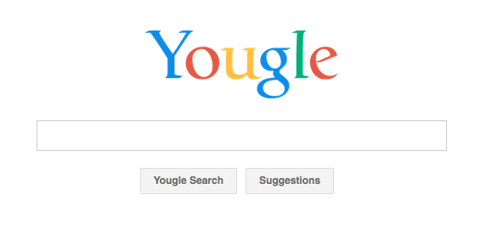
o
w
n
s
e
a
r
c
h
s
h
ite
o
w
t
o
m
a
k
e
m
y

Slide 2
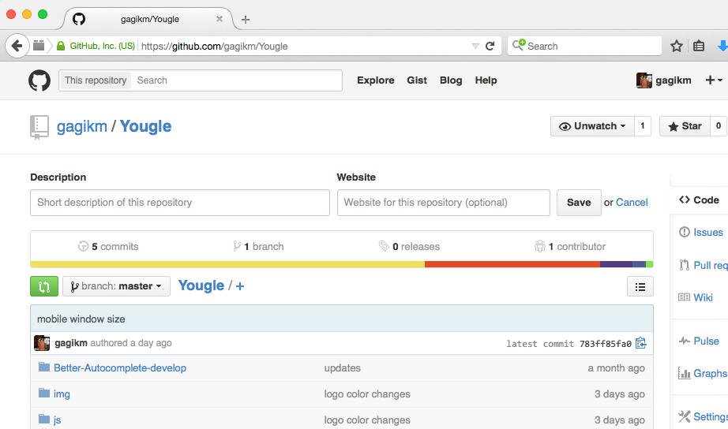
Go to github.com/gagikm/Yougle

Slide 3
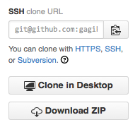

github.com/gagikm/Yougle
Click the
DOWNLOAD ZIP
button to download the contents of the repo to your computer.
(Or if you are familiar with github, feel free to fork)

Slide 4
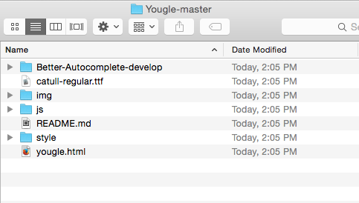
Unzip and open the folder

Slide 5
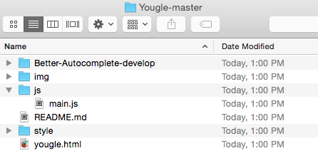
Unzip and open the folder
The two files will be editting are:
yougle.html and main.js

Slide 6
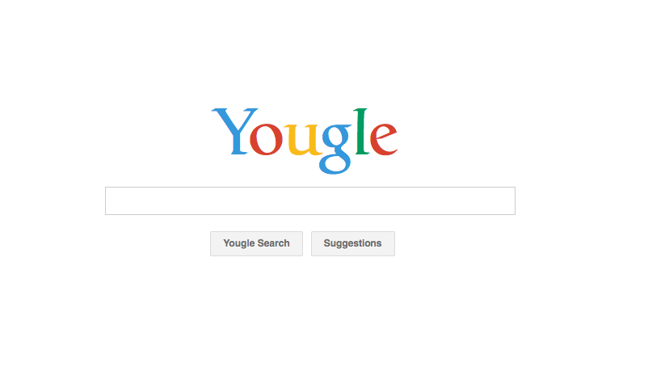
If you double-click on yougle.html, you should see this open in a web browser:

Slide 7
If you double-click on yougle.html, you should see this open in a web browser:
Keep this page open in your browser. As you make
changes, you will see them appear when you
refresh the page.

Slide 8
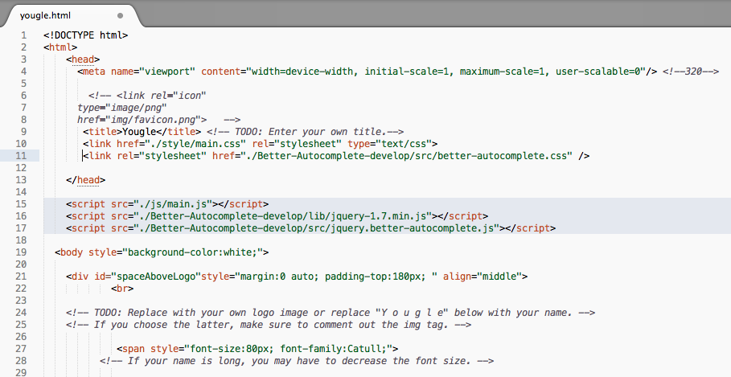
Now, open yougle.html with a text editor

Slide 9
Now, open yougle.html with a text editor
Find the word TODO in the text. (Use Ctrl-F or Cmd-F) These are the changes we will make in this file. There are four in yougle.html

Slide 10

First TODO in yougle.html
Change the title of the page to your name (or anything you want.)
change
<title>Yougle</title>
to
<title>John Wooden</title>
This title appears on your browser tab!

Slide 11
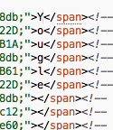
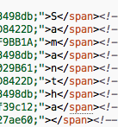
Second TODO in yougle.html
Replace “Y o u g l e” with your name. This is the logo of your website
to
Example: If your name is Samantha, do this.

Slide 12


Third TODO in yougle.html
Replace the label of the “Yougle Search” button to a label of your choice.
to

Slide 13
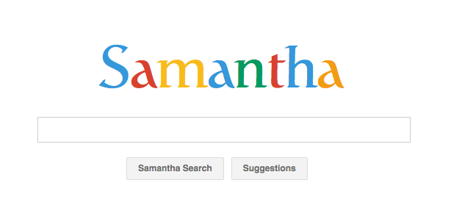
Reload your webpage in the browser and you will see the updated title, logo, and button

Slide 14
Fourth TODO in yougle.html (optional)
The suggestions button comes with preset suggestions that appear when the button is pressed.
You can add your own!
Later, in main.js, we will specify what happens when these words are searched, so you may want to come back to this.

Slide 15
Fourth TODO in yougle.html (optional)
To add your own suggestions, add to the given list:
var suggestions = [
'|Projects',
…
'|Full Name',
'|Birthday’,
‘|NewSuggestion1’,
‘|NewSuggestion2’
];
Commas and apostrophes are important! No comma after last suggestion!

Slide 16
Now, open main.js in your text editor

Slide 17
Now, open main.js in your text editor
This is the JavaScript code that tells the browser what to do when certain terms are searched

Slide 18
Now, open main.js in your text editor
This is the JavaScript code that tells the browser what to do when certain terms are searched
For example, searching “facebook” can redirect the browser to your facebook profile, and searching “ucla” can change the background image to Powell Library.

Slide 19
Now, open main.js in your text editor
This is the JavaScript code that tells the browser what to do when certain terms are searched
For example, searching “facebook” can redirect the browser to your facebook profile, and searching “ucla” can change the background image to Powell Library.
Let’s look at the code that makes this happen!

Slide 20
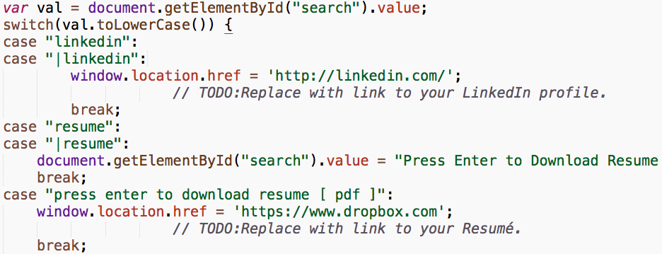
main.js
Input to the search box is saved to the variable var. Then a switch is called on the lower case version of val.

Slide 21
main.js
The switch explains what action to take for each case. For example, when the value you enter into the search box is “linkedin”, the browser will redirect to ‘http://linkedin.com/’
Cases are separated by the keyword break.

Slide 22
main.js
When the value entered into the search box is “resume”, this code will change the value to “Press Enter to Download Resume [ PDF ]”

Slide 23
main.js
Now, if enter is pressed with this new input value, the browser will redirect to ‘https://www.dropbox.com’. This is handled by another case!

Slide 24
TODOs in main.js
Just like in yougle.html, the necessary changes are marked with TODO.
Make these changes, save your files, and your personalized search engine is complete!
To get your site on the internet, you will have to get a domain name and a hosting service. I use namecheap for domain names and AWS for hosting.
There are lots of tutorials online on how to do this and we may have an ACM Teach talk on this topic in the future.

Slide 25
