Slide 1
Eigenspaces
Andres Gomez-Lievano
Postdoc meeting Sept. 4, 2018

Slide 2
Two empirical observations anchoring much of our research
Product similarity predict diversification appearances (aka, “density regressions”)
ECI, a supposed measure of collective knowhow, is associated with diversity, wealth and growth.

Slide 3
We have a “unifying framework” (the scrabble metaphor) to accommodate these observations.
But is there a unifying mathematical formalism?

Slide 4
Questions the formalism should answer
What does ECI measure and why is it important?
Which other quantities are important and we should be measuring?
Explain general empirical patterns about diversification (e.g., why the triangularity of Mcp).

Slide 5
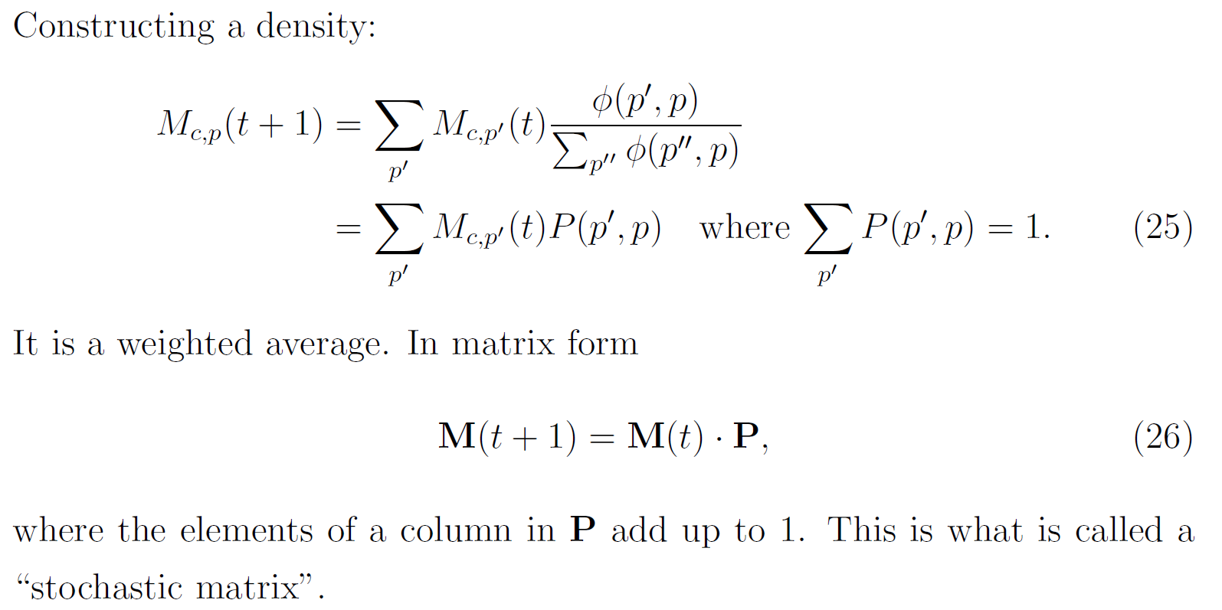
Density regressions

Slide 6

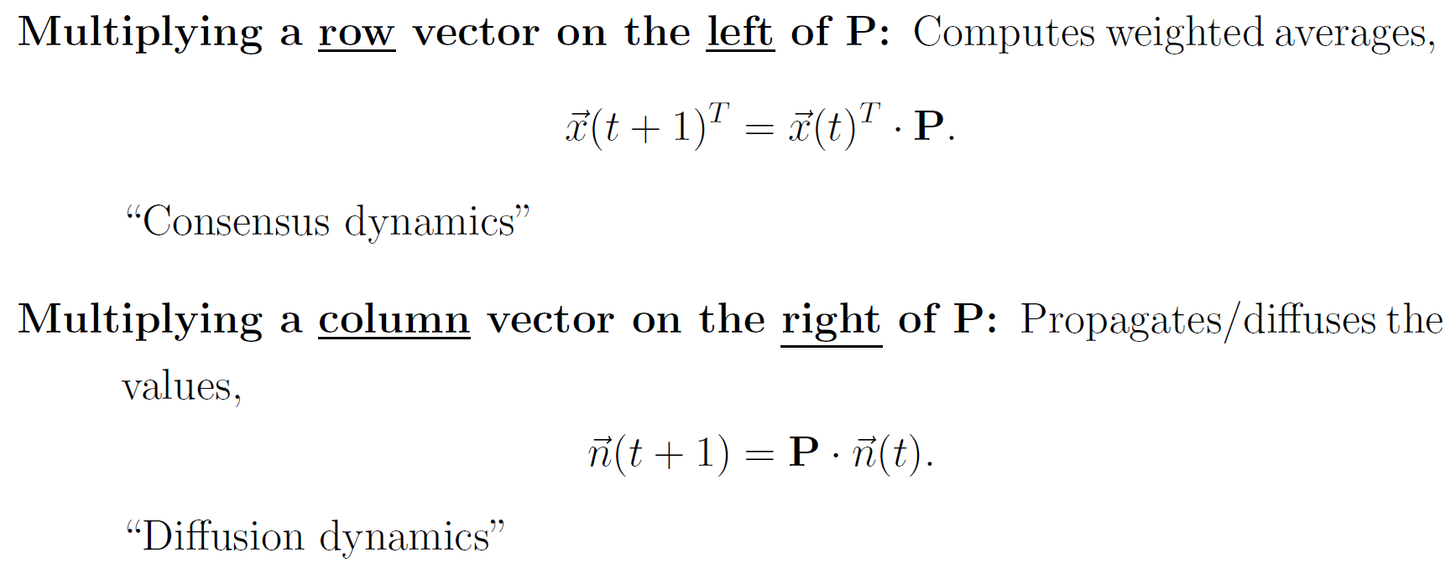
Some comments

Slide 7
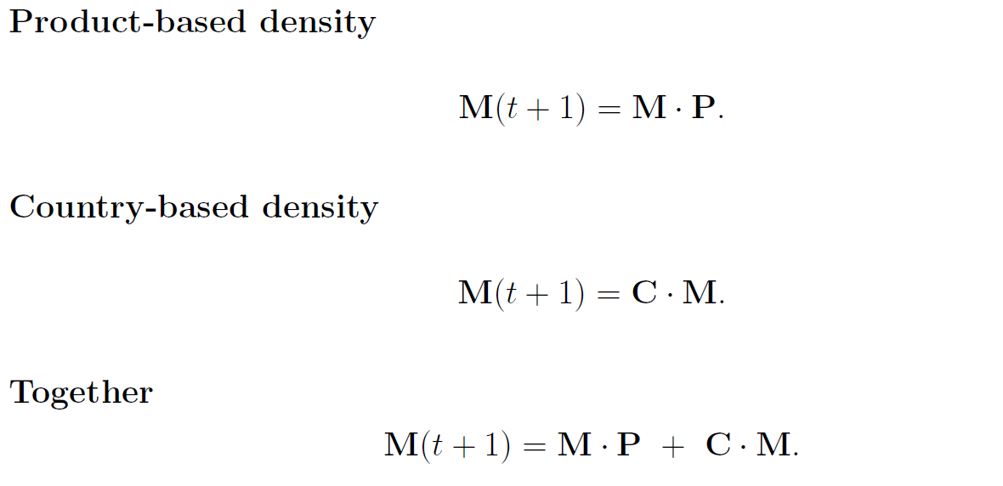
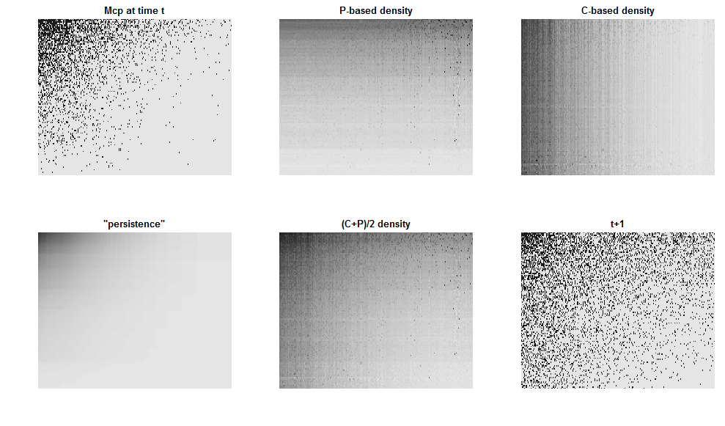
More comments

Slide 8
A small comment
Consensus dynamics drive the system to total homogeneity.
Perhaps it is a good model only of short-term dynamics?

Slide 9
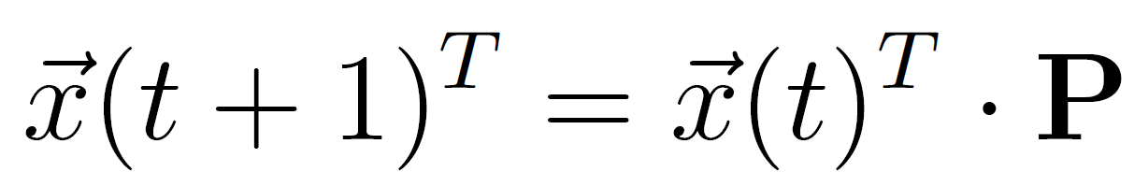
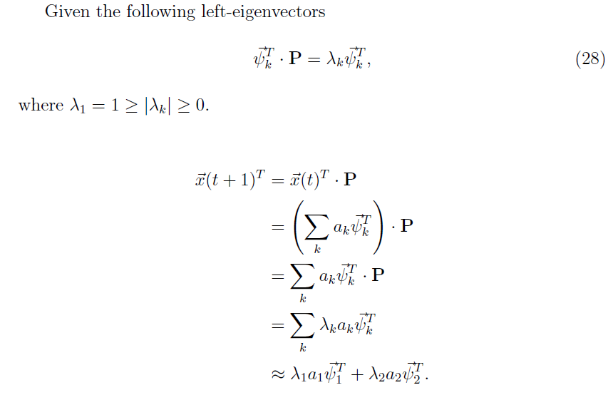
Low-dimensional representation of consensus dynamics

Slide 10
Left-eigenvectors generate a “clustering space”

Slide 11
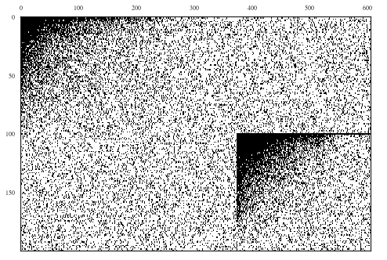
Toy model: Cca matrix
Let’s assume there are two sets of capabilities
Some countries tend to adopt the first set, some the second. Hence, the world is split in two communities of countries.
Type 1 Capabilities
Type 2 Capabilities
Type 1 Countries
These “off-diagonal” parts of the Cca matrix allow countries of one type to be able to produce a few of the products that countries of the other type produce.
Type 2 Countries

Slide 12
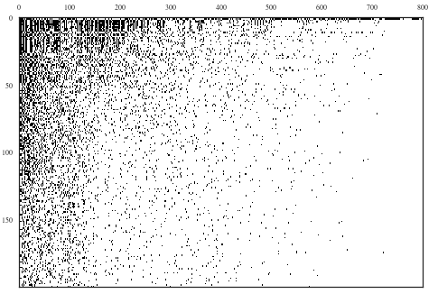
Leontief production function: Mcp matrix
A triangular-shaped matrix of products produced by countries (as expected)
Products
Countries
Note: In this image, the matrix has been sorted with most diverse countries on top and most ubiquitous products on the left.

Slide 13
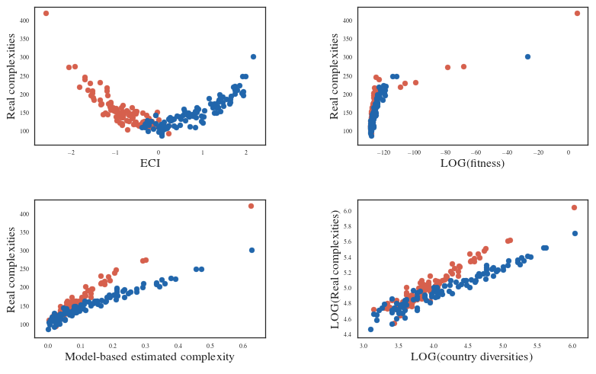

How do the measures perform estimating the complexities of countries ? (given the two community structure of this toy world)
Most complex country of community 1
Most complex country of community 2
Indeed!
Type 1 Countries
Type 2 Countries

Slide 14
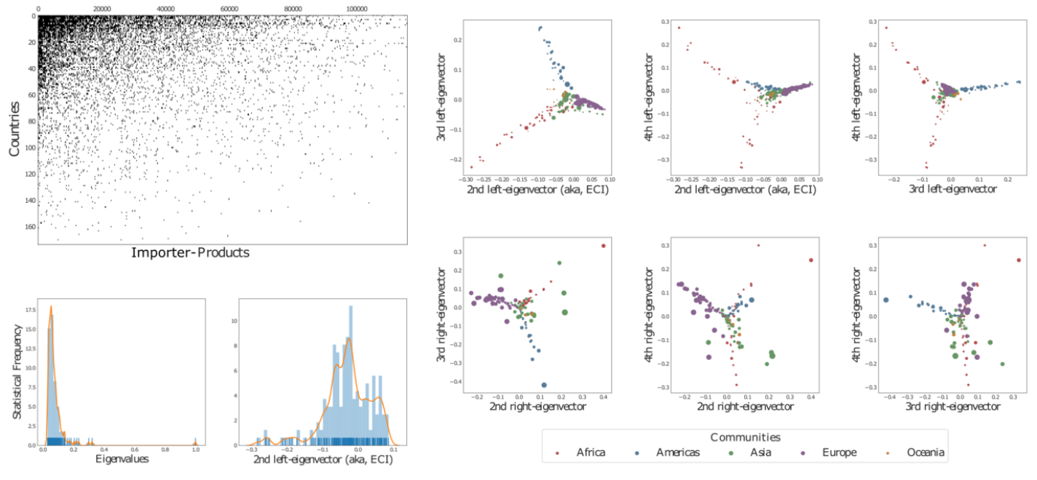
Eigenspaces: left and right

Slide 15
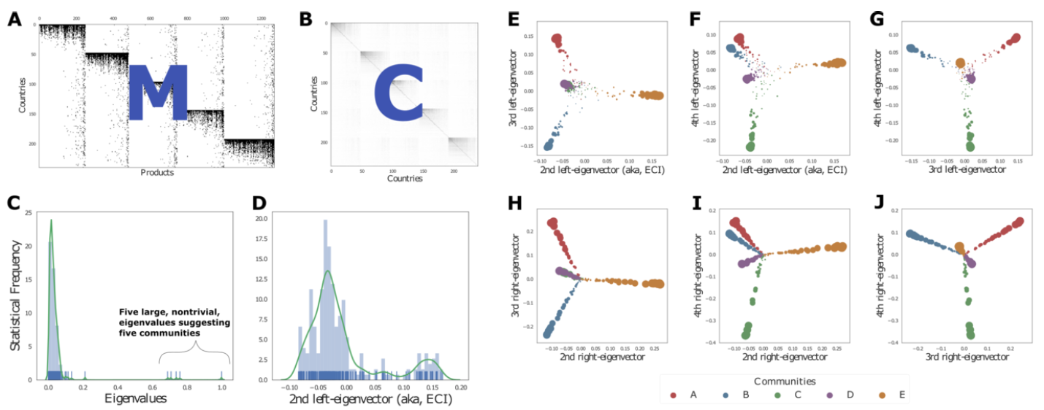
Toy world

Slide 16
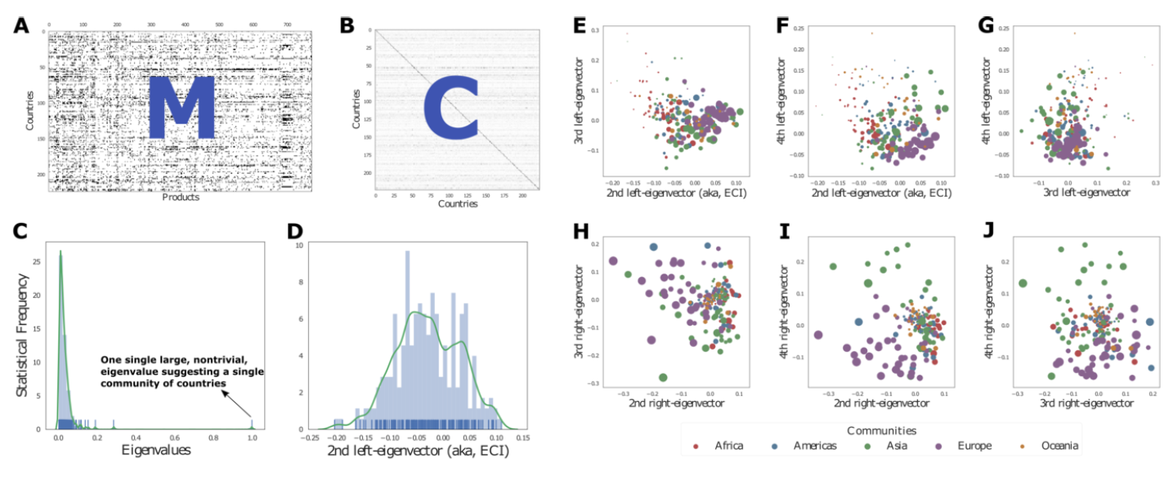
Real exporter-product

Slide 17
Growth is the consequence of both
An “absolute effect” (how much you know)
A “relative effect” (how much others ahead of you know)

Slide 18
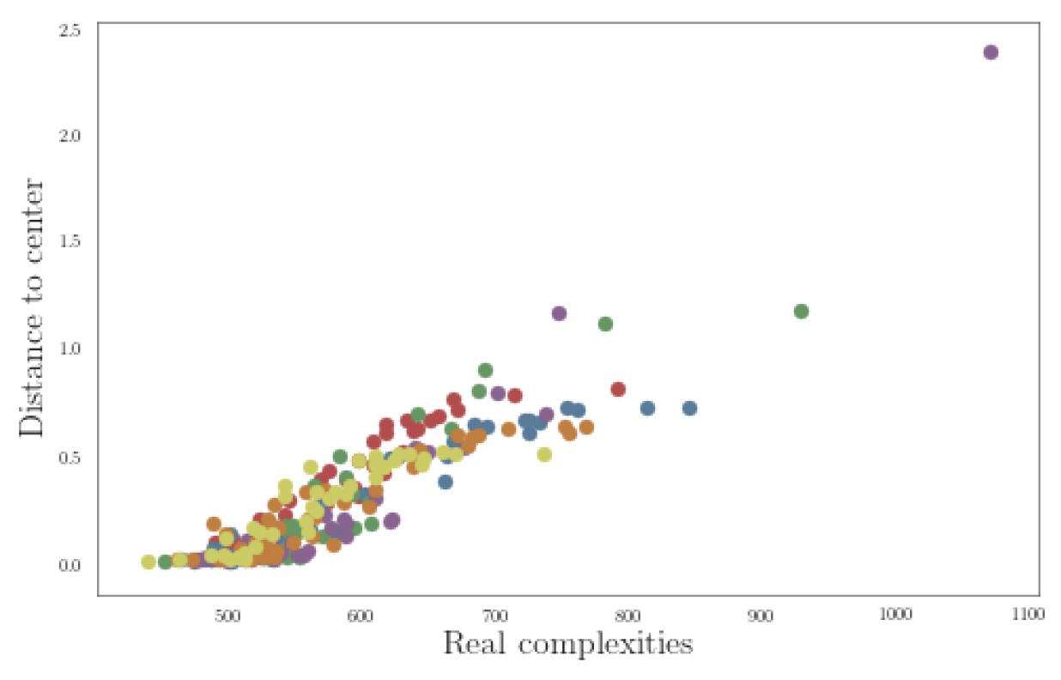

Slide 19
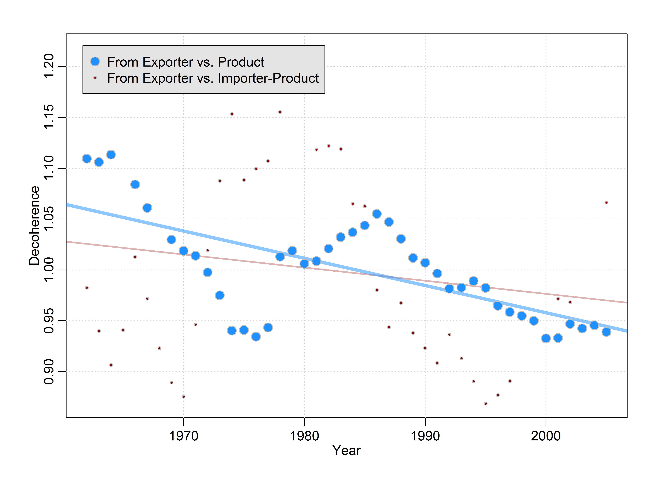
Is the world “homogeneizing”?

Slide 20
HYPOTHESIS
Inputs (letters/capabilities/ingredients) evolve according to diffusion dynamics
Outputs (words/products/recipes) evolve according to consensus dynamics.

