Slide 1
Tell me your company, and I'll tell you how much you know, how much you will grow, and what you will grow
Economic complexity index as a community index, and a new way of inferring a country’s collective know-how
Preliminary Work of Andres with Michele

Slide 2
Results in brief:
ECI finds the two main communities of countries, and assigns a value to how embedded a country is to its own community.
We know that the value of ECI is aligned with our intuitions about how a country’s collective know-how.
CONCLUSION: There are two main communities of countries in the world:
Those that know much
Those that know little
We have a model, based on first principles, which can provides us with a way of estimating the complexity of countries (and products).

Slide 3
Before we jump into the math, let’s play with some simulations…

Slide 4
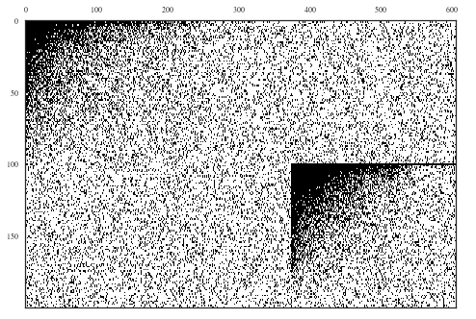
Toy model: Cca matrix
Let’s assume there are two sets of capabilities
Some countries tend to adopt the first set, some the second. Hence, the world is split in two communities of countries.
Type 1 Capabilities
Type 2 Capabilities
Type 1 Countries
These “off-diagonal” parts of the Cca matrix allow countries of one type to be able to produce a few of the products that countries of the other type produce.
Type 2 Countries

Slide 5
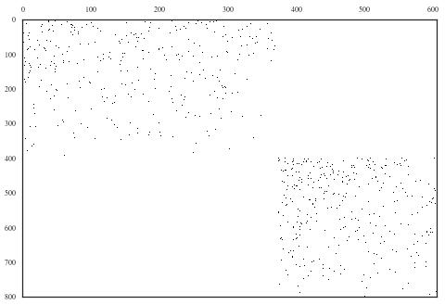
Toy model: Ppa matrix
Type 1 Capabilities
Type 2 Capabilities
Type 1 Products
… One can check that leaving empty these “off-diagonal” parts of the Ppa matrix has absolutely no consequence on how countries will cluster...
Type 2 Products

Slide 6
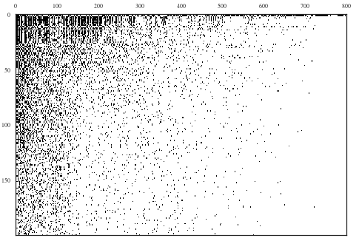
Leontief production function: Mcp matrix
A triangular-shaped matrix of products produced by countries (as expected)
Products
Countries
Note: In this image, the matrix has been sorted with most diverse countries on top and most ubiquitous products on the left.

Slide 7
Let’s calculate complexity indices!
Real complexities: The number of capabilities we know countries have (because we are the gods of this toy world).
ECI: The sub-dominant left-eigenvector of the left-stochastic matrix of a random walker that makes jumps like country-product-country.
Fitness: Derivative of ECI by Pietronero’s group, based on the intuition that the complexity of a country can only increase with diversification.
Model-based complexity: Based on Hausmann & Hidalgo (2011)’s model, Gomez-Lievano, Patterson-Lomba & Hausmann (2017) developed a way to compute directly the complexity of places and economic activities using a fixed-effects regression estimation.
Country diversity: Simple count of how many products in Mcp matrix each country produces.

Slide 8
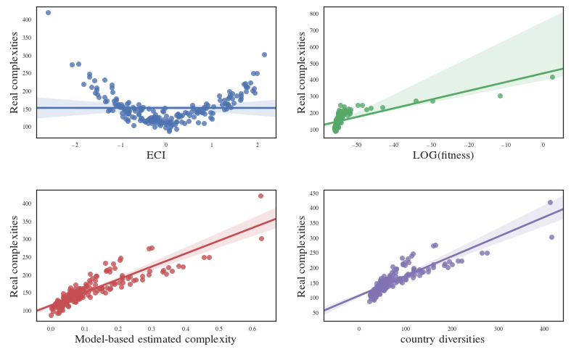
How do the measures perform estimating the complexities of countries ? (given the two community structure of this toy world)
Each dot is a country in our Toy World

Slide 9
How do the measures perform estimating the complexities of countries ? (given the two community structure of this toy world)
Are these the two communities we originally crafted in the toy world?

Slide 10
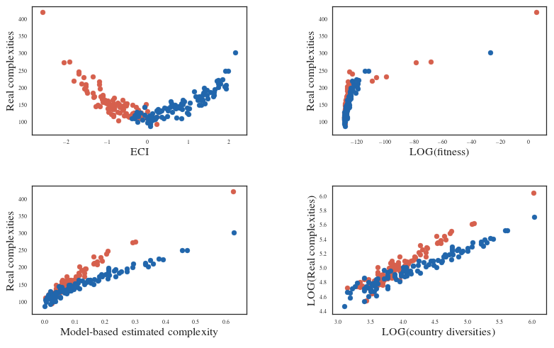

How do the measures perform estimating the complexities of countries ? (given the two community structure of this toy world)
Most complex country of community 1
Most complex country of community 2
Indeed!
Type 1 Countries
Type 2 Countries

Slide 11
Conclusions (at this preliminary point)
ECI indeed is a community discovery index
Can we implement one that is better?
ECI confirms the results that, in the real world, know-how diffuses! That is why wealthy countries look alike! (Anna Karenina’s Principle 2.0?)
Fitness does find a positive correlation with the true complexities, but not a very good one.
Estimating the complexities using our mathematical model performs very well!
Alternatively, the logarithm of diversity is, by itself, a very good estimator of the logarithm of the number of capabilities (who ordered a power-law?).

Slide 12
Ricardo’s emails
In the presentation, you have tested only one particular structure, i.e. a Cca that is split in 2 areas. What happens if it is split in N areas? What if the data generating process of the Cca is more generalized?
why does the structure of the Ppa not matter? Intuition?
is there info in the density function of eci (the histogram of eci) regarding the underlying structure of the eci? If the Cca was partitioned in several blocks, would the histogram be multi-modal?
are countries that are near in the Cca also near in the country space? How do eci and pietronero capture this? Are products that are near in the Ppa also near in the product space? How does pci and pietronero capture this?
What is the relationship between eci (pci) and a community discovery algorithm on the country (product) space? Do these spaces help in the task at hand?
what is the difference if we assume that the data generating process is more akin to the nature paper of Andres rather than the JOEG paper?
The whole Pietronero-ECI debate is about transforming the Map or Xcp into a scalar measure. But this obviously implies throwing away a lot of information. Why do we do this? It has to be for a clear purpose. It is not clear to me what the purpose is.
One can imagine that there are other ways to extract information from the matrix. For example, if the matrix was perfectly nested, it should be the case if the export basket of country a is a subset of the export basket of country b, then country a is less complex than country b. An ordering that maximizes nestedness would be a measure of complexity. I think that Muhammed has shown that Pietronero is better at nesting the Mcp matrix.
When the export basket of country a includes products that the export basket of country b does not include and vice versa we would want the countries to be ranked by the size and complexity of the products that are different. But maybe we do not want to rank them. We may want a representation in two dim tensions rather than a single one. What would the second dimension be and what would it mean?
Pietronero is more correlated with GDP and ECI is more correlated with GDP per capita. Why? Does it mean that the development process (higher GDP per capita) involves some selection among the things that are feasible? (You abandon short words because you can better use those letters in making longer words?)
The other dimension mentioned in point 3 above would be “block-diagonalness”. If the Map matrix was block-diagonal rather than nested, diversity would not change that much but the change would be in another dimension. What is it?

