Slide 1

NYC EMS Response Times
Project 3
Group 1: Holly Cornett, Alejandra Gomez, Dominic Marin, Caleb Thornsbury

Slide 2

Project Proposal
The aim of our project is to uncover patterns in EMS response times in NYC boroughs.
We’ll examine relationships between response time v. income
Response time before and during the COVID-19 pandemic (Feb 22, 2020 – April 22, 2020)
Response time v. initial severity level reported.

Slide 3

Data
EMS Response Times in NYC dataset
Source: kaggle.com
Data is generated by the EMS Computer Aided Dispatch System
Data spans from the time the incident is created in the system to the time the incident is closed in the system
Dataset hosted by the City of New York. The city has an open data platform and they update their information according to the amount of data that is brought in.

Slide 4
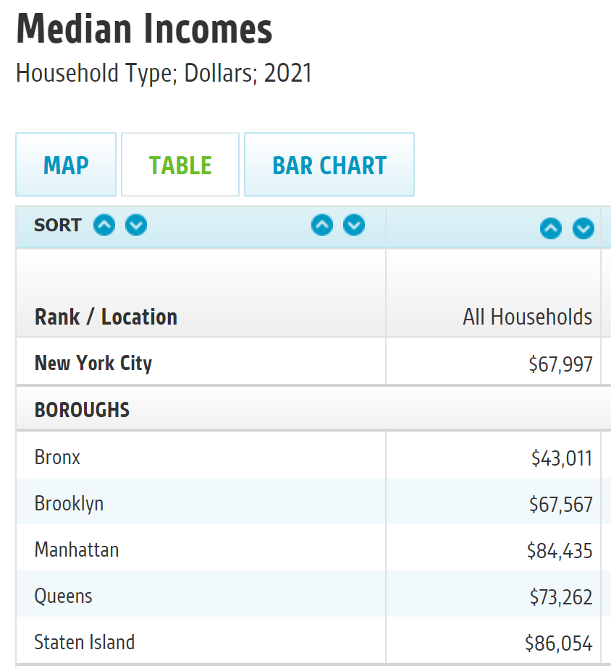
Data
Average Incomes in NYC
Source: data.cccnewyork.org
Data is pulled from U.S. Census Bureau
Median household income
Dollar amounts for all years adjusted to constant 2021 dollars using the Consumer Price Index Research Series

Slide 5
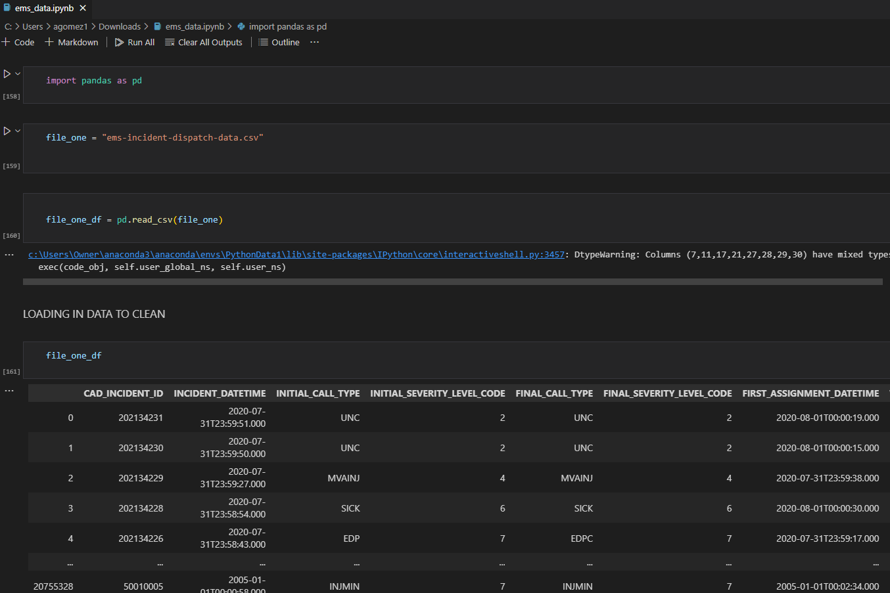
Data Analysis
Imported data into python
Cleaned data with Pandas
Created data frames
Exported csv files

Slide 6
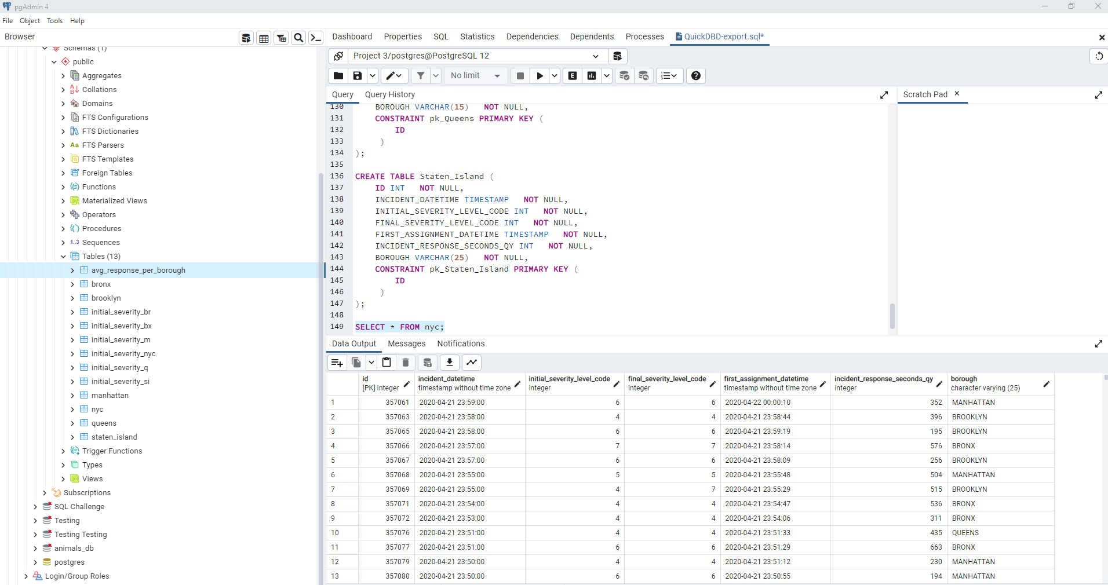
Database
Used QuickDBD to create the tables and codes
Inserted ID column to create an index for every table
Inserted into PG Admin 4
Imported csv files into each table
Selected tables to verify information was correct

Slide 7
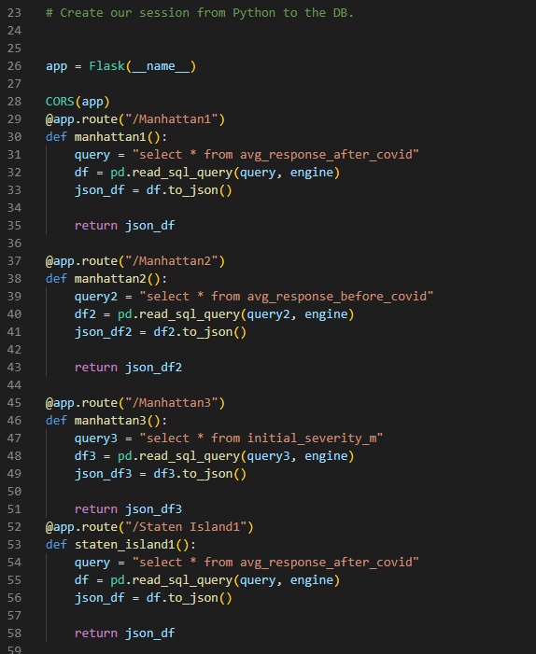
Flask API
Created an app.py file to hold our Flask API
Used SQL Alchemy to create the flask to our Postgres SQL server
Created different app routes to pull information from selected database tables
Returned the information as json to use d3 in javascript

Slide 8
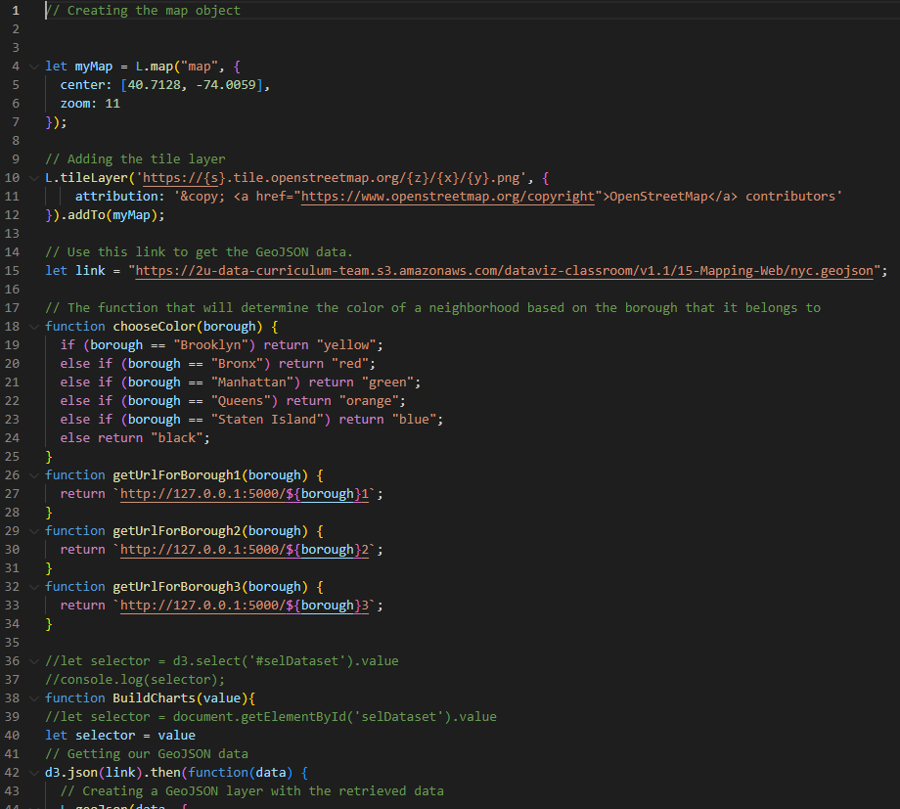
Javascript
Used the geojson data for NYC from class activity along with json from Flask API to create different plotly charts

Slide 9
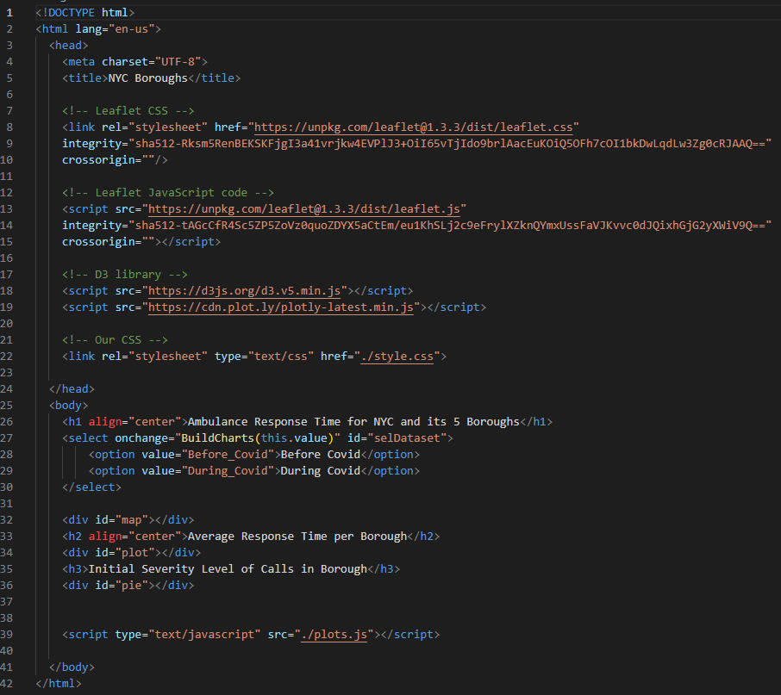
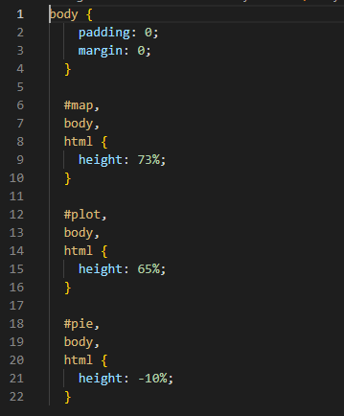
HTML & CSS

Slide 10
Web Page

Slide 11

Thank you.

