Slide 1
GPM Nowcasting Brainstorm

Slide 2
Plan
What do we use now?
  Overview of what is on the stocks and quick demos
What should we be using?
  Do we need to invest in new techniques?
How do we incorporate nowcasting in our outputs
  A role for pure statistical tracking in monitoring outputs/forecast presentation?

Slide 3
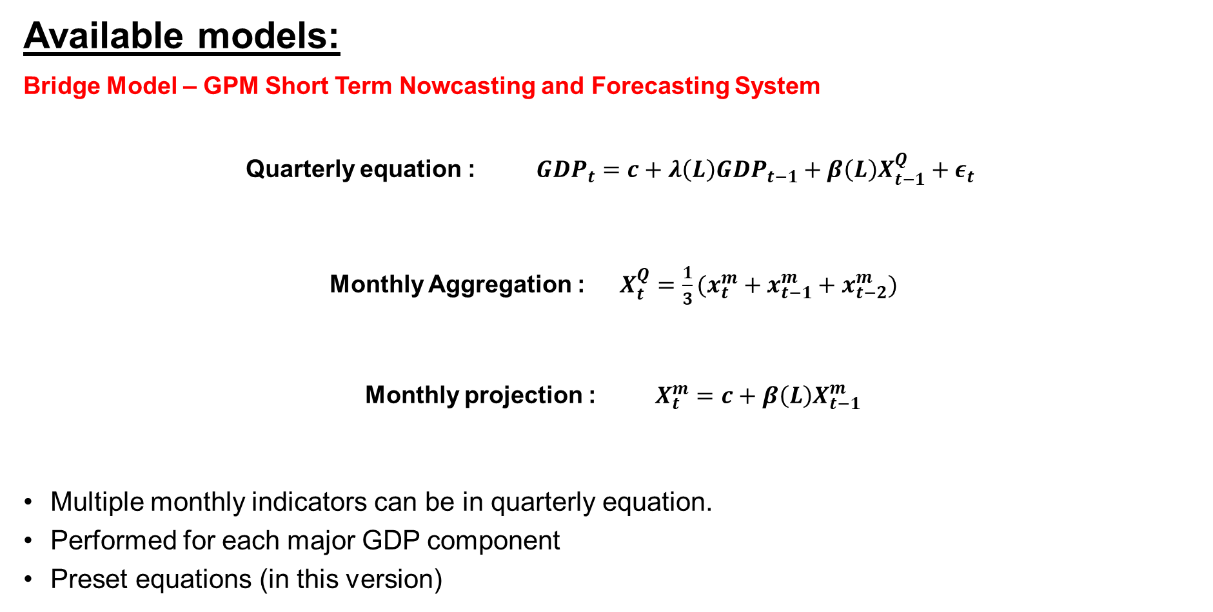
Available models:
Bridge Model – GPM Short Term Nowcasting and Forecasting System
Quarterly equation : $GDP_{t}=c+λ\left(L\right)GDP_{t−1}+β\left(L\right)X_{t−1}^{Q}+ε_{t}$
Monthly Aggregation : $X_{t}^{Q}=\frac{1}{3}(x_{t}^{m}+x_{t−1}^{m}+x_{t−2}^{m})$
Monthly projection : $X_{t}^{m}=c+β\left(L\right)X_{t−1}^{m}$
Multiple monthly indicators can be in quarterly equation.
Performed for each major GDP component
Preset equations (in this version)

Slide 4
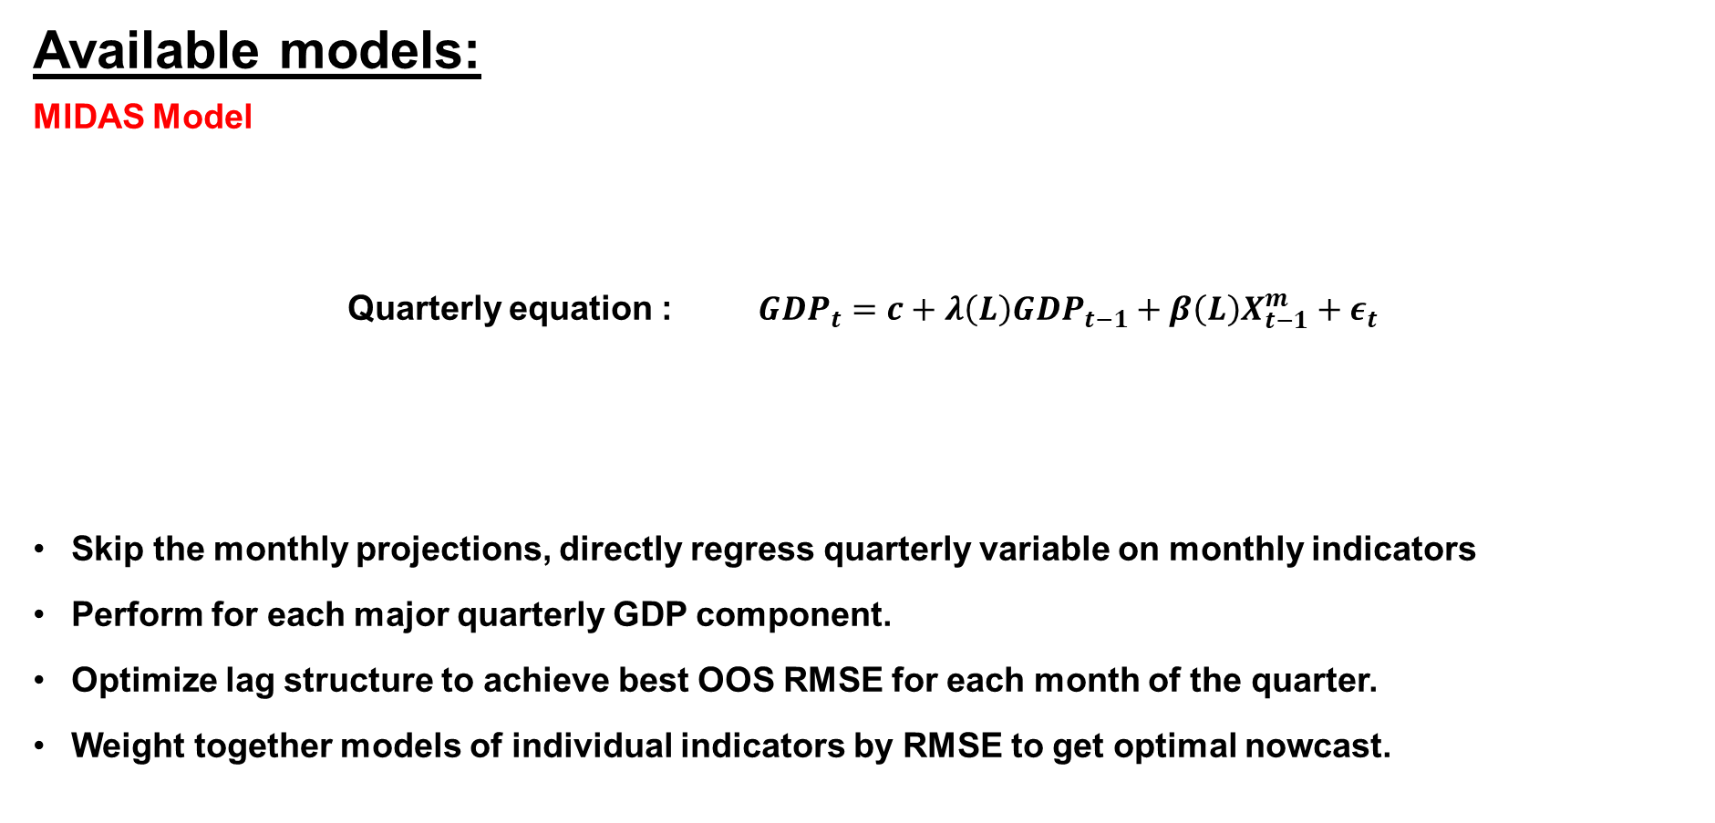
Available models:
MIDAS Model
Quarterly equation : $GDP_{t}=c+λ\left(L\right)GDP_{t−1}+β\left(L\right)X_{t−1}^{m}+ε_{t}$
Skip the monthly projections, directly regress quarterly variable on monthly indicators
Perform for each major quarterly GDP component.
Optimize lag structure to achieve best OOS RMSE for each month of the quarter.
Weight together models of individual indicators by RMSE to get optimal nowcast.

Slide 5
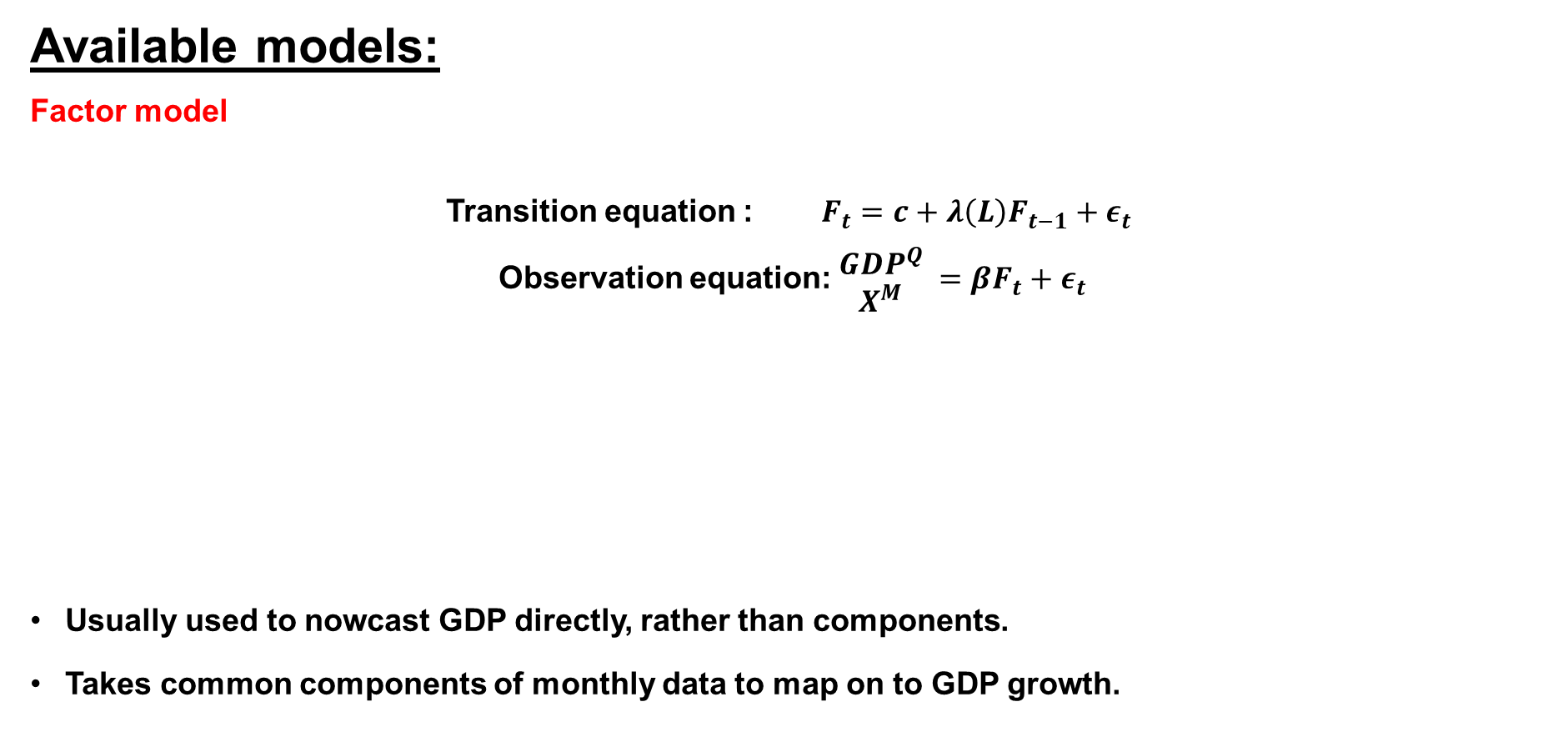
Available models:
Factor model
Transition equation : $F_{t}=c+λ\left(L\right)F_{t−1}+ε_{t}$
Observation equation: $\begin{matrix}GDP^{Q} \\ X^{M}\end{matrix} =βF_{t}+ε_{t}$
Usually used to nowcast GDP directly, rather than components.
Takes common components of monthly data to map on to GDP growth.

Slide 6
Costs and benefits
When lots of data that is released is erratic or non-informative, factor model can be best to parse signal and noise.
Downside to factor models: when monthly releases contain information about erratic components of GDP, factor model can ignore them (NY Fed).
All models have some benefit: MIDAS is easy to re-estimate and update for changing coefficients. Bridge models are easiest to understand. Factor models can handle the most data.

Slide 7
What else should we be using?
New types of data?
  Sample usually short
New models?
  A role for machine learning?
  Advanced techniques in existing models (i.e. time-varying variance in DFMs)

Slide 8
How do we incorporate into our products?
A role for pure nowcasts in the GPM package
  JPM and BoE (internally) presented pure statistical models
High-frequency “news” models that provide analysts with marginal data information on every release.
What else?

